Slide 1
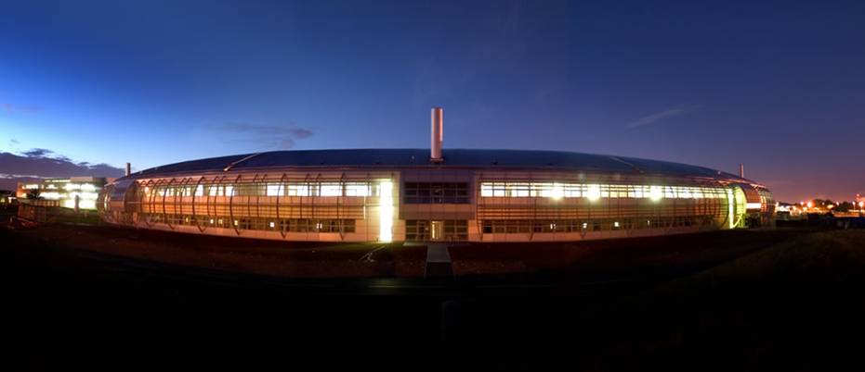
EPICS at Diamond
Mark Heron
Head of Controls Group
Diamond Light Source

Slide 2
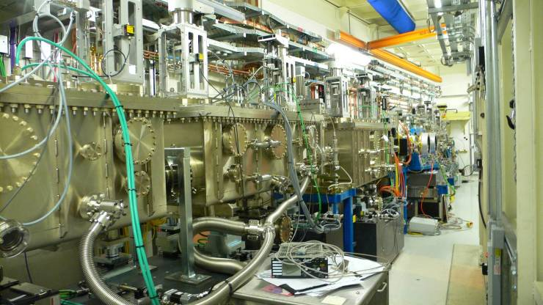
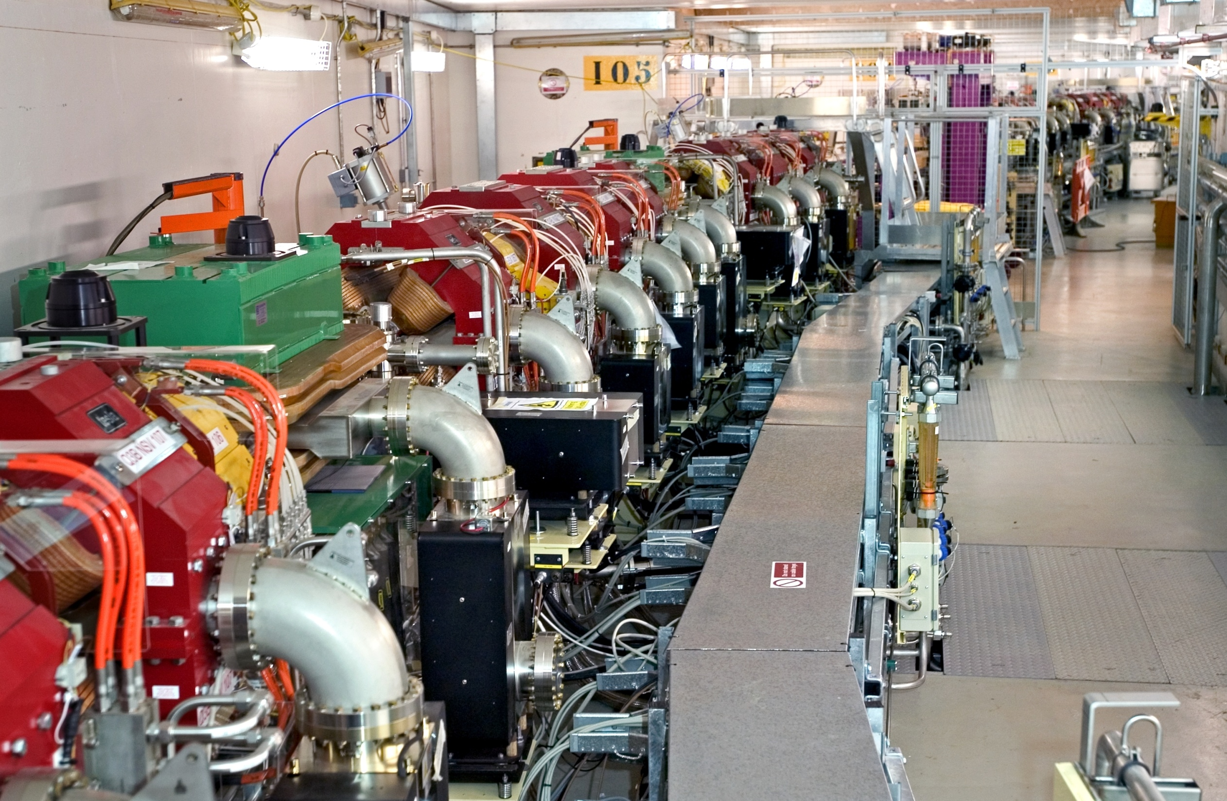
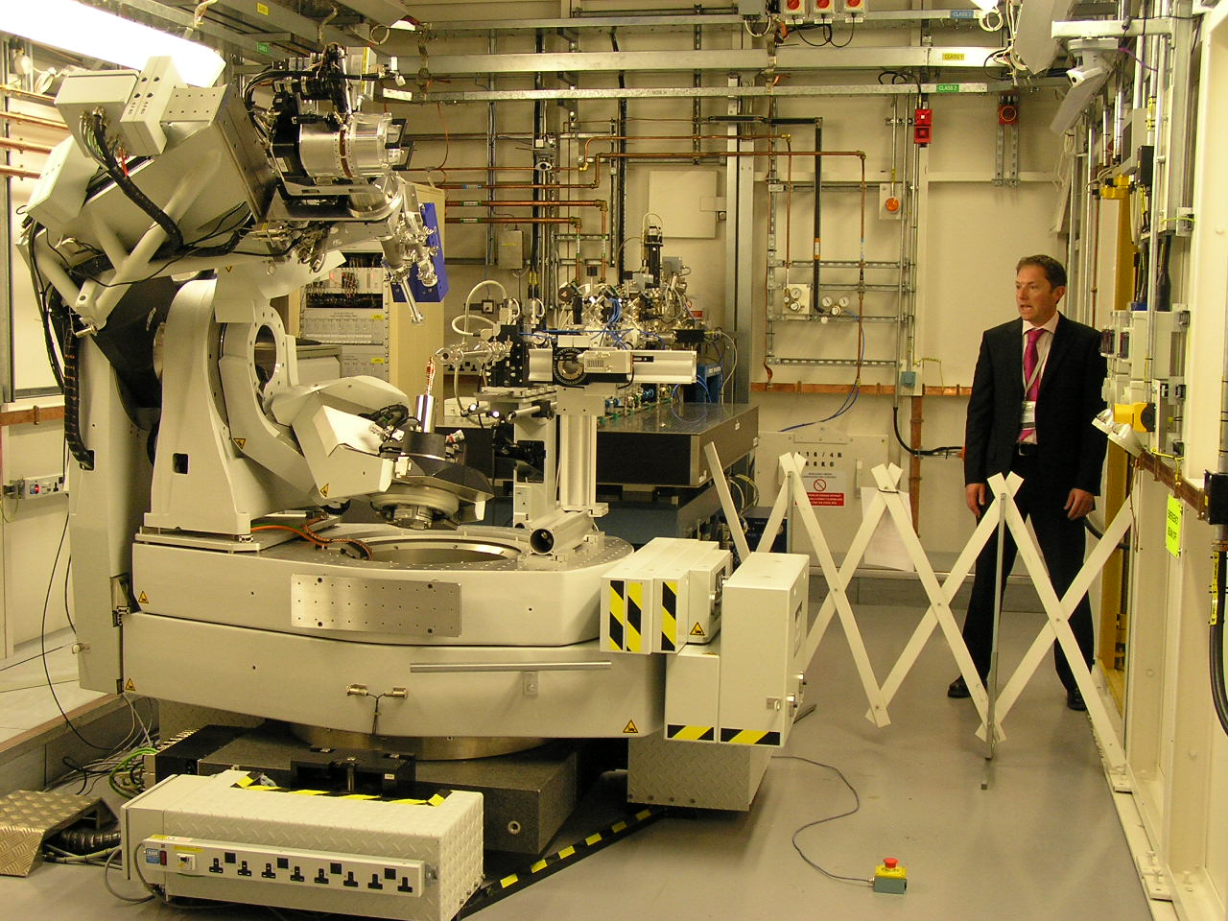
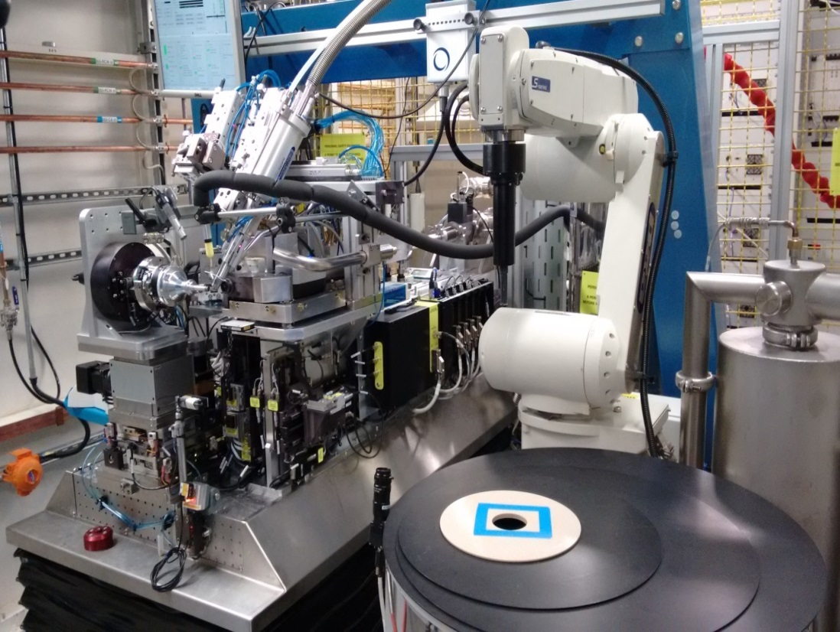
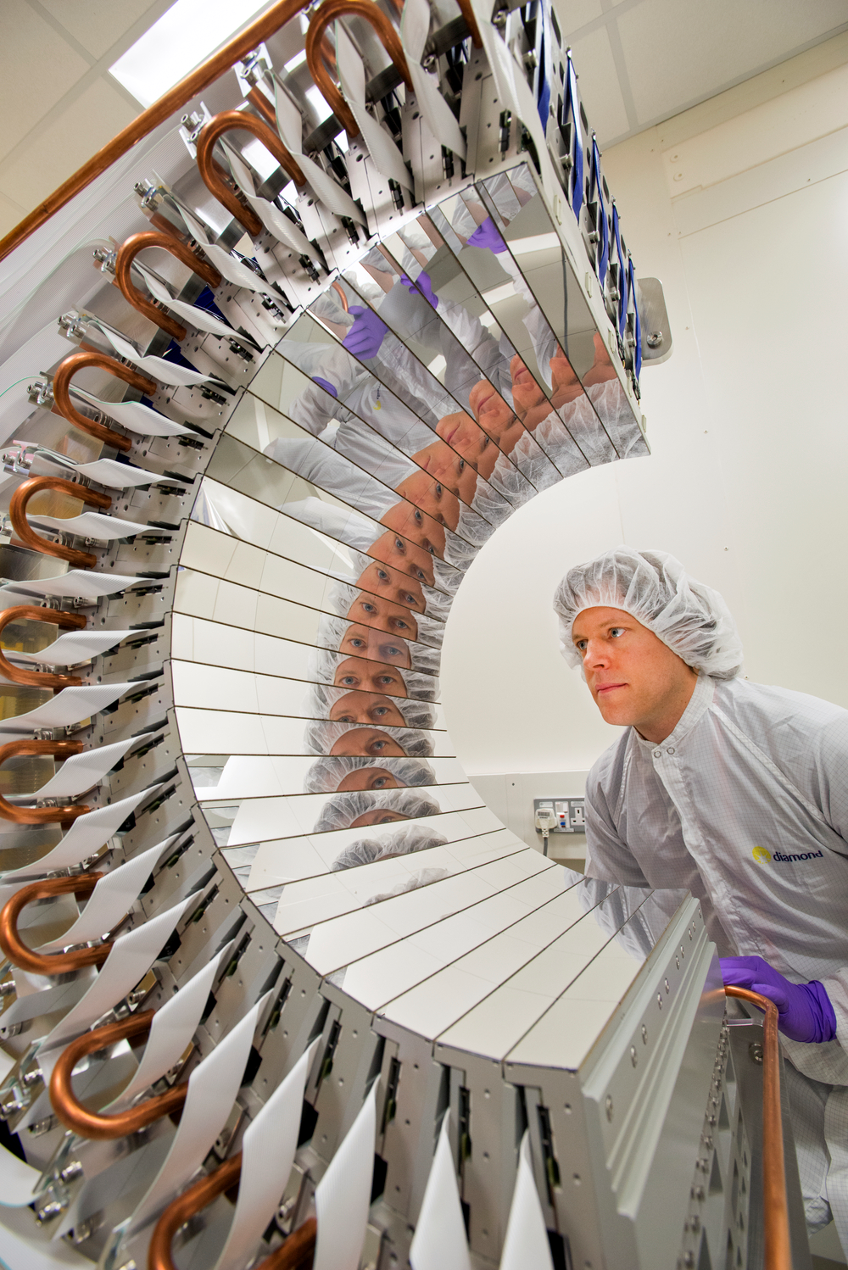

Slide 3
Current Diamond Control System (1)
EPICS: 3.14.12
PVs: Acc. 862,050, Beamlines 2,376,386
IOCs: Acc. 363, Beamlines 1017
Channel Archiver: 52 Archives, 256,839 PVs, 35TB
EDM: ~7000 panels
Gateways: ~40
Hardware: 467 VME, 56 x86 ~240 ARM, ?? Soft
Extensions: asyn, Area Detector, Motor Record, Streams, ….
Clients: EDM, CSS, BURT, ALH, Channel Archiver, ….
Client Libs: C++, Python, GDA (Java), MML (Matlab), .Net, ….

Slide 4
Current Diamond Control System (2)
EPICS V4
Detector integration
Malcolm a middlelayer framework that implements high level configure/run behaviour for continuous scan

Slide 5
Future Diamond Control System (1)
EPICS 7
Migration path
PVA Gateway, PVA Archiver, PVA DM
Moving to EDM to CSS, CA to AA
PVA WebDM
Services to eg Malcolm uses EPICS V4
PVA Client libraries Python, Java, .Net
Blessed
Area Detector NTNDArray
Mark Rivers is planning IOC
CA-to-PVA Gateway
Training material and documentation

Slide 6
Future Diamond Control System (2)
IOCs
Dynamically create/delete records
Introspect to define PVs that make up a “Device”
Refresh Records
Motor Record behaviour
Python IOCs
Build EPICS support modules in a more ‘standard’ fashion ie ./configure
Removes edit of configure/* files
Supports use of Continuous Integration services
Stability of code base and releases

Slide 7
Diamond’s Commitment
Historically Diamond has had at least 1FTE on working on EPICS Core
Was David Hickin now with European XFEL
Other developments and contribution
CSS, CAtools, Area Detector, Various Device Support, Ethercat, ….
Diamond very willing to contribute
Needs to be against a plan for EPICS
We need to show organisational benefit
See EPICS council as important in defining future direction

Slide 8
Thank you
Questions

