Slide 1

CS-Studio and EPICS7
Kunal Shroff
Gabriele Carcassi

Slide 2

Diirt Architecture

Slide 3
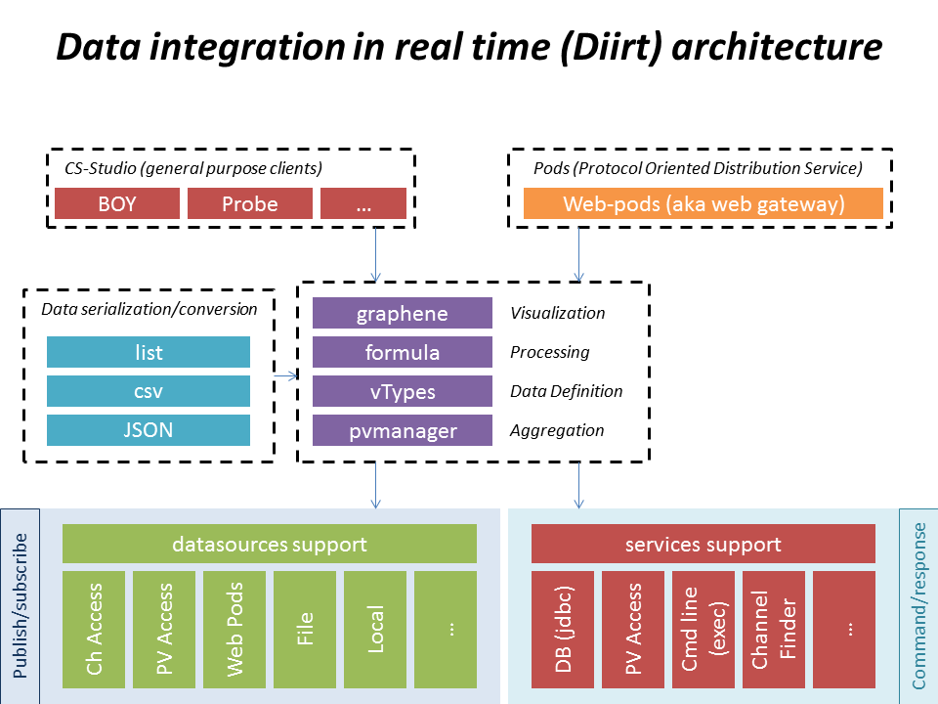

Slide 4
CS-Studio and V4 channels

Slide 5
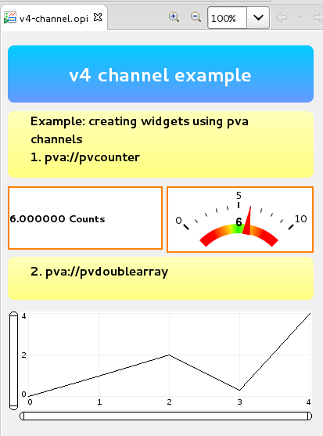
Creating EPICS7 channels
pva datasource
The pvaccess datasource prefix when creating the channel
pva://<name>
Notes:
Publish susbscribe

Slide 6
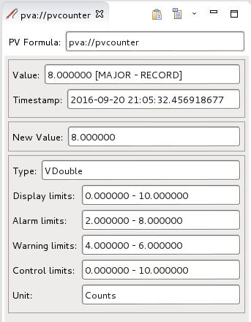
Creating EPICS7 channels
pva datasource
Use the pvacess datasource prefix when creating the channel
pva://pvcounter
epics:nt/NTScalar:1.0 -> Vdouble
Notes:
Publish susbscribe
Alarm_t, display_t, time_t, control_t
o.diirt.support.pva.adapters
PVFieldto Vtypes

Slide 7
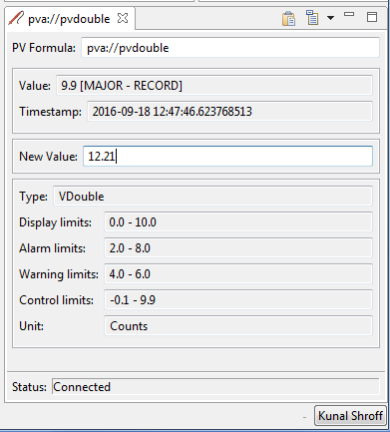
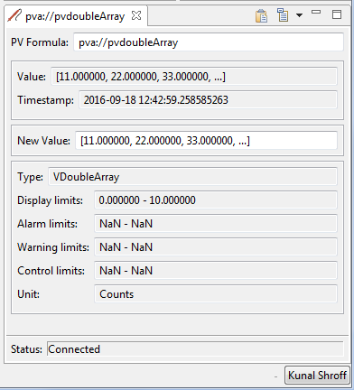
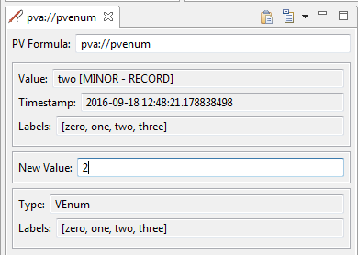
Accessing EPICS7 structured data
pva NTType support
The pva module provides the mapping for NTTypes to Vtypes
  Currently supported NTTypes includes
  General Normative Types
    NTScalar
  NTScalarArray
    NTEnum
  NTTable
  Specific Normative Types
    NTMultiChannel
    NTNDArray
Notes:
General Normative Types
NTScalar
NTScalarArray
NTEnum
NTMatrix
NTURI
NTNameValue
NTTable
NTAttribute
Specific Normative Types
NTMultiChannel
NTNDArray
NTContinuum
NTHistogram
NTAggregate

Slide 8

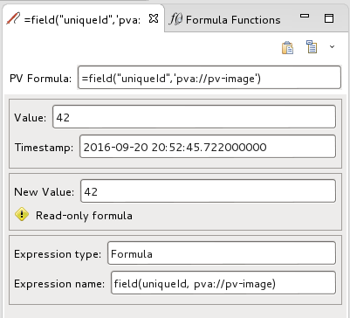
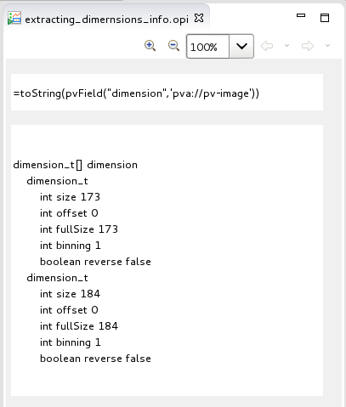
Accessing EPICS7 structured data
pva Type support
Formula Functions
Allow parsing of any EPICS7 data structure into a Type that can be used by cs-studio applications
Notes:
General Normative Types
NTScalar
NTScalarArray
NTEnum
NTMatrix
NTURI
NTNameValue
NTTable
NTAttribute
Specific Normative Types
NTMultiChannel
NTNDArray
NTContinuum
NTHistogram
NTAggregate

Slide 9

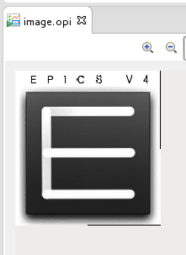
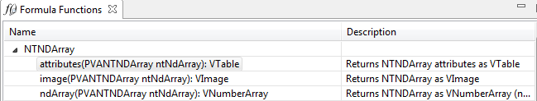
Accessing EPICS7 structured data
pva formula support
NTNDArray formula set
image
Creates an VImage from the NTNDArray using all the appropriate fields (value, dimensions, …)
ndArray
  Extracts the raw values as a VNumberArray
attributes
Creates a VTable from the attributes structure of this NTNDArray
Notes:
General Normative Types
NTScalar
NTScalarArray
NTEnum
NTMatrix
NTURI
NTNameValue
NTTable
NTAttribute
Specific Normative Types
NTMultiChannel
NTNDArray
NTContinuum
NTHistogram
NTAggregate

Slide 10
CS-Studio and EPICS7 services

Slide 11
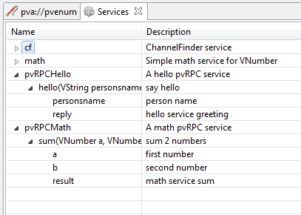
Describing V4 services
for Diirt
Services provide a means to execute and retrieve the result EPICS7 RPC calls
  Preparing the arguments
  Mapping Vtype <-> NTTypes
  Handle asyn/synchronous calls (todo)
New diirt services can be contributed via java SPI
Notes:
Publish susbscribe

Slide 12
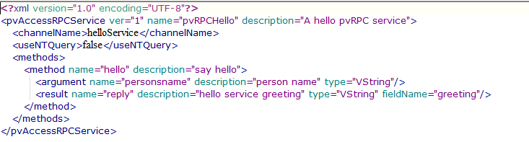
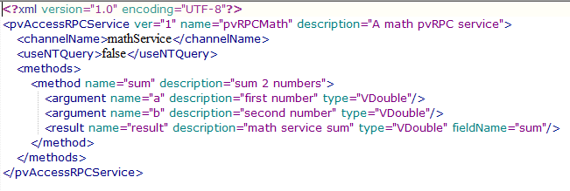
Describing V4 services
for Diirt
Simple services can be described via xml files which
  Service name to be connected
  List of arguments
  List of results, along with the fields the result maps to and the Type
Configuration file location
  /configuration/diirt/pvarpc/
helloService.xml mathService.xml
Notes:
Publish susbscribe

Slide 13
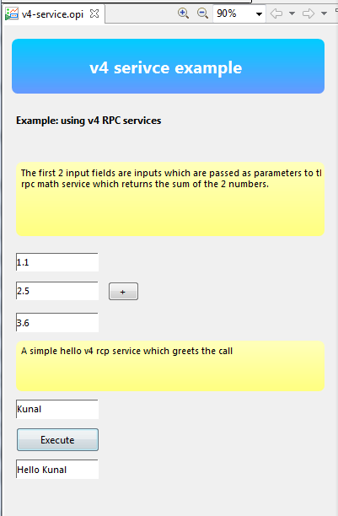
Using EPICS7 RPC services
with Diirt
The services button
  Defines the V4 service to be use
  RPCMath/Sum
The channels from which to create the argument list
loc://pv_a (VDouble) -> argument a
loc://pv_b (VDouble) -> argument b
Provide the channel to which the result will be written
loc://pv_sum (Vdouble)
Notes:
Publish susbscribe

Slide 14
CS-Studio and EPICS7
Next steps

Slide 15
NEXT STEPS
Create new VTYpes for NTTypes currently not supported
Improve existing widgets and create new widgets optimized for structured data
  Image
  Tree
  Table
Improve pvDataJava and pvAccessJava

Slide 16
Improve pvDataJava and pvAccessJava
Next steps

Slide 17
OBSERVATIONS ON THE PVDATA API
Writting client code to handle type casting is not trivial
Using Arrays is not intuitive nor easy

Slide 18
Epics-util and pvdata
Working with direct types
// Common superclass for all numerical arrays. Returns a no-copy array wrapper with a generic interface
PVNumberArray pvArray = ...
ListNumber values = pvArray.get();
// Provides index access for any primitive type taking care of casting (including unsigned conversions)
float sum = 0;
for (int i = 0; i < values.size(); i++) {
sum += values.getFloat(i);
}
// Provides iterator access
IteratorNumber iter = values.iterator();
double sum = 0;
while (iter.hasNext()) {
sum += iter.nextDouble();
}
// Allows writing from any type to any type
pvArray.put(5, CollectionNumbers.toListDouble(1,2,3));
Notes:
General Normative Types
NTScalar
NTScalarArray
NTEnum
NTMatrix
NTURI
NTNameValue
NTTable
NTAttribute
Specific Normative Types
NTMultiChannel
NTNDArray
NTContinuum
NTHistogram
NTAggregate

Slide 19
Epics-util and pvdata
Working with direct types
// Specific arrays return concrete unmodifiable array wrappers. Direct use of the wrapper provide no performance cost over array (after JIT warmup)
PVUByteArray pvArray = ...
ArrayUByte values = pvArray.get();
// Slicing array just provides a view
ArrayUByte slice = values.subList(3, 5);
// You can always make explicit (and mutable) copies
ArrayUByte sliceCopy = new ArrayUByte(slice);
// The wrapped array is always accessible
UnsafeUnwrapper.Array<byte[]> data = UnsafeUnwrapper.readSafeByteArray(values);
for (int i = data.startIndex; i < data.size; i++) {
byte b = data.array[i];
}
// You can also ask for a write safe version
UnsafeUnwrapper.Array<byte[]> data = UnsafeUnwrapper.writeSafeByteArray(values);
Notes:
General Normative Types
NTScalar
NTScalarArray
NTEnum
NTMatrix
NTURI
NTNameValue
NTTable
NTAttribute
Specific Normative Types
NTMultiChannel
NTNDArray
NTContinuum
NTHistogram
NTAggregate

Slide 20
Epics-util and pvdata
Working with arrays
org.epics.util.array
// Provides numerous utility functions to work with generic arrays of numbers. Including unsigned type casting
float floatValue toFloat(unsignedLongValue);
// Array copies from all combinations
doubleArray.setAll(0, longArray);
double[] array = list.toArray(new double[list.size()]);
// Transparently uses System.arraycopy when possible
doubleArray.setAll(0, otherDoubleArray);
// Lazy math operations on arrays
ListDouble sum = ListMath.add(list1, list2);
ListDouble concat = ListMath.concatenate(list1, list2);
Notes:
General Normative Types
NTScalar
NTScalarArray
NTEnum
NTMatrix
NTURI
NTNameValue
NTTable
NTAttribute
Specific Normative Types
NTMultiChannel
NTNDArray
NTContinuum
NTHistogram
NTAggregate

Slide 21
Thank You for Your Attention!

