Slide 1

EPICS 7 Services
Kunal Shroff
Guobao Shen
Michael Davidsaver
Ralph Lange
Gabriele Carcassi
Jaka Bobnar
Eric Berryman

Slide 2
Middle Layer Services & EPICS7
Physics Application
Client Library
CS-Studio
Client Library
Others
Client Library
Ethernet
EPICS 7
MASAR
Python
EPICS 7
HTTP/REST
Archiver
Python
EPICS 7
HTTP/REST
Lattice/Model
Python
EPICS 7
HTTP/REST
Channel Finder
Java
EPICS 7
HTTP/REST
Olog
Java
EPICS 7
HTTP/REST
BEAST
Java
SQLite/MongoDB
MySQL
MongoDB
Elastic Search
MySQL
MySQL
Distributed Front-Ends
EPICS (7)
Online Model
EPICS (7)
Virtual Accelerator
EPICS (7)
Hardware System
EPICS (7)
Data Acquisition
EPICS (7)
Data Analysis
…
EPICS
Others
Simulation Engine
Simulation Engine

Slide 3

MASAR

Slide 4
MASAR: Machine Snapshot, Archiving, and Retrieve
A control room application to help machine commissioning & operation
Core features:
Allows for the creation of user defined collection of PV’s across multiple IOCs called a MASAR configuration
Snapshot machine status for given configuration
Restore machine status back to snapshot point
Both snapshots and configurations can be tagged and queried
Notes:
Motivation and introduction

Slide 5
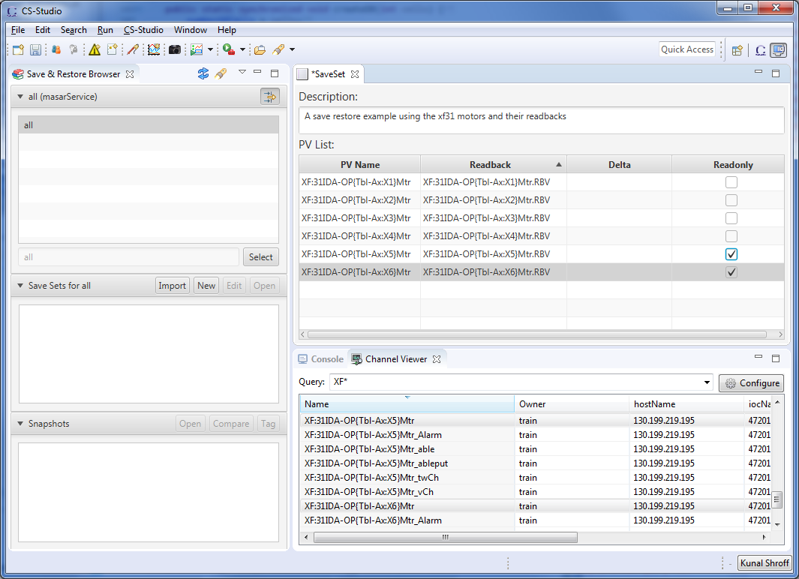
CS-STUDIO MASAR: Editor
Create a configuration of setpoint pv’s
Pair setpoint and readback pv’s
Tag pv’s that are to be excluded from restore
Define deltas
Masar cs-studio client Editor

Slide 6
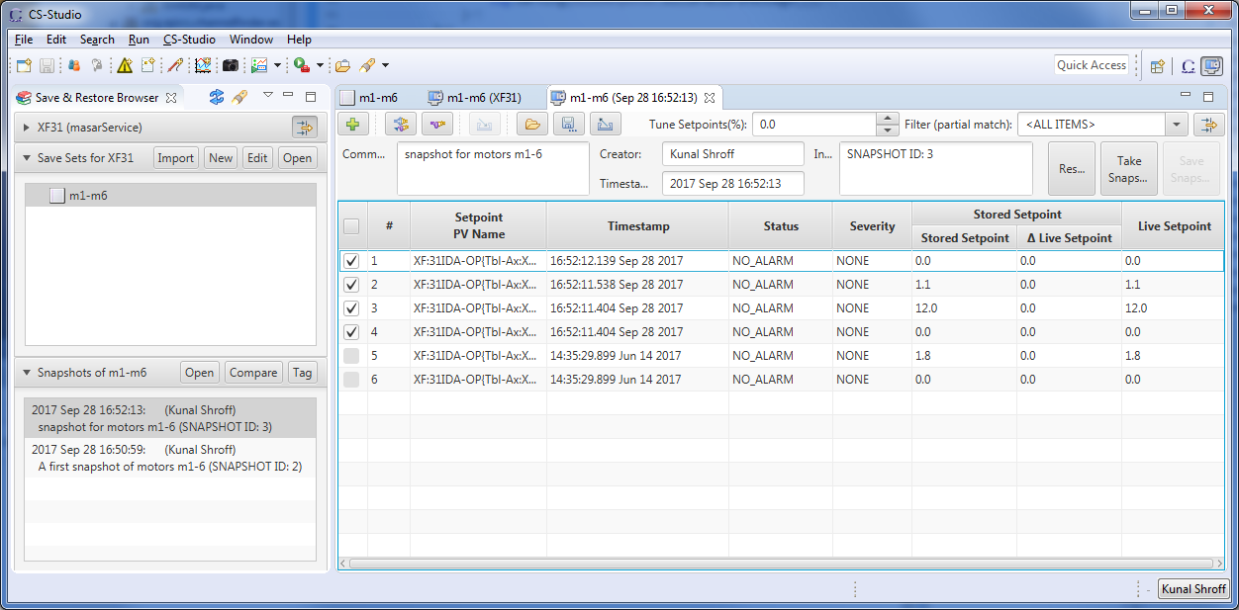
Masar cs-studio client snapshot viewer
Notes:
Create configuration

Slide 7
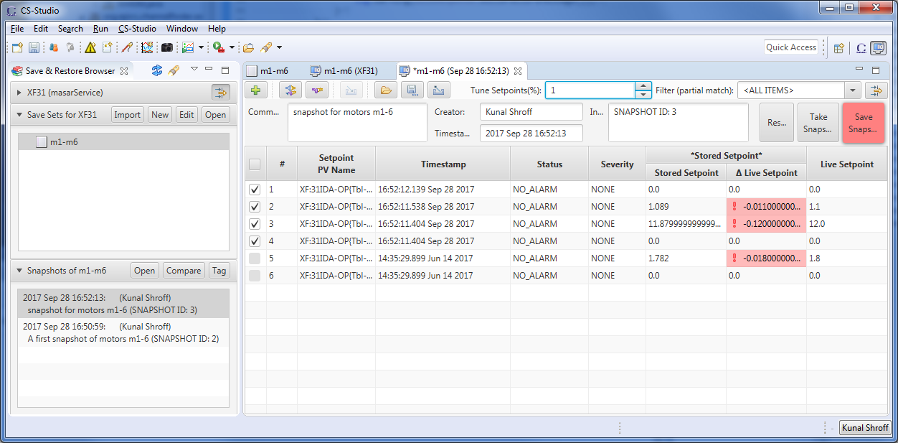
Masar cs-studio client snapshot viewer
Notes:
Take a snapshot

Slide 8
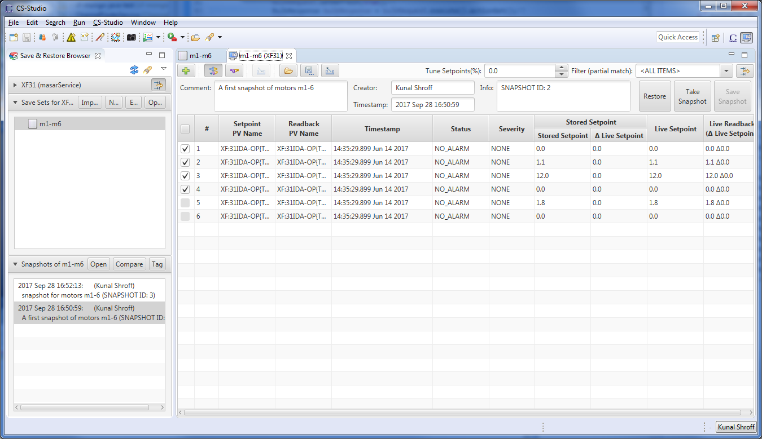
Masar cs-studio client snapshot viewer
Notes:
Take a snapshot

Slide 9
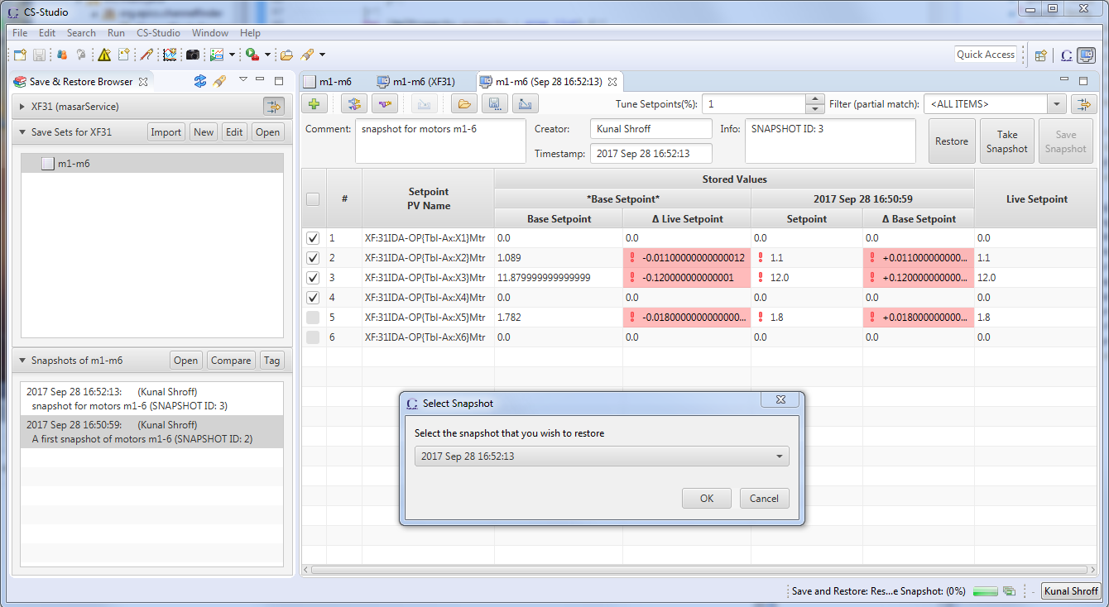
Masar cs-studio client snapshot viewer
Notes:
Take a snapshot

Slide 10
NEW MASAR SERVICE
Has added functionality to create and update configurations
storeServiceConfig()
Support for multiple backends – mongodb, sqlite, etc…
All service methods requests and results use NTTypes
storeServiceConfig() requires an NTTable getLiveMachine(), retrieveSnapshot(), and saveSnapshot()
return a NTMultiChannel
Support for the use of user defined tags, groups, and read only flags
A standardized service request structure
Notes:
Motivation and introduction

Slide 11
Channel finder
Epics directory service

Slide 12
ChannelFinder
A simple directory service
The channelfinder service is a simple directory service which consists of a list of channels/pvs with user defined tags and properties; which are key value pairs associated with it.
  Queried based on the channel name, property value and tags
  e.g.
  XF:31*IDA*&axis=4*&tag=sys.XF:31
  All pvs from the insertion device 31 belonging to axis 4 with tag sys.XF:31
Notes:
The channelfinder service is a simple directory service which consists of a list of channels/pvs with user defined tags and properties; which are key value pairs associated with it.
A simple directory server
The directory data consists of Channels, with an arbitrary set of Properties(name-value pairs), and an arbitrary set of Tags(names).
Queried based on the channel name, property value and tags
e.g.
XF:31*IDA*&axis=4*&tag=sys.XF:31
All pvs from the insertion device 31 belonging to axis 4 with tag sys.XF:31

Slide 13
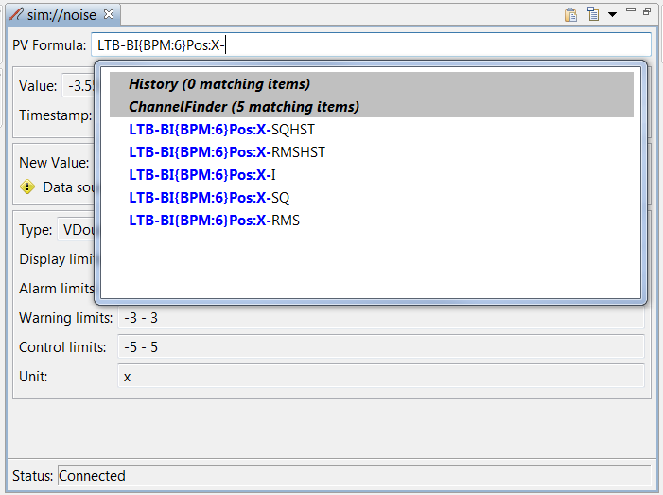
ChannelFinder
Usage
Auto-complete
  Autocomplete hints for PV Names can be populated from channelfinder query results.
Notes:
The channelfinder service is a simple directory service which consists of a list of channels/pvs with user defined tags and properties; which are key value pairs associated with it.
A simple directory server
The directory data consists of Channels, with an arbitrary set of Properties(name-value pairs), and an arbitrary set of Tags(names).
Queried based on the channel name, property value and tags
e.g.
XF:31*IDA*&axis=4*&tag=sys.XF:31
All pvs from the insertion device 31 belonging to axis 4 with tag sys.XF:31

Slide 14
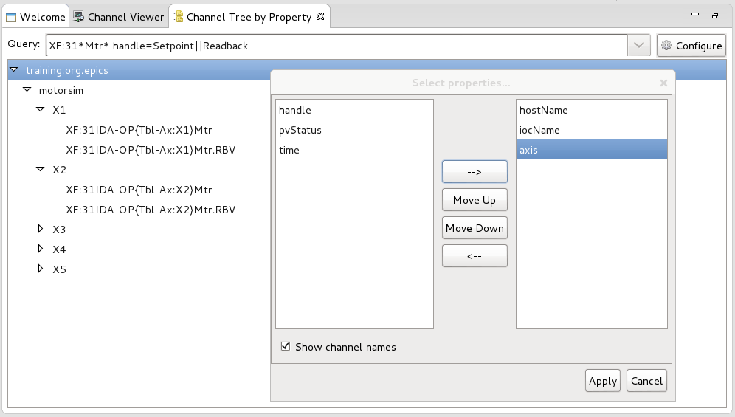
ChannelFinder
Usage
Tree View
  Create hierarchical views based on properties and tags
Notes:
The channelfinder service is a simple directory service which consists of a list of channels/pvs with user defined tags and properties; which are key value pairs associated with it.
A simple directory server
The directory data consists of Channels, with an arbitrary set of Properties(name-value pairs), and an arbitrary set of Tags(names).
Queried based on the channel name, property value and tags
e.g.
XF:31*IDA*&axis=4*&tag=sys.XF:31
All pvs from the insertion device 31 belonging to axis 4 with tag sys.XF:31

Slide 15
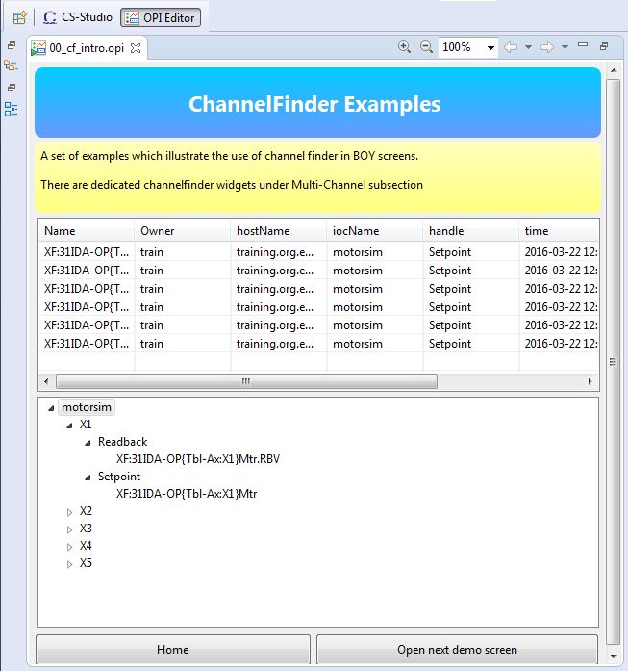
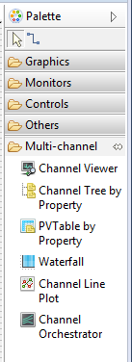
ChannelFinder
Usage
Boy integration
  Dedicated ChannelFinder widgets
  Channel Viewer
  Channel Tree by Property
  Waterfall
  Channel Line Plot
Notes:
The channelfinder service is a simple directory service which consists of a list of channels/pvs with user defined tags and properties; which are key value pairs associated with it.
A simple directory server
The directory data consists of Channels, with an arbitrary set of Properties(name-value pairs), and an arbitrary set of Tags(names).
Queried based on the channel name, property value and tags
e.g.
XF:31*IDA*&axis=4*&tag=sys.XF:31
All pvs from the insertion device 31 belonging to axis 4 with tag sys.XF:31

Slide 16
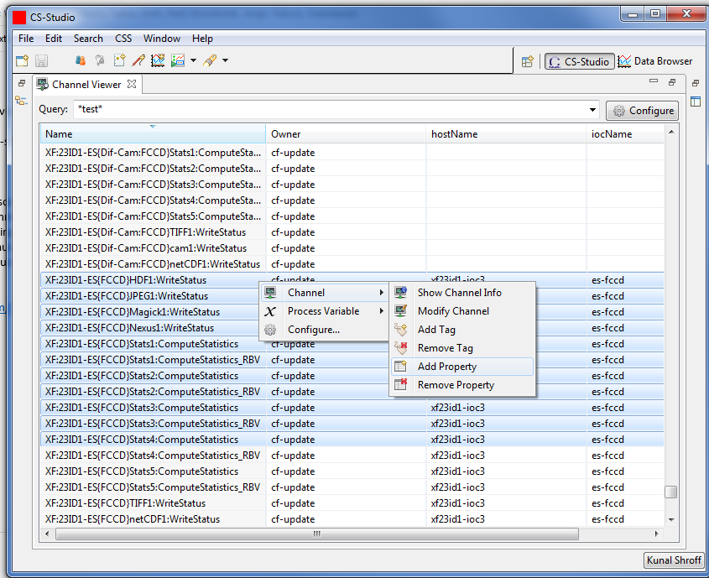
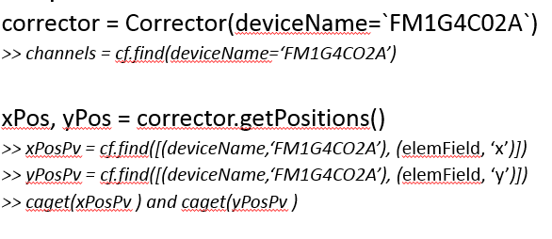
CS-Studio
Python hla modules
https://github.com/ChannelFinder/hla
CS-Studio Clients
Python Clients
Clients
Java client library
Python client library
https://github.com/ChannelFinder/pyCFClient
https://github.com/ChannelFinder/javaCFClient
Servers
https://github.com/ChannelFinder/recsync
ChannelFinder
(REST)
pvaChannelFinder
(pvaccess)
Recsync (cfstore)
IOC’s
epics recsync
IOC’s
https://github.com/ChannelFinder/ChannelFinderService
https://github.com/ChannelFinder/pvaChannelFinder
epics recsync
ElasticSearch
Automatic population
Notes:
https://github.com/ChannelFinder/ChannelFinderService
https://github.com/ChannelFinder/pvaChannelFinder
https://github.com/ChannelFinder/javaCFClient
https://github.com/ChannelFinder/pyCFClient
https://github.com/ChannelFinder/recsync
https://github.com/ChannelFinder/hla

Slide 17
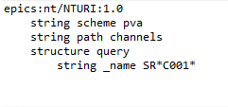
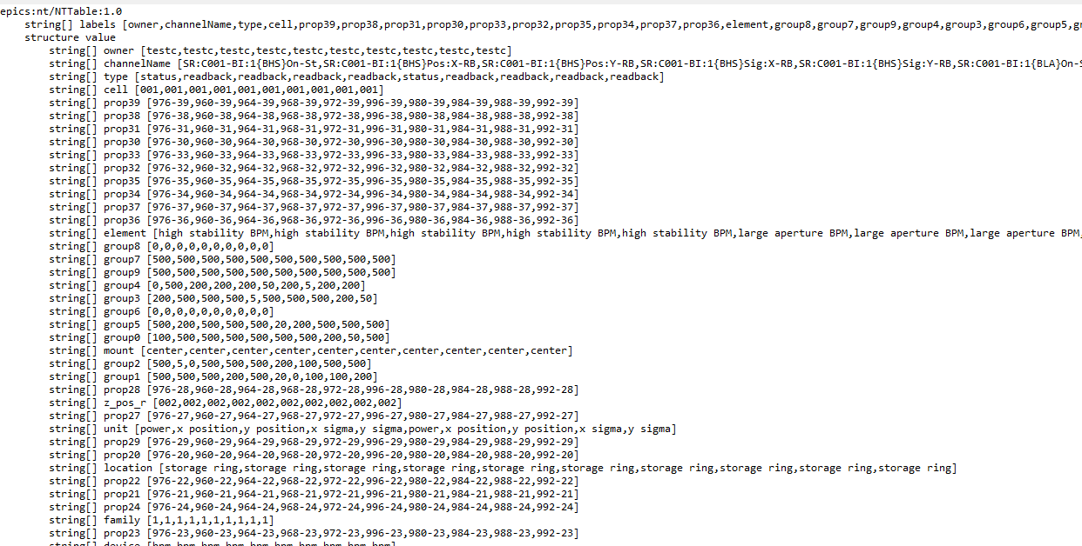
pvaChannelFinder
  A EPICS7 RPC service
  Request is a NTURI
  name, tag, or property
  value
  * & % wildcard chars
  Result is a NTTable
  List of all the matching
  channels and their
  associated properties and
  tags
Notes:
The channelfinder service is a simple directory service which consists of a list of channels/pvs with user defined tags and properties; which are key value pairs associated with it.
A simple directory server
The directory data consists of Channels, with an arbitrary set of Properties(name-value pairs), and an arbitrary set of Tags(names).
Queried based on the channel name, property value and tags
e.g.
XF:31*IDA*&axis=4*&tag=sys.XF:31
All pvs from the insertion device 31 belonging to axis 4 with tag sys.XF:31

Slide 18
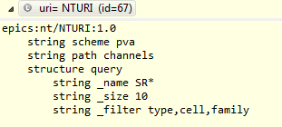
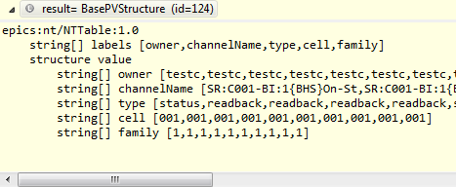
pvaChannelFinder
Filtering
  The query defines the tags and properties to be included in the result
  Improves performance

Slide 19
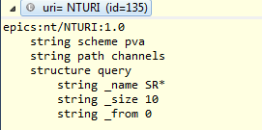
pvaChannelFinder
Pagination
  The result can be fetched in parts using the _size and _from arguments
  Results in the creation for more robust and responsive clients

Slide 20
Performance Consideration
  Database
    200k channels
    40 properties
    60 tags
  Queries
  Search using wildcards for channel names and property values
  Result Size
  Each channel is 1127 bytes

Slide 21
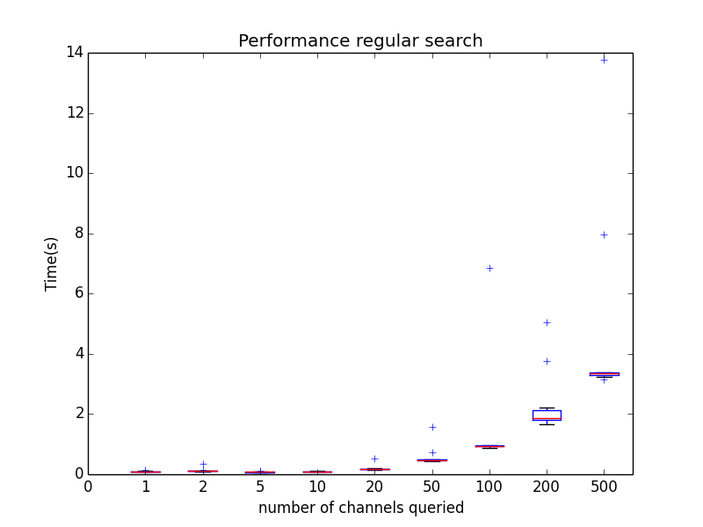
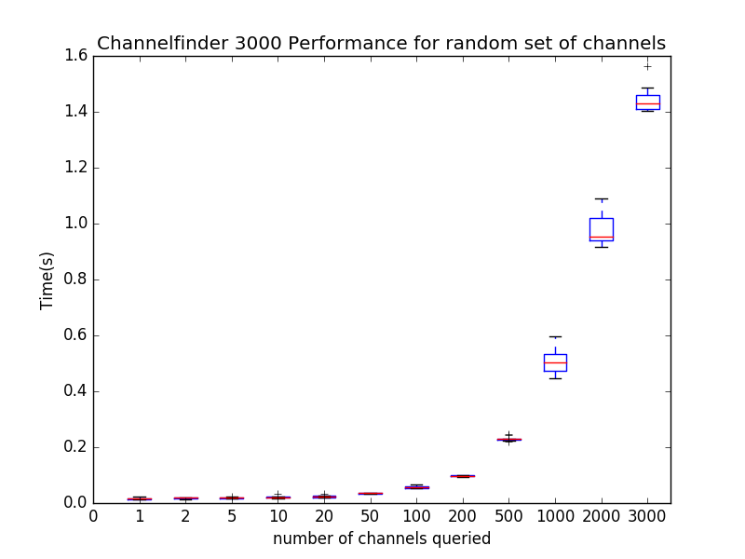
Performance Numbers
  CF v1:
  Mysql performance results
  CF v3:
  Elastic performance results

Slide 22
Links
Fork us on github
MASAR
https://github.com/epics-base/masarService
ChannelFinder
https://github.com/channelfinder
https://github.com/channelfinder/pvaChannelFinder
CS-Studio
https://github.com/cs-studio
Notes:
Motivation and introduction

Slide 23
Thank You!

