Slide 1
areaDetector
What’s New and What’s Next
Mark Rivers
GeoSoilEnviroCARS, Advanced Photon Source
University of Chicago

Slide 2
Outline
Last update was September 2016 at Oak Ridge
areaDetector and ADCore Releases since then: R2-5, R2-6, R3-0, R3-1
EPICS V4 driver and plugin
ImageJ plugins
ADSupport repository
NDPluginDriver enhancements for multi-threading
Roadmap for R4-0 and R5-0

Slide 3
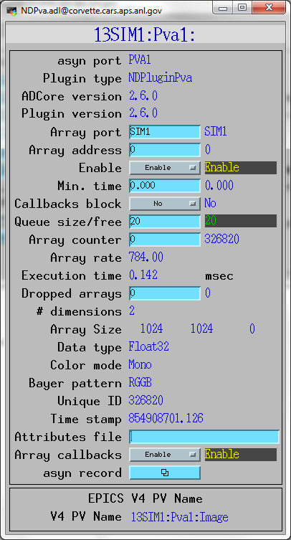
NDPluginPva
New plugin that converts NDArrays into the EPICSv4 normative type NTNDArray
An embedded EPICSv4 server serves the new NTNDArray structure as an EPICSv4 PV
High performance, ~3.2GB/s shown here
Can be received by any EPICSv4 client
Java, Python, C++ versions of pvAccess
CSS has a widget that can display NTNDArrays
New ImageJ plugin
Can include an NTNDArray receiver in another IOC
From Bruno Martins

Slide 4
EPICS_NTNDA_Viewer ImageJ plugin
New ImageJ plugin written by Tim Madden and Marty Kraimer
Essentially identical to EPICS_AD_Viewer.java except that it displays NTNDArrays from the NDPluginPva plugin, i.e. using pvAccess to transport the images rather than NDPluginStdArrays which uses Channel Access.

Slide 5
EPICS_NTNDA_Viewer Advantages
NTNDArray data transmitted "atomically" over the network
With Channel Access size and data type of waveform record is fixed at iocInit, cannot be changed at runtime.
To view both 8-bit and 64-bit double FFT images waveform record needs to be 64-bit double, 8X network overhead for 8-bit. pvAccess changes the data type of the NTNDArrays dynamically at run-time.
Channel Access requires setting EPICS_CA_MAX_ARRAY_BYTES, considerable confusion and frustration for users.
NDPluginPva is 5X-10X faster than NDPluginStdArrays
ImageJ is 1.5-2X faster with pvAccess than with Channel Access.

Slide 6
Other ImageJ Viewers
EPICS_AD_Controller. Allows using the ImageJ ROI tools (rectangle and oval) to graphically define the following:
The readout region of the detector/camera
The position and size of an ROI (NDPluginROI)
The position and size of an overlay (NDPluginOverlay)
The plugin chain can include an NDPluginTransform plugin which changes the image orientation and an NDPluginROI plugin that changes the binning, size, and X/Y axes directions. The plugin corrects for these transformations when defining the target object.
Chris Roehrig wrote an earlier version of this plugin.

Slide 7
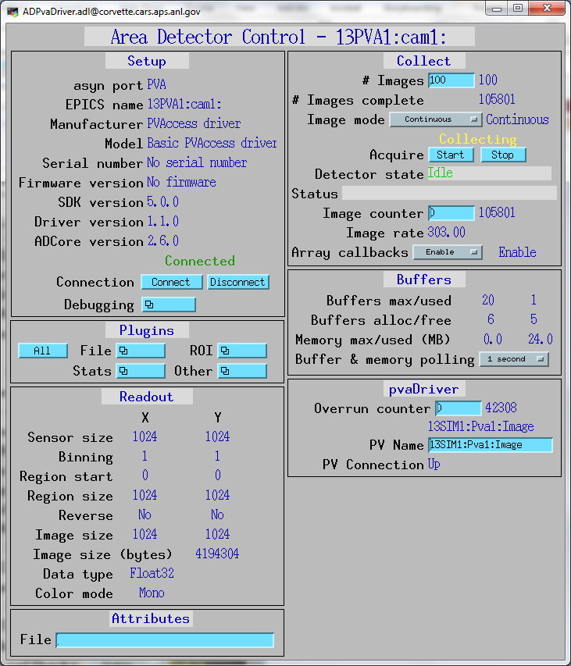
pvAccess Driver
New pvAccess driver receives NTNDArrays over the network, converts to NDArrays and calls plugins
Can be used to run areaDetector IOC and plugins on another machine or in another process
High performance:
~1.2 GB/s shown here with interprocess communication
Saturating 10 Gb Ethernet links has been demonstrated
From Bruno Martins

Slide 8
NDPluginDriver (R3-0) Multiple Threads per Plugin
Added support for multiple threads running the processCallbacks() function in a single plugin.
Can improve the performance of the plugin by a large factor. Linear scaling with up to 5 threads (the largest value tested) observed for most of the plugins that now support multiple threads.
Maximum number of threads that can be used for the plugin is set in constructor and in IOC startup script.
Actual number of threads to use controlled via an EPICS PV at run time, up to the maximum value passed to the constructor.
Note that plugins need to be modified to be thread-safe for multiple threads running in a single plugin object.

Slide 9
Multiple Threads per Plugin Sorting of Output NDArrays
When plugin uses multiple threads likely that the NDArray output will be slightly out of order, i.e. NDArray::uniqueId fields will not be monotonically increasing.
This is because the threads are running asynchronously and at slightly different speeds.
A downstream file plugin plugin would write NDArrays to the file in the "wrong" order.
Plugins have an option to sort the NDArrays by uniqueId to attempt to output them in the correct order. Sorting enabled by setting SortMode=Sorted

Slide 10
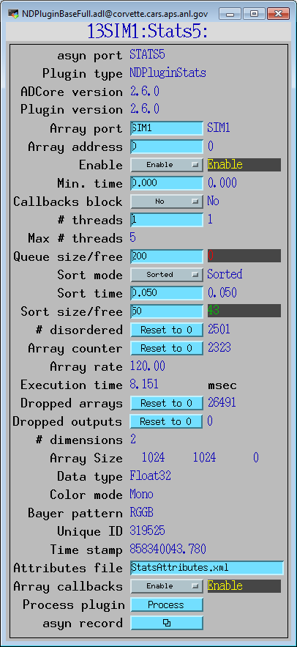
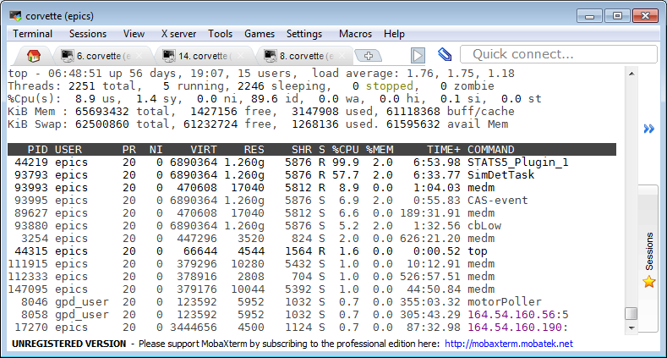
Multiple Threads with NDPluginStats 1 Thread

Slide 11
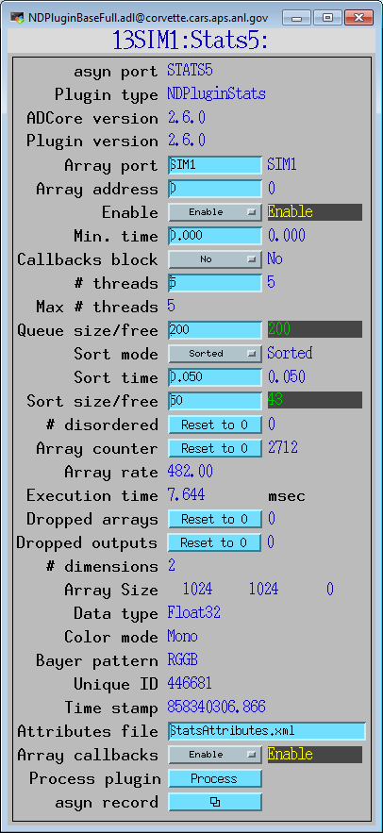
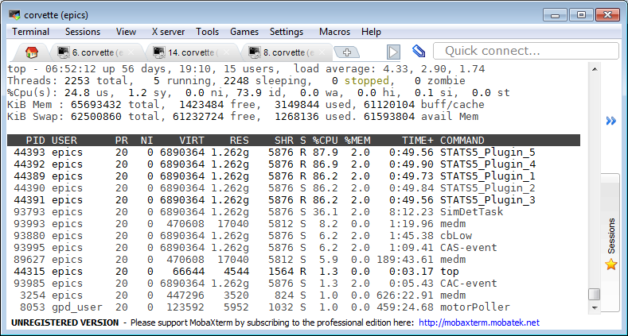
Multiple Threads with NDPluginStats 5 Threads

Slide 12
Multiple Threads per Plugin
Plugin | Supports multiple threads | Comments
NDPluginColorConvert | Yes | Multiple threads supported and tested
NDPluginFFT | Yes | Multiple threads supported and tested
NDPluginOverlay | Yes | Multiple threads supported and tested
NDPluginROI | Yes | Multiple threads supported and tested
NDPluginROIStat | Yes | Multiple threads supported and tested NOTE: time series needs ordering
NDPluginStats | Yes | Multiple threads supported and tested NOTE: time series needs ordering
NDPluginStdArrays | Yes | Multiple threads supported and tested NOTE: waveform callbacks will be out of order
NDPluginTransform | Yes | Multiple threads supported and tested

Slide 13
NDPluginScatter
Used to distribute (scatter) the processing of NDArrays to multiple downstream plugins
Allows multiple instances of a plugin to process NDArrays in parallel, utilizing multiple cores to increase throughput.
Designed to be used together with NDPluginGather, which gathers the outputs from multiple plugins back into a single stream.
Works differently from other plugins that do callbacks to downstream plugins.
Other plugins pass each NDArray that they generate to all downstream plugins that have registered for callbacks.
NDPluginScatter does not do this, rather it passes each NDArray to only one downstream plugin.
Modified round-robin algorithm for choosing which plugin to pass the next NDArray to
More complex to set up than multiple threads in a single plugin, but allows the plugins running in parallel to have different configurations or even be different plugins

Slide 14
NDPluginGather
Used to gather NDArrays from multiple upstream plugins and merge them into a single stream.
When used together with NDPluginScatter it allows multiple instances of a plugin to process NDArrays in parallel, utilizing multiple cores to increase throughput.
Works differently from other plugins that receive callbacks from upstream plugins.
Other plugins subscribe to NDArray callbacks from a single upstream plugin or driver.
NDPluginGather allows subscribing to callbacks from any number of upstream plugins.
Combines the NDArrays it receives into a single stream which it passes to all downstream plugins.

Slide 15
NDPluginScatter + V4
Distribute file writing to multiple IOCs (4096 x 3078 8-bit)
IOC #1
IOC #2
IOC #3
IOC #4
ADSimDetector
NDPluginScatter
NDPluginPva
NDPluginPva
NDPluginPva
pvaDriver
pvaDriver
pvaDriver
NDFileHDF5
NDFileHDF5
NDFileHDF5
# IOCs | Files/sec | GB/sec
1 | 101.0 | 1.19
2 | 195.2 | 2.29
3 | 217.5 | 2.55

Slide 16
ADSupport
New repository ADSupport
Source code for all 3rd party libraries used by ADCore.
hdf5, jpeg, GraphicsMagick, netCDF, nexus, szip, tiff, xml2, zlib
ADBinaries no longer used.
Pre-built libraries for Windows too difficult to maintain, now all built from source using EPICS build system
ADSupport can be built for
Windows (Visual Studio or MinGW, 32/64 bit, static/dynamic),
Linux (currently Intel architectures only, 32/64 bit),
Darwin
vxWorks (currently big-endian 32-bit architectures only).
vxWorks previously supported only netCDF file plugin
All file saving plugins now supported on vxWorks 6.x (TIFF, JPEG, netCDF, HDF5, Nexus).
HDF5 and Nexus are not supported on vxWorks 5.x because the compiler is too old.
Could imagine migrating saveData to HDF5 since it now works on all platforms.

Slide 17
Roadmap: ADCore R4-0
Put more functionality into ADDriver base class
Derived class would call ADDriver::doPluginCallbacks(), which would handle setting attributes, getting timestamp, calling plugins, etc.
Simplify file saving modes (no more Single, Capture, Stream) and eliminate AutoSave
Implement NDPluginFile::readFile() for TIFF, perhaps others
Add flag to prevent overwriting files

Slide 18
Roadmap: ADCore R5-0
Change NDArray to NTNDArray for passing data to plugins
Use PVDatabase
“local” provider within IOC
“pva” provider between IOCs
Smart pointers automatically eliminate all unnecessary copying
Eliminates need for NDPluginPva
V4 clients can immediately receive data from any point in plugin chain
Distribute load to multiple IOCs without pvaDriver
Bruno Martins has demonstrated this working for ADSimDetector and NDPluginStats

