Slide 1
Keithley 6482
EPICS module prototype
Carolina Bianchini, Leonid Sapozhnikov
10/07/2017

Slide 2
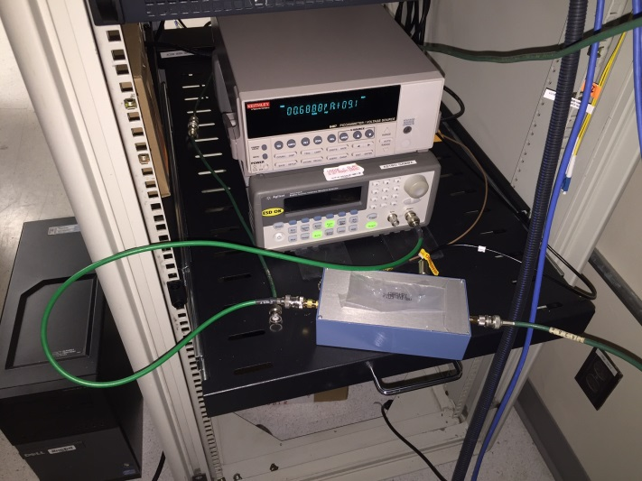
PicoAmmeter
Bunch Charge Monitor for LCLS-II:
- Faraday Cup:
Off-the-shelf picoAmmeter with Signal Conditioning for measurements.
picoAmmeter
Pulse generator (test only)
Conditioning Box

Slide 3
Keithley 6487 vs 6482
Model | Current | Resistance | N. Channels | Source | PC Interface
6487 | 10fA - 20mA | 10Ω - 10¹⁵Ω | 1 | 0 – ±500V | GPIB, RS-232
6482 | 10fA - 20mA | N/A | 2 | 0 - ±30V, each channel | GPIB, RS-232

Slide 4
SCPI Commands
6487 | 6482
SYST:ZCHECK | No equivalent. Used when range changing to eliminate impedance change transients
SYST:KLOCK | :SYSTem:RWLock
SYST:ZCOR | :SYSTem:AZERo:STATe ON|OFF
RANG:AUTO | CURR:RANG AUTO
DAMP | No equivalent. Suggesting using an active filter or increase NPLC value
TRIG:DEL:AUTO | No equivalent. Used to control coordinated measurement/switch with 7000 Series Switch Mainframe.
SOUR:VOLT:STAT | OUTP ON or OUTP2 ON. Turn on supply.
SOUR:VOLT:INT | No equivalent. 6482 does not have an interlock since the supplies do not reach hazardous levels.
RANG | CURR:RANG Channel specific command. SENS1 is default and can be omitted. Must specify SENS2 for channel 2
SOUR:VOLT:ILIM | No equivalent command. Dual power supplies are limited to 20 mA maximum.

Slide 5
Summary
Epics module “Keithley6482” tested and will be use for Early Injection Commissioning of LCLS-II.
Other features available:
Example: Ground connect mode
2 Channels

Slide 6
End
Thank you

