Slide 1
EPICS at PSI
Markus Janousch:: Controls :: Paul Scherrer Institut
EPICS Collaboration Meeting at ICALEPCS 2017, Barcelona

Slide 2
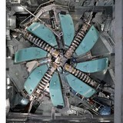
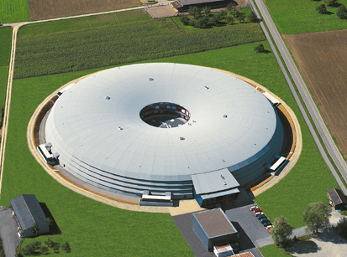
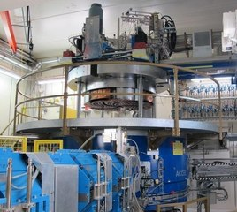
PSI Accelerator Environment
High Intensity Proton Accelerator (HIPA). A 40+ year old cyclotron. Feeds the
Neutron source SINQ, muon facility, particle physics program and UCN.
Swiss Light Source (SLS), a 3rd generation synchrotron with 18 beamlines.
Comet, a superconducting cyclotron with four beamlines. Used for proton
therapy.
SwissFEL a 5.8 GeV hard X-ray FEL. One beamline, 2 experimental stations. Currently being commissioned.
Standardizations
Boundaries
New Requirements
The Controls group has to support a diverse and complex range of accelerator facilities and different test rigs with a rather interesting historical background.
Notes:
Of course, there are several other test-facilities and laboratories related to the accelerator facilities.
This large array of different facilities and set-ups around the laboratory poses quite a challenge to be handled by one Controls group. Therefore a lot of emphasis has been put on standardization on the equipment that is supported and the tools that are being used within the Controls group. However, there are new experiments and test set-ups constantly coming up that need to be supported on the one hand on the other one has to watch a growing heap of legacy components and code that have to be maintained. E.g. HIPA is operational since over 40 years

Slide 3
Controls at PSI up to 2021
From the experience of constructing and implementing the SwissFEL we came up with an internal project (Controls 2020).
Access the EPICS IOC real-time database through other communication protocols
  We use ZeroMQ for beam synchronous DAQ at SwissFEL
  ( EPICS 7, codecs/plugins in pvAccess)
Implementing a device model (across different IOCs)
  Abstraction
  Automatic generation of basic GUIs
  Automatization of EPICS Database generation
Name server (also device name server)
Mechanism that allows “IOC” to push/publish data to archiver instead of pulling by archiver (see Dirk’s previous talk).

Slide 4
Controls at PSI beyond 2021
In a Strategy Document from July 2017 the Swiss States Secretary for Education, Research and Innovation emphasizes the importance of digitalization which is penetrating all economic and scientific sectors and changing the working environment. A central role in development, application and utilization of this new technology has been assigned to the area of Education, Research and Innovation.
How do we address the challenges of “digitalization” (IoT, CPS, Industry 4, …)in EPICS in the future?
RESTful web services?
System engineering based approach. Controls involved at the very beginning of a design. Have an integral approach for data sources and sinks.

Slide 5
Wir schaffen Wissen – heute für morgen
My thanks go to
my colleagues for their work
for your attention

Slide 6
PSI Colour Scheme
PSI‘s basic colours
Colour options for graphs:
1st choice
Colour options for graphs:
2nd choice

