Slide 1

  ODH Software development,
  Verification and Validation Yong Kian Sin

Slide 2

Oxygen Deficiency Hazard (ODH)
A large leak of helium / nitrogen in the
superconducting radio frequency cavity cryomodules
the target hydrogen moderator
sample environment systems and
superconducting magnets of some neutron instruments
will cause lack of oxygen and represent an ODH.
The ODH detection system will detect and alarm through the OXIGRAF oxygen deficiency monitors in the event of levels dropping below 19.5% and 18%

Slide 3
Software Requirement
ESS – 0117628 Accelerator Division’s requirements for the oxygen deficiency detection system to be installed in HCB, dog shed, CXB and CTL Gallery
Software related Requirements:
ACC-ODH-02: Alert the personnel in order to facilitate their safe and fast evacuation in case of oxygen depletion.

Slide 4
Software Requirement
ACC-ODH-06: The ODH flashing lights and evacuation alarms in the above-mentioned areas/buildings shall be activated upon detection of low level of oxygen (≤18%) from at least one oxygen deficiency detector as follows:
In case of low level of oxygen in ACH, TCH or HPGS the flashing lights and evacuation alarms of the entire HCB shall be triggered except the dog shed.
In case of low level of oxygen in the dog shed, only the flashing lights and evacuation alarms of the dog shed shall be triggered.
In case of low level of oxygen in the CTLG, only the flashing lights and evacuation alarms of the CTLG shall be triggered.
In case of low level of oxygen in the CXH, the flashing lights and evacuation alarms of the entire Coldbox Building (CXB) shall be triggered.

Slide 5
Software Requirement
ACC-ODH-07: If the O2 concentration drops below 18%: the oxygen deficiency detection system shall send a signal to the main control room and cryogenic control room. The lights and alarms shall remain active as long as the digital signal from the oxygen deficiency detection system’s relay module is active.
ACC-ODH-08: If the O2 concentration drops below 19.5%, the oxygen deficiency detection system shall send a signal to the main control room and cryogenic control room.

Slide 6
Configuration
Siemens S7 1500 Series CPU
Programming software: Siemens TIA Portal V14 SP1
Analog signal: A measure of percent oxygen at 4 – 20mA analog output. (Siemens Analog Input: 6ES7134-6HD00-0BA1 / 6ES7193-6BP00-0DA0)
Digital signal, input: Received the signal from O2iM relays (Siemens Digital Input: 6ES7131-6BH00-0BA0 )
Digital signal, output: Trigger alarm such as siren (Siemens Digital Output: 6ES7132-6BH00-0BA0 )
ODH Detector: Oxigraf O2iM

Slide 7
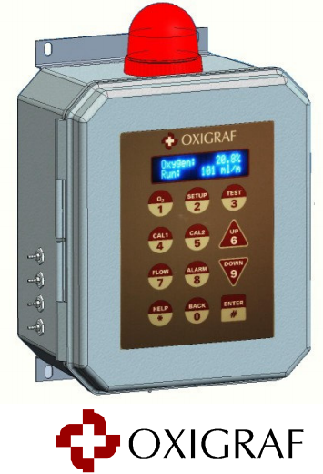
Oxigraf O2iM

Slide 8
Oxigraf O2iM
The Oxigraf sensor uses laser diode absorption technology to measure oxygen concentration in the gas sample.
Single or Multipoint Scan mode.
Warm up for full accuracy ≈ 10 minutes
Connection to ODH PLC:
  Analog signal (connected to Analog Input of PLC) to show oxygen percentage, and
  Relays (connected to Digital Input and Digital Output of PLC) to show system OK, limit of oxygen and alarm

Slide 9
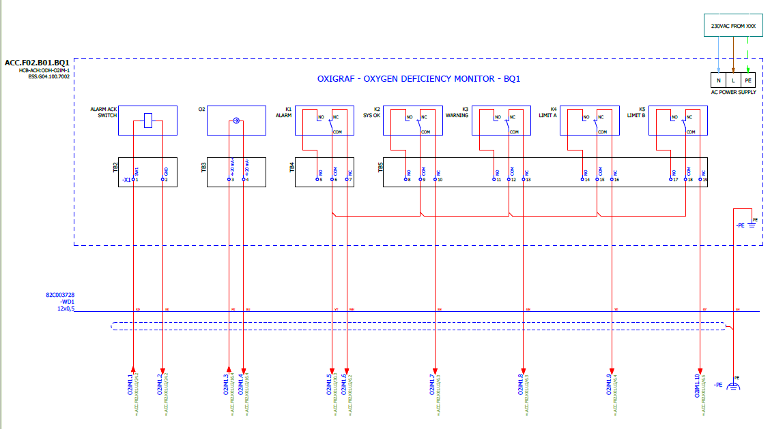
Oxigraf O2iM

Slide 10
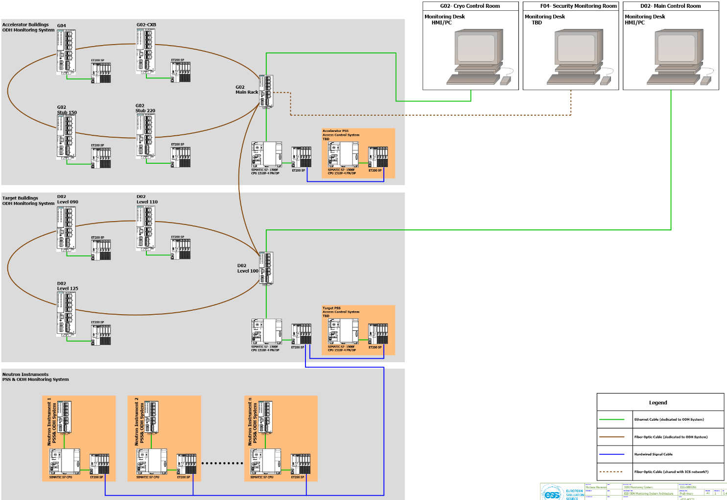
ODH Overall Architecture

Slide 11
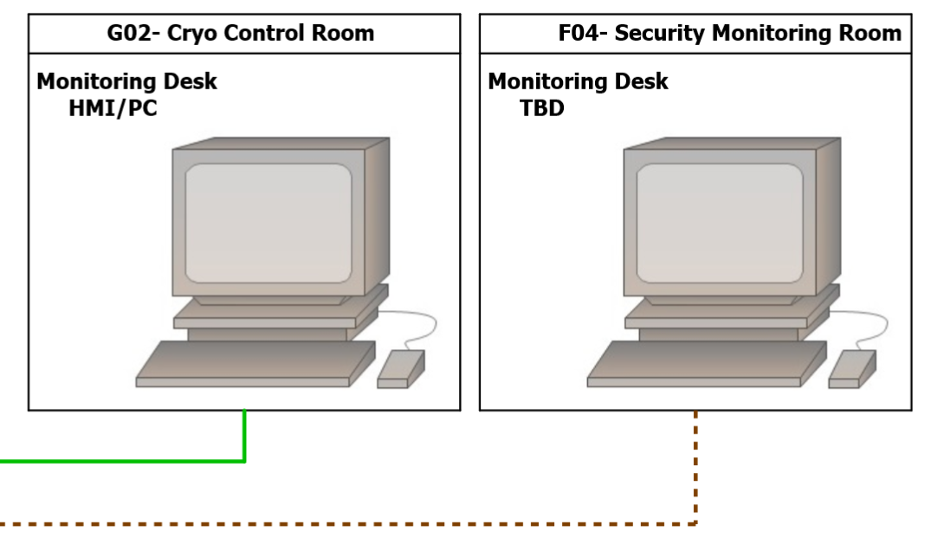
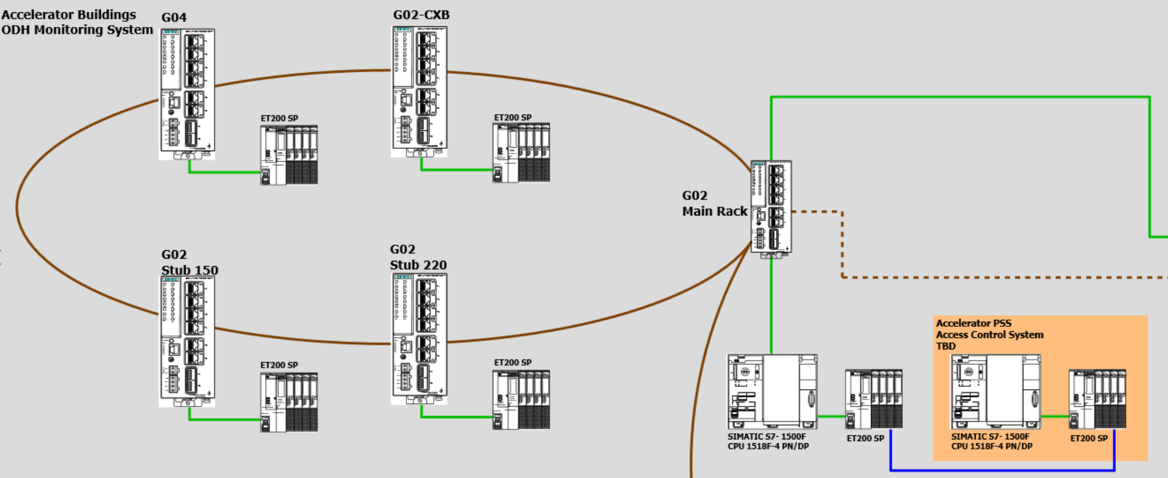
GO4 Architecture

Slide 12
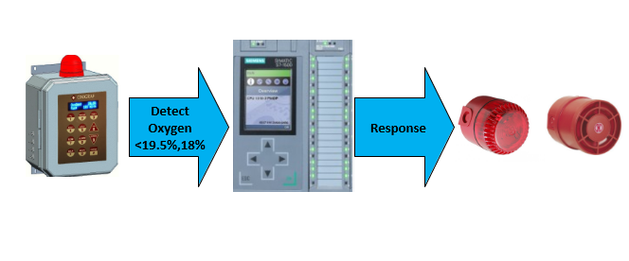
Detect, Process, Response

Slide 13
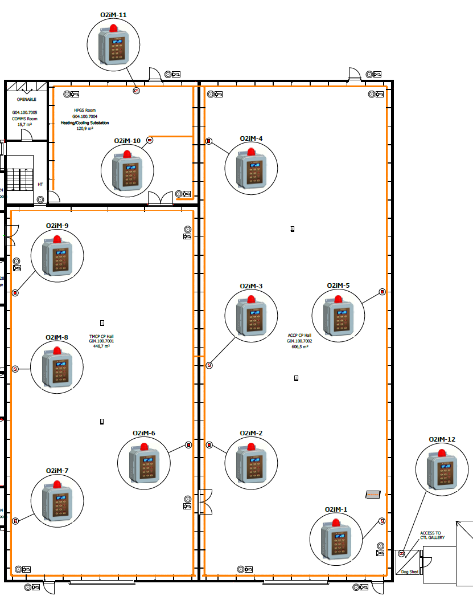
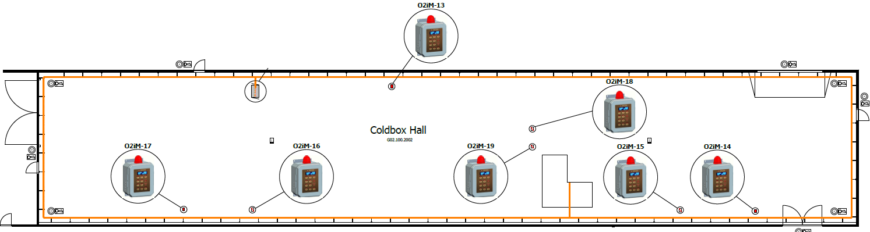
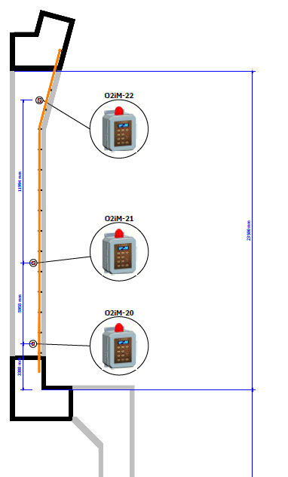
ODH Physical Layout (HCB, CXB, CTL)

Slide 14
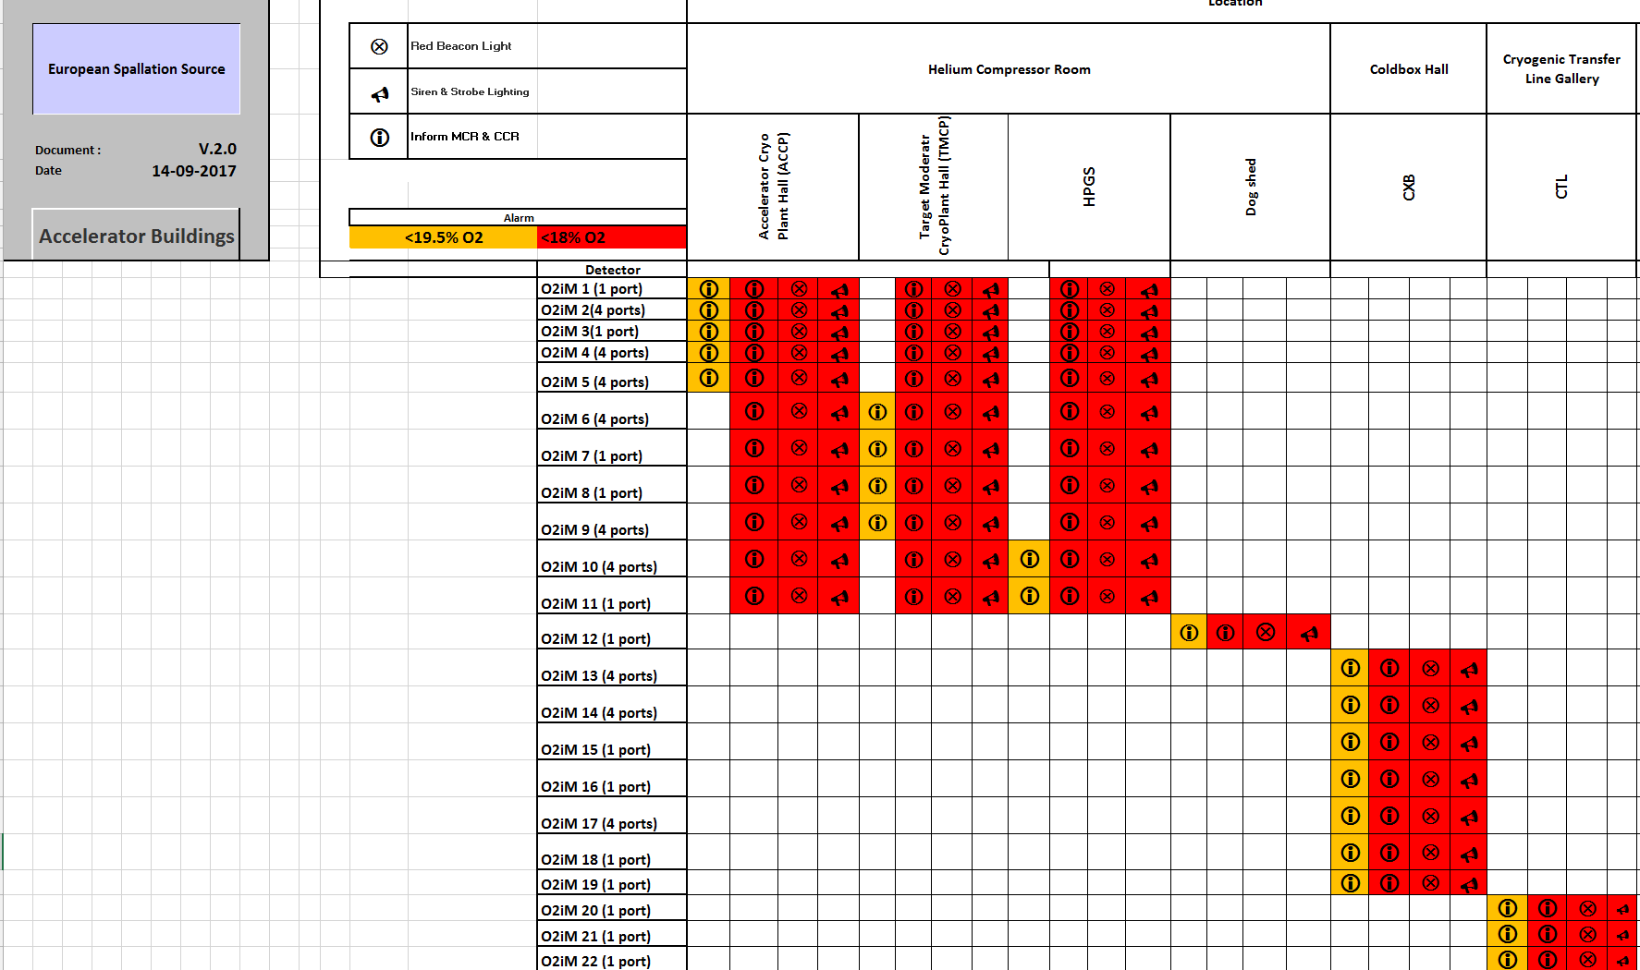
ODH Matrix

Slide 15
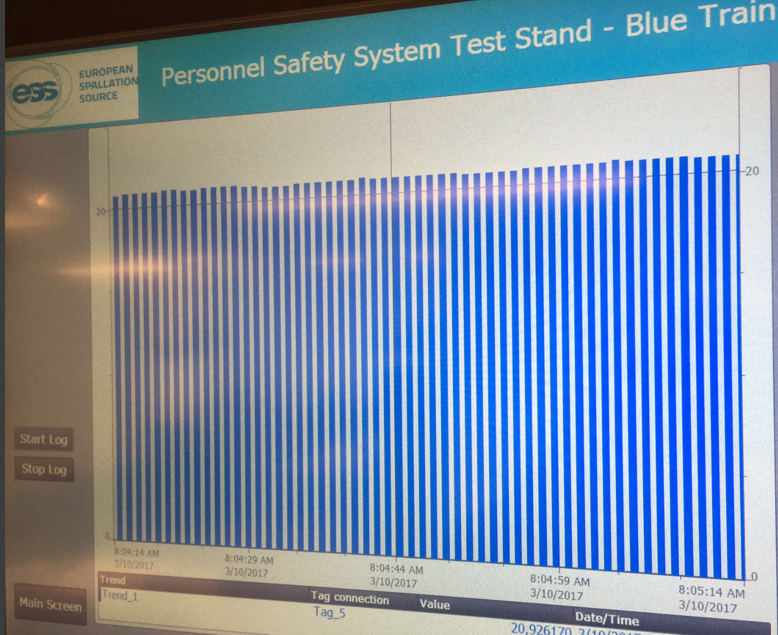
Logging
Logging system: Siemens SIMATIC HMI TP1500 Comfort Panel
      Output type: .csv
      Storage: SD card

Slide 16
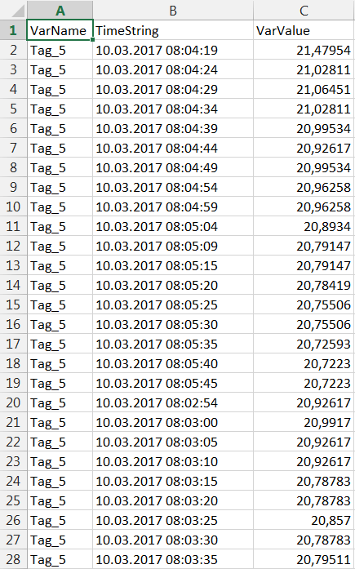
.csv format data stored in SD card

Slide 17
Details and interface of tested data logging in PS lab
Type of the chart: Bar chart
Color of the bar: Blue
Duration of Log: Until memory card full, then FIFO will be applied.
Resolution of log: 10 seconds or more, to not affect the capability of PLC
Type of connection: Ethernet
Memory card type: SD card
Programming software: Siemens TIA Portal V13
Log: Oxygen percentage more than 0% it will start to log
Type of document retrieve: .csv
Hardware: Siemens SIMATIC HMI TP1500 Comfort Panel
Analog signal: A measure of percent oxygen at 4 – 20mA analog output.
ODH Detector: Oxigraf O2iM

Slide 18
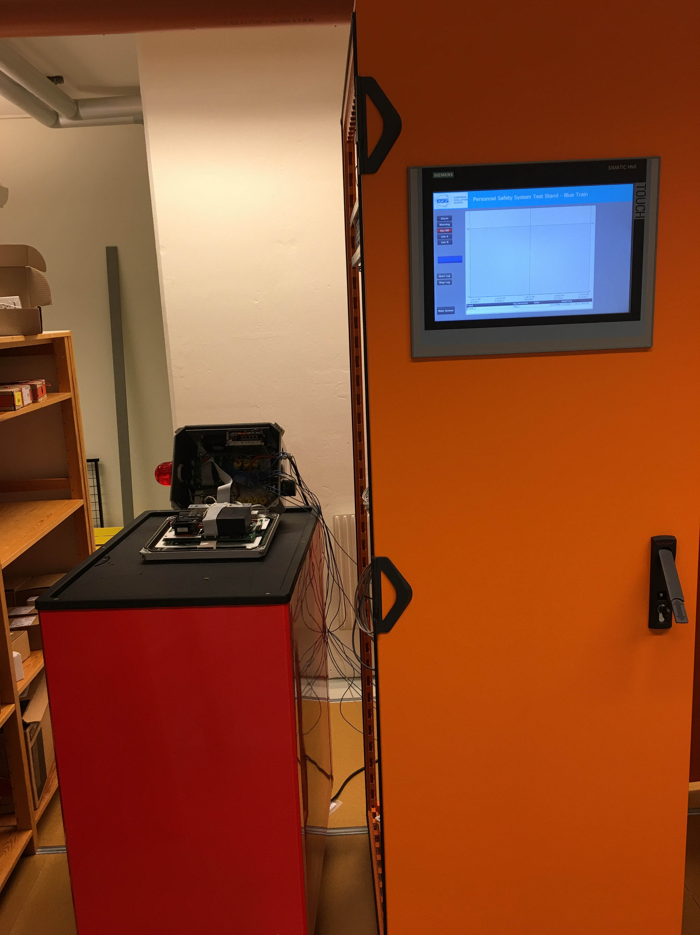
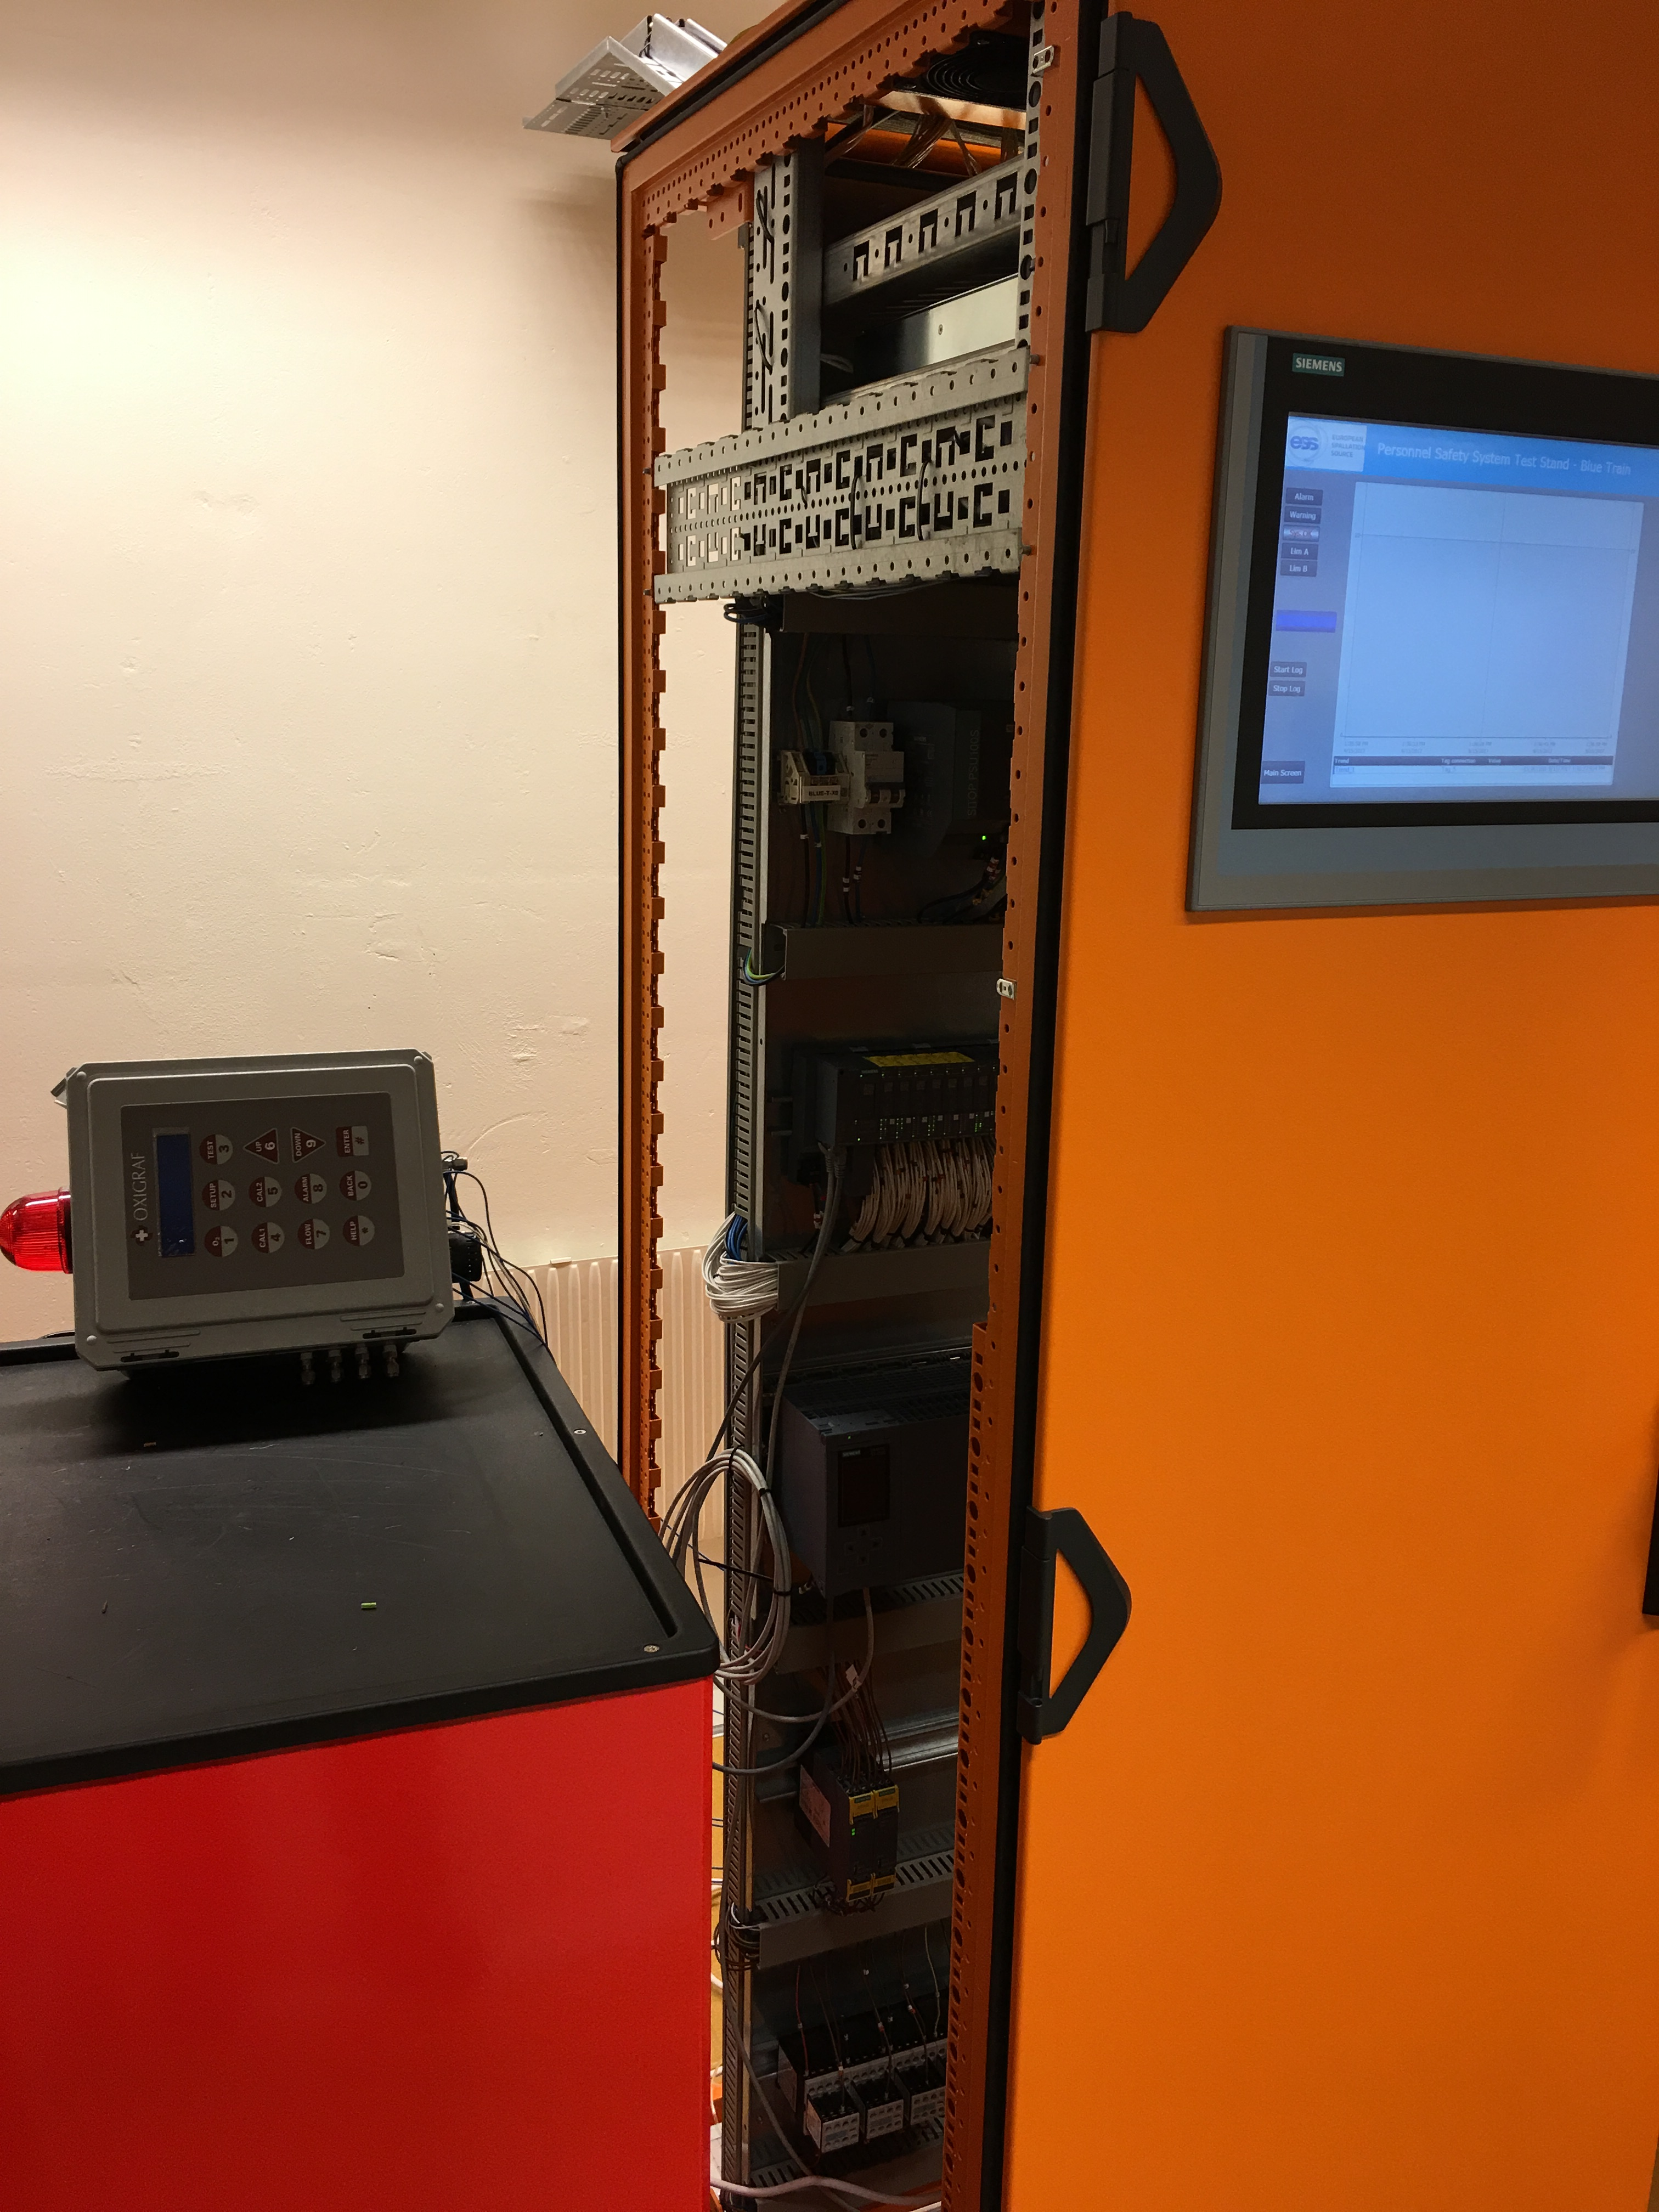
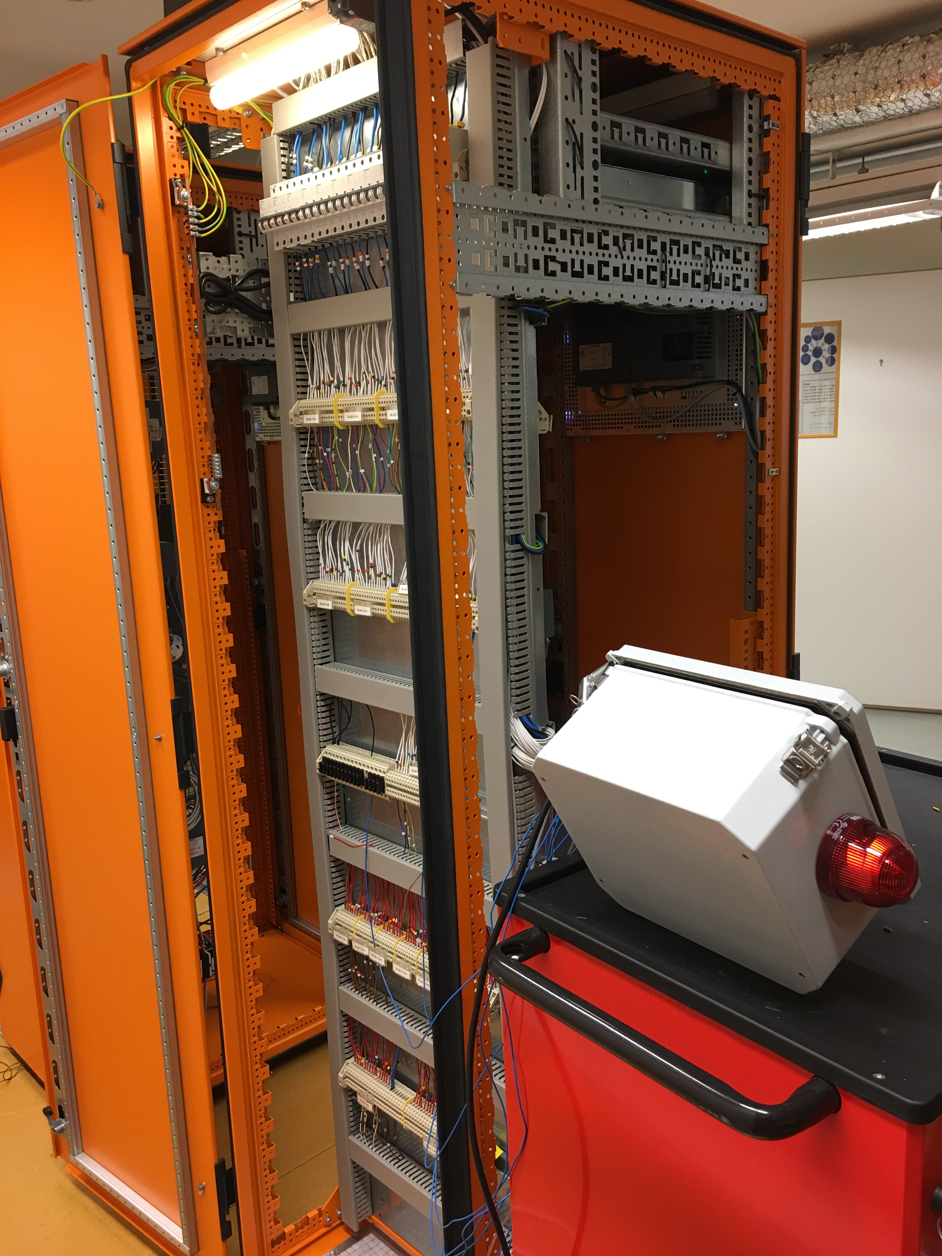
Testing of ODH system in PS Lab

Slide 19
Verification and Validation
Verification:
Verification is the process that has the aim of determining whether the output of a given phase of the development life cycle or not meet the requirements for that phase.
Validation:
Validation process is to evaluate output of a given phase of the development life cycle to ensure that these products meet the mission and the needs for which they were made.

Slide 20
Verification and Validation
Verification:
The Verification Plan shall document all the
criteria,
techniques and
tools
to be utilised in the verification process for each phase of the PSS Quality Assurance and Development Plan.

Slide 21
Verification and Validation
The verification plan shall describe the activities to be performed to ensure correctness and consistency with respect to the products and standards provided as input to that phase.
In each development phase it shall be shown that the functional, reliability, performance and safety requirements are met.

Slide 22
Verification and Validation
The verification plan shall address the following:
the selection of verification strategies and techniques.
the selection and utilisation of the test equipment;
the selection and documentation of verification activities;
the evaluation of verification results gained;
the roles and responsibilities of those involved in the test process;
the degree of test coverage required to be achieved.

Slide 23
Verification and Validation
Validation
The validation plan shall describe the activities (analyse and test) to ensure compliance with the ODH detection system Requirements Specification with particular emphasis on the functional aspect.

Slide 24
Next Step
Hardware and software design test
- testing performed on each module
- problems and their solutions
Factory Acceptance Test / Site Acceptance Test
- after the programmed software and hardware is merged. With analysis and test, the Verifier has to make sure, that the requirements defined are met.

Slide 25
Next Step
Loop Check
- Interconnections from one unit to the assigned unit
- Correct evaluation at the I/O card (Current vs. Voltage)
- Correct protocol for network connections
- Correct polarity

Slide 26


