Slide 1
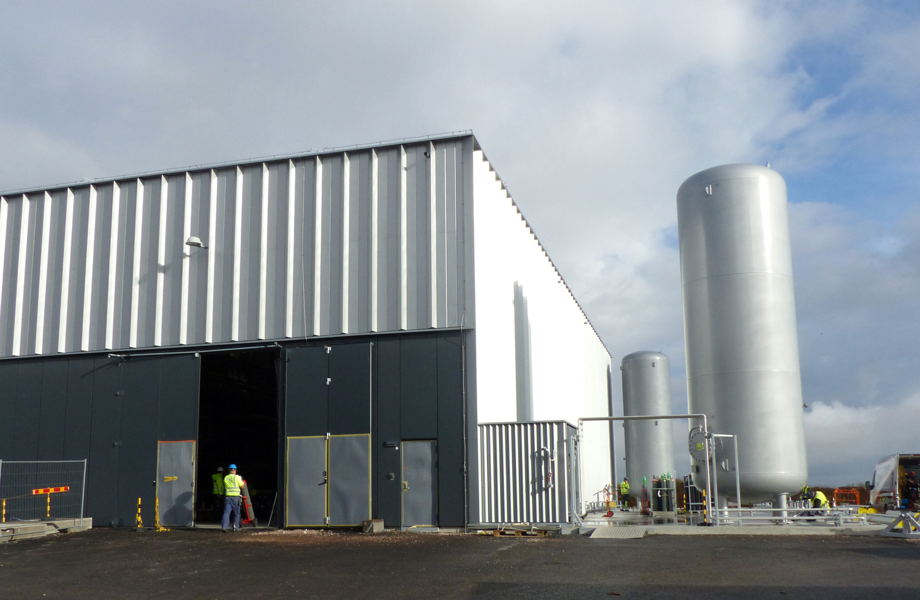
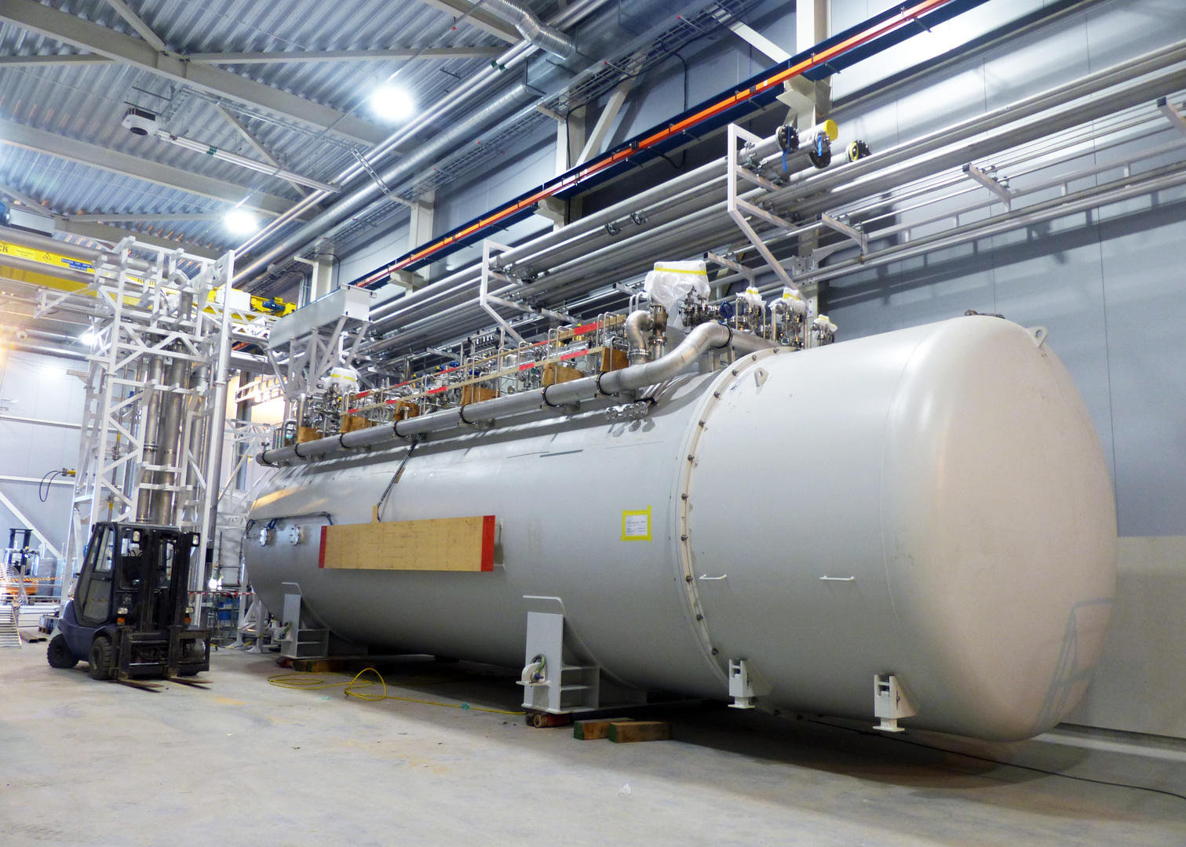
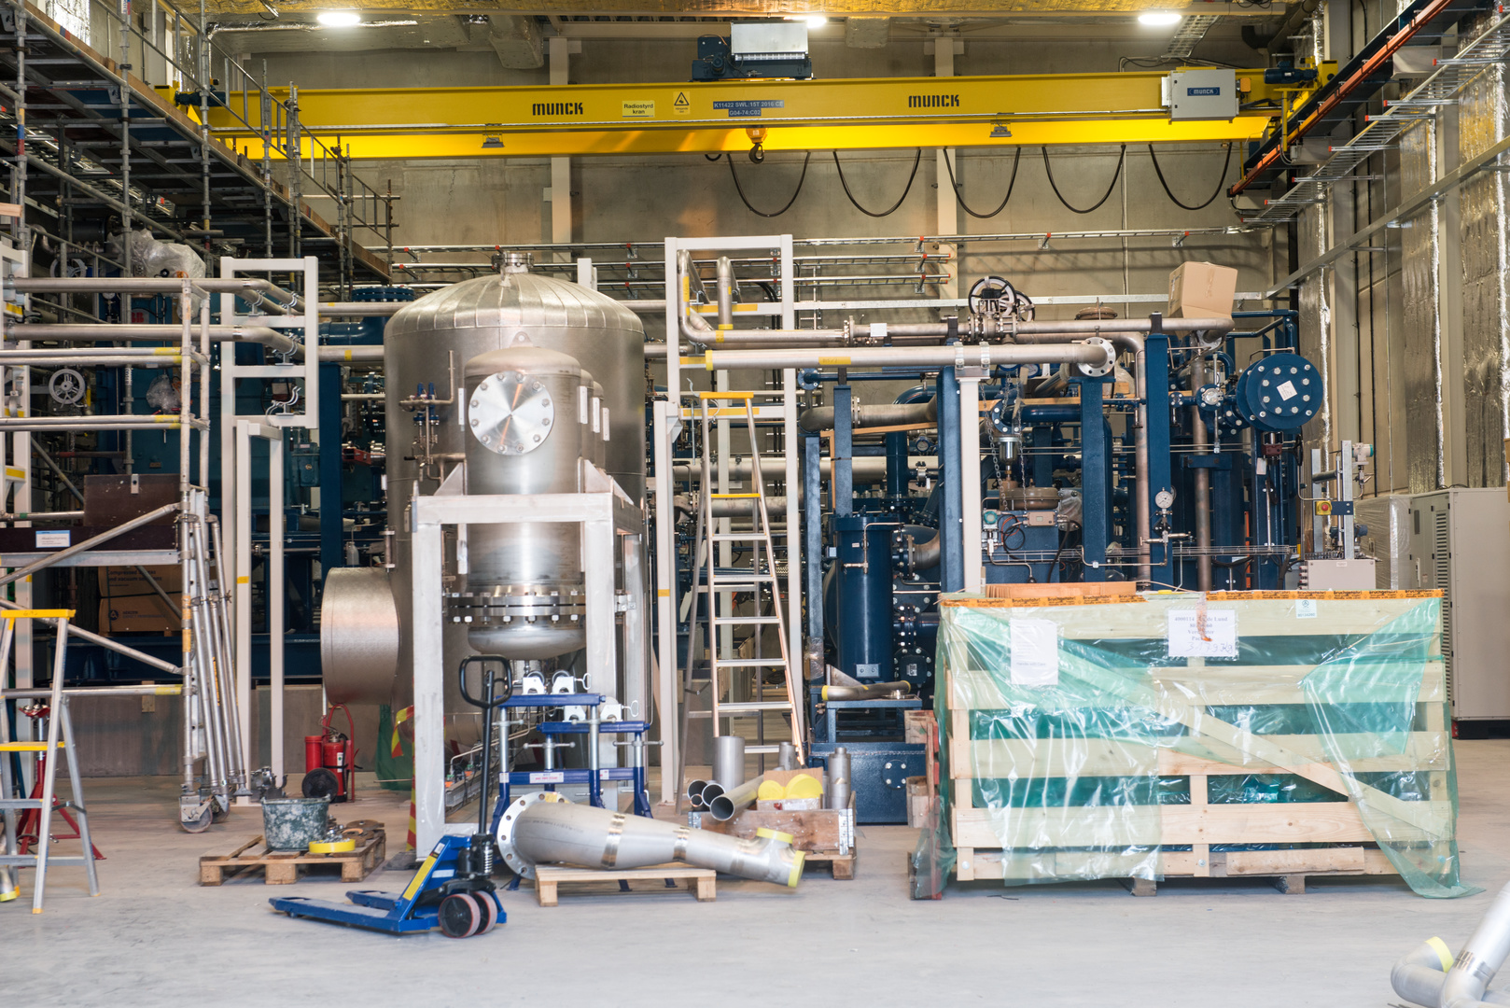
AD REQUIREMENTS FOR THE ODH DETECTION SYSTEM
HCB, DOG SHED, CXB AND CTL GALLERY
Internal CDR for ODH detection system

Slide 2
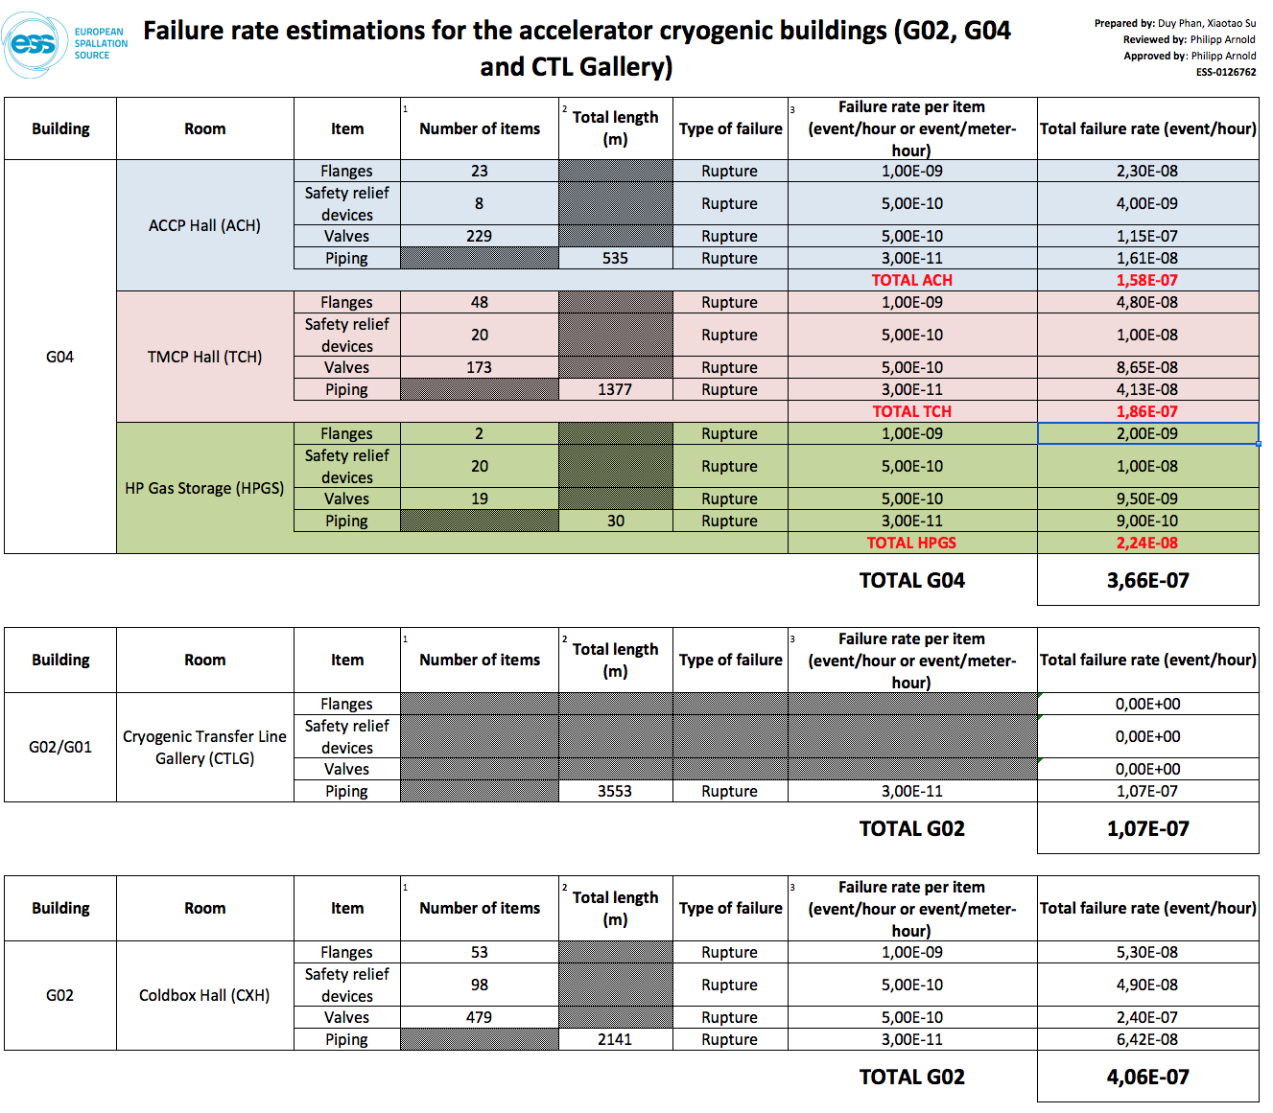
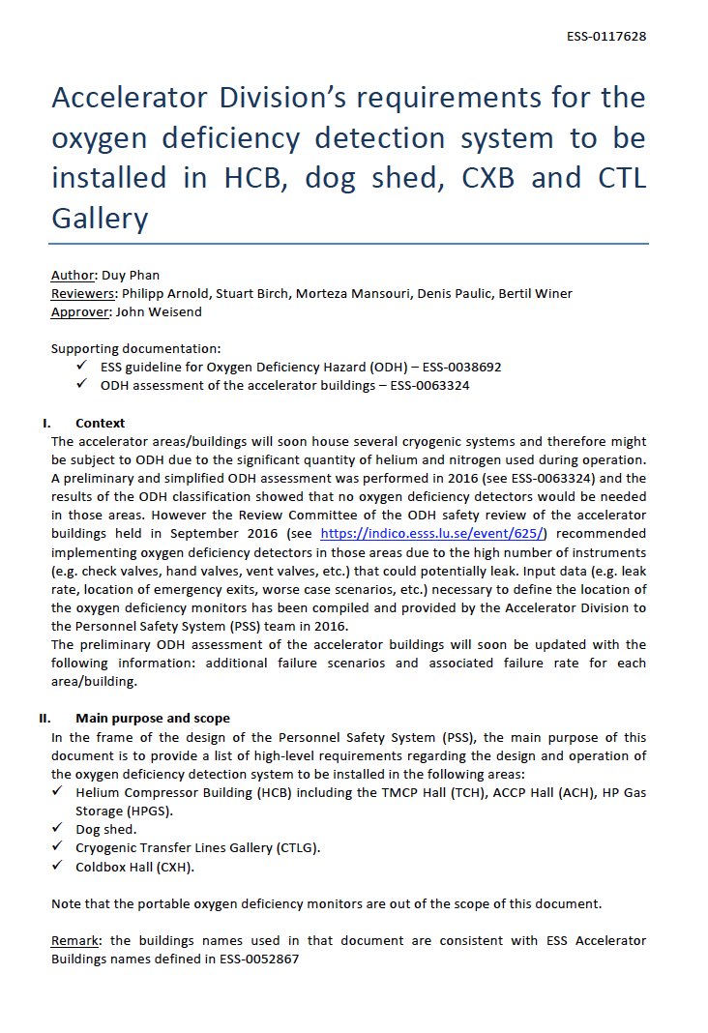
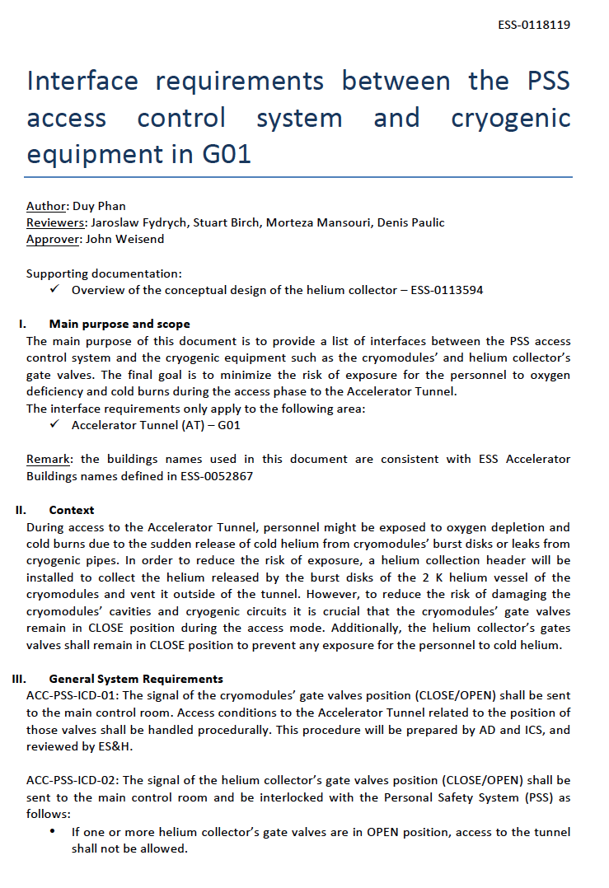
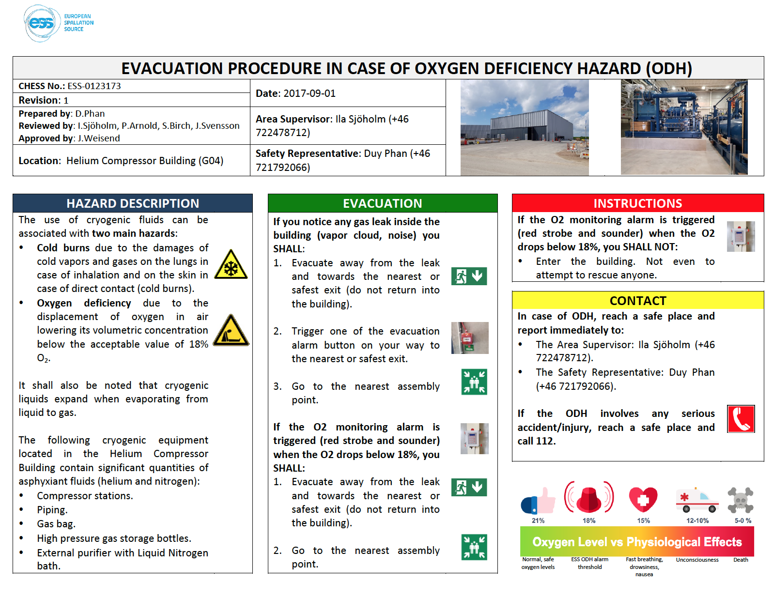

Timeline – ODH related documentation
Release of ESS-0117628.
ESS-0118119, ESS-0123173 and ESS-0126762 are still under revision
Sept. 17
ESS-0126762
ODH phase 2
ESS-0117628
ESS-0118119
ESS-0123173
May 17
First draft of the deliverables prepared by AD
ICS-PSS requested AD to prepare a list of technical requirements for the ODH detection system (see ICSPS-269)
April 17
Preliminary ODH assessment of the accelerator cryo buildings (ESS-0063324)
Sept. 16

Slide 3
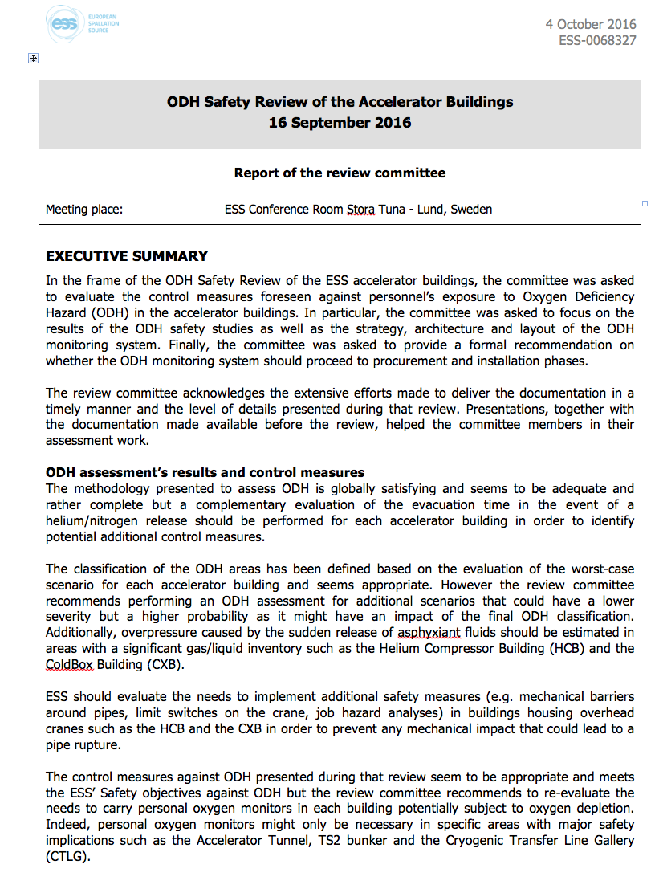
ODH Safety Review of the Accelerator Buildings – Oct. 2016
Main objective: evaluate the control measures foreseen against personnel’s exposure to Oxygen Deficiency Hazard (ODH) in the accelerator buildings, in particular the results of the ODH safety studies as well as the strategy, architecture and layout of the ODH monitoring system.
Main recommendations for G02 and G04:
Evaluate the needs to implement additional safety measures (e.g. mechanical barriers around pipes, limit switches on the crane, job hazard analyses) in buildings housing overhead cranes such as the HCB and the CXB in order to prevent any mechanical impact that could lead to a pipe rupture.
Evaluate the necessity of establishing a philosophy for the flashing lights including the aspect of not entering the hazardous area (e.g. visible from every position in the hazardous area, at every entrance, etc.).
Align the ODH and fire alarms and flashing lights
ESS-0068327

Slide 4
ODH Safety Review of the Accelerator Buildings – Oct. 2016
Main recommendations for G02 and G04:
Evaluate the necessity of a policy for evacuating adjacent areas and buildings if an ODH event occurs (e.g. case by case following a Risk Assessment, systematically or other). The ODH action matrix should also be updated accordingly.
Re-evaluate the needs for back-up generators (UPS) for oxygen monitors as well as flashing lights, sirens and beam-off stations in all accelerator buildings as one-hour back-up might not be sufficient from a safety perspective.
Evaluate the necessity for keeping trends/records of the data from the oxygen monitors at ESS, as it might be useful for guiding people in emergency situations (control room, intervention, crisis management team, etc.) as well as post-mortem to understand causes of incident (e.g. location and duration of leaks).

Slide 5
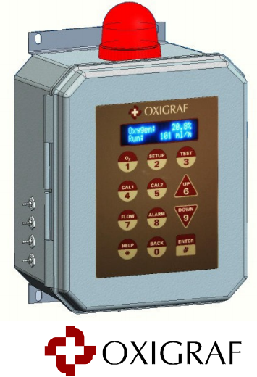
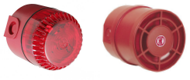
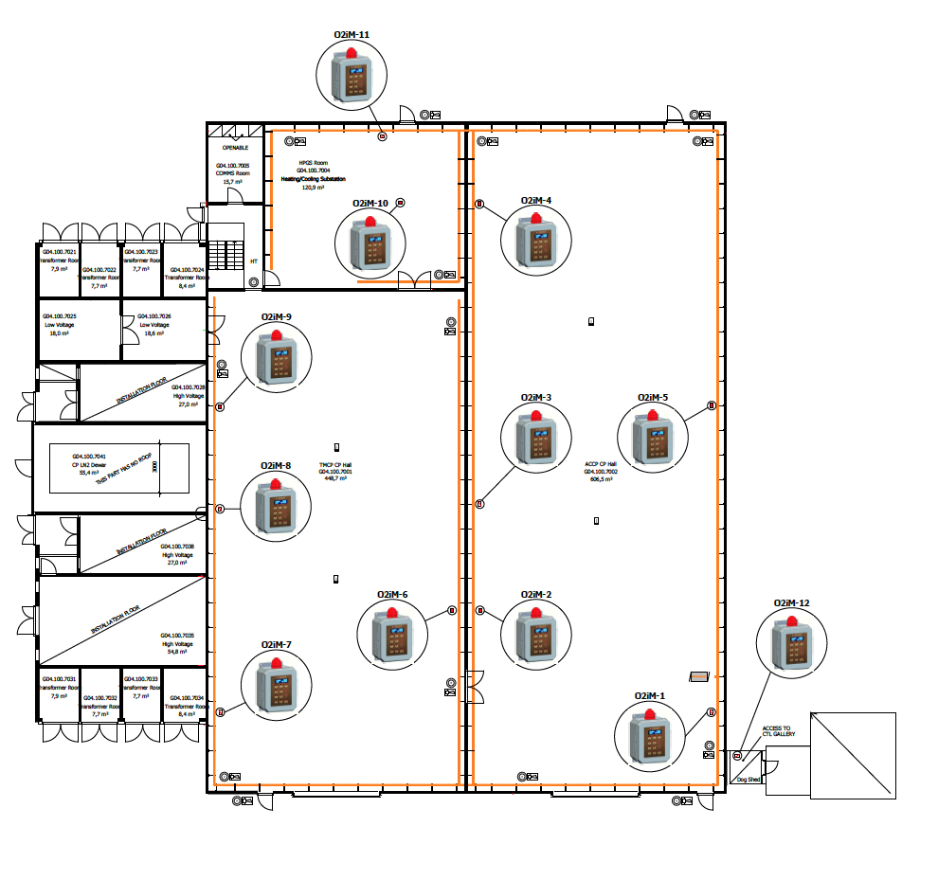
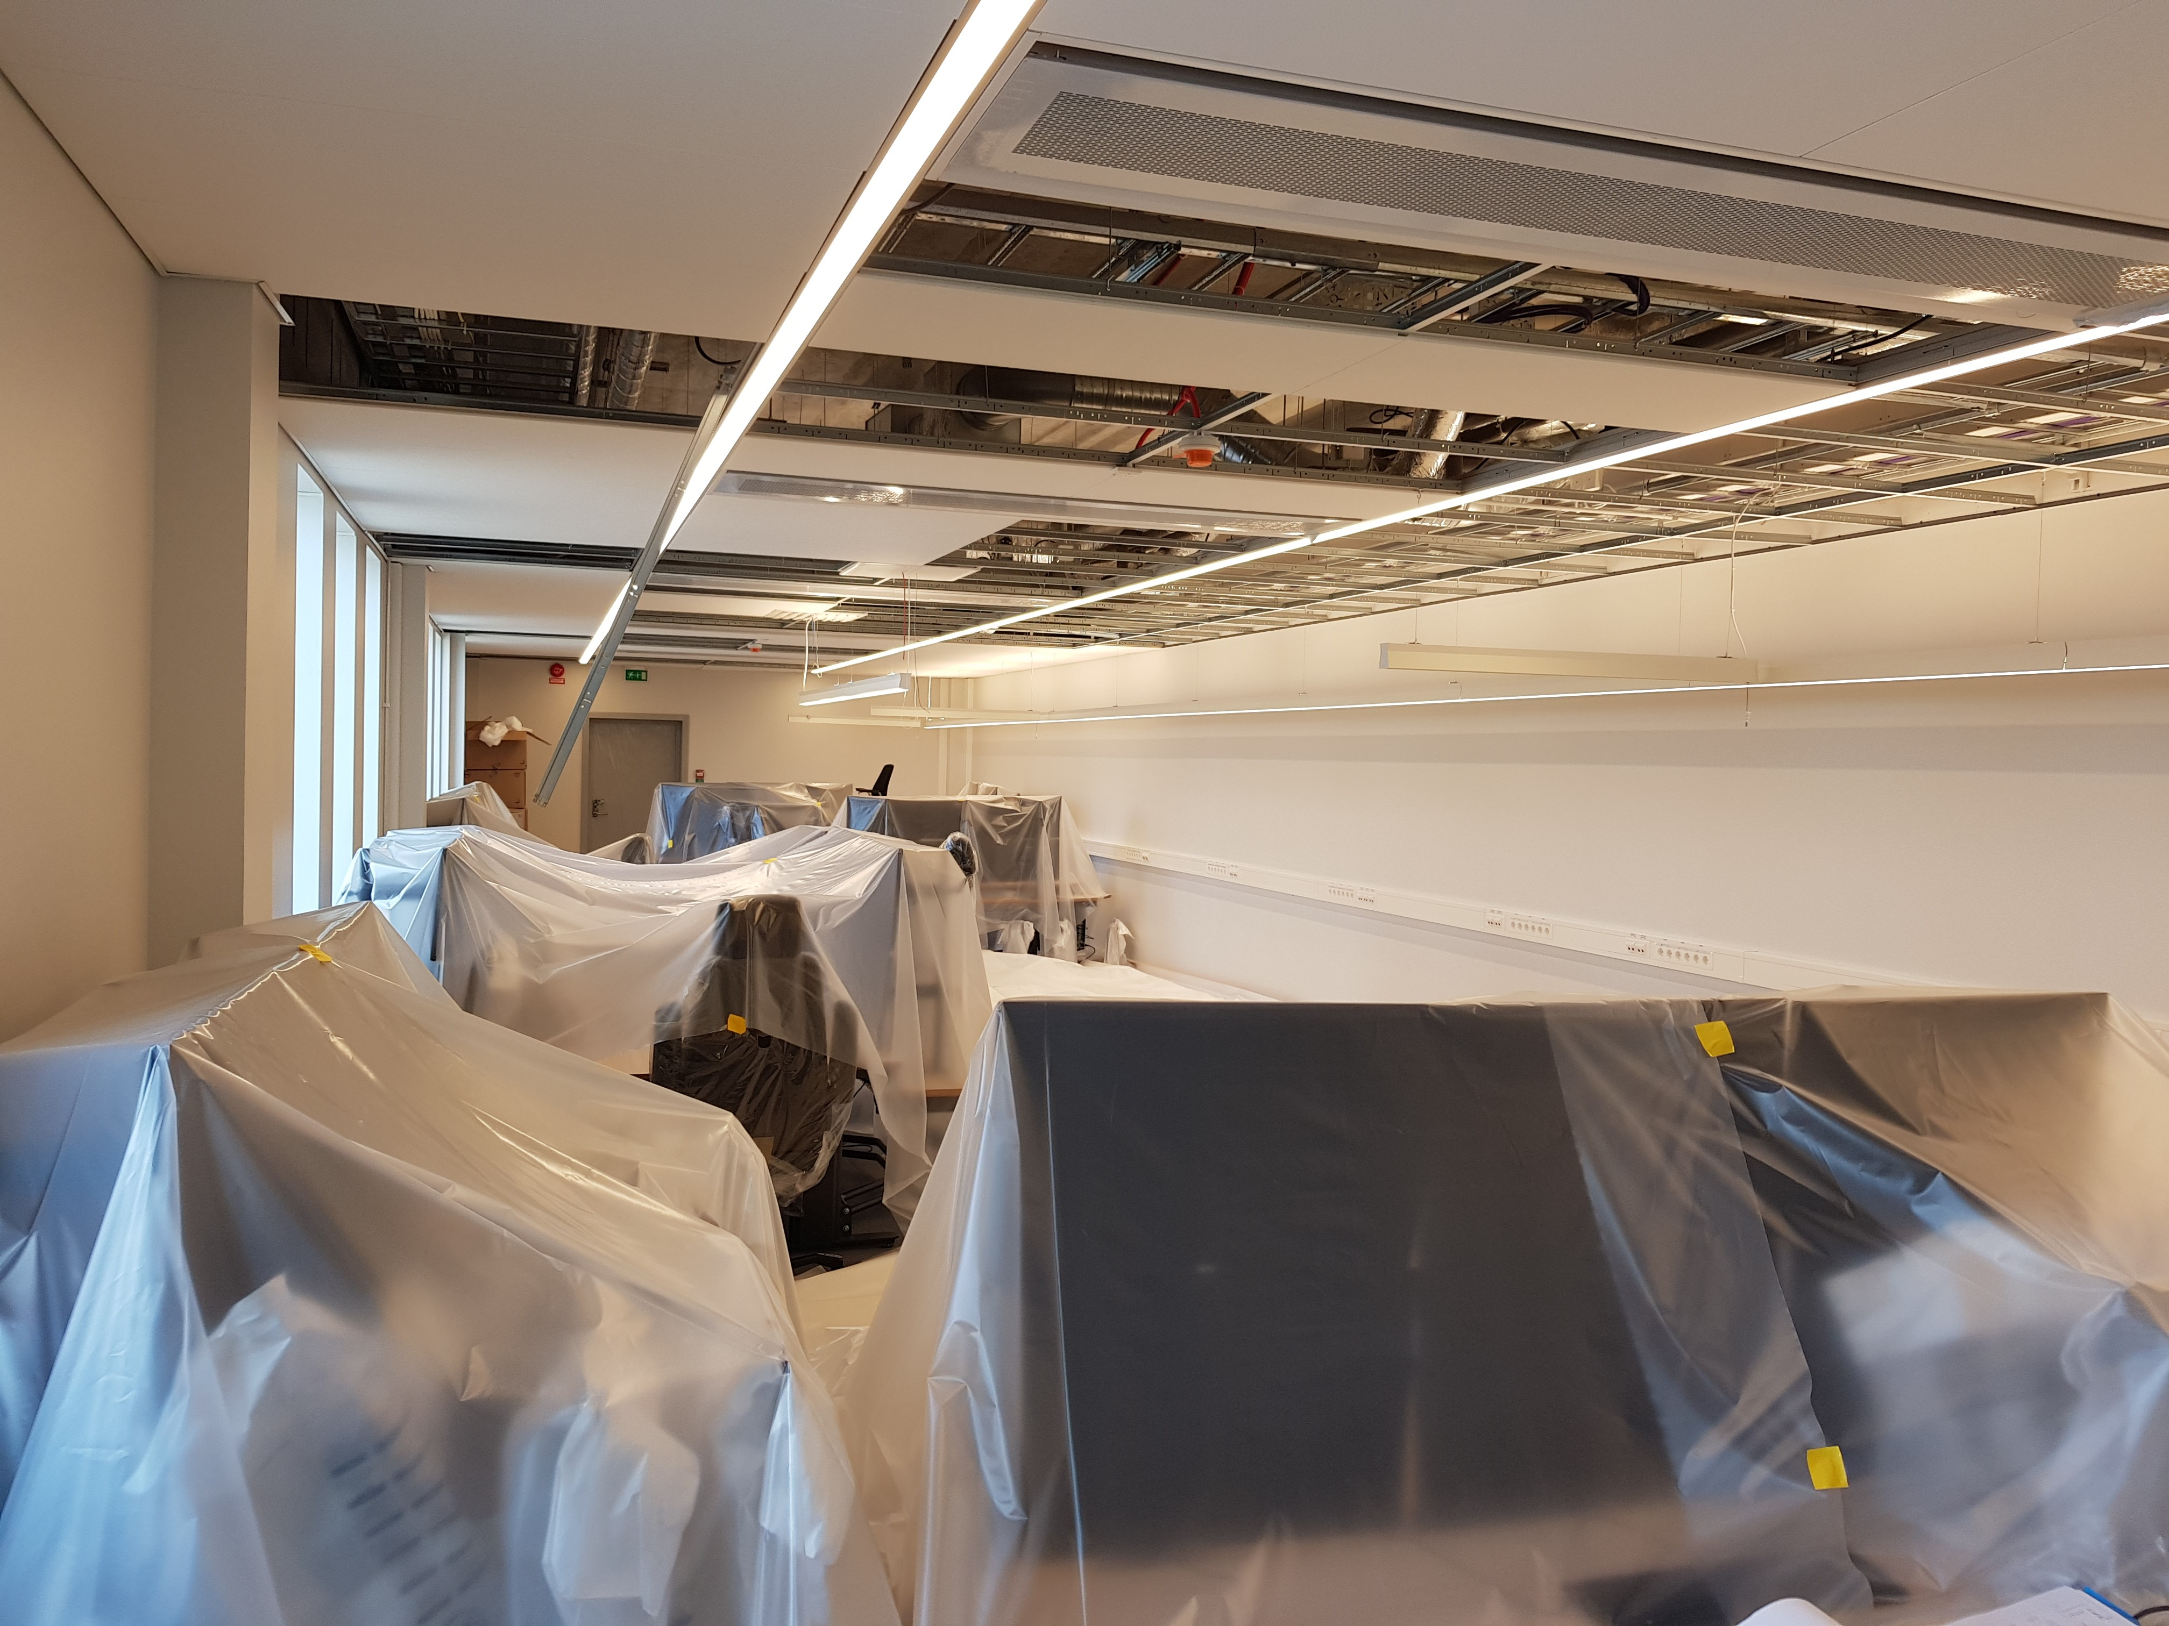

AD requirements for the cryo. buildings
Main objective: provide a list of high-level requirements regarding the design and operation of the oxygen deficiency detection system to be installed in the accelerator cryogenic buildings (G01 excluded)
Part I
General System Requirements
Part II
Alarm Requirements
ESS-0117628
Lights and sounders
O2 levels
Technology used
Recomm. from ODH safety review committee
Location of monitors
Signal flow to MCR and LCR
Emergency back-up power

Slide 6
AD requirements for the cryo. buildings
Main objective: provide a list of high-level requirements regarding the design and operation of the oxygen deficiency detection system to be installed in the accelerator cryogenic buildings (G01 excluded)
Out of the scope of this document:
Alarm acknowledgement by the main control room and cryogenic control room
Date acquisition (e.g. frequency, data archiving)
Emergency preparedness
ESS-0117628

Slide 7
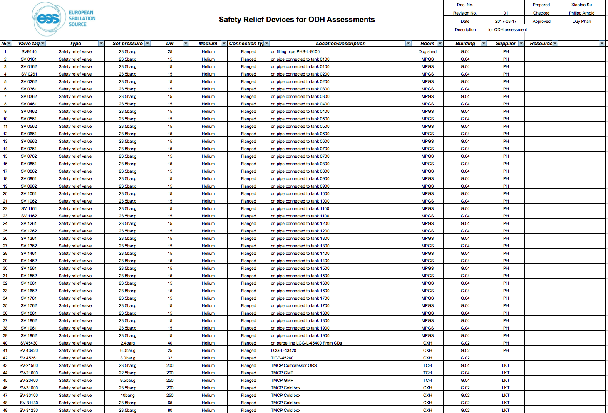
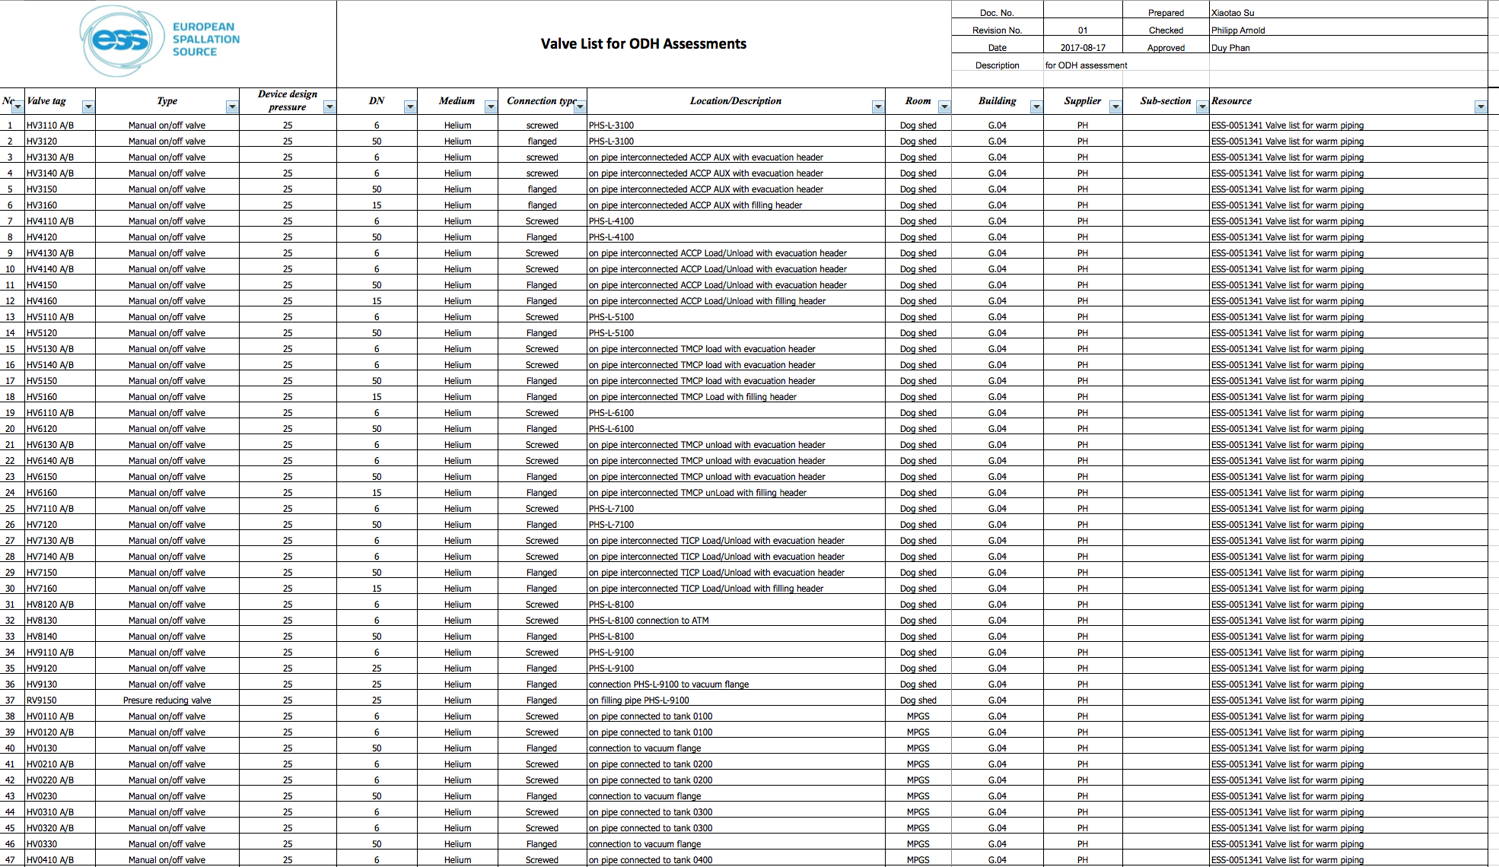
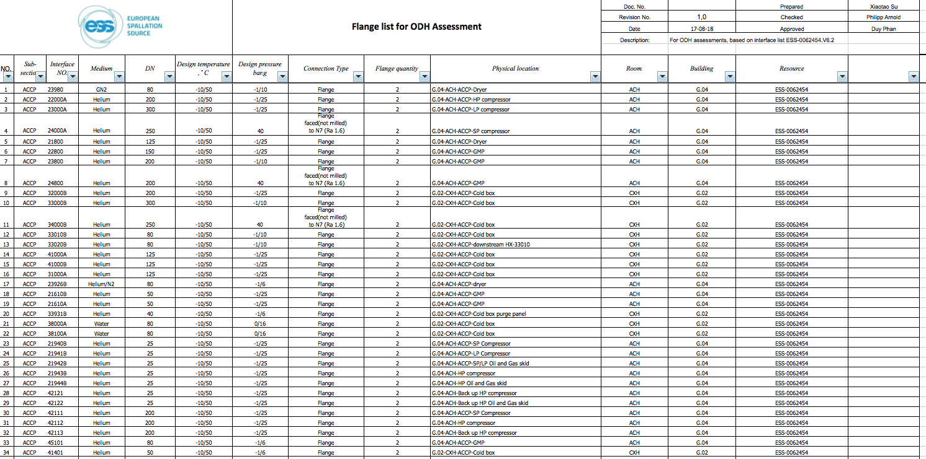
Failure rate estimation for the accelerator cryo. buildings
ESS-0126762
Main objective: provide a list of the cryogenic instruments that can fail and lead to an accidental release of asphyxiant fluids in the G-buildings (G02 and G04). This list is meant to be used as input data for the risk analysis of the ODH monitoring system performed by the ICS-PSS team.
Sources:
Safety relief devices list
Valves list
Flanges list
Acknowledgement: Xiaotao Su

Slide 8
Failure rate estimation for the accelerator cryo. buildings
ESS-0126762

Slide 9
Evacuation procedure in G04 in case of ODH
ESS-0123173
Main objective: provide safety instructions to operators working in in the helium compressor building (G04)
in case an ODH event
Evacuation procedure for G02 to be prepared

Slide 10

Duy.Phan@esss.se

