Slide 1
ODH Detection System Hardware and Architecture
Morteza Mansouri
Engineer for Safety Critical Systems
www.europeanspallationsource.se
17-09-19

Slide 2
Content
Answers to PDR (2016-09-16)
ODH Detection System Architecture and Physical Topology
ODH Detector Specifications
ODH Detector Calibration and Maintenance
ODH Rack(s) Design
Lights & Sounders Specifications

Slide 3
Answers to PDR (2016-09-16)
Answers to requirements/recommendations by the PDR review committee:
The need to have public address system in other areas than the accelerator tunnel should also be evaluated by ESS. According to the discussion with AD, no public address system is needed for ODH Detection System in accelerator buildings, except the accelerator tunnel. PSS will install a PA system in accelerator tunnel, mainly aimed for radiation protection purposes, but we can benefit from this system for ODH Detection System as well. ICSPS-116
ESS should install additional and clearly visible flashing lights in the middle of areas housing high equipment to improve reaction time in case of an emergency as well as signs at each entrance warning people not to enter the building if the evacuation alarm goes off. Lights and sounders installed at all entrance points to designated buildings. In order to avoid collisions with other systems installations, the lights and sounders in the middle of the halls (in the designated buildings) will be installed as soon as other installations are finalized.
ESS should align the ODH and fire alarms and strobe lights, and consider reducing the number of lights of the beam-off stations. As the Fire Detection System was installed by CF long time before ODH installation, this did not happen in G04, CXB and CTLG. Personnel will be trained to differentiate between them. The beam-off station and its ODH lights is being re-designed.
ESS should also consider implementing evacuation push buttons in the accelerator tunnel in order to manually trigger the evacuation in case of an ODH event. Ongoing discussion with ESH to prepare a ESS alarm strategy to figure out the best solution to implement shared (between Fire and ODH detection systems) evacuation buttons, alarms, etc.

Slide 4
Answers to PDR (2016-09-16)
ESS should re-evaluate the needs for back-up generators (UPS) for oxygen monitors as well as strobe lights, sirens and beam-off stations in all accelerator buildings as one-hour back-up might not be sufficient from a safety perspective. The back up power (UPS/diesel generator) to the ODH Detection System and PSS is agreed to be provided by AD (ESS-0101777). Since this is not ready yet, a temporary solution for back-up power to ODH Detection System PLCs and alarms is in place now. See the Rack design slide for details.
ESS should evaluate the necessity for keeping records of the data from the oxygen monitors at ESS, as it might be useful post-mortem to understand causes of incident (e.g. location and duration of leaks). There are two ways of collecting data from O2iM units: ICSPS-115
Communication via RS-232 or RS-485. There is a software tool, OxiSafe, that communicates with the RS-232 port to provide remote viewing and logging of the O2iM units. OxiSafe will ONLY work with one (1) unit. Oxigraf had looked at a multiple channel version (maybe 10 units at most) at one time, but did not ever have a reason to finish that update. The OxiSafe software is LabView runtime.
Communication via 4-20 mA output which provides the O2 levels and this is also in the RS-232/485 information. Here we need to add AI PLC modules to the distributed I/Os. The graphic user interface and archiving of data should be done separately as well. See Software presentation for more details.

Slide 5
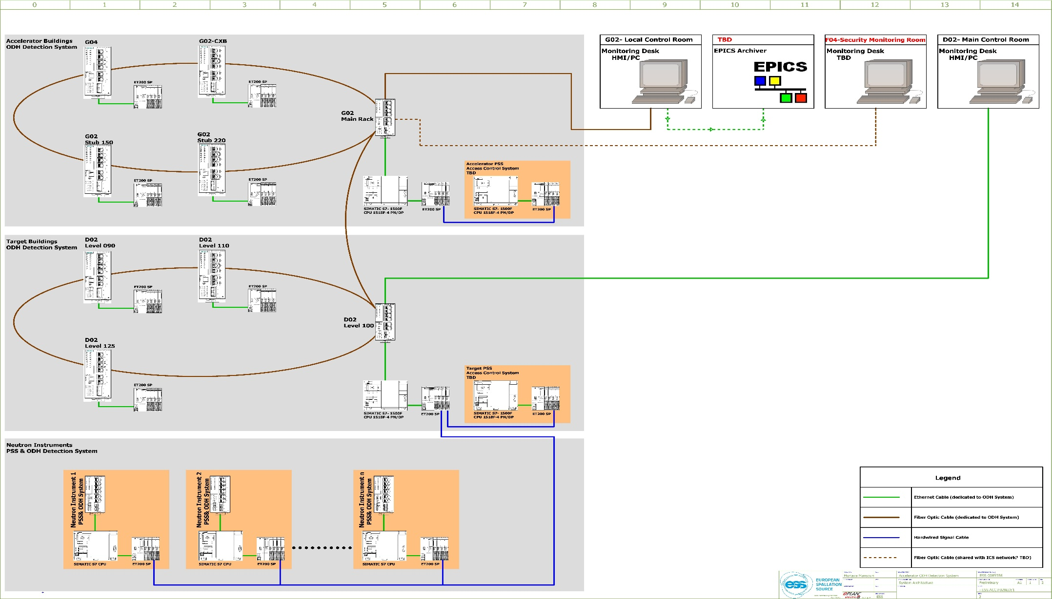
ODH Detection System Architecture

Slide 6
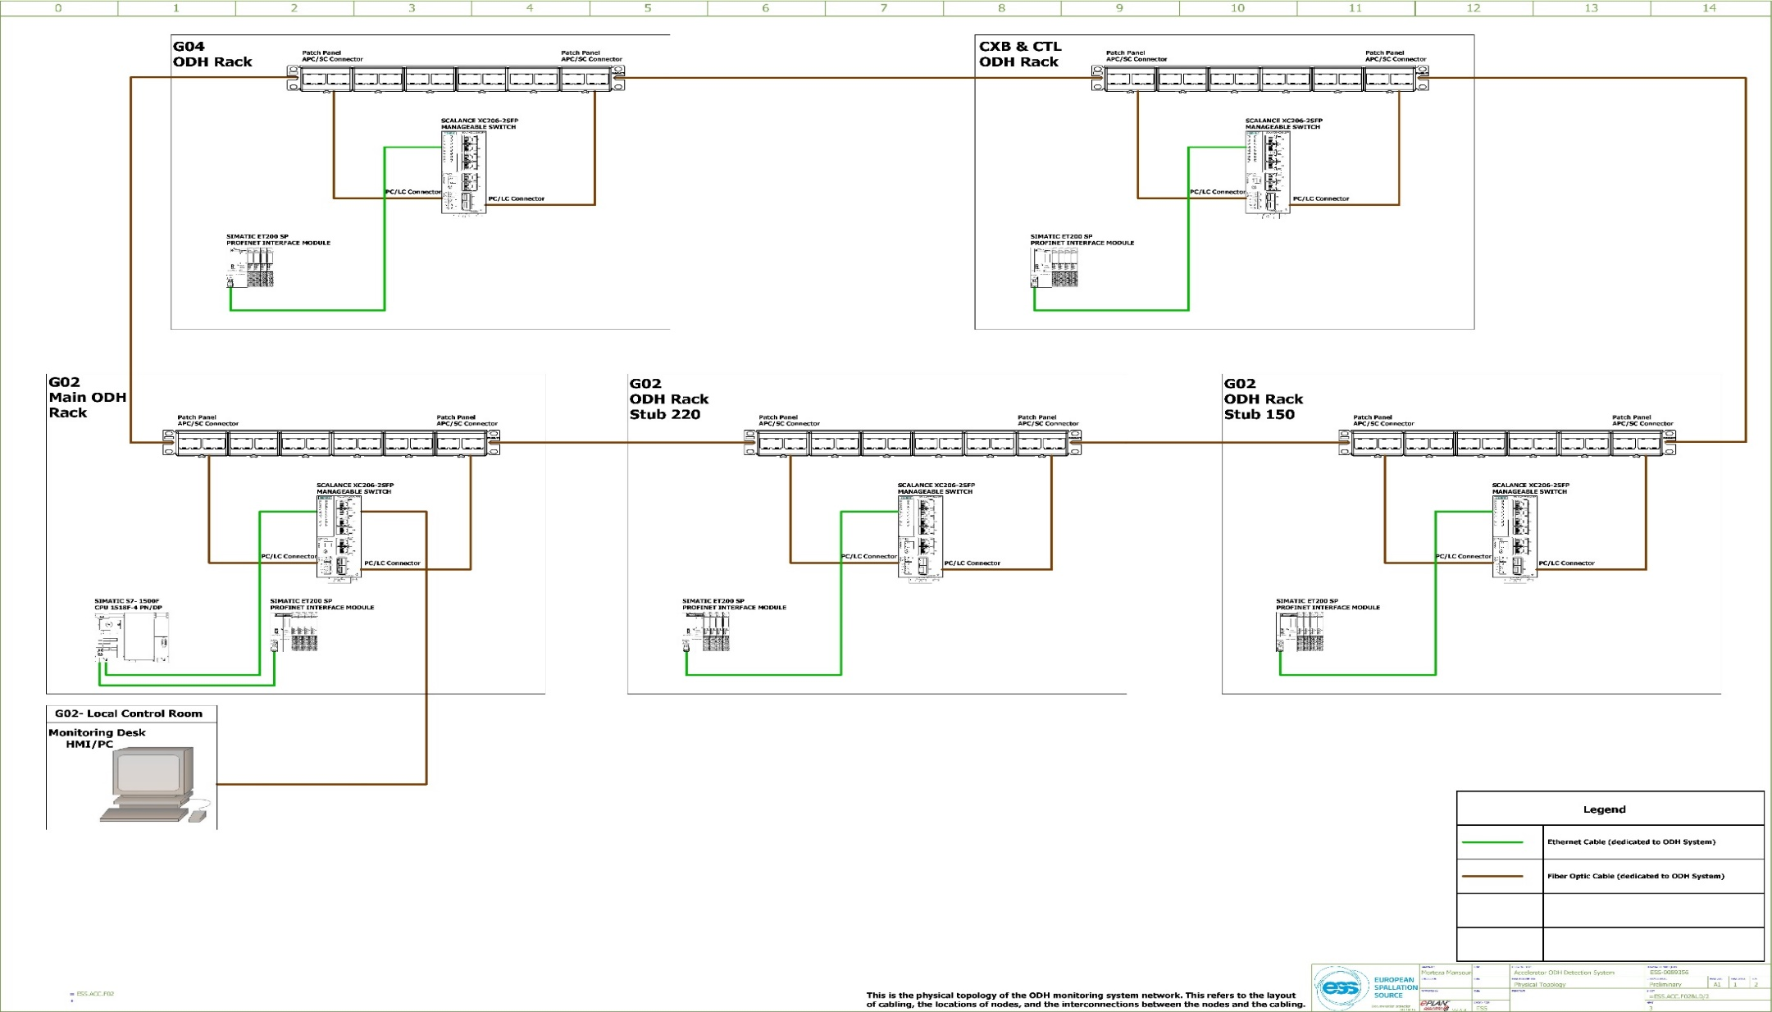
ODH Detection System Physical Topology (Accelerator Buildings)
This is the physical topology of the ODH Detection System network. This refers to the layout of cabling, the locations of nodes, and the interconnections between the nodes and the cabling.
Phase 1
Phase 2

Slide 7
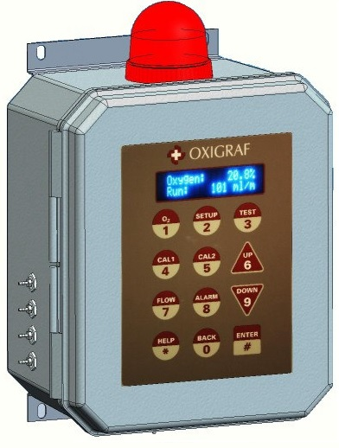
ODH Detector Specifications
Oxigraf O2iM oxygen deficiency monitor ( The Oxigraf sensor uses laser diode absorption technology to measure oxygen concentration in the gas sample.)
The O2iM measures and displays the oxygen concentration in a gas sample drawn through the instrument. Gas is pumped sequentially from up to four input sample ports, through the oxygen sample cell, and out the exhaust port.
IP66 rated for exposure to water and dust
Class 1 laser product. It contains an embedded laser diode, so the user cannot come into contact with the emission of laser radiation.
Performance conditions and specifications:
Ambient temperature | -10º to 50º C operating; -20 º to 60 º C storage
Warm-up for full accuracy | 10 minutes (Cold Start >0ºC)
O2 Range | 5 to 100%
Resolution | O2: 0.1%
Response time | 1s @150 ml/min flow

Slide 8
ODH Detector Calibration and Maintenance
Calibration must be performed before use and at regular intervals.
Calibration Modes:
Autocal enables the O2iM to operate unattended for extended periods. With nothing to deteriorate, wear out or degrade over time, the O2iM is virtually maintenance-free.
The inlet will be put in a nearby room where there are no possible sources of liquefied gases and the environment is maintained by a normal HVAC system, and gas sources that could affect the quality of the air should not be present.
Manual calibration:
Using CAL 1 key to set Low Point value. A cal gas with an O2 concentration (21%) equal to the cal point value should be connected to the CAL gas inlet and flowing through the analyzer.
Using CAL 2 key to set High Point value. A cal gas with an O2 concentration (100%) equal to the cal point value should be connected to the CAL gas inlet and flowing through the analyzer.
Calibration gases should be instrumentation grade and be supplied with a Certificate of Analysis (COA) indicating an accuracy of +- 0.05% or better.
The sensor (ODH monitor) must always be protected from water and dust by using the included hydrophobic gas filter on the sample inlet. This filter should be replaced at regular intervals as it clogs with contaminants. The internal hydrophobic filter should also be inspected and replaced as needed.

Slide 9
Response Time
The High Flow pump option is used in conjunction with the built-in sampling pump to provide presampling of long or larger diameter sample lines (>50 feet) for improved response times when using four (4) port sample configuration.
The ODH monitor monitor response time is 1s @150 ml/min flow.
In phase 1 installation, the maximum length of sampling pipes is 16 meters ≈ 52.5 feet

Slide 10
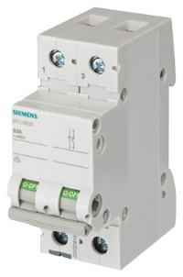
Rack Design
EMC (shielding 50 dB at 1 GHz)
Painted in RAL 2000, and labeled “PSS”.
Air-cooled (half-perforated EMC front door as air inlet, and fans on top as air outlet.)
230 VAC only available on the first row of rear side of the mounting plate!
AC and DC signals completely separated.
Isolator switches for LOTO foreseen for AC and DC (battery) sources during maintenance.
The top 300 mm of the rack reserved for the FO patch panel (to be delivered by Coromatic).
A temporary solution to provide UPS back-up power to PLC modules, lights and sounders has been implemented in the three ODH racks by installing UPS and battery in each rack. Siemens SITOP selection tool was used to size the UPS and battery.
Note:
The ODH monitors will not be backed up by any emergency power until the PDBs will be connected to UPS and diesel generators.

Slide 11
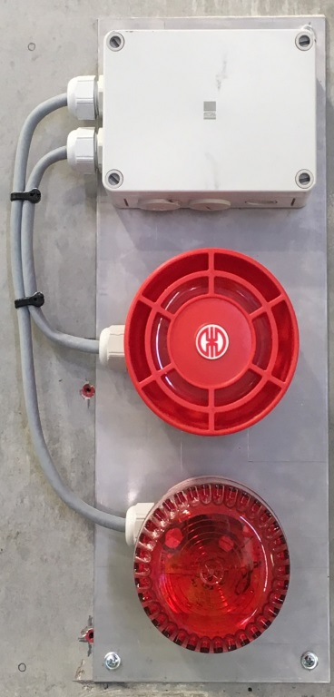
Lights & Sounders
According to the noise maps provided by AD the maximum sound power level at 1 meter distance (without insulation) from equipment in Helium compressor hall is 108 dB.
The sound output of the selected/installed sounder is 115 dB with the possibility of 32 tones.
Xenon flash light, with single/double flash rate @ 1Hz. Installed indoors (on the walls) and outdoors (IP 65).
Rotating beacon to be installed in the middle of the halls.

Slide 12
Fiber Optics Infrastructure
Single mode (glass type) FO will be used for the ODH Detection System infrastructure. Typically for distances between 3 to 15 km (without repeater).
Thanks to ICS infrastructure group efforts, there is a framework agreement (with Coromatic) in place for network infrastructure installations.
The contractor has been provided with the drawings for ODH Detection system architecture and physical topology, and scope of work.
Provide and pull single mode FO cables between G04 and G02 (CXB, Klystron gallery and local control room) for ODH detection system. It includes FO cables up to the racks patch panels and SCALANCE switches.
Provide and install the FO patch panel in three ODH Detection System 19” racks.
Terminate the FO cable in the ODH Detection System 19” racks (FO patch panel & SCALANCE switch)
The estimated date to have the ODH Detection System FO infrastructure ready is week 1743.

Slide 13
Thank you for your attention!

Slide 14
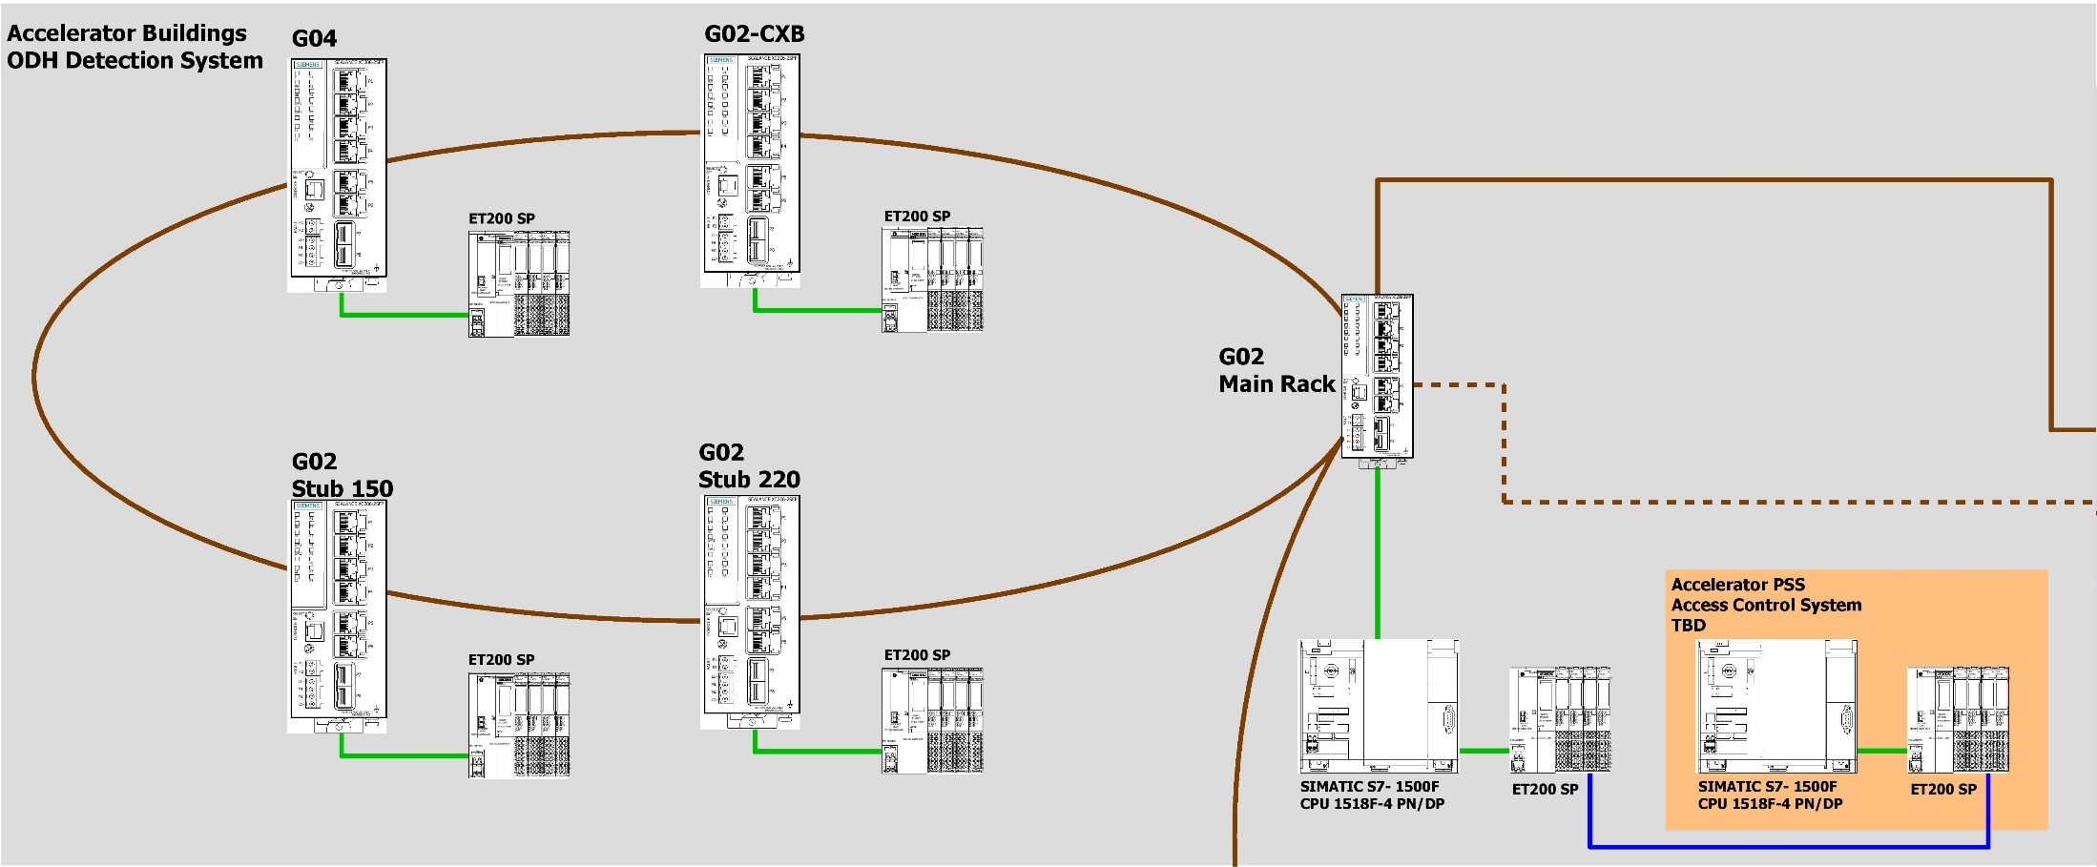
ODH Detection System Architecture (Accelerator Buildings)

Slide 15
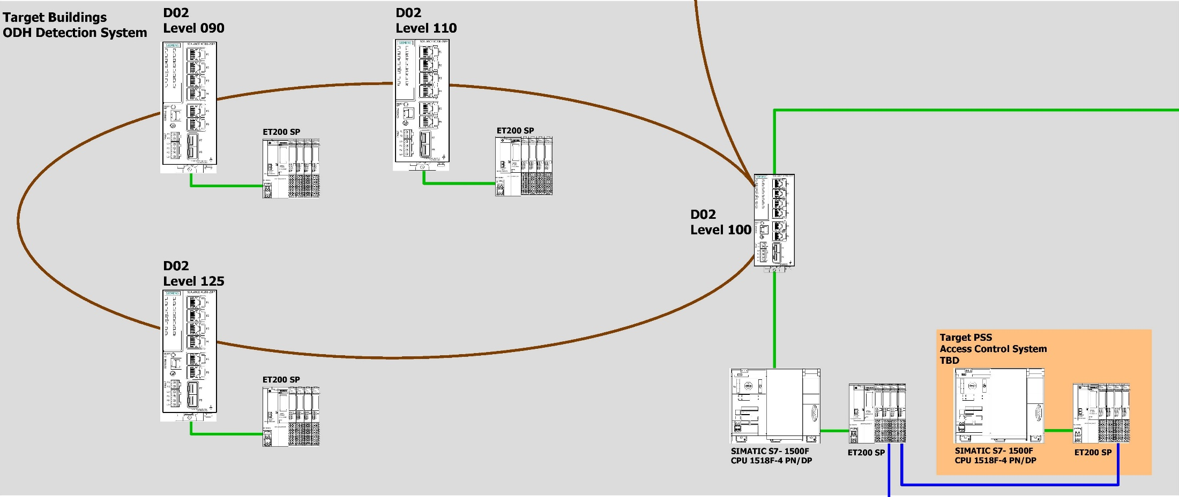
ODH Detection System Architecture (Target Buildings)

Slide 16
ODH Detection System Architecture (Neutron Instruments)

Slide 17
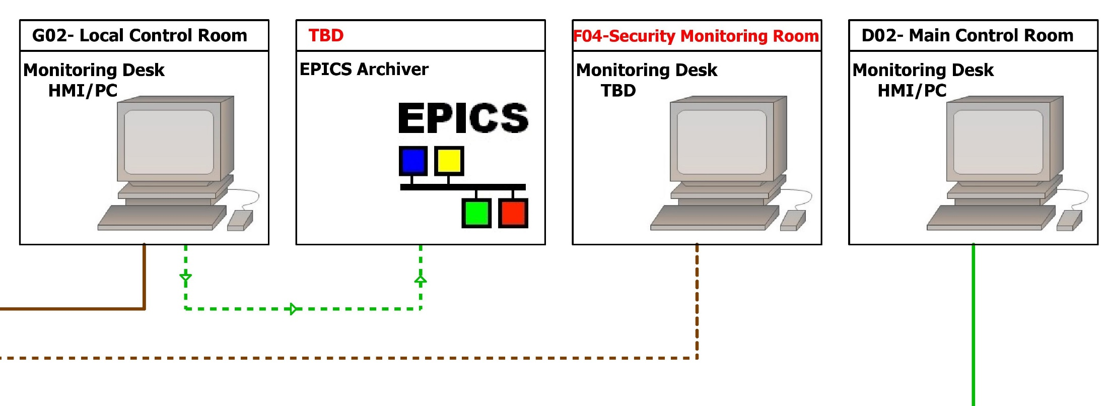
ODH Detection System Architecture (Potential Monitoring Locations/Systems)

Slide 18
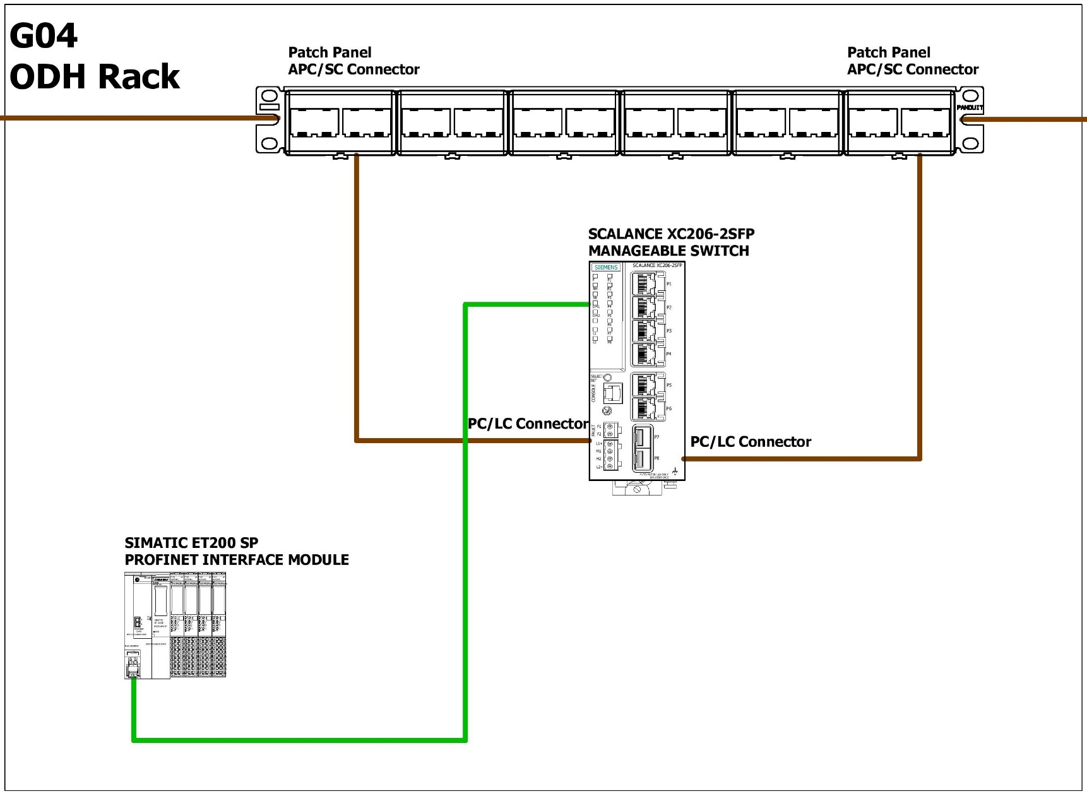
ODH Detection System Physical Topology (Remote I/O Rack)

Slide 19
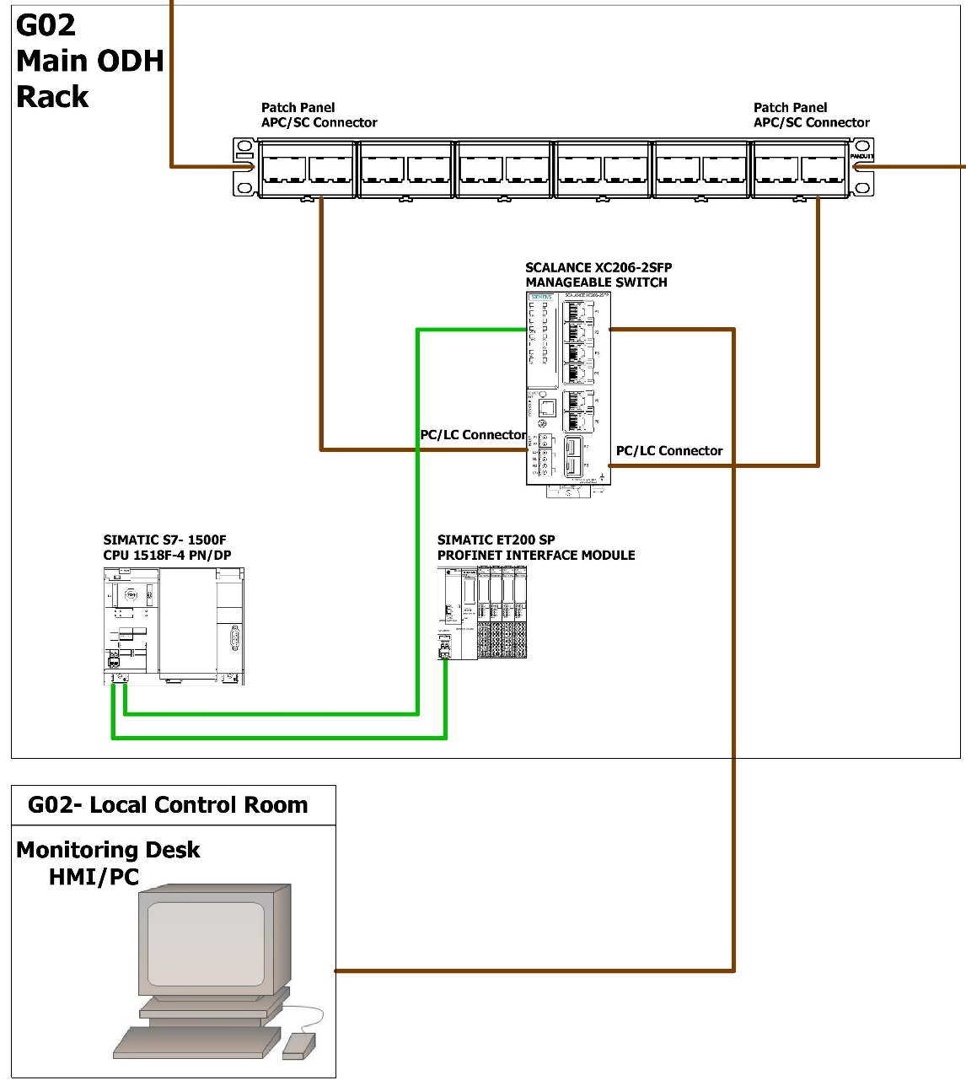
ODH Detection System Physical Topology (Main Rack)

