Slide 1
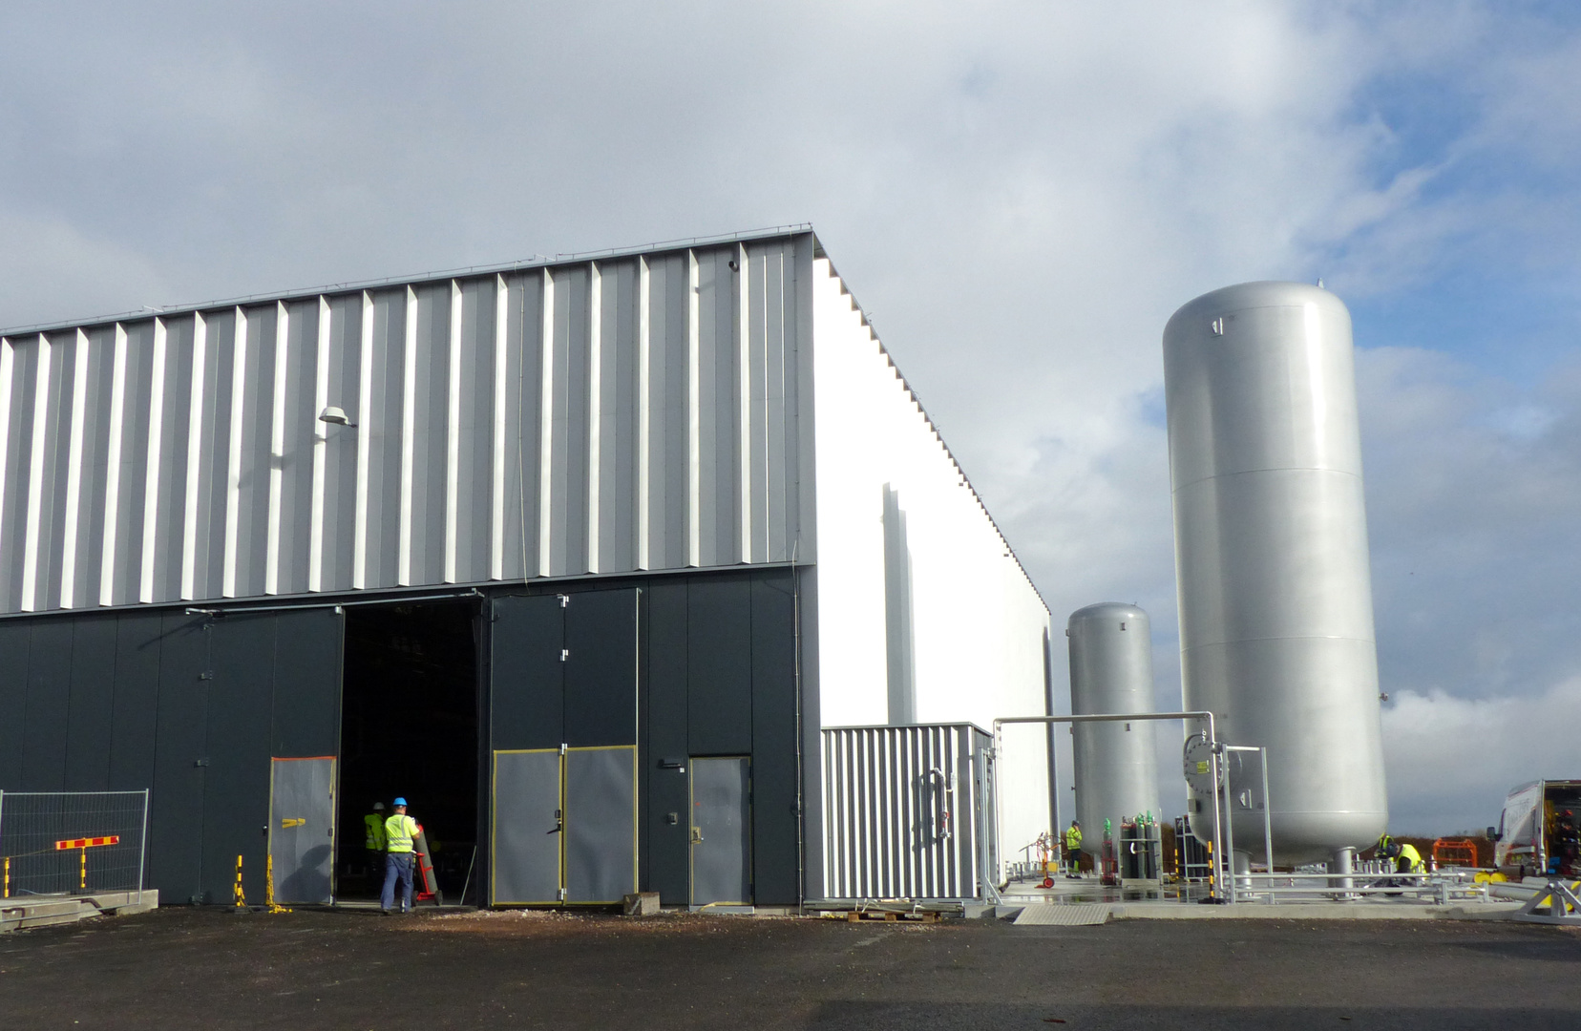
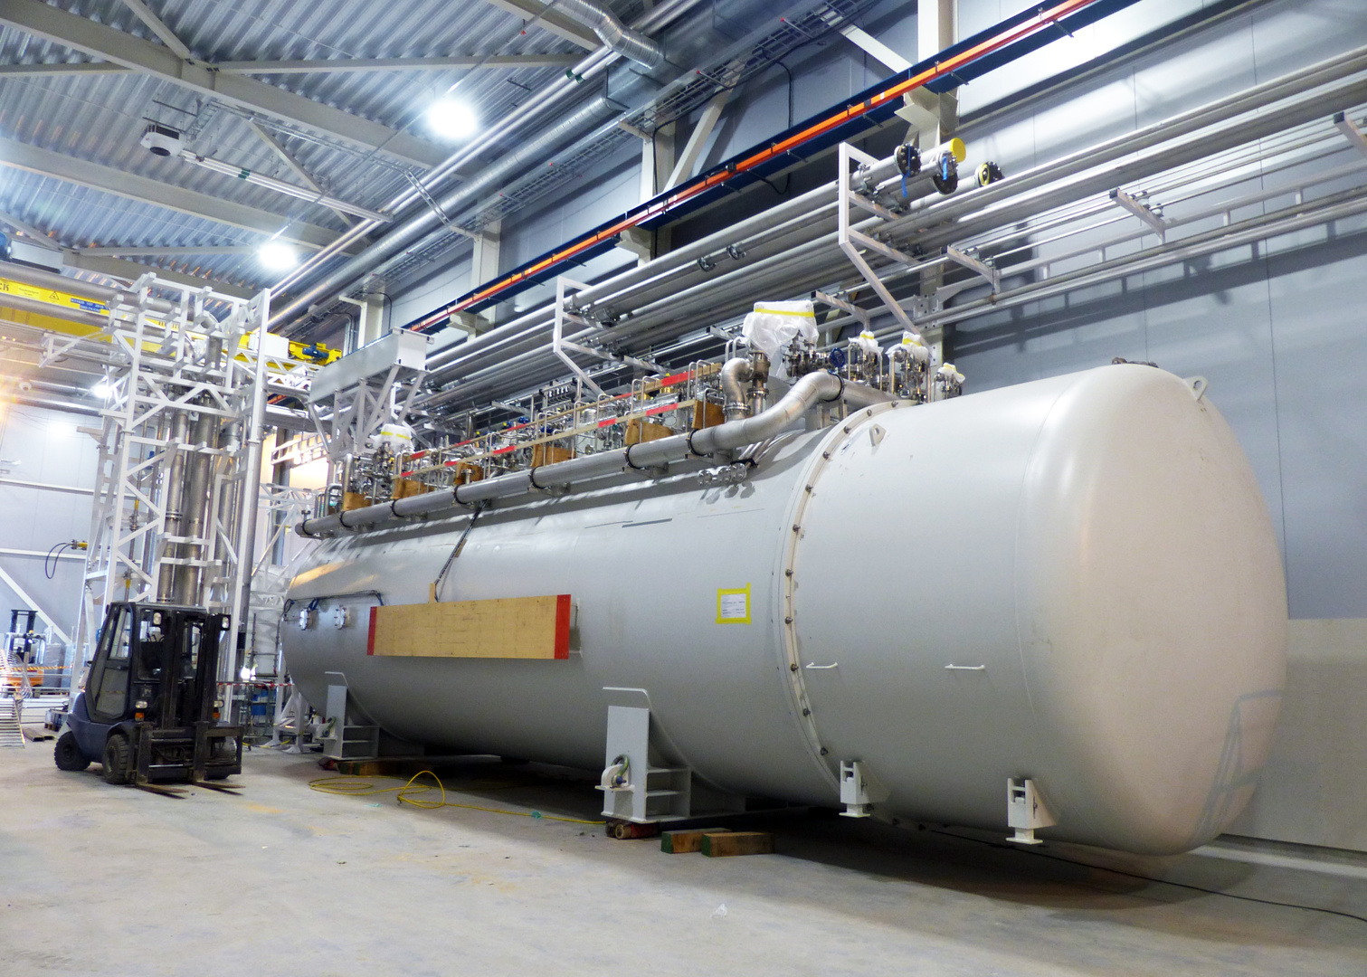
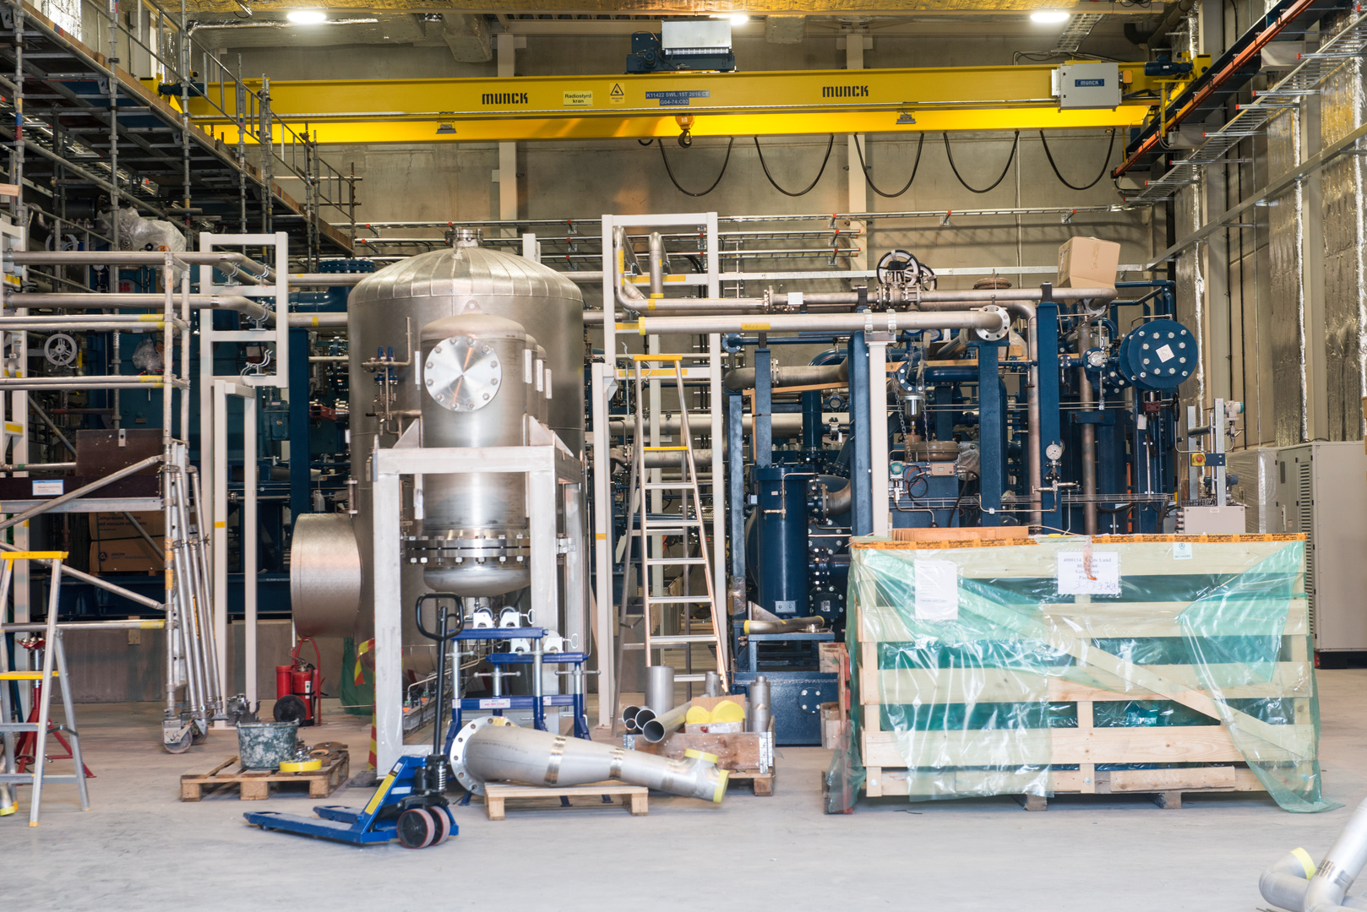
OVERVIEW OF THE NEXT CRYOGENIC MILESTONES AND ASSOCIATED ODH HCB, DOG SHED, CXB AND CTL GALLERY
Internal CDR for ODH detection system

Slide 2
Timeline – Helium Compressor Building (G04) 1/2
 | Installation and commissioning phases | Area | Date | Medium | Personal O₂ monitors | Fixed O₂ monitors | UPS and emergency back-up power
Installation | Pressure and leak tests (outside working hours) | G04 (ACH) | Nov. 2017 | He and N₂
 |  | G04 (TCH) | TICP: Oct. 2017 TMCP: Q1 2018 | He and N₂
Pre-commissioning | Adsorber drying (N₂ connection and heating) | G04 (ACH) | 1st week Dec. 2017 | N₂
 |  | G04 (TCH) | Nov. 2017 | N₂
 | System clean-up (He injection and vacuum pumping) | G04 (ACH) | 1st half Dec. 2017 | He
 |  | G04 (TCH) | End Oct. 2017 | He

Slide 3
Timeline – Helium Compressor Building (G04) 2/2
 | Installation and commissioning phases | Area | Date | Medium | Personal O₂ monitors | Fixed O₂ monitors | UPS and emergency back-up power
Commissioning | Helium purifier commissioning | G04 (ACH) | Nov. 2017 | LN₂
 | Compressor start-up | G04 (ACH) | 2nd week Dec. 2017 | He
 |  | G04 (TCH) | Nov. 2017 | He

Slide 4
Timeline – Coldbox Hall (G02) 1/2
 | Installation and commissioning phases | Area | Date | Medium | Personal O₂ monitors | Fixed O₂ monitors | UPS and emergency back-up power
Pre-commissioning | Adsorber drying (N₂ connection and heating) | G02 (ACCP) | Jan. 2018 | N₂
 |  | G02 (TICP) | Nov. 2017 | N₂
 | System clean-up (He injection and vacuum pumping) | G02 (ACCP) | Jan. 2018 | He
 |  | G02 (TICP) | Nov. 2017 | He
Commissioning | Compressor start-up | G02 (ACCP) | 2nd week Dec. 2017 | He
 |  | G02 (TICP) | Nov. 2017 | He

Slide 5
Timeline – Coldbox Hall (G02) 2/2
 | Installation and commissioning phases | Area | Date | Medium | Personal O₂ monitors | Fixed O₂ monitors | UPS and emergency back-up power
Commissioning | 5000 LHe Dewar filling | G02 (TICP) | Jan. 2018 | LHe
 | 20 000 LHe Dewar filling | G02 (ACCP) | March 2018 | LHe

Slide 6
Timeline – Cryogenic Transfer Line Gallery (CTLG)
 | Installation and commissioning phases | Area | Date | Medium | Personal O₂ monitors | Fixed O₂ monitors | UPS and emergency back-up power
Commissioning | Compressor start-up | CTLG (ACCP) | 2nd week Dec. 2017 | He
 |  | CTLG (TICP) | Nov. 2017 | He

