Slide 1
Factory Acceptance Test document for ODH detection system in HCB, CTLG & CXH
Author Team Supervisor
A. Toral M. Mansouri S.L. Birch
Y.K. Sin

Slide 2
Introduction:
What’s is going to be tested? Three racks for ODH detection system related to cryogenics infrastructure, HCB + CTLG + CXH.
Who is going to perform the test? The subcontractor Processkontroll AB with MM and ATD as witnesses.
What’s the purpose of testing? To validate the compliance of the delivered equipment's with European standards and ESS rules:
SS-EN 62381:2012 & SS-EN 60204-1
ESS-0094204 & ESS-0015433

Slide 3
SS-EN & ESS rules:
SS-EN 62381:2012 Automation systems in the process industry – FAT, SAT and SIT.
SS-EN 60204-1 Safety of machinery - Electrical equipment of machines - Part 1: General requirements.
ESS-0094204 Guideline for Validation Factory Acceptance Test (FAT) and Site Acceptance Test (SAT).
ESS-0015433 Rules for electrical design.

Slide 4
Dedicated FAT document:
We have prepared a single FAT document (ESS-0099064) to test the three racks of the ODH system, that are the following:
=ACC.F02.K01-U1, ODH PLC rack in GTA/TS2
=ACC.F02.K01-U2, ODH Remote IO rack in HCB/ACH
=ACC.F02.K01-U3, ODH Remote IO rack in CXH
This FAT document has been developed from an existing template for FAT procedures created by Electrical and I&C section, ESS-0113710

Slide 5
Structure of the FAT document:
Roles definition and responsibilities.
List of equipment for test and reference documentation.
Checks, for each rack:
Compliance with manufacturing documentation
Protection against indirect contacts
Insulation resistance
Disruptive discharge
Residual voltages
Functions
Punch list
FAT Certificate.

Slide 6
Roles and responsibilities:
Test and validation coordinators: MM & ATD
Test leader: ATD
PLC programmer: YKS
Reference documentation:
Circuit diagrams (ESS-0089356)
Cabinet lay-out
Part list
Cable list
ESS rules for electrical design (ESS-0015433 )
ESS Generic requirements for marking and labelling (ESS-009409)

Slide 7
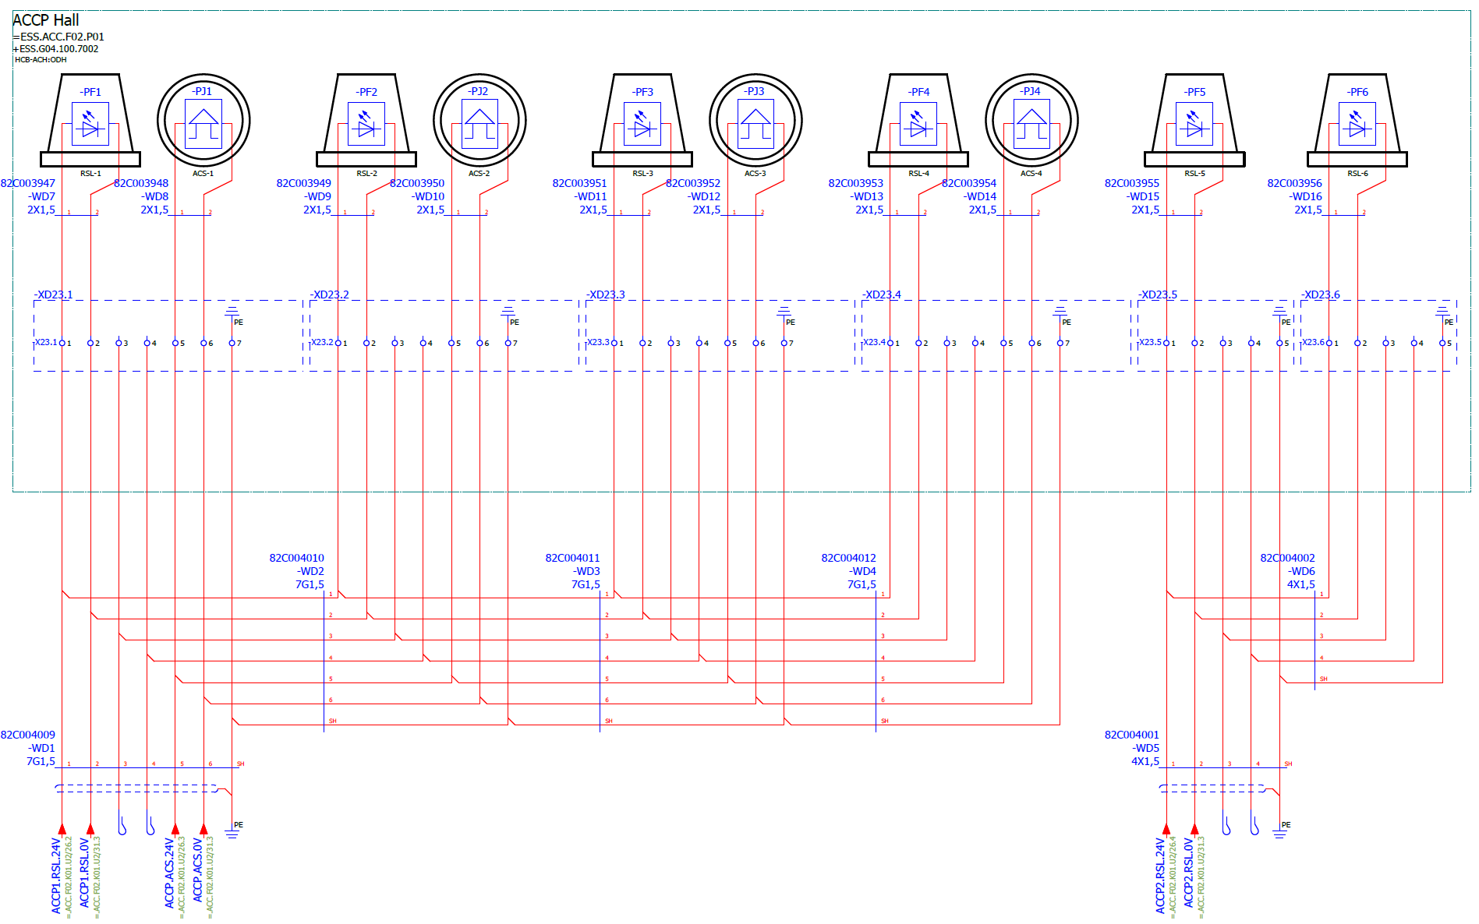

Slide 8
Checks:
Compliance with manufacturing documentation
Conductors, marking, components, IP-class, functional bounding, routing, connections…
Protection against indirect contacts
Continuity between protection bonding circuit and PE terminal.
Setting and characteristics of overcurrent protection devices.
Insulation resistance
Between the power circuit conductors and the protective bonding circuit, e.g. at 500VDC should not be less than 1MΩ

Slide 9
Checks:
Disruptive discharge (Max. voltage test)
Shall have a value of twice the rated supply voltage of the equipment or 1000V, approx. for 1 second.
The requirements are satisfied if no disruptive discharge occurs.
Residual voltages → N/A
Only for live parts having a residual voltage > 60 V

Slide 10
Checks:
Functions
Disconnecting device ON: all electrical components shall be electrically supplied, and CPU shall go into RUN mode.
Disconnecting device OFF: all electrical supply to the controlled equipment shall be isolated.
PLC test of:
Digital inputs → Simulating an activation and checking feedback via the programing tool.
Digital outputs → By forcing the outputs via the programming tool.
Analog inputs → Via current generator. Maximum value, minimum value, and center value is to be simulated for each signal.
Analog outputs → N/A

Slide 11
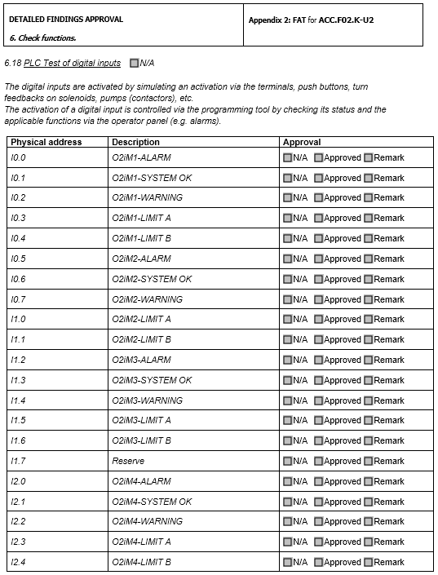

Slide 12
Checks:
Punch list.
Any incomplete work or non-conformances detected during the FAT shall be recorded on a punch list.
Punch list will be categorized as follows:
to be cleared on the spot, FAT to continue after rectification.
on-going rectification during FAT.
FAT to be repeated.
modifications to be made after FAT, before the rack is shipped to the site.
remaining work to be rectified, i.e. at site.

Slide 13
FAT Certificate:
The FAT shall be considered complete when the manufacturer has successfully proven all necessary test according to the FAT document.
Upon successful completion of the FAT, authorized representatives of the ESS and the manufacturer shall sign the FAT certificate.
This FAT document (ESS-009064) might be modified in the future in order to include additional details from the test carried out by Processkontroll AB.

Slide 15
Thank you for your attention,
any questions?

