Slide 1
ESS Target Proton Beam Imaging Systems CDR Status of ICS EPICS and FPGA at Oslo
Erik Adli
Department of Physics, University of Oslo, Norway
University of Oslo, October 24, 2017

Slide 2
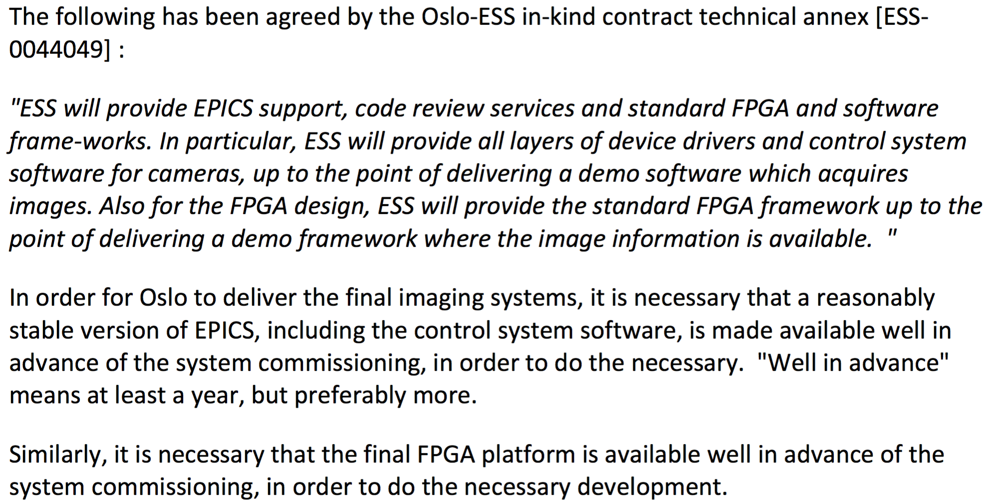
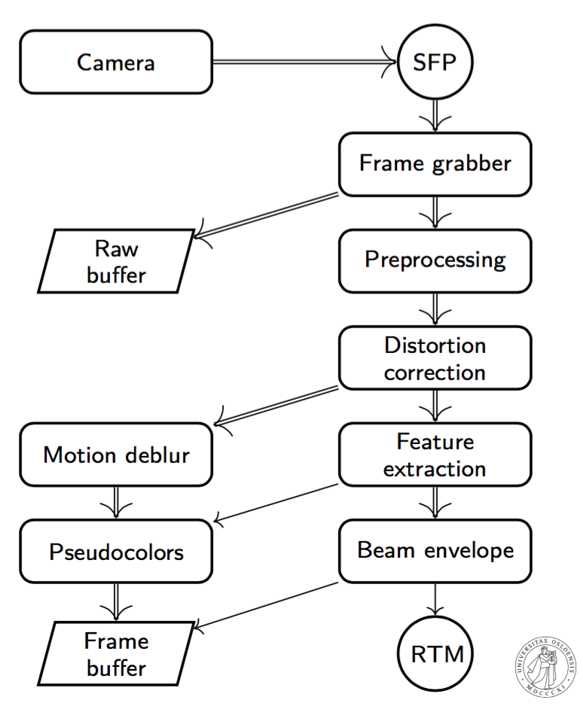
Premise for Oslo contribution :
work with raw images and build functionality from there
Oslo resources tuned to start development from a delivered picture.
In addition to not having the resources, we also do not have the competence to integrate hardware (device driver writing and such).
The work split also makes sense in that ESS is the one that will maintain the system for the long term: University custom solutions and "hacks" would be hard to maintain (different for each in-kind partners)

Slide 3
Status of ESS FPGA support
FPGA algorithm development is proceeding despite the fact that the FPGA development team at Oslo has not received the final FPGA platform hardware from ICS (or even concrete specifications for what this hardware will be).
The Oslo development team has made guesses at what the final FPGA hardware platform will be like and has used these guesses to run simulations and extract estimates as to weather the image processing algorithms under development will meet the final system timing requirements.
These simulations and estimates suggest that the final system timing requirements will be met.
Proof of timing can only be made by implementation of final hardware prototypes. Currently implementing on different Oslo hardware. While may be useful for learning, it does not guarantee timing, and it is double work.

Slide 4
Effect of late EEE server
ESS EPICS Environment (EEE) itself is currently unable to support Oslo selected cameras and spectrometer due to EEE dependency issues.
This was reported to ICS but no action was taken to resolve the problem (https://jira.esss.lu.se/browse/EPICSENV-76). Others (IKC and BD) have reported similar problems, too, with no resolve. This situation is impacting the progress of software development Oslo is responsible for.
Need to go to temporary solutions (should be avoided as it is double work, and was avoided as long as possible) : Oslo for the moment does not use EEE. Selected camera and spectrometer work can be made to work under community supported EPICS (also help from ESS BI). Only way to proceed with software development. Also this integration requires maintenance (double maintenance for the overall project).

Slide 5
Impact on coating development
Oslo strives to use the same cameras, spectrometers and other measurement equipment in the coating development work as will be used for the final systems.
This gives important proficence and experience with the actual imaging system hardware.
The effect of gaining experience would be multiplied if Oslo could use the actual hardware with the actual ESS integration enviroment.
Up to now we have mostly resorted to vendor-specifikk software for data analysis. Disadvantages:
- double work (learn first vendor software, then ESS integration)
- poor and incompatible DAQs for vendor softare (camera, spectrometer)

Slide 6
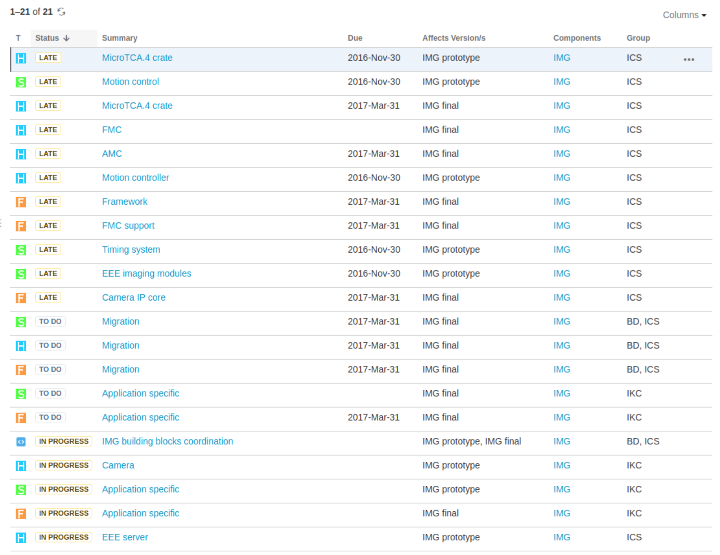

Slide 7
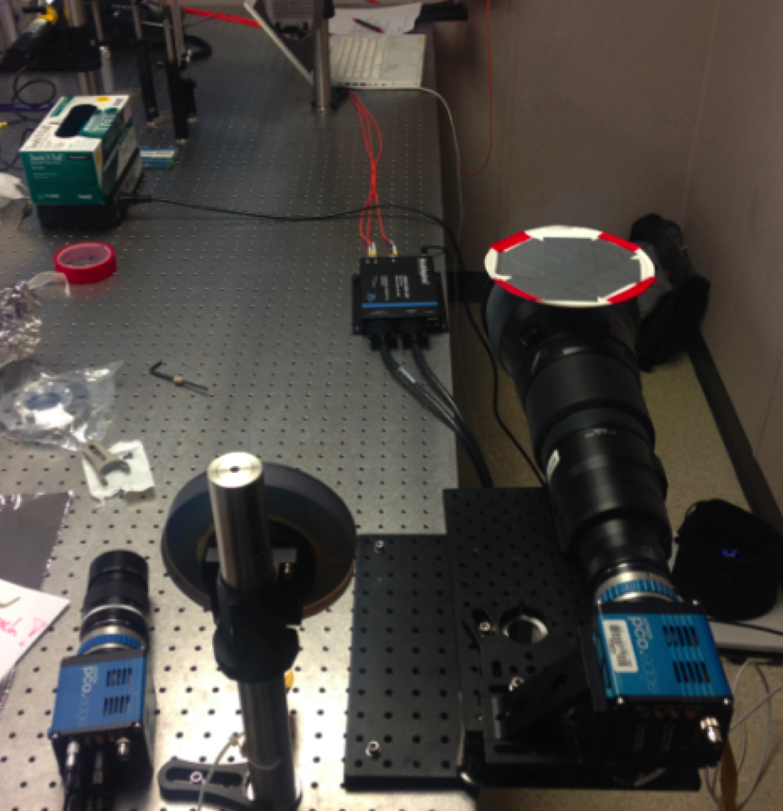
Integration efforts: personal experience
Experience of integration of a scientific camera with CameraLink, of type PCO Edge, into EPICS, at a project I worked on at SLAC: more than one year of hard work, by a very clever person (not me), even with support of the SLAC "ICS" group.

Slide 8
Summary
Urgent need for prototype FPGA hardware for proof of timing and implementation of beam synchronous processing
realistic time scale?
Urgent need for integrating Camera, spectrometers, illumination system hardware in to EPICS
- realistic time scale?
What about non-GigE camera integration, USB 3.0 or CameraLink
what is realistic time scale?
Need to decide on protocol before we buy prototype
What is the status for other parts of the instrumentation (ion source) ?

