Slide 1
Protective Mirror coatings against corrosive environment
Dr. Cyrille Thomas
ESS Beam Instrumentation
www.europeanspallationsource.se
19 October, 2017

Slide 2
Introduction notes
Production of nitric acid is commonly observed in radiation environment where moist air at various pressure is present:
Modelling of nitric acid production in the Advanced Cold Process ...
Formation of nitric acid during high gamma dose radiation
Measurement of radiolytic yield of nitric acid in air
Single number to assess the amount produced: G, number of molecules produced per 100eV of ionizing radiation absorbed by the system
For nitric acid G =1.46

Slide 3
Evaluation of HNO₃
Energy absorbed: Stopping power*
Production of HNO3 molecules:
E_{proton} (GeV) |  | 1mbar | 0.1 mbar | 0.001 mbar
 | Dry air density (µg/cm3) | 0.7994 | 0.0799 | 0.0001
 | H₂O density (µg/cm3) | 0.2295 | 0.0230 | 0.0007
0.5 | [HNO₃] (moles) | 3.1489 | 0.3149 | 0.0025
1 |  | 2.5418 | 0.2542 | 0.0020
2 |  | 2.3558 | 0.2356 | 0.0019
* Source PSTAR

Slide 4
How to mitigate the issue
Select mirror coating resistant to HNO₃
Au, metals in the Platinum group (ruthenium, rhodium, palladium, osmium, iridium, and platinum).
Reflectivity can be an issue
Provide protection layer mirror
standard SiO₂ layer
Select mirror coating + protection layer:
Optimize optics transmission
Protection layer efficiency must be tested:
Planned tests with various HNO₃ concentration on standard mirrors produced by Kugler, and eventually other manufacturers (Thorlabs)
Complement test with mirror irradiation
SNS tests on standard off-the-shelves mirrors to be exposed to moist air environment under radiation

Slide 5
Metallic surfaces reflectivity
Nitric acid resistant materials:
Only Au applies, and only to Al₂O₃:Cr at 695nm
Reflectivity after 1 mirror
Reflectivity after 4 mirror

Slide 6
How to mitigate the issue
Select mirror coating resistant to HNO₃
Au, metals in the Platinum group (ruthenium, rhodium, palladium, osmium, iridium, and platinum).
Reflectivity can be an issue
Provide protection layer mirror
standard SiO₂ layer
Select mirror coating + protection layer:
Optimize optics transmission
Protection layer efficiency must be tested:
Planned tests with various HNO₃ concentration on standard mirrors produced by Kugler, and eventually other manufacturers (Thorlabs)
Complement test with mirror irradiation
SNS tests on standard off-the-shelves mirrors to be exposed to moist air environment under radiation

Slide 7
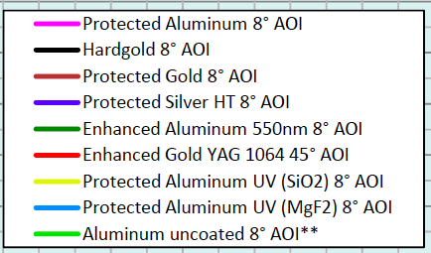
Reflectivity of the mirrors
Material | R @500nm | R⁴ | R @700nm | R⁴
Protected Aluminum | 89% | 63% | 95% | 81%
Hardgold | 54% | 9% | 94% | 78%
Protected gold | 35% | 2% | 92% | 72%
Protected silver | 98% | 92% | 98% | 92%
Enhanced aluminium 550nm | 95% | 81% | 92% | 72%
Enhanced gold YAG 1064 | - | - | 98% | 92%
Protected Aluminum UV (SiO₂) | 87% | 57% | 79% | 39%
Protected Aluminum UV (MgF₂) | 85% | 52% | 83% | 47%
Aluminum uncoated | 89% | 63% | 85% | 52%
Kugler

