Slide 1
Target Station and PBIP update Target Imaging Systems
Mattias Wilborgsson
Work Unit Leader, Monolith Systems
www.europeanspallationsource.se
20 October, 2017

Slide 2
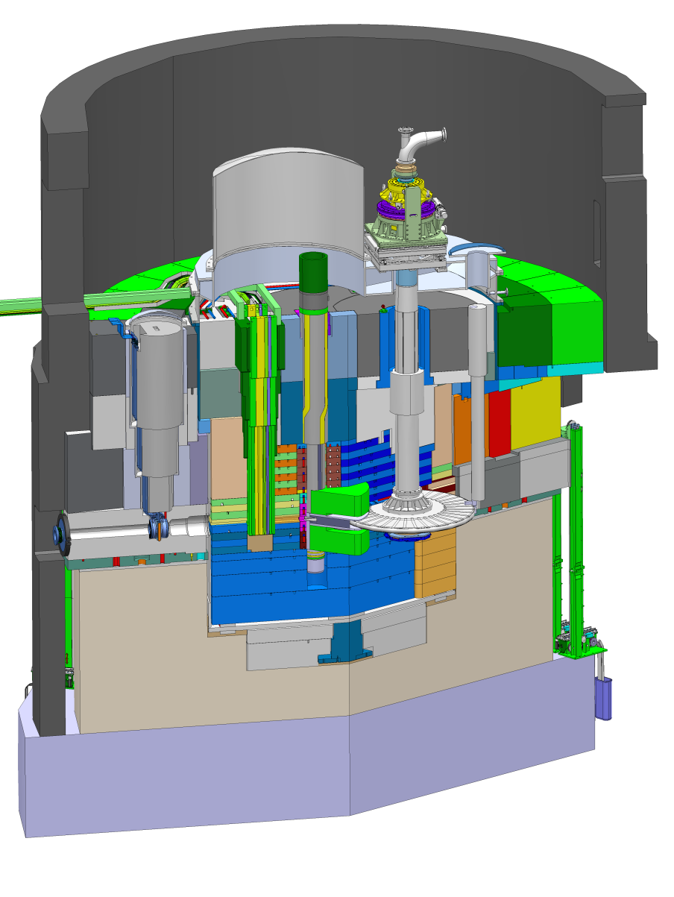
Target Station layout
Proton Beam Instrumentation Plug
Proton Beam Window
Neutron Beam Extraction
Proton beam envelop
representation
Target Wheel
Moderator and Reflector Plug

Slide 3
Target Station components Proton Beam Instrumentation Plug (PBIP)
Function
Support, cool and align the PBI
Allow an optical view of the PBW and the BEW
PBIP components
Beam instrumentation slices (3)
Optical slices (2)
Minimum lifetime of PBI part
Two years at full power operation (5 MW)
Instrumentation slices
Shielding block
Optical slices
Actively cooled support structure
Position of first mirror

Slide 4
Target Station components Proton Beam Instrumentation Plug (PBIP)
Target Imaging Systems
Mirrors
4 mirrors in each optical slice
Demanding requirements for thermal deformation
Antireflective coating of optical paths
Coating needs to be defined
PBW
BEW

Slide 5
Monolith atmosphere
Operating pressure in Monolith Vessel is <1 mbar (<100 Pa).
If there is nitrogen and water in the vessel, nitric acid will be produced.
We can monitor the concentrations.
Nitric acid production can be reduced by lowering the operating pressure in the vessel.

Slide 6
Schedule
PBIP
Test assemble of mirrors in optical slices in Spain
Manufacturing of slices finished Q1 2019
Final assemble and alignment of mirrors in Mock-Up
PBIP delivered to Lund Q2 2019

Slide 7
The End
Thank you!

Slide 8
Backup slide

