Slide 1
ESS Target Proton Beam Imaging Systems CDR System Update
Erik Adli
Department of Physics, University of Oslo, Norway
University of Oslo, October 23, 2017

Slide 2
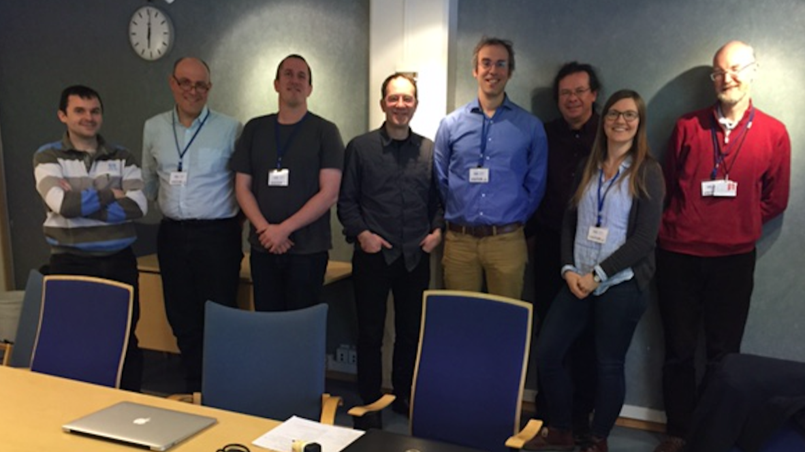
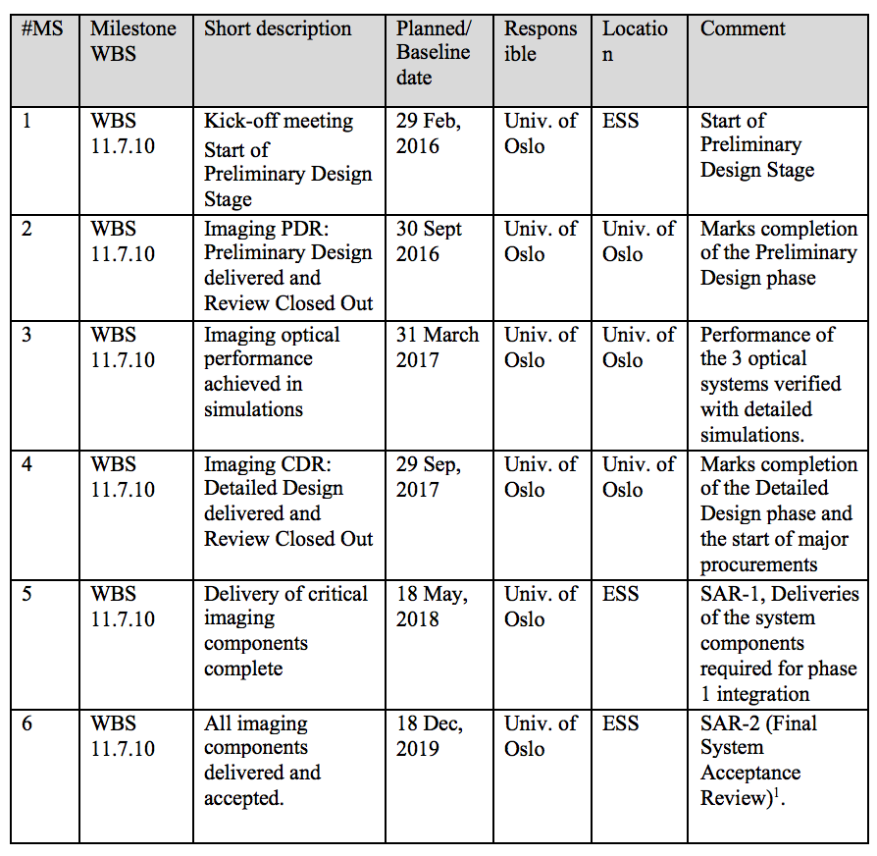
Schedule
PDR
Imaging system milestones
Delivery of
critical components
complete
2018-05
Delivery of
all components
complete
2019-12
Simulation
design frozen
2017-03
Kick-off, 2016-02
PDR
2016-09
CDR
2017-09
2016-01
2017-01
2018-01
2019-01
2019-12
PBIP PDR
2016-03
PBIP CDR
2017
TW BEW
components
ready for welding
2017-09
ESS beam
ready for target
mid-2019
TW
assembly
complete
2018-01
Tuning dump
vacuum comp.
CDR 2016-12
Some milestones for interfacing systems
( )
Imaging system development is driven by interfacing system milestones, not by beam on target/dump.

Slide 3
Schedule
Imaging system milestones
Delivery of
critical components
complete
2018-05 ?
Delivery of
all components
complete
2019-12
End of contract
Simulation
design frozen
2017-04
Kick-off, 2016-02
PDR
2016-09
CDR
2017-10
2016-01
2017-01
2018-01
2019-01
2019-12
PBIP PDR
2016-03
ESS beam
on dump and target
late 2020
PBIP CDR
2017
TW CDR
~ 2017-11
Tuning dump
vacuum manifacturing commence
Some milestones for interfacing systems
- now IMG leads other system: positive (for IMG)
Schedule and contract discussion: Tuesday 16h00.

Slide 4
PDR
Since the PDR, a number of new Oslo personnel and resources have joined the imaging project, including CAD expertise, mechanical workshop, FPGA expertise.

Slide 5
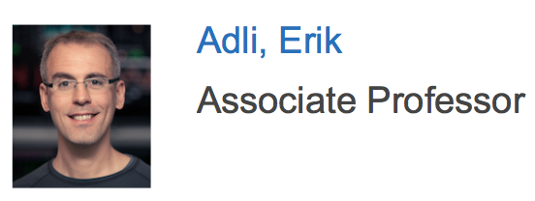
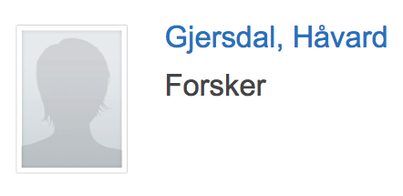
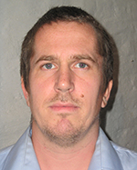
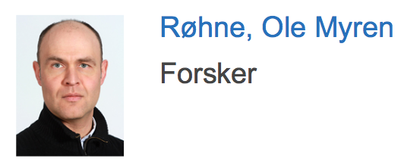
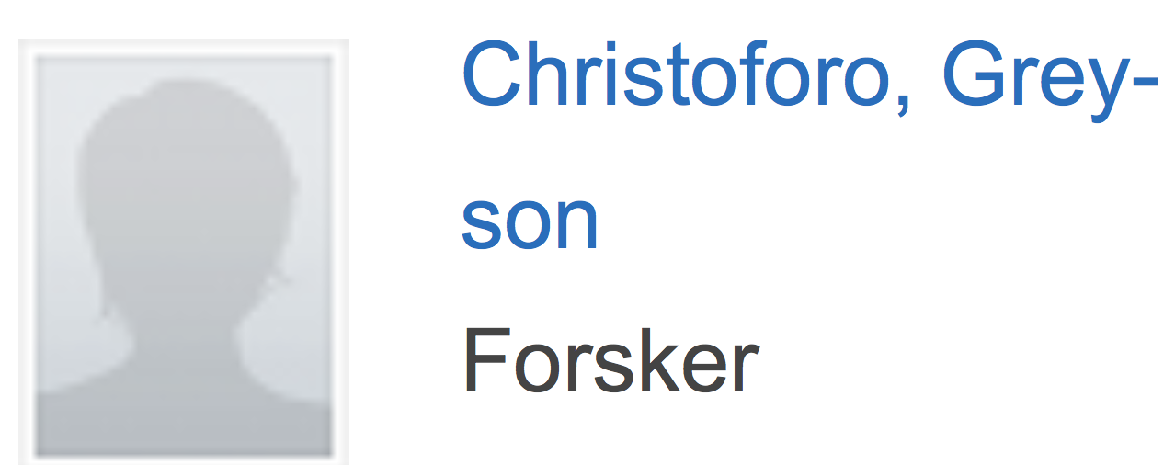
Core Oslo team
Responsible for the Oslo in-kind contribution. Overall Project manager.
Schedule, budget and resource control.
Representing in ESS boards and committees.
Lead researcher and daily leader for the Oslo in-kind contribution.
Optical system design and coating development.
Co-manager for the electronics and software part of the project.
Researcher (new arrival)

Slide 6
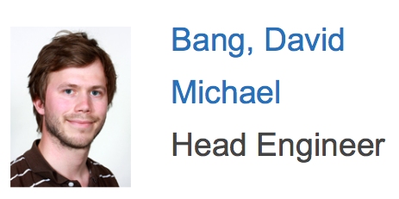
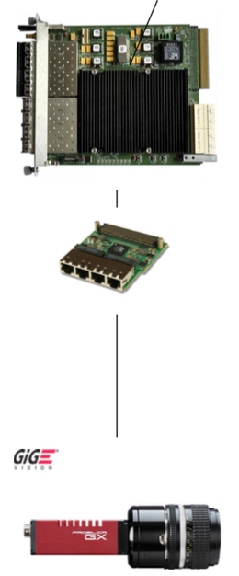
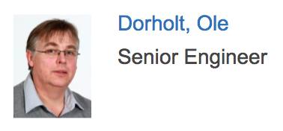
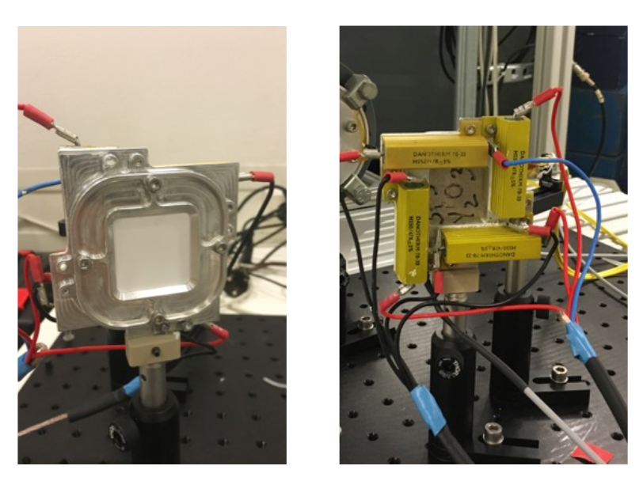
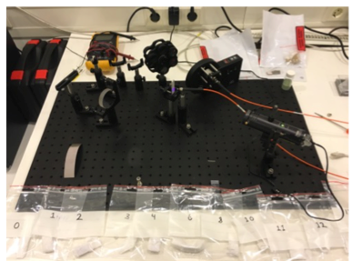
The Electronics laboratory
IMG project support :
Electronics architecture
FPGA developments
Coating tests hardware
Software development

Slide 7
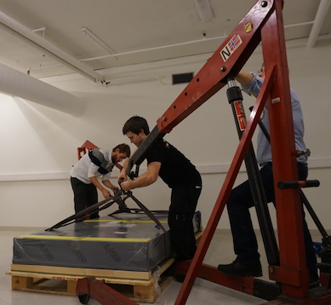
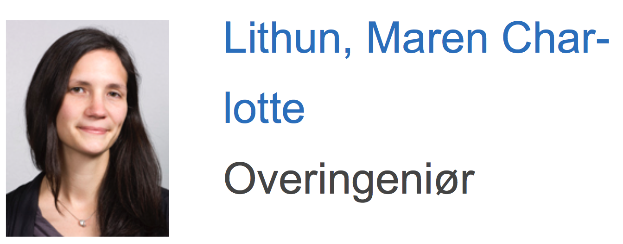
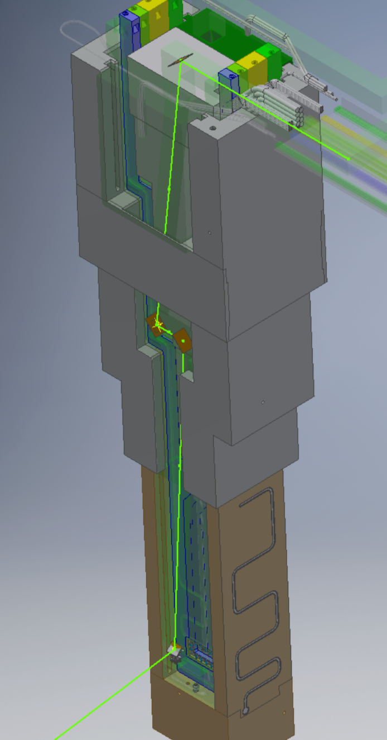
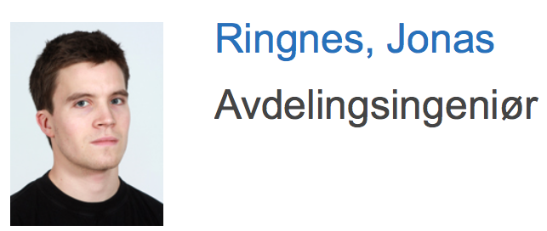
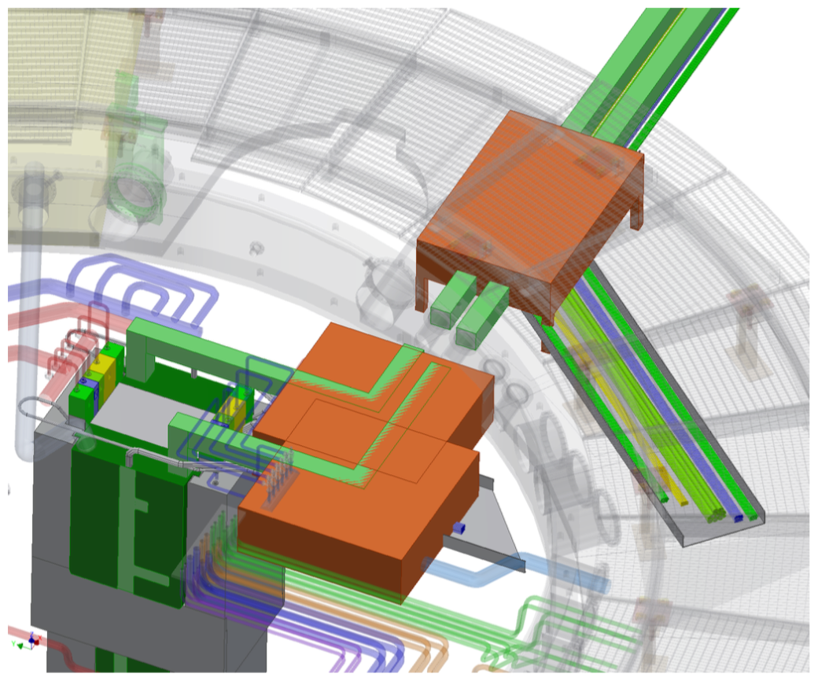
The Instrument Workshop
IMG project support :
CAD
Thermomechanical simulations
Tooling and machining
Help with prototype
Opto-mechanical components

Slide 8
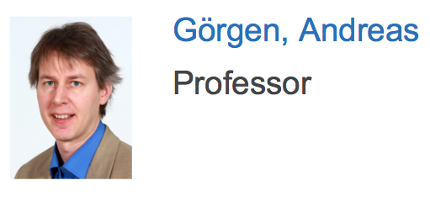
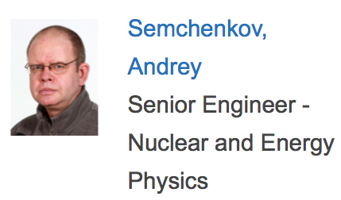
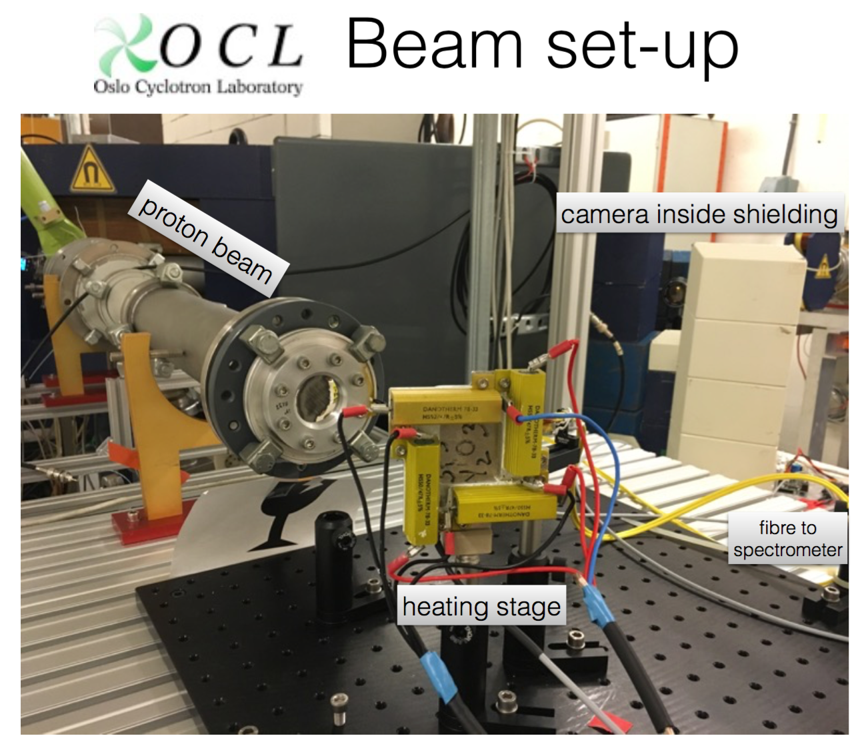
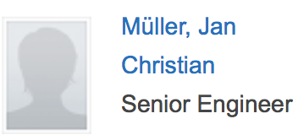
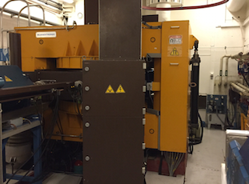
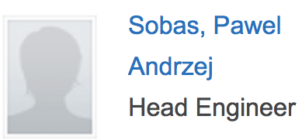
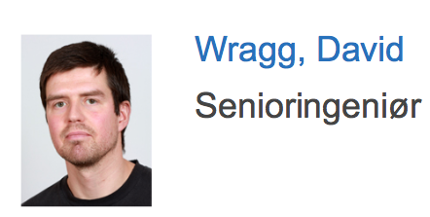
The Oslo Cyclotron Laboratory (OCL)
OCL : only research accelerator in Norway, a MC-35 Cyclotron (p, d, ³He, ⁴He, up to 35 MeV p). The laboratory serves as an experimental center for various fields of research and applications. Very welcoming to the IMG project, very good collaboration.
Use for testing of luminescent materials. Can be used for tuning dump camera irradiation tests (lifetime)
Not ideal parameters for irradiation tests
The IMG test beam line (permanent installation)
XRD support
Laboratory Manager
Norwegian National Centre for X-ray Diffraction and Scattering

Slide 9
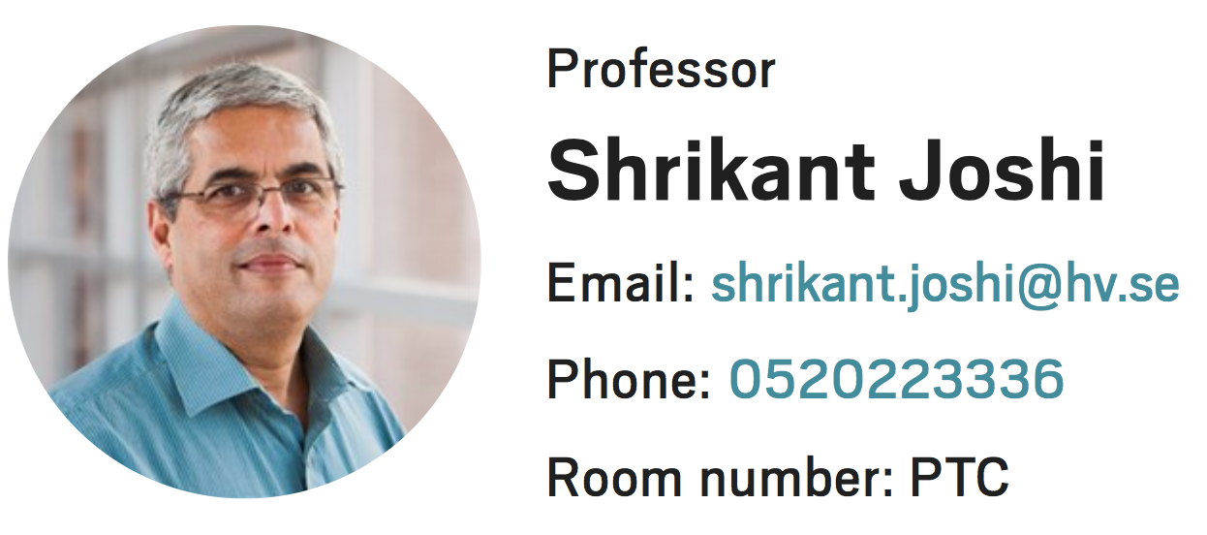
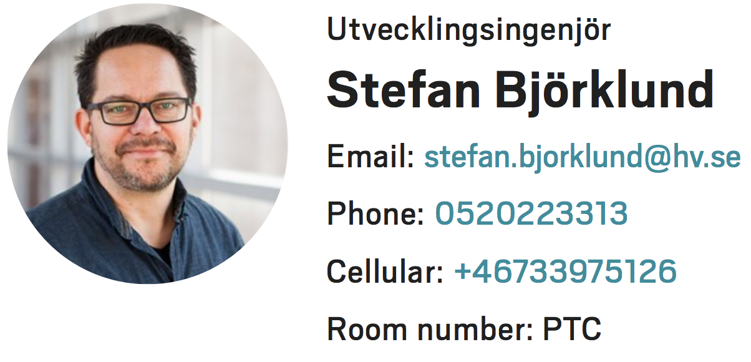
Other non-ESS contributors to the CDR
Prof. Shrikant Joshi and Stefan Björklund, University West
Thermal spray expertise for coating development and final coating
Dr. Mark Ibison, Cockcroft Institute
Subcontracted by Oslo for Tuning Dump Design
Liaison Oslo-ESS-Cockcroft institute for tuning dump optical system vacuum vessel integration.
ESS: also contributes heavily to the review documentation
Cyrille Thomas, ESS project manager
Mattias Wilburgsson, ESS target liaison
Fabien Rey, ESS alignment
Yngve Levinsen, ESS beam dynamics
And many others.

Slide 10
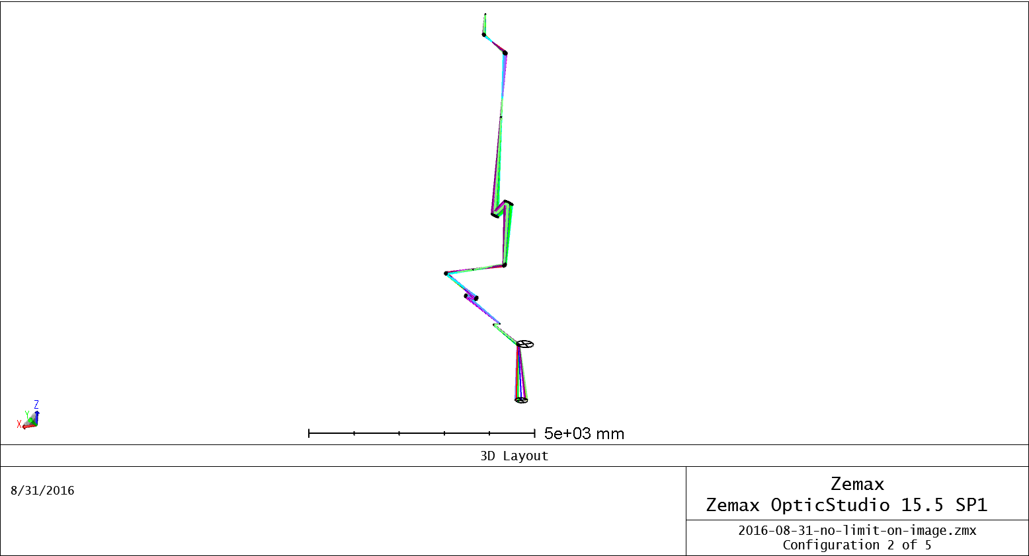
Target imaging systems
PDR
PDR optical system :
4 curved and 2 flat mirrors in the PBIP (until a intermediate real image)
4 curved and 1 flat mirrors in the transport to access area
A total of 8 curved and 3 flat mirrors, per system.
In literature: not found description of similar systems.
Transport
line
PBIP
z

Slide 11
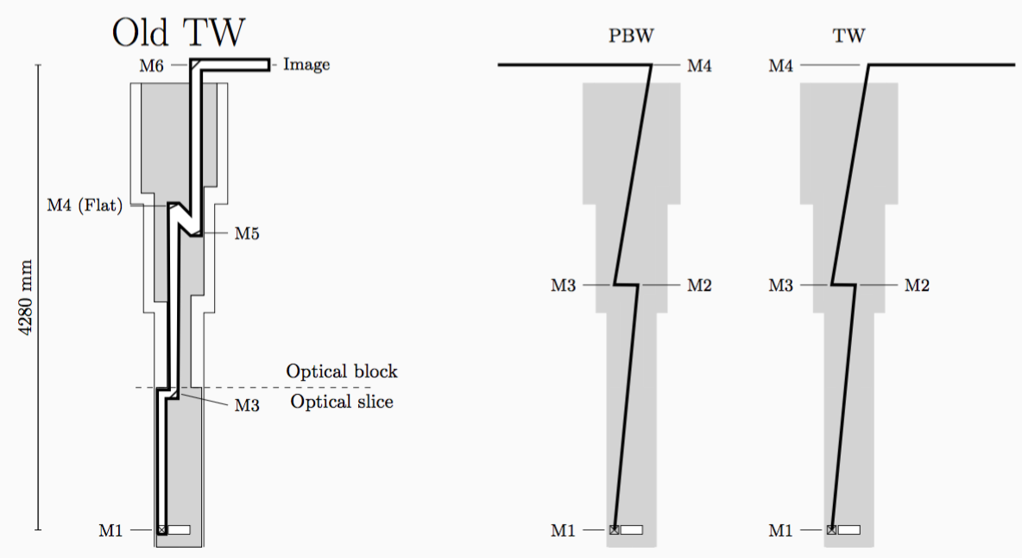
Update: redesign to simpler system
Consistent with strong recommendations from the PDR report
Reduced number of mirrors, per system: 11 to 8 (ok'd with shielding)
All but first mirror flat. Greatly eases tolerancing and tolerances
PBIP: block and slice, merged, as result of tolerancing process
Same effective numerical aperture as previous system (still small, ∼0.001)
No longer all-reflective, need refractive lens on camera

Slide 12
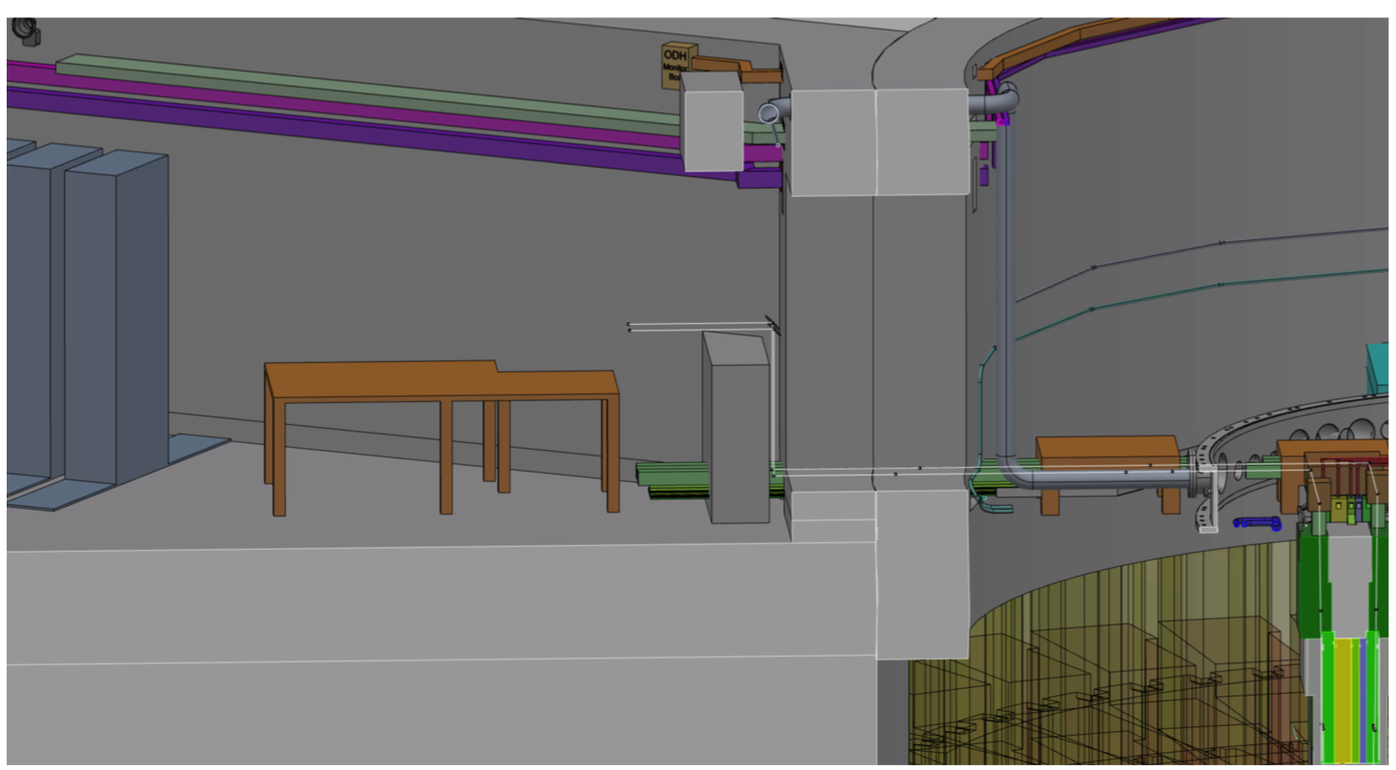
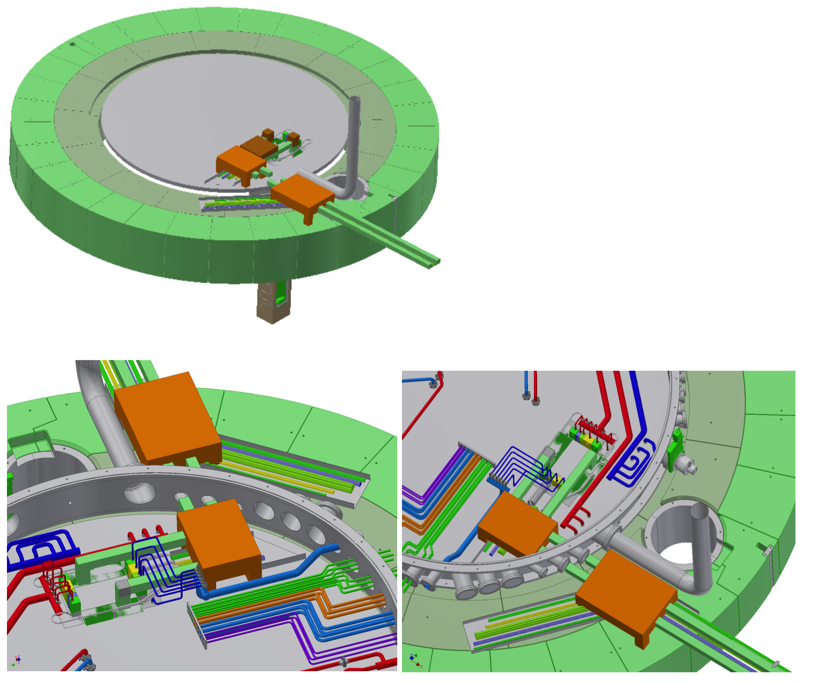
Update: connection cell
Allocations of space for optical system components, including tables and space to perform alignment has been made in the connection cell and all the way to the A2T Access Area
Integrated into the master ESS CAD model

Slide 13
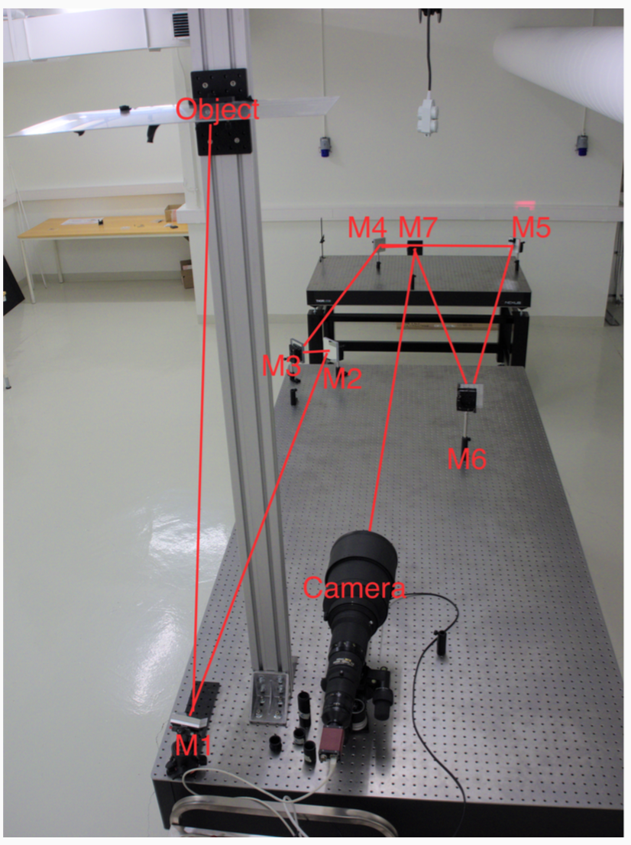
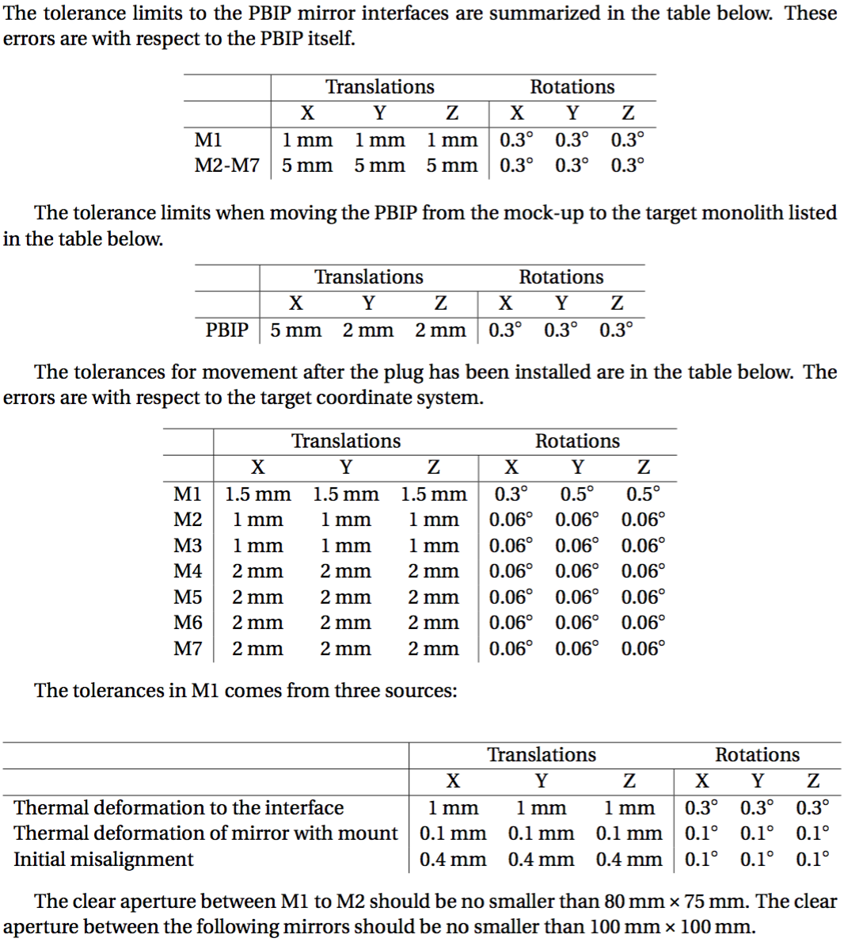
Update: hardware in place! Prototype
Prototype constructed at Oslo
Consistent with recommendations from the PDR report
Performance assumptions verified
Invaluable for tolerance and alignment studies
Close dialog with ESS target and ESS Bilbao has led to the present tolerances, and the installation and alignment strategy
Tolerances tables

Slide 14
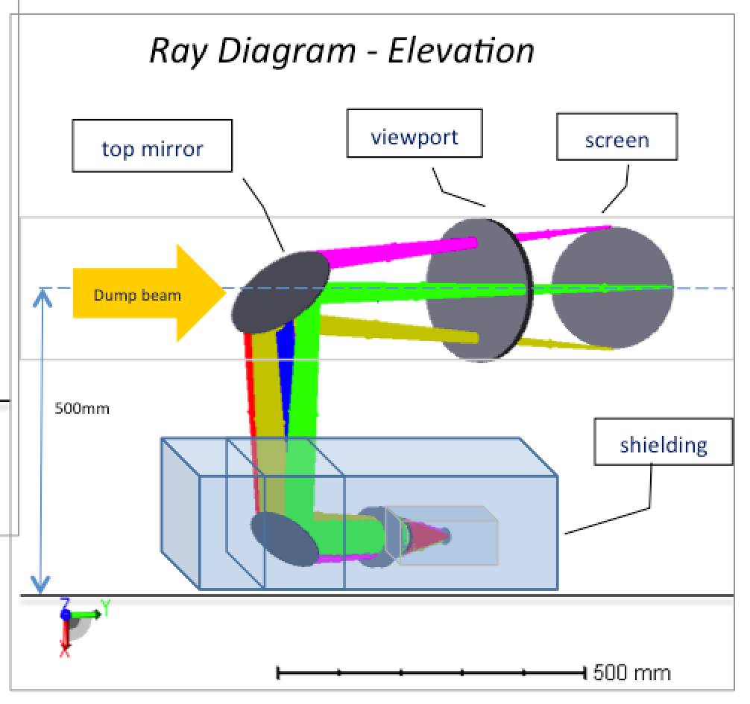
Tuning beam dump system
PDR
At PDR, open questions :
- where to put cameras
- how complex the optical system would need to be
- the radiation levels expected

Slide 15
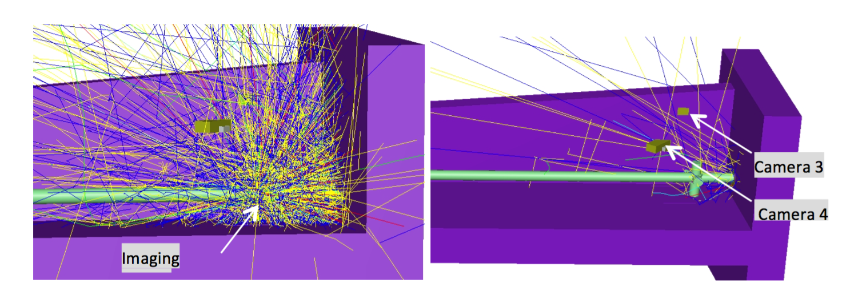
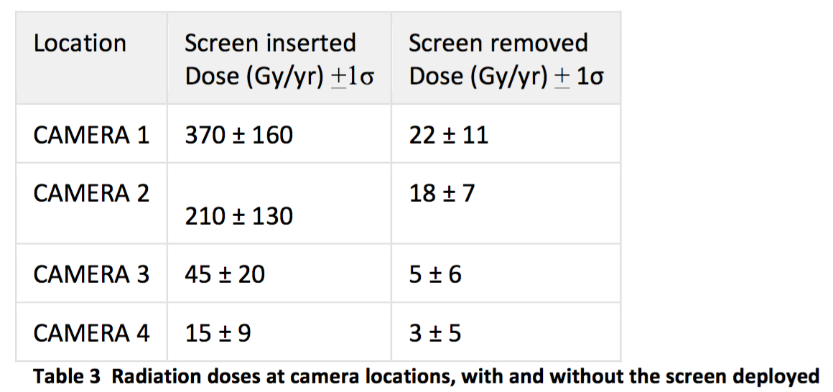
Update: detailed radiation studies performed
Detailed radiation studies of dump using FLUKA (recommendation from PDR)
Used to select camera location, to minimum radiation areas

Slide 16
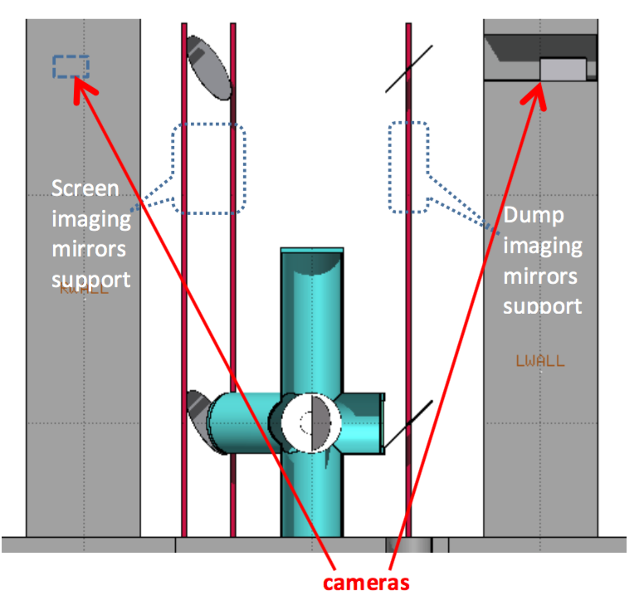
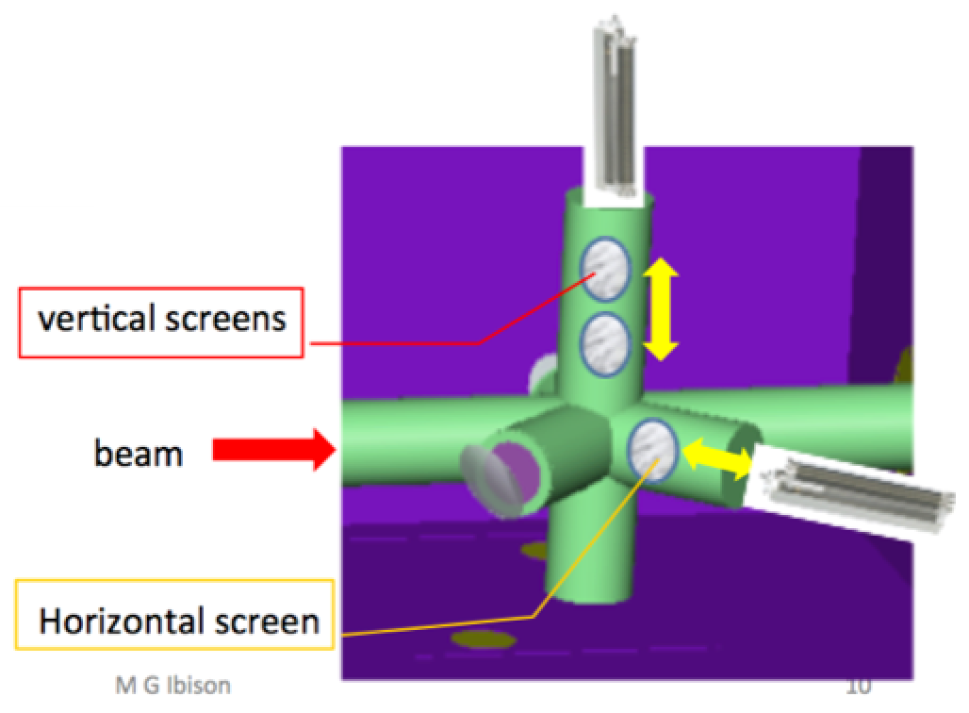
Update: simple optical system,
cameras in tunnel
Radiation studies points to optimal camera locations (high alcoves inside wall)
Keeps optical system simple.
Access to replace cameras and parts has been studied
Multiple-screen actuator system design, based on proven accelerator technology
Interfaces with vacuum vessel and dump well understood, due to continuous dialog Oslo (Ibison) and Cockcroft

Slide 17
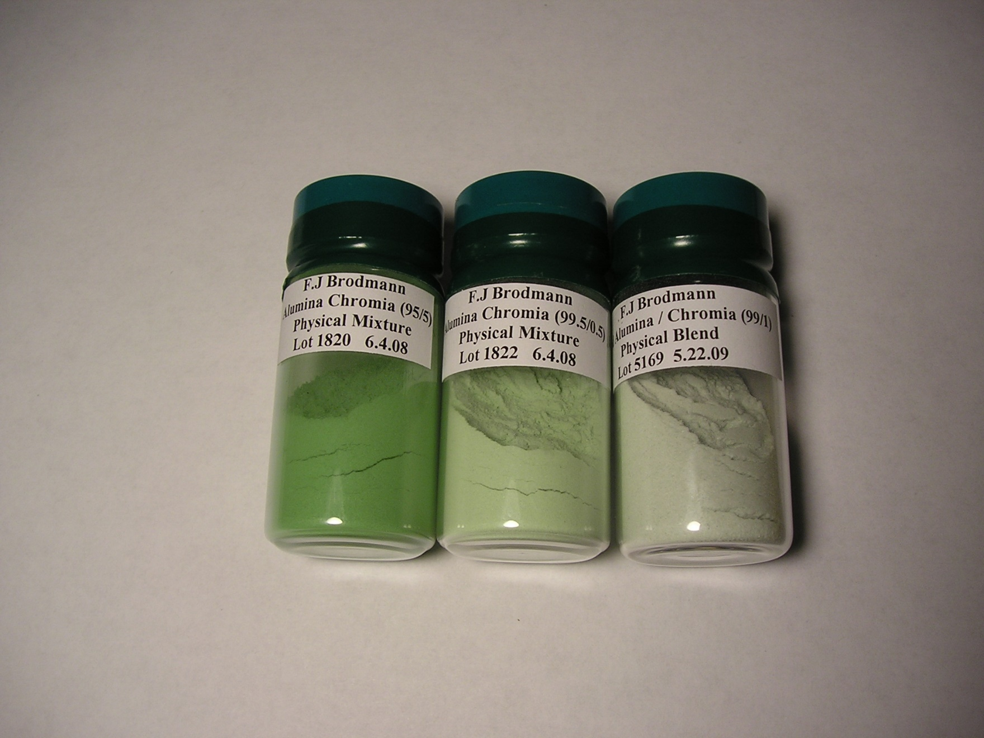
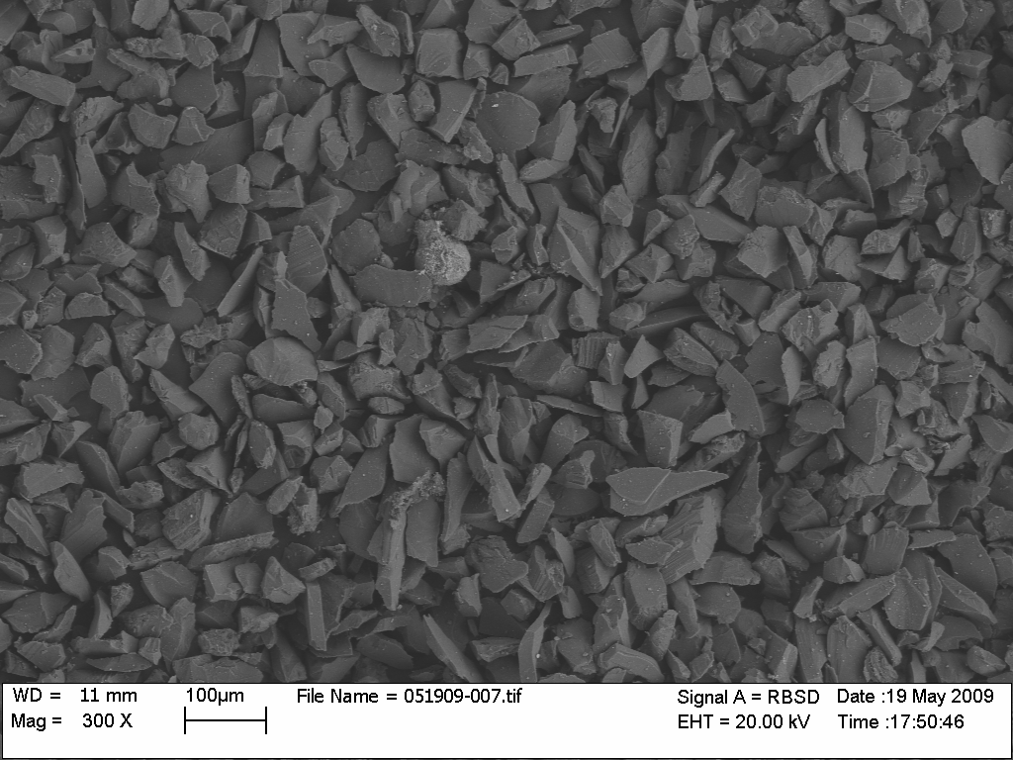
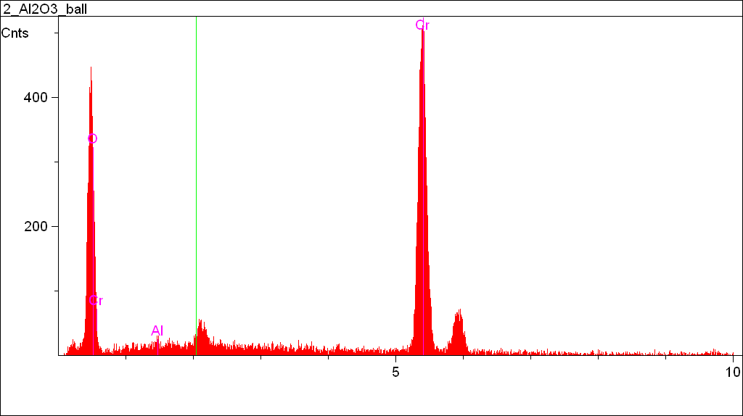
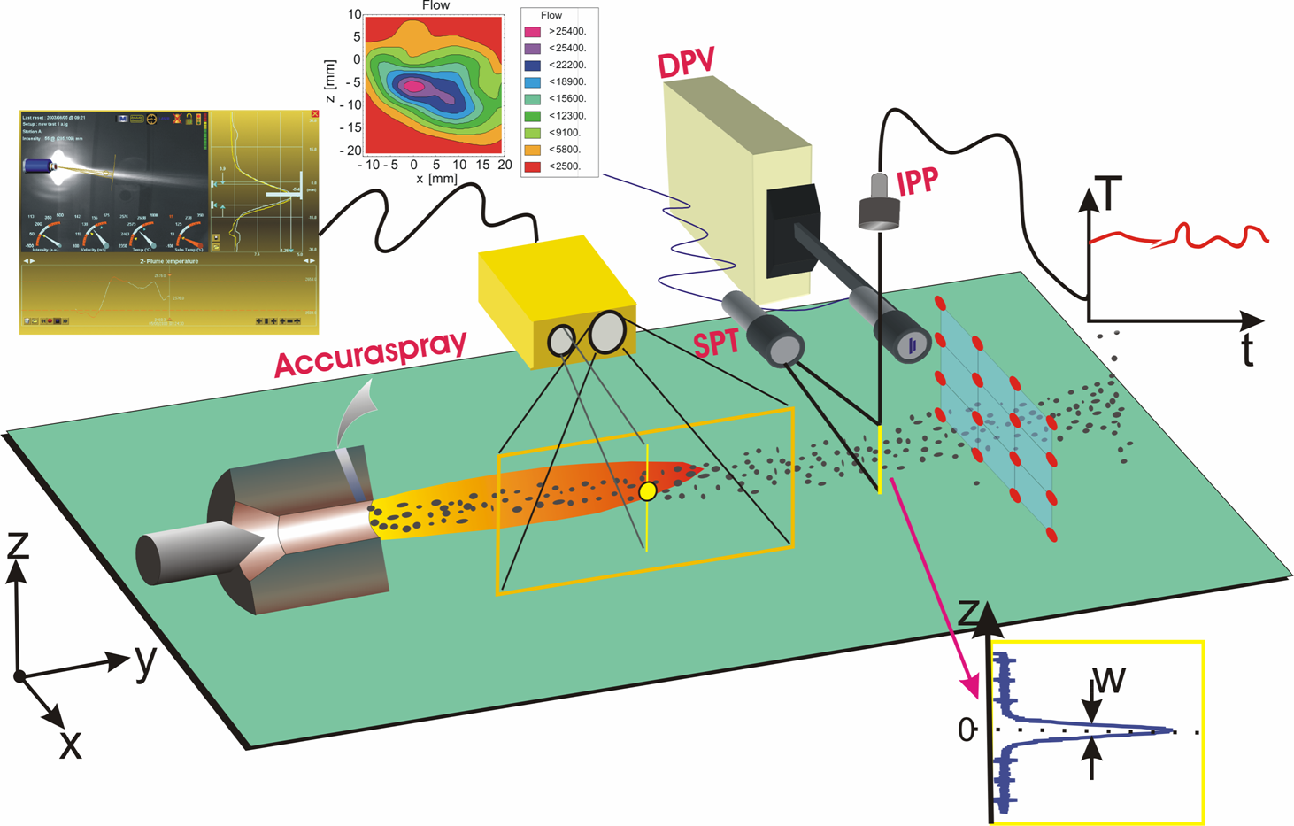
Photon source
PDR
At PDR: unclear when, and how target and PBW should be coated. Research
for new materials and coatings was started.
Coating must be flame/plasma sprayed onto surfaces.
SNS coating development

Slide 18
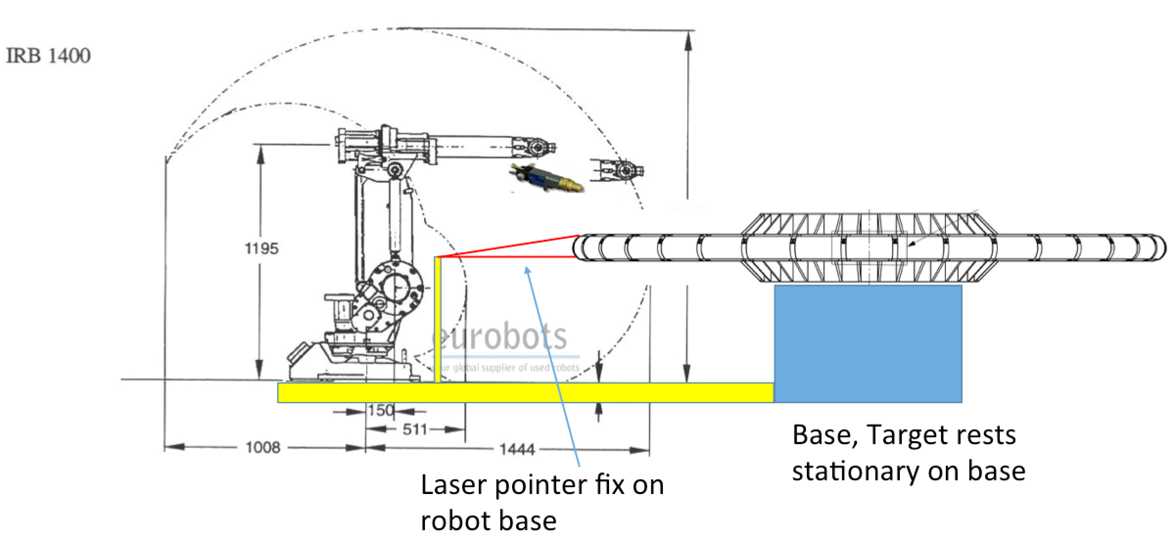
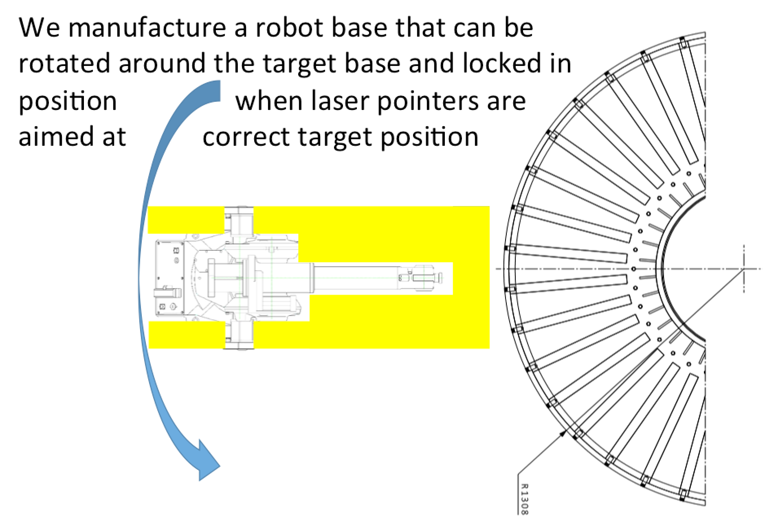
Update: target wheel needs to be coated in one, or two, pieces
As consequence, portable combustion spray solutions preferred
This suggests to use a SNS-like Cr:Al2O3 coating for first target
Coating can in principle be done at ESS Lund, but a complicated set-up needs to be put in place
Schedule discussed with target
Industrialization of process underways

Slide 19
Update: coating development:
Increased network of coating development partners
New materials studied (Yttria, Y₂WO₆)
Irradiation at BLIP performed, new irradiation campaign with DTU started

Slide 20
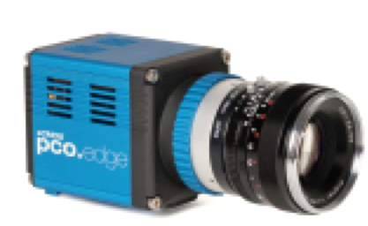
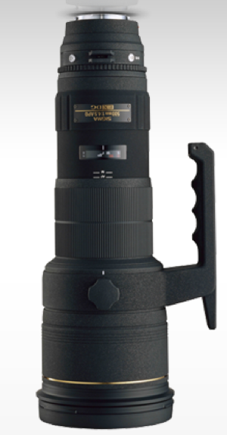
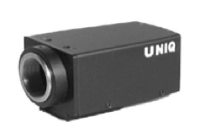
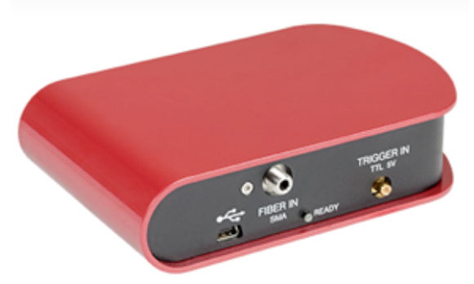
Electronics
PDR
At PDR: rough idea about components needed. Overall system architecture
chosesn (ESS-driven).
Main camera, connected to the ICS
OD,
Band filters
Beam splitter (permanent?)
OD,
Band filters
Spectrometer,
analyzer camera
Beam splitter (for illumination)
Illumination laser

Slide 21
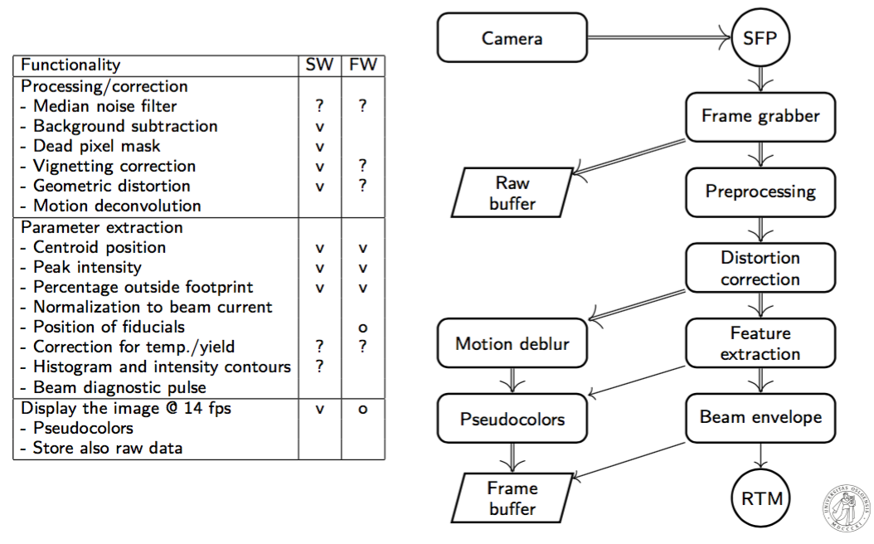
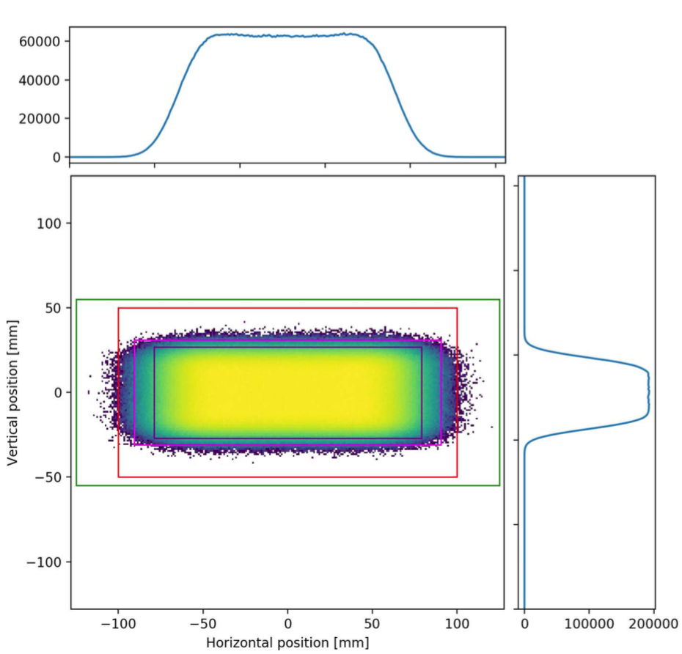
Update: functional description
Core functionality has been defined, with ESS, and documented
Advanced imaging processing algorithms (distortion correction and motion de-blur) have been developed and implemented
Simulation of functionality using realistic beam distributions started

Slide 22
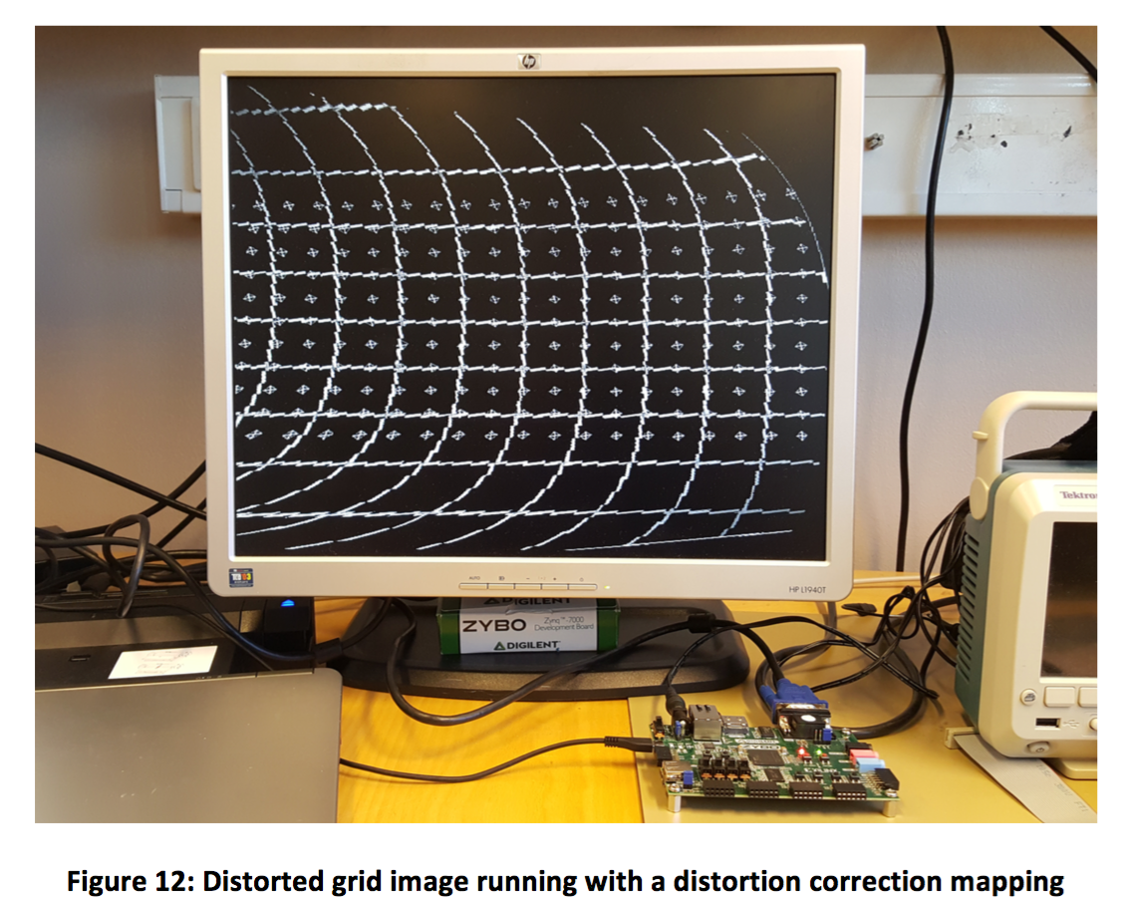
Update: FPGA-implentation of algorithms
FPGA-functionality should ensure beam-synchronous response
Core algorithms implemented and benchmarked on Oslo FPGA-platform
By having access to a prototype of the ESS FPGA-platform, more confidence in results can be obtained, and double work avoided

Slide 23
Actions required after PDR: status
Lead time for critical components verified
Clear scheduling with Target (PBIP, target wheel) compiled
Installation and transport of optical components discussed with Target Division and ESS Bilbao
Project Quality Plan (PQP) generally conforming to ESS-0037830 template has been delivered
In general: communication with ESS and other stakeholders have greatly improved
- weekly meetings Oslo-ESS-UW, with minutes on ESS confluence
- on recommendation from PDR : a number of separate meetings to define interfaces with PBIP, target and tuning dump vacuum vessel have taken place
Many thanks to ESS for facilitating communication; Cyrille Thomas, Mattias Wilborgsson and others

Slide 24
More recommendations from PDR report
(also, PBIP CDR has been delayed)
(also, Target CDR has been delayed)
(also, TCD CDR was delayed)
(full PBIP thermo. sim to be done,
but not within of scope
this work package)
(simplified system, easier to align full path)

Slide 25
(TBC)
(was done, but recent
atmosphere update
redefines task)
(done for tuning dump)

Slide 26
(partially done)

Slide 27
Update: new developments, new risks
Target atmosphere specifications changed (or, concretized) from 1 atm He, to "0.1 – 1 mbar air". Not received any formal specification document (still under discussion?)
Poor vacuum has seemingly lead to corrosion at SNS and KEK
At SNS the corrosion has lead to critical failure of their imaging system
Protective coating may help, however, risk for schedule delay

Slide 28
Summary
The imaging system is a challenging system
Progress has been good since PDR. PDR actions and recommendations have been taken into account
Arrived at a design for the imaging systems
Collaboration between Oslo, ESS, HV and other partners has been good. Communication intensified
Imaging systems in principle (still) on schedule. How to align with new ESS schedule to be discussed
New major risks identified

Slide 29
Extra

Slide 30
Note, the baseline solution : same chemistry for scintillators as used at CERN ("Chromox")
Cr:Al₂O₃
The accelerator community, worldwide, seems to have not pushed scintillator development the last few decades. Opportunity to make progress?

Slide 31
Older version of the designs
Older versions of the PBIP optical design, before Oslo entered the project.

