Slide 1
Target and Dump Proton Beam Imaging Systems CDR
Thermal Heat Load Analysis
of First Mirror

Slide 2
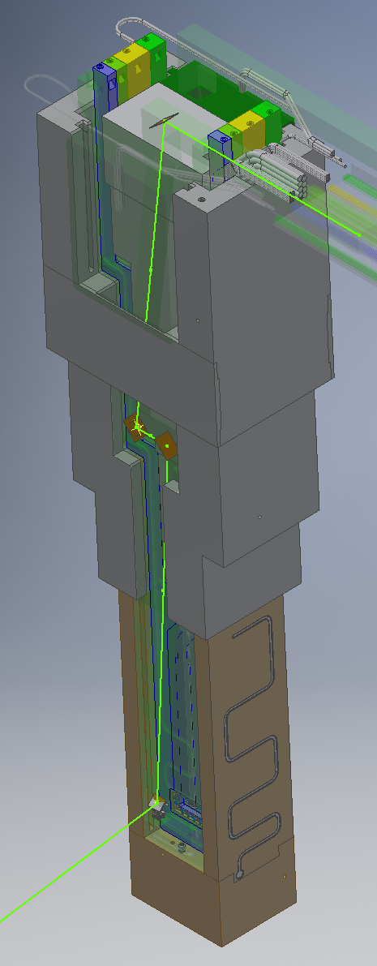
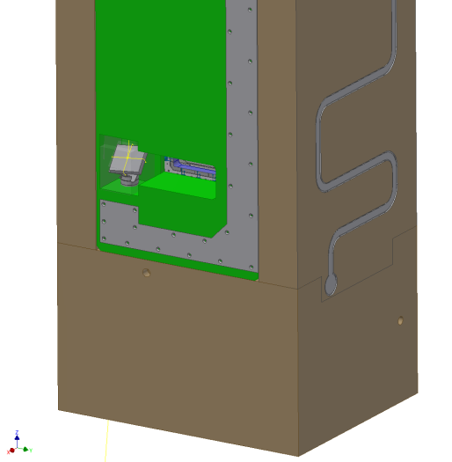
Introduction
Notes:
Heat induced/generated from spallation products from target wheel.
There is a possibility that the generated heat load is so large that it will result in permanent damage of mirror and/or mirror mount.
In addition, deformations of mirror and/or mount can cause optical problems.
Thus: need to ensure that there is sufficient thermal connection to the cooled PBIP.

Slide 3
Aim of the Heat Laod Analysis
Plot deflections of the first mirror and mount.
Affect on beam path
Note: Not looking into deformations of the PBIP
Find most optimal mount design
Shape
Material
Note: This is a simplified heat load analysis, to get a first indication of how mirror and mount is affected by the heat load. A more detailed analysis shall be run, including the complete PBIP.

Slide 4
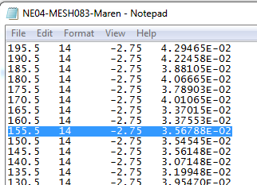
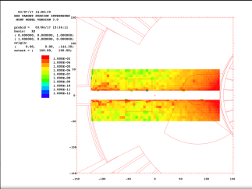
The Heat Load
Input from ESS target division
Heat load [W/cm3] around proton beam line inside the monolith vessel. Data for each point (x,y,z), the coordinate system is TCS. (March 2017)
.
x=0 is inside the target wheel and the x axis is pointing along the beam axis towards the proton beam window.
Coordinates close to the mirror (150, -16, 0) and mirror mount.
We considered this area (ref. Alan Takibayev):
153 < X < 158
-13 < Y < -20
-3.5 < Z < 3.5
Average heat load: 0.0216 ± 0.0017 W/cm³ = 21600 W/m³
Worst case/Max heat load approx.: 0,4 W/cm³ = 4x10⁵ W/m³

Slide 5
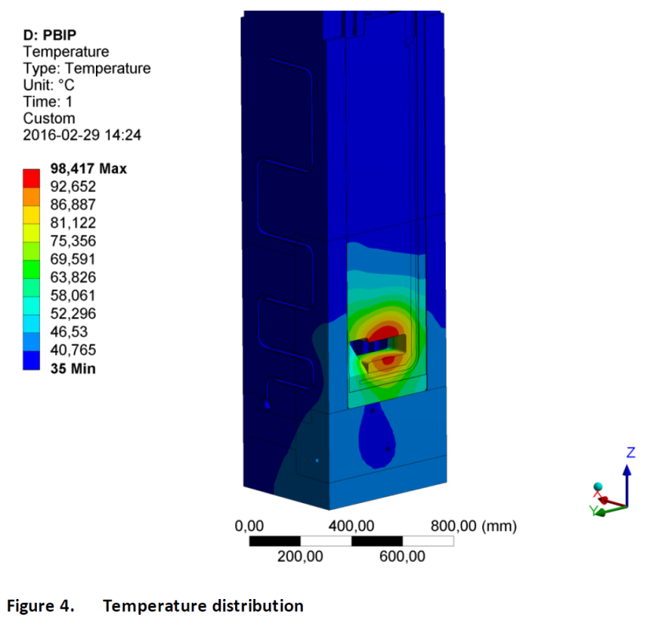
PBIP Temperature
Doc nr. ESS-0052276 (March 2016) Thermal deformation of the PBIP
PBIP temperature is about 60 ͦC at the surface where mirror and mount will be located.

Slide 6
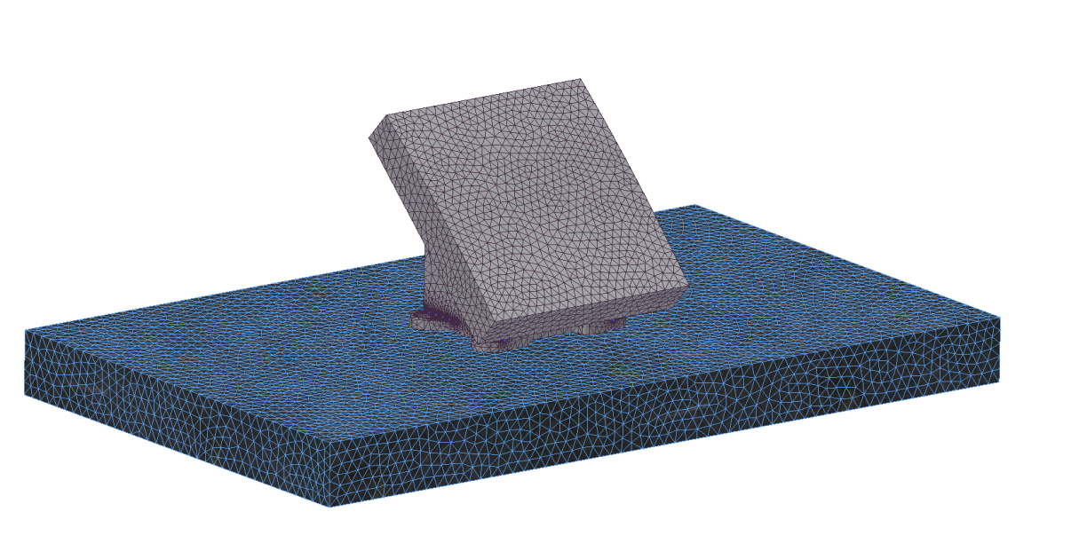
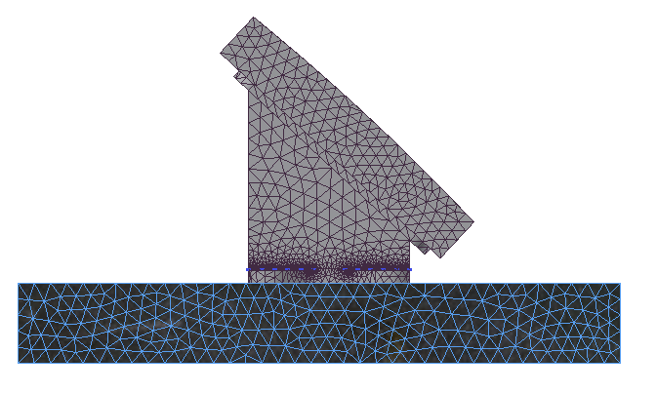
Simulation Model CAD model – Mesh – Boundary Cond.
Mirror
Mount
Base Plate
(Section of the PBIP that the mount is fixed onto)
Type of boundary condition | Value | Comment
Initial temperature of mirror and mount. | 308 K (35 ͦC) | Same boundary condition as used for PBIP thermal analysis. Doc nr. ESS-0052276 (Mar. 2016)
Base plate temperature | 333 K (60 ͦC) | This value is taken from the old analysis: Thermal deformation of the PBIP. Doc nr. ESS-0052276 (Mar. 2016)
Convection from mirror and mount, to surrounding gas/vacuum | 0,5 W/m²K | With specified ambient temp 308 K (35 ͦC)
Heat radiation emissivity for Aluminium | 0,05 | With specified ambient temp 308 K (35 ͦC)
Heat radiation emissivity for Steel | 0,1 | With specified ambient temp 308 K (35 ͦC)

Slide 7
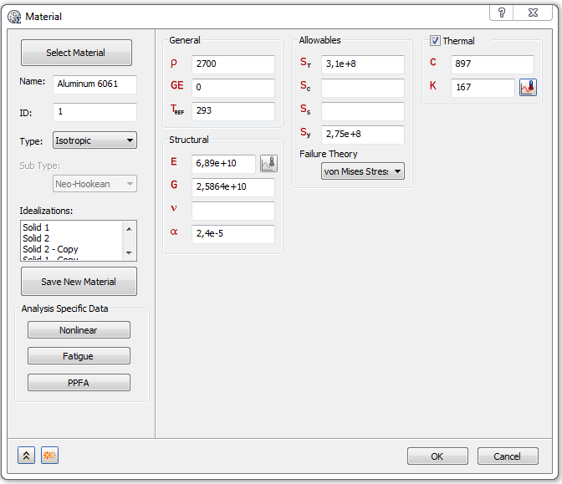
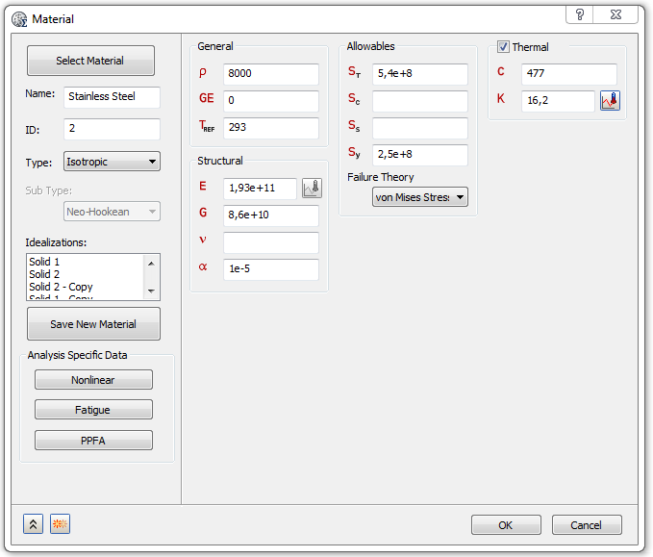
Simulation Model Material Properties
Material Property | Material
 | Al 6061 | Stainless Steel
C, Specific Heat [J/kg K] | 897 | 477
K, Thermal conductivity [W/m K] | 167 | 16,2
α, Thermal Exp. Coeff [/K] | 2,4e-5 | 1e-5
Reference Temperature [K] | 293 | 293

Slide 8
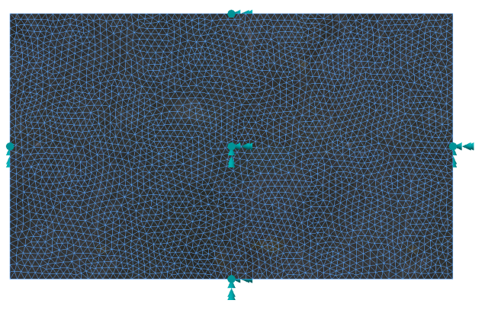
Simulation Model Loads and Constraints
Bonded surface contact between:
Mount and base plate
Mount and mirror
Base plate constraints
Fixed constraint for all surfaces, except from the top surface.
Heat loads
Average: 21600 W/m³
Max: 4 x 10⁵ W/m³

Slide 9
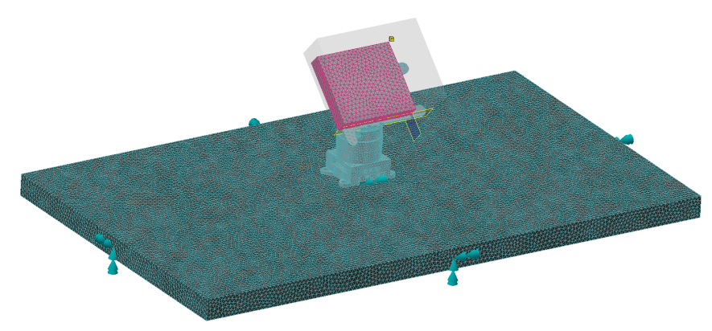
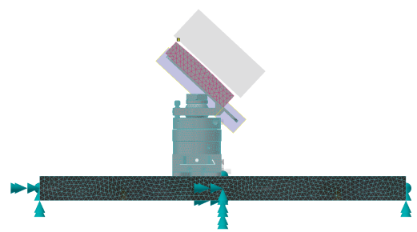
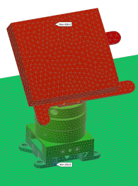
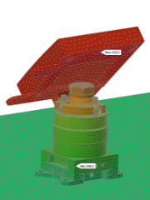
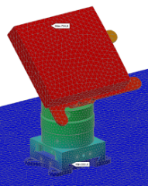
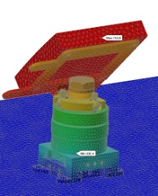
First simulation model Bendamount
Steel
Load case | Temperature of mirror | Figure
21600 W/m³ heat load | 426 K / 153 ͦC
4 x 10⁵ W/m³ heat load | 755 K / 482 ͦC

Slide 10
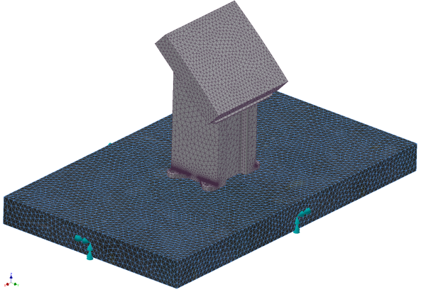
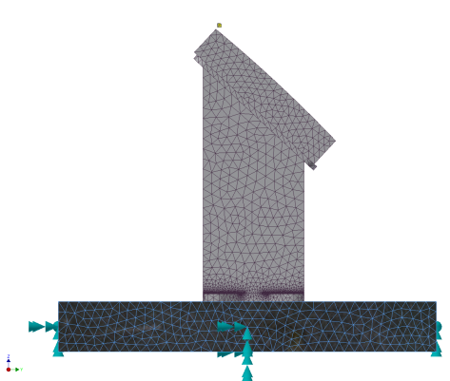
Simplified Mount Larger Surface Contacts
Load case | Temperature of mirror Bendamount | Temperature of mirror Simplified steel mount | Temperature of mirror Simplified aluminium mount
21600 W/m³ heat load | 426 K / 153 ͦC | 340 K / 67 ͦC | 334 K / 61 ͦC
4 x 10⁵ W/m³ heat load | 755 K / 482 ͦC | 476 K / 203 ͦC | 353 K / 80 ͦC

Slide 11
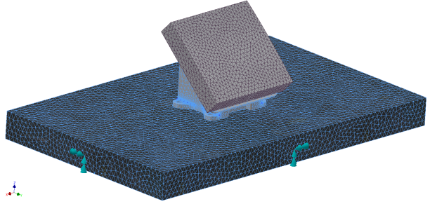
Simplified Mount Mirror Deflections
Load case | Max deflection Steel mount | Max deflection Aluminium mount | Max deflection SHORT steel mount
21600 W/m³ heat load | 340 K / 67 ͦC 0,859 x 10⁻⁴ m | 334 K / 61 ͦC 1,161 x 10⁻⁴ m | 334 K / 61 ͦC 0,670 x 10⁻⁴ m
4 x 10⁵ W/m³ heat load | 476 K / 203 ͦC 3,175 x 10⁻⁴ m | 353 K / 80 ͦC 1,578 x 10⁻⁴ m | 378 K / 105 ͦC 1,567 x 10⁻⁴ m

Slide 12
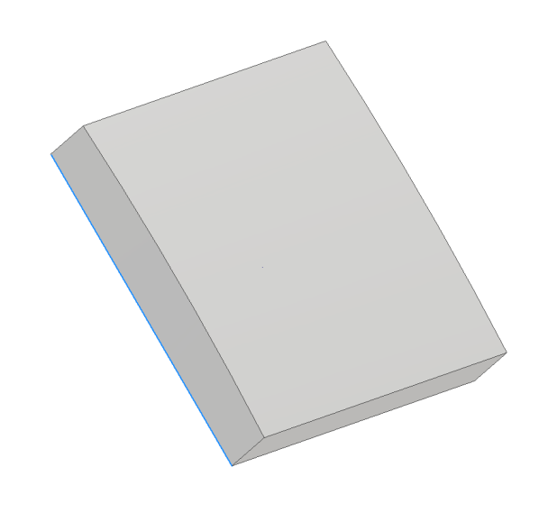
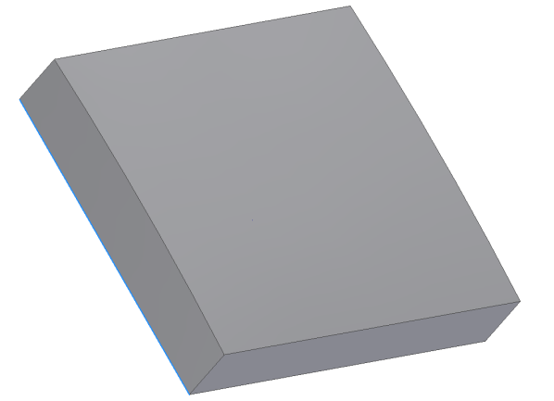
Design Change - Mirror
65 mm
75 mm

Slide 13
Short Mount Mirror Deflections
Load case | Max deflection SHORT steel mount Original mirror | Max deflection Steel mount Large mirror
21600 W/m³ heat load | 334 K / 61 ͦC 0,670 x 10⁻⁴ m | 334 K / 61 ͦC 0,721 x 10⁻⁴ m
4 x 10⁵ W/m³ heat load | 378 K / 105 ͦC 1,567 x 10⁻⁴ m | 380 K / 107 ͦC 1,558 x 10⁻⁴ m

Slide 14
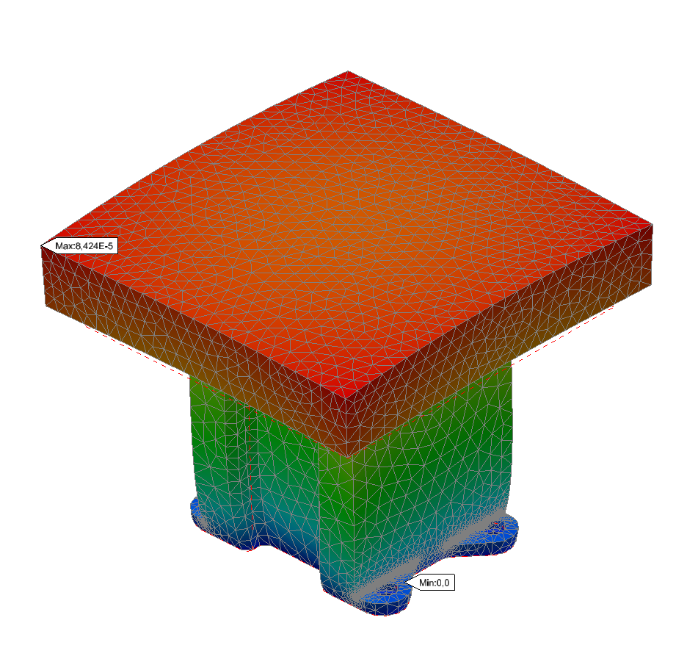
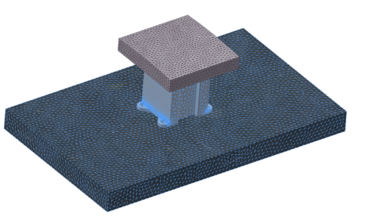
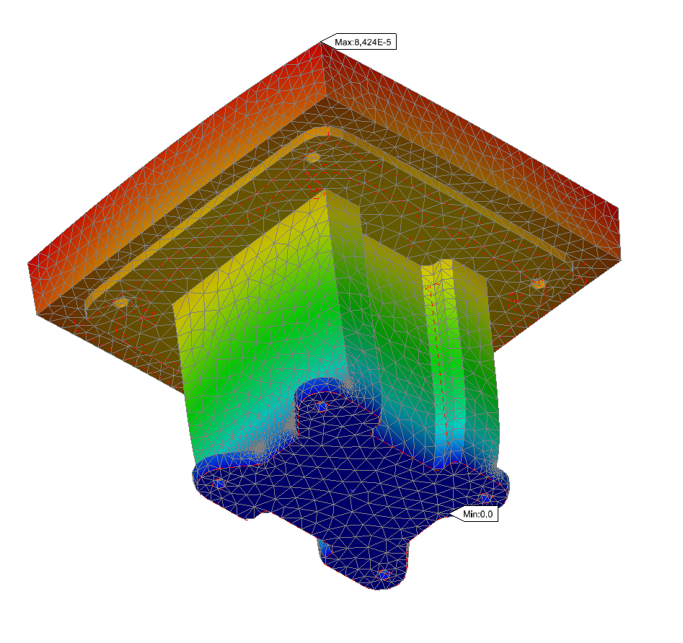
Short Mount Mirror Deflections
Load case | Max deflection Steel mount Large mirror | Max deflection Aluminium mount Large mirror | Max deflection Straight Steel mount Large mirror | Max deflection Straight Al. mount Large mirror
21600 W/m³ heat load | 334 K / 61 ͦC 0,721 x 10⁻⁴ m | 333 K / 60 ͦC 0,788 x 10⁻⁴ m | K / 62 ͦC 0,570 x 10⁻⁴ m | 428 K / 155 ͦC 0,815 x 10⁻⁴ m
4 x 10⁵ W/m³ heat load | 380 K / 107 ͦC 1,558 x 10⁻⁴ m | 342 K / 69 ͦC 0,858 x 10⁻⁴ m | 428 K / 155 ͦC 2,27 x 10⁻⁴ m | 344 K / 71 ͦC 0,842 x 10⁻⁴ m

Slide 15
Conclusion
Simplified mount design
Short mount
Angled mount design (Do not need to implement angled surface in plug)
Aluminium material
Note: These conclusions are based on PBIP reference temperature of 60 ͦC, from “Thermal deformation of the PBIP” Doc nr. ESS-0052276.

Slide 16
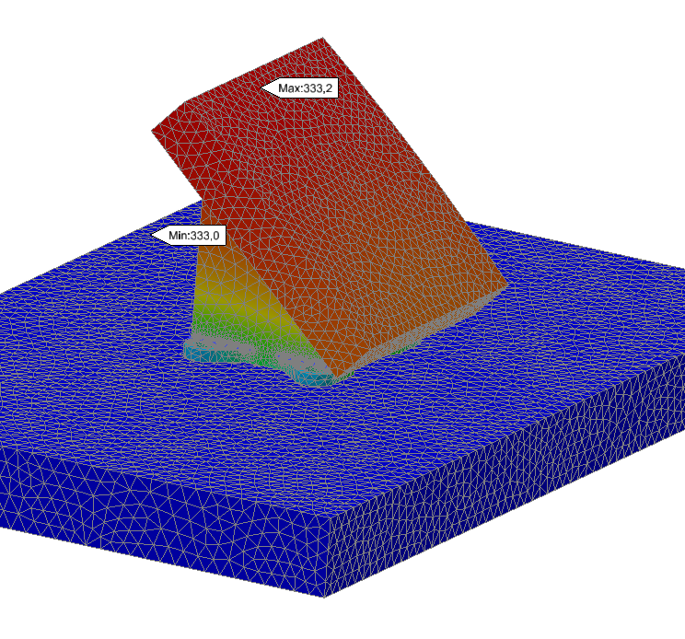
Result plots Current mirror and mount design
Load case | Aluminium mount Large mirror | Figures
21600 W/m³ heat load | 333 K / 60 ͦC
 | 7,876 x 10⁻⁵ m
4 x 10⁵ W/m³ heat load | 342 K / 69 ͦC
 | 8,582 x 10⁻⁵ m

Slide 17
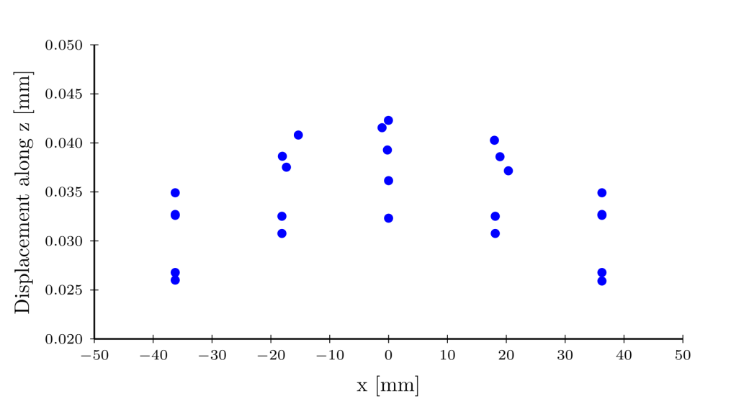
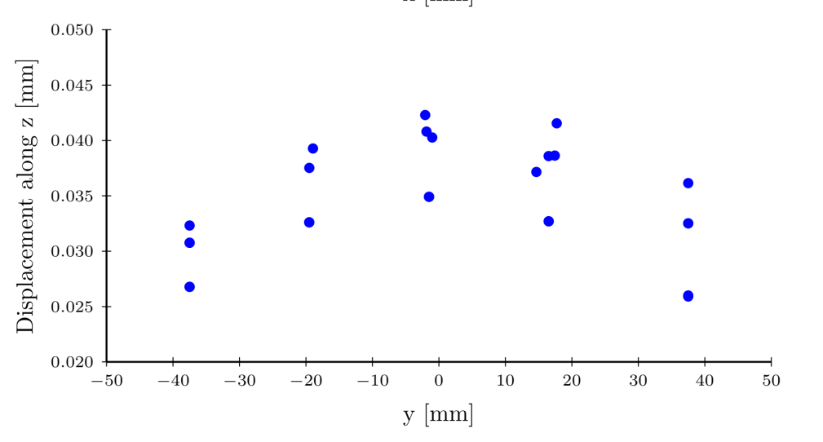
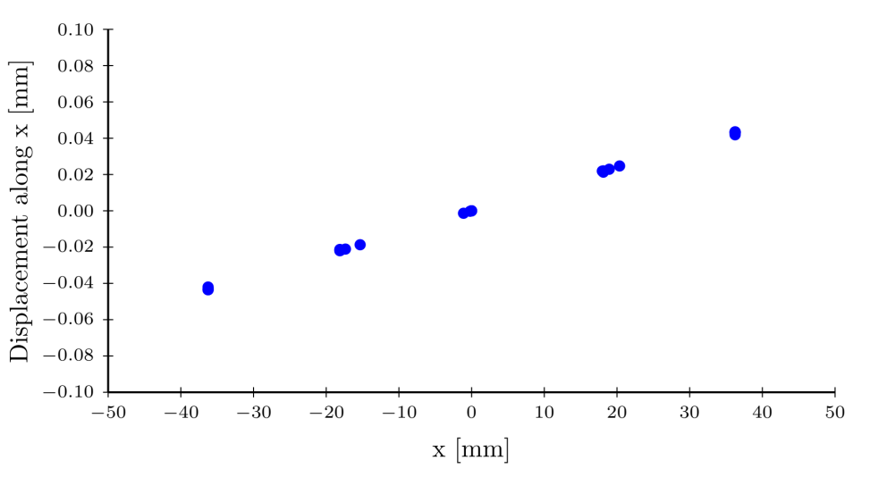
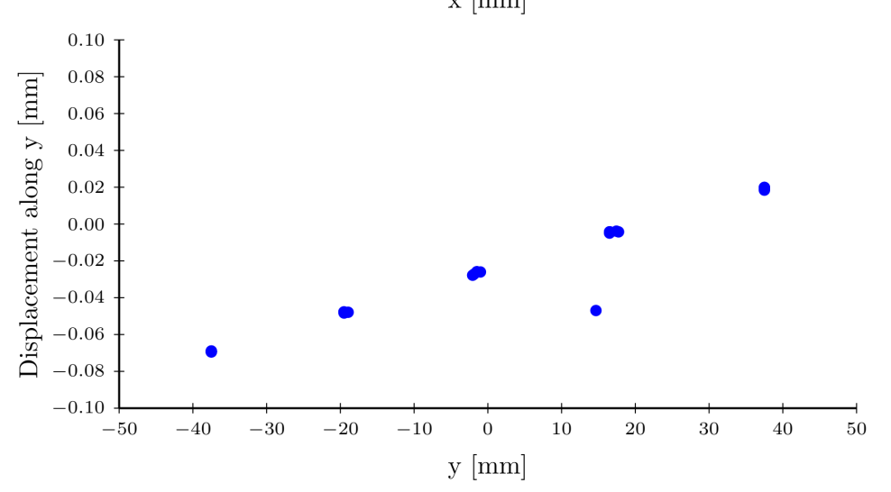
Result plots
In order to study the optical effects of the thermal deformations,
the deformations in the worst case heat load have been used.

Slide 18
Further Work
Final mount design
Shape
Assembling method
Interface towards PBIP
Final, more detalied thermal analysis, including PBIP.

