Slide 1
Target Wheel and PBW
Target Imaging Systems
Mattias Wilborgsson
Work Unit Leader, Monolith Systems
www.europeanspallationsource.se
23 October, 2017

Slide 2
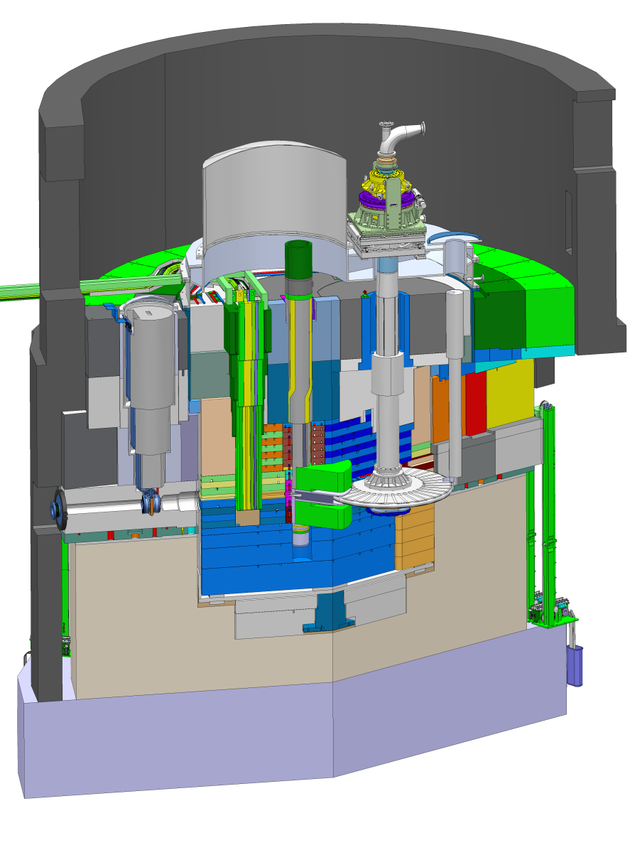
Target Station layout
Proton Beam Instrumentation Plug
Proton Beam Window
Neutron Beam Extraction
Proton beam envelop
representation
Target Wheel
Moderator and Reflector Plug

Slide 3
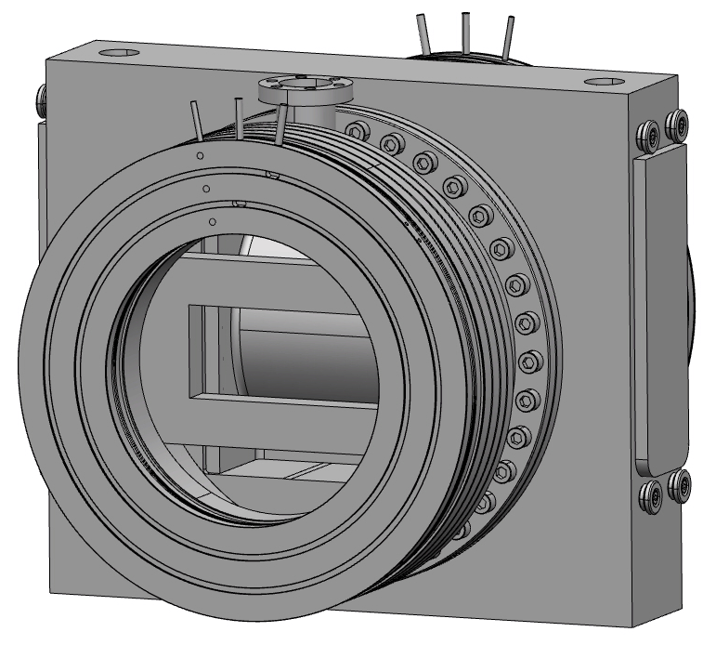
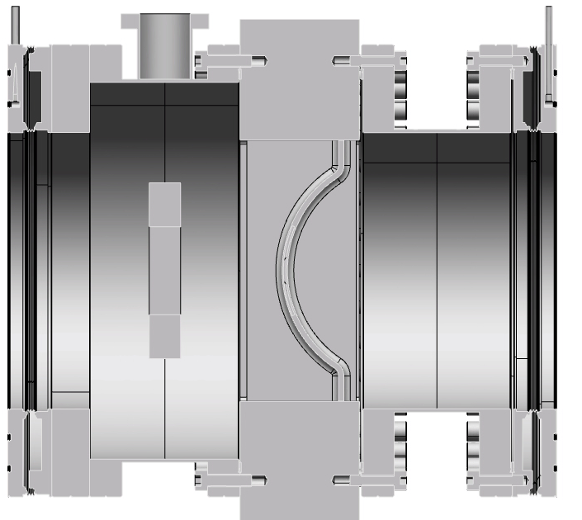
Target Station components
Proton Beam Window (PBW)
Function
  Separating the monolith atmosphere from the high vacuum of the accelerator beam pipe
Expected lifetime
  A half up to one year at full power operation (5 MW)
Target Imaging Systems
  Luminescent coating
    Thickness of the coating needs to be defined
    Quality assured uniformity of the coating
    Max temp. 130°C for < 0.5 h
    Coating procedure needs to be qualified
  Fiducials
    Placement and dimensions not defined
    Manufacturing process needs to be defined
Window
Al6061-T6
Luminescent
coating

Slide 4
Target Station components
Target Wheel/ Beam Entrance Window (BEW)
Function
  Conversion of a highly intense, pulsed proton beam to free neutrons via the spallation process
  Distribute the power over a large volume and remove heat from the target material
Expected lifetime
  The current estimation of the maximum target wheel lifetime is 5 to 10 years
Target Imaging
  Luminescent coating on BEW
    Thickness of the coating needs to be defined
    Quality assured uniformity of the coating
    Coating procedure needs to be qualified
BEW

Slide 5
Schedule
PBW
Preferable to coat the PBW in Trollhättan before assembly of complete plug
Maufacturing finished Q3 2018
Installation in Monolith September 2019
BEW
Portable combustion-gun → Coating on the complete TW can be made in Lund
TW/BEW delivered to Lund Q2 2019
Installation in Monolith February 2020
PBIP
Test assemble of mirrors in optical slices in Spain
Manufacturing of slices finished Q1 2019
Final assemble and alignment of mirrors in Mock-Up
PBIP delivered to Lund Q2 2019
Installation in Monolith April 2020

Slide 6
The End
Thank you!

Slide 7
Backup slide

