Slide 1
Cold NPM electric field uniformity
P. Abbon, F. Belloni, F. Benedetti, G. Coulloux, C. Lahonde-Hamdoun, P. Le Bourlout, Y. Mariette, J. Marroncle, J.P. Mols, V. Nadot, L. Scola (CEA)
Cyrille Thomas (ESS)
BI FORUM #4

Slide 2
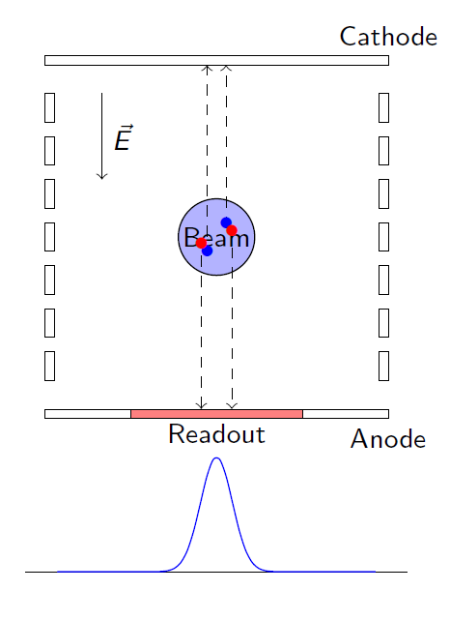
Why uniformity is Important ?
ESS Requirements
  The transverse beam profile shall be measured with a total measurement error:
      in the RMS extension of the beam of less than ±10%
      in the 95% extension of the beam of less than ±10%
Real IPM: profile distortion !
  Space charge & initial momentum
      See talk of Francesca Belloni (BI Forum #3)
  Electric field uniformity
      Not parallel plate ➔ Side effect
      Detector geometry
      Vacuum vessel geometry
      And etc.

Slide 3
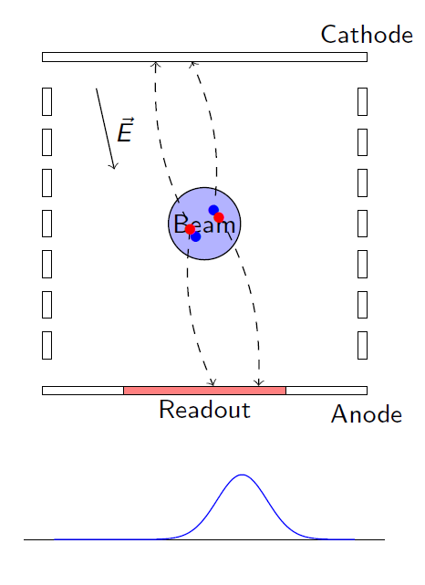
Why uniformity is Important ?
ESS Requirements
  The transverse beam profile shall be measured with a total measurement error:
      in the RMS extension of the beam of less than ±10%
      in the 95% extension of the beam of less than ±10%
Real IPM: profile distortion !
  Space charge & initial momentum
      See talk of Francesca Belloni (BI Forum #3)
  Electric field uniformity
      Not parallel plate ➔ Side effect
      Detector geometry
      Vacuum vessel geometry
      And etc.

Slide 4
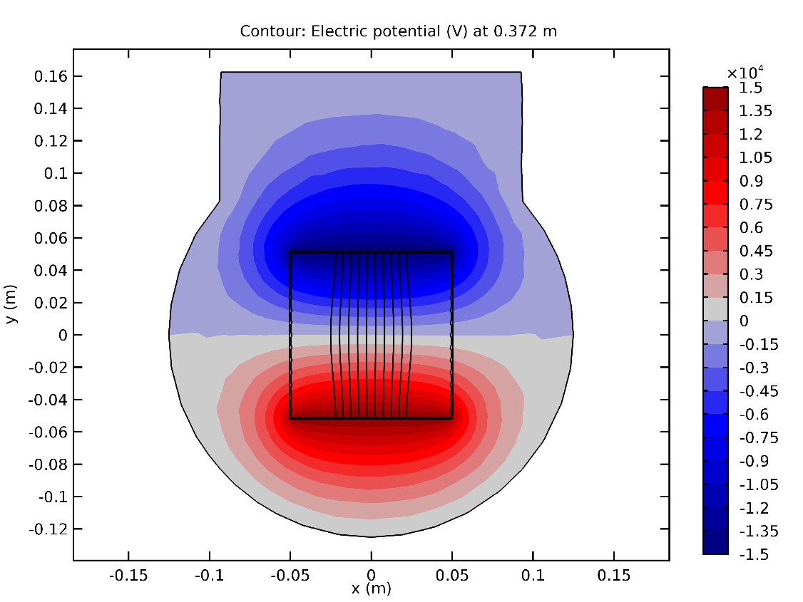
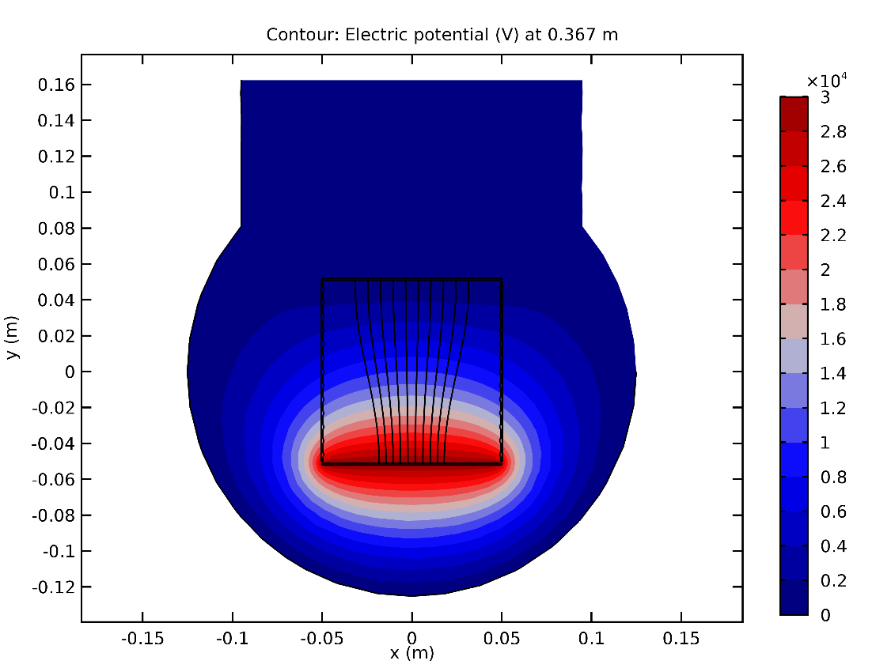
Problems (1/2)
2 types of IPM
  Asymmetric
  Symmetric

Slide 5
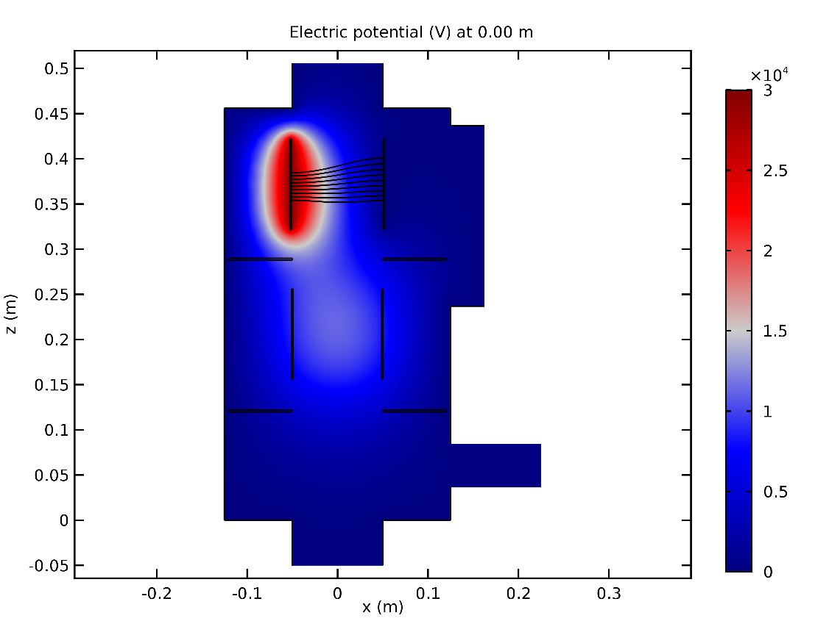
Problems (2/2)
A NPM = IPM X + IPMY
  Cross interaction

Slide 6
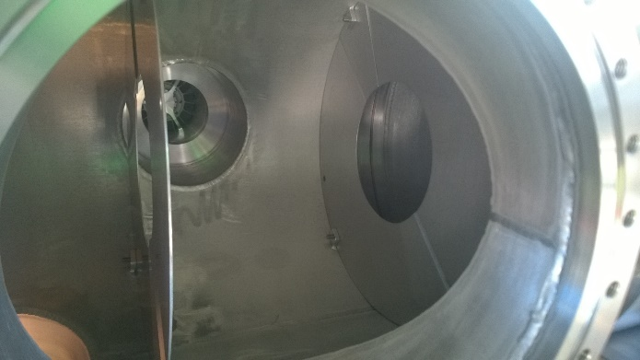
How to correct electrical field ?
3 main leverages
  Disks
      Shield IPM from each other
      Independent systems
  Field correctors
      Correction in transversal direction
  Curved electrodes
      Increase the shielding effect
      Correction in longitudinal direction

Slide 7
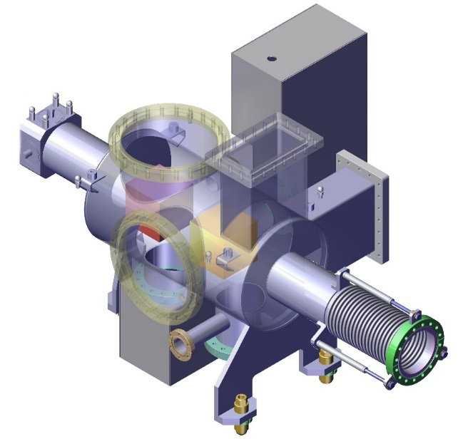
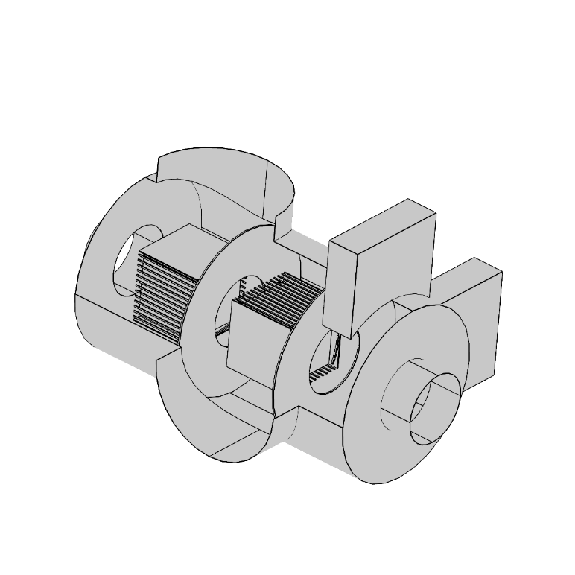
Simulations setup
COMSOL
  All-in one Finite Element Method software
      Geometry construction (1D, 2D, 3D)
      Mesh generation
      Boundaries Condition
      Solution solver
      Visualization
  Support different type of solver/physic
      Static/Temporal
      Optimization
  Drawbacks
      Sometimes, it looks like a black box
      Segmented product
      Export data to other software

Slide 8
How to quantify uniformity ?
Criteria
  3D vector data are difficult to represent directly
      Go back to 2D
      Streamlines
  Find a way to quantify the uniformity

Slide 9
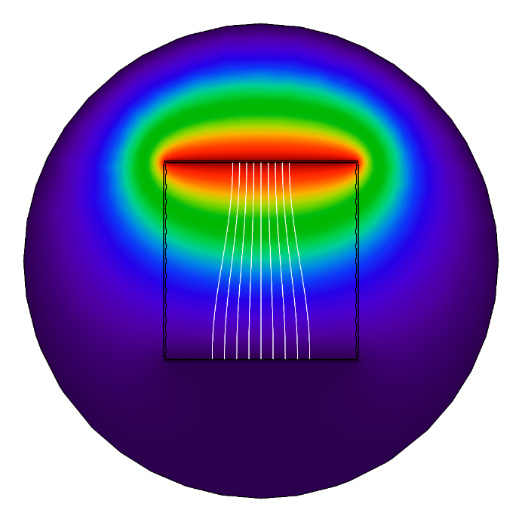
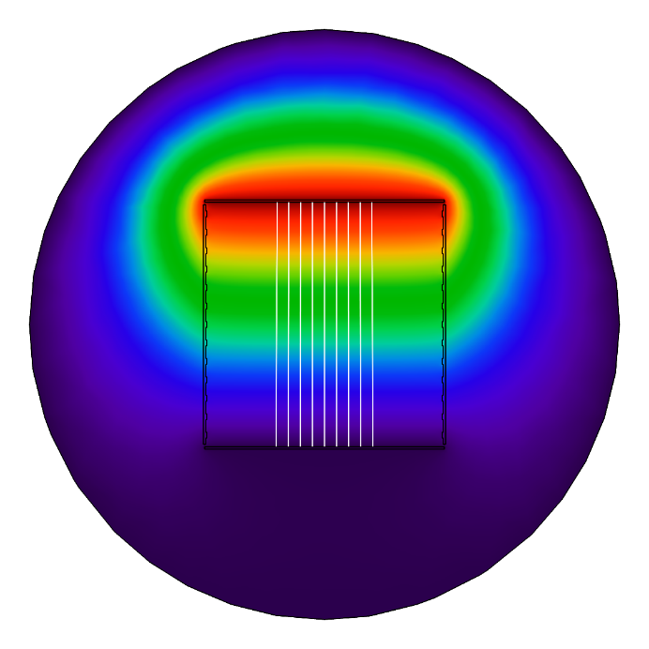


How to quantify uniformity ?
Criteria
  3D vector data are difficult to represent directly
      Go back to 2D
      Streamlines
  Find a way to quantify the uniformity
Image
  Plot an image from the solution
  Advantages
      Simple, include in COMSOL
  Drawbacks
      How to quantify/compare

Slide 10
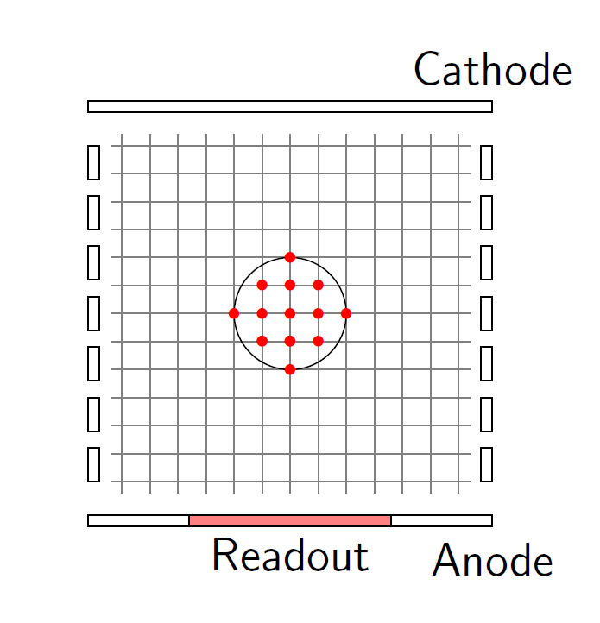
How to quantify uniformity ?
Criteria
  3D vector data are difficult to represent directly
      Go back to 2D
      Streamlines
  Find a way to quantify the uniformity
Statistical
  Make a slice in Z direction
  Calculate the quadratic mean value of E field in the area close by to the beam
  Sweep over Z
  Advantages
      Quadratic ➔ No compensation
      Error FEM solver only
  Drawbacks
      Quadratic ➔ Lost sign

Slide 11
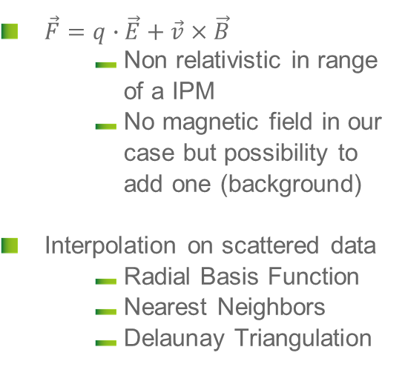
How to quantify uniformity ?
Criteria
  3D vector data are difficult to represent directly
      Go back to 2D
      Streamlines ➔ Particles tracking in our case
  Find a way to quantify the uniformity
Particle tracking
  Draw randomly (or not) particles and store the initial position
  Integrate the equation of motion w.r.t the Lorentz equation
  Store the final position
  Advantages
      That’s all we want
  Drawbacks
      Error: FEM+Interpolation+Integration
  $\vec{F}=q∙\vec{E}+\vec{v}×\vec{B}$
      Non relativistic in range of a IPM
      No magnetic field in our case but possibility to add one (background)
  Interpolation on scattered data
      Radial Basis Function
      Nearest Neighbors
      Delaunay Triangulation

Slide 12
Analysis workflow
Load data from COMSOL
Goals
  Load data from COMSOL and create n field objects (can be electric or magnetic)
  Perform stats computation on these fields
  Generates particles and tracks them
  Different ODE solvers and interpolation methods
  With reasonable time of computation
Third Party libs used
  Boost
      ODE integration
      Random generation
  Nanoflann for k-Nearest Neighbors search
  Intel TBB for parallelization
  VTK and ROOT for visualization
Field object
Field object
Stats
Particles
Particles
Particles
ODE
ODE
ODE
Interpolation
Interpolation
Interpolation
Integration
Integration
Integration
Track
Track
Track
Stats/Visualization

Slide 13
Asymmetric IPM

Slide 14
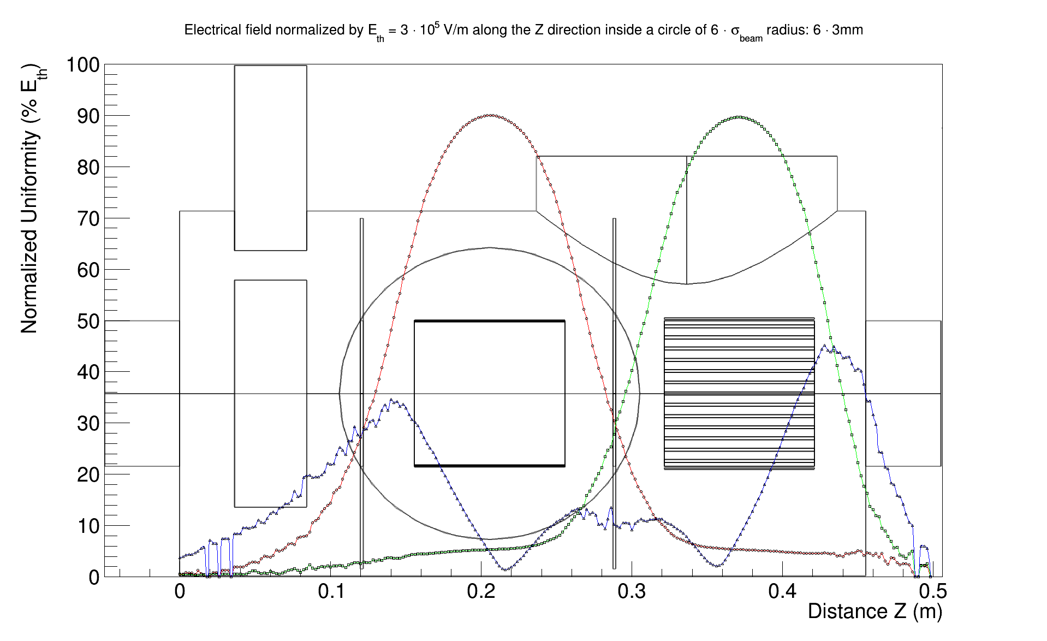
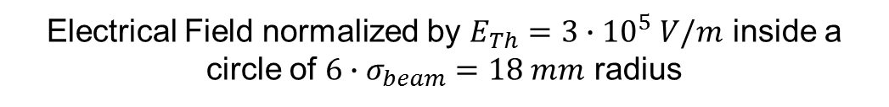
Asymmetric without any correction
Electrical Field normalized by $E_{Th}=3∙{10}^{5} V/m$ inside a circle of $6∙σ_{beam}=18 mm$ radius

Slide 15
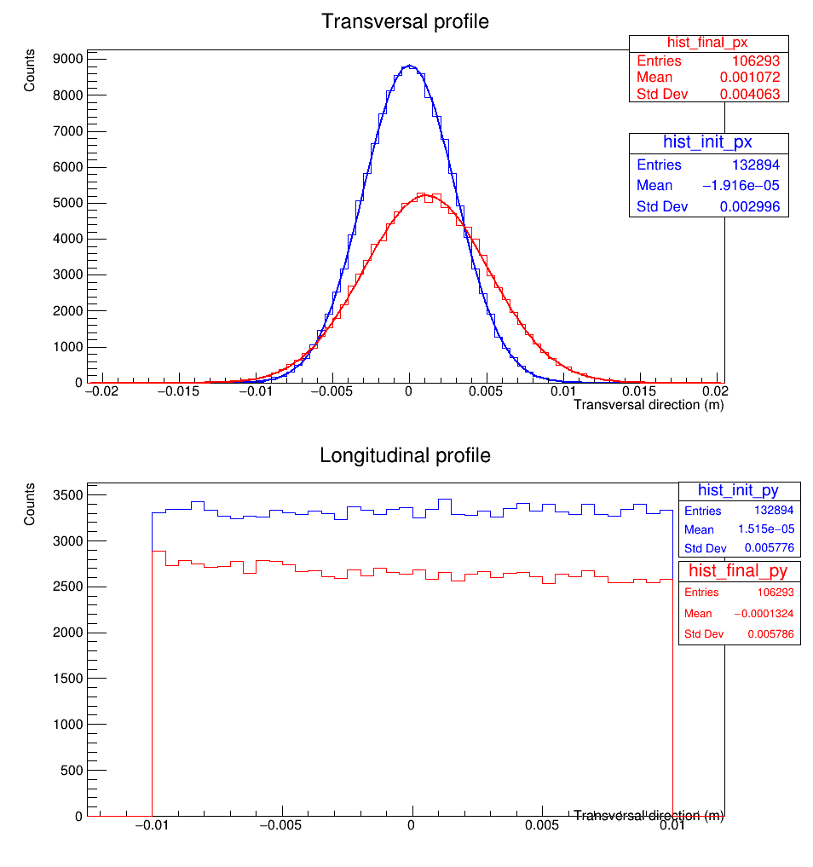
Tracking asym. WITHOUT ANY CORRECTION
Shift
Error on profile: +35%
Not acceptable !
Due to defocusing effect of asymmetric
21% of initial particles are “lost” also due to defocusing effect.

Slide 16
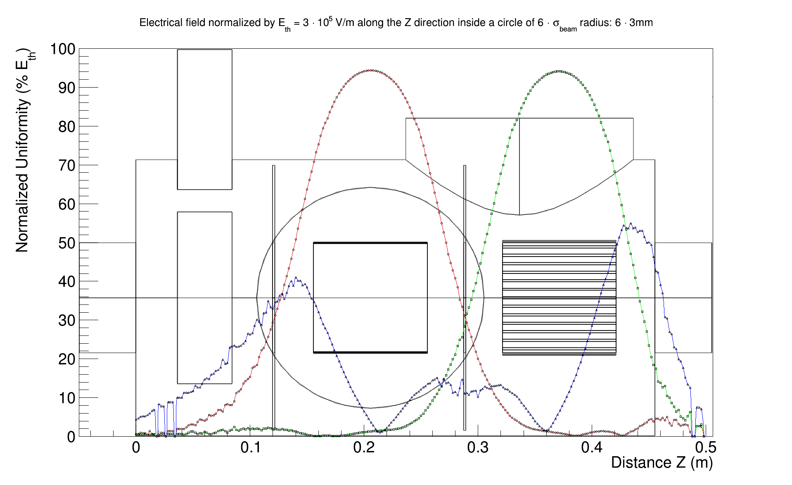
Asymmetric (CORRECTORS)
Electrical Field normalized by $E_{Th}=3∙{10}^{5} V/m$ inside a circle of $6∙σ_{beam}=18 mm$ radius

Slide 17
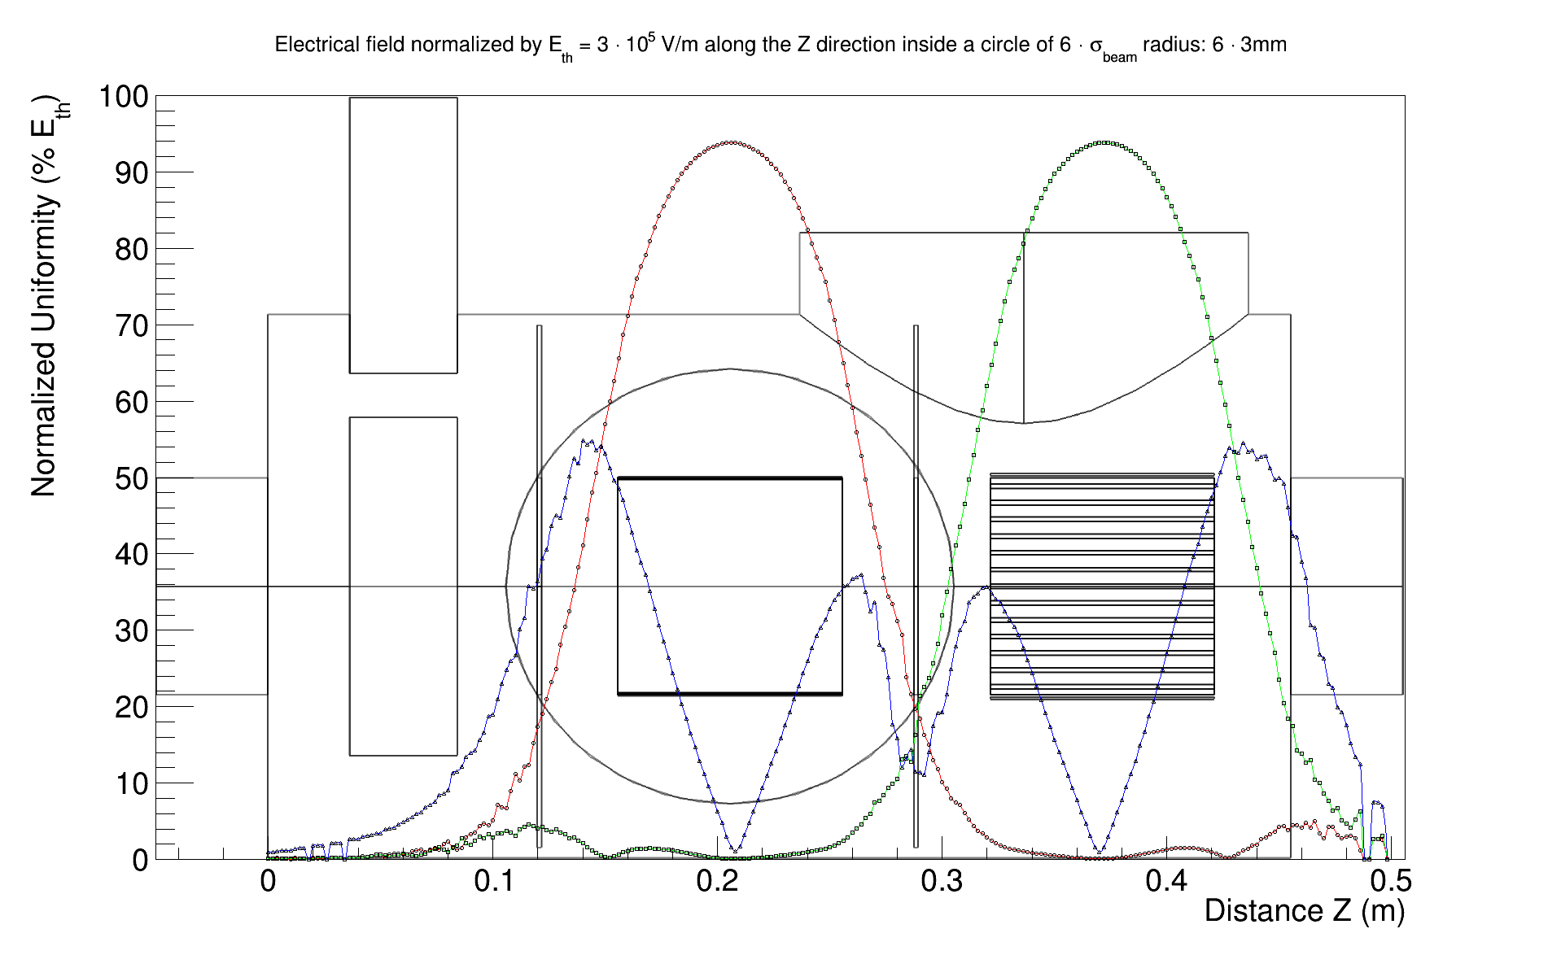
Asymmetric (DISKs + correctors)
Electrical Field normalized by $E_{Th}=3∙{10}^{5} V/m$ inside a circle of $6∙σ_{beam}=18 mm$ radius

Slide 18
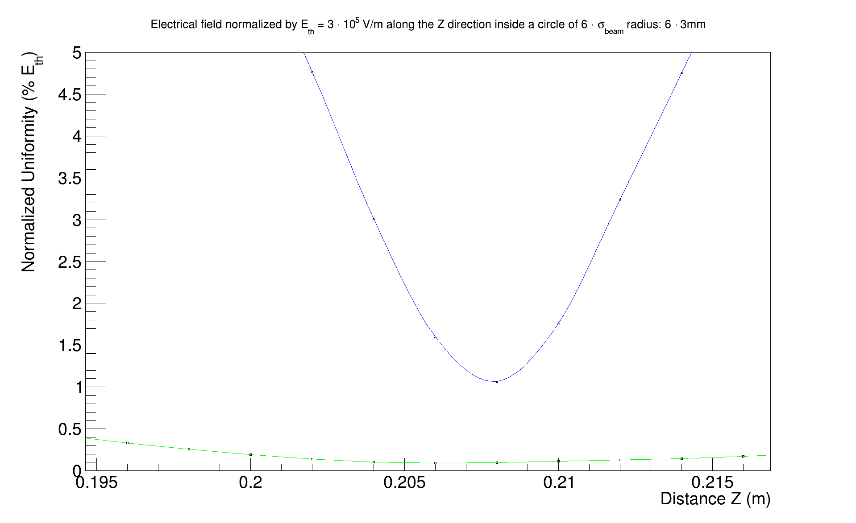
Asymmetric (DISKs + correctors) ZOOM
Electrical Field normalized by $E_{Th}=3∙{10}^{5} V/m$ inside a circle of $6∙σ_{beam}=18 mm$ radius

Slide 19
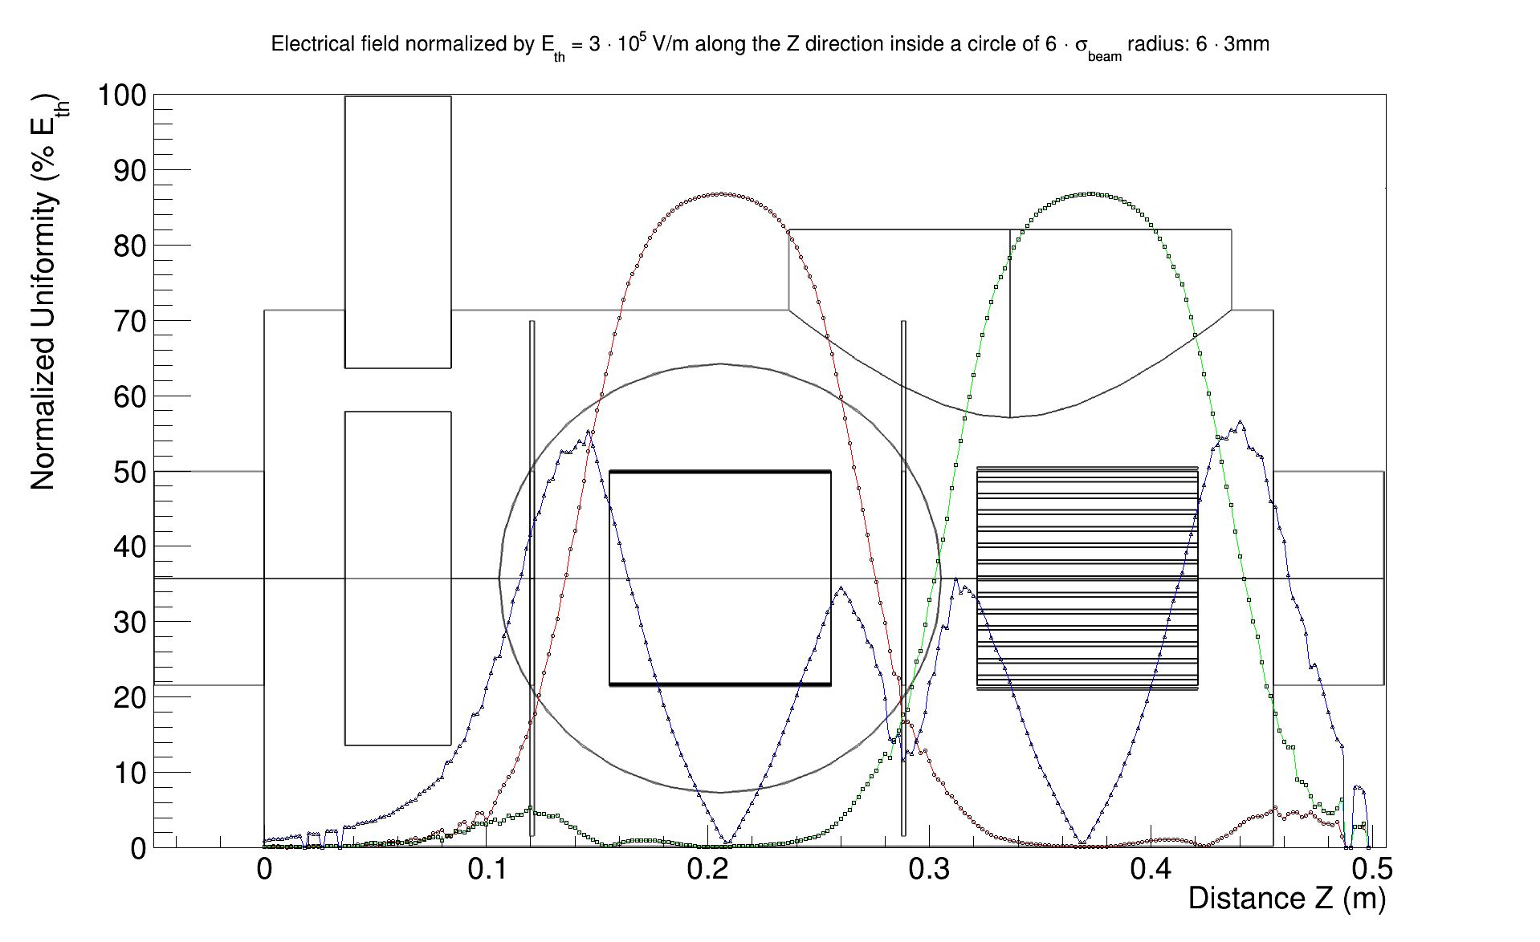
Asym. (DISKs + correctors + CURVED)
Electrical Field normalized by $E_{Th}=3∙{10}^{5} V/m$ inside a circle of $6∙σ_{beam}=18 mm$ radius

Slide 20
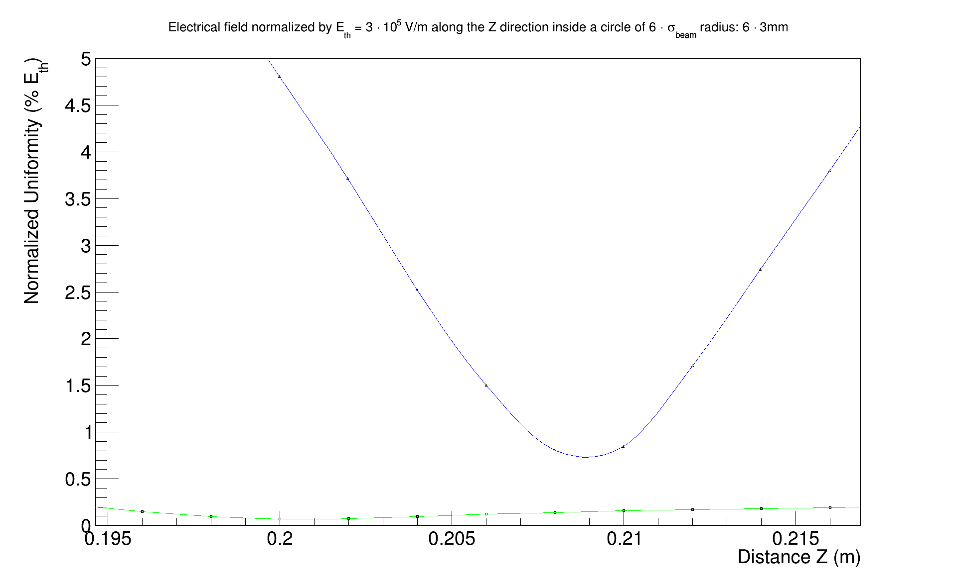
Asym. (DISKs + correctors + CURVED) ZOOM
Electrical Field normalized by $E_{Th}=3∙{10}^{5} V/m$ inside a circle of $6∙σ_{beam}=18 mm$ radius

Slide 21
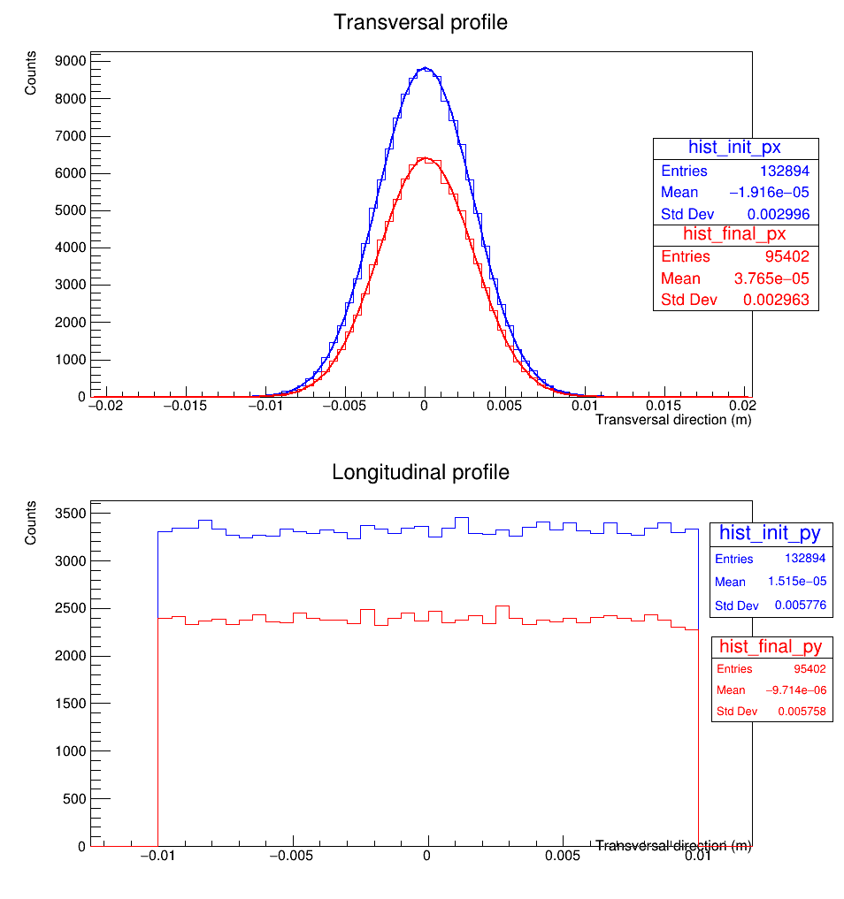
Tracking asym. (DISKS + CORRECTORs)
No more shift
Error on profile: 1,1%
But now 29% of initial particles are “lost”

Slide 22
symmetric IPM

Slide 23
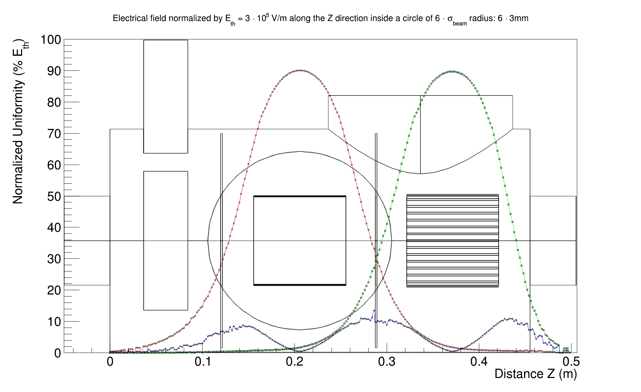
Symmetric (without any correction)
Electrical Field normalized by $E_{Th}=3∙{10}^{5} V/m$ inside a circle of $6∙σ_{beam}=18 mm$ radius

Slide 24
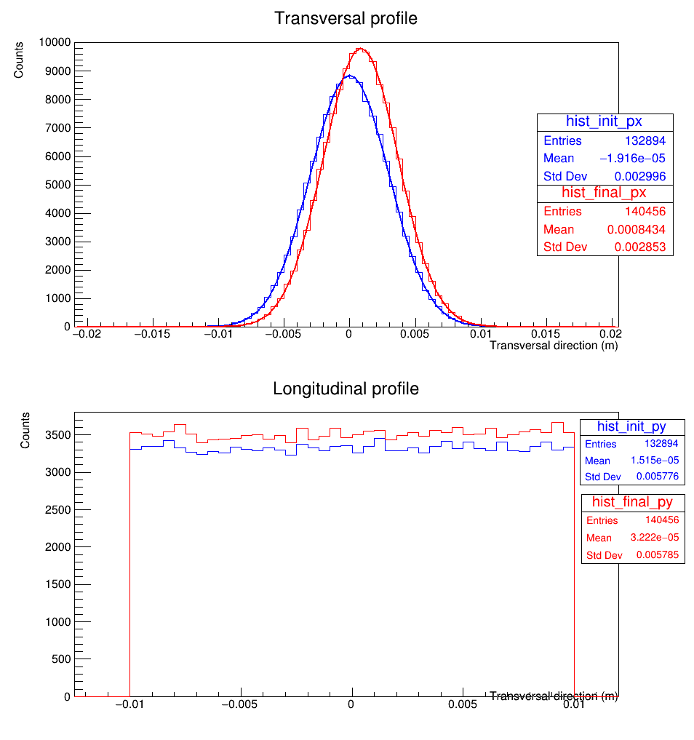
Tracking sym. (without any correction)
Small shift
Error on profile: -4%
Without correction !
Due to focusing effect of symmetric
5% more particles
Due to focusing effect of symmetric

Slide 25
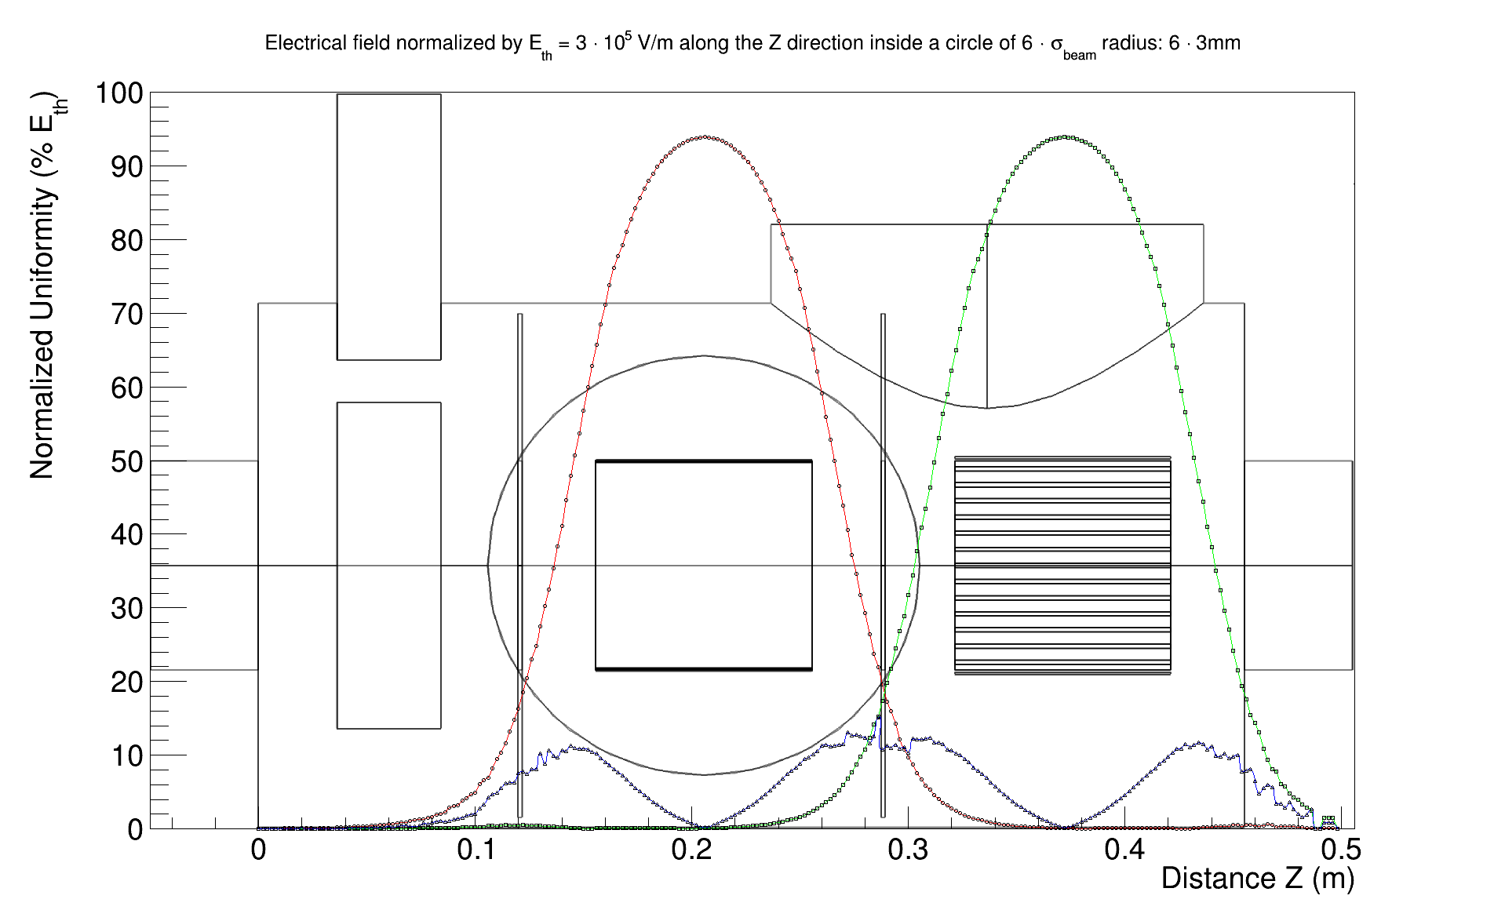
symmetric (DISKs + correctors)
Electrical Field normalized by $E_{Th}=3∙{10}^{5} V/m$ inside a circle of $6∙σ_{beam}=18 mm$ radius

Slide 26
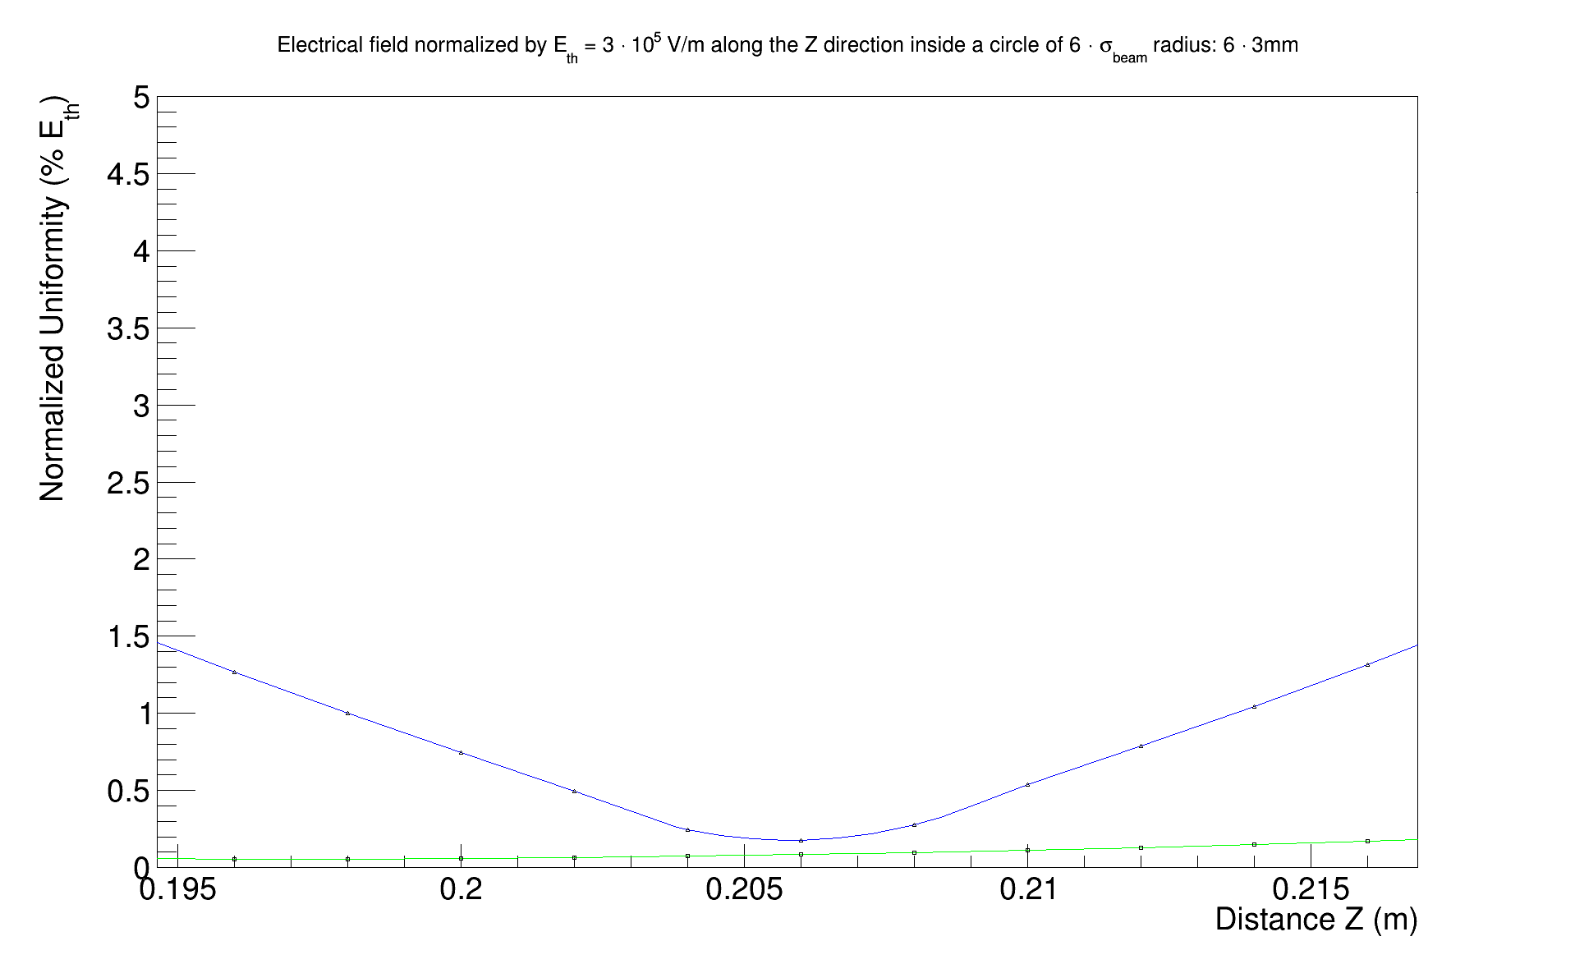
Symmetric (DISKs + correctors) ZOOM
Electrical Field normalized by $E_{Th}=3∙{10}^{5} V/m$ inside a circle of $6∙σ_{beam}=18 mm$ radius

Slide 27
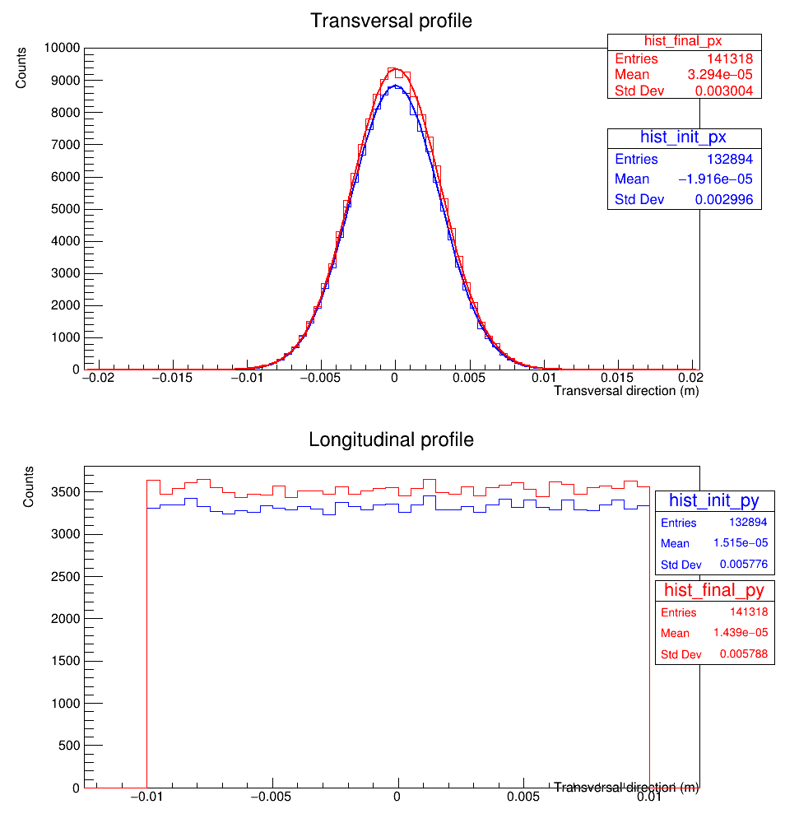
Tracking sym. (DISKs + CORRECTORS)
No more shift
Error on profile: +0.2%
5% more particles

Slide 28
Conclusions & outlooks
Conclusions
  The uniformity unlike other phenomena can be “hardware” corrected
  Correctors are mandatory in order to perform a good uniformity
  Disk are the easiest and efficient way to isolate IPM
  Curved electrodes may not be useful since our IPM are “big”
Outlooks
  Add “noise” to simulation
      Magnetic background
      Other BI systems
      Etc.
  Investigate more on error in analysis process
  Continue to improve and keep up to date the simulation model/analysis code

Slide 29
Thank for you attention
-
Questions ?

Slide 30
Backup SLIDES
BI FORUM #4

Slide 31
Beam physics – beam envelopes
NPM locations in cold linac

Slide 32
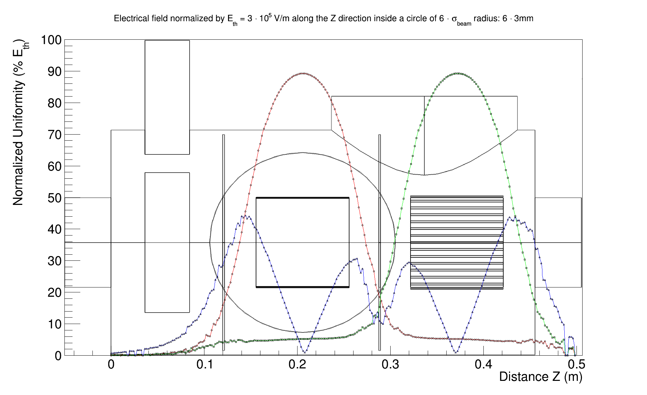
Asymmetric (with DISKs)
Electrical Field normalized by $E_{Th}=3∙{10}^{5} V/m$ inside a circle of $6∙σ_{beam}=18 mm$ radius

Slide 33
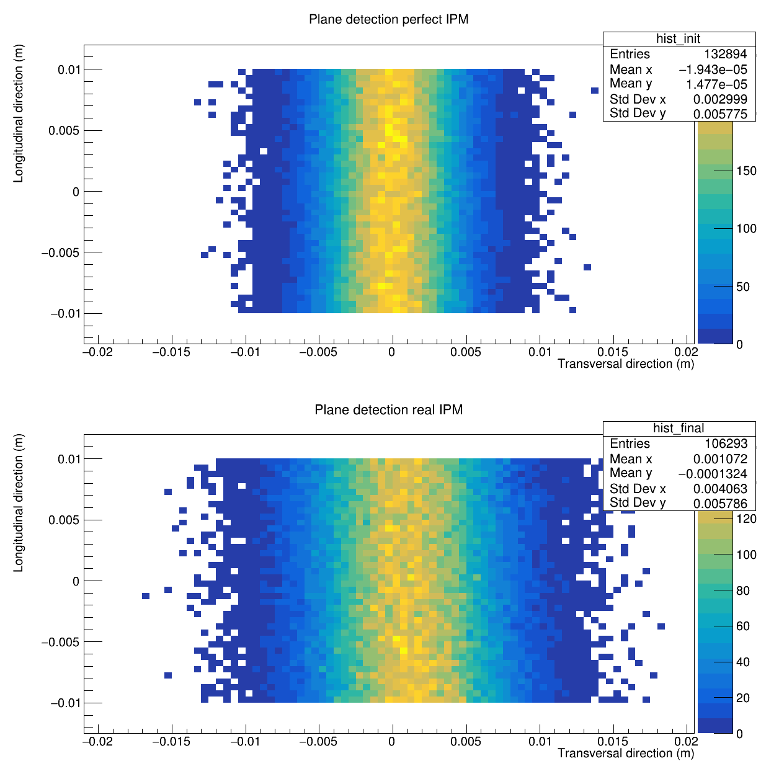
Tracking asym. WITHOUT ANY CORRECTION

Slide 34
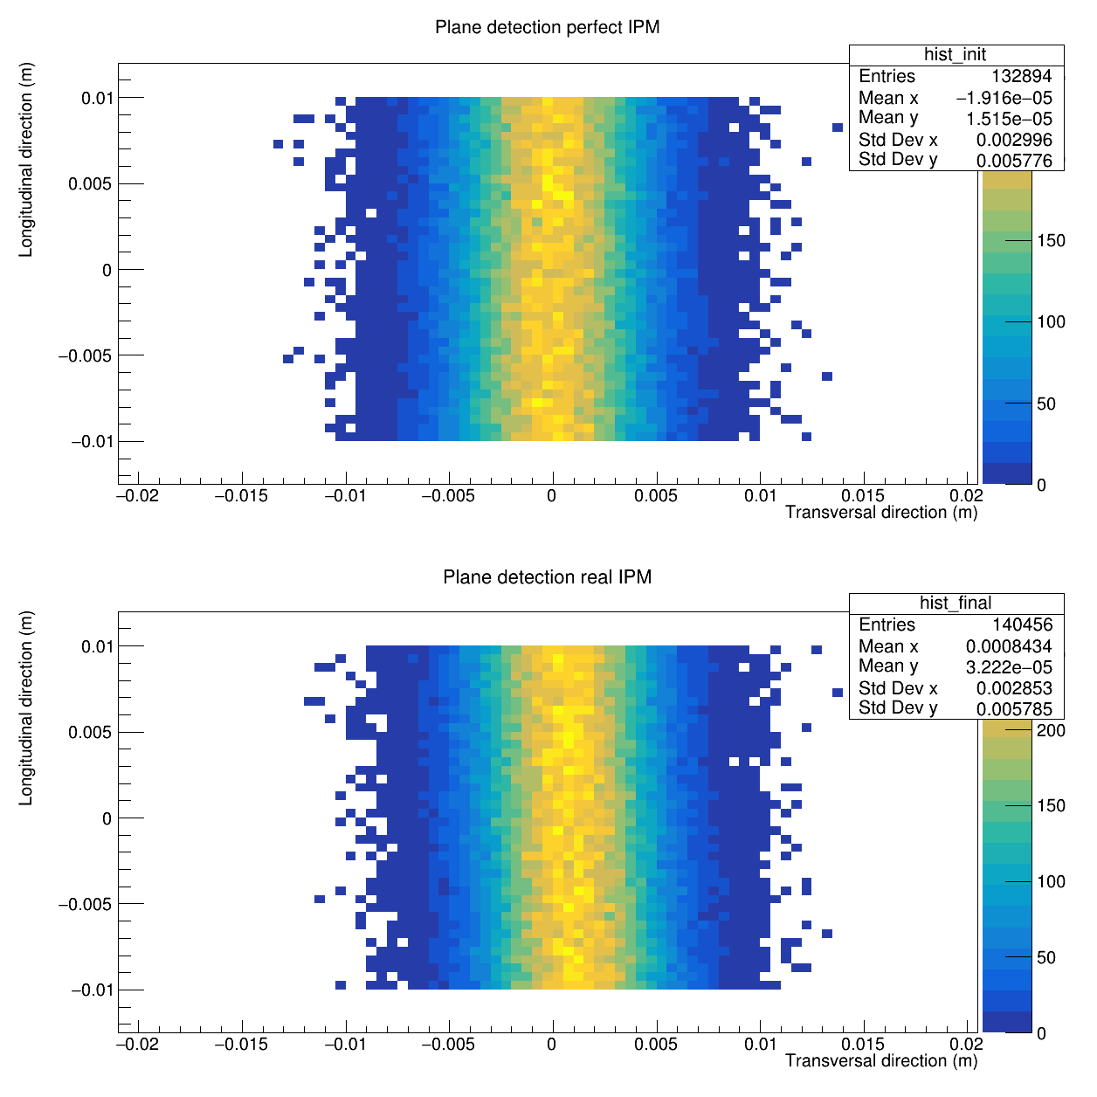
Tracking sym. WITHOUT ANY CORRECTION

Slide 35
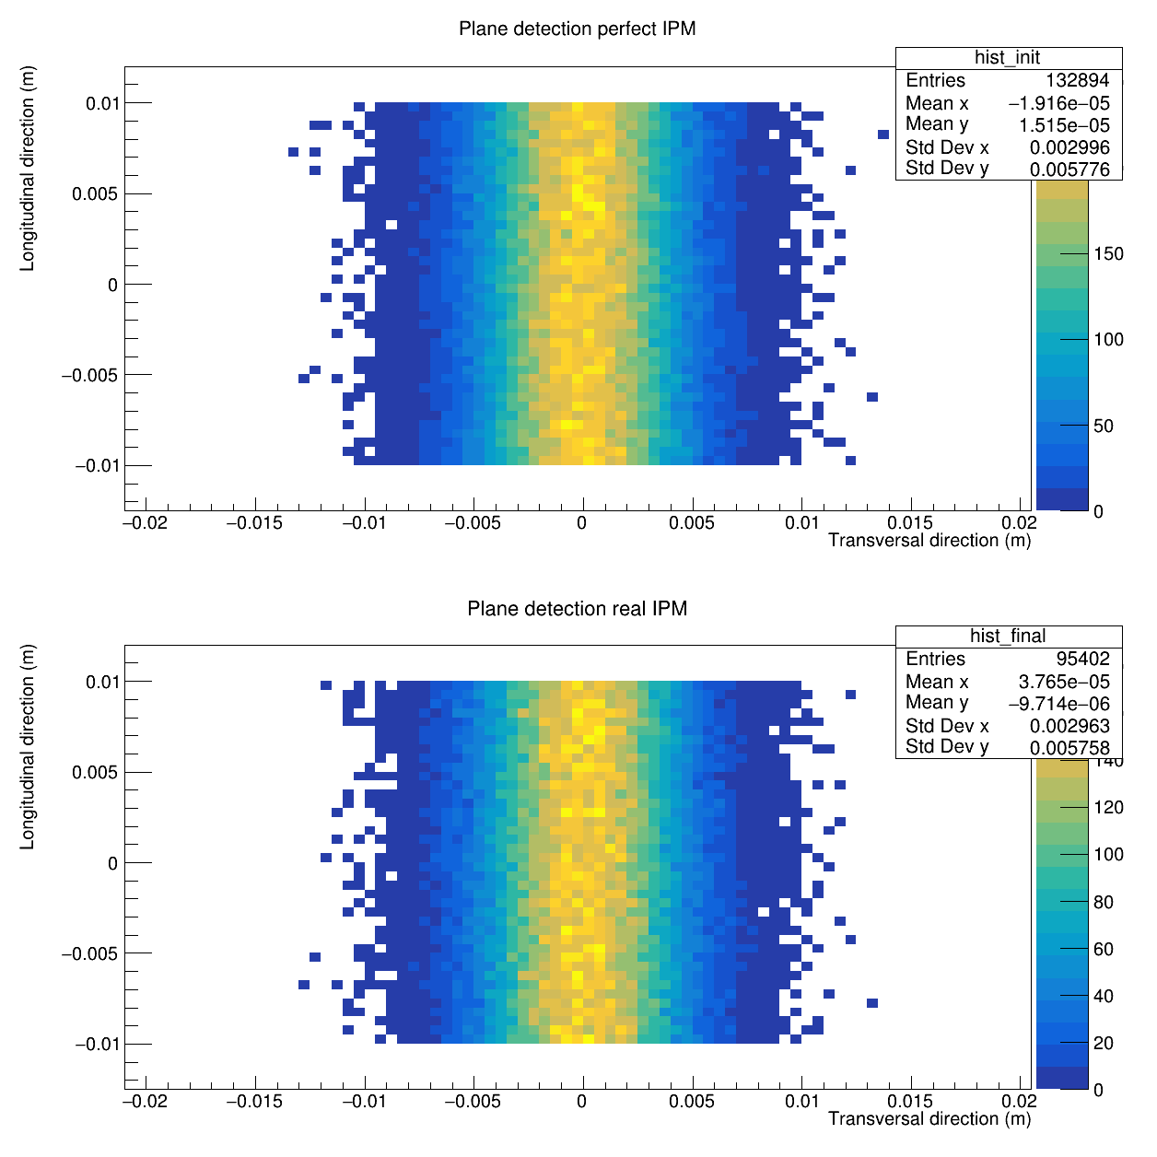
Tracking asym. WITh CORRECTIONs

Slide 36
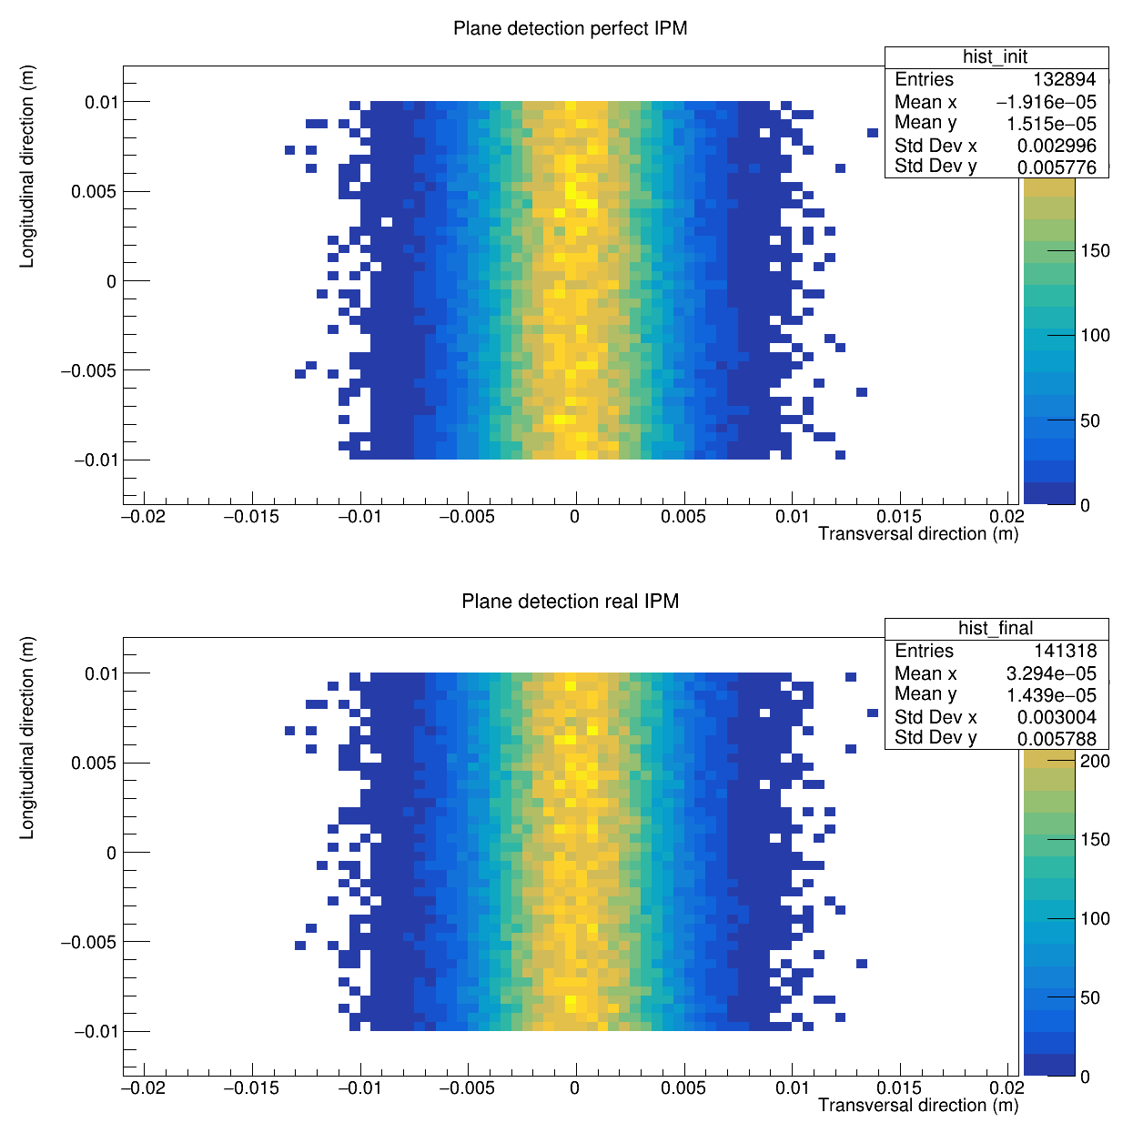
Tracking sym. WITH CORRECTIONs

