Slide 1
Notes:
Slide 1: Company Logo Full Page
Before you start editing the slides of your talk change to the Master Slide view:
Microsoft Office :Menu: View > Slide Master;
Macintosh – View > Master > Slide Master
Edit the following items:
On the Slide Master (first master slide) – lower area
a) On the left Delete the text and write the title of the event/Conference, Location
b) On the right delete the text and write the name and surname of the speaker and the date (day, month , year)
Close Master View
1

Slide 2
Wire Scanner AFE Electronics:
results from WS AFE tests at CERN LINAC4
2
Notes:
Slide 2: Title of the Presentation
Before you start editing the slides of your talk change to the Master Slide view:
Microsoft Office :Menu: View > Slide Master;
Macintosh – View > Master > Slide Master
Edit the following items:
On the Slide Master (first master slide) – lower area
a) On the left Delete the text and write the title of the event/Conference, Location
b) On the right delete the text and write the name and surname of the speaker and the date (day, month , year)
Close Master View
To start adding slides insert a new slide and select a Layout:
For Title & Subtitle
For text with bullet points
For Text
For Picture, graphs, visuals
Two columns
Blank
2

Slide 3
ESS WS tests @ CERN LINAC 4
Test phases
September 2017 @ elettra:
Test feasibility study
Test diagram definition
Preparation of cable adapters
10-11 Oct 2017 during LINAC4 shutdown: (M. Ferianis,S.Cleva, R. De Monte)
Installation of AFE in LINAC4 tunnel
Temporary installation of all acquisition electronics in LINAC4 Service area
Preliminary test without beam of ALL the electronics
Removing the temporary installation of all acquisition electronics
8-9 November 2017 during LINAC4 operations:(M. Ferianis,S.Cleva, R. De Monte)
Reinstall of all acquisition electronics in LINAC4 Service area for test
Tests the electronics with a real beam!
Remove ALL the electronics (including AFE from tunnel)

Slide 4
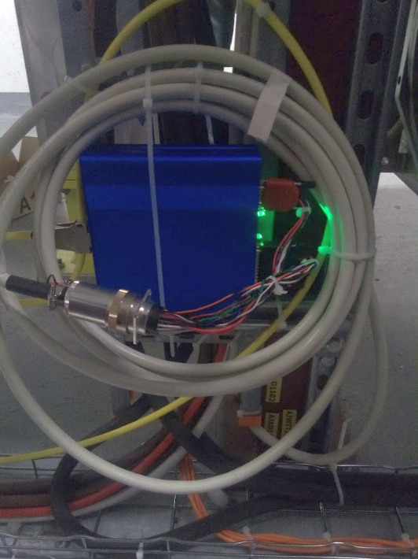
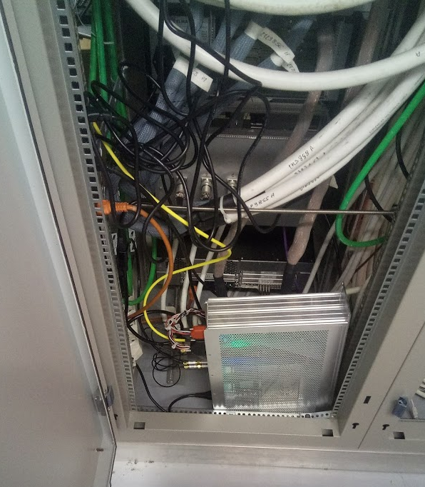
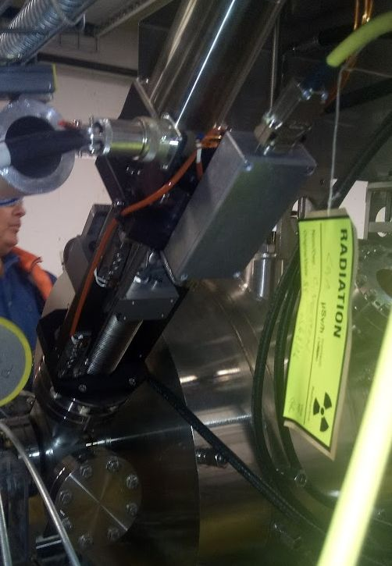
ESS WS tests @ CERN LINAC 4
Block Diagram
Twisted to
Triax
Adapter
(1)
ESS
WS
Analog
Front
End
DB9+DB25
To
BURNDY28
(2)
BURNDY28
BURNDY28
BURNDY28
to
DB9+DB25
(3)
ESS
WS
Back
End
16 bit
ADC
uTCA
System
Wire
Scanner
Patch
Box
DB9
4mt of
5pairs cable
Approx 60mt
14pairs cable
Legenda:
Existing L4 Hardware/cables
Existing Elettra/ESS WS Hardware
Adapers to be built

Slide 5
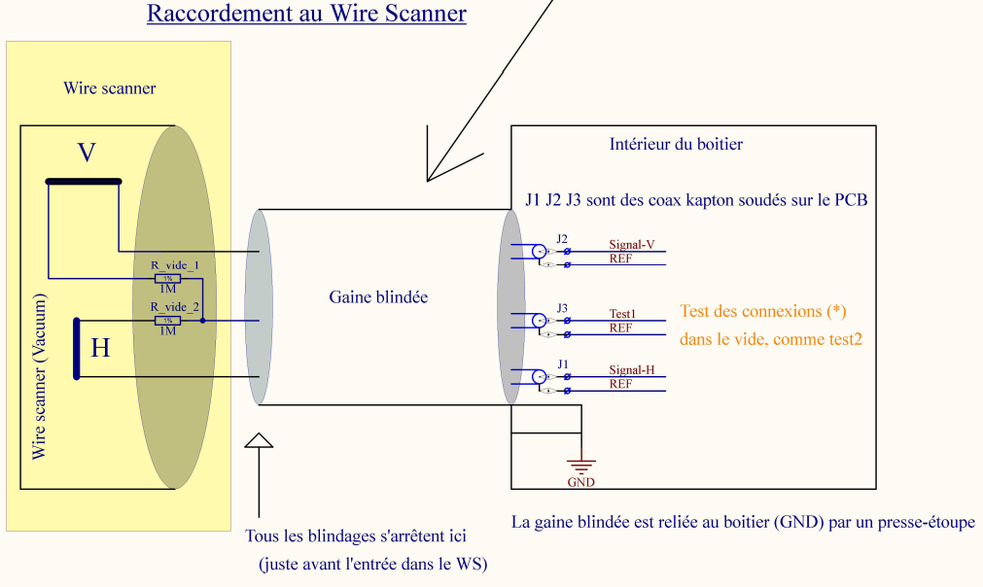
ESS WS tests @ CERN LINAC 4
CERN Linac4 WS diagram
Image courtesy of Jean Tassan-Viol

Slide 6
Simplified Block Diagram for AFE
Analog Front End
TWO IDENTICAL STAGES: Horizontal and Vertical
Single shield twisted
pair cable
Low gain
Wide range
RL1 *
+- 5VCC_HV
+-5VCC_BF
In vacuum
Single End
To
Differential
Differential
TX Buffer
LP
Filter
-
+
1M
1M
HIGH gain
Small range
RL2 *
LP
Filter
-
Single End
To
Differential
Differential
TX Buffer
+
To other plane
opamps
* Var gain 2 pos with relay
+-5VCC_BF
High voltage (+- 100VDC) Floating Ground
RL1
RL2
RL3
6
Notes:
Slide 3 – (..) : Content of the presentation
Insert a new slide: Home > “New Slide” and choose a slide Layout:
For Title & Subtitle
For text with bullet points
For Text
For Picture, graphs, visuals
Two columns
Blank
If you want Copy & paste an element from the Clip Board to the particular slide:
1. Click on a box to mark it.
2. Position the mouse pointer on the box frame: Copy!
3. Click on the particular slide: Paste!
How you intend to use the elements is your choice.
You can combine the text block style with the background colour in different manner.
6

Slide 7
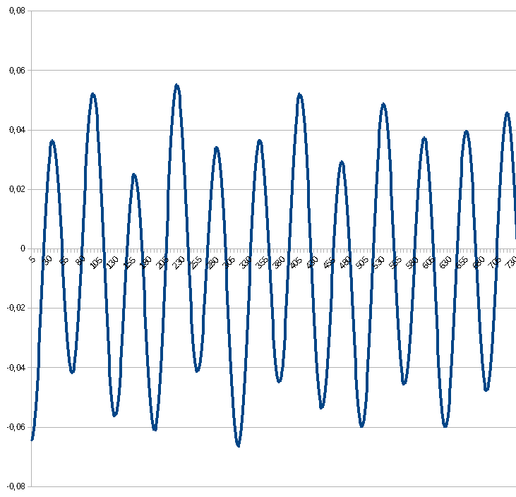
ESS WS tests @ CERN LINAC 4
First surprise!
10Msmps
Zoom
@125Msmps
Zoom
@125Msmps

Slide 8
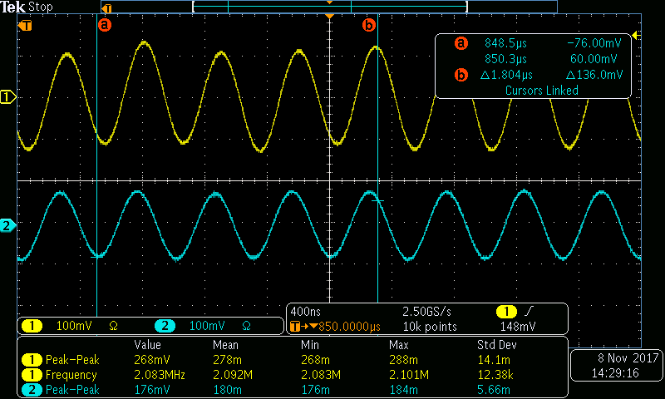
ESS WS tests @ CERN LINAC 4
Scope traces of Back End analog OUT

Slide 9
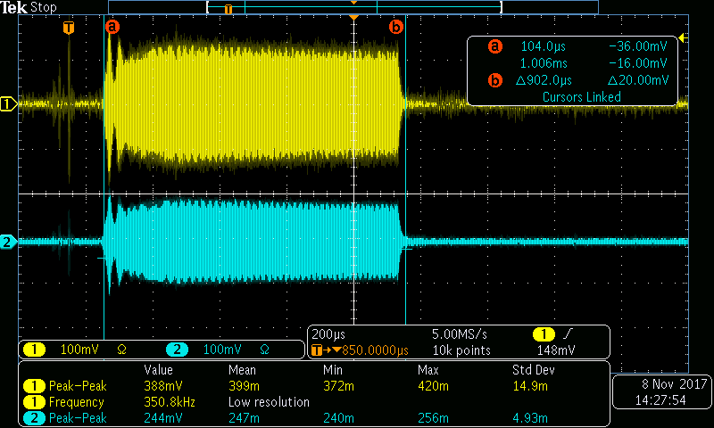
ESS WS tests @ CERN LINAC 4
2MHz burst duration 900us
Amp. = 380 and 244 mV pkpk

Slide 10
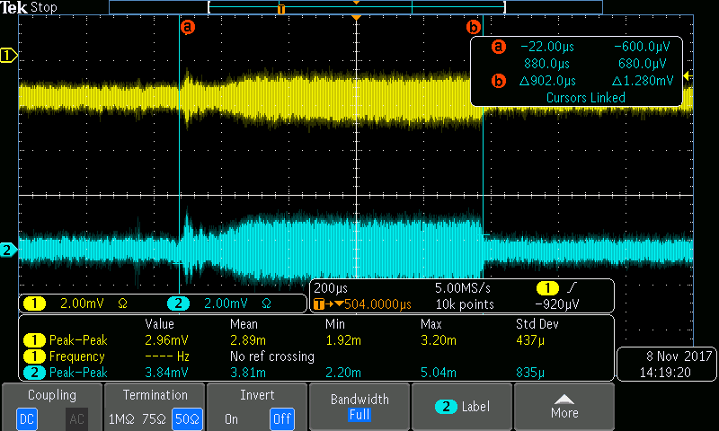
ESS WS tests @ CERN LINAC 4
Powering off the first stage of the AFE (+- 5VCC_HV OFF)

Slide 11
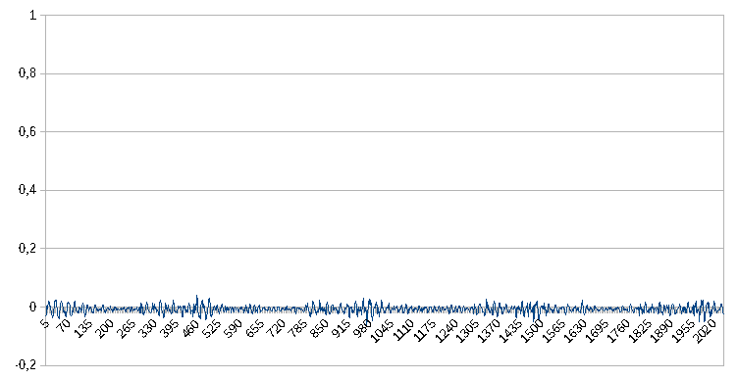
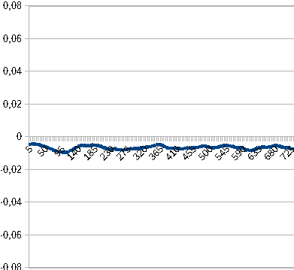
ESS WS tests @ CERN LINAC 4
With LINAC4 H- source OFF ,RF ON
Zoom
@125Msmps

Slide 12
ESS WS tests @ CERN LINAC 4
Electrical noises measurements
With RF ON
Worst case: HIGH gain channel
RMS value of 048 samples with klystrons ON
Without L4 beam source: 1.1mv RMS ≈ 150nA
With L4 beam source: 6 mv RMS ≈ 750nA
Making a mean of 100 or more ADC samples can reduce the effect by a factor of 10. Note that the L4 source 2 MHz signal is constant and in phase with the beam.

Slide 13
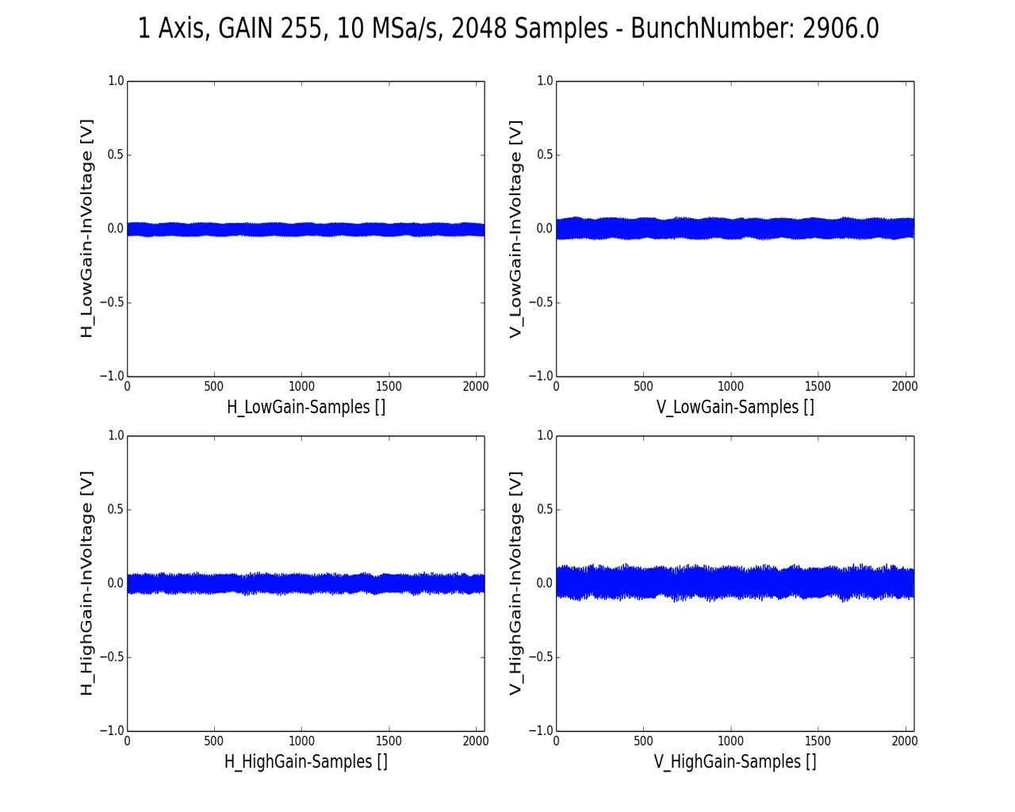
ESS WS tests @ CERN LINAC 4
Acquisitions
According to standard LINAC4 WS motion scheme, the wire first go completely out in fast mode, then the measure will start always in the same direction (out to in)
Thanks to S. Cleva for this animation

Slide 14
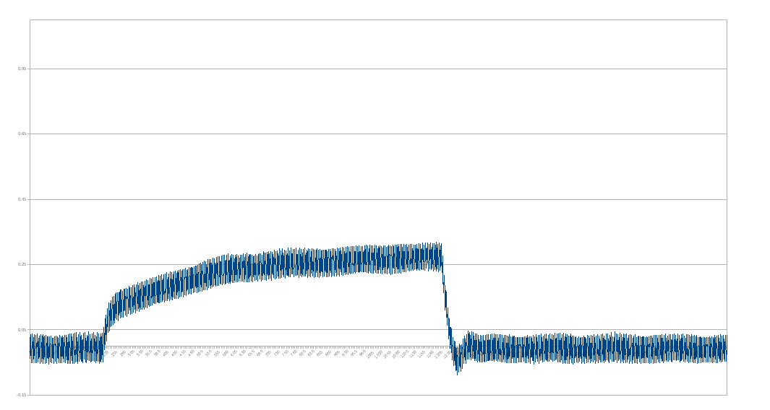
ESS WS tests @ CERN LINAC 4
Signal charge computation
To calculate the A.U. value for the beam profile plot we use a simple integral value
(simple sum) of samples from 900 to 1100 that are more “quiets” than previous (head)
or subsequents (tail)
A good idea is to make these parameters configurable in the user interface of the beam profile measurement system
1
230
900
1100
1230
2048

Slide 15
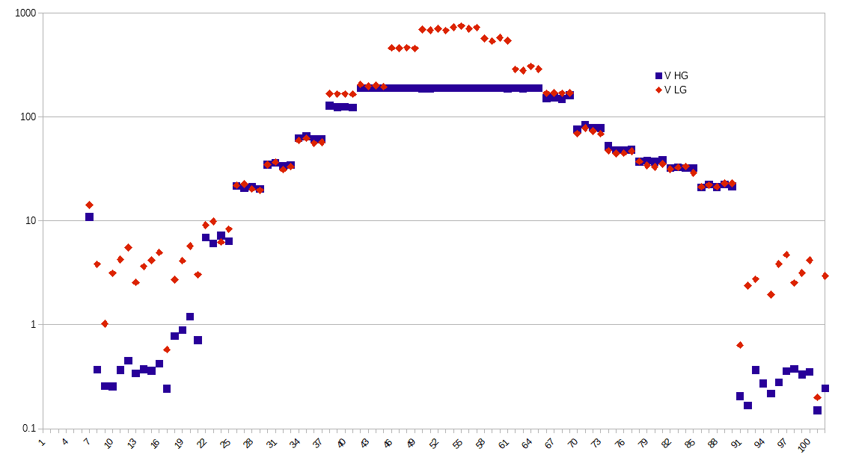
ESS WS tests @ CERN LINAC 4
Horizontal Beam Profile (LowGain Mode)
Plot of raw data from single acquisition

Slide 16
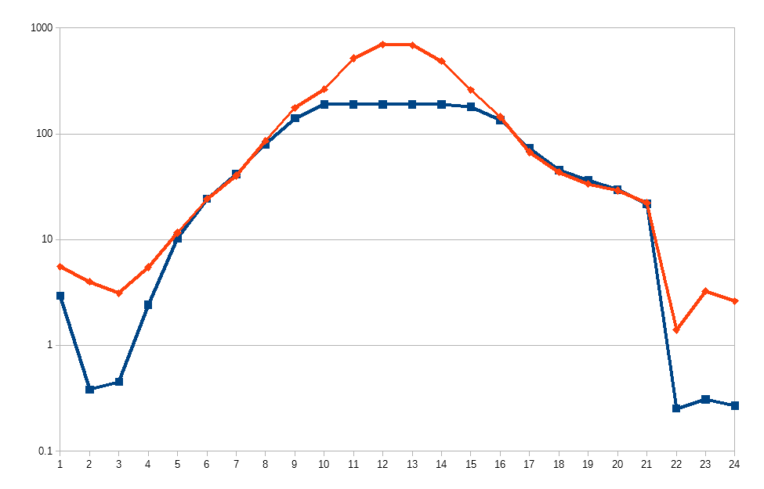
ESS WS tests @ CERN LINAC 4
Horizontal Beam Profile (LowGain Mode)
Average of 4 acqs per dot

Slide 17
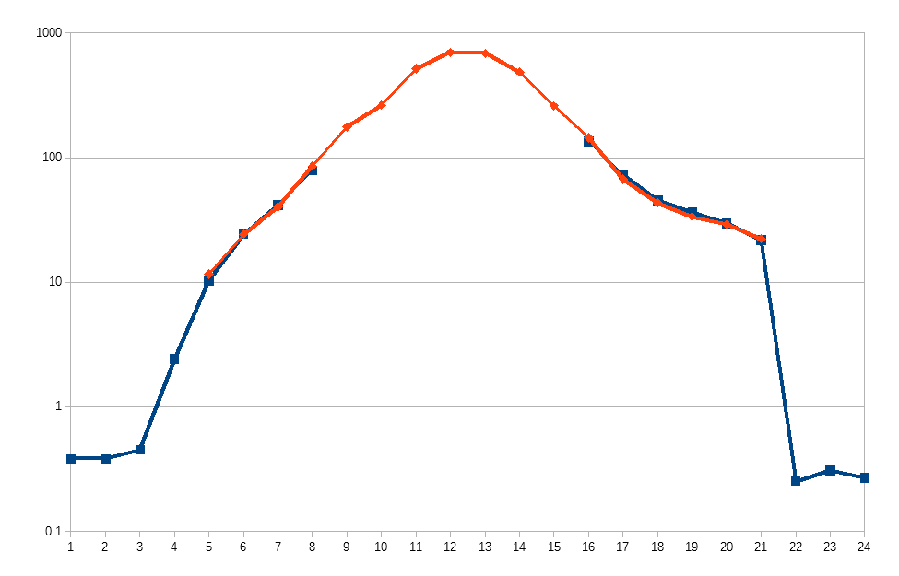
ESS WS tests @ CERN LINAC 4
Horizontal Beam Profile (LowGain Mode)
Plot of the COMBINATION
of the two input stages

Slide 18
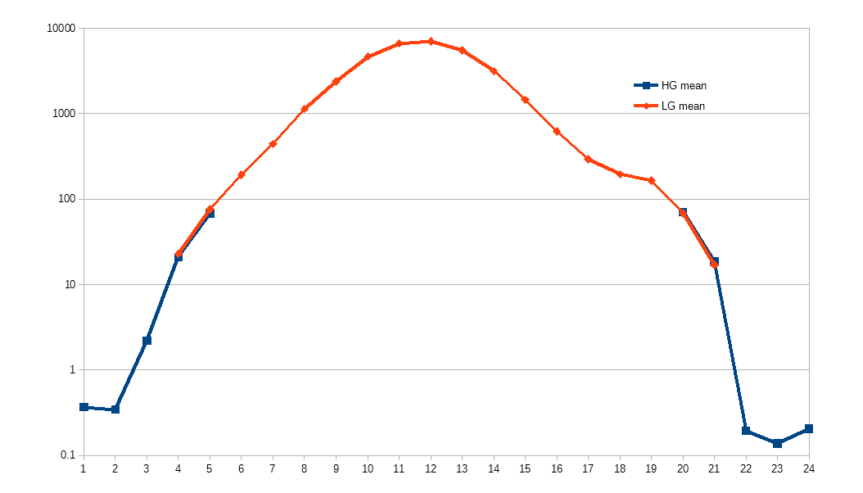
ESS WS tests @ CERN LINAC 4
Horizontal Beam Profile (HighGain Mode)
Plot of the COMBINATION
of the two input stages

Slide 19
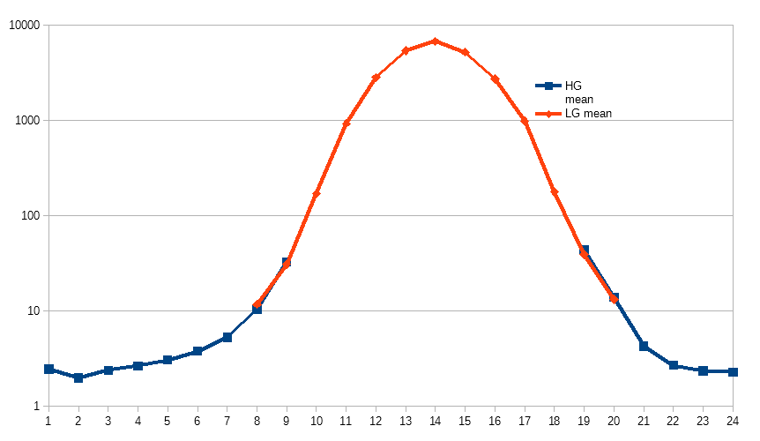
ESS WS tests @ CERN LINAC 4
Vertical Beam Profile (HighGain Mode)

Slide 20
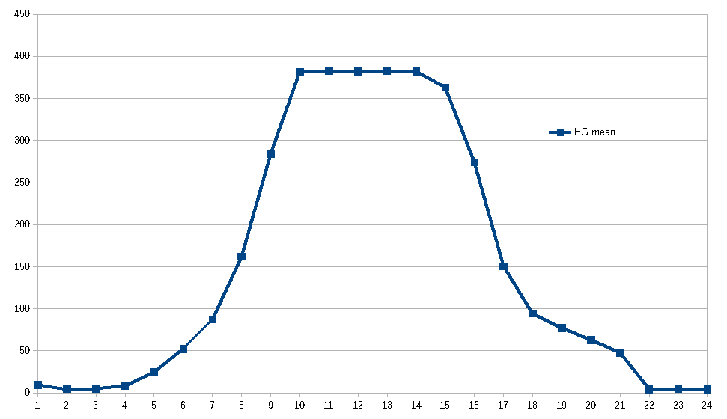
ESS WS tests @ CERN LINAC 4
Vertical Beam Profile
Plot of the High Gain input stage in LINEAR scale
(more halo details?)

Slide 21
ESS WS tests @ CERN LINAC 4
Issues found
A minor fault has been observed in the Back End high voltage part that in certain conditions required a reset (an electrical disturb was affecting a feedback control) now fixed.
In this configuration the input cables with nA signals were multipolar and with unique shielding: a lot of noise was coming from there: note that the AFE was at 50cm from a waveguide
An issue with the EPICS acquisition system has been observed while the debug output was sent thru the network instead of local terminal
The 2MHz signal seems to be collected by the wires at the input, but in ESS installation the source will be completely different.
The klystrons noise wasn't affecting too much the measure (less than 1% → 0.01 on +- 1V → 0,1uA) Making a mean of 100 or more ADC samples can reduce the effect by a factor of 10
21
Notes:
21
Slide 3 – (..) : Content of the presentation
Insert a new slide: Home > “New Slide” and choose a slide Layout:
For Title & Subtitle
For text with bullet points
For Text
For Picture, graphs, visuals
Two columns
Blank
If you want Copy & paste an element from the Clip Board to the particular slide:
1. Click on a box to mark it.
2. Position the mouse pointer on the box frame: Copy!
3. Click on the particular slide: Paste!
How you intend to use the elements is your choice.
You can combine the text block style with the background colour in different manner.
21

Slide 22
ESS WS tests @ CERN LINAC 4
Considerations /Conclusions
The working principle of the extended range analog front end has been tested with a real beam and it works as expected
The signal cables and all the current detection part should be shielded as much as possible
The 2MHz signal coming from L4 source is affecting our measure, but also with this big issue we measure with a 4 decades range
Without this disturb, at least a factor of 5 will get back
A laboratory calibration is possible using the in house developed “wire scanner electronic simulator” because we tested that is very similar to the real beam
An automated calibration procedure, using a programmable pulse generator and our “wire scanner electronic simulator” will be performed to create an exhaustive calibration table that will be used by the software to use as best as possible the combination of the two amplifiers (LO and HI gain)
22
Notes:
22
Slide 3 – (..) : Content of the presentation
Insert a new slide: Home > “New Slide” and choose a slide Layout:
For Title & Subtitle
For text with bullet points
For Text
For Picture, graphs, visuals
Two columns
Blank
If you want Copy & paste an element from the Clip Board to the particular slide:
1. Click on a box to mark it.
2. Position the mouse pointer on the box frame: Copy!
3. Click on the particular slide: Paste!
How you intend to use the elements is your choice.
You can combine the text block style with the background colour in different manner.
22

Slide 23
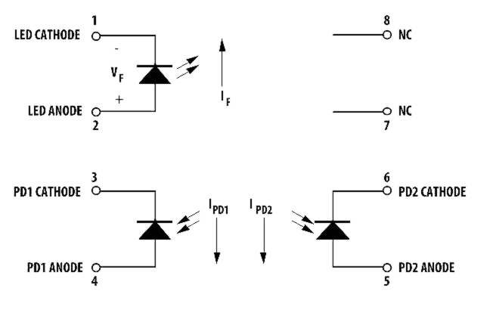
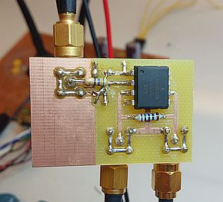
Wire scanner
electronic simulator
PULSER
HCNR201
High-Linearity Analog Optocoupler
VAR AMP
V LED | uA Tot
1,300 | 0,1
1,421 | 0,5
1,449 | 1
1,530 | 5
1,590 | 10
1,691 | 20
1,791 | 30
1,867 | 40
1,952 | 50
2,380 | 100
3,110 | 160
3,500 | 200
4,800 | 300
R_wire
100R
I_w 1
I_w 2
R_wire simulate the wire resistance in the two possibile
conditions: tungsten or carbon
23
Notes:
Slide 3 – (..) : Content of the presentation
Insert a new slide: Home > “New Slide” and choose a slide Layout:
For Title & Subtitle
For text with bullet points
For Text
For Picture, graphs, visuals
Two columns
Blank
If you want Copy & paste an element from the Clip Board to the particular slide:
1. Click on a box to mark it.
2. Position the mouse pointer on the box frame: Copy!
3. Click on the particular slide: Paste!
How you intend to use the elements is your choice.
You can combine the text block style with the background colour in different manner.
23

Slide 24
Acknowledgments
In these two trips at CERN's LINAC4 we were able to learn a lot of useful information about the PRACTICAL operation of beam profile measurement in a real proton LINAC environment with Wire Scanner.
Many Thanks to:
Federico Roncarolo
Jean Tassan-Viol
all of the LINAC4 Beam diagnostics staff and
the LINAC4 operators
Thank you for your attention

Slide 25
Notes:
Last Slide 2: Aerial Photo of Elettra
25

Slide 26
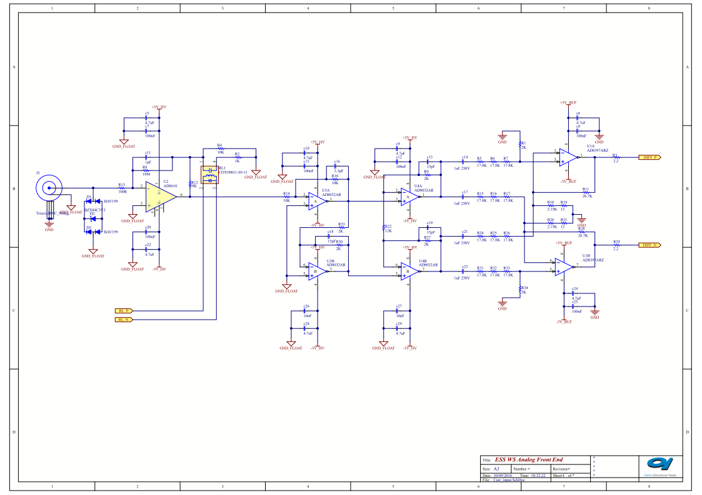
SPARE SLIDES
26
Notes:
26
Slide 3 – (..) : Content of the presentation
Insert a new slide: Home > “New Slide” and choose a slide Layout:
For Title & Subtitle
For text with bullet points
For Text
For Picture, graphs, visuals
Two columns
Blank
If you want Copy & paste an element from the Clip Board to the particular slide:
1. Click on a box to mark it.
2. Position the mouse pointer on the box frame: Copy!
3. Click on the particular slide: Paste!
How you intend to use the elements is your choice.
You can combine the text block style with the background colour in different manner.
26

Slide 27
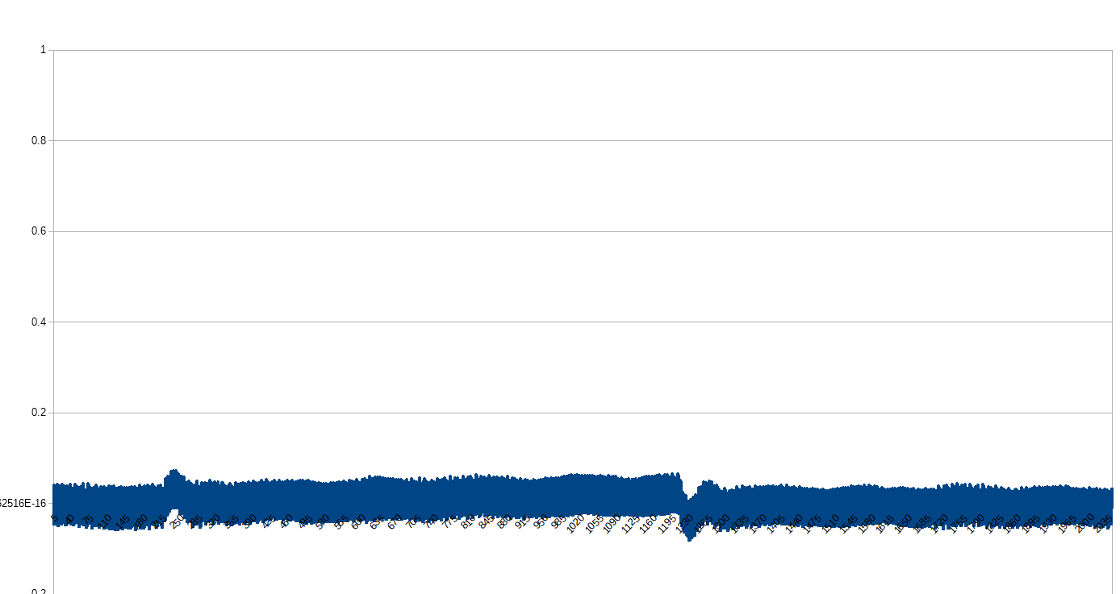
Low signal detection

Slide 28
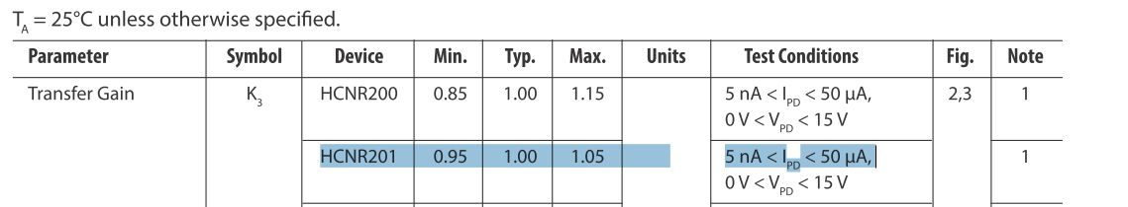
Wire scanner
electronic simulator
HCNR201
High-Linearity Analog Optocoupler
=
PULSER
Proton beam
VAR AMP
R_wire
10R to 1K
I_w 1
I_w 2
I_w 1
I_w 2
R_wire simulate the wire resistance in the two possibile
conditions: tungsten or carbon
28
Notes:
Slide 3 – (..) : Content of the presentation
Insert a new slide: Home > “New Slide” and choose a slide Layout:
For Title & Subtitle
For text with bullet points
For Text
For Picture, graphs, visuals
Two columns
Blank
If you want Copy & paste an element from the Clip Board to the particular slide:
1. Click on a box to mark it.
2. Position the mouse pointer on the box frame: Copy!
3. Click on the particular slide: Paste!
How you intend to use the elements is your choice.
You can combine the text block style with the background colour in different manner.
28

Slide 29
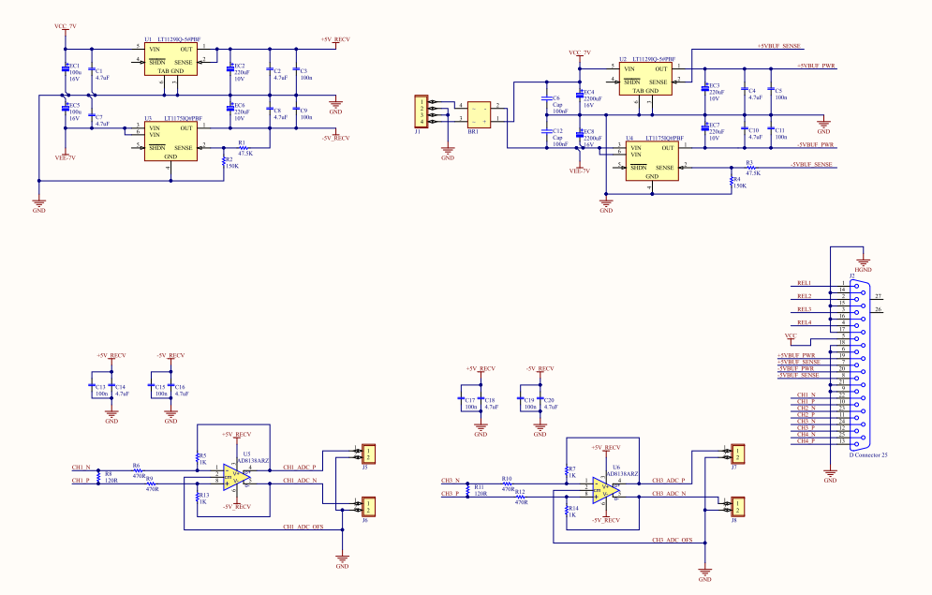
SPARE SLIDES

Slide 30
Analog Opto Current
Pulse Generator
Signal simulation:
It is necessary to generate two pulsed signals, equals and with ultra low currents to feed the AFE prototype.
Square Wave Pulses: from 10nA to 400µA , from 10µs to 100µs.
Commercial available current generators aren’t able to simulate this kind of signals.
We are using an in-house developed solution.
The beam's simulator is made using an analog high precision optocoupler driven by a pulser with variabile output.
The circuit is calibrated in DC, by driving the variable current/voltage circuit and reading the output with pico-ammeter.
Then the known current/voltage driving will be pulsed.
To validate this method we also put a DC current from Keythley picoAmpere source generator at the circuit input and we measure the corresponding voltage from TIA (Transimpedance Input Amplifier) at various currents from 100nA to 300µA .
30
Notes:
Slide 3 – (..) : Content of the presentation
Insert a new slide: Home > “New Slide” and choose a slide Layout:
For Title & Subtitle
For text with bullet points
For Text
For Picture, graphs, visuals
Two columns
Blank
If you want Copy & paste an element from the Clip Board to the particular slide:
1. Click on a box to mark it.
2. Position the mouse pointer on the box frame: Copy!
3. Click on the particular slide: Paste!
How you intend to use the elements is your choice.
You can combine the text block style with the background colour in different manner.
30

Slide 31
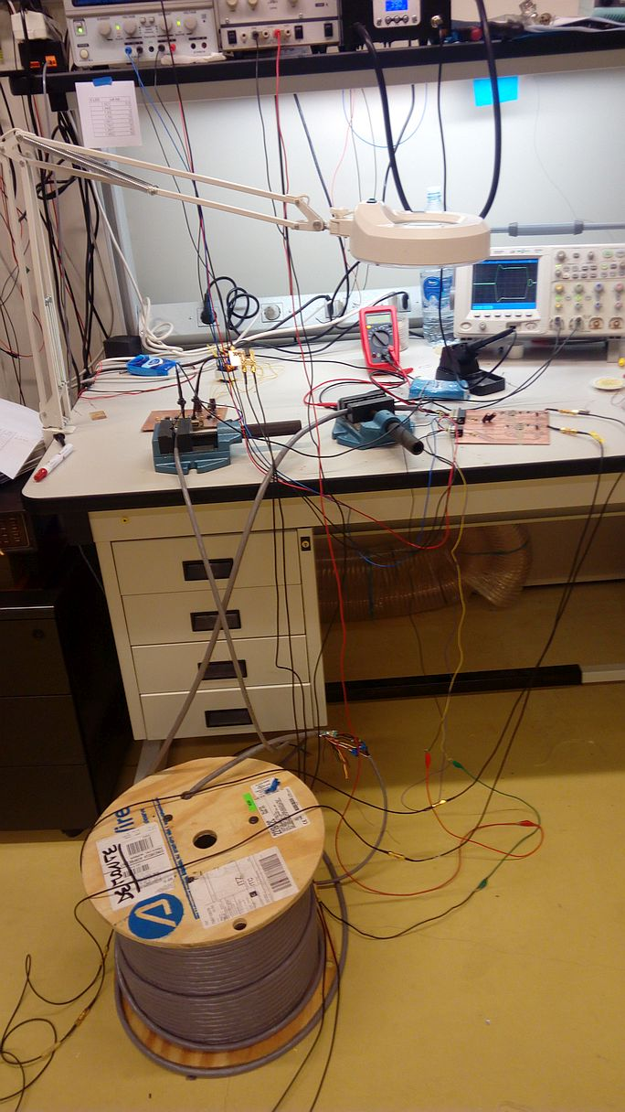
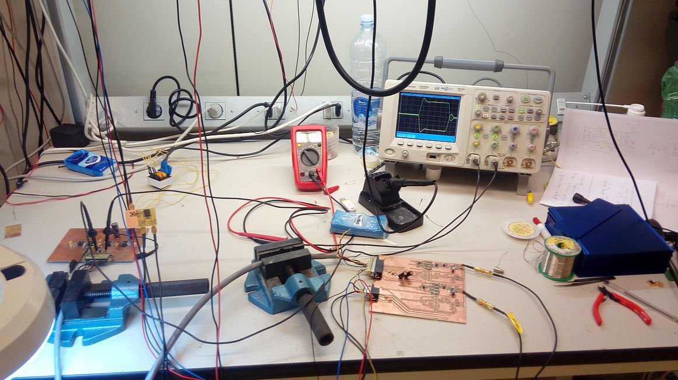
WSAS simplified system laboratory test bench
31
Notes:
31
Slide 3 – (..) : Content of the presentation
Insert a new slide: Home > “New Slide” and choose a slide Layout:
For Title & Subtitle
For text with bullet points
For Text
For Picture, graphs, visuals
Two columns
Blank
If you want Copy & paste an element from the Clip Board to the particular slide:
1. Click on a box to mark it.
2. Position the mouse pointer on the box frame: Copy!
3. Click on the particular slide: Paste!
How you intend to use the elements is your choice.
You can combine the text block style with the background colour in different manner.
31

