Slide 1
nBLM SYSTEM STATUS
Laura Segui
(laura.segui@cea.fr)
21/11/2017
4th ESS BI Forum

Slide 2
OUTLOOK
nBLM
Detector
Gas System
FEE
BEE and Control System

Slide 3
OUTLOOK
nBLM
Detector
Gas System
FEE
BEE and Control System
New Mechanics
Tests planned
Distribution and installation in ESS
Dedicated talk by Y. Mariette
General update
Dedicated talk by P. Legou

Slide 4
Motivation
nBLM → neutron Beam Loss Monitoring system based on the detection of fast neutrons with Micromegas detectors. + low sensitivity to gammas and X-Rays.
Objective: Protection + monitoring normal operation
To maintain accelerator activation at a low level (loss << 1 W/m)
For fine beam tuning purpose, particularly for high beam intensity
Machine Protection
Project to deliver and commission 42 modules (84 detectors) by April 2019
To be installed mainly in the DTL and Spokes regions: E_{proton} 3.6 – 216 MeV
Some will be tested also at higher energies
Why new BLM?
Complementary to the others ESS BLM systems
At low beam energy only neutrons and photons can escape beam pipe
Photons :
X-rays and γ’s are highly produced by the RFQ and superconductive cavities
Impossible to distinguish contributions coming from beam or RF…
Neutrons :
Thermal neutrons: no loss locations
Fast neutrons: good for beam loss representation
BLM insensitive to photons
BLM insensitive to thermal n’s
L. Segui 21/11/2017 – 4th ESS-BI Forum 1

Slide 5
PROJECt planning
Dec. 2017: CDR1.1
Jun 2017: PDR1.2 Start prototype tests
Dec 2016: PDR1.1
Oct 2018:
SAR vertical integration test
April 2018: CDR1.2 (Final)
ESS commissioning 2019
→ Juillet 2016: kick-off meeting
→ Déc. 2016: PDR1.1
First design of the prototype
MC studies
July 2017: Final PDR + 1st prototypes tests
Dec. 2017 CDR1.2 + new detector design
Nov 2017 – Avril 2018 tests at different radiation facilities
Avril 2018: CDR1.2 Final
Avril-Oct 2018: Detector production and QA/QC
System delivered to ESS Nov. 2018
ESS hand over: April 2019
L. Segui 21/11/2017 – 4th ESS-BI Forum 2

Slide 6
nBLM Detectors
Two types of detectors: slow and fast
Different physical reaction to create the charged particles from the neutrons
Different applications
 | SLOW | FAST
Convertor | B₄C | Mylar or Polypropylene
Reaction | (n,α)¹⁰B | (n,p)
Signal | Fast neutrons after moderation | Fast neutrons
Detected energy | ~constant | Continuum distribution of energies
Sensitivity | 10⁻⁶ < En < 100 MeV | En > 0.5 MeV
Solid angle | 4π | 2π, n coming from the front only
Efficiency | ~few n·cm^{-2·}s⁻¹ | ~10-100 times smaller
Response time | ~200µs | ~0.01µs
Objective | Monitoring of small losses | Alarm (in 5 µs) Fine structure of the lost
Shielding | Yes, for thermal neutrons | Not needed
L. Segui 21/11/2017 – 4th ESS-BI Forum 3

Slide 7
nBLM Detectors
Two types of detectors: slow and fast
SLOW
FAST
Absorber shielding
Detection of fast neutrons after moderation in polyethylene (~4cm)
Gas chamber with layer of B4C
(n, α) ¹⁰B reaction
More efficient, 4π, but slower response
Recoil protons produced by neutrons in polypropylene
High flux high energy n's (>0.1 MeV)
Faster response
Just the gas chamber with polypropylene at the cathode
Polyethylene moderator
n,
γ
n,
γ
Aluminium chamber
Plastic deposited on Al
He+CO₂ gas
MMs detector
Borated rubber (1mm)
Polyethylene (4cm)
Aluminium chamber
B4C deposited on Al
He+CO₂ gas
MMs detector
L. Segui 21/11/2017 – 4th ESS-BI Forum 4

Slide 8
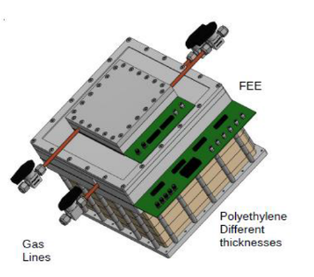
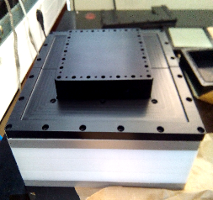
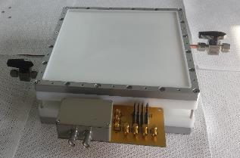
nBLM Detectors
Two types of detectors: slow and fast
SLOW
FAST
Absorber shielding
Detection of fast neutrons after moderation in polyethylene (~4cm)
Gas chamber with layer of B4C
(n, α) ¹⁰B reaction
More efficient, 4π, but slower response
Recoil protons produced by neutrons in polypropylene
High flux high energy n's (>0.1 MeV)
Faster response
Just the gas chamber with polypropylene at the cathode
L. Segui 21/11/2017 – 4th ESS-BI Forum 4

Slide 9
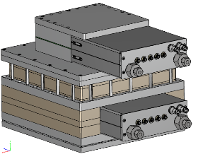
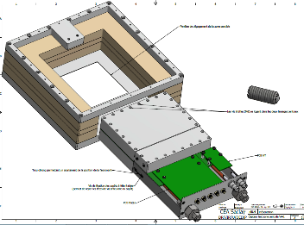
nBLM Detectors
New detectors design
New mechanics to improve electronic shielding
More compact, easier for installation, more “industrialized”
All connections in front
Same mechanics for fast /slow
New electronics: mezzanine cards
One for signals + PAs; another for HV
Fastr replacement
Easier to test different options → no need to change detector
More details in Philippe’s talk
Design of closed gas recirculation system via an oxisorb filter
Needed for tests at LINAC 4
Signal, HV, LV, gas connectors
Mezzanine card
New
Design
Old Design
L. Segui 21/11/2017 – 4th ESS-BI Forum 5

Slide 10
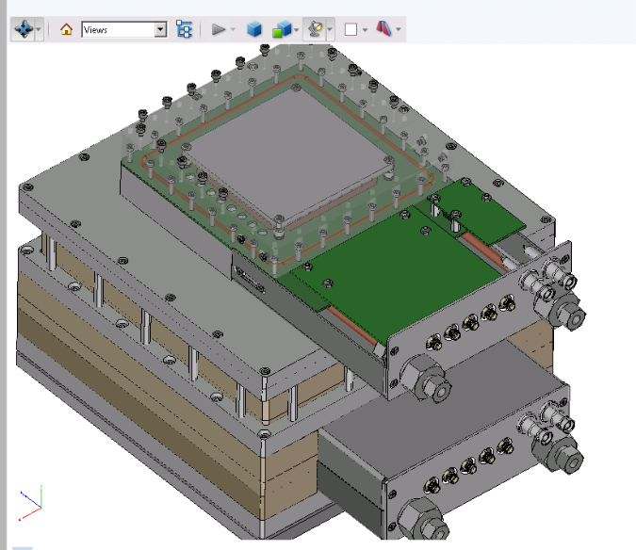
nBLM Detectors – new design

Slide 11
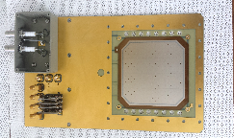
New Detector production
Mechanics
Initially construct 4 chambers → for Dec 2017
When finalized, ~90 chambers
Production to start in ~June 2018
Micromegas
3x3 detectors per PCB (hopefully!)
2 boards initially → for Dec 2017 – Jan. 2018
10-12 boards by June 2018
Bulking at DEDIP lab
Pre-series production to start immediately
FEE + HV boards
Design done (more details in Philippe’s talk)
First boards will be ordered soon
Gherber for 3x3 MMs board
Actual design with electronics on-board. The detector itself does not change
L. Segui 21/11/2017 – 4th ESS-BI Forum 6

Slide 12
nBLM PLAnned TESTS
Test Facility | Particle | Test | Date
Birmingham MC40 | Protons to material target | - Response under different loss scenarios - Electronics ageing | Nov-17 + in 2018
LINAC-4 | Protons | RF backgrounds and response to losses | Feb-April 2018
ORPHEE CEA/Saclay | Thermal neutrons | Response to thermal neutrons | 2018
Amande (CEA/Cadarache) | Mono-energetic neutrons | Efficiency studies. Different poly and convertors thickness | Feb or March 2018 (6days)
IPHI | Neutron production | Response study for different energies | From January 2018
Upssala + Saclay | Testing the ESS cryo- modules | Response to RF backgrounds | From January 2018
L. Segui 21/11/2017 – 4th ESS-BI Forum 7

Slide 13
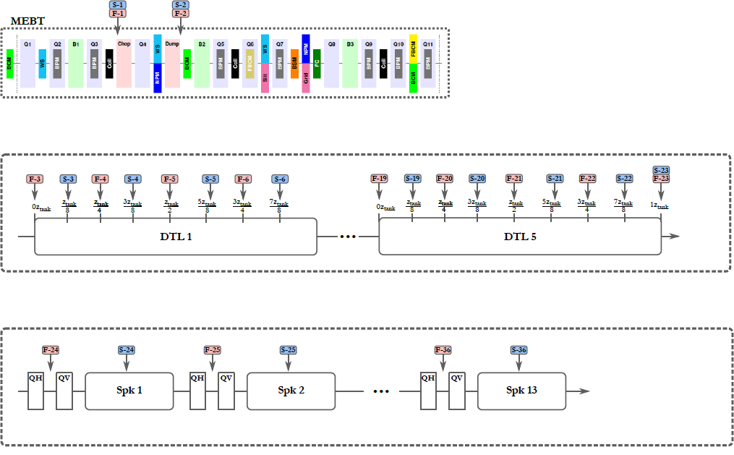
nBLM detectors distribution (I)
Irena and Thomas G. work
 | Detectors
MEBT | 4
DTL | 42
SPK | 26
Fast
Slow
L. Segui 21/11/2017 – 4th ESS-BI Forum 7

Slide 14
nBLM detectors distribution (II)
Irena and Thomas G. work
 | Detectors
MEBT | 4
DTL | 42
SPK | 26
MB | 2
HB | 2
PBW | 6
Total | 82
L. Segui 21/11/2017 – 4th ESS-BI Forum 8

Slide 15
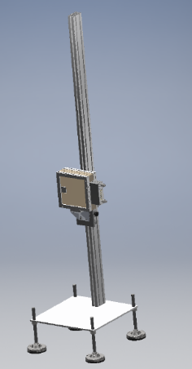
nBLM detectors Integration in ess (I)
System of 82 detectors will be installed
164 HV cables + 82 signal cables + 3x82 LV cables + gas lines
Detectors will be grouped for the gas lines and amplifiers low voltage cables
Two type of patch panels (2x6):
Gas
Cables connectors
Start design of detectors support
Rail along linac
Flexibility to move the detector in order to optimize the beam losses detection
Detectors in | Gas line | # of detectors
MEBT-DTL1 | Line 1 | 12
DTL2 | Line2 | 8
DTL3 | Line 3 | 8
DTL4 | Line4 | 8
DTL5 | Line 5 | 8
SPK1-4 | Line6 | 8
SPK5-8 | Line 7 | 8
SPK9-13 | Line8 | 10
MB-HB | Line 9 | 4
Bend Magnet | Line 10 | 6
L. Segui 21/11/2017 – 4th ESS-BI Forum 9

Slide 16
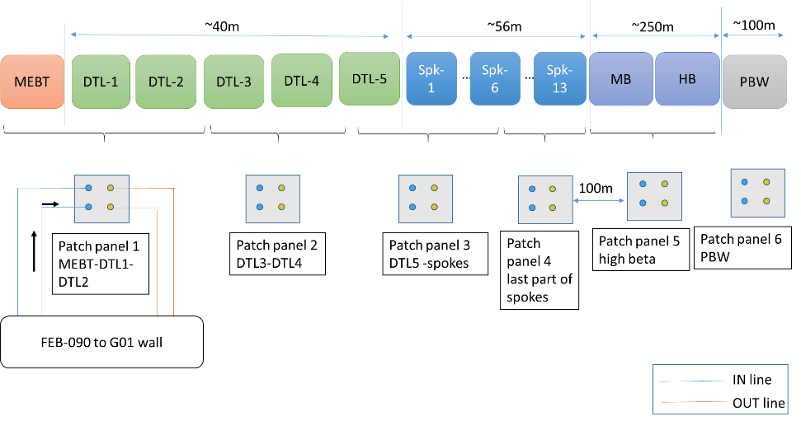
nBLM detectors Integration in ess (II)
L. Segui 21/11/2017 – 4th ESS-BI Forum 10

Slide 17
nBlm gas system
General design
The gas system consists in 3 parts:
The bottle storage area outside the building
Gas distribution system
Distribution and return lines from (to) the rack to (from) the accelerator tunnel
10 distribution + 10 return lines
Gas Line system fo group of detectors
Gas bottle storage
Gas rack controller
Patch panels in Accelerator tunel
Each nBLM module
Exhaust
L. Segui 21/11/2017 – 4th ESS-BI Forum 11

Slide 18
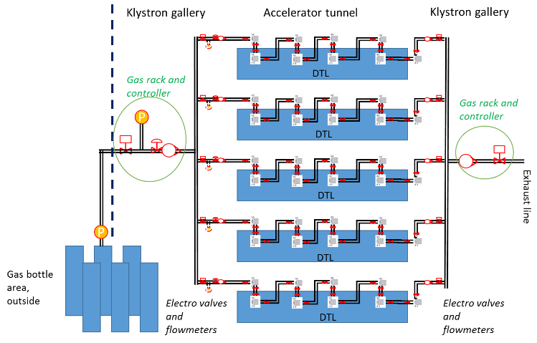
nBlm gas system
Gas | He + 10% CO₂
Total flow | 10 - 20 l/h
Flow per line | 1-2 l/h
Pressure | 1atm
Micromegas are gaseous detectors. Work in circulation with open circuit
High reliable system for the 84 detectors
L. Segui 21/11/2017 – 4th ESS-BI Forum 12

Slide 19
CONclusions
Since last BI Forum
Initial tests with prototypes
→ Design of new detectors
Mechanics
Electronics → Philippe’s talk
PDR1.2 approved
Fix distribution of detectors
Start design of detectors supports and their integration in the linac
Definition of analysis algorithm
Specification of control system
GUI development
Next months are critical to maintain schedule
New detectors ready by beginning next year for full characterisation
Finish cable definition for installation.
First tests with full acquisition system on-going
Integration of gas pipes design into model on-going → Thank you for the support from ESS!
Yannick’s
talk
L. Segui 21/11/2017 – 4th ESS-BI Forum 13

Slide 20
THANK YOU
DEDIP
DIS
Stephan Aune
System de Gaz
Détecteurs MicroMegas
Michel Combet
Front-End
Electronics
Daniel
Desforge
Mechanical
Designer
Mariam Kebbiri
Détecteurs MicroMegas
Françoise
Gougnaud
Quentin
Bertrand
Caroline
Lahonde-Hamdoun
Détecteur
specialiste
Pascal Le Bourlout
Front-End
Electronics
Philippe Legou
Detector et
Front-End Electronics
Olivier
Maillard
Front-End
Electronics
Tom Joannem
Yannick Mariette
Jacques Marroncle
ESS-I WP Diagnostics
Laura
Segui,
Post-doc
Thomas
Papaevangelou,
Chef de Projet
Georgios
Tsiledakis,
Post-doc
Victor
Nadot

Slide 21
BACK-UP

Slide 22
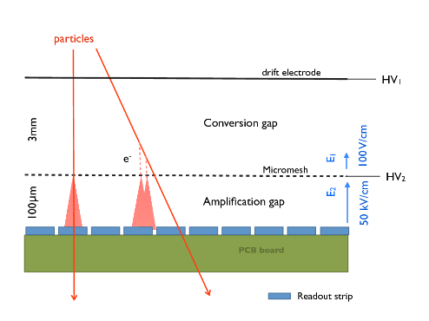
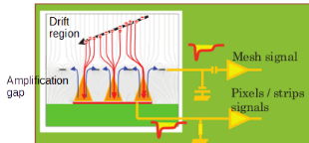
Micromegas detectors
To detect neutrons we need to place a convertor in the entrance of the conversion zone
MicroMesh Gaseous Structures (Micromegas) are an improved amplification structure used to measure the ionized signal in a gaseous detector.
The detector consists on two parallel plates:
a metallic micromesh suspended over an anode plane by insulator pillars
The device operates as a two-stage parallel plate avalanche chamber in two stage
Conversion zone
Amplification zone
30-150µm

Slide 23
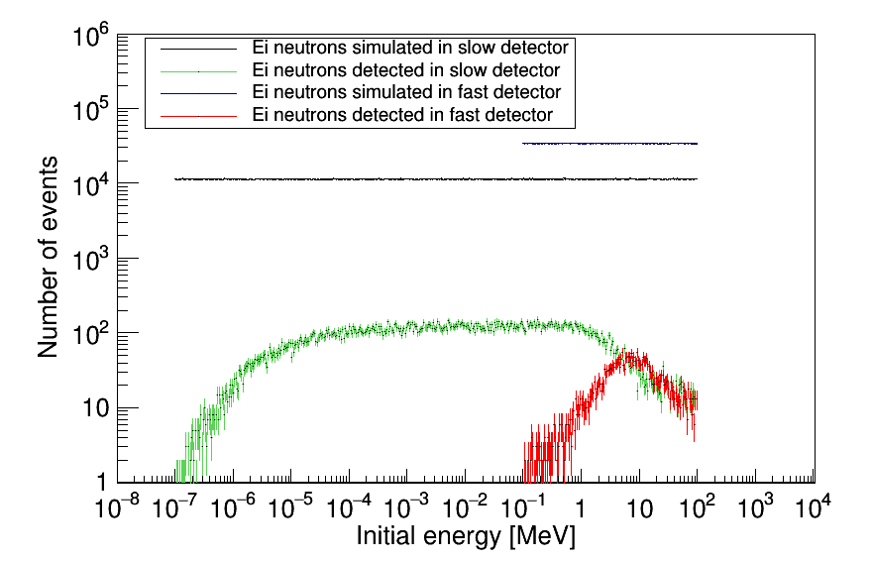
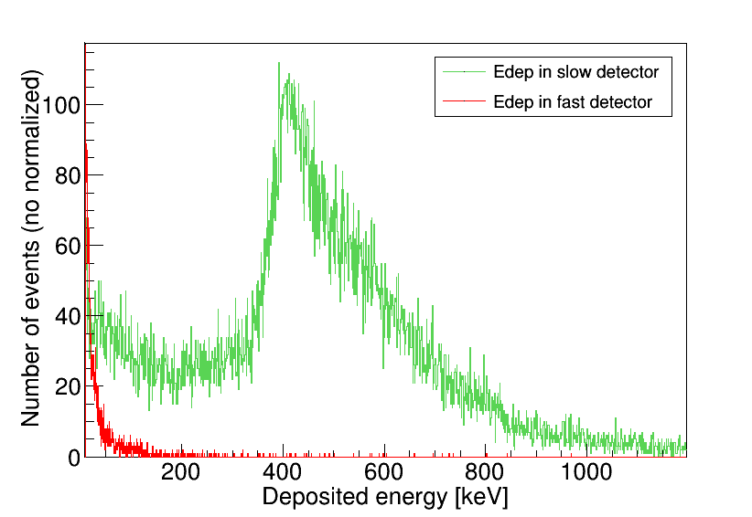

Slide 24
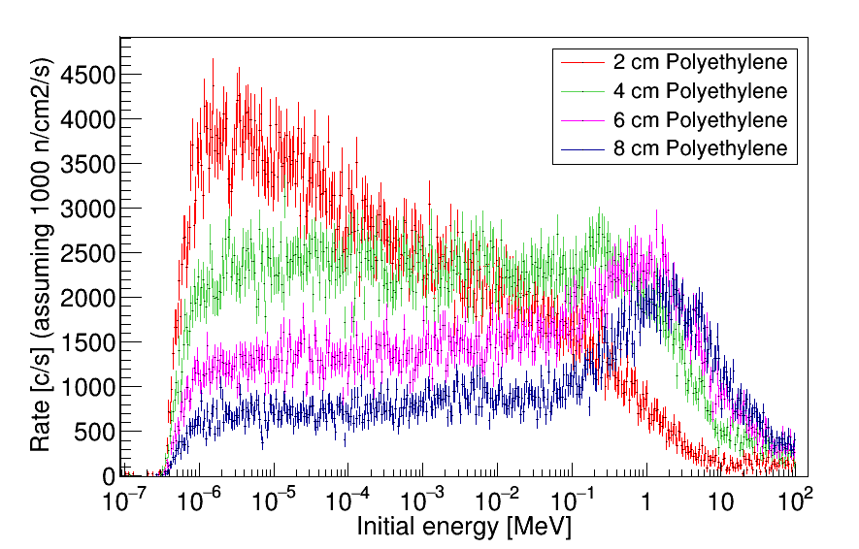
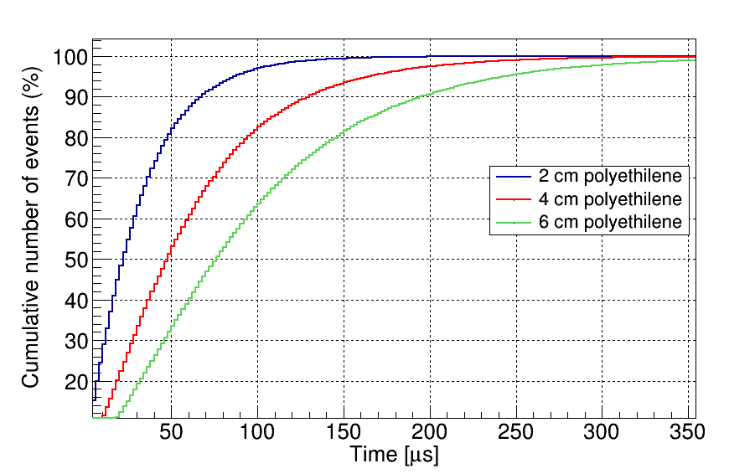
Studies by MC simulations
SLOW DETECTOR
Relative efficiency
Response time
Dependency with
Moderator thickness
MMs size
B4C thickness
Absorber thickness
Dependency with initial neutron energy
4 cm gives the most constant response over all range of energies
Dependency with moderator thickness
~5% detected in <1 µs for 4 cm
Requirement by ESS 5 µs response in total, 3µs for detection and FEE
Dependency with initial neutron energy

Slide 25
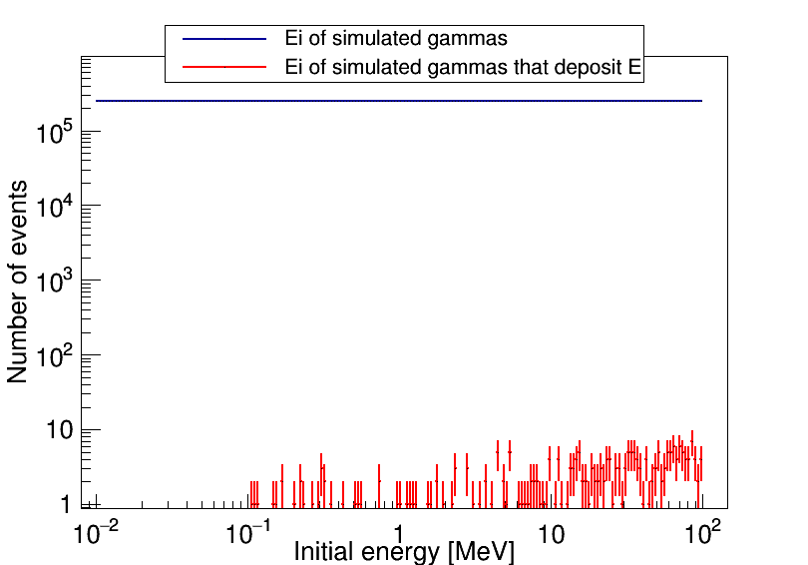
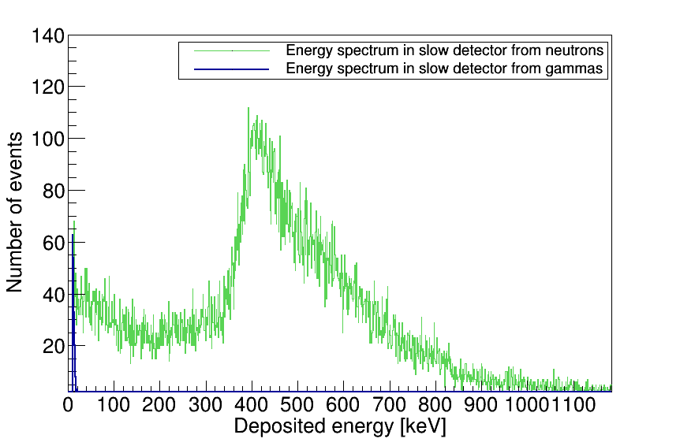
éTUDES PAR SIMULATION MC
SLOW DETECTOR
Gamma discrimination
Blind to gammas
Only sensitive to high energie gammas
With an energy threshold we can reject them
Thermal neutrons
Energies between 0.01 and 1 eV
Efficiency of < 0.007 % already with an energy deposited threshold of 10keV

Slide 26
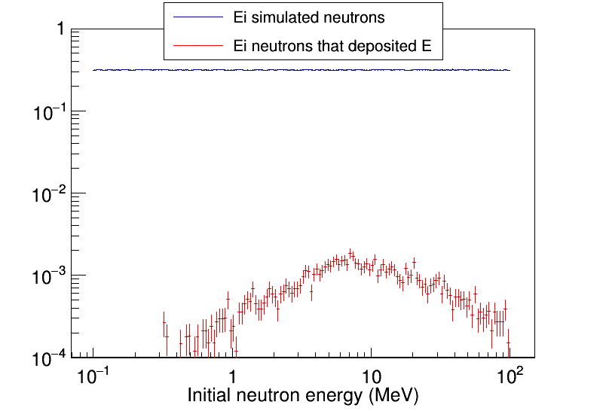
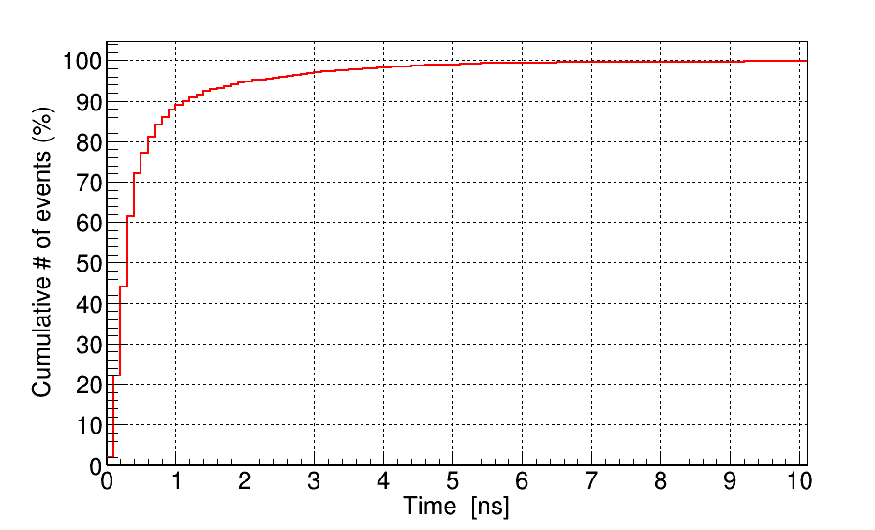
éTUDES PAR SIMULATION MC
FAST DETECTOR
Neutron efficiency
Initial neutrons from 0.1eV to 100 MeV
Time response:
just ToF, detector immediate response
Neutron initial entre
0.1eV et 100 MeV
100% events in <10 ns
Only sensitive to energies >0.5 MeV

Slide 27
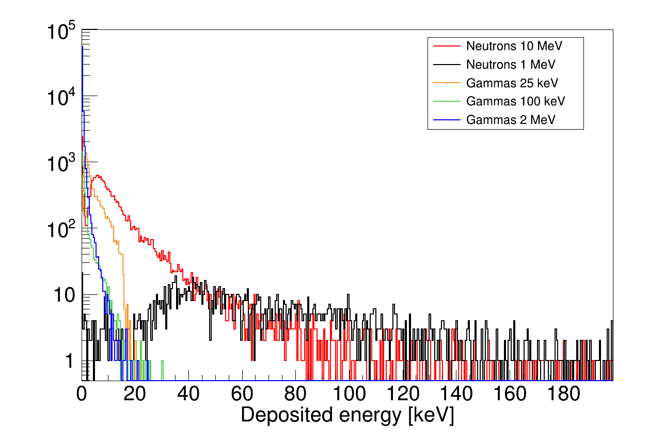
éTUDES PAR SIMULATION MC
FAST DETECTOR
Gamma discrimination
Blind to gammas

Slide 28
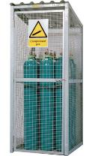
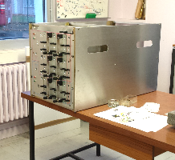
nBlm gas system
Gas: He + 10% CO₂
Flow: ~ 5 l/h, in recirculation
P ~ 1 atm
Volume/detector ~ 0.25 l
Leak tight and low outgassing
Gas bottle storage: 6-12 rack premix
~200 bar/bottle, 50 l →
2 IN/2 OUT lines (1 in use, 1 spare)
Outside gallery
From gas bottle to gas rack to patch panel to tunnel
Distribute in 5 lines → one per DTL, in parallel
5 IN/5 OUT Lines going to tunnel (+ spares)
Electrovalve in/out in Klystron gallery
Isolate system
Flowmeter in/out in Klystron gallery
Leak monitoring
Gas in serial for detectors in DTL
Bottle rack
Gas controller
nBLM- PP-Gallery-
IN
OUT
Designed by Stephan Aune
Serial
Serial and shunt?

Slide 29
nBLM detectors Integration in ess (III)
Detail of one nBLM gas distribution patch-panel
MEBT
DTL-1
DTL-2
Note only the slow draw
Flexibles
IN line
Shielding wall
OUT line

