Slide 1
Cable status, issues, solution & EMI emphasize and “proposals”. Paris Beam Instrumentation Forum 171120/22
Edvard Bergman
Technician
www.europeanspallationsource.se
17 November, 2017

Slide 2
Cable status
Due date 30-11-17 for warm LINAC cables shall be in cable data base.
Systems. BCM, icBLM, nBLM, BPM, BSM, EMU, FC, NPM, WS, DPL and COLL.
The main consideration is good conductive matter, low capacitance and screening / shielding of the cables, some cables high voltage as 6,2kV and higher.
The “desire” cables for both high voltage feeds and signal is triaxle cables. Optional, coaxial with a braided metal screen. For BPM phase stable cables.
Difficulties to get cable samples from manufacture. Not on stock. Have to make an order for manufacturing and minimum amount of 500 meters and obligated for purchase several kilometers.
Difficulties to get triaxial connectors. CERN had the same problem.
The nBLM characteristic signal is needed to have impedance matched cables but is not needed for icBLM.

Slide 3
EMI BLM, BPM & BCM
CEA detected noise on the received signal from nBLM. The noise is around 100kHz. Similar is detected I Lund but for the BCM system. We improved the GND of the cards in the create and reduced the level very little. When replacing the power supply the noise almost disappeared, however after a while the noise returned but with reduced level. Suspected noise resonance.
At CERN, they have seen noise and disturbance from switched mode power supply, timing cards, RF, kicker, radiation, vacuum pumps and from microphonic.
We/I suspect the switched mode power supply (SMPS). Common working frequency is from 30kHz up to 500kHz.
Some solutions. Usually manufactory could regulated the SMPS in voltage mode or current mode. Voltage mode gives static-EMI and current mode gives magnetic-EMI. My suggestion is to aske the manufactory if it is possible to change the mode? Preferable in current mode! Second way is to add beads/ferrite (common mode choke) and decoupling.

Slide 4
Braided screen, similar function as triax.

Slide 5
Common mode filter.

Slide 6
Common mode filter.

Slide 7
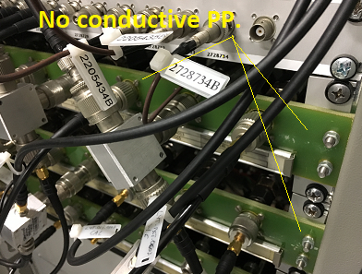
The cable connectors shell has to be separated not touching each other. Nonconductive patch panel as an option.

Slide 8
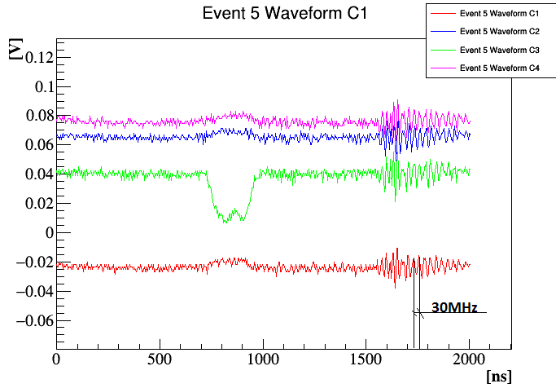
nBLM signal noise around 100kHz
Noise received on the signal, frequency around 100 kHz and “modulated” noise around 30MHz.

Slide 9
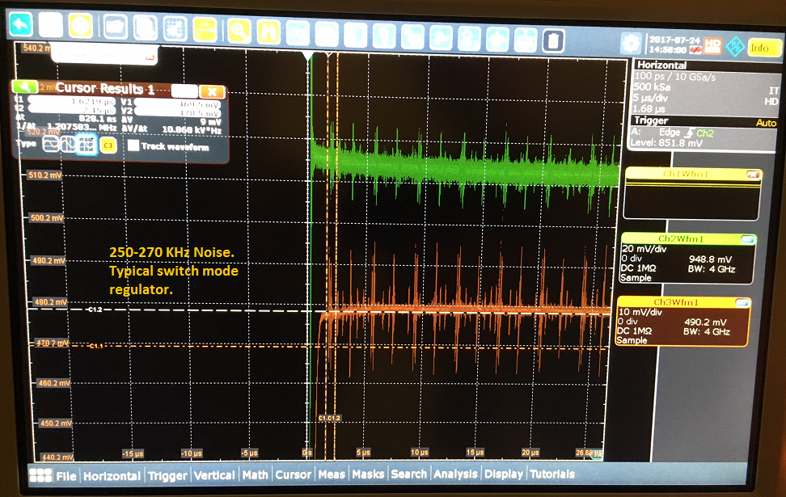
BCM EMI
EMI from (suspected) switched mode regulator impact on Beam current Measurement. 250kHz to 270kHz

Slide 10
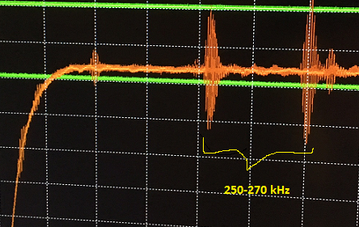
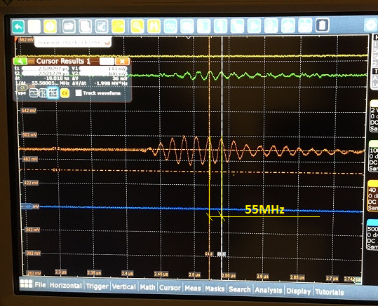
BCM EMI
Noise. 250kHz and 55MHz “modulated” on the noise.

Slide 11
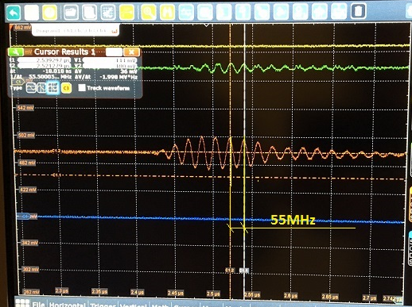
Similarity noise nBLM & BCM
Similar noise frequency 100kHz to 270KHZ with modulated noise 30-50 MHz.
nBLM/cea BCM/Lund

Slide 12
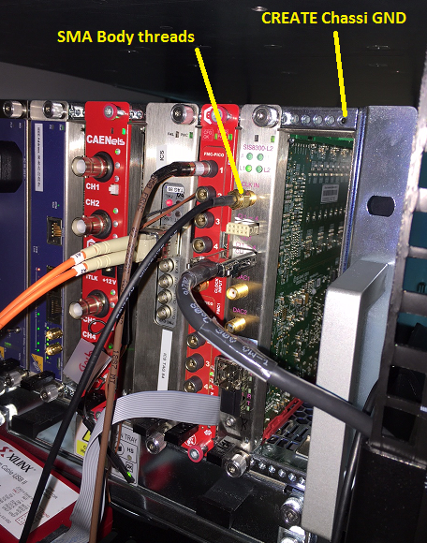
Bad grounding chusions on cards in CREATE
Between the ground cushion on AMC PBA and SMA connector body threads. Has 4-10 ohms resistance. Bad gound conductivity. We saw a subjective reduced noise level when grounded proper.

Slide 13
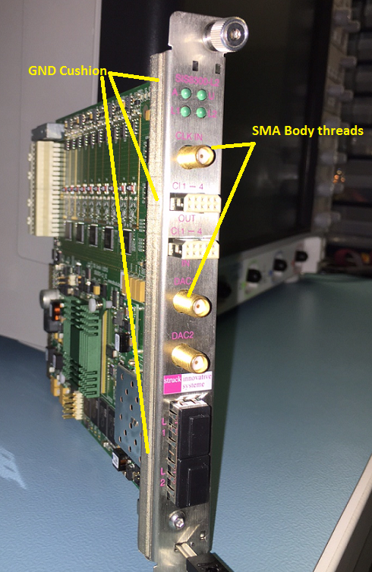
Cushion on AMC PBA. 4-10 ohms rsistance.
Copper/metal spring is a better option for grounding or other cushion type. Not as the picture shows, cushion with bad gnd.

Slide 14
Cable impedance nBLM/icBLM
Triaxial cables are recommended. We need to protect the power wires to pick up false signals and interfere with the received signal.
50 ohm impedance matching are desired for nBLM due to the characteristic signal (CW) covers DC up to several 100kHz.
For the icBLM the characteristic signal is an pulse, it will not be necessary to have matching impedance for the cable.

Slide 15
Propose 1

Slide 16
Propose 2

Slide 17
Propose 3

