Slide 1
IBEX – Current Status Kevin Woods, Tessella (ISIS/ESS/PSI ECP, December 2017)
Notes:
Purpose of today’s presentation is to bring you up to date with progress on IBEX.
IBEX is the new Instrument Control Program which will replace SECI & LabVIEW at ISIS

Slide 2
IBEX
IBEX is the next generation instrument control system at ISIS
EPICS
CS-Studio
IBEX is replacing SECI
.NET / C# GUI
LabVIEW

Slide 3
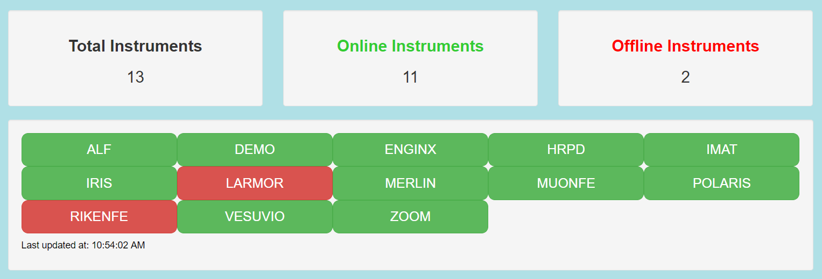
IBEX
Currently 13 production instances of IBEX
Also using “mini-inst” instances of IBEX
To control specific devices on some instruments

Slide 4
IBEX: Muon Front-End
HIFI
SECI
MUONFE
MUSR
IBEX
SECI
PVs via CALab
Magnet power supplies
Momentum slits
EMU
SECI
Notes:
3 existing muon instruments continue to use SECI
IBEX controls the magnets & slits used to steer protons to muon target
PVs are available to muon instruments via CALab.

Slide 5
IBEX: RIKEN Front-End
Interlocks
PLC
RB3
RB4
RQ7
RQ4
RQ2
RB1
RQ1
RIKENFE
RQ10
RQ19
RQ20
RQ18
RQ16
RQ17
IBEX
SY1
SY2
RQ5
RQ15
RQ8
RQ6
RQ3
XF1
XF2
RQ11
RQ9
RQ12
RQ13
RQ14
XFD3
RB3
Notes:
29 power supplies
4 serial RS422 chains to the PSUs (to speed up comms)
IBEX also monitors He level meters
New proposals to extend control logic are in the pipeline

Slide 6
IBEX: Next Instruments
February 2018: 3 more instruments
EMMA
GEM
SANDALS
May 2018: 2 more instruments
MAPS
MARI
may consider a 3rd, if time allows
Notes:
Rolling programme of instrument migrations

Slide 7
IBEX: Migration
Migration can only be done during shutdown periods
Use cycles to prepare for migration
3 instruments is practical limit per shutdown
During shutdown
Migrate (install, configure, etc.)
Test
Train
Support
when cycle re-starts
Notes:
Obviously migration is not possible when an instrument is being used
In cycle, we can prepare for migration by creating drivers & GUIs, migrating configs & scripts
4 shutdowns per year (there are more, but the additional ones are very short)
Need a shutdown of 2-4 weeks
Experience shows that we can migrate up to 3 instruments per shutdown (depending on instrument & device complexity and length of shutdown)
During shutdown we need to
Perform the installation & configuration
Test the newly installed IBEX – i.e. make sure instrument still works as expected
Train the scientists & technicians
In the new cycle we need to provide support
Our ability to provide support to more than 3 newly migrated instruments is a limiting factor

Slide 8
IBEX : New Developments
EPICS v3.15.5
ESS Beckhoff driver on IMAT
New version of the EPICS Galil driver (ANSTO)
Being tested
NI equipment
EPICS drivers for:
NI GPIB for Instron stress rig (ENGIN-X)
Delft PXI (LARMOR)
CALab for LabVIEW
MUONFE, SANS2D

Slide 9
IBEX : New Developments
Migrate to Eclipse 4
Current IBEX GUI is Eclipse 3 / CS-Studio 3
Eclipse 4 is a pre-requisite for CS-Studio 4
Eclipse 4 also permits:
Greater flexibility to develop GUI
e.g. Live detector view using EPICS V4

Slide 10
IBEX : New Developments
Scripting
prototype scripting server
based on NICOS
proposed some changes to NICOS
submitted to NICOS code-base
Next steps
extend the prototype
release to scientists

Slide 11
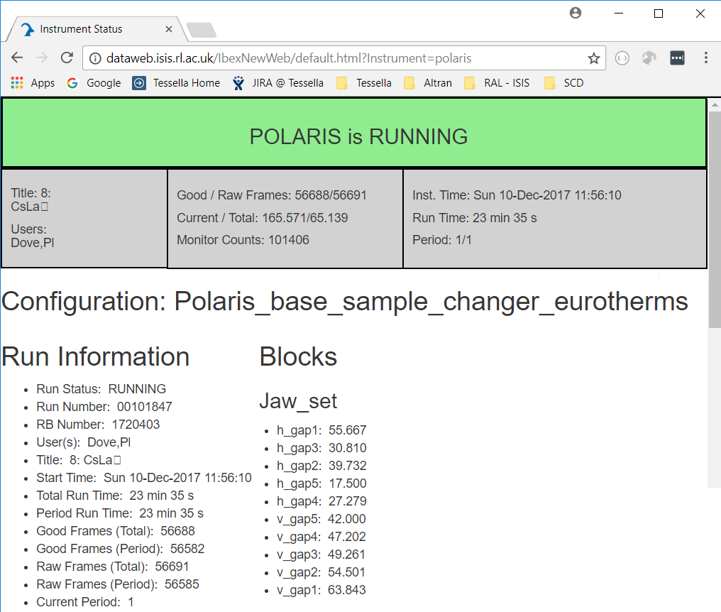
IBEX : New Developments
New web dashboard

Slide 12
IBEX : New Developments
genie_python
Python 2 support ends in 2020
Prepare genie_python to work with both Python 2 and Python 3
Full migration to Python 3 needs to happen in step with Mantid.

Slide 13
IBEX : Testing
Invested significant effort to improve testing
Improved testing for
OPIs, UIs, configs
genie_python unit testing
IOC Test Framework
LeWIS
Improved quality, improved confidence
Fewer problems during migrations

Slide 14
IBEX : Deployment
In addition to new migrations …
previously migrated instruments need to be kept up to date as IBEX develops
deployment workload is growing
Increased automation
faster, smoother, more consistent deployment
better able to both migrate & upgrade instruments during shutdowns
Consider containerisation for future

