Slide 1
Plots from the band gem test
Davide
18/10/2017

Slide 2
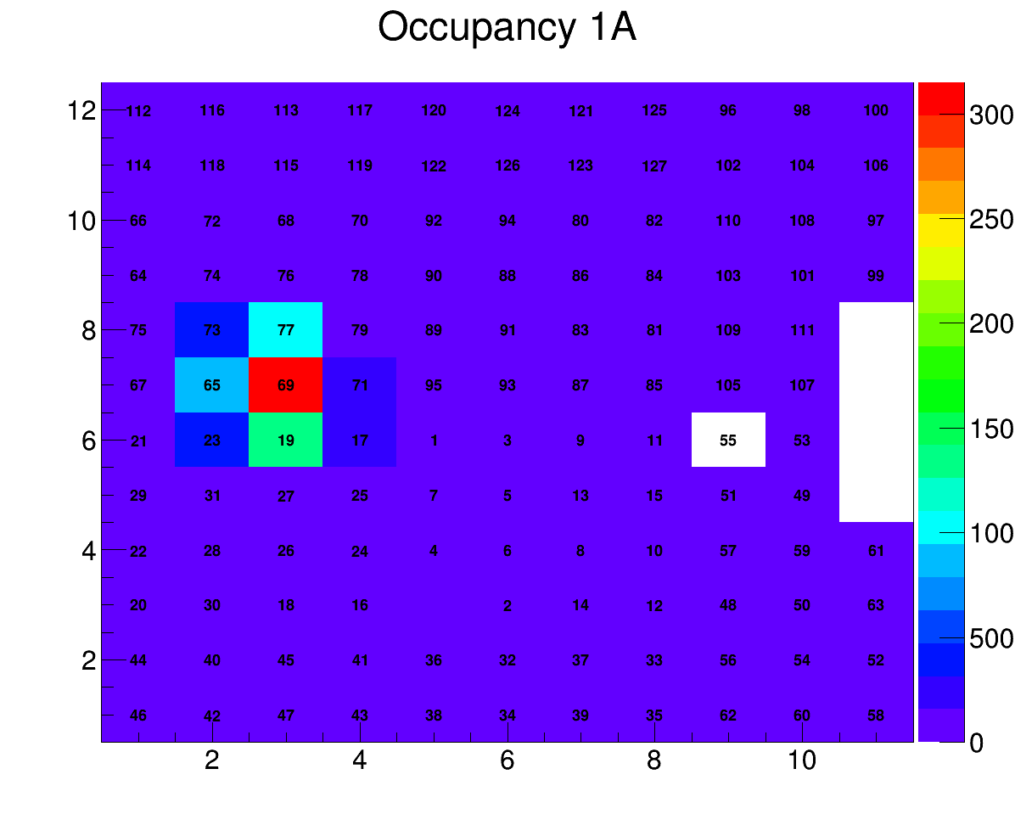
Position Spectrum

Slide 3
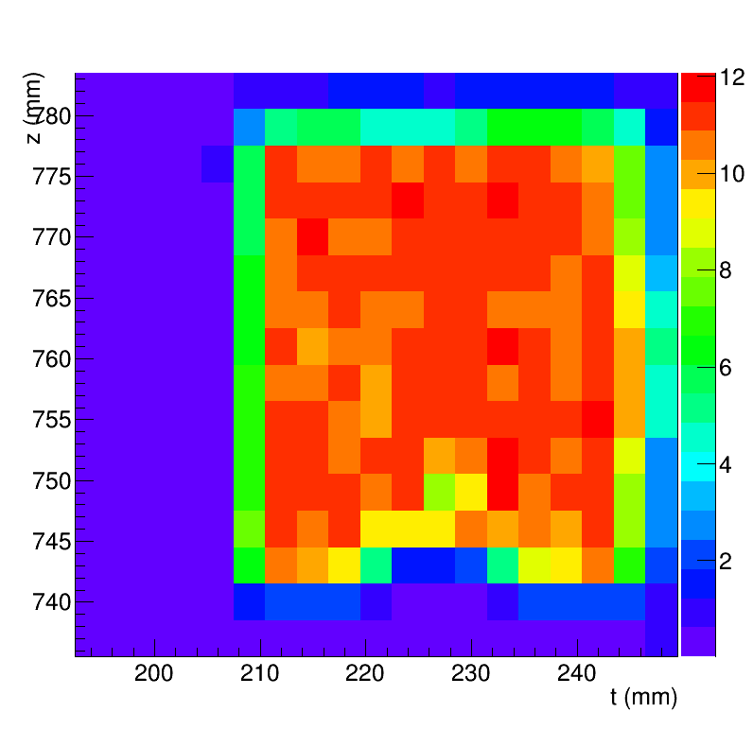
uniformity

Slide 4
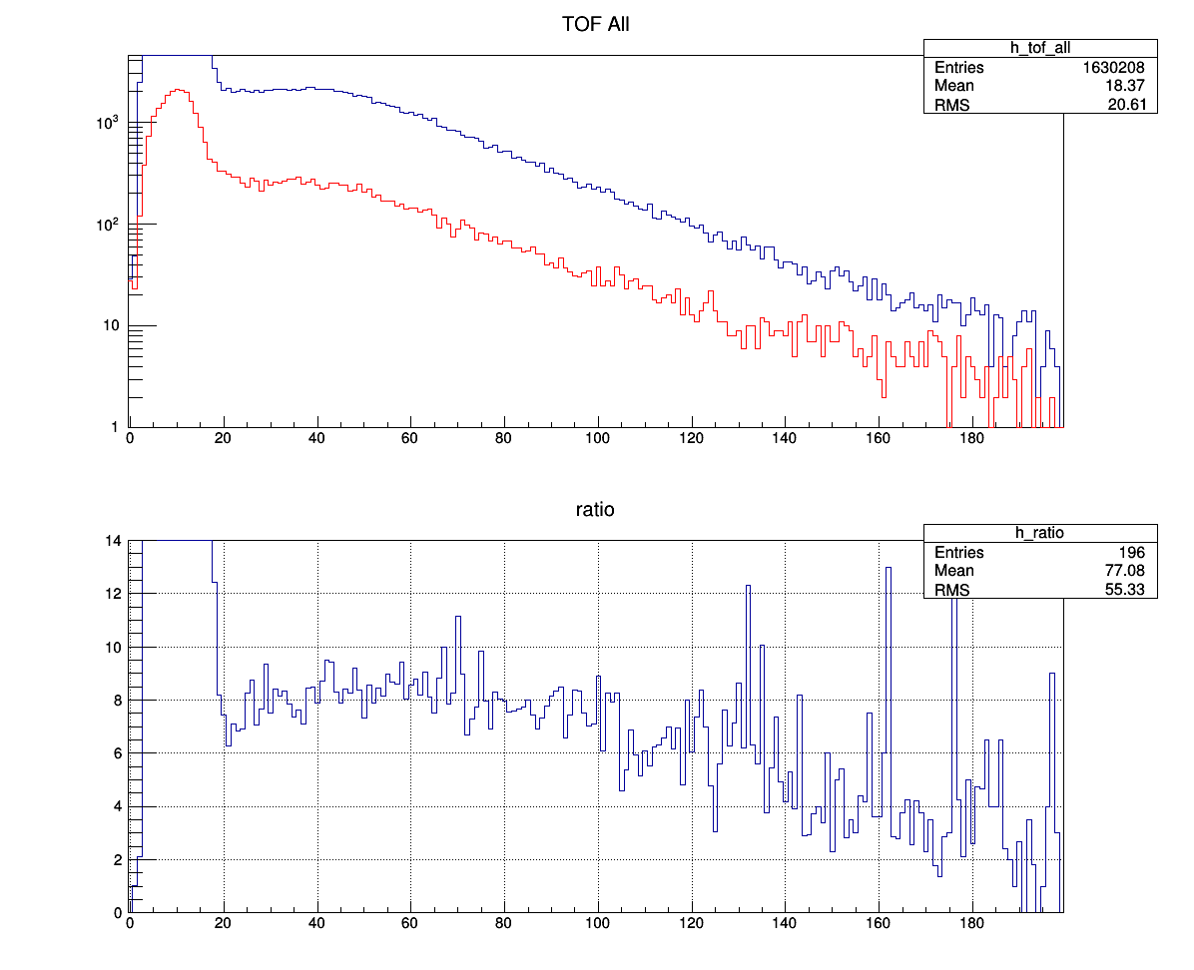
tof
BandGEM
Mon

Slide 5
Monitor 16_3 and 17_2

