Slide 1
NSS construction works and Installation model
Antonio Bianchi
NSS Installation coordinator
Clara Lopez
Instrument Integration
www.europeanspallationsource.se
14th February 2018

Slide 2
NSS construction works: E02 load test
Preliminary shielding design
Shielding “simulation” (concrete blocks)
Plan view
Section view

Slide 3
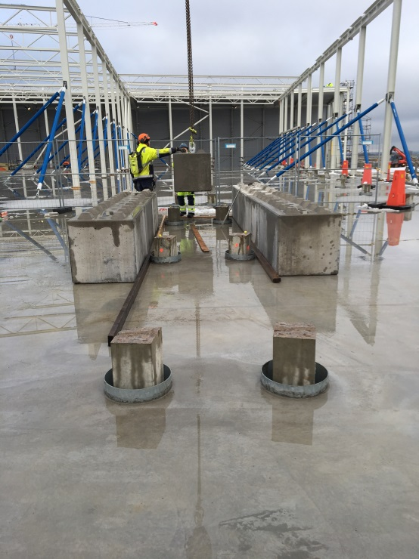
E02 load test location
TEST LOCATION
(E02.2)
W7

Slide 4
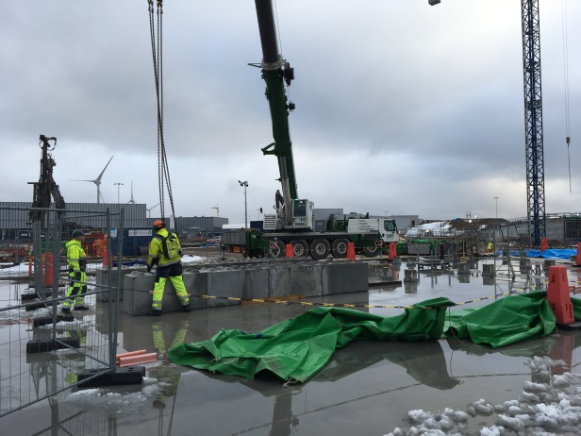
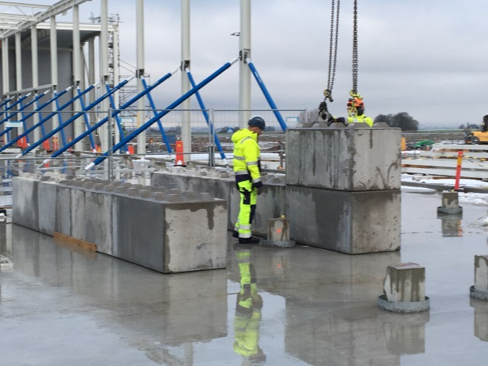
E02 load test – on going work
BMS – MOBILE CRANE AND CRANE DRIVER
SKANSKA PERSONNELL

Slide 5
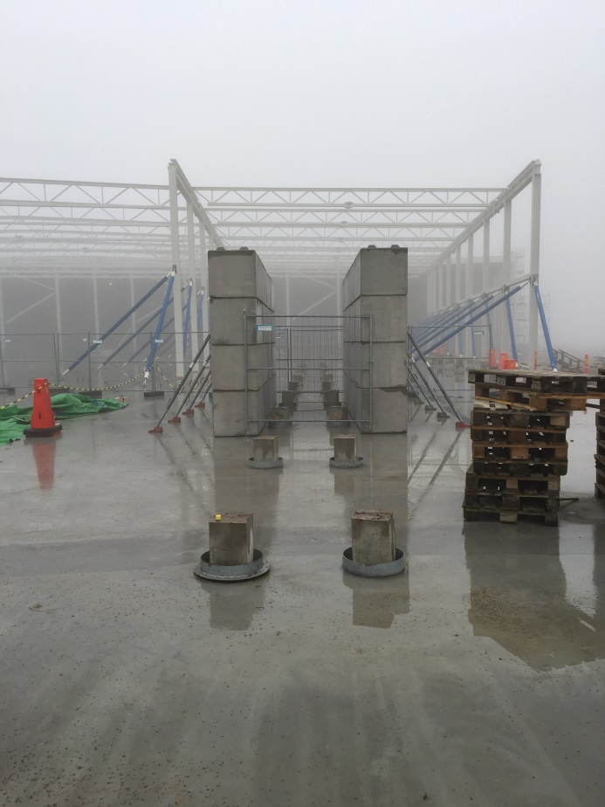
E02 load test – Final Configuration
SURVEYING STILL ON-GOING (ESS METROLOGY GROUP)

Slide 6
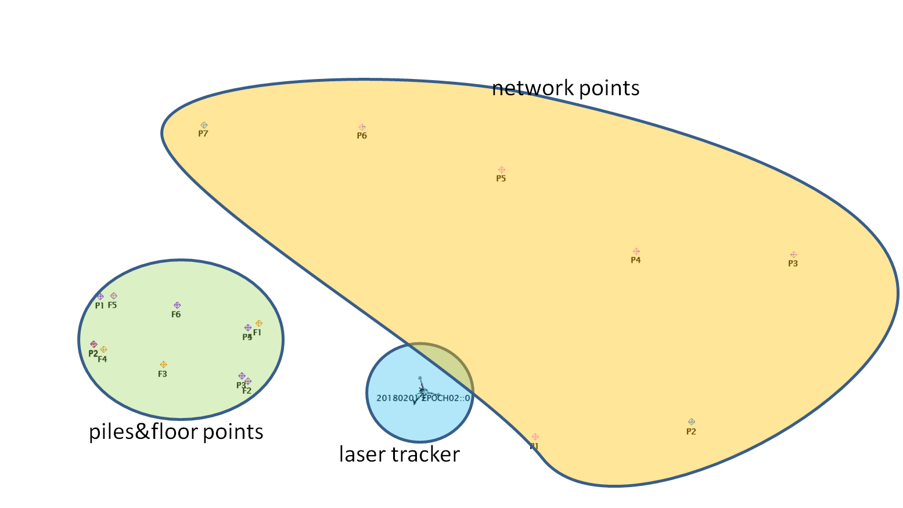
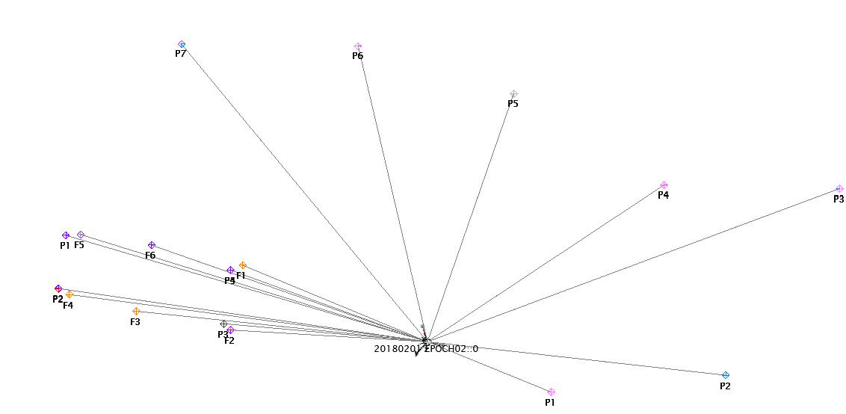
E02 slab and piles deflection
ESS-0237432
Date | Epoch | Comments
11/01/2018 | 0 | Initial Measurement – No load
26/01/2018 | 1 | 15 days after loading
01/02/2018 | 2 | 21 days after loading

Slide 7
Load test results (1 Epoch)
0,13 mm
0,95 mm
Piles
Floor
0,11 mm
0,00 mm
15 days after loading

Slide 8
Load test results (2 Epoch)
0,12 mm
1,91 mm
Piles
Floor
0,09 mm
21 days after loading
0,26 mm

Slide 9
Installation Model
Ready,…
Delivery process from partner
ACCESS at ESS
Installation
Partner site
ESS site
Steady…., go!
Integrated components
Logistics at ESS
Integrated plan
Infr. & Utilities
FIP & components
Areas prepared
Installation and SAT (if apply)
As Built drawings
Teams in place
Instrument team area
Integrated plan ESS/Instruments
Resources
Logistics - Transportation
Regulatory requirements
Field installation Packages (FIP)
Planning coordination – work order

Slide 10
Objectives of Installation planning phase
Resources:
Man power, Equipment, Materials, tools, etc.
Field Installation packages (FIP)
Pn
P2
NSS Installation plan
Instrument at ESS
P1
Integration
Regulatory requirements: QA, ES&H, radiation protection, PPS, etc.
Notes:
Align schedule with project phasing: design, manufacturing, installation and start up of operations.
Optimize resources (personnel, time, tools, reduce redundant activities, etc.)
Define field installation packages based on sequences
Fulfill safety and QA requirements
Reduce risks
Perform inspections and obtain test certifications
Facilitate integration process / responsabilities from NSS- Instrument

Slide 11
Integrated components
Assembled components at Partner site
FAT Factory acceptance test
CE Marking documentation
Packing list
Manuals for components
Documentation related: Drawings, models, datasheet for materials, etc.

Slide 12
Logistics at Partner site
Transport preparation
Packing list: ID, list, weight, description, etc.
Logistic procedure: ESS & partner
Regulations
Site inspection at arrival

Slide 13
Field installation Packages
To facilitate management of installation an instrument will be divided into a set of field installation packages. These will be chosen to be of manageable size and defined by the sequence of engineering work and the assembly process. The FIPs will be prepared in an organized way to deliver the scope of work needed for the process of installation required at ESS by the partner and ESS installation teams.
This process is aligned with the detailed design phase, manufacturing process, installation, QA & safety requirements, and specific constraints and requirements specific to the relevant installation areas.

Slide 14
Field installation packages
Envelope space in instrument halls
Instrument
Field installation packages
P5
“Definition of field installation packages and the installation sequence are specific to each instrument.”
P2
P4
P1
P3
Pn

Slide 15
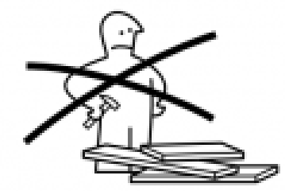
Field installation packages
Instrument Work packages
Field Installation packages

Slide 16
Field installation package document P1, P2,, Pn
Package ID. (logistic operations)
Work description: Scope of work
Schedule: time and man power estimation
Site preparation needed for field installation package (grouting, mounting supports, alignment plates, etc.)
Pre assembly activities for field installation packages
List of Drawings /Mounting instructions/Figures/ Electrical schemes/reference documents P&ID’s/specifications, 3d scans, photo archives, etc.
Particular considerations: access permits, regulatory requirements, risks, safety, temporary provisions, special limitations or recommendations for lifting equipment, subcontractors, vendors support, etc.
List of equipment, tools, consumables and materials
Location identification at site (bunker-hall-sectors)
Boundaries: dimensions LxWxH and mass
Utilities distribution preassembly needs: fluids, power, data, signals, etc. Check lists
Scaffolding, cranes and construction equipment requirements
Critical interface verification
Test validation to perform at site: ref document
Pn
P2
P1

Slide 17
Logistics at ESS - Available space
Unpacking
Preassembly
Final adjustments
Reworks
Visit workshops if is needed- Support functions
Pre-installation checks

Slide 18
Logistic: handover of externals areas
END OF JUNE 2020
(green areas)

Slide 19
Site aerial view – Main site entrance
E01 building
Installation start October 2019
Gate B

Slide 20
External storage area (E buildings)
Instruments team storage area from middle 2019
1000 m2 (on-going discussion with Skanska)

Slide 21
Logistics and storage areas inside the building
Storage coordination
Transportation
Site inspection – Instrument team and Tech groups
Regulations
Temporary storage areas according to the work progress
Installation works
Choppers
Workshop
(permanent)
Temporary
Pre-assembly
areas
Main entrances
Storage areas will follow the integrated installation plan and the work-progress.

Slide 22
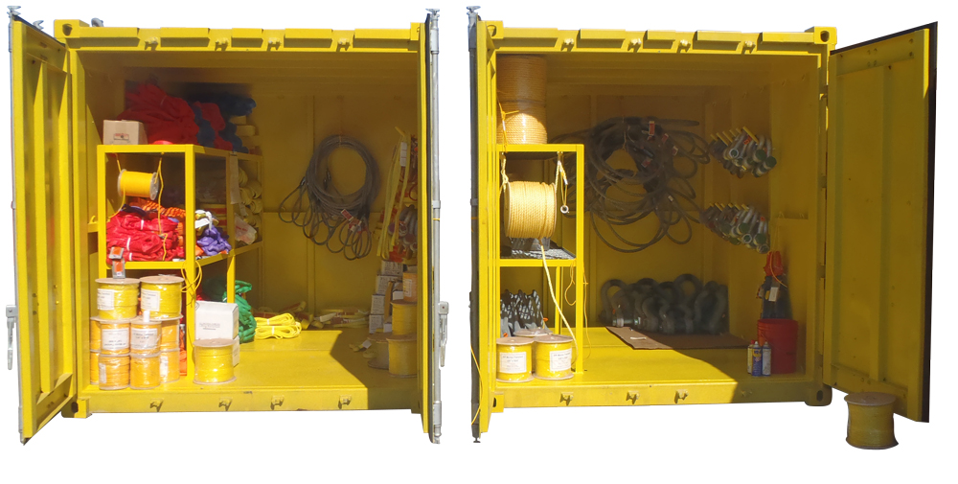
Instrument teams areas
Provisional offices for teams
Container space
Instrument equipment location
Lockers

Slide 23
Resources Equipment
Instrument teams
Technical groups
Cranes
Forklifts & Hand truck
Fences
Scaffolding
Special equipment
Tools workshop
Ladders
Consumables, materials, etc.
Previously identified in Field installation Packages FIP

Slide 24
ESS Support function
SUPPORT FUNCTIONS
(to be extended)
FOR EACH OF THE SUPPORT FUNCTION
Scaffolding
Laydown Areas
Crane drivers
Logistics/Transport
Heavy lifting
Temporary Power Fluids
Concrete drilling
Survey/Alignment
General support
(washing/cleaning)
Office support
PPE and general consumables
Safety fencing
Workers cabin
Waste management
ESS RESPONSIBLE
CONTACT PERSON
MANDATORY/OPTIONAL
FREE/COST
PROVIDER NAME
NSS INSTALLATION COORDINATOR
INSTRUMENT TEAM

Slide 25
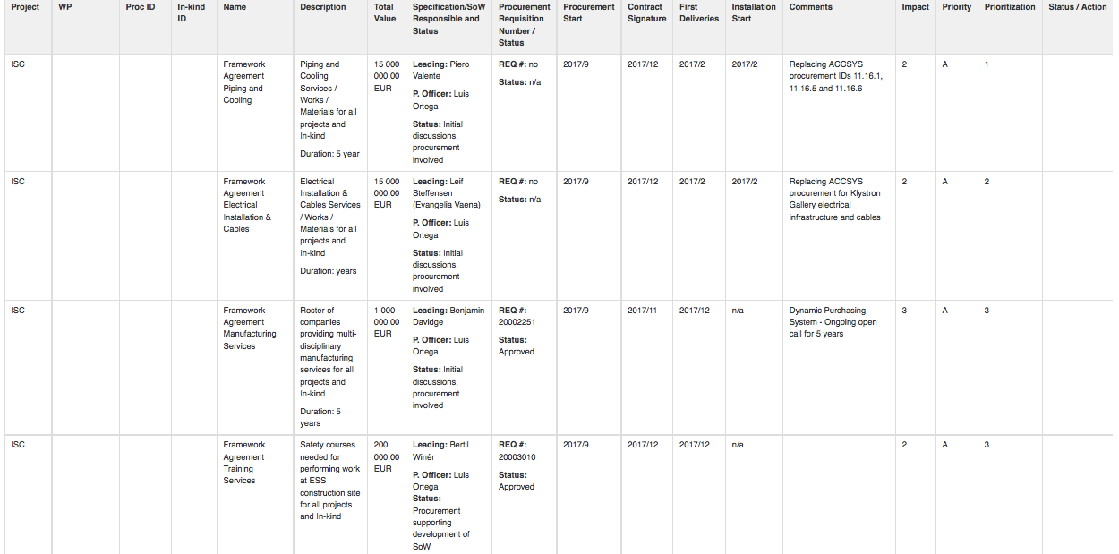
Framework agreements
PIPING & COOLING
ELECTRICAL INSTALLATION
TRAINING

Slide 26
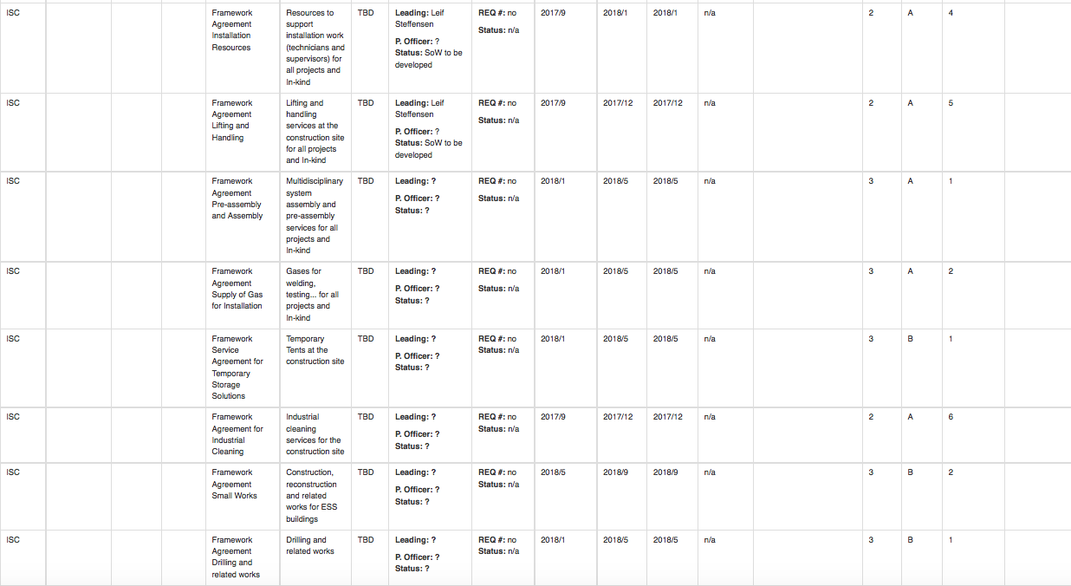
Framework agreements
INSTALLATION RESOURCES
LIFTING & HANDLING

Slide 27
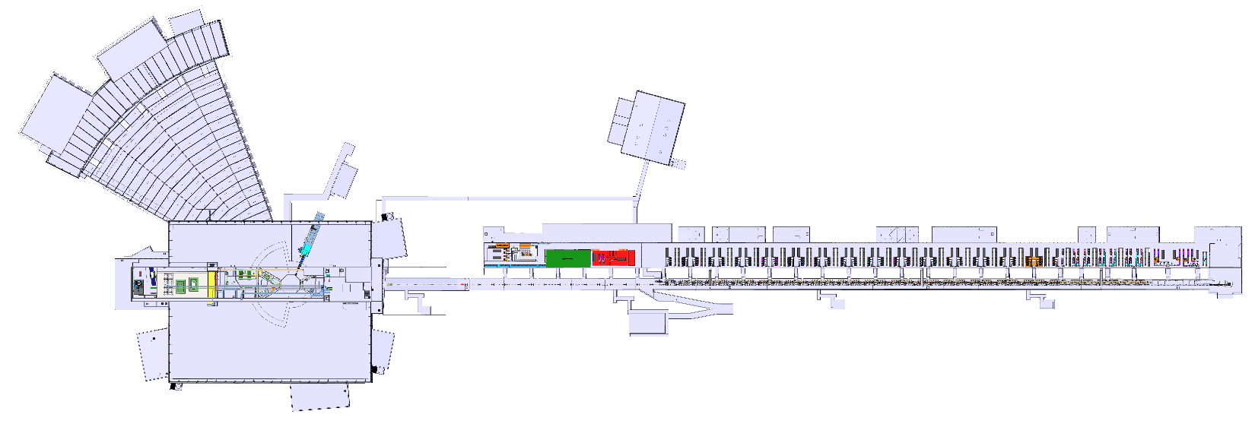
Manufacturing Section – Temporary Technical Center
Engineering & Integration Support Division
HoD Peter Rådahl
Formal establishment of new Manufacturing Section in August 2017
Section is part of new Machine Engineering Service Group within E&IS Division
Appointment of Benjamin Davidge as Section Leader in October 2017
Machine Engineering Service Group
GL Fabien Rey (Acting)
Section Mandate:
“Provide support for all mechanical disciplines of manufacturing to ESS as necessary to support installation, commissioning & operation of the facility."
Survey Alignment Metrology Section
SL Fabien Rey
Spatial Integration Section
SL Fabien Rey (Acting)
Delivered through:
Coordination of a central mechanical workshop
Extensive network of external vendors
Experienced staff
Manufacturing Section
SL Benjamin Davidge
Planned permanent location of central workshop not available for occupancy until earliest mid-2020
Availability of on-site mechanical workshop deemed essential during installation phase
Location for establishment of a temporary mechanical workshop found in Gallery building
To be called the Temporary Technical Center (TTC)
Location of Temporary Technical Center (TTC)

Slide 28
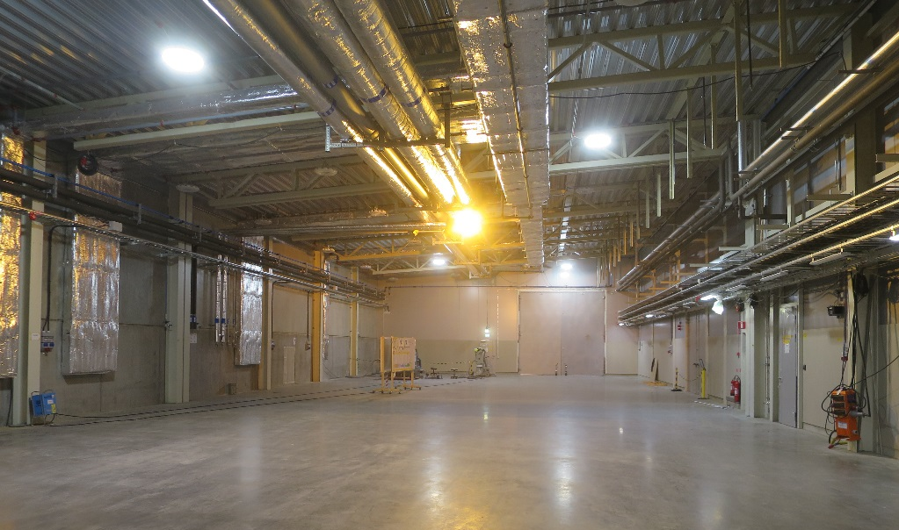
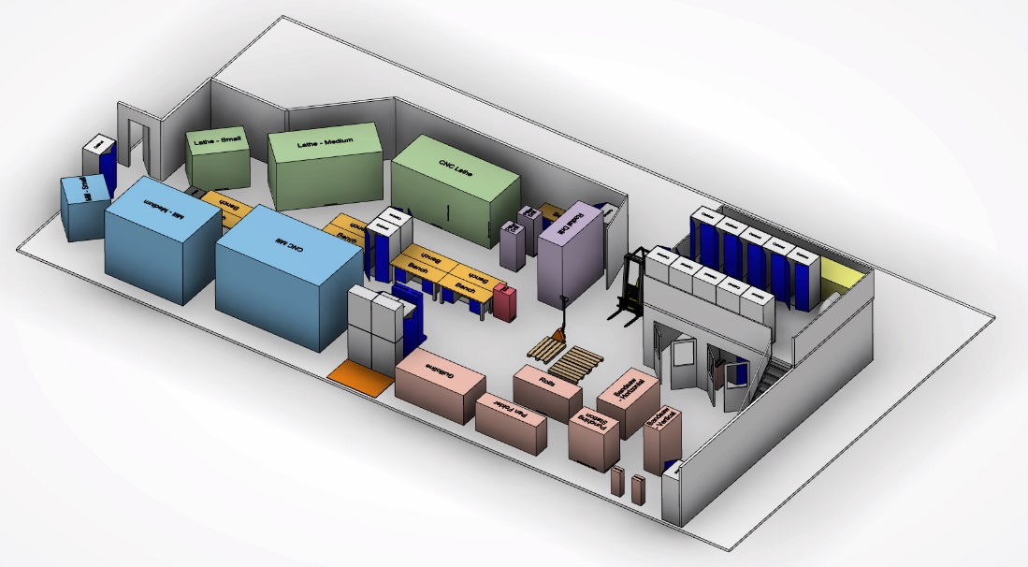
Manufacturing Section – Temporary Technical Center
~300 m2 TTC floor area
Preparation of space starting end of March 2018
Machinery and equipment purchasing underway
Machinery for machining, material cutting, basic sheet metal/fabrication, welding
Limited assembly space – No overhead crane
Location as at Dec-2017
Proposed layout realized mid-2019
Dedicated Manufacturing Section technicians only – Not open access
First technician recruitment almost complete, plans for 3 full-time technicians available by mid-2019
Please visit the Manufacturing Section page on confluence for more information and latest updates
https://confluence.esss.lu.se/display/EIS/Manufacturing+Section

Slide 29
Regulatory Requirements
Certifications – External
Risk assessments
Permits and authorizations
ESS training- ESS Safety code
QA requirements
Site Access teams – forms and formalities
Emergency procedures
Personal protective equipment PPE
Monitoring and compliances
Handling waste
Safety training, matrix,
Electrical safety
Crane operator
Swedish regulation for work environment

Slide 30
Main ESS installation documents
Below are summarised relevant documents about installation in the ESS facility:
ESS-0147103 General Information
ESS-0147089 ESS Guidelines For Accessing And Performing Work On Site
ESS-0012721 ESS Rules for Electrical Safety
ESS-0147093 Fire Safety Plan
ESS-0147094 Responsibility of Electrical Safety
Permanent ESS Electrical System
ESS-0147099 Emergency notice. Safety plan
ESS-0147100 Safety Training Matrix for Installation Activities on Site
ESS-0147101 ESS Site Logistics

Slide 31
Swedish Work Environment Authority
Reference provisions from Swedish work environment Authority:
building-and-civil-engineering-work-provisions-afs1999-3;
scaffolding-provisions-afs2013-04;
use-of-lifting-devices-and-lifting-accessories-provisions-afs2006-6;
who-is-responsible-for-what-within-building-and-construction-adi704-eng;
Web site
https://www.av.se/en/work-environment-work-and inspections/publications/foreskrifter/
“Good planning and design lead to a safer construction site with reduced risk of ill health and accidents, more effective production, and increased profitability”.
(Swedish Work Environment Authority)

Slide 32
Installation Safety matrix

Slide 33
Safety training programs
Safety courses are currently under development.
ATEX (basic)
Crane Operator
ESA-14 (Advanced)
ESA-14 (Basic)
First Aid: Basic (incl. electrical injuries)
Hot work
Radiation training for personnel working on TS2
Use of epoxy
Safety Training Website under development (on Confluence):
https://confluence.esss.lu.se/display/ESH/Safety+Training+Program
(Responsible: Lars Aprin (EH&S Division)

Slide 34
Mandatory PPE on Construction Site
GENERAL RULE
Helmet as in picture
Safety glasses
Reflective clothing class 2 (chest)
Safety gloves
Long sleeve trousers
Safety shoes
Exceptions from the general rule must be agreed with SEC
Blue – site operative Green – OHS personnel
White - supervisor Red - visitor

Slide 35
Installation safety: NSS Area Safety Coordinator
Up to the end of SKANSKA construction works
Site Responsible BAS-U (construction safety)
NSS Area safety coordinator (E buildings)
Note
A Safety Manager has to be appointed from each Instrument team, to interface with the the NSS Area Safety Coordinator
NSS Area safety coordinator (D buildings)

Slide 36
Installation Electrical safety
An “Electrical contractor” is a person who has been authorized by The Swedish National Electrical Safety Board to perform electrical installation work within the scope of The Act on Electrical Contractors (SFS 1990:806).
To get authorization as “Electrical Contractor” you need qualification e.g. right education and experience to work with electrical installations in Sweden (High or Low Voltage)
“Electrical contractor” may perform electrical installation work relating to the execution, alteration or repair of electrical installations and installations of electrical devices, where such a voltage, current or frequency that can be dangerous to persons or property.

Slide 37
Electrical safety: Need of Authorization and Authorization types
An authorization is needed to:
perform fixed connection/disconnection of devices to and from an electrical installation that could be dangerous to people or property.
An authorization is not needed to:
perform electrical installations for machinery and vehicles such as cars & aircrafts are excluded from the electrical installation regulations.
perform electrical installations and works within machinery considered as a non-fixed electrical installation.
There are 2 types of authorization
General authorization- High and Low Voltage (AB)
Can perform all types of electrical installation work
General authorization – Low Voltage (ABL)
Can perform all types of electrical installation work on facilities for nominal voltage up to 1 000 Volt AC or 1500 Volt DC.

Slide 38
Electrical safety: In-Kind Contributors
An Electrical contractor with qualifications from an EES country other than Sweden may temporarily perform electrical installation work.
Must submit an application to get a temporary authorization.

Slide 39
Electrical safety: how to register with E-NAV
Application
Prepare following before register starts
Self-audit scheme shall be handed over to ESH&Q when registration starts.
In-Kind Contributors need to have an authorization (Certificate) in the home-country in EU. (AB or ABL)
The work shall be performed temporary in Sweden and during a limited time period.
More information:
http://www.elsakerhetsverket.se/en/electrical-installation-companies/register-your-company/

Slide 40
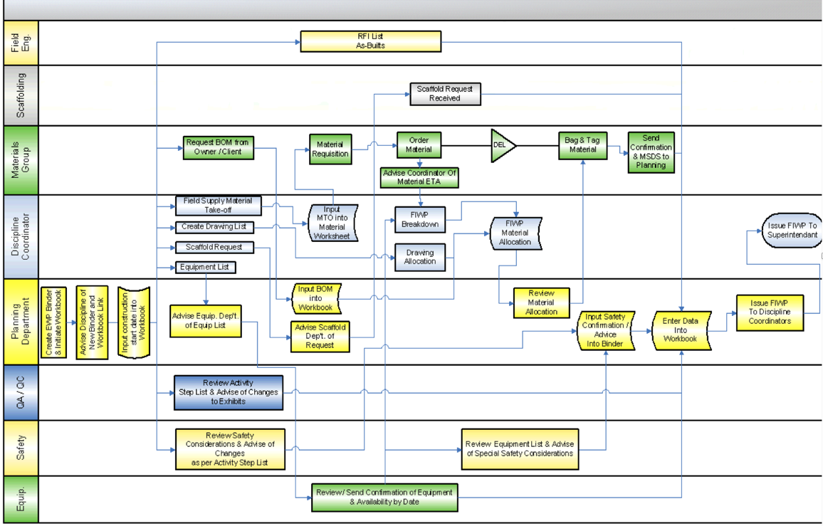
Integrated plan
Master plan schedule and Work process at site installation

Slide 41
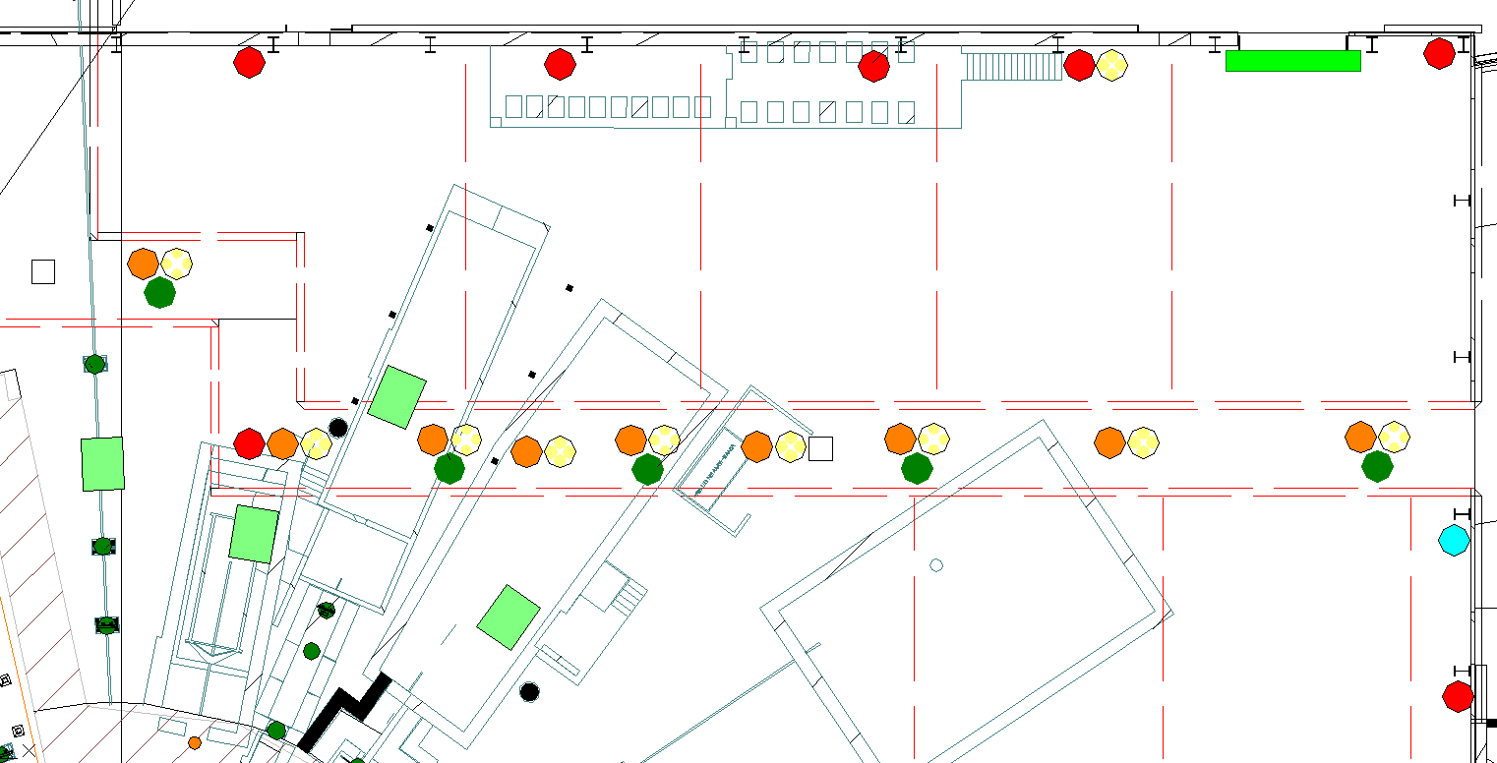
Infrastructure and utilities
According to the Instrument Installation package and the integrated project schedule, NSS will ensure all the required connection points for utilities distribution (fluids, power, data, signals, etc. ) are in place.
DO3
Power ;
Cooling water;
Compressed air;
Vacuum pumps;
Data;
………….;
………….;
Instrument gallery

Slide 42
Teams in place
Coordination :
Technical groups
Instrument crew
ESS installation crew
ESS Equipment/tools
Configuration – Bunker preparation/mobile cranes, etc.

Slide 43
What is needed?
Planning NSS/Instruments
Field Installation Packages (FIP) – start !
Definition of resources
Responsible /Team/clear communication
Definition of equipment and tools

Slide 44
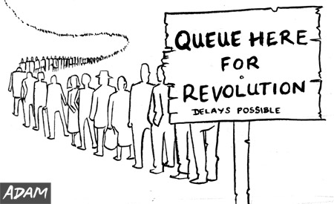
Questions?
QUEUE HERE
For last moment installation!

