Slide 1
The Bunker Steel Structure – Structural Analysis
Mikael Möller
Structural Engineer, Analysis Section
www.europeanspallationsource.se
2017-11-28

Slide 2
Review status.
Internal review conducted by Anders Olsson, ESS.
External third party review conducted by Peter Sjöberg, Sweco Structures AB.

Slide 3
Bunker Steel Structure Requirements.
Support roof weight 6.6 tonnes / m² + 50 % during maintenance operations due to stacking elements on top of roof.
Any beam element must be removable from above.
Bunker in D02 shall resist an H4 seismic event.
Bunker in D01 & D03 may not fall inwards during an H4 seismic event.

Slide 4
Stability considerations, D02 bunker.
From space requirements, diagonal bracings are ruled out in D02.
The bottom shielding steel elements between R6 and R9 are pinned to the R6 & R9 beams, creating a diaphragm which transfers horizontal seismic loads to R6 & R9 diagonal wall anchoring.
During maintenance, structural elements may be removed and stability of the structure relies on clamped column base.

Slide 5
Stability considerations, D01 & D03 bunker.
Diagonal bracing is arranged in radial direction such that strength of the system is much larger in radial inwards direction than in radial outwards direction. So, if structure falls during H4 seismic, it falls either radially outwards or circumferentially.
During maintenance, structural elements may be removed and stability of the structure relies on clamped column base.

Slide 6
Column loads.
Maximum nominal column load in R6 is 190 kN. Load factor 1.35 on DW. Hence design load including an extra 50 % is then 190 x 1.35 x 1.5 = 385 kN.
Maximum nominal column load in remaining D01/D02/D03 is 470 kN. Hence design load 470 x 1.35 x 1.5 = 950 kN.

Slide 7
Further stability considerations.
Load scenarios with smaller column loads may be more dangerous due to eccentricity of load.
For that reason, it is desireable with a semi-rigid beam-to-column connection because it enhances stability.
Beam top flange is 400 x 100 mm for shielding purposes. Below that, a VKR 400 x 200 x 10 is welded.

Slide 8
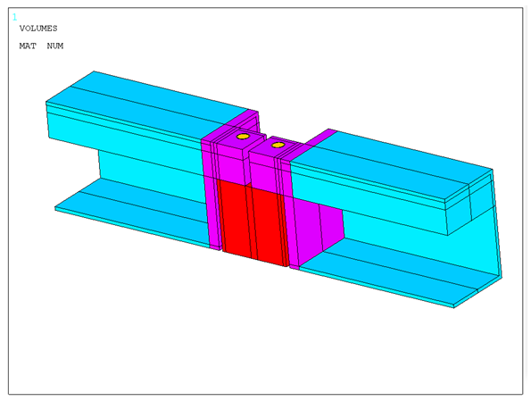
Beam-to-column connection (half structure shown, symmetry).

Slide 9
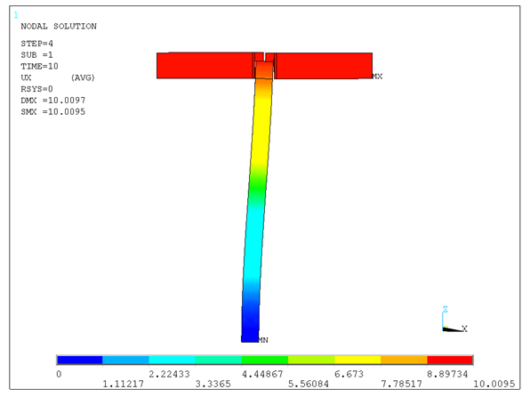
Lateral stiffness 2.4 kN/mm compared to 0.8 kN/mm hinged and 6.2 kN/mm rigid beam-to-column connection.

Slide 10
Rudimentary code (EC3) resistance assessment to start with.

Slide 11
VKR 100 x 100 x 8 S355 R6 column resistance, both ends pinned. Resistance 580 kN as compared to design load 385 kN.

Slide 12
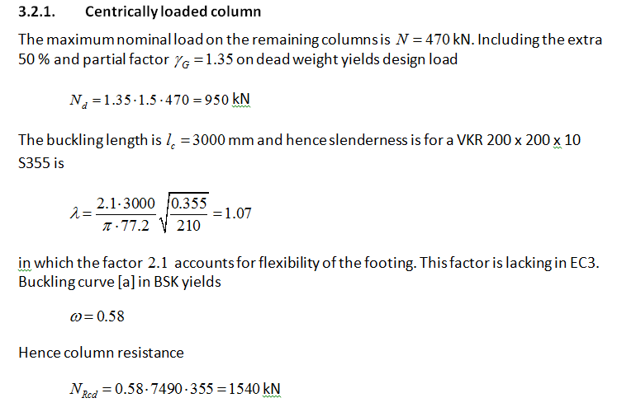
VKR 200 x 200 x 10 S355 > R9 column resistance, clamped foot, free top (cantilever column). Centric load. Resistance 1540 kN as compared to design load 950 kN.

Slide 13
VKR 200 x 200 x 10 S355 > R9 column resistance, clamped foot, free top (cantilever column). Eccentric load (e=100 mm). Resistance 785 kN as compared to design load 950/2 = 475 kN.

Slide 14
FE-analysis to determine resistance for different loading scenarios.
All analysis is elastoplastic large deformation analysis including geometrical initial imperfections.
Residual stresses no concern since all columns are hot formed hollow sections (EC3 buckling curve [a] in code assessment).
This ensures maximum accuracy and maximum resistance.
Color plots display effective plastic strain (not stress) prior to collapse.

Slide 15
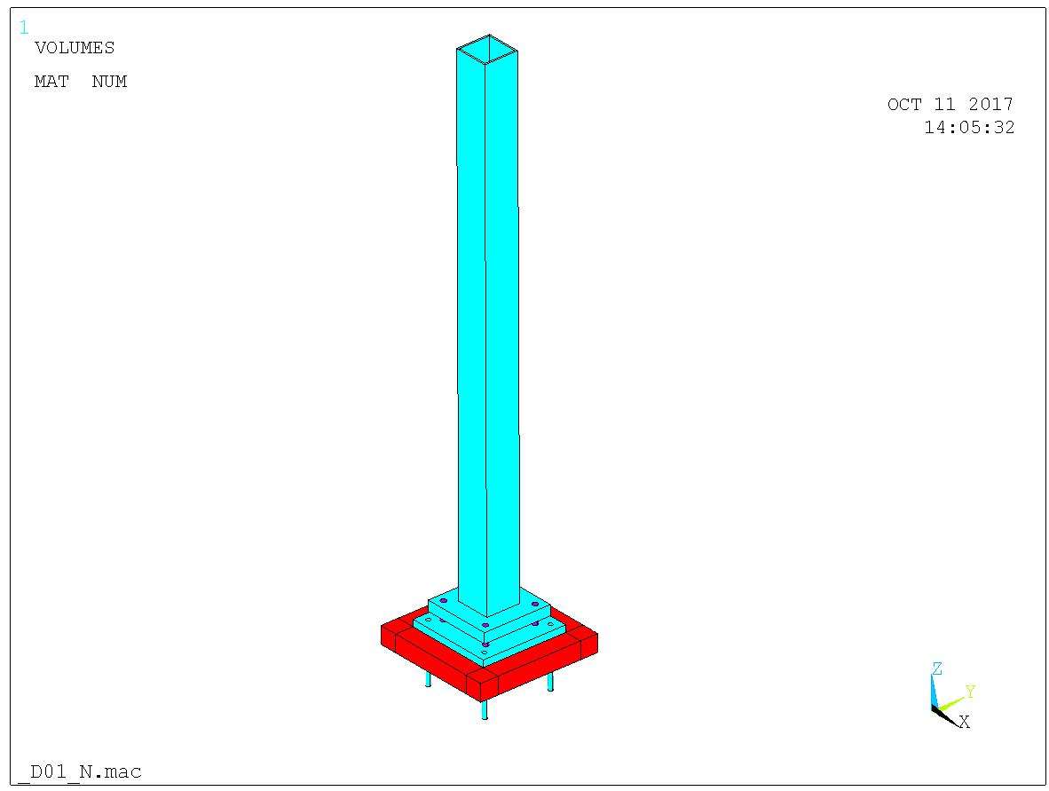
Initially the cantilever 200 x 200 x 10 S355 case. Centric load.

Slide 16
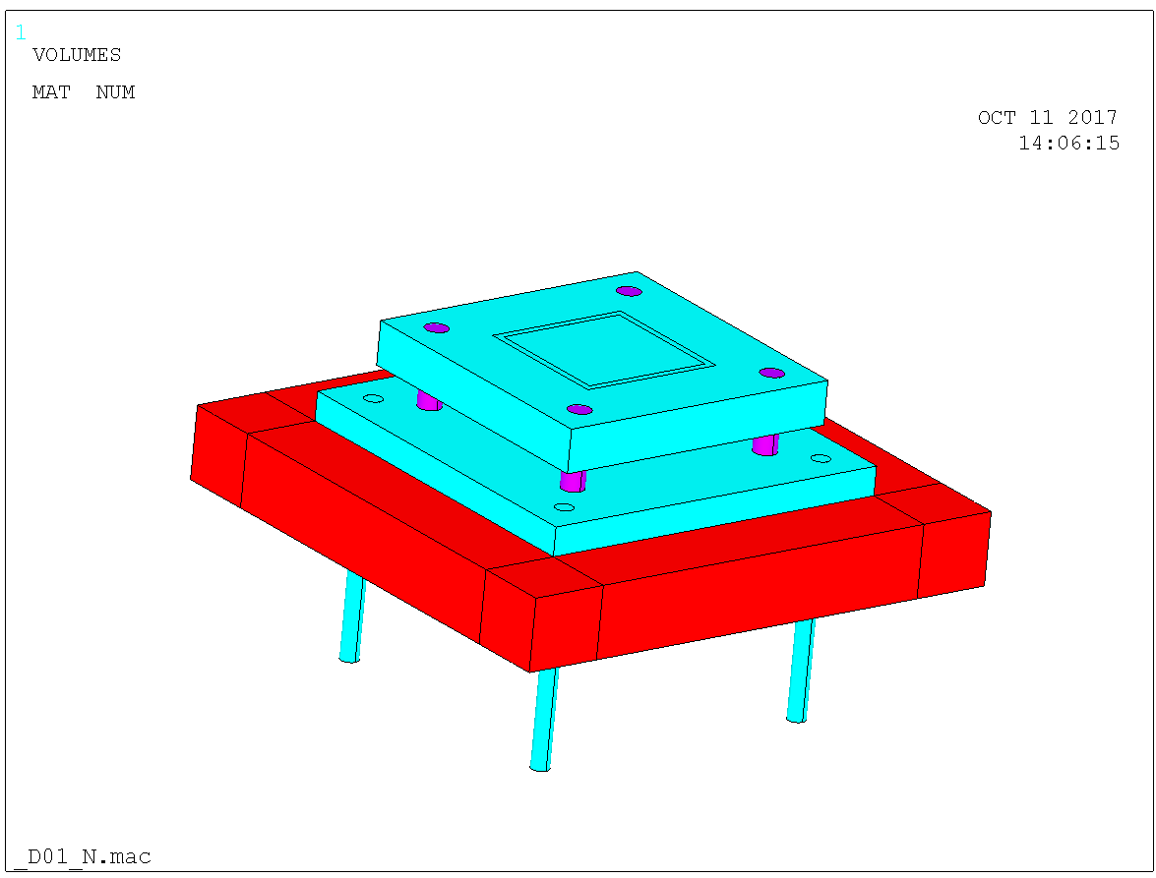
Detail of the column footing.

Slide 17
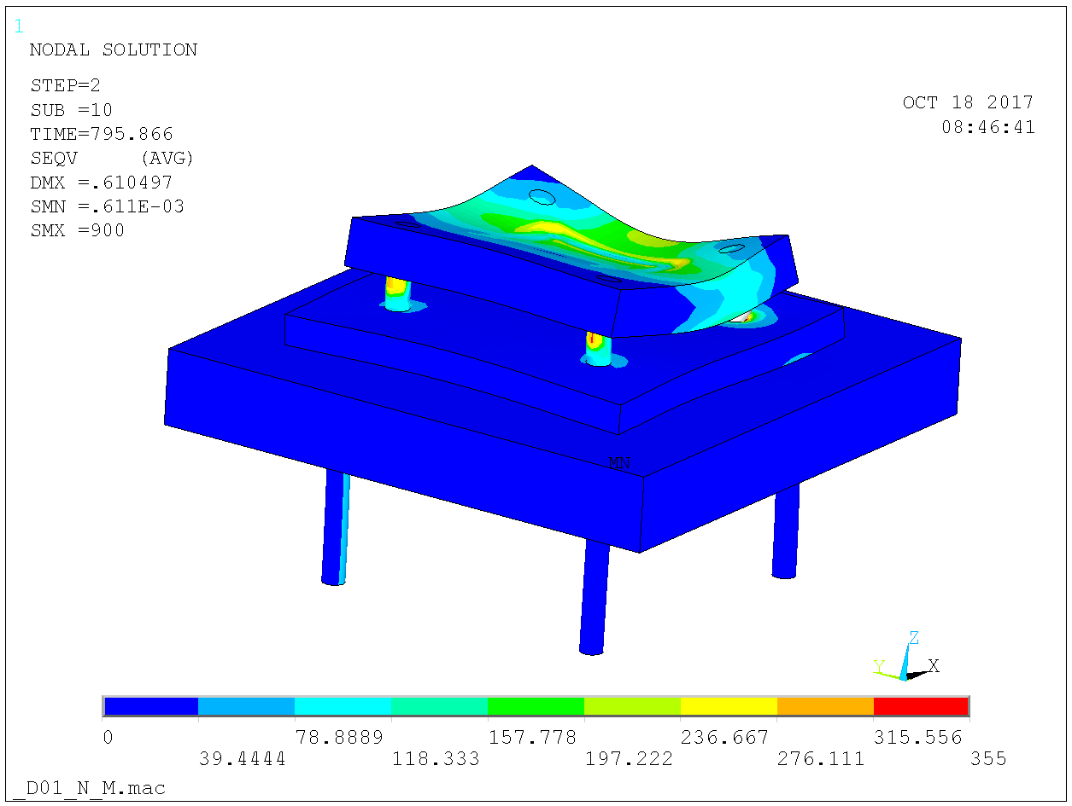
Flexibility of foot plate accounted for, which affects stability of column.

Slide 18
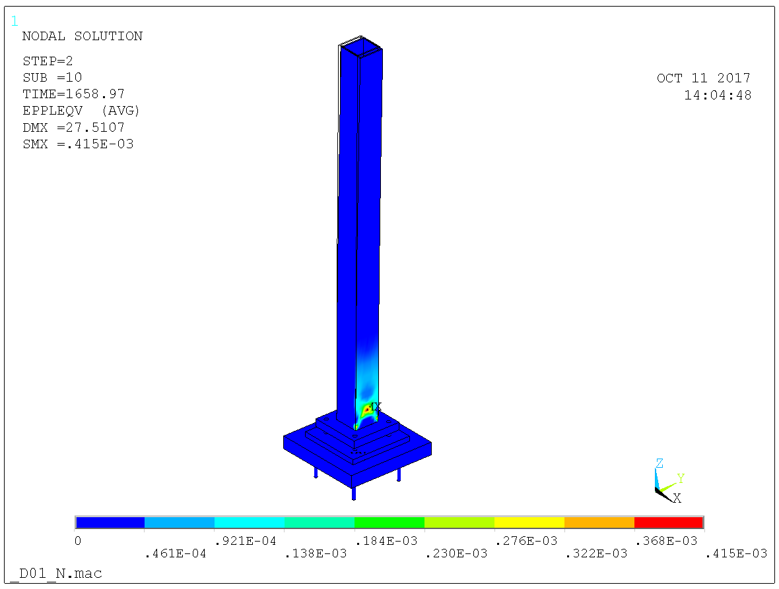
Resistance 1660 kN with perfect clamp on column foot as (compared to 1510 kN code resistance).

Slide 19
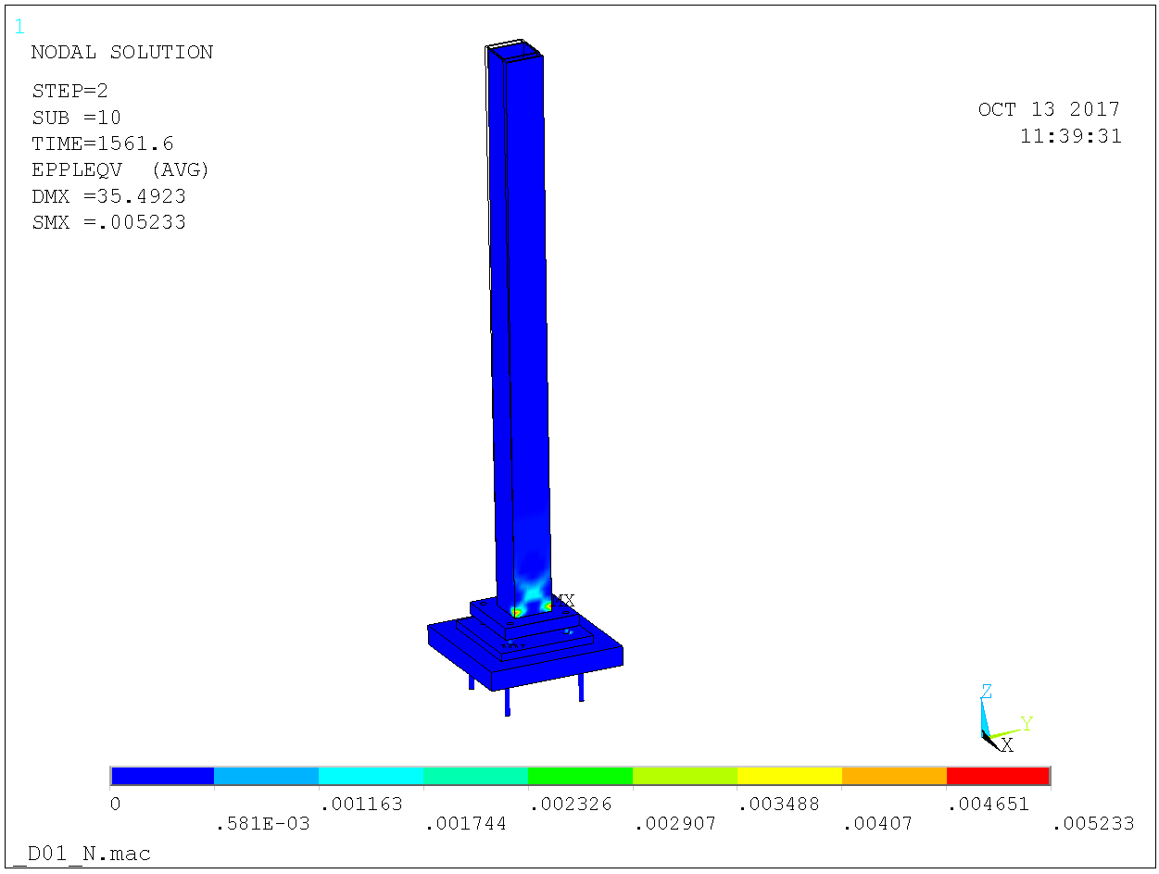
Resistance 1560 kN with plate bolts M36 10.9 and foot plate 60 mm.

Slide 20
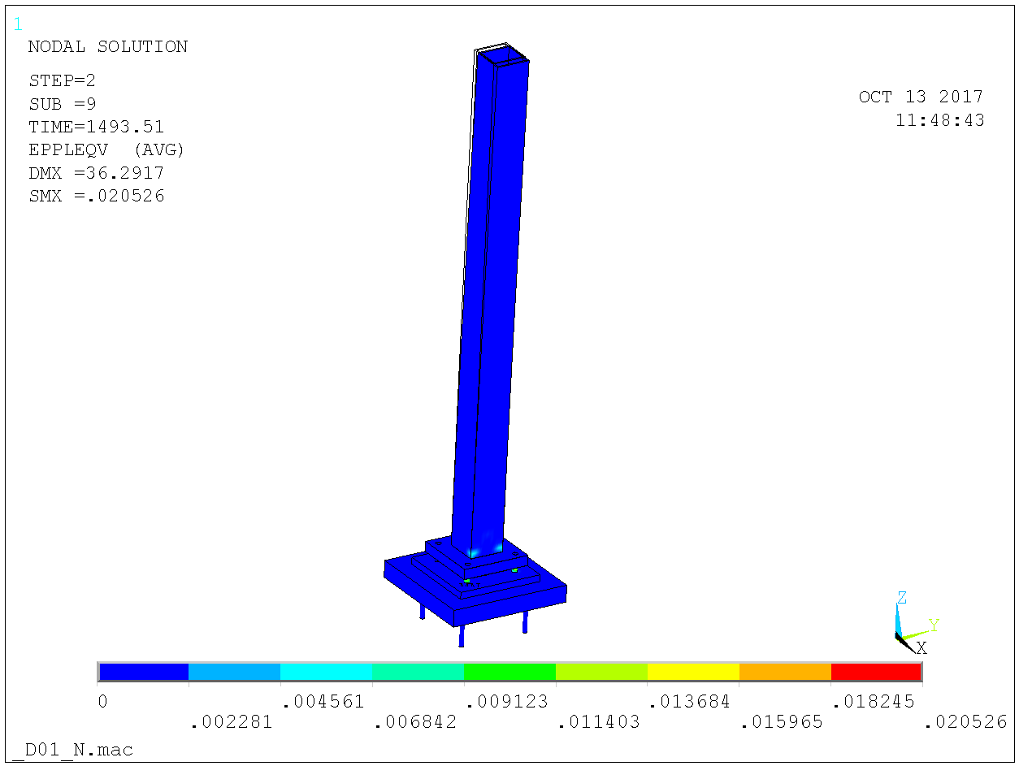
Resistance 1495 kN with plate bolts M36 8.8 and foot plate 60 mm.

Slide 21
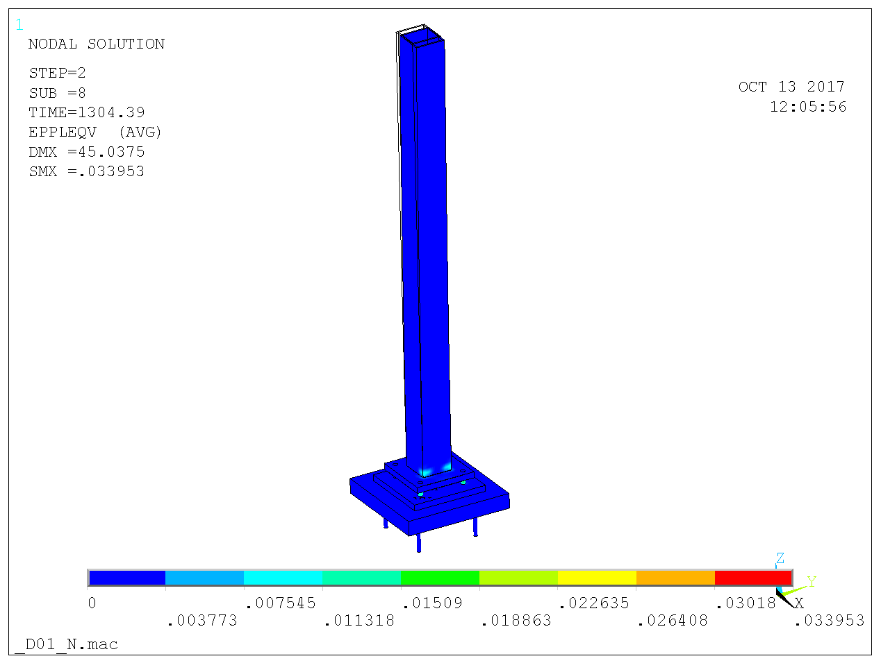
Resistance 1305 kN with plate bolts M36 8.8 and foot plate 40 mm.

Slide 22
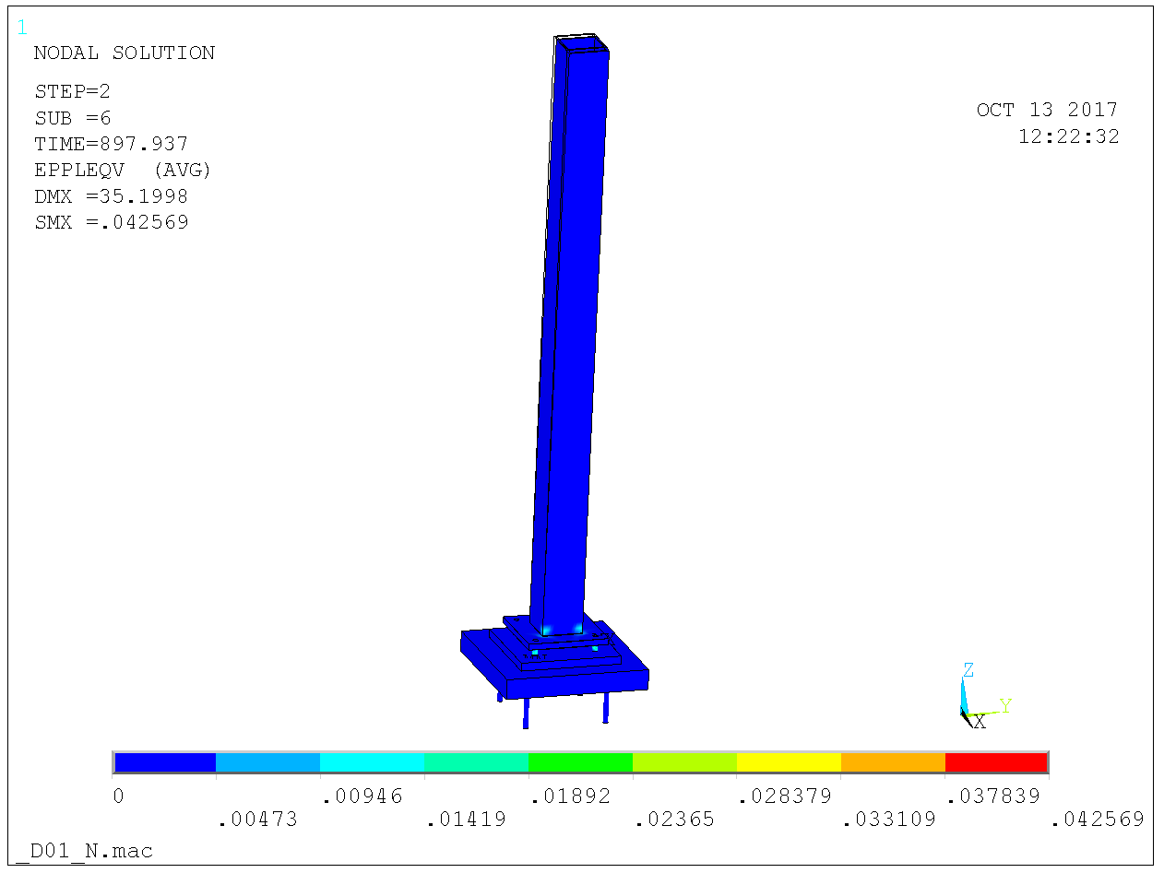
Resistance 895 kN with plate bolts M30 8.8 and foot plate 30 mm.

Slide 23
Cantilever 200 x 200 x 10 S355 case. Eccentric load, eccentricity 100 mm.

Slide 24
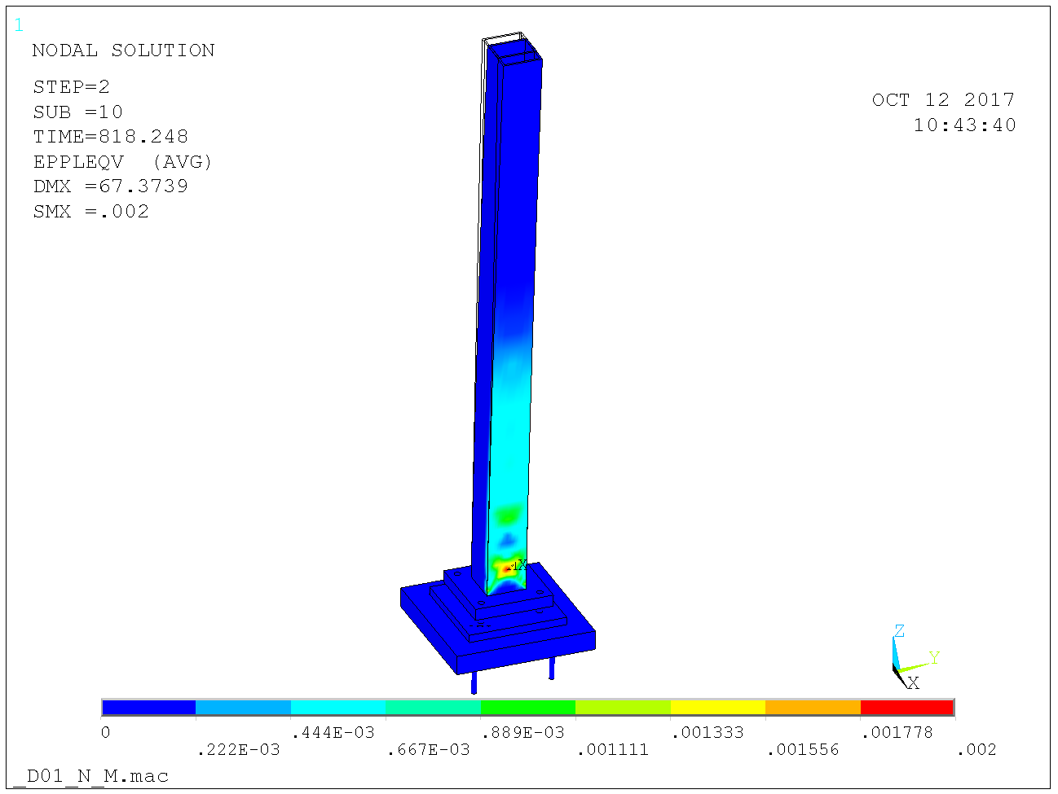
Resistance 820 kN with perfect clamp on column foot as (compared to 785 kN code resistance).

Slide 25
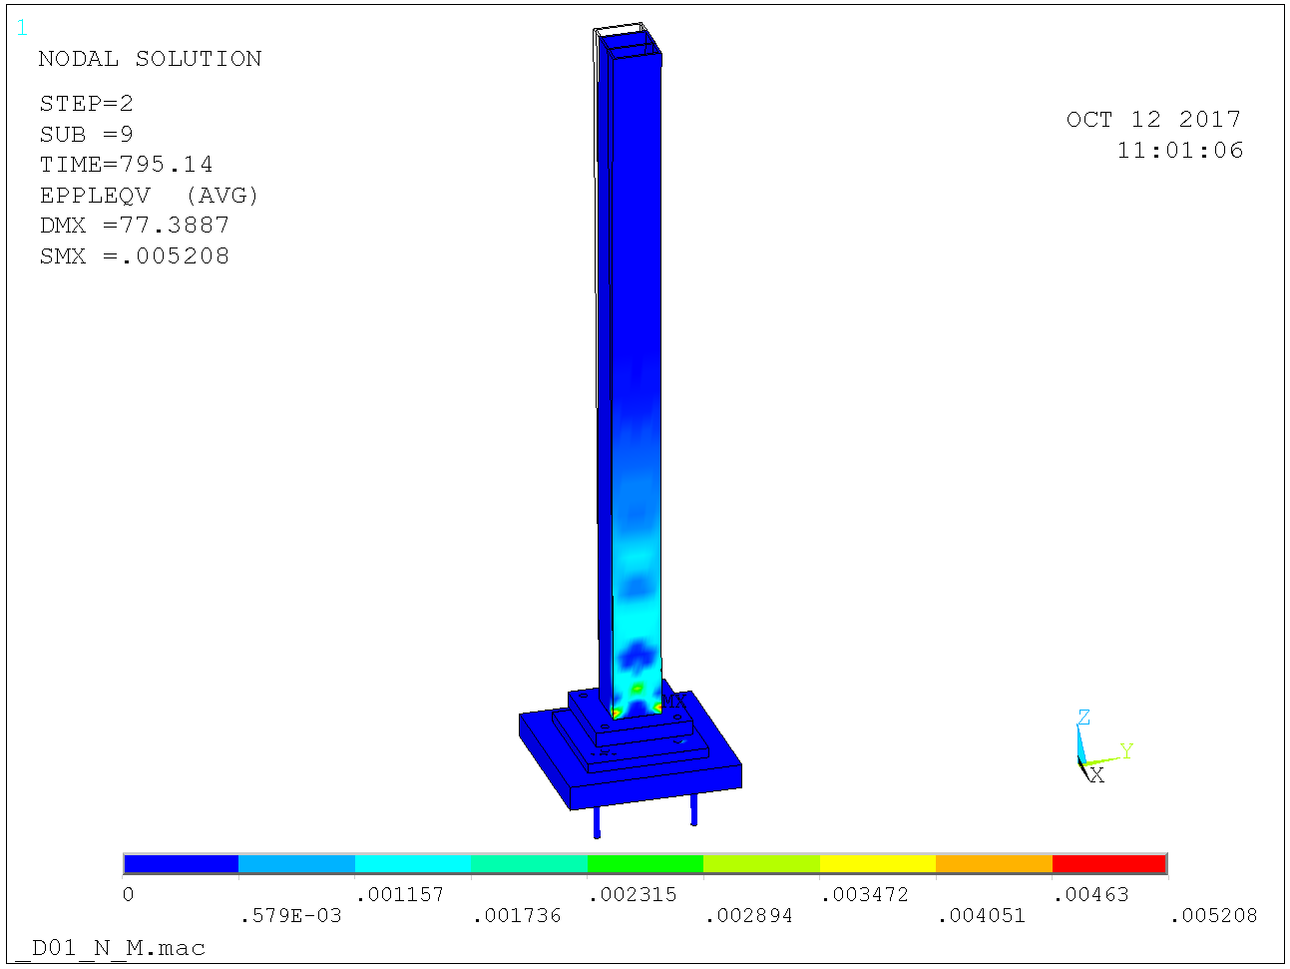
Resistance 795 kN with plate bolts M36 10.9 and foot plate 60 mm.

Slide 26
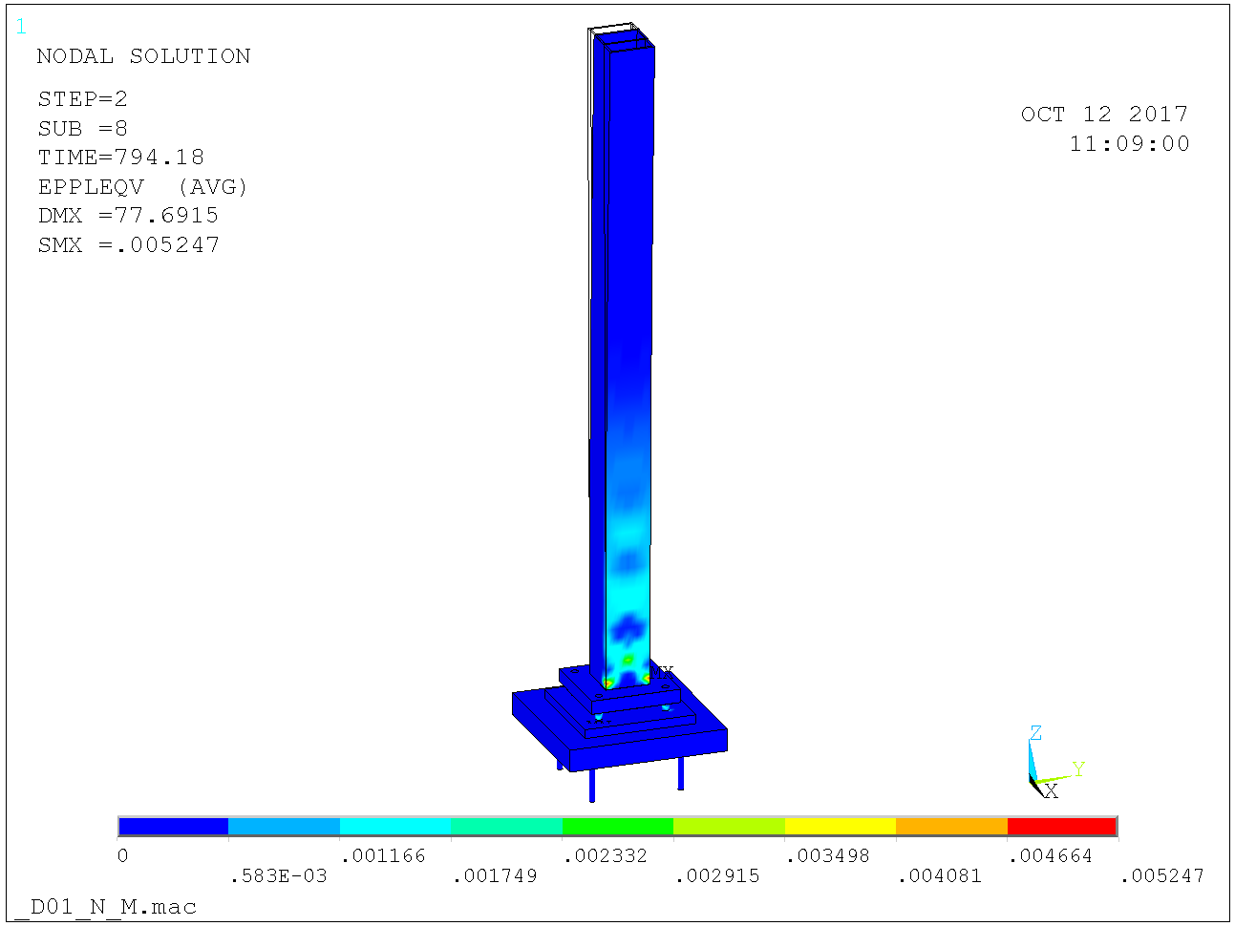
Resistance 755 kN with plate bolts M36 8.8 and foot plate 40 mm.

Slide 27
Hence: M36 10.9 bolts and 60 mm foot plate.

Slide 28
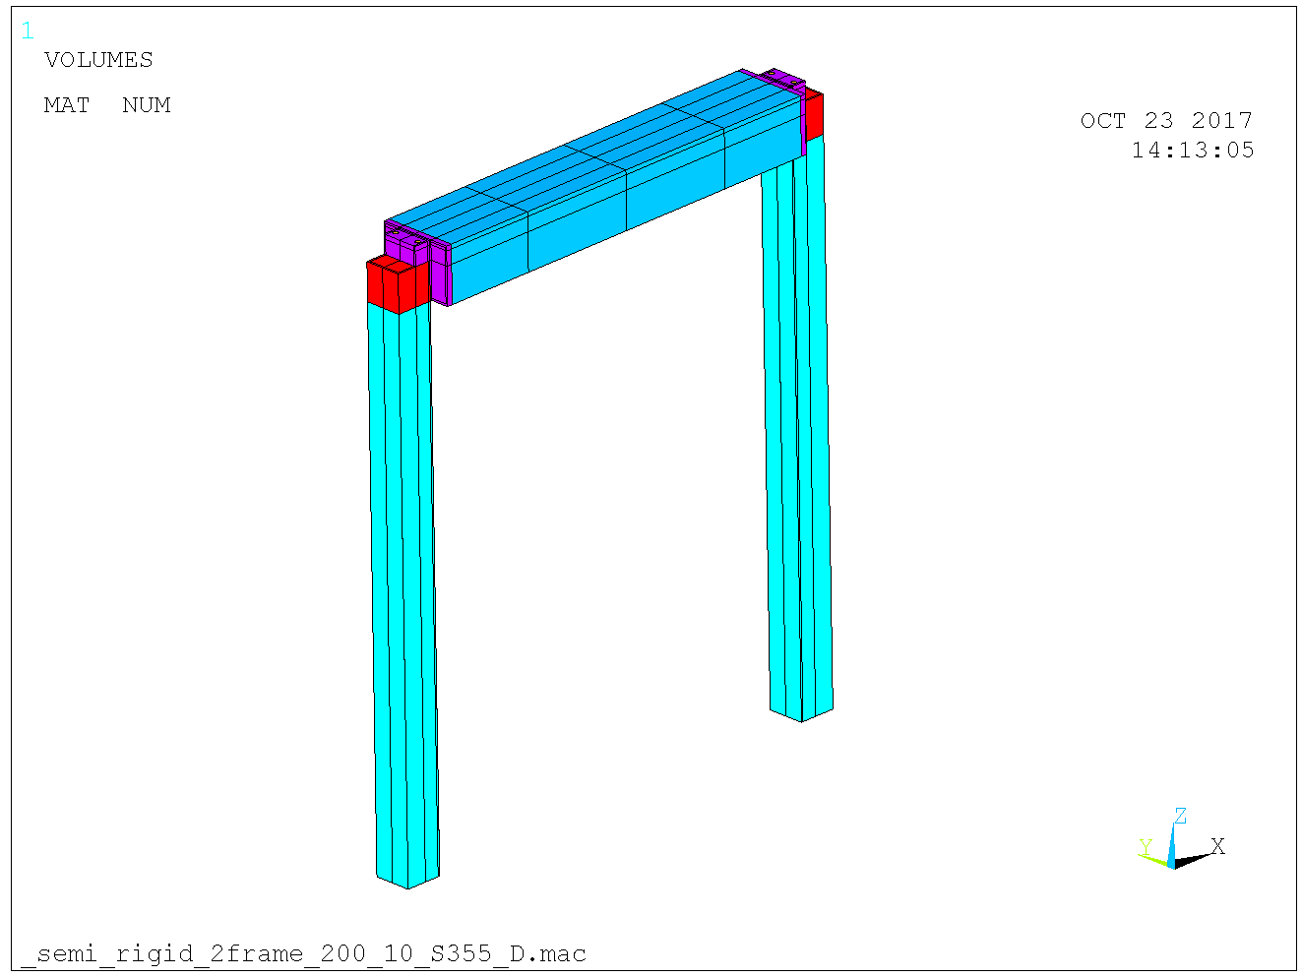
Detailed analysis accounting for semi-rigid beam to column connection.

Slide 29
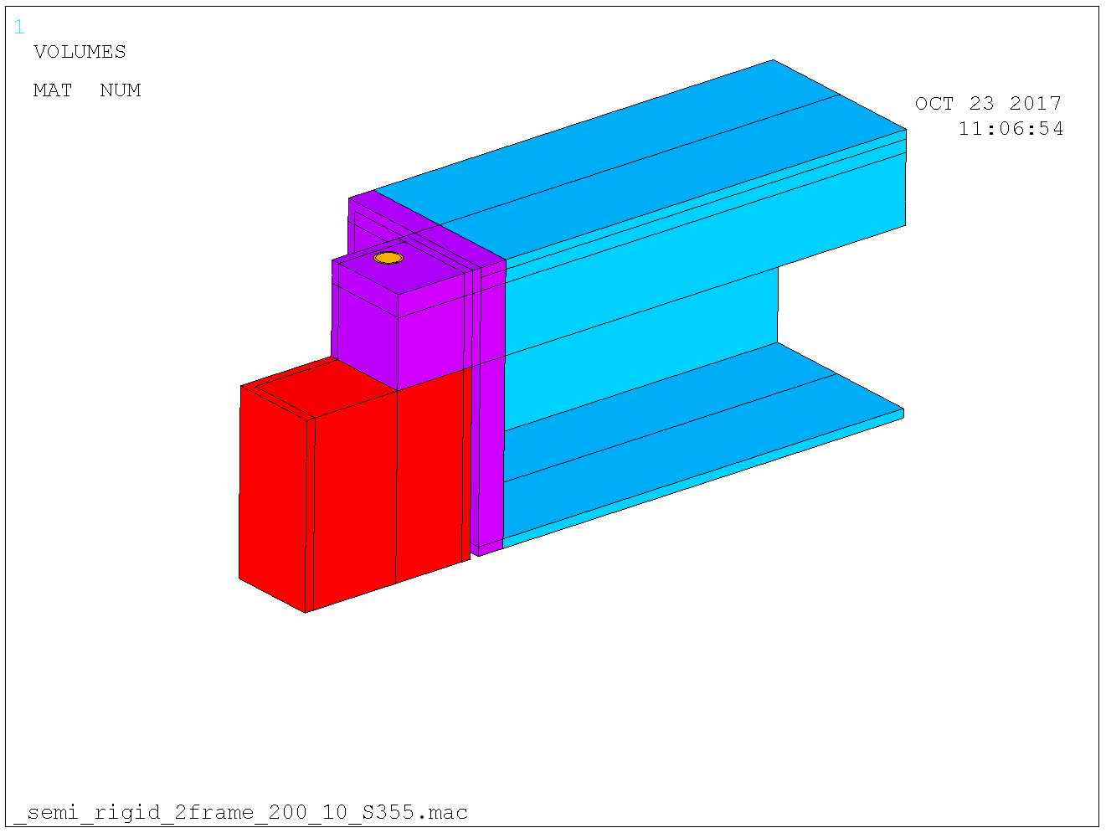
Detailed of the connection. Massive block at column top and 100 mm thick top flange of beam (from shielding considerations).

Slide 30
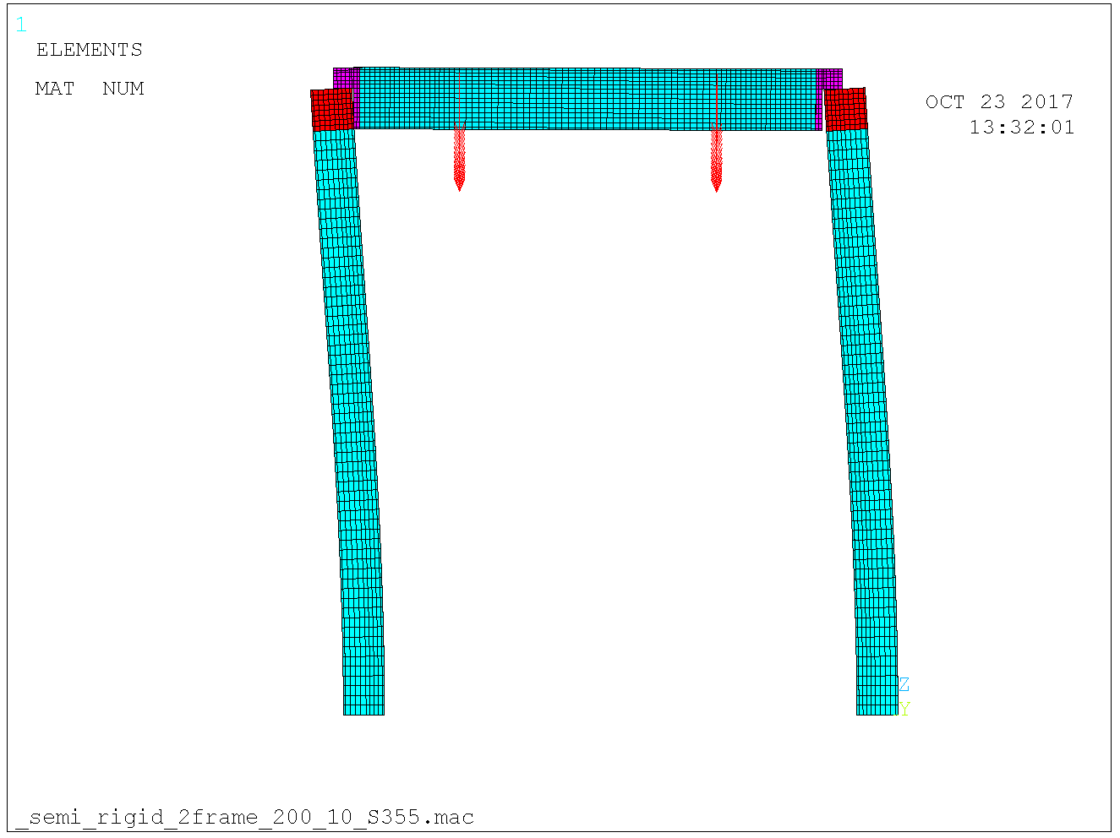
Frame de-coupled from neighboring structural elements. Initial imperfection 0.5 % sway deformation (exaggerated in picture). In plane buckling mode initially studied.Initial imperfections visible (exxagerated).

Slide 31
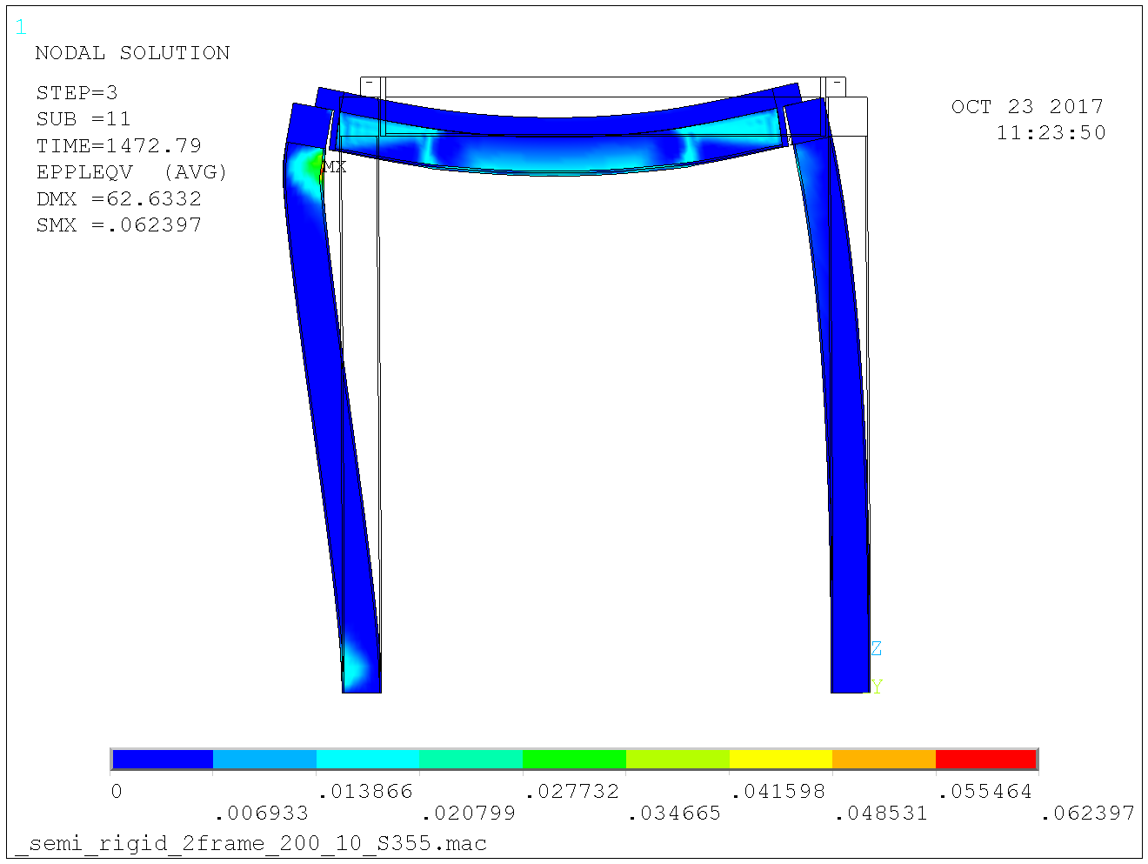
Resistance 1470 kN per column. Plastic strains prior to collapse shown. Design load for this case 950 / 2 = 475 kN.

Slide 32
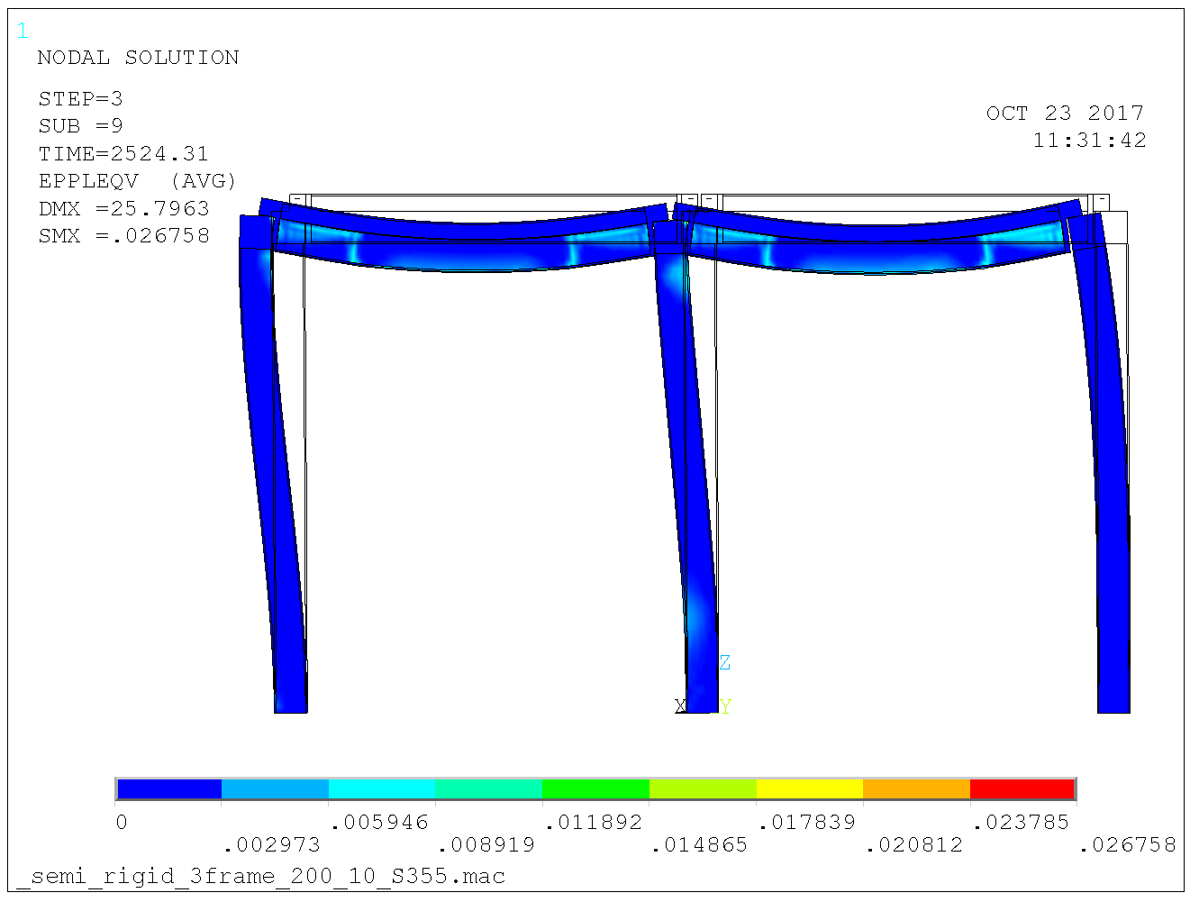
Adding a frame: Resistance 2540 kN on mid column and 1270 kN on outer columns. Design load for this case 950 kN on mid column and 950 / 2 = 475 kN on outer columns.

Slide 33
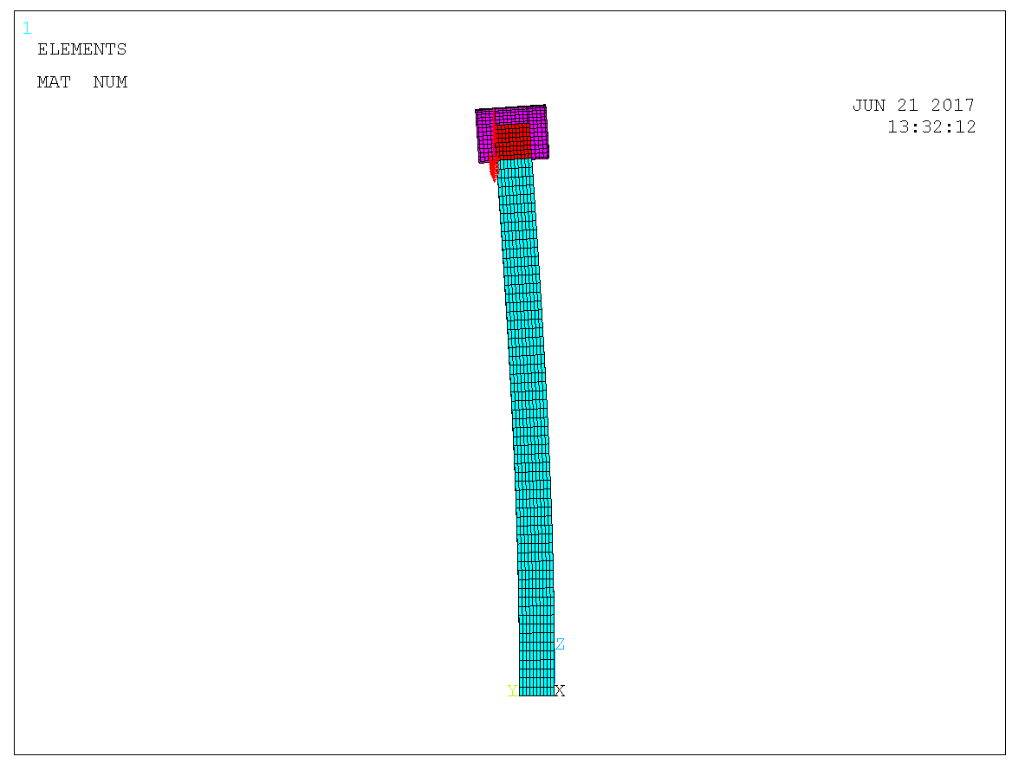
Adding 100 mm eccentricity (load from one side only). Initial imperfection visible (exxagerated).

Slide 34
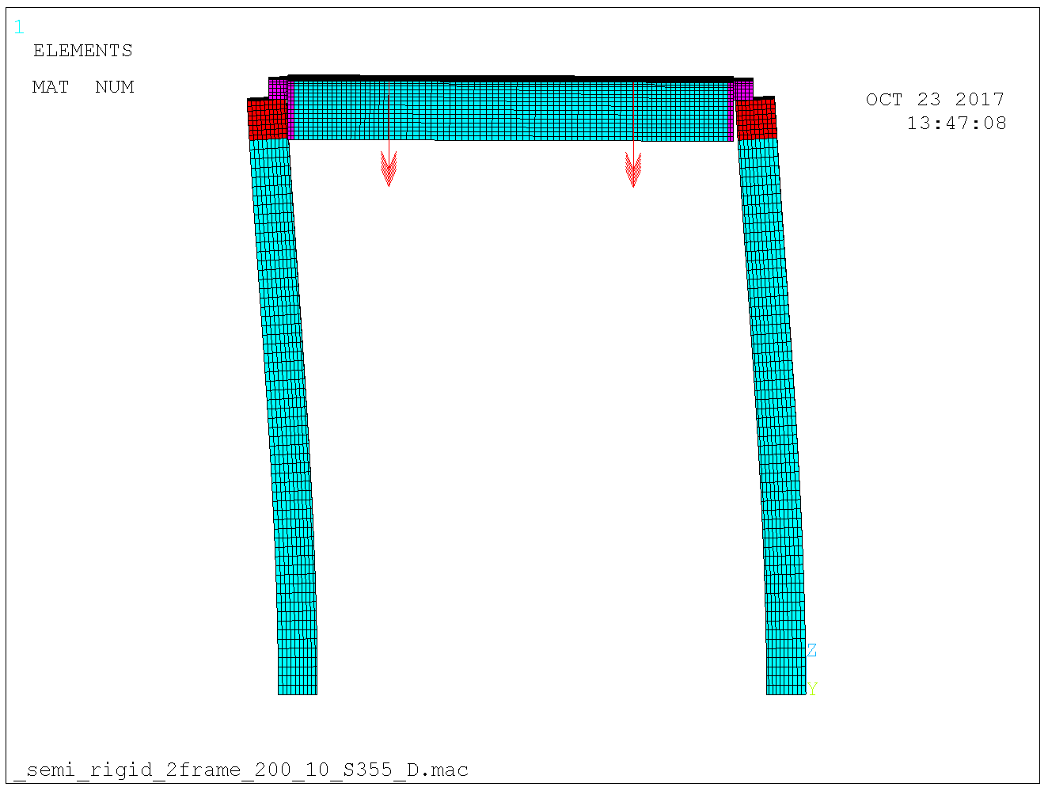
Sway imperfection still there.

Slide 35
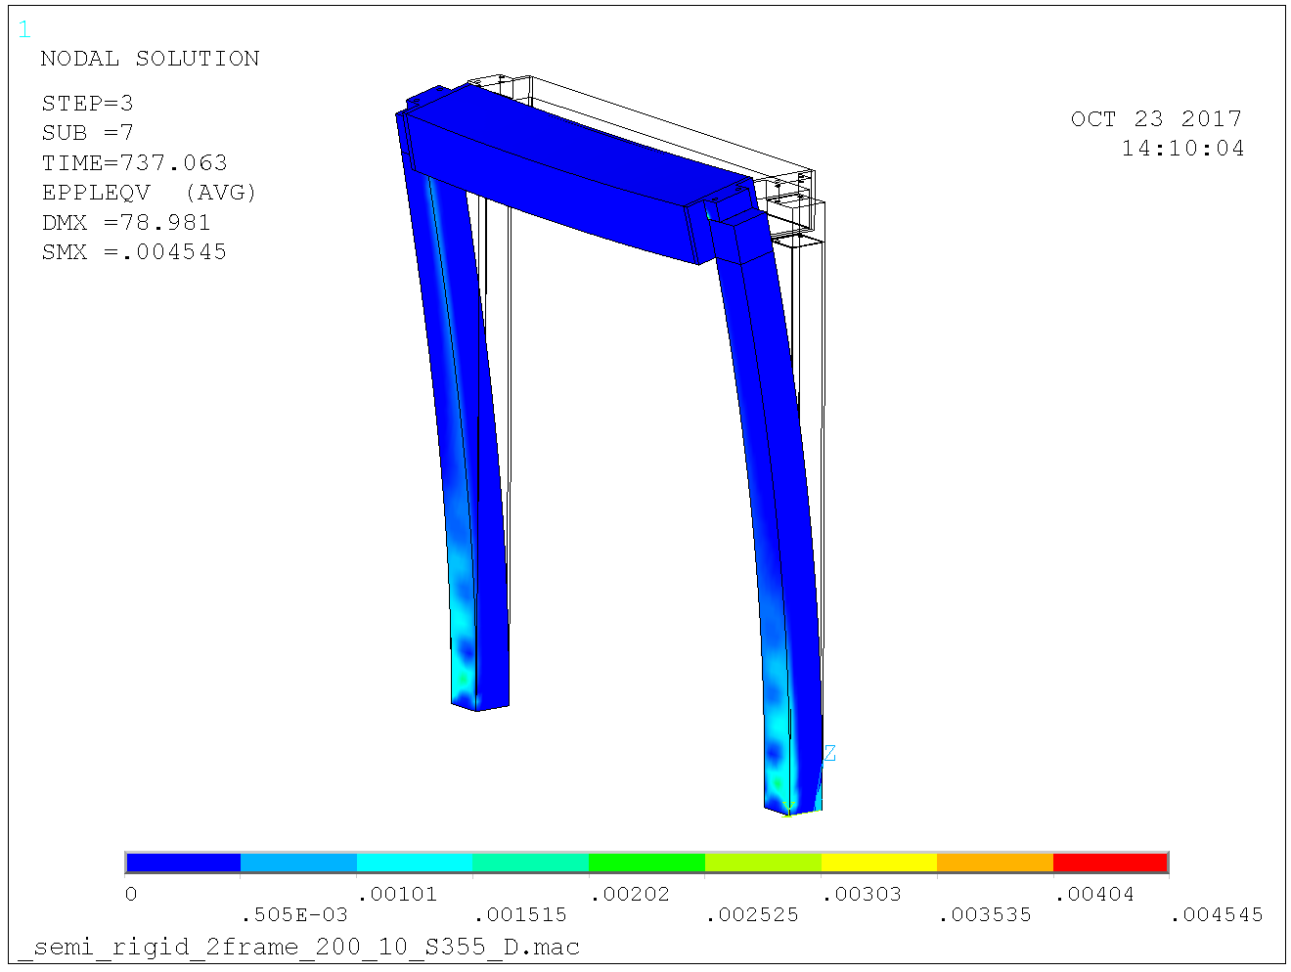
Resistance 740 kN on per column. The design column load is 950 / 4 = 240 kN.

Slide 36
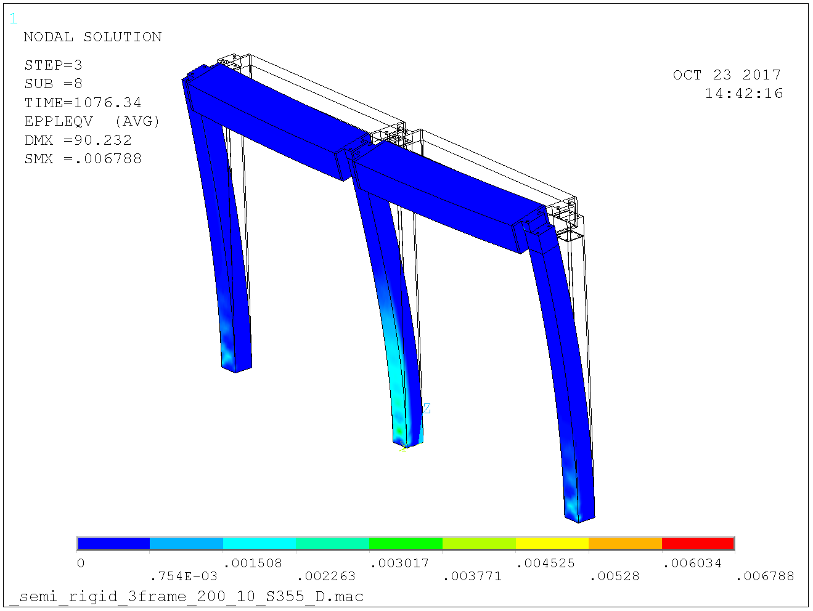
Adding a frame: Resistance 1080 kN on mid column and 540 kN for outer columns. Design load 950 / 2 = 475 kN on center column and 950 / 4 = 240 kN on outer columns.

Slide 37
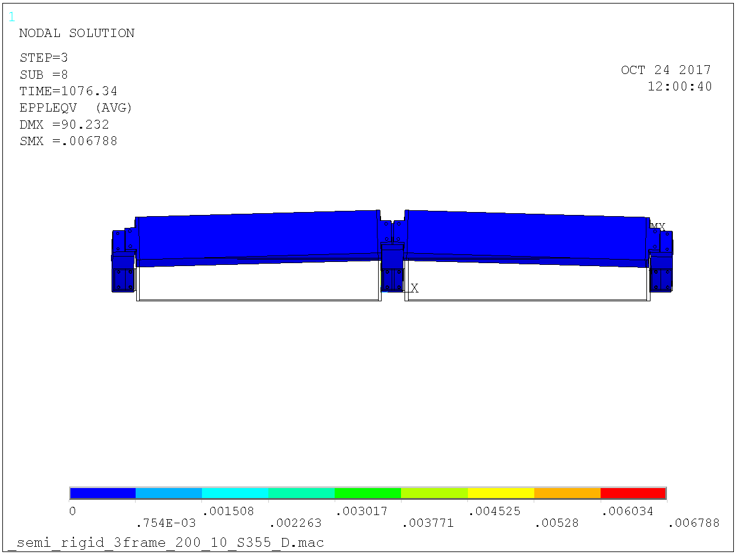
Center column assisted by outer columns, hence larger resistance than the 820 kN on slide 23.

Slide 38
Stability considerations for D01 & D03 bunker
No seismic loads is at hands. Bunker may fall radially outwards and circumferentially.
To ensure the bunker do not fall inwards, bracing is arranged that makes the structure much stronger inwards than outwards.
The bracing must then be much stronger than the framing itself. A factor 1.25 was selected in agreement with COWI.

Slide 39
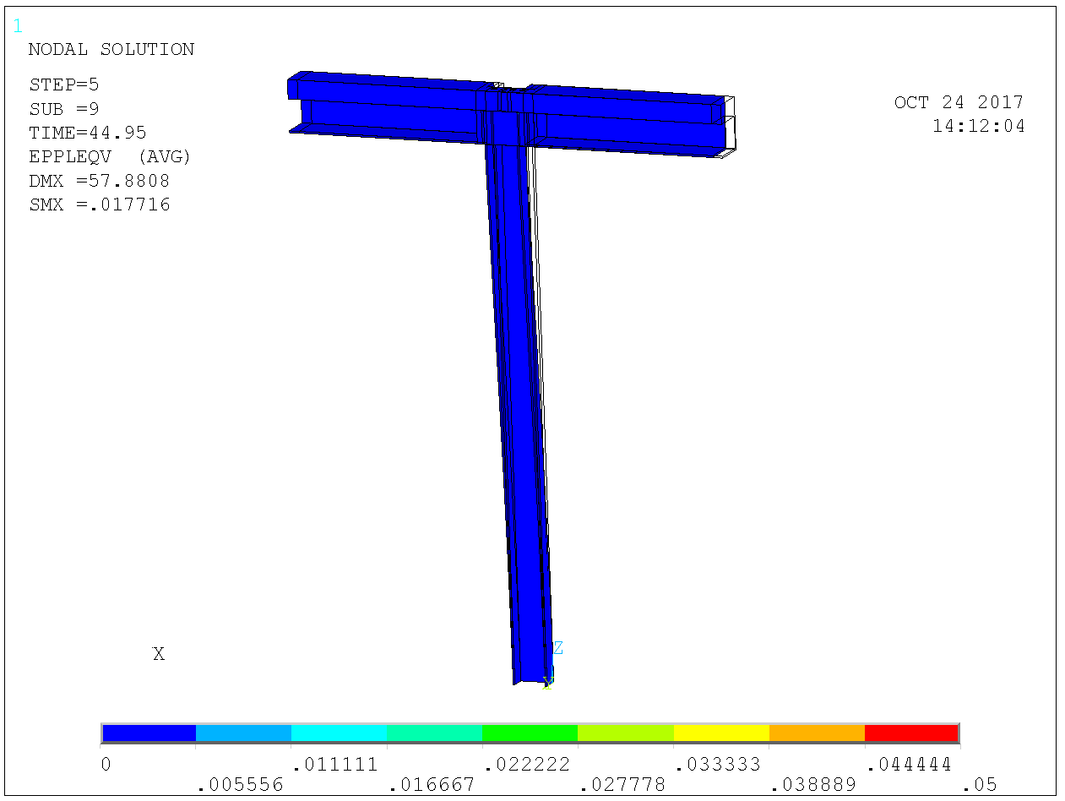
Lateral resistance: 55 mm displacement for 90 kN, collapse imminent. No axial load in column.

Slide 40
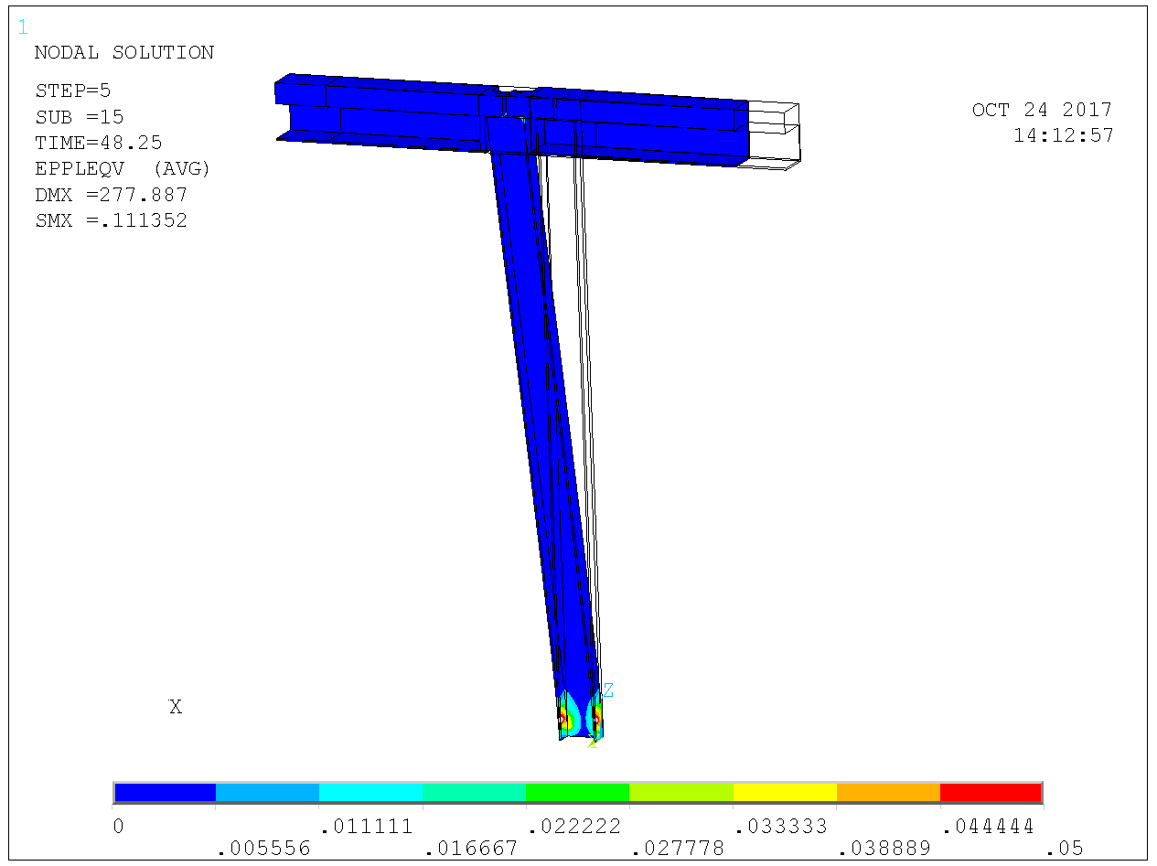
Lateral resistance: 275 mm displacement for 95 kN. No axial load in column.

Slide 41
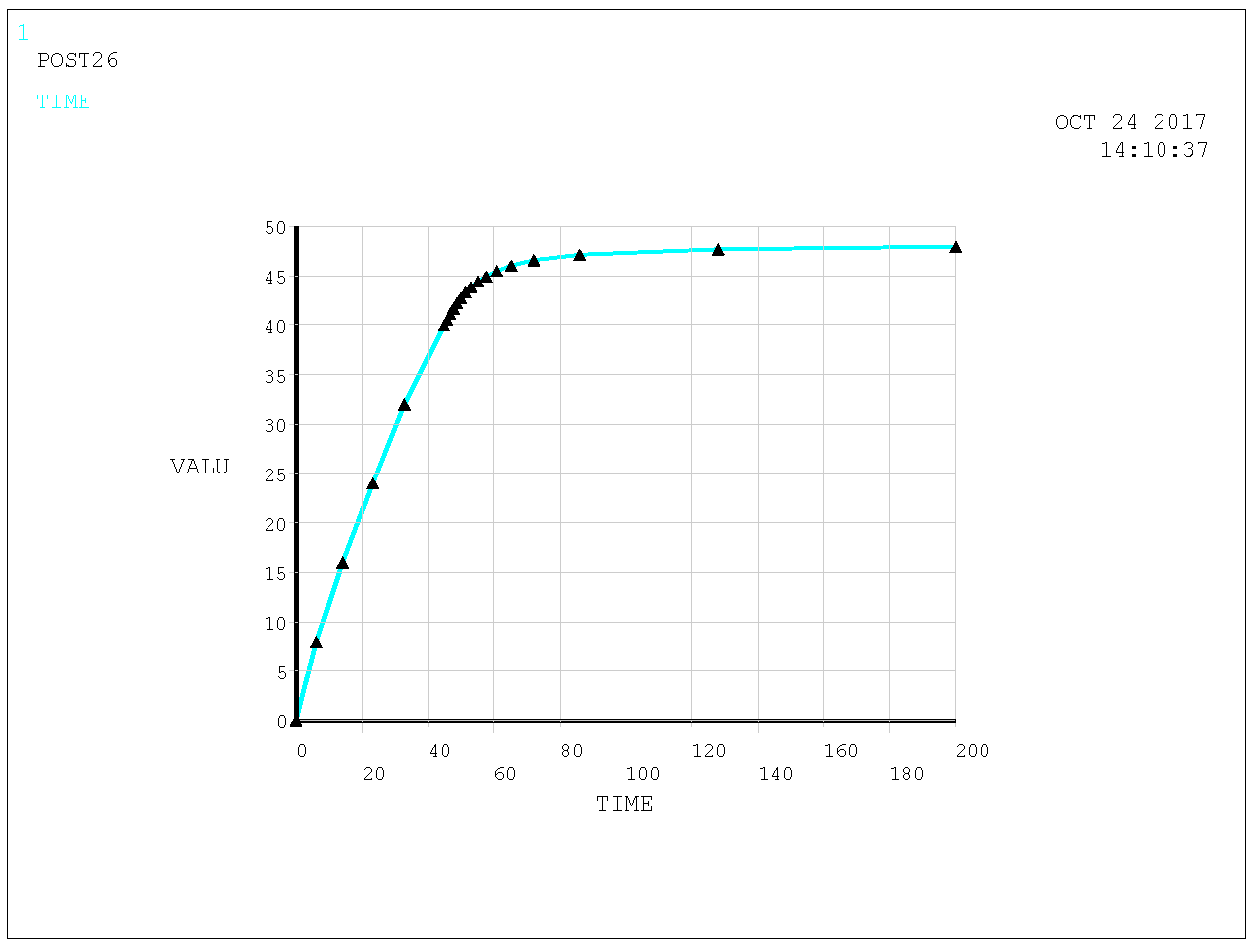
Lateral resistance: Load-displacement curve (symmetry model). Resistance 95 kN for no axial load in column.

Slide 42
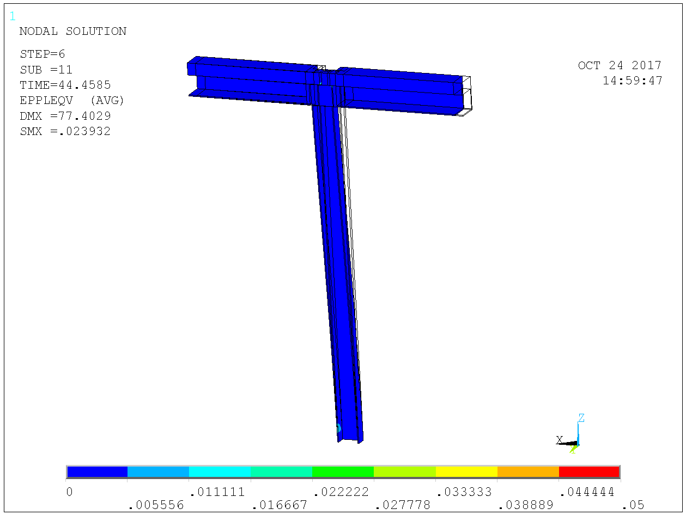
Lateral resistance: 45 mm displacement for 90 kN, collapse imminent. 300 kN axial load in column.

Slide 43
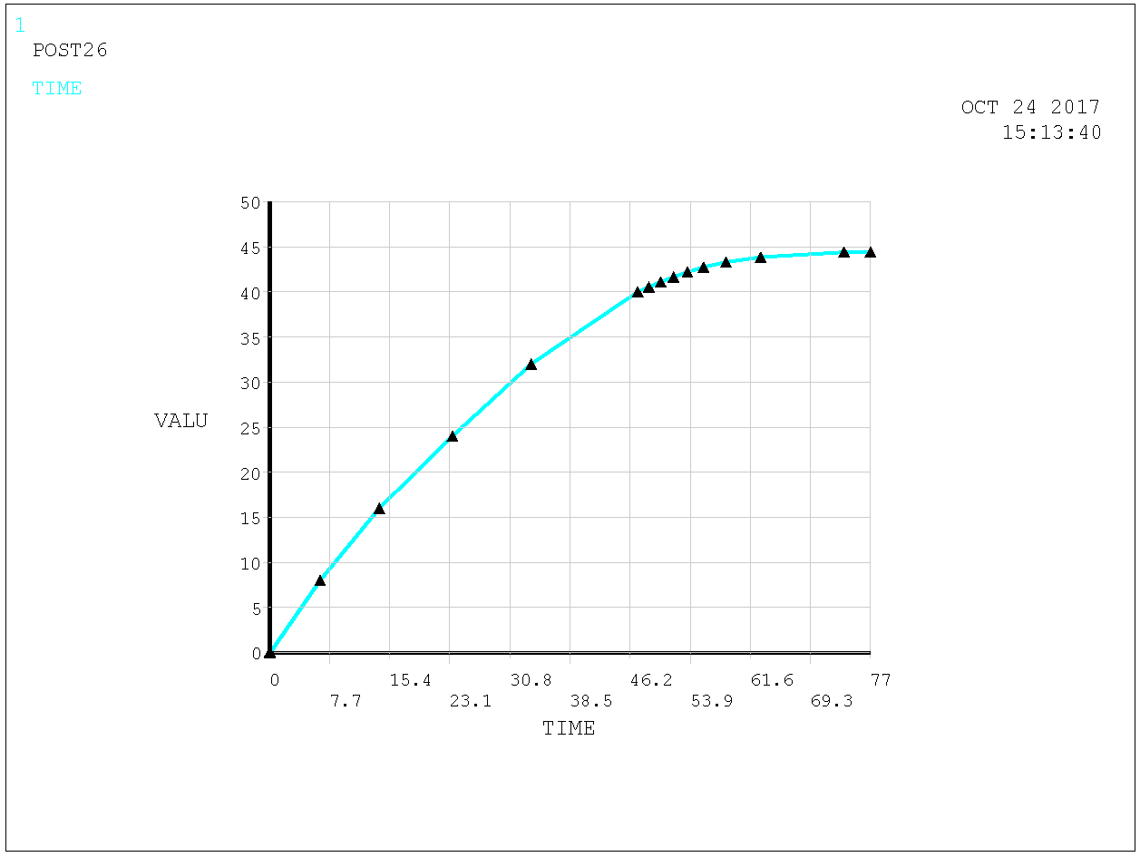
Lateral resistance: Load-displacement curve (symmetry model). Resistance 90 kN for 300 kN axial load in column. Hence minor second order contributuions.

Slide 44
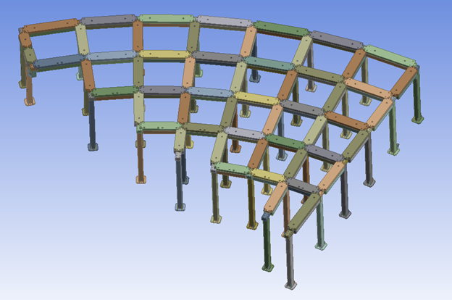
Maximum six columns radially, hence max 6 x 90 x 1.25 = 675 kN radial resistance of the framing per radial line of columns.

Slide 45
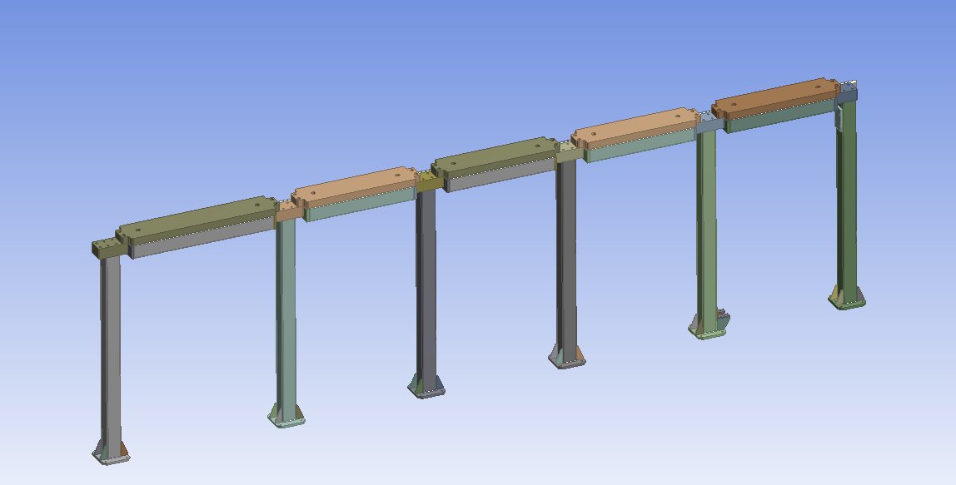
To be resisted by diagonal struts, strong inwards and weak outwards.

Slide 46
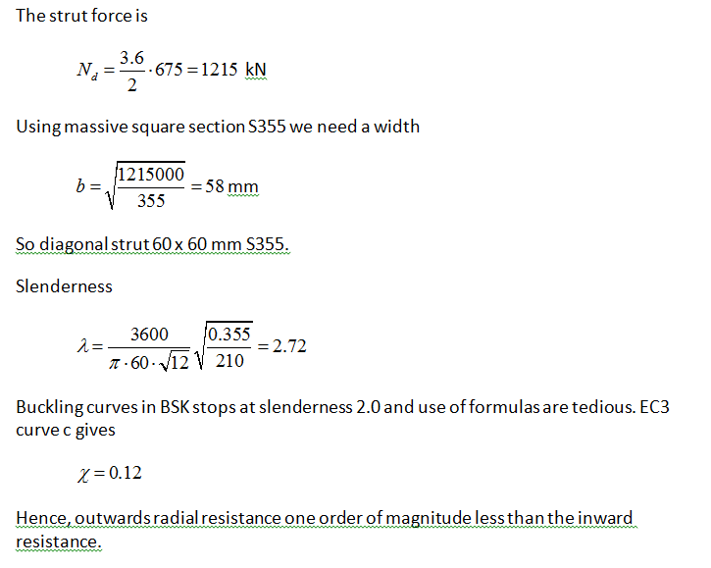
Solid diagonal brace 60 x 60 S355 does the job with negligible resistance outwards.

Slide 47
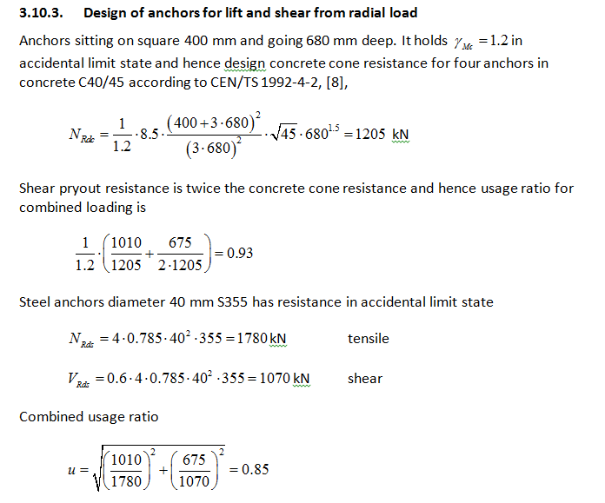
Anchor lift too large for post-installed anchors. Cast in anchors D=40 mm L = approx 680 mm required (Same anchor length used also for remaining plates in D01 & D03).

Slide 48
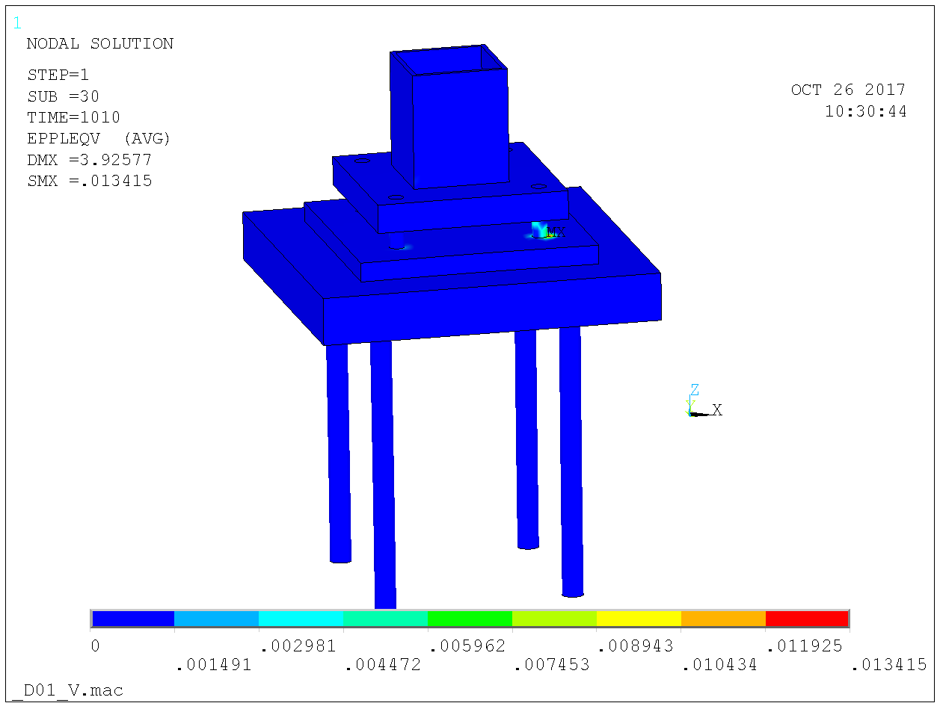
Same footing as remaining D01 & D03 columns may be used, resists the loads from the strut.

Slide 49
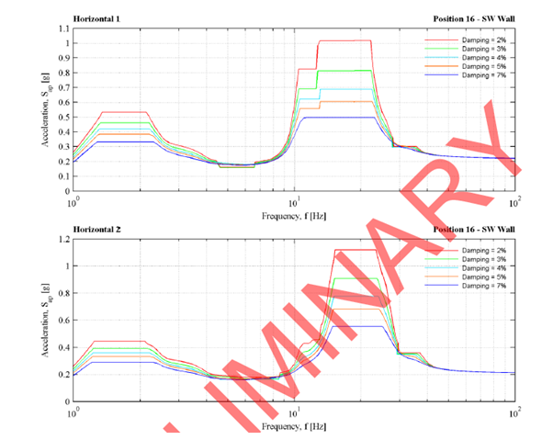
Seismic analysis
Horizontal seismic is addressed by means of response spectrum analysis of beam model. Based upon modal superposition.
Horizontal seismic affects
the beam structure.
Response spectra provided
by Scanscot.

Slide 50
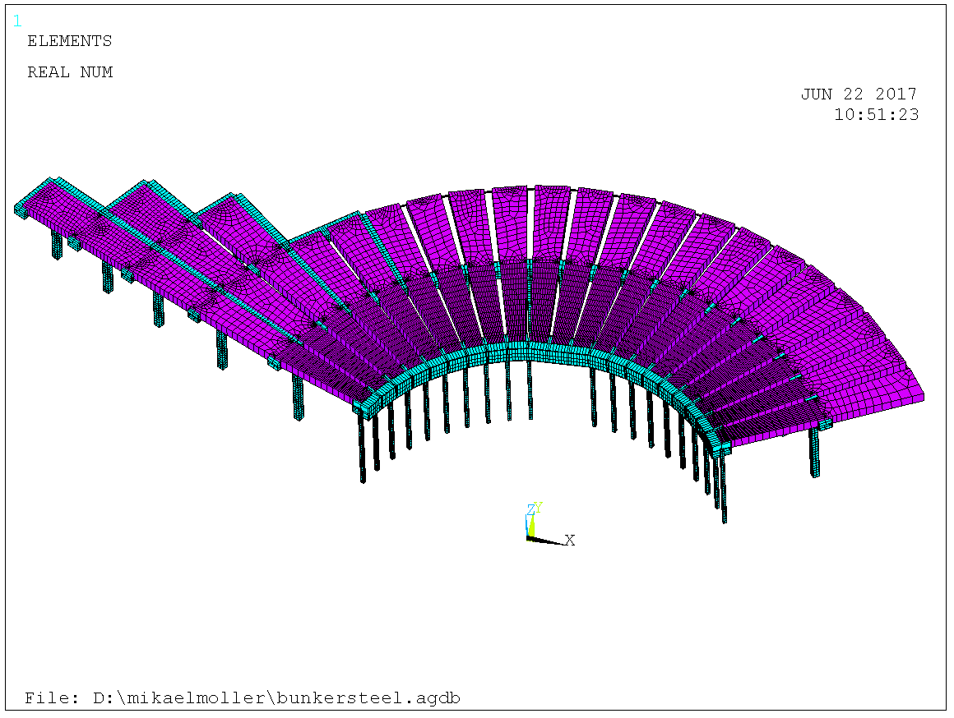
Analysis model for horizontal seismic. Bottom steel shielding pinned to circumferential R6 & R9 beams to generate a diaphragm.

Slide 51
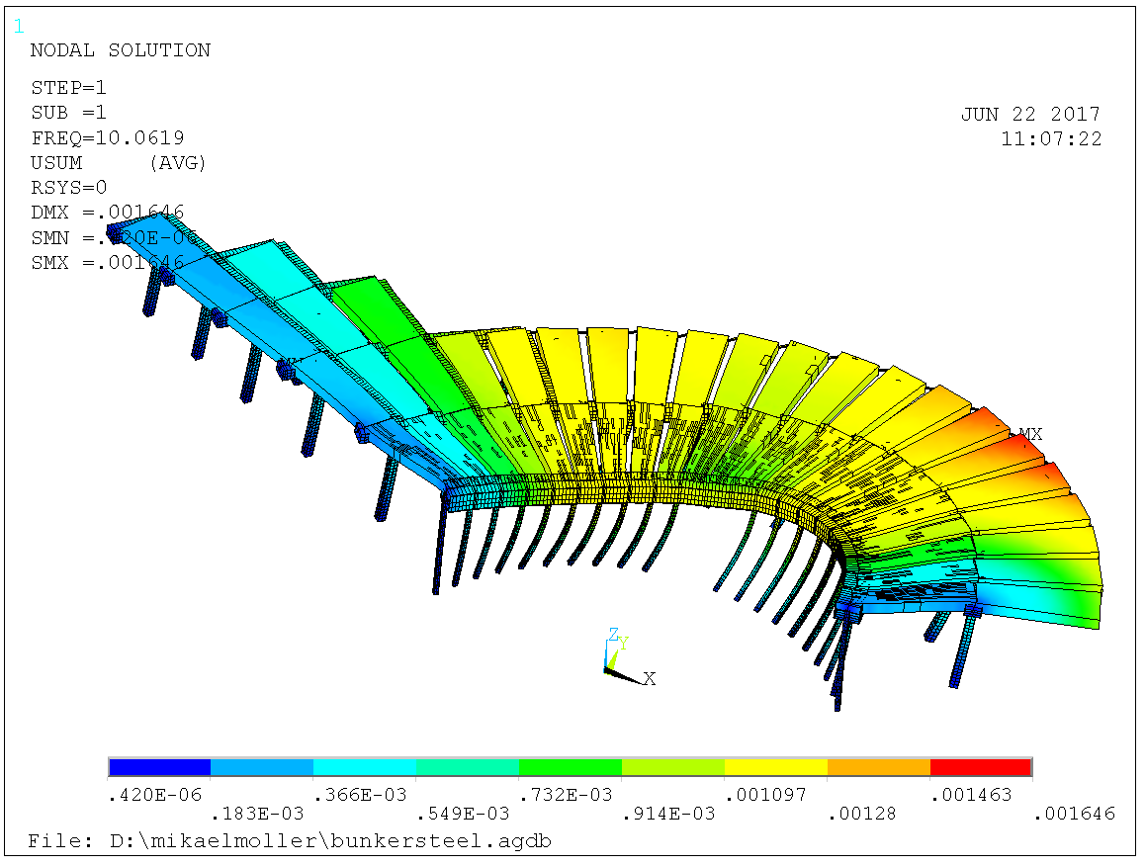
First eigenmode 10 Hz.

Slide 52
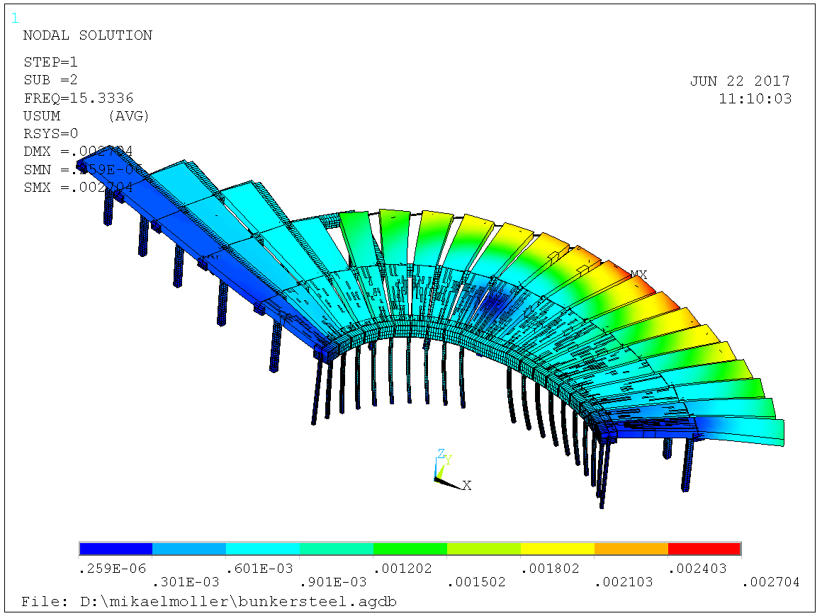
Second eigenmode 15 Hz.

Slide 53
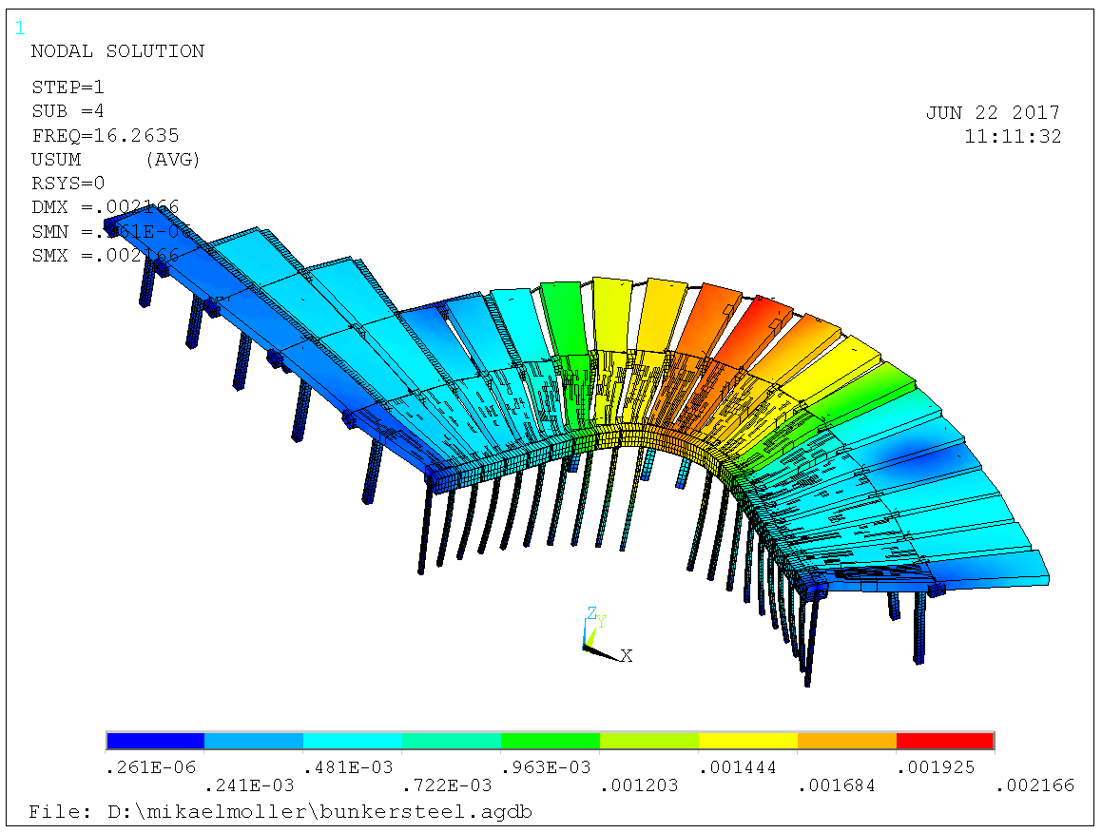
Third eigenmode 16 Hz, and so forth. 100 modes included.

Slide 54
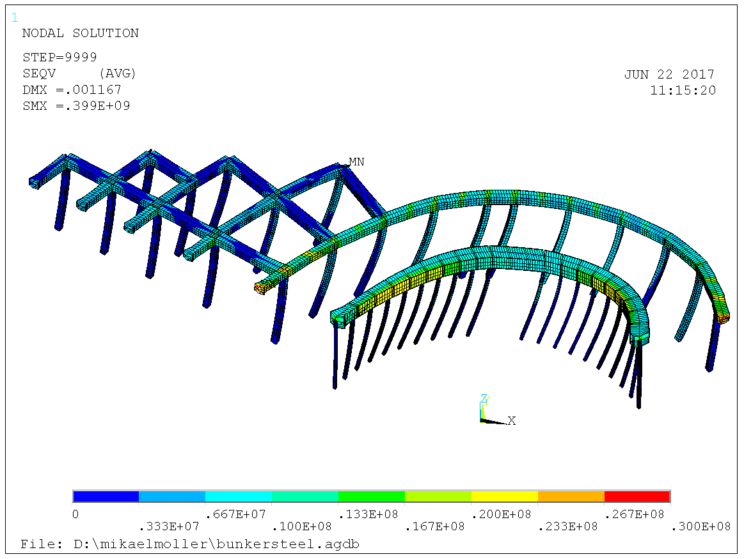
Moderate stresses in structure, about 30 MPa.

Slide 55
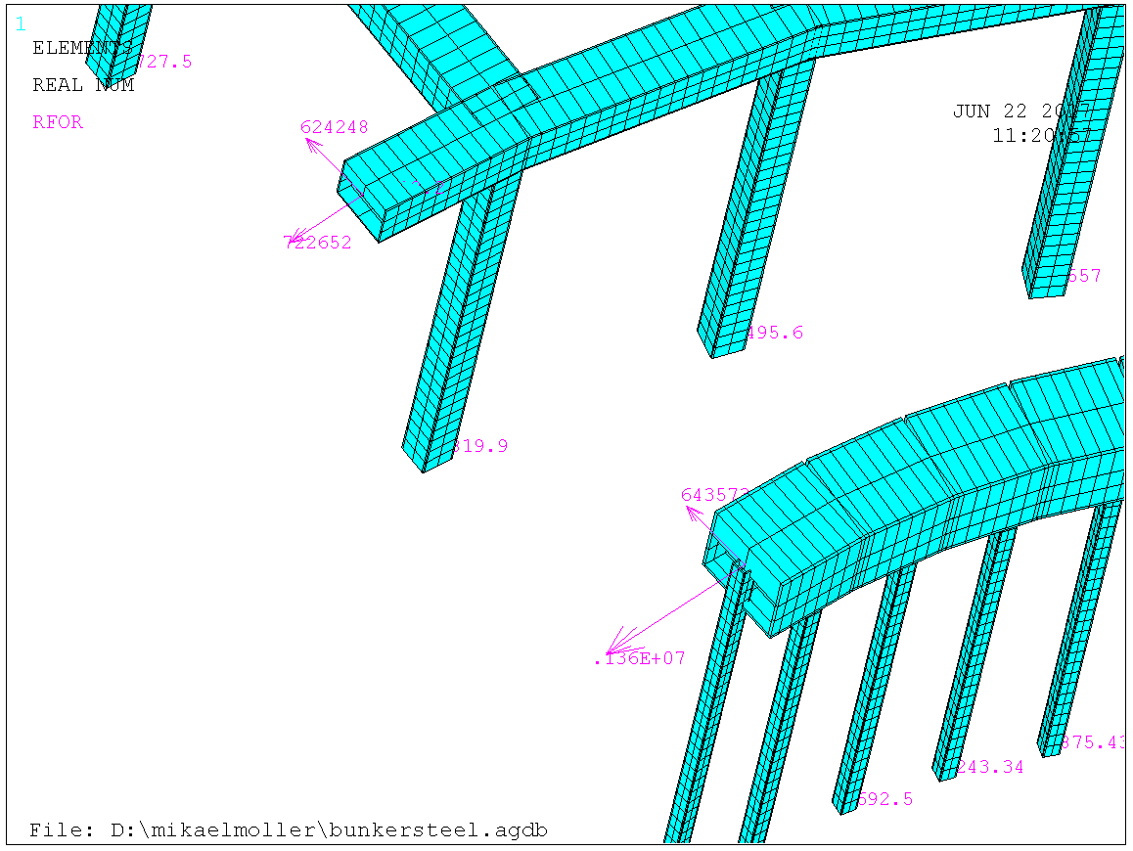
But large reaction forces at the wall, 1300 kN. Sweco mitigated this to 900 kN by including frame in their master model dynamic analysis.

Slide 56
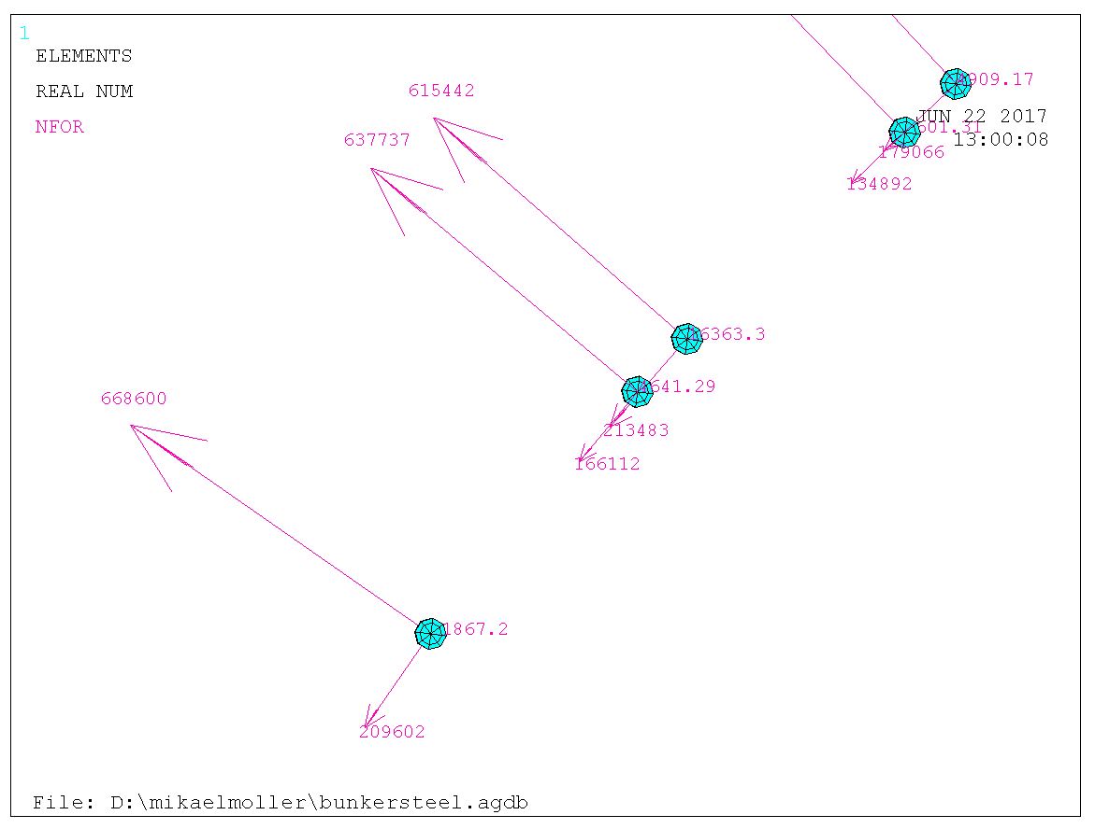
Also large pinning forces between lower steel shielding and R6 & R9 beams. Maximum 700 kN resisted by D=50 mm pin 8.8.

Slide 57
Vertical seismic
Vertical response spectra indicated larger accelerations than +/- 1g, meaning need for vertical anchoring of roof, highly unwanted.
Response spectrum analysis yields a conservative bound of dynamic events.
To increase accuracy, vertical seismic is addressed directly by Scanscot in their dynamic analysis model, by including the frame. This way, +/- 1g was reached.

Slide 58
Questions

