Slide 1
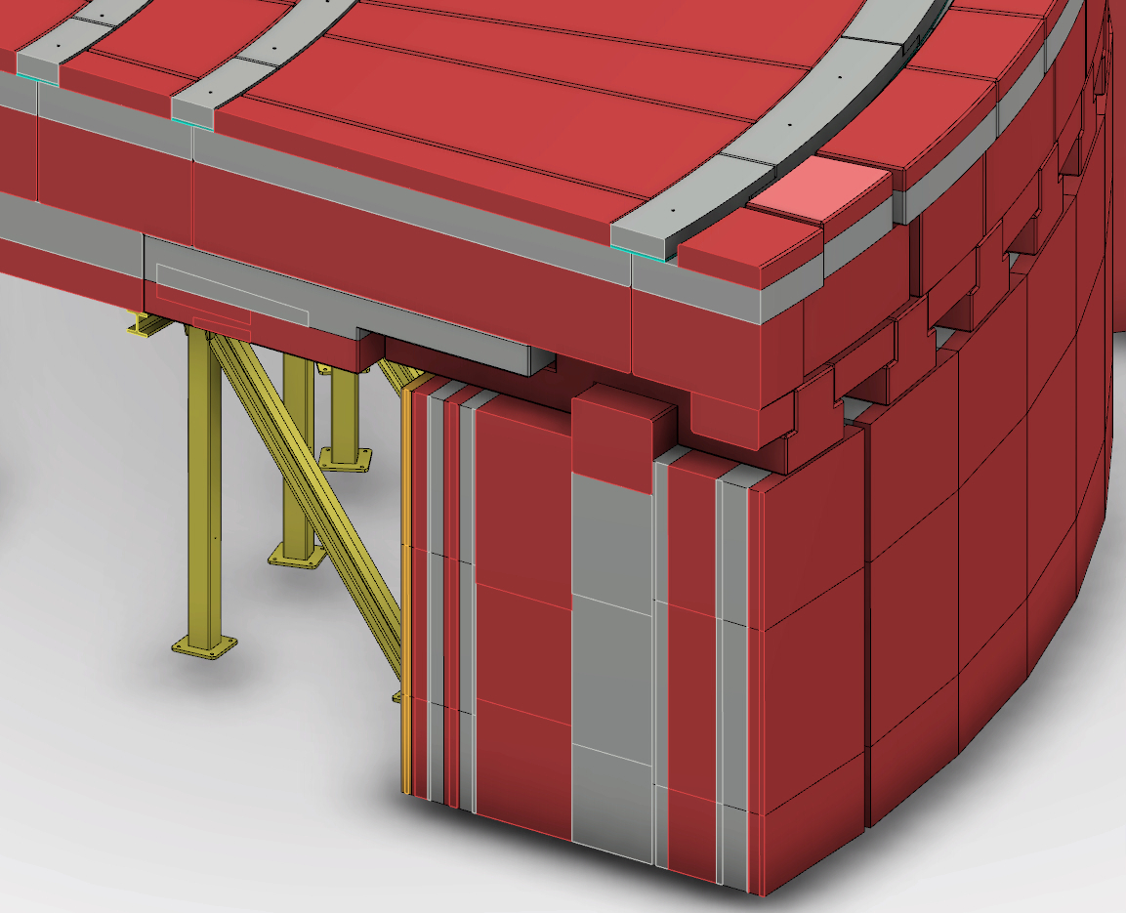
Feed through neutronics calculation Valentina Santoro on behalf of the neutronics bunker team G. Muhrer, D. Di Julio, S. Ansell, E. Klinkby

Slide 2
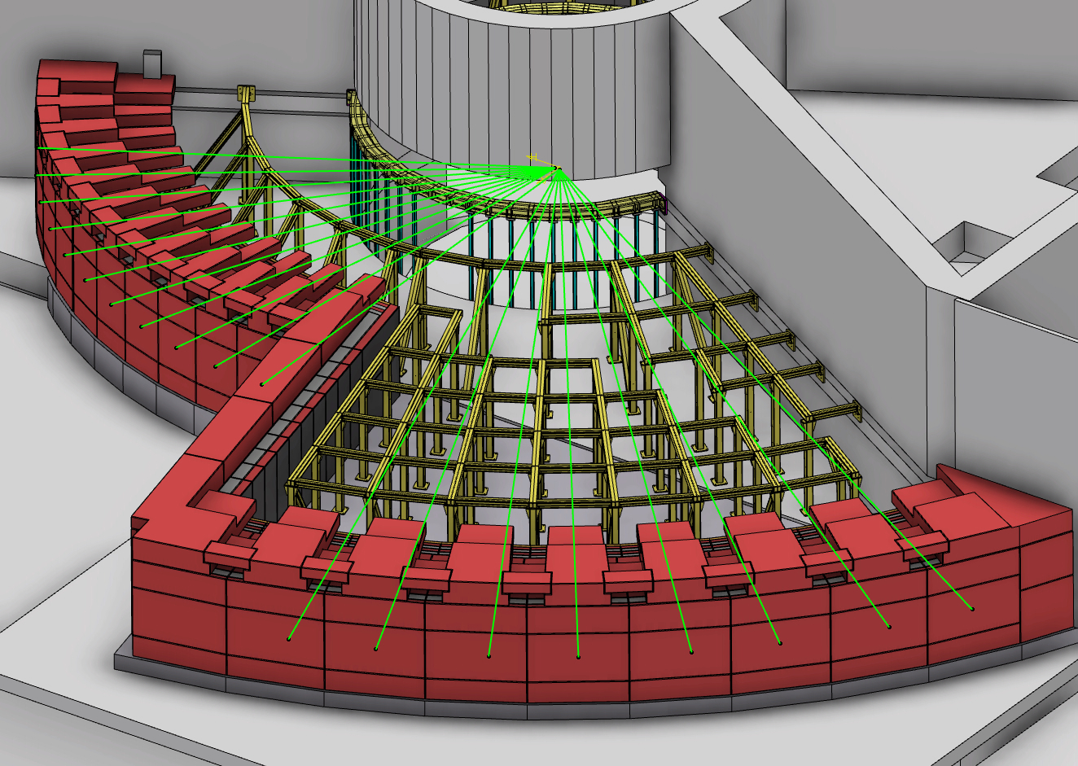
Utilities feed through (I)
Detailed simulation in mcnp6 of the engineering model
The utilities feed-through are located on top of the beam line

Slide 3
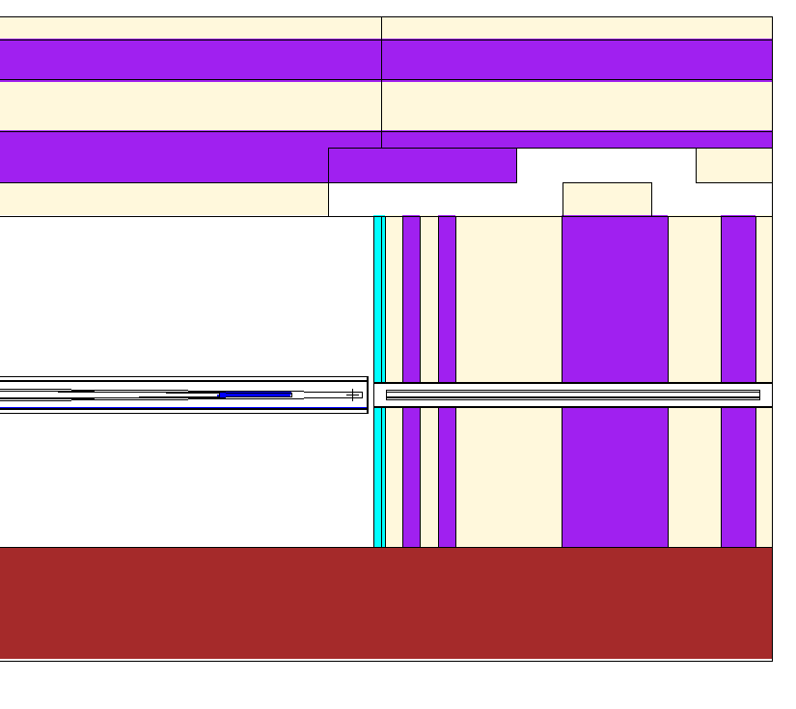
Utilities feed throughs(II)
MCNP6 Model
Engineering Model
Detailed simulation in mcnp6 of the engineering model
Feed through neutronics calculation

Slide 4
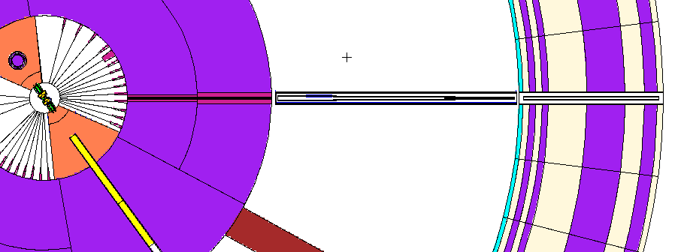
Assumptions
We computed the feed-through radiations using the worst
possible case scenario for spreading the radiation throughout
the bunker roof
This scenario is represented by a straight focusing metallic
guide
Guide in the bunker starts at 6m with a width and height of 10 cm (aluminum substrate)
Guide ends before the bunker wall at 11.5 m with a width and height of
1 cm (aluminum substrate )

Slide 5
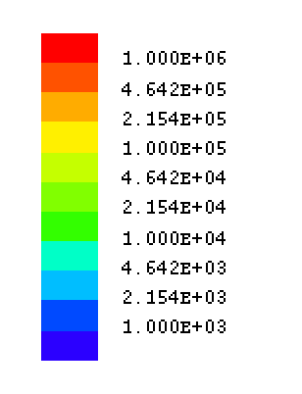
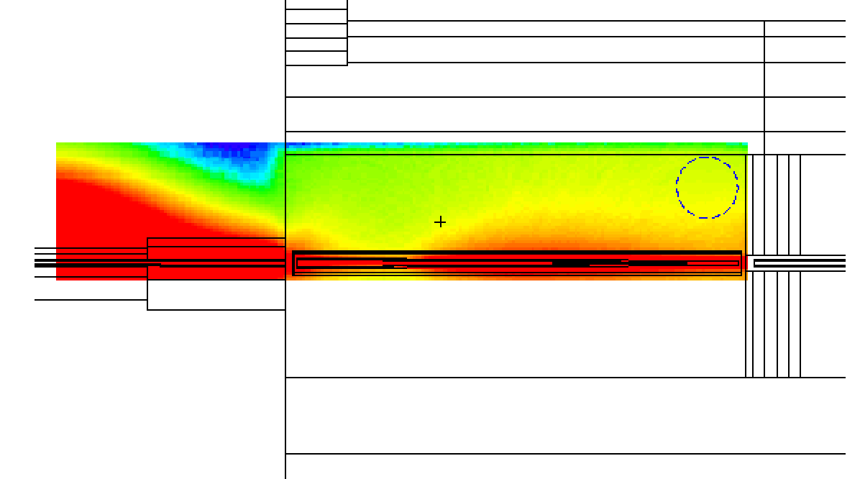
Radiation Dose Map in the bunker
μSv/h
Entrance of Feed-throught
~ 58mSv/h
Bunker Roof
Monolith
Al Guide
Bunker Wall
Feed through neutronics calculation

Slide 6
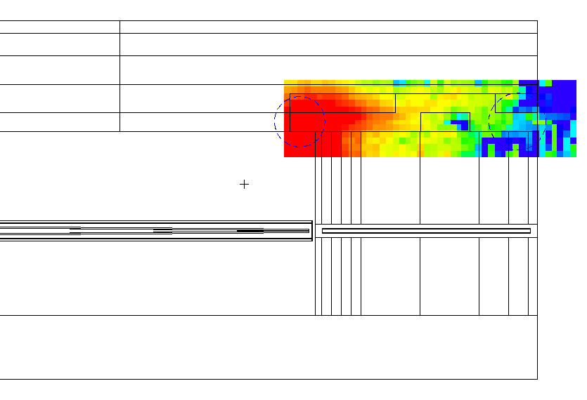
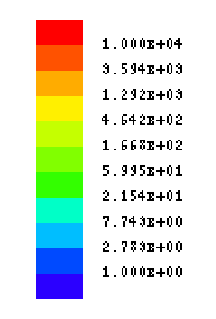
Radiation Dose Map in the feed-through
Exit of Feed-through ~ 10μSv/h
μSv/h
Feed-through
Al Guide
Bunker Wall
NEUTRONS
Feed through neutronics calculation

Slide 7
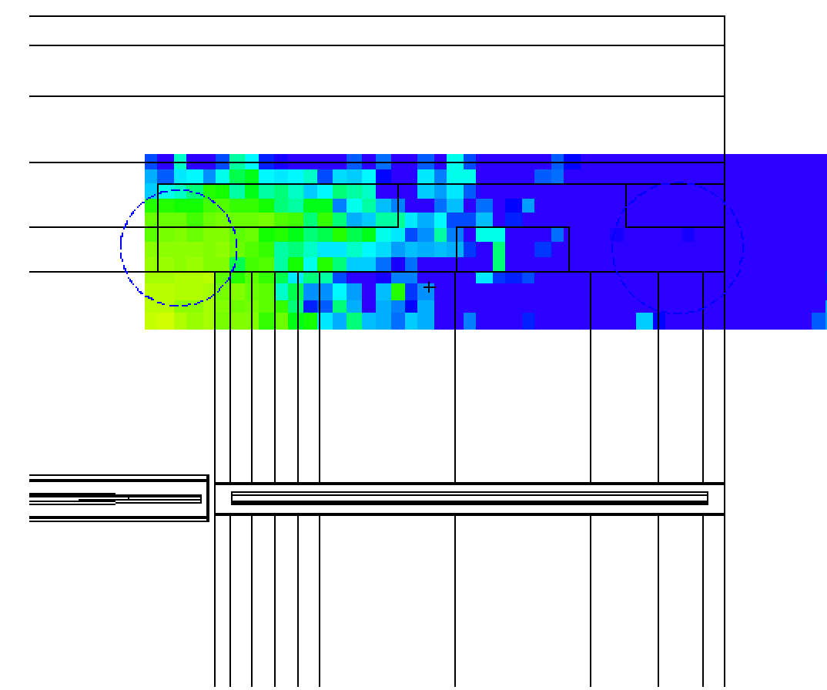
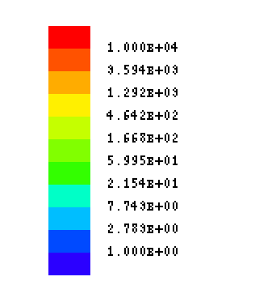
Radiation Dose Map in the feed-through
Exit of Feed-through << 1μSv/h
μSv/h
Bunker Wall
Al Guide
PHOTONS
Feed through neutronics calculation

Slide 8
Status of the neutronics calculation after PDR
the radiation escaping the feed-through are around 10-15 μSv/h
to achieve the safety limit of 3 μSv/h (1.5 μSv/h in Monte Carlo simulation) we need to fill the feed-through
from neutronic point of view we need to simulate a sufficient filling fraction to reduce the amount of the radiation
Note: these numbers have been verified with hand calculation (see
ESS-0118440)
Feed through neutronics calculation

Slide 9
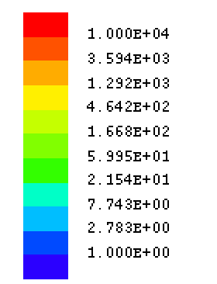
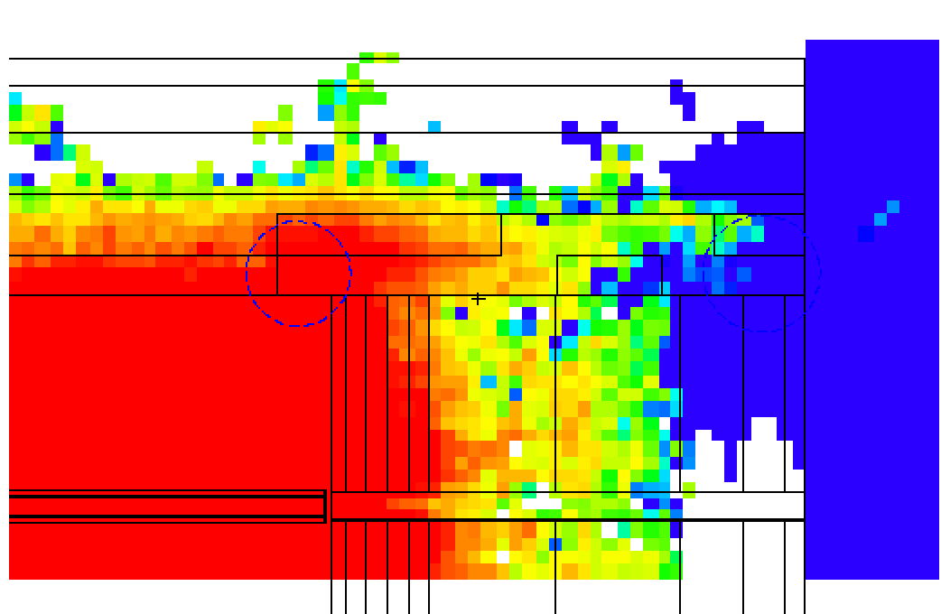
Radiation Dose Map in the feed-through
Exit of Feed-through << 1μSv/h
μSv/h
Feed-through
Bunker Wall
Al Guide
50% filling fraction
Imp =0 for guide in the bunker wall
Feed through neutronics calculation

Slide 10
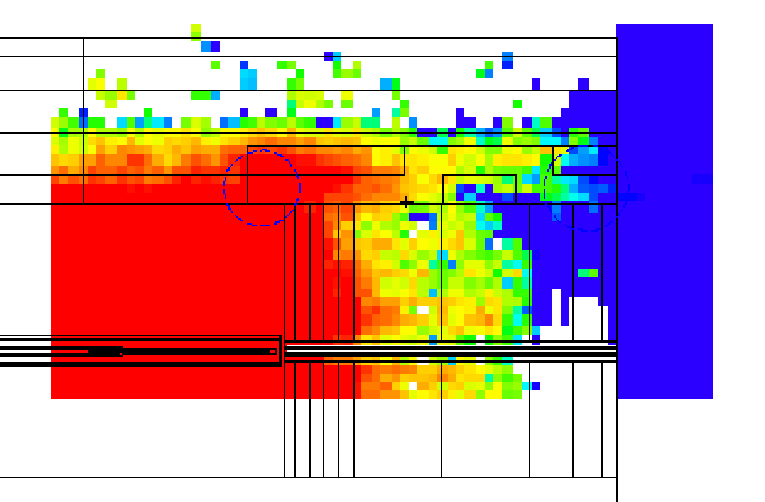
Radiation Dose Map in the feed-through
μSv/h
Exit of Feed-through < 1 μSv/h
Feed-through
Bunker Wall
Al Guide
Imp =0 for guide in the bunker wall
30% filling fraction
Feed through neutronics calculation

Slide 11
Summary
Neutronics calculation for the utilities feed-through have been performed
The feed-through design is viable
A filling fraction of 30% is enough to bring the radiation to the required safety limit for a standard ESS-beam line
For additional information ESS-0118440
Feed through neutronics calculation

Slide 12
BACK-UP SLIDES

Slide 13
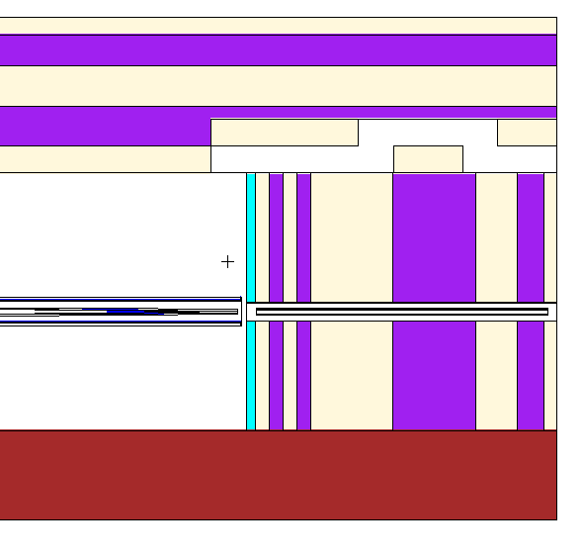
Bunker feed throught HAND CALCULATION
H₂
H₃
H₀
H₁
H₄
H₅
L₁

Slide 14
Assumptions (II)
Source term at the 2m position
LOKI BEAM LINE N7

Slide 15
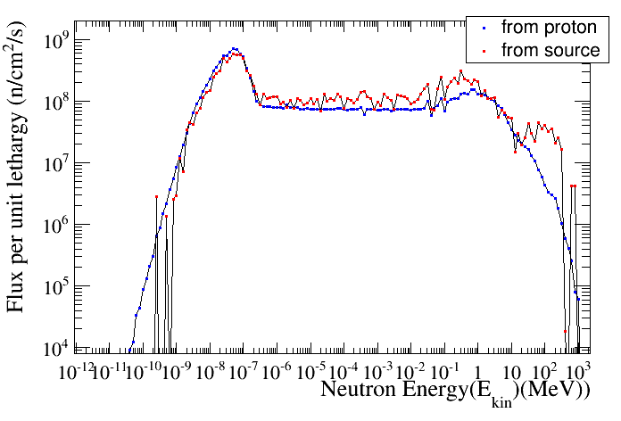
Source term

Slide 16
Exit of Feed-through ~ 10μSv/h
μSv/h
Feed-through
Al Guide
Bunker Wall

Slide 17
Exit of Feed-through << 1μSv/h
μSv/h
Bunker Wall
Al Guide

Slide 18
Exit of Feed-through << 1μSv/h
μSv/h
Feed-through
Bunker Wall
Al Guide
Imp =0 for guide in the bunker wall

Slide 19
μSv/h
Exit of Feed-through < 1 μSv/h
Feed-through
Bunker Wall
Al Guide
Imp =0 for guide in the bunker wall

