Slide 1
Bunker Internal Review
Welcome & Charge
Shane Kennedy
NSS Project Leader
www.europeanspallationsource.se
5th December 2017

Slide 2

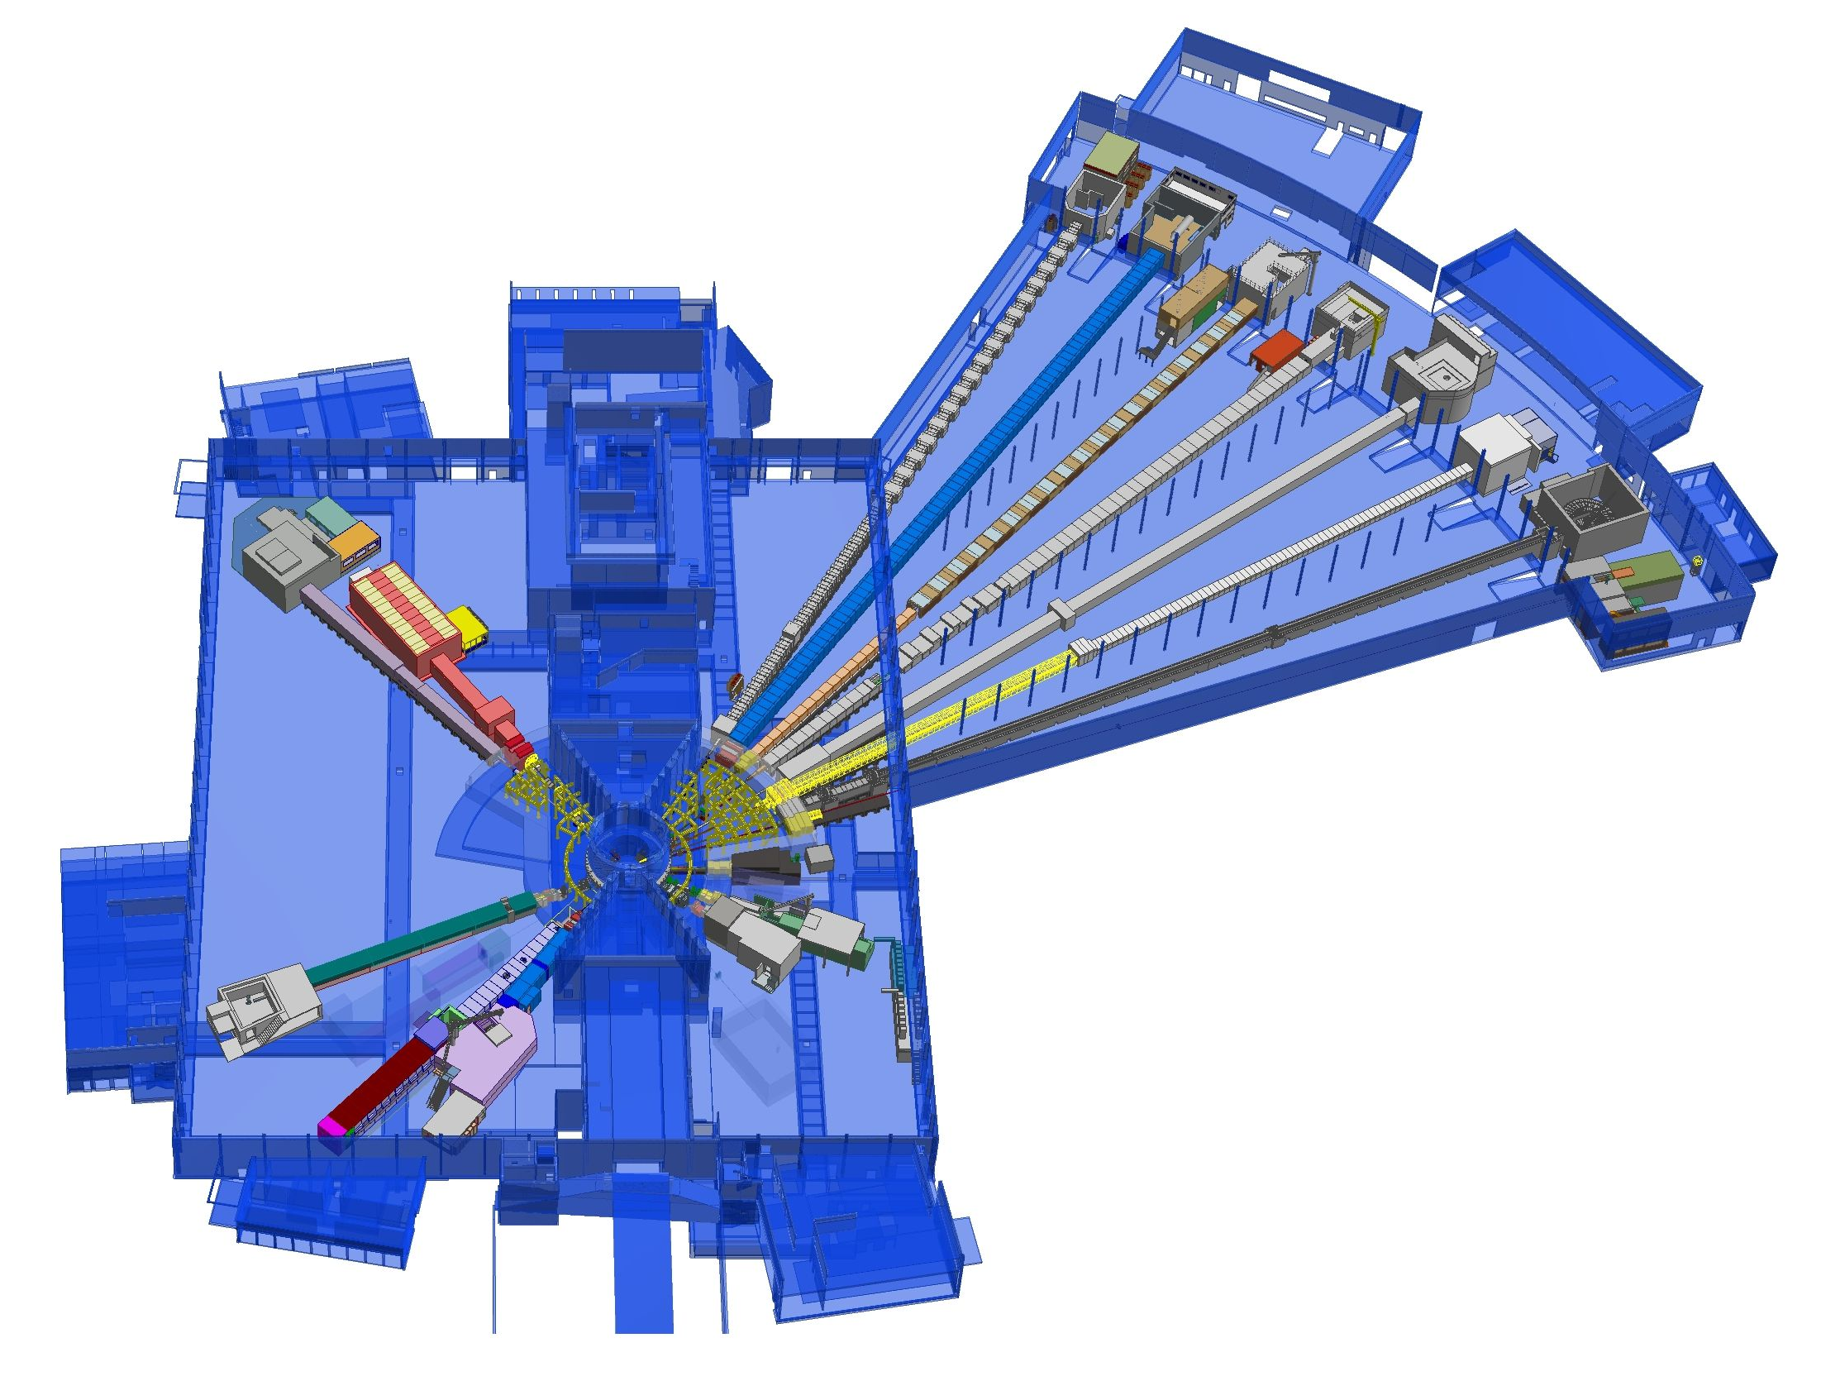











NSS Neutron Instruments:
Project scope -15 instruments + test beamline
ESS Lead Partners for instrument construction
+
Nuclear Physics Institute
NMX
+
BEER
C-SPEC
BIFROST
MIRACLES
MAGIC
ODIN
T-REX
DREAM
HEIMDAL
Test Beam Line
VESPA
LOKI
FREIA
SKADI
ESTIA
+
ESS In-Kind Partners also collaborate on sample environment, data management systems etc.
ESS Instrument Layout (September 2017)

Slide 3
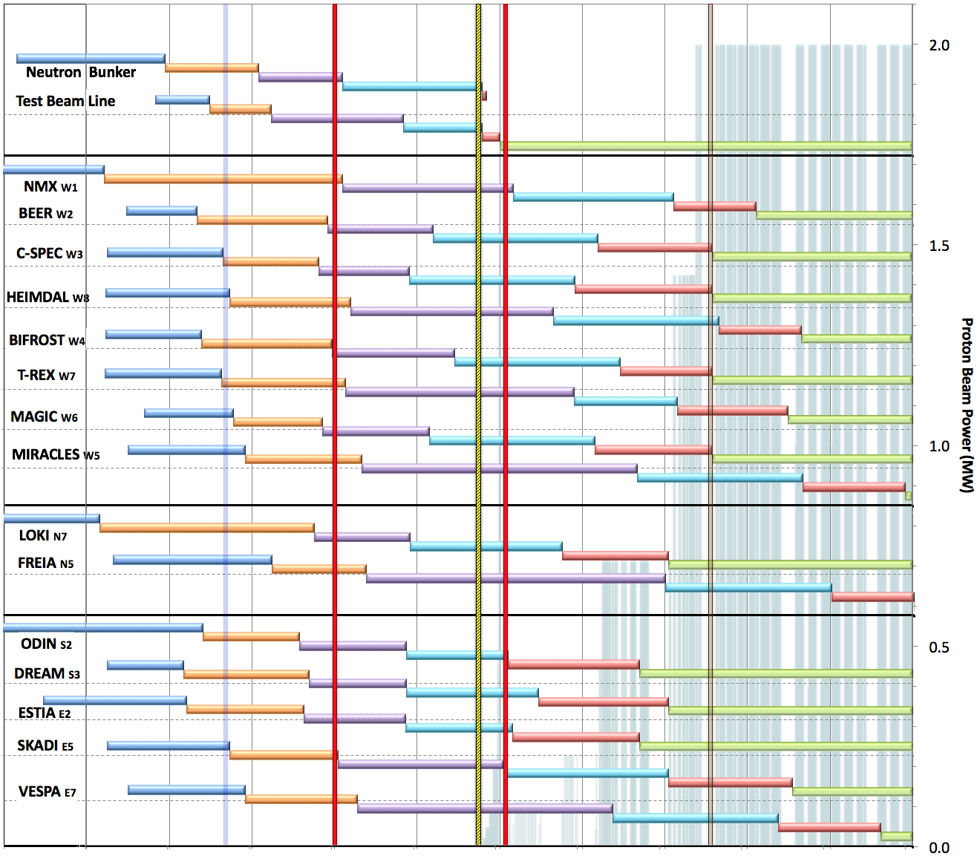

Internal* Neutron Beam Instrument Schedule
Draft for Discussion V3.4, 15th September 2017
Current date
First access to NSS areas
Hot Commission
instruments
Start User Program
* still under discussion with ESS-ERIC Council
Beam on Target
NOTES:
Assumes 2MW maximum power until end 2025
Phases aligned with TG2 reviews on 1st 10 NBIs
Installation & Integration (TG4) + Hot Commissioning (TG5) for first 8 NBIs aligned with draft BOI plan (schedule match typically within 1 month)
West sector
North sector
East and South sectors
Preliminary Design
Detailed Design
Manufacturing & Procurement
Installation & Integration
Hot Commissioning/Early science
Operation
2016 2017 2018 2019 2020 2021 2022 2023 2024 2025
Notes:
This schedule assumes
obtaining the radiological licenses in a timely fashion from SSM. A trigger ‘first optical instrument component outside the monolith’ and a 6 months period from submission of the application to obtaining the SSM license - have been assumed (pending formal confirmation from ESH).
an initial hot commissioning of Accelerator and Target (A&T) to establish reliable beam on target at design frequency and pulse width.
In 2021, commissioning of the first (4-5) neutron instruments is to be conducted at low power, where possible, in order to minimize activation of in-bunker components of the neutron instruments. In the current plan, the duration of this initial commissioning period is 10-12 weeks.
Over 2022 and 2023 beam power and availability will increase, as the first 8 or more neutron instruments start hot commissioning, with a goal of reaching 2 MW source power by the start of the user program and maintaining that level until 2026.
Commencement of hot commissioning for the first 8 neutron instruments (TG5 in Table 1) is closely aligned with the schedules presented by those instrument build teams at TG2. This order matches well with the NSS “Early Science Success” strategy, and distributes responsibility for delivery widely among our experienced In-Kind partners. Changes to this order will be made if necessary to mitigate effects of delays to individual neutron instrument projects.
TG5 dates for neutron instruments 9-15 will be delayed to concentrate on-site resources for installation and commissioning (both cold commission and hot commissioning) on the first eight instruments to facilitate early science success for those instruments. This is discussed further below and illustrated in the NSS Installation and Commissioning schedule (Fig. 3).
TG3 dates refer to “final” approval of detailed design, when the integrated design of all major components is judged to be complete, and beyond which no further approval from NSS management is required for manufacturing. At this point in time these TG3 dates are not fixed, but NSS management plans for this to occur in staged manner. “Early procurement” approval dates for in-monolith optics and other critical path procurements (such as in-bunker components for the first instruments) are not shown in the figure

Slide 4
CDR committee members
External members:
Erik Iverson (chair), SNS
David Anderson, SNS
Steven Lilley, STFC
David Turner, STFC
Internal (ESS) Members:
Ken Andersen, Neutron Instruments
Mark Anthony, Target Division
Masatoshi Arai, Technical Coordinator
Stuart Birch, ICS Division
Peter Jacobsson, ESH
François Javier, Systems Engineering

Slide 5
Charge for this review meeting
Purpose: to assess whether bunker design satisfies all stated design requirements and whether it is defined at a level of detail consistent with release for fabrication and/or procurement; according to the procurement/production plan for the project:
Specific questions:
Are system requirements and interface requirements properly defined and complete?
Have safety and hazards been properly considered and addressed?
Do the System Design Description documents and related drawings adequately describe the design to the degree needed for fabrication or procurement; as per the project plan?
Does the design satisfy the functional and performance requirements?
Are the Manufacturing Plan, the Installation Plan, and System Analysis Reports finalized and do they support the stated design?

