Slide 1
BUNKER SYSTEM REQUIREMENTS Critical Design Review (CDR) 5 December 2017
Mark Ridgley
Technical Documentation Coordinator
Bunker Project
europeanspallationsource.se

Slide 2
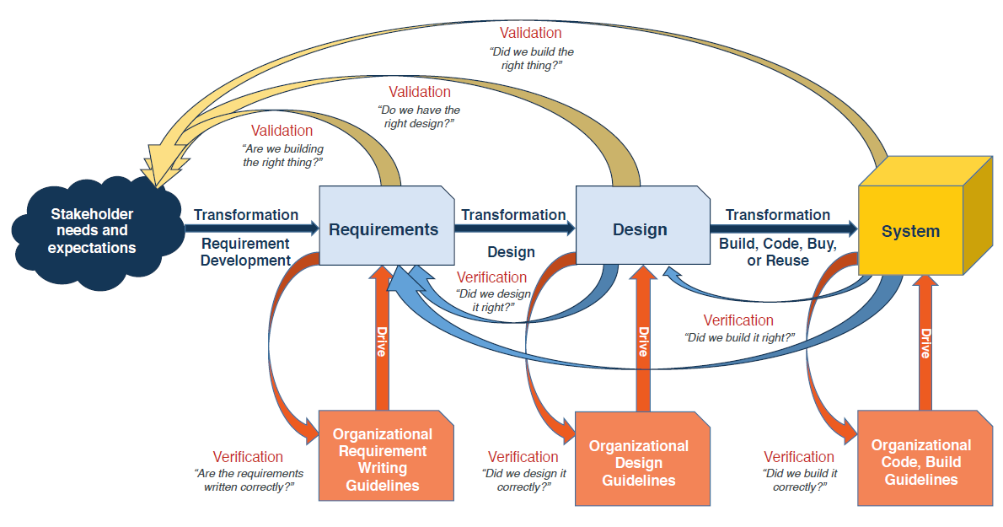
Bunker System Requirements ESS-0060210 - System Requirements Specification (SRS)
Extracted from: Guide for Writing Requirements, INCOSE-TP-2010-006-02.1, 30 June 2017

Slide 3
Bunker System Requirements Stakeholders Expectations
Stakeholders expectations for the Bunker System:
See ESS-0123251, ConOps for the Bunker System, Section 3. (Systems Documentation folder in Material)

Slide 4
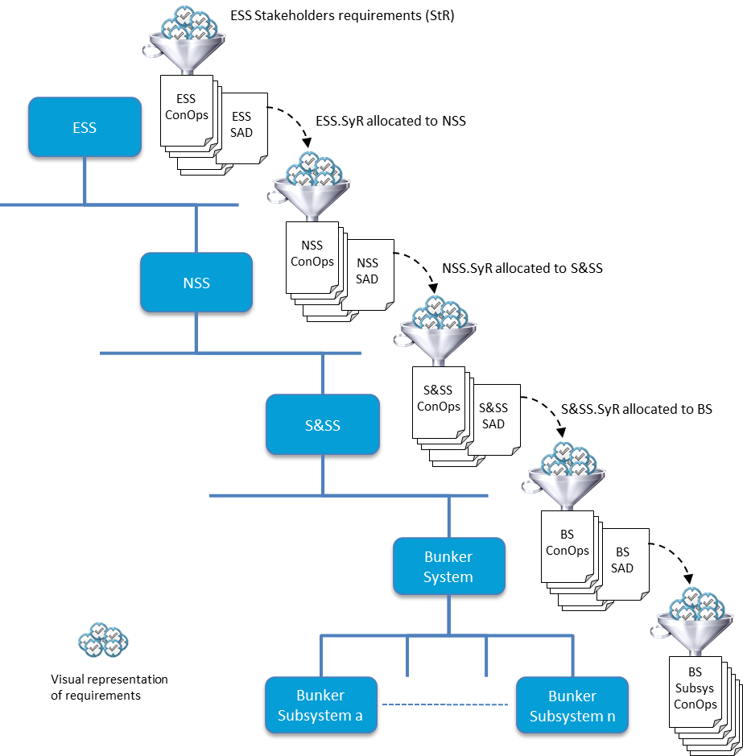
Bunker System Requirements Flow down of High-level System Requirements
In general the high-level system requirements applicable to the Bunker System flow down from Shielding & Safety System (S&SS) as allocated by its System Architecture Description (SAD).
High-level system requirements together with constraint requirements and the information presented elsewhere in ConOps for the Bunker System, are the primary source for the system requirements for the Bunker System (BS.SyR).

Slide 5
Bunker Subsystem Requirements High-level system requirements
High-level system requirements allocated to the Bunker System by its parent system the Shielding & Safety System:
See ESS-0123251, ConOps for the Bunker System, Section 4. (Systems Documentation folder in Material)

Slide 6
Bunker System Requirements ESS-0060210 - System Requirements Specification (SRS)
All system requirements are captured and specified in the System Requirements Specification (SRS) for the Bunker System.
Derived from:
high-level requirements allocated by the parent system - Shielding & Safety System
ConOps for the Bunker System
feedback from the evolving design development of the system
BS.SyR are defined according to the different categories and each is uniquely identified:
Functional Requirements
Constraint Requirements
Seismic Safety Requirements
Radiation Safety Requirements
Interface Requirements
BS.SyR are applied to the requirements driven development of the system design.

Slide 7
Bunker System Requirements ESS-0060210 - System Requirements Specification (SRS)
As well as baselined BS.SyR that are transformed into the design of the system, the system design process is driven and/or guided by:
ESS dedicated rules, procedures, manuals and guidelines that guide and/or drive the design process.
European and International standards and norms.

Slide 8
Bunker System Requirements ESS-0060210 - System Requirements Specification (SRS)
Before acceptance as a requirement on the Bunker System:
Requirements must be achievable - reflect need or objective for which a solution is technically achievable at costs considered affordable.
Requirements must be verifiable - expressed in a manner that allows verification to be objective.
Requirements must be unambiguous.
Requirements must be expressed in terms of need, not solution.
Requirements must be consistent with other requirements without conflict.
Requirements must be appropriate for the level of system hierarchy without constraining solutions for the level of design.

Slide 9
Bunker System Requirements ESS-0060210 - System Requirements Specification (SRS)
For all Bunker System requirements (BS.SyR):
See ESS-0060210, SRS for the Bunker System. (Systems Documentation folder in Material)

Slide 10
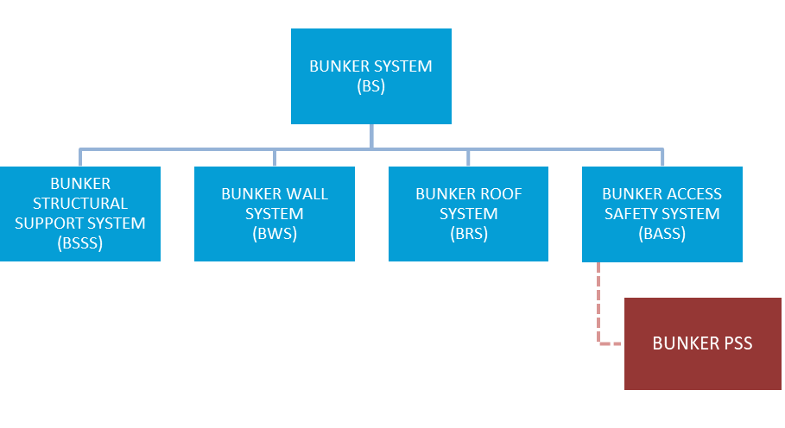
Bunker System Requirements ESS-0123443 - System Architecture Description (SAD)
As well as describing the system architecture, SAD allocates BS.SyR to subsystems accordingly.
BS.SyR are allocated to at least one subsystem.
Bunker System Breakdown Structure
(simplistic)

Slide 11
Bunker System Requirements ESS-0123443 - System Architecture Description (SAD)
For allocation of Bunker System requirements (BS.SyR) to the subsystems:
See ESS-0123443, SAD for the Bunker System, Section 4. (Systems Documentation folder in Material)

Slide 12
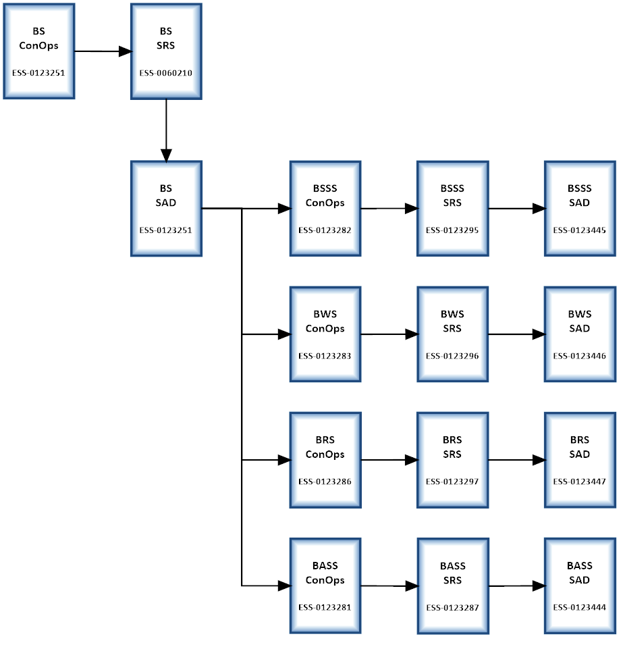
Bunker System Requirements ESS-0123443 - System Architecture Description (SAD)
Flow of requirements

Slide 13
Bunker Structural Support System System Requirements
For high-level requirements (BS.SyR) allocated to the Bunker Structural Support System:
See ESS-0123282, ConOps for the Bunker Structural Support System.
For all Bunker Structural Support System requirements (BSSS.SyR):
See ESS-0123295, SRS for the Bunker Structural Support System.
For allocation of Bunker Structural Support System requirements (BSSS.SyR) to the first level subassemblies:
See ESS-0123445, SAD for the Bunker Structural Support System.
(All available in Systems Documentation folder in Material)

Slide 14
Bunker Wall System System Requirements
For high-level requirements (BS.SyR) allocated to the Bunker Wall System:
See ESS-0123283, ConOps for the Bunker Wall System.
For all Bunker Wall System requirements (BWS.SyR):
See ESS-0123296, SRS for the Bunker Wall System.
For allocation of Bunker Wall System requirements (BWS.SyR) to the first level subassemblies:
See ESS-0123446, SAD for the Bunker Wall System.
(All available in Systems Documentation folder in Material)

Slide 15
Bunker Roof System System Requirements
For high-level requirements (BS.SyR) allocated to the Bunker Roof System:
See ESS-0123286, ConOps for the Bunker Roof System.
For all Bunker Structural Support System requirements (BRS.SyR):
See ESS-0123297, SRS for the Bunker Roof System.
For allocation of Bunker Roof System requirements (BRS.SyR) to the first level subassemblies:
See ESS-0123447, SAD for the Bunker Roof System.
(All available in Systems Documentation folder in Material)

Slide 16
Bunker Access Safety System System Requirements
For high-level requirements (BS.SyR) allocated to the Bunker Access Safety System:
See ESS-0123281, ConOps for the Bunker Access Safety System.
For all Bunker Access Safety System requirements (BASS.SyR):
See ESS-0123287, SRS for the Bunker Access Safety System.
For allocation of Bunker Access Safety System requirements (BASS.SyR) to the first level subassemblies:
See ESS-0123444, SAD for the Bunker Access Safety System.
(All available in Systems Documentation folder in Material)

