Slide 1
Bunker Project
Operation aspects
Zvonko Lazic, Iain Sutton
www.europeanspallationsource.se
December 2017

Slide 2
Intro
ESS Context
Equipment
Activities
Maintenance environment
Strategy for maintenance
Logistics

Slide 3
Context
ESS specific context
  Long source instruments
    Components@ R6
  Shielding common volume
    Vertical access
High Power source issues
  Neutron activation
  Neutron damage
Project constraints
  Minimize initial investment
Notes:
Large open shielding volume reminisant of reactor beamlines ILL FRM2
As a spallation source shielding thicknesses are consequent and it tightly surrounded by instrument
Contrany to rIt does not contain only neutron guides
But Large quantities of mechanical components

Slide 4
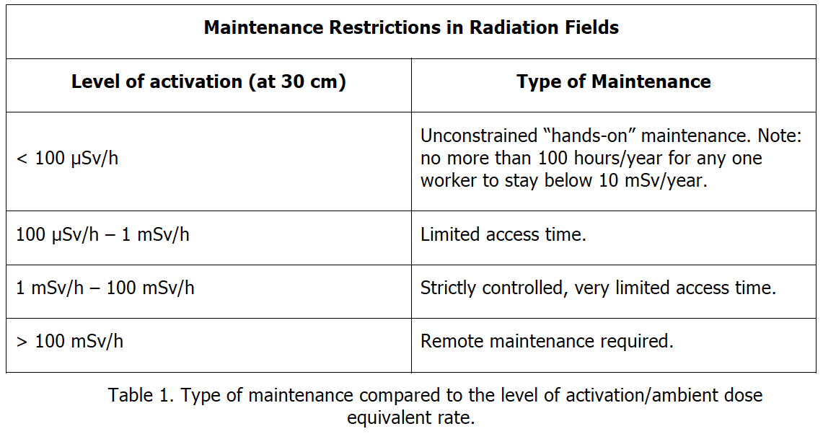
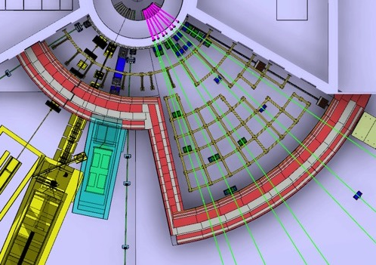
Dose limits
& Zones
Legal
Maximum acceptable annual dose 10mSv
Entry Non rad worker 25microSv
Entry rad worker <2.5mil Sv
> 1 mSv/h
Strictly controlled access
Zone I
Requirement;
All systems shall be remote handling installation compatible
0.1 -1 mSv/h
Restricted access
Zone II
Requirement;
All systems shall be vertical handling installation compatible.
‘Hot’ components shall be remote handling installation compatible
Notes:
Access will be controlled
Removal of hot spots
Installation of tempory shielding
Time limited
Increasingly over time
Forward area particularly unpleasant
Remote handling obligatory

Slide 5
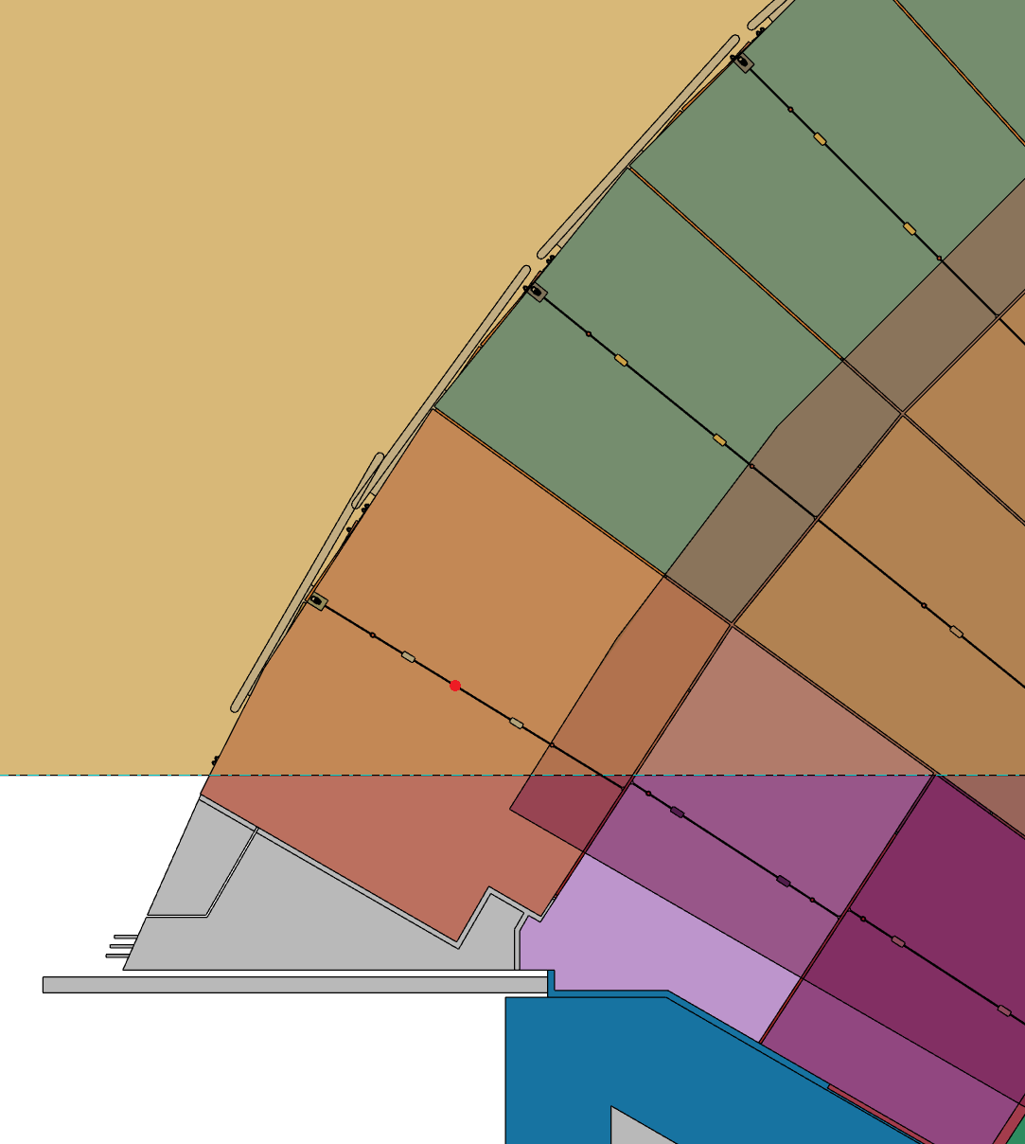
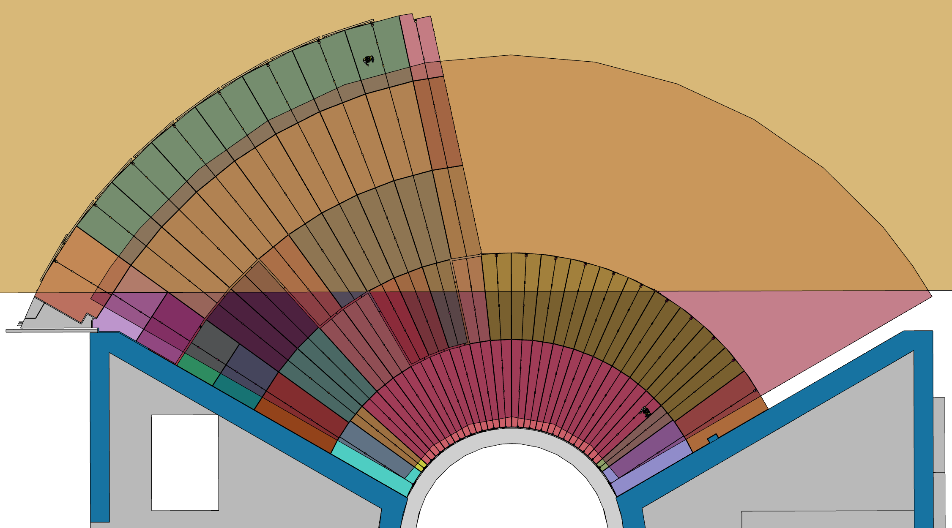
Blocks installation – cranes coverage areas
Definition of transfer zones is shown in ESS-0047079.3
Experimental Hall crane coverage area
Cranes crossover (load interchange) area
Monolith crane coverage area
Third level block and its CoG

Slide 6
Lifting
Clearance between the bunker roof top and the underside of the crane hook flange is 2,750m (+0/-0,1),
The largest block is 0,65m tall,
This gives available clearance for outrigging (spreader bar), and hook system of 2,1m,
The largest chopper is ~2m,
Therefore, available clearance for outrigging and hook system of 0,75m,
Special mountings will be required to ensure installation compatibility,
Mitigating low transport clearance (hook height) is done by removing additional blocks to from the rooftop,

Slide 7
Lifting
The bunker blocks (as well as instrument hardware) can be placed on top of the roof.
Shown below are 10 blocks placed on the roof, and ready for the transfer.

Slide 8
Lifting
Mitigating low transport clearance (hook height) is done by removing additional blocks from the rooftop.

Slide 9
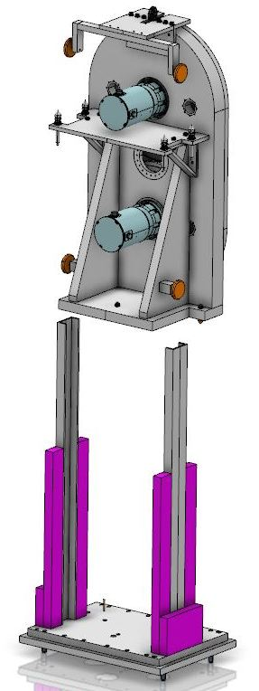
Summing up
Strategy headlines
High reliability
Long service intervals
Standard interfaces
All designed for vertical removal
‘Critical’ systems equipped for remote handling
Common tooling
Notes:
Starts with having a plan
Push for reliability
Building in Maintainability , manage risk
Priority on critical systems
Operational Integration
Tooling
Schedules
Spares
Work with experienced parters
It not going to be perfect use the precious early years to Learn
don't reinvent the wheel SNS
ISIS
Ensure future compatibility
upgrade path

Slide 10
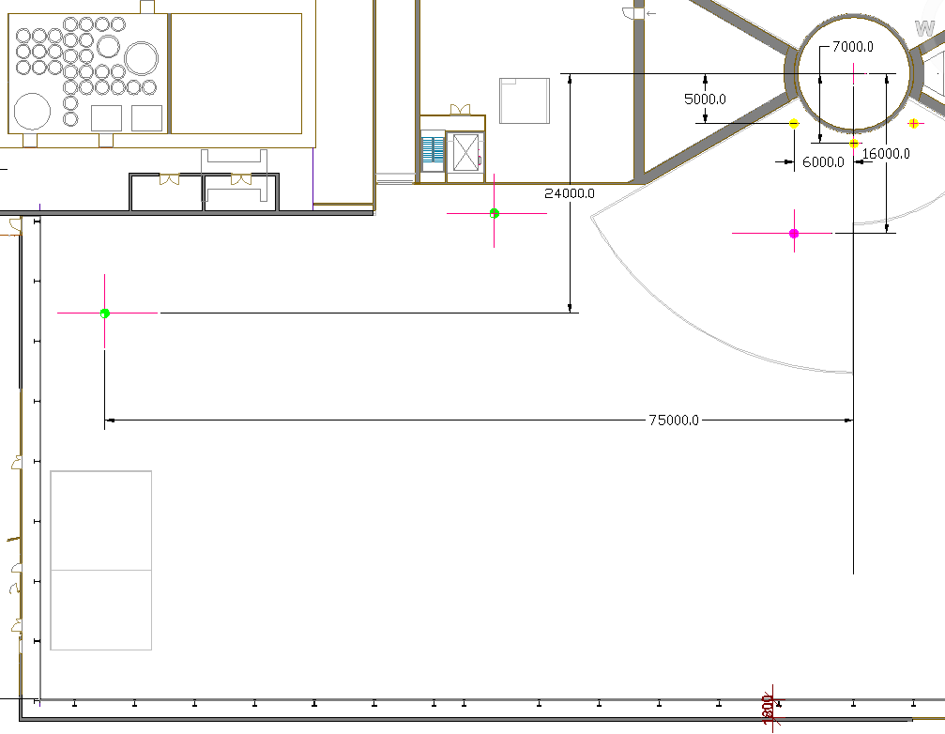
Crane route
Bunker crane
Exchange zone
Storage zone
Hall crane

Slide 11
Roof removal – access @ R6-R9
Example - Freia
  Minimum access – 6 blocks

Slide 12
Roof removal – access @ R6-R9
Example - Freia
  Minimum access – 6 blocks
  Removing chopper – 9 blocks (minimum)

Slide 13
Roof removal – access @ R6-R9
Example - Freia
  Minimum access – 6 blocks
  Removing chopper – 9 blocks (minimum)
  Clearing for short sector full access – 24 blocks (minimum)

Slide 14
Roof removal – access @ R6-R9
Example - Freia
  Minimum access – 6 blocks.
  Removing chopper – 9 blocks (minimum) .
  Clearing for short sector full access – 24 blocks (minimum).
  Full short sector access with frame beam cleared – 27 blocks

Slide 15
Scheduled & Regular
Activity Incidence over 10yr period
Beam port systems inspection 40
Neutron chopper maintenance 100
Optics realignment 20
Instrument shutter maintenance 20
Other component maintenance 60
Removal neighboring & Hot 80
Total 320

Slide 16
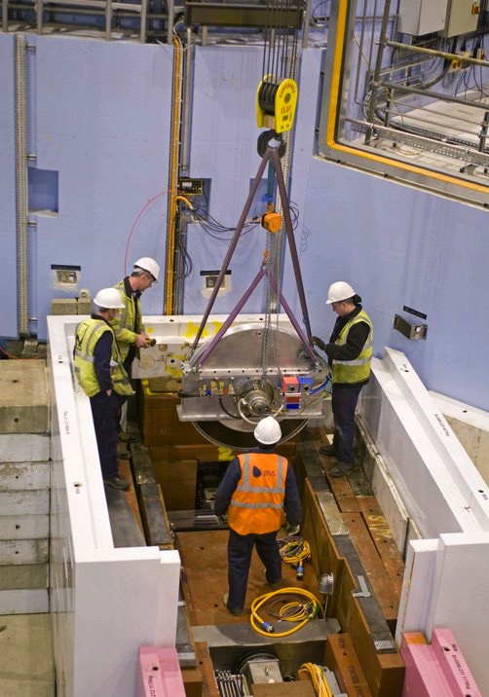
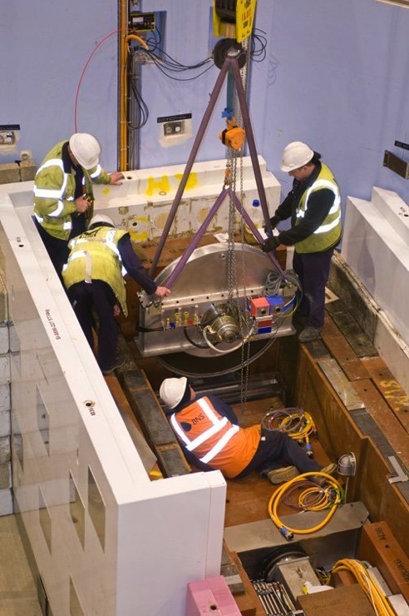
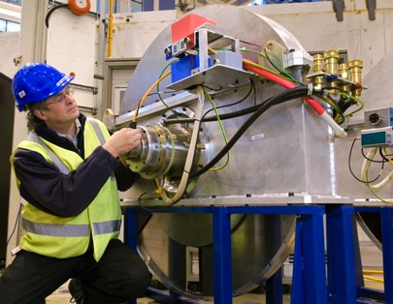
“Another” facility chopper/pit
.2.1m
1.4m

Slide 17
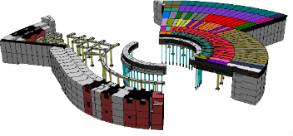
The Bunker – Operation Aspects
Q/A
End of presentation
Q/A

