Slide 1
Hazard Analysis ESS-0192522 Bunker Project CDR
Alexander Seguljev and Zvonko Lazic
www.europeanspallationsource.se
6 December, 2017

Slide 2
System Description
Straight wall
R28m wall
R6m
Roof
R15m wall
Suporting Frame
Temporary shielding blocks
R15m wall
Straight wall
R28m wall

Slide 3
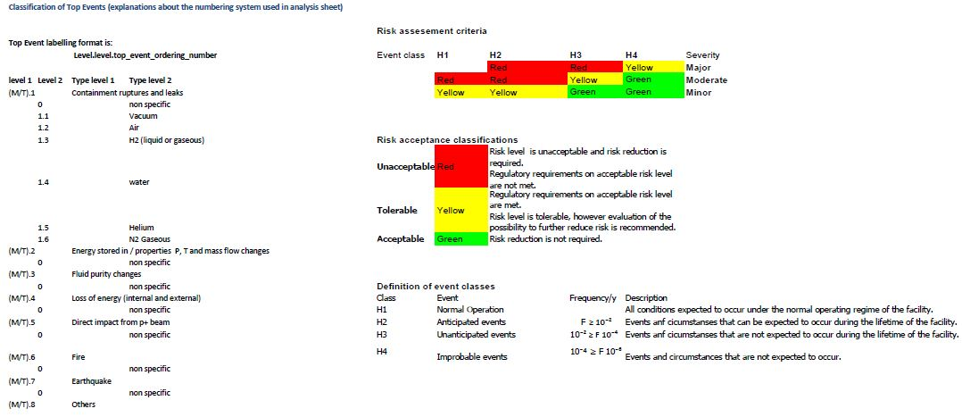
Definitions

Slide 4
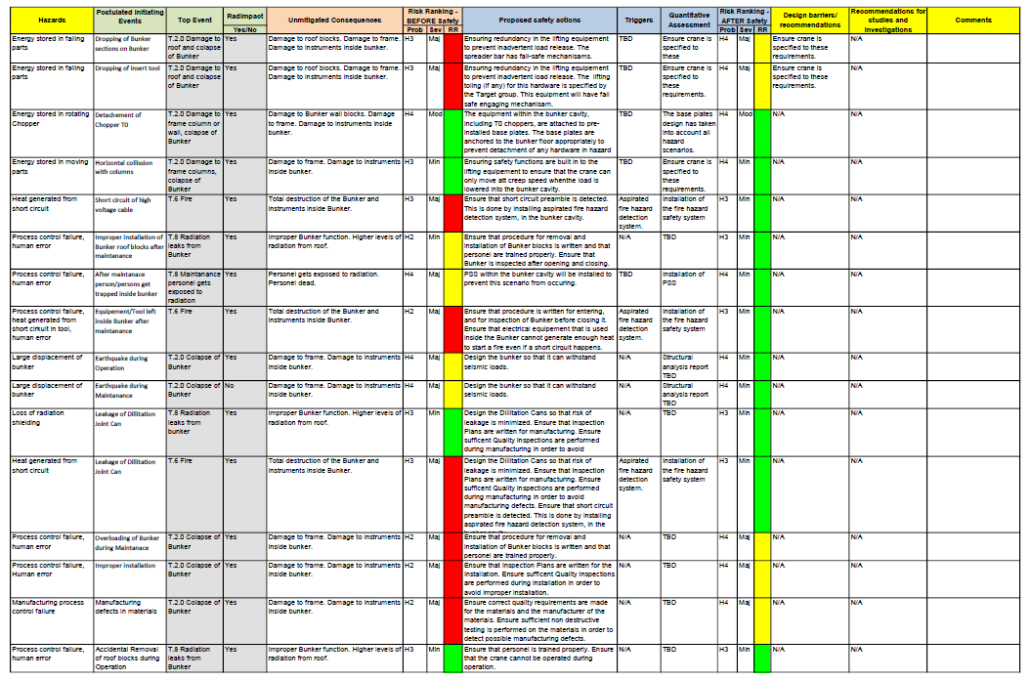
Hazard Analysis - Bunker

Slide 5
Questions
Any questions?

