Slide 1
Roof PSS Bunker Project CDR
Dawid Patrzalek
Mechanical Design Engineer
www.europeanspallationsource.se
24 November, 2017

Slide 2
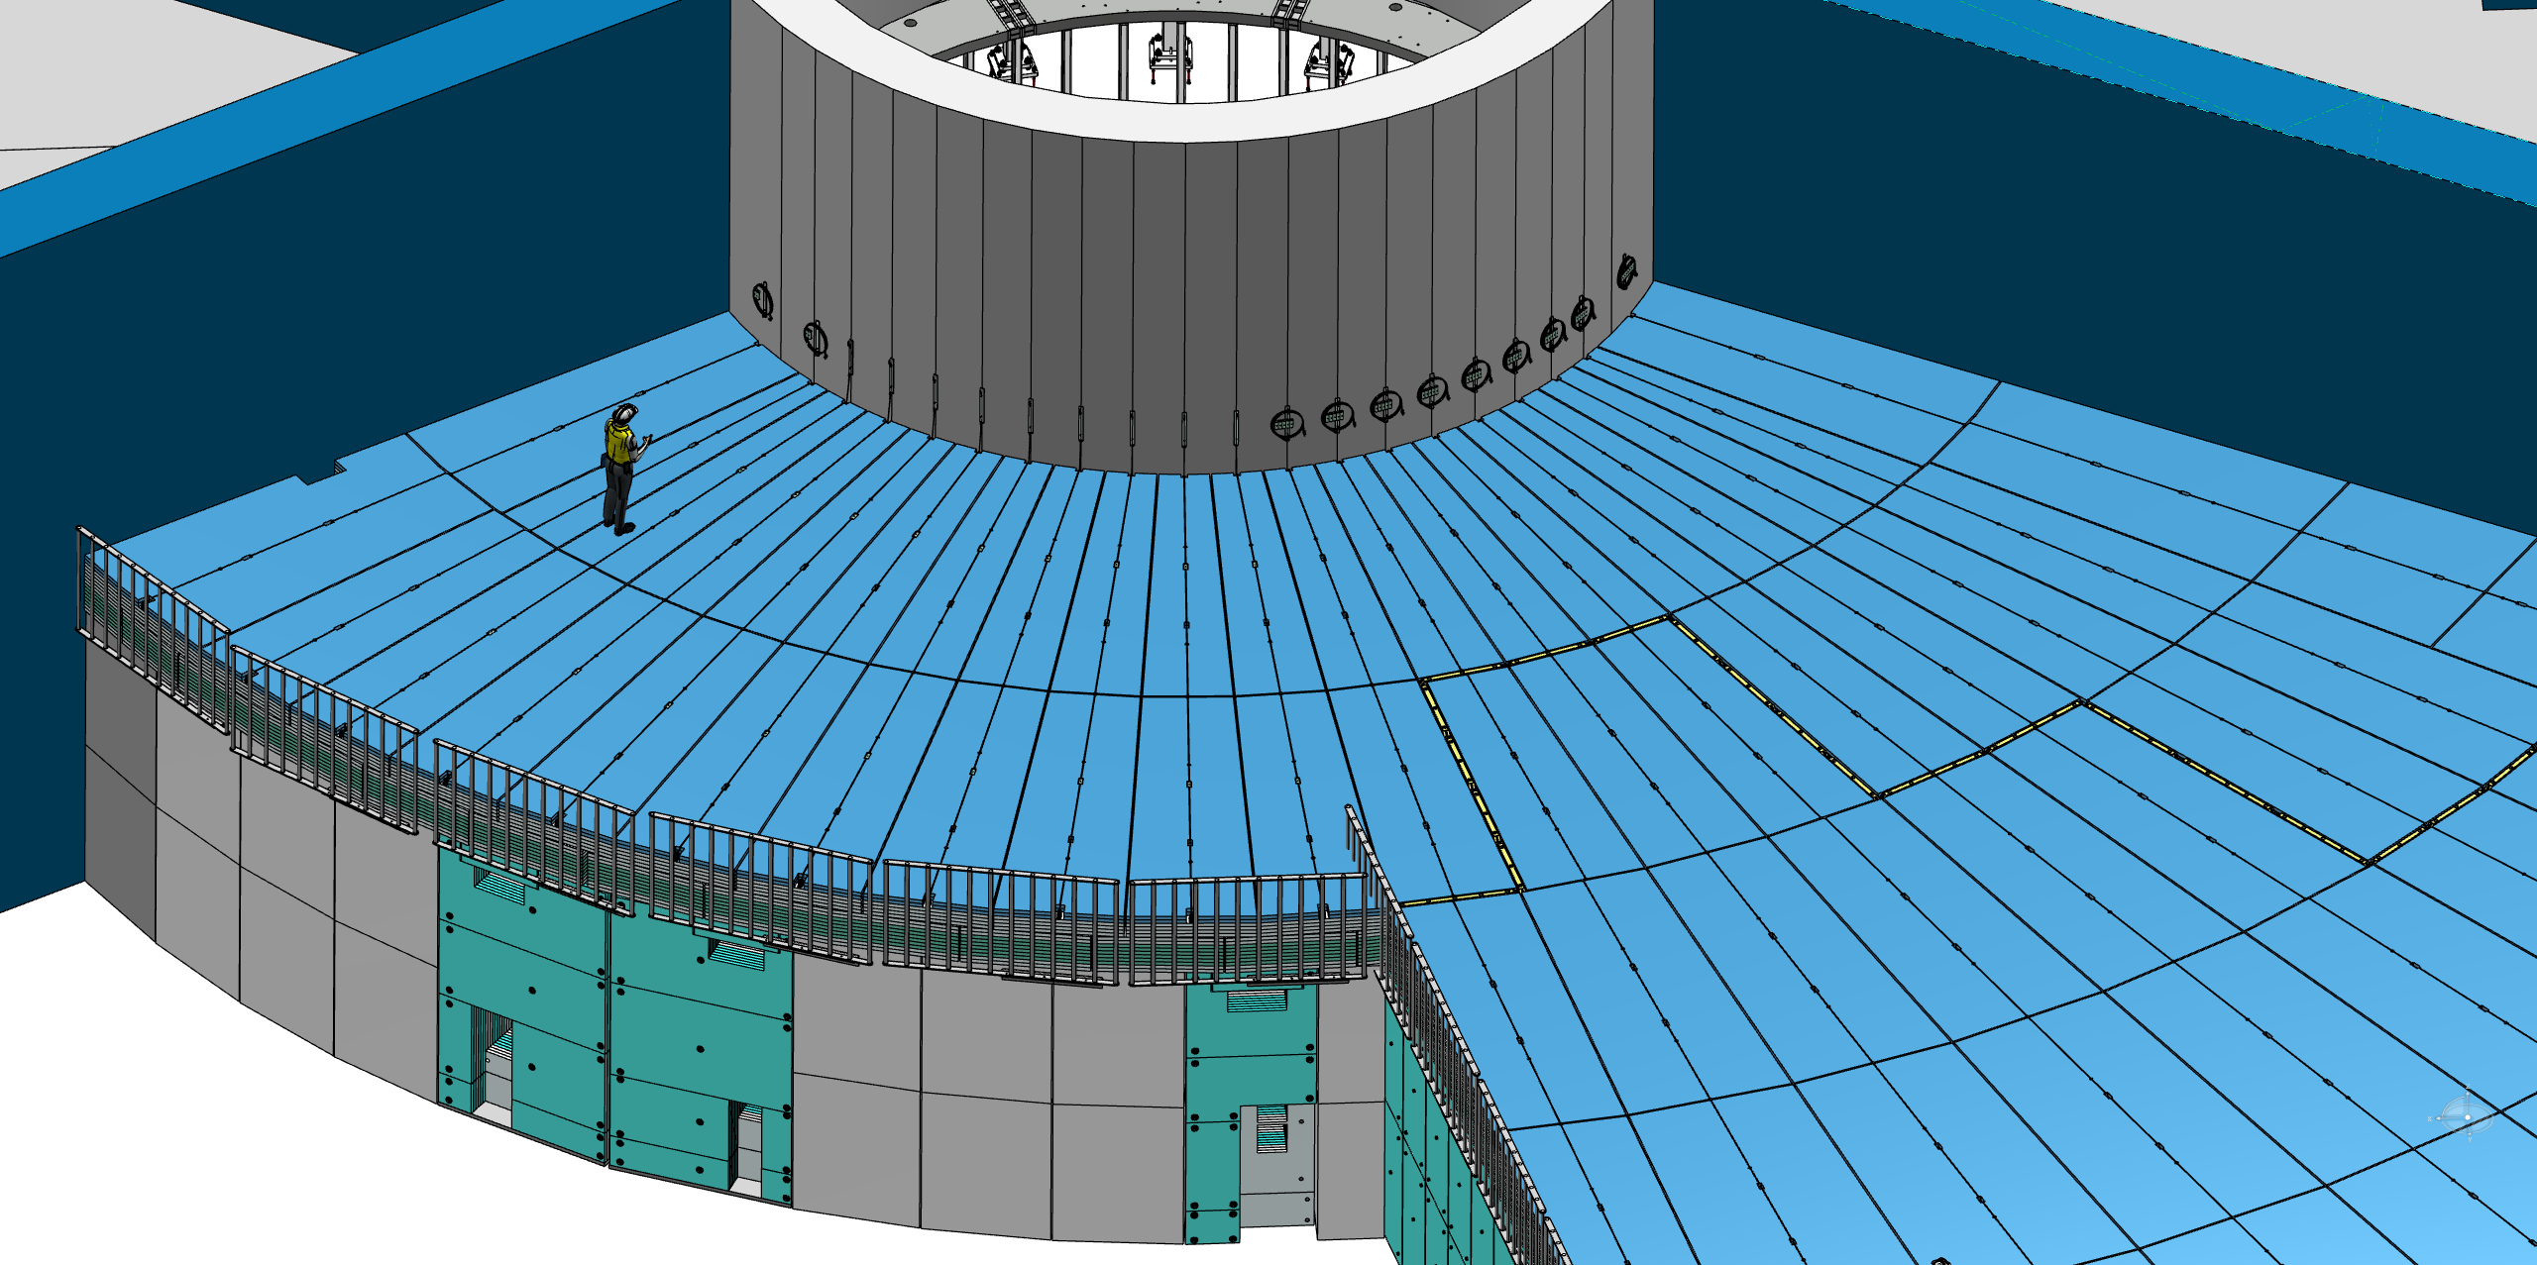
Personal Safety System – design overview
PSS requirements:
Prevent unauthorized access into the bunker
Minimize number of interlocks used

Slide 3
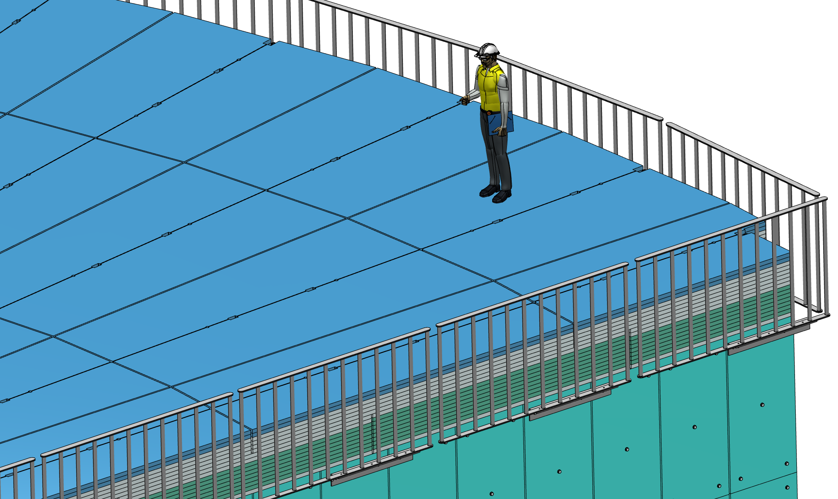
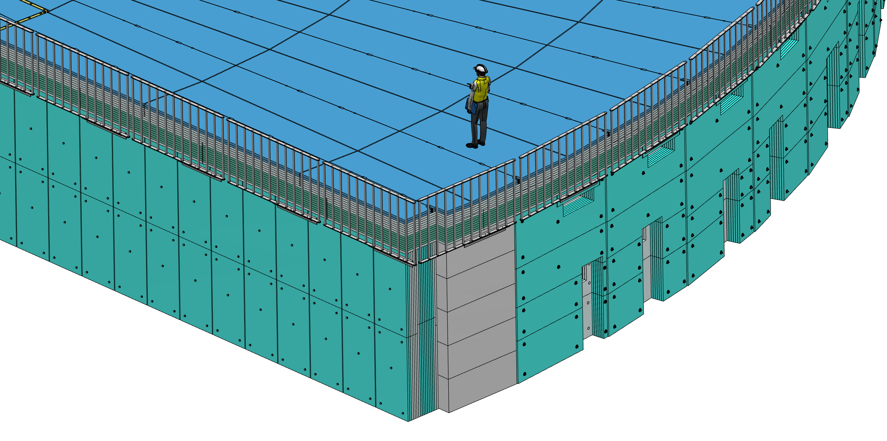
Personal Safety System – a fence
In order to prevent unauthorized access onto the bunker roof, a fence and lockable stairs will be installed.
Presented fence design is preliminary, and the final design will be provided together with access stair cases.

Slide 4
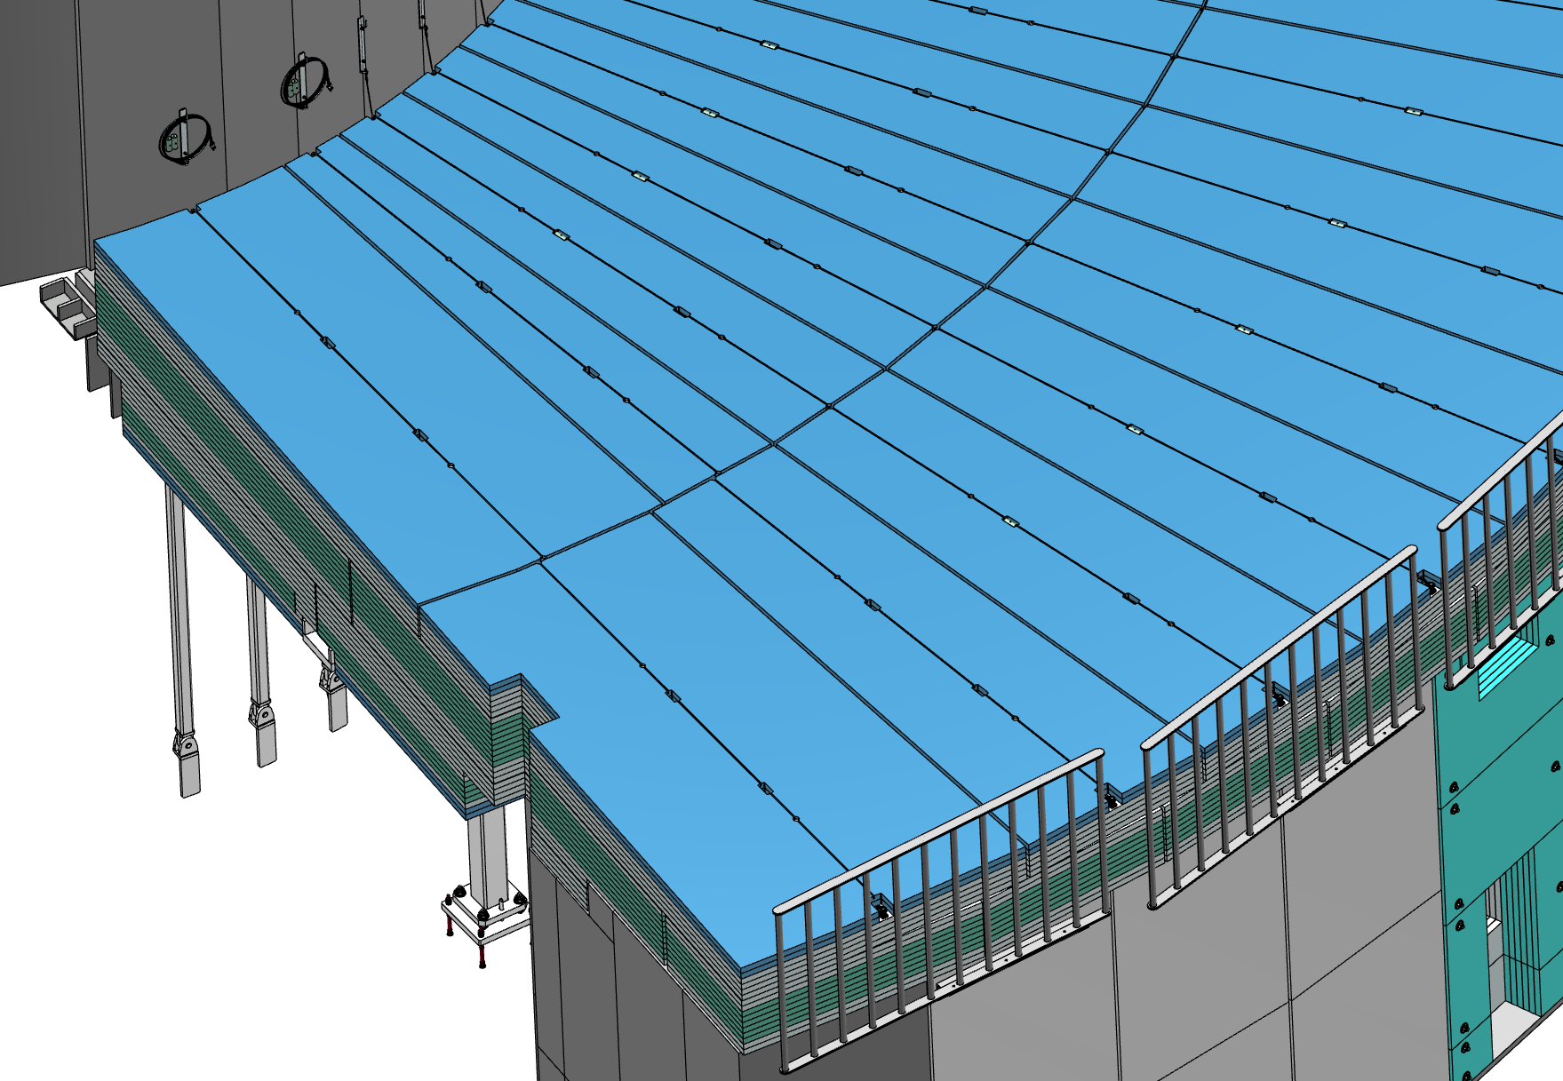
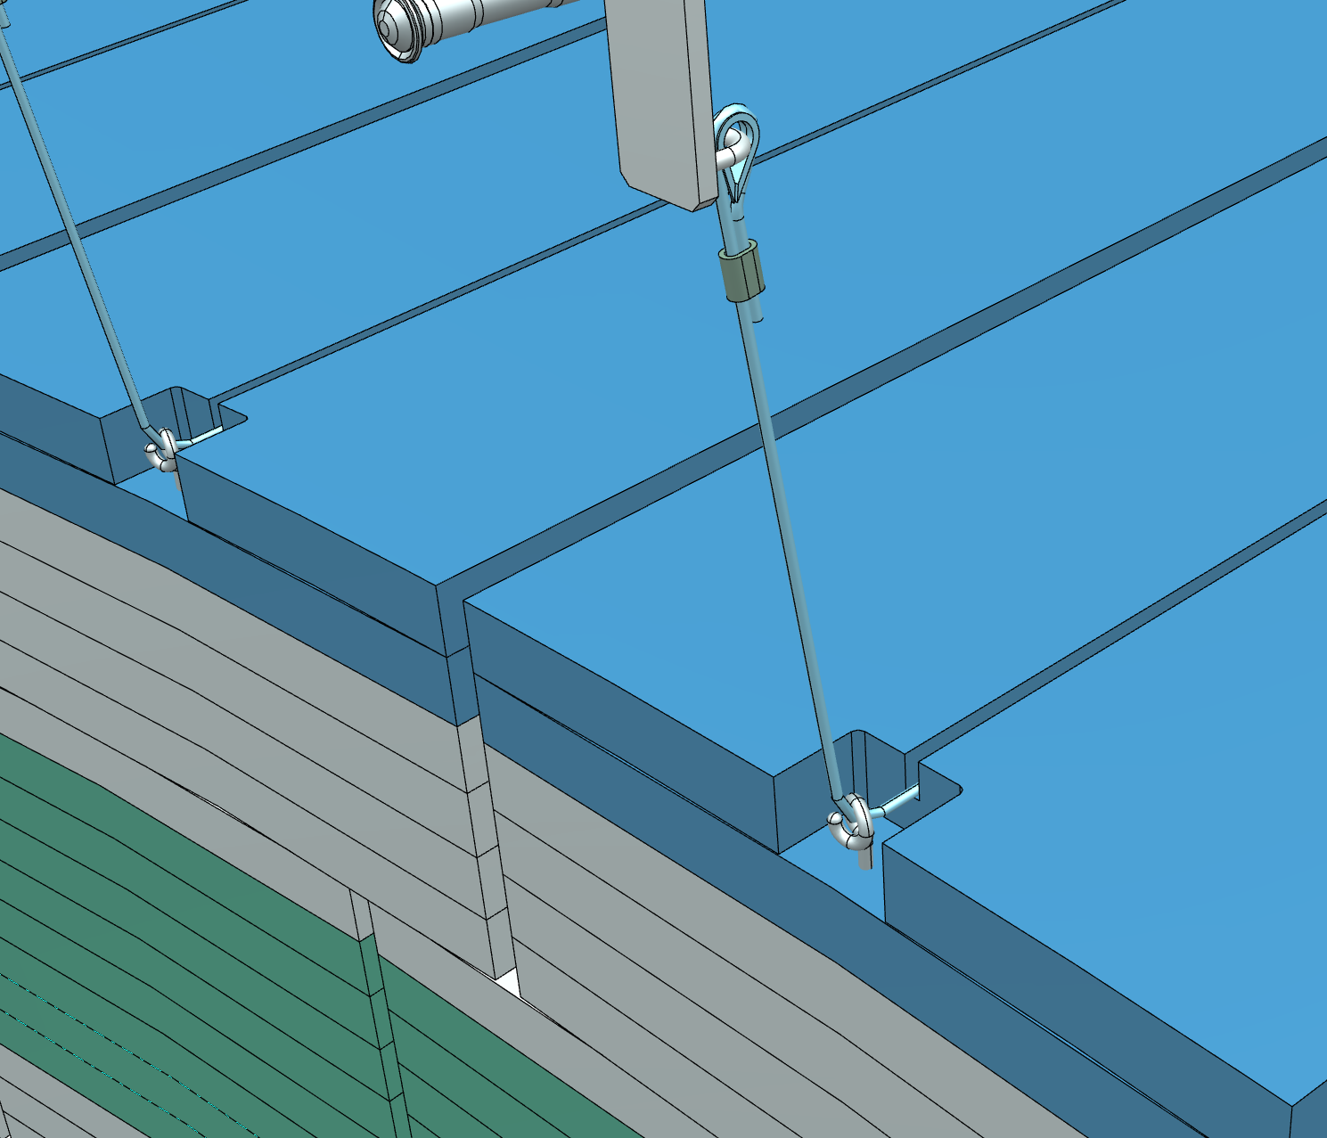
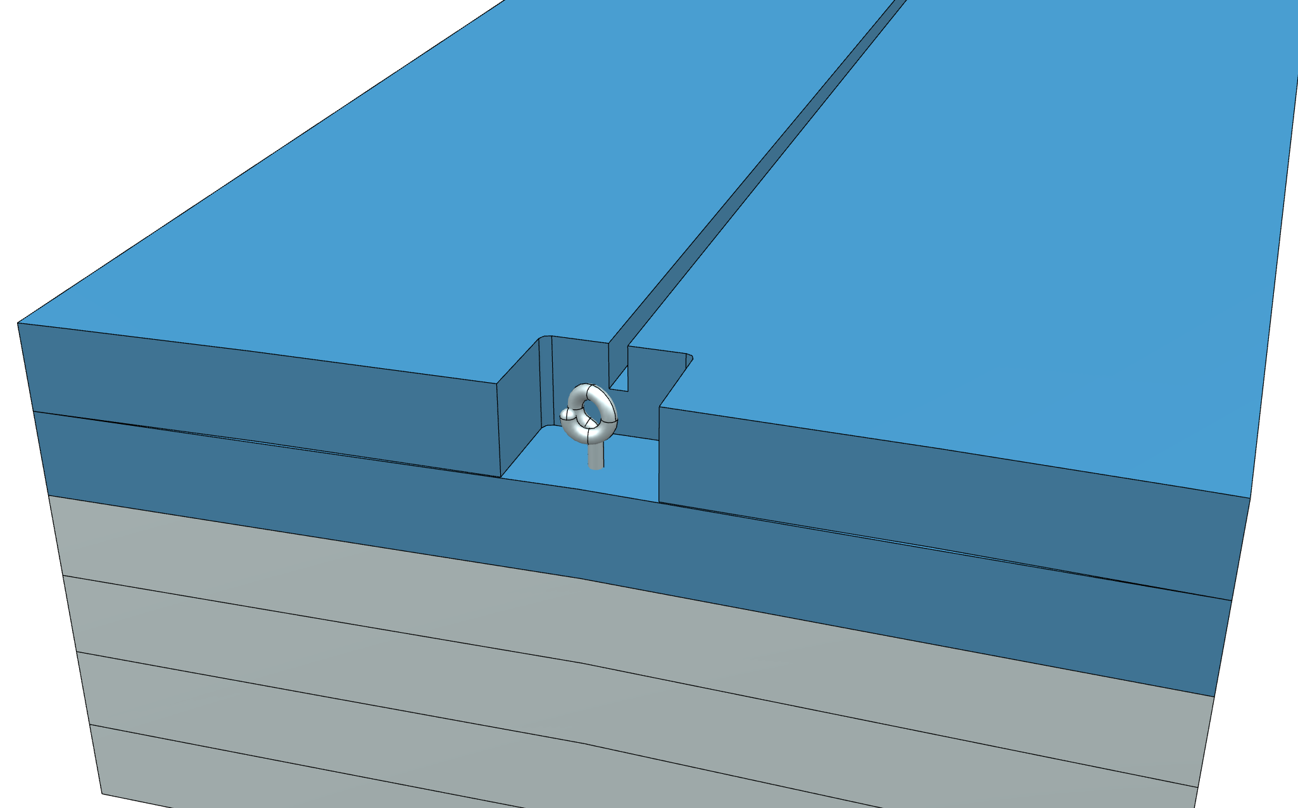
Personal Safety System – interlock design overview
The interlock design uses steel lines, which go from the Monolith skirt shield wall, through the blocks in the top level, up to the interlocks which are placed on the outer blocks row of the roof.

Slide 5
Personal Safety System – interlock design overview

Slide 6
Questions and ideas
Any questions or ideas?

