Slide 1
Status ACCSYS December 2017
Håkan Danared, Lena Gunnarsson, Magnus Israelsson,
Peo Gustavsson, Mats Lindroos, John Weisend
www.europeanspallationsource.se
November, 2017

Slide 2
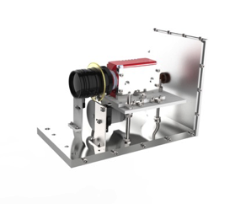
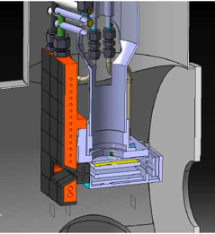
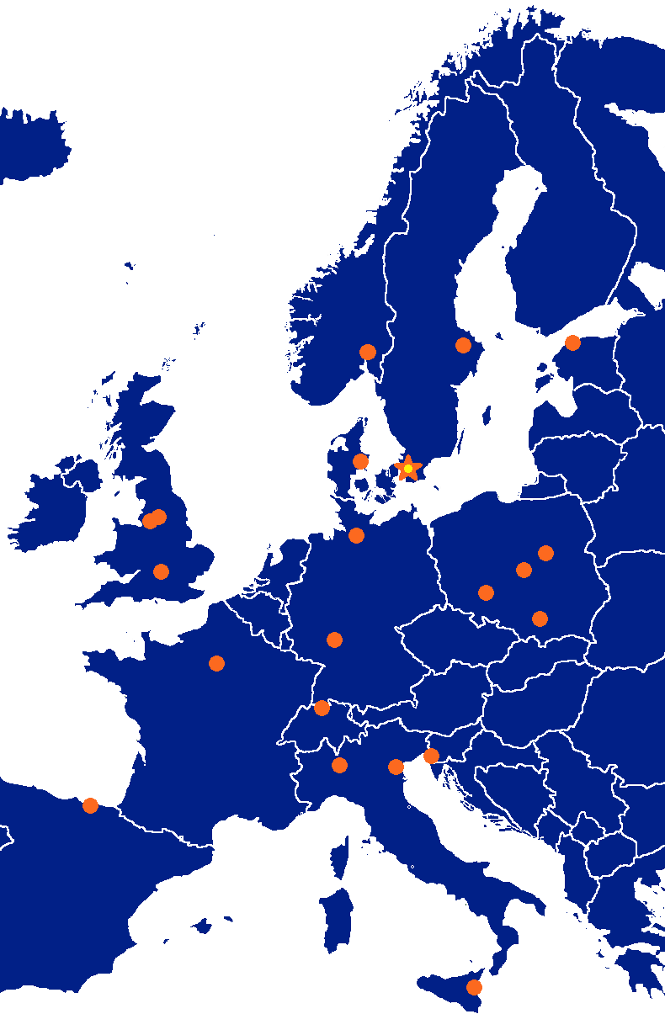
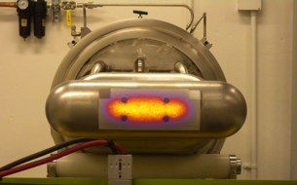
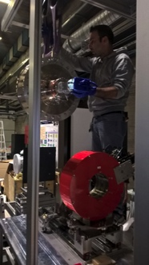
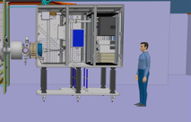
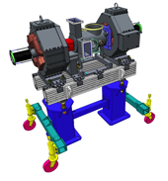
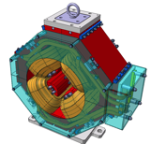
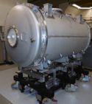
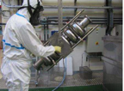
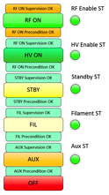
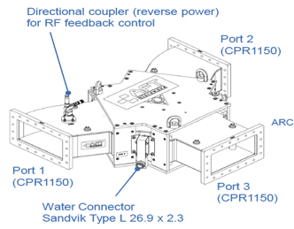
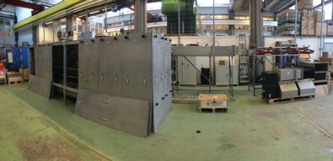
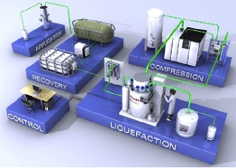
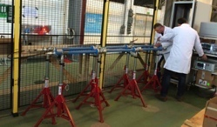
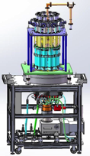
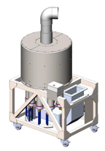
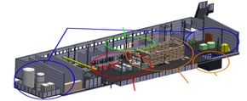
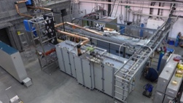
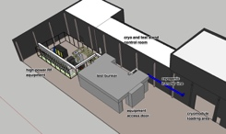
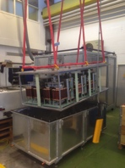
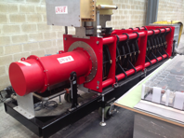
Accelerator Collaboration - Accelerator
352.21 MHz
704.42 MHz
2.4 m
4.6 m
3.8 m
39 m
56 m
77 m
179 m
Target
Source
LEBT
RFQ
MEBT
DTL
Spokes
Medium β
High β
HEBT & Contingency
75 keV
3.6 MeV
90 MeV
216 MeV
571 MeV
2000 MeV
2

Slide 3
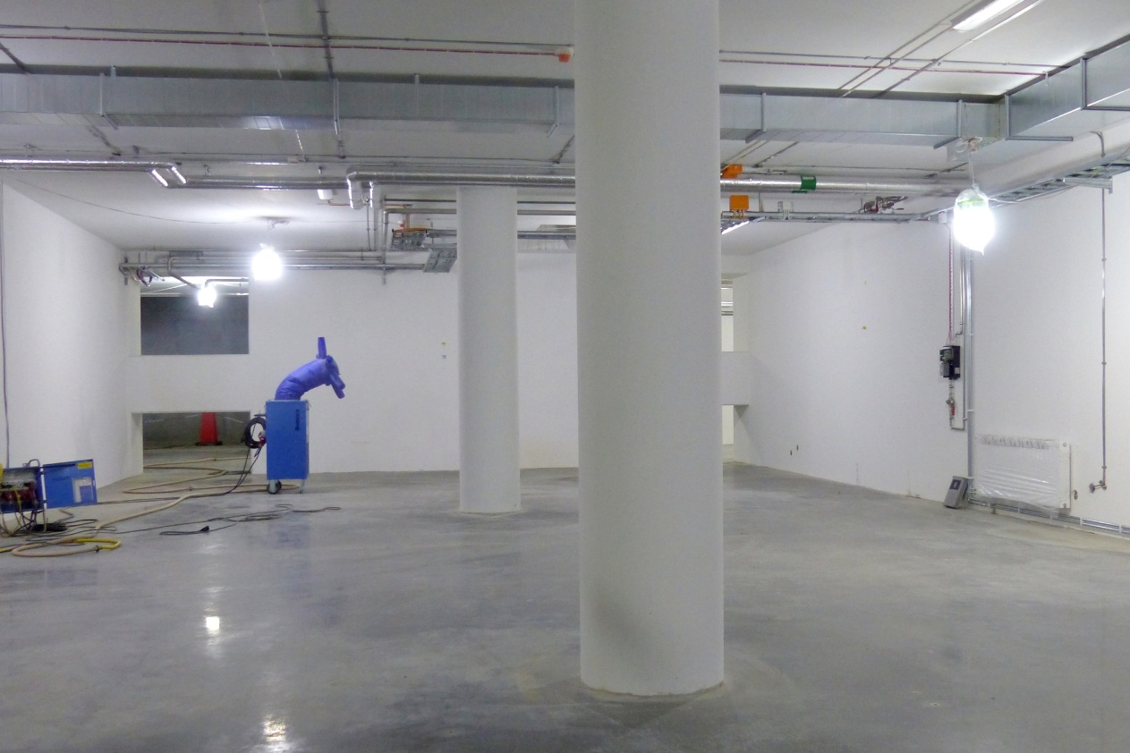
Linac tunnel
Tunnel, view from HEBT
Front End Building

Slide 4
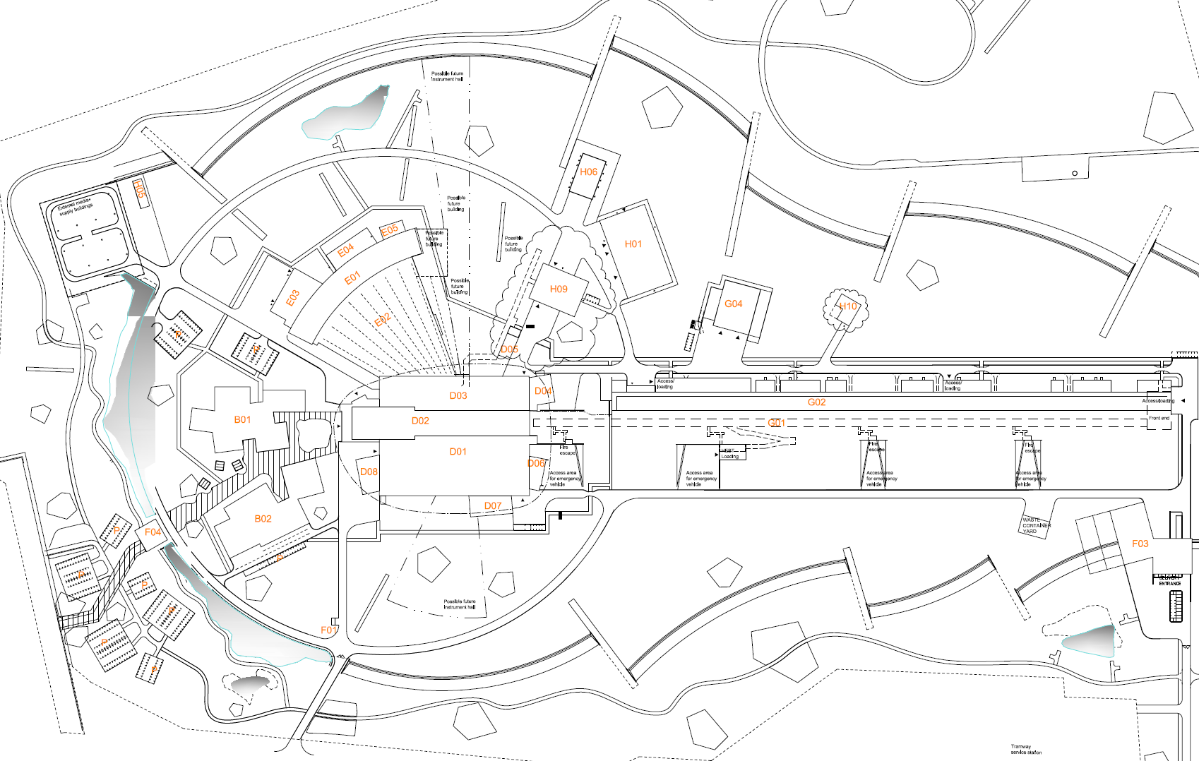
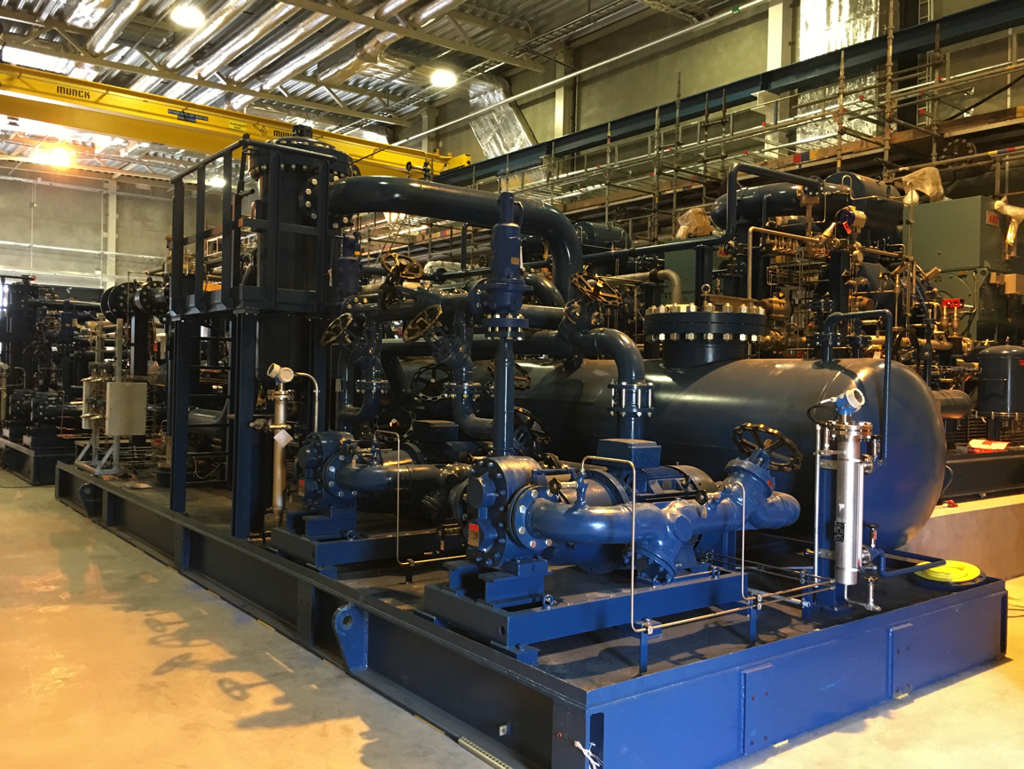
Installation has started on site (e.g. phase reference line and cryogenics)
Helium Recovery System Compressors
Reference line
Reference line

Slide 5
Accelerator Division– organigram for line org and In-kinds
Head Count: 127 (2017-12-01)
85 employees
31 from Eng & Integr Support, Consultants, Students, Planners
11 In-kind
Mats Lindroos – Head of Division
Håkan Danared – Deputy Head of Division
John Weisend II – Deputy (sub) Project Leader
Administration
Caroline Prabert
Inga Tejedor
WeiYing Li
Planning and Project Control
Lena Gunnarsson
Magnus Israelsson
Diana Bergenholtz
Luisella Lari (C)
Beam Physics, Operations & Beam Diagnostics
Andreas Jansson - GL
Installation
Interim: Håkan Danared
Nick Gazis
Marcus Green (C)
Dennis de Wit (C)
Emmanouil Trachanas (C)
Christoforos Kourkoutis (C)
IKC Coordination
Peo Gustafsson
Ebbe Malmstedt (C)
Specialized Technical Services
John Weisend II – GL
Gunilla Jacobsson
Beam Physics
Mamad Eshraqi – SL
Renato de Prisco
Ryoichi Miyamoto
Yngve Levinsen
Ciprian Plostinar
Natalia Milas
Quality
Kent Wigren (C)
Utilities and Test Stand Wolfgang Hees - SL
Anton Lundmark
Evangelia Vaena
Frithiof Jensen
Emilio Asensi
Owen Buchan
Steven McGlasson
Jörgen Jönsson (EIS)
Akif Coku (C)
Andreas Olenmark (C)
Fredrik Persson (C)
Kevin Patching (C)
Miguel Lund (C)
Engineering Resources
David McGinnis – GL
Eugene Tanke
Carl-Johan Hårdh (C)
Mats Pålsson (C)
Pontus Jönsson (C)
Linac
Håkan Danared- GL
Radio Frequency Systems
Anders Sunesson- GL
Safety
Lali Tchelidze – Interim GL
Duy Phan
Frank Kornegay (C 15%)
Beam Diagnostic
Tom Shea– SL
Benjamin Cheymol
Cyrille Thomas
Hooman Hassanzadegan
Hinko Kocevar
Irena Dolenc Kittelmann
Rafael Baron
Stephen Molloy
Edvard Bergman
Clement Derrez
Slava Grishin
Thomas Grandsaert (EIS)
Johan Norin (C)
Mehdi Mohammadnezhad (C)
Accelerator Integration
Vacant– SL
Aurélien Ponton
Iñigo Alonso
Power Converters
Carlos Martins – SL
Göran Göransson
Marko Kalafatic
Paulo José Torri
Rutambhara Yogi
Petro Pohorilo
Dana McKenzie
Anders Andersson (C)
IN-KIND from Norway
Øystein Midttun, Bergen
Greyson Christoforo, Oslo
Front End & Magnets
Edgar Sargsyan – SL
Georg Hulla
Janet Schmidt
Richard Bebb
Frank Hellström (C)
Cryogenics
Philipp Arnold – SL
Jaroslaw Fydrych
John Jurns
Xilong Wang
Xiaotao Su
Johnny Råström
Mattias Olsson
Per Nilsson
Ila Sjöholm (C)
Piotr Tereszkowski (C)
IN-KIND from IFJ-PAN Poland
Leszek Hajduk
Krzysztof Myalski
Michal Sienkiewicz
Tadeusz Ostrowicz
Edward Gornicki
Wawrzyniec Gaj
Jan Zbroja
Marek Skiba
IN-KIND from INFN, Italy
Gianluigi Cibinetto
RF Sources
Morten Jensen – SL
Rihua Zeng
Rafael Montano
Bruno Lagoguez
Chiara Marelli
Staffan Ekström
Stevo Calic
Iñigo de la Fuente
Anders Svensson
Christian Amstutz
Walther Borg
Superconducting RF
Vacant– SL
Christine Darve
Felix Schlander
Cecilia Maiano
Paolo Pierini
Saeid Pirani
Nuno Elias (EIS)
Fredrik Håkansson (C)
Younguk Sohn (visitor until June 2018)
Operations
Lali Tchelidze – SL
Marc Munoz
Vacuum
Marcelo Juni Ferreira – SL
Hilko Spoelstra
Simone Scolari
Christophe Jarrige
Fabio Ravelli
Kristell Barthélemy
Ralf Huber
Laurence Page
Peter Ladd (C 50%)
Notes:
§

Slide 6
Accelerator Systems (sub-) Project (ACCSYS) – organization
WBS/WP# | TITLE | LEADER | EXT. WP | DEPUTY WP LEADER for EXTERNAL WPS | PCC
11 11.01 | ACCSYS MANAGEMENT | M. LINDROOS J.G. WEISEND II | NO |  | 110100001 & 110100002
11.02 | ACCELERATOR PHYSICS | M. ESHRAQI | NO |  | 110200001
11.03 | NORMAL CONDUCTING FRONT END | S. GAMMINO | YES | E. SARGSYAN | 110300001
11.04 | SPOKE CRYOMODULES | G. OLRY | YES | C. DARVE | 110400001
11.05 | ELLIPTICAL CRYOMODULES | P. BOSLAND | YES | C. DARVE | 110500001
11.06 | BEAM DELIVERY SYSTEMS | S. MØLLER | YES | I. ALONSO | 110600001
11.07 | BEAM DIAGNOSTICS | T. SHEA | MIX |  | 110700001
11.08 | RF SYSTEMS | M. JENSEN | MIX |  | 110800001
11.09 | Not used
11.10 | TEST STANDS | W. HEES | MIX |  | 111000001
11.11 | CRYOGENICS | P. ARNOLD | MIX |  | 111100001
11.12 | VACUUM | M. JUNI-FERRERA | MIX |  | 111200001
11.13 | SAFETY | L. TCHELIDZE | NO |  | 111300001
11.14 | ACCELERATOR INTEGRATION | H. DANARED | NO |  | 111400001
11.15 | ELECTRICAL SUPPORT | F. JENSEN | NO |  | 111500001
11.16 | COOLING SUPPORT | A. LUNDMARK | NO |  | 111600001
11.17 | POWER CONVERTERS | C. MARTINS | MIX |  | 111700001
11.18 | ENGINEERING RESOURCES | D. MCGINNIS | NO |  | 119900001
11.98 | GENERAL INSTALLATION SUPPORT | H. DANARED | NO |  | 119800001
11.99 | INSTALLATION | H. DANARED | NO |  | -
Accelerator Collaboration Board (ACB) – meets twice annually:
Reps from each IKC & collaborating institute (one elected as chair)
ESS Technical Director
ACCSYS Sub-Project leader
Accelerator Technical Board (ATB) – meets quarterly:
AccMT & all WP leaders and deputies
Reps of all contracted institutes if not already a WP leader
ESS Machine Management Team members invited
Accelerator (Project) Management Team (AccMT) – meets weekly:
Mats Lindroos: Project Leader
Caroline Prabert: Administration
John Weisend II: Dep. Proj Leader (WP 1) & STS (WPs 11,12,15,16)
Lena Gunnarsson & Magnus Israelsson: Project Planners
Lali Tchelidze: Safety manager including radiation safety (WP13)
Peo Gustafsson: IKC coordination manager
Nick Gazis: Acc site infrastructure coord (WPs 98,99)
Håkan Danared: Installation coordinator & Linac systems leader (WPs 3,4,5,6,14)
Andreas Jansson: Beam Physics, Diagnostics, Ops planning mgr (WPs 2,7)
Anders Sunesson: RF power systems leader (WPs 8,17)
Note: Section Leaders (AD line) can be called to participate in AccMT meetings
IKC coordination, IKC liaisons & BrightNESS IKC ‘field coordination’:
Peo Gustafsson: IKC coord mgr Ebbe Malmstedt (C): assists overall IKC coord
Georg Hulla: for WP 3 IKC Felix Schlander: for WP 4 & WP 5
Frank Hellström (C): for WP 3 IKC Nuno Elias: for WP 4 & WP 5 IKC
Fredrik Håkansson (C): for WP 4 & 5

Slide 7
Highlights
Ion source and LEBT tested in Catania and now being transported to ESS
Successful Cool Down and Low Power Tests of M-ECCTD prototype cryomodule
Successful test of continuous He II transfer between Valve Box and Spoke Cavity Cryomodule – no flow instabilities observed
New ITC plan moved into P6: it is now being ”resourced” and the joint planning with ICS has started
Installation of Cable Trays, Cables, water cooling and electronics at Test Stand 2
Annual Review, TAC and collaboration board held
Strong support from TAC for AD and EIS approach to integration and installation for FEB
Scope transfer to CF for FEB installation of cables, cables trays, watercooling and equipment moving and fixation
Work on-going and the cooling water installation is close to complete
We started discussion with Cf to continue this approach for RF gallery and tunnel

Slide 8
Issues
Important delays on Ready For Installation (RFI) dates for several key in-kind partners will only enable beam from NC linac in 2019 and beam to target at 572 MeV in October 2020
Stub installation testing confirmed that it is impossible to safely insert heavy shielding material between the waveguides (limited space) and that more is needed to find a solution
The ES&H procedures are still being put in place for work on site but with scope transfer we can handle it
QA/QC Planning and preparation for Partner visits to align expectations on CoC and CE requirements

Slide 9
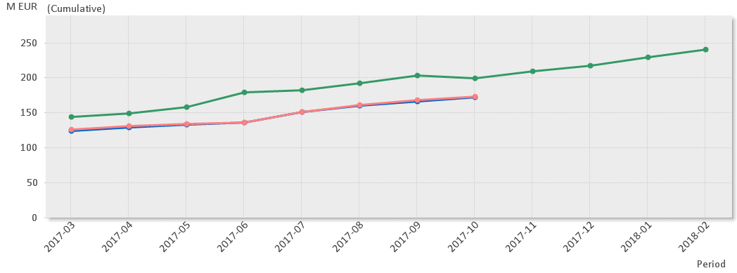
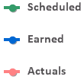
EV Graph
(* No InKind included)
Current Status
Cost Variance is by end of Sep -946 k€ (last month it was -1.9 M€).
Main contributors to the CV are: Beam Delivery Systems, Beam Diagnostics and Cooling Support.
Schedule variance is by end of Sep -27.5 M€ (improved by 9.3 M€ since last month).
Main contributors to the SV are: NCFE, Beam Delivery Systems, Vacuum and Electrical Support.

Slide 10
Milestones (1/2)
ID | Name | Baseline | Current Forecast | Δ since last month (days) | Float | Impact/Action
A20162350 | LEVEL2.2G.ACCSYS.WP03.Start RFQ machining | 30-jul-16 | 1 Jan-17 | 0 |  | Completed
A20161610 | LEVEL1.1G.ACCSYS.WP08.Thales and Toshiba and CPI/ Klystron Prototypes delivered | 1-jun-16 | 1 Feb-17 | 0 |  | Completed
A50070 | LEVEL1.1G.ACCSYS.WP08.CPI/Thales and L3 IOT prototypes delivered | 30-sep-16 | 3 Jul-17 | 0 |  | Completed
A20141060 | LEVEL1.1G.ACCSYS.WP04.WP05.Spoke & MB CM production launched | 23-dec-16 | 1 Nov-17 | -20 | -184 | Obsolete. Will be split into 2 milestones
A20161740 | LEVEL1.1G.ACCSYS.WP05.MB CM testing starts | 2-Oct-17 | 1 Nov-17 | -20 | -20
A50060 | LEVEL1.1G.ACCSYS.WP08.Decision IOT or Klystron for High Beta Linac | 3-Jan-18 | 28 Mar-18 | 0 | -60 | Impact is only on Post 2019 High Beta CMs
A20141410 | LEVEL1.1G.ACCSYS.WP11.Accelerator cryoplant ready for CDS | 11-jun-18 | 3 Jul-18 | 0 | -15

Slide 11
Milestones (2/2)
ID | Name | Baseline | Current Forecast | Δ since last month (days) | Float | Impact/Action
A20161580 | LEVEL1.1G.ACCSYS.WP02.Start RFQ commissioning | 16-jul-18 | 12 Nov-18 | 0 | -70 | This is a knock-on effect from the start of RFQ machining. If delivery date of RFQ is met, this will also be met
A20161620 | LEVEL1.1G.ACCSYS.WP02.Beam commissioning completed for ISRC-LEBT-RFQ-MEBT | 08-oct-18 | 16 Sep-19 | 0 | -228 | Replanning underway for MEBT.
A20161630 | LEVEL1.1G.ACCSYS.WP02.Beam commissioning completed for NCFE but DTL5 | 25-feb-19 | 25 Nov-19 | 0 | -164 | Connections in P6 needs to be revised.
A49760 | LEVEL1.1G.ACCSYS.WP08.RF system for MB ready | 13-may-19 | 21 Dec-17 |  |  | Needs to be checked.
A20141030 | LEVEL1.1G.ACCSYS.First Protons on Target, 570 MeV | 28-jun-19 | 1 jul-19 | 0 | 0
A20161650 | LEVEL1.1G.ACCSYS.WP05.1-11 High Beta Cryomodules installed | 02-jun-21 | 02-jun-21 | 0 | 0
A20161660 | LEVEL1.1G.ACCSYS.WP05.12-21 High Beta Cryomodules installed | 04-jul-22 | 04-Jul-22 | 0 | 0
A20141040 | LEVEL1.1G.ACCSYS.Accelerator installed for 2.0 GeV | 23-sep-22 | 23-sep-22 | 0 | 0

Slide 12
EAC (1/2)
M EUR | Item | Comment
0 | Cryomodule Stands | This is being removed as money already in WP4/5 has been identified for this effort
0 | Coupler HV Bias | CCB CR0080. Solved. Updated 20170707.
0 | Expected change orders on warm He gas piping contract | Funded internally in WP11.
0 | He Collector in the Tunnel | CCB CR0163. Approved by EMT 20170926.
0 | NB sheet scanning | Funded internally.
0 | Quench detector | CCB CR0080. Solved. Updated 20170707.
0 | Reduce Linac Power 3 MW (High beta RF) | CCB CR0144. Solved. Updated 20170707.
0 | Coupler Arc Detectors | CCB CR0080. Solved. Updated 20170707.
0 | Coupler electron Pickups | CCB CR0080. Solved. Updated 20170707.
0 | Auxiliary RF costs | CCB CR0080. Solved. Updated 20170707.
0 | CM Beam gate valves for elliptical cryomodules | CCB CR0164. Approved by EMT 20170926.
0 | End of Construction milestones | CCB CR0147. Solved. Updated 20170707.

Slide 13
EAC (2/2)
M EUR | Item | Comment
0,5 | UPS Battery System | Orphan scope ( was thought to be CF originally) Optimization of requirements underway)
0,65 | Limited spare parts for High Power RF Amplifiers | This is to avoid single point failures that could cost us up to 12 months delay
3,3 | ESS cost due to requested schedule acceleration at IK partner institutes | Reduced by 1.7 Million Euros due to implementation of CR transferring this amount from contingency
20,4 | Additional costs for installation (staffing & material) | Reduced by 1 million Euros as some additional funds were found in the existing project
5 | Salary expenses due to delay into Transition into Operations | -
O.5 | Purchases in support of timely RFQ & DTL commissioning | Recent decision in support of RFQ and DTL conditioning as soon as possible.
30,35 | Total Forecast Variance | -
489,98 | Budget At Completion (BAC) | CCB CR0163, CCB CR0164 added to total budget in Sep. CCB CR0181 added in Oct.
520,33 | Estimate At Completion (EAC) | -

Slide 14
Risk Mitigation Status (data from Exonaut)
Risk ID | Event | Potential Impact | Prob. | Mitigation measures | Due date
2 | - In-kind contributors do not meet scope and schedule requirements. - Un identified construction problems | - 4-6 month project delays - Impact on several requirements | 35% | -Acc Re-baselined new ITC, based on new RFI dates -Elettra VAT and contract structure agreed - Specific partners and actions to be defined | 170915 170904 180131
240 | Insufficient Acc and ICS coordination can lead to; -undefined control architecture and insufficient functional description -undefined ownership and responsibility - Coordinated schedule demands not clarified | 7-9 month delays | 90% | - Time schedule coordination and dependencies clarification meetings started - Project coordination and priority meetings initiated - Work follow-up continues, development of strategy | 170901 170925 171215
63 | Installation complexity underestimated | 7-9 month | 65% | -Installation risk WS to be performed | 171220

Slide 15
Risk Mitigation Status (data from Exonaut)
Risk ID | Event |  | Potential Impact | Prob. | Mitigation measures | Due date
241 | Implementation of CE/CoD |  | 1-3 month 2,5 M Euro (Ext) 1,0 M Euro (Int) | 90% | -Inform all institutions on expectations (TB & Acc Colab & Selected partners) - Define ESS ambition level | 171215 180315
242 | Lack of spares when needed -Undefined amount of spares -No funding of spares |  | 7-9 month 5 M Euro (sufficient?) | 65% | -Decision on SRF facility (ext partner ?) -Identify founding needed -Identify and quantify amount / system
Mitigation actions performed since last report |  | - Risk Retired 223 (Equipment damage), 205 ( Klystron spares) , 27 (On site adjustments), 209 (personal injuries due electrical shock), 131 (Failing power down equip),
Acc Risks 238
Retired 5
New 3
Value of Acc cost risk = 12.1 M€ (8,8 M€ last month). CE and Spares drive the increase. Future evaluation of double booking of cost and cleanup will lower/balance the risk cost
Latest risk workshop: 170901 ; Next workshop scheduled for: Before 171220

Slide 16
Information
Next TAC meeting 11-13 April should review progress in all areas of the LINAC
We will organize a poster session for all IK partners and collaboration partners
Weiying Li will coordinate the poster session from ESS
Next years TB meetings
15 February, 14 June (Uppsala), 13 September 22 November

Slide 17
And finally
Thanks for all your hard work for ESS!
I’m afraid we still have a lot of hard work ahead of us
But together we are strongest

