Slide 1
CE marking
ESS-CEA ESSI Coordination Committee
www.europeanspallationsource.se
Dec 06

Slide 2
Outline
Introduction
Decision and implementation
ESS strategy
TA ”contract agreement”
Why ! Declaration of Conformity – DoC
How ! Declaration of Conformity – DoC
What ! Declaration of Conformity – DoC
Conclusions

Slide 3
Introduction ”declaration of confomity”
In order to support the construction of ESS facilities, ESS Management have decided on a strategy to organize the plant information to comply with EU standards and directives for all deliveries
ESS need for "declaration of conformity” implementation :
a CR will be issued to formalize the request “at the right time”
before a CR is issued we jointly need to understand the impact and implications ”for evaluation purposes”
ESS agree, this is ”partly” new requirement
For the ACC project, most of the cases, will lead to “declaration of conformity” or “declaration of incorporation” not CE marking
Due to bespoke equipment, where we heavily lean against our design and review process

Slide 4
Organization and delegation of requirement to be implemented
Director General
John Womersley
Associate Director ESH&Q
Ralf Trant
Head of Quality Division
Mattias Skafar
Quality Assurance Officer,
Quality Control Officer,
Document mgmt./arch. specialist,
Quality Inspections Tech.
Overall QA/QC
responsibility
and coordination
Acc. Project
Project
Delegated QA/QC
responsibility
WPM
WPM
Notes:
.

Slide 5
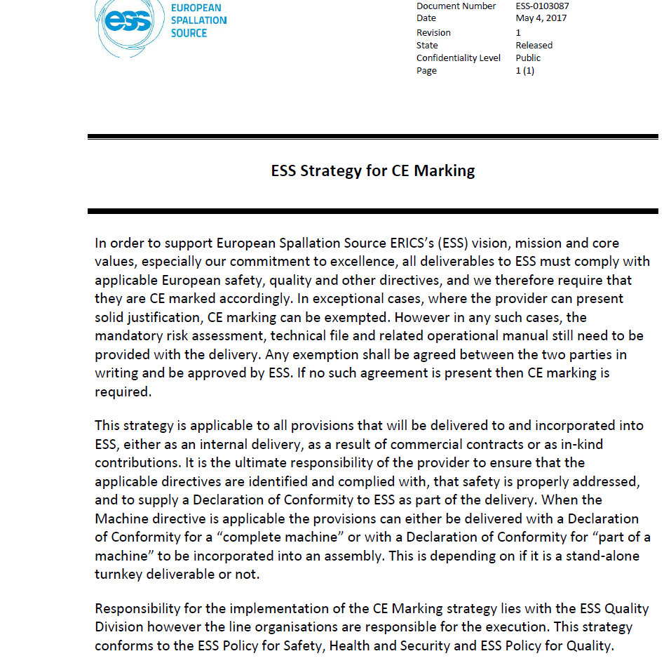

Slide 6
ESS Strategy for CE Marking (ESS-0103087)
All deliverables to ESS must comply with applicable European Safety, Quality and other directives including CE marking.
The strategy is applicable to all equipment delivered to ESS (IK, ESS self performed or commercial agreement)
The provider, In-Kind or contractors has the responsibility to ensure that the applicable directives are identified and fulfilled.
The conformity declaration is pending the boundaries of the delivery;
Complete machine, Part of the machine, Specific component, or a part of a component of the machine
ESS shall be able to aggregate all information up to the complete machine
aggregations of parts, components and systems will be done according to the ACC ITC plan.

Slide 7
Technical Annex text ” TA”
We didn't foresee CE verification when we wrote the contract, if so, it would have been explicitly written;
The Partner shall ensure that all work and deliverables comply with applicable European and national regulations, directives and other acts,
also any additionally specified standard, regulation or restriction identified in the documents of the baseline reference design specified
The Partner shall identify and list the standards the Partner will comply with in executing this Sow, in the [PQP]
The Partner is responsible, in accordance with applicable European and national regulations for safety and health at work, for the safe conduct of the activities to perform this SoW.

Slide 8
Technical Annex text ” TA”
The Partner shall prepare a consistent and comprehensive Project Quality [PQP].
Planning and compliance documentation required might be principally generated from the Partner’s own quality management system when applying a system manual with defined procedures.
ESS remains directly responsible to SSM for licensing and it is the responsibility of ESS to identify and describe SoW to the partner.
any specific requirements for the Partner, any specific deliverables to be provided by the Partner and any specific process(es) to be followed by the Partner which enable ESS to achieve SSM licensing.
ESS may at a later stage, request of the Partner additional information required by, or in support of ESS’ responsibilities for SSM licensing.

Slide 9
Why ! Declaration of Conformity – DoC
Verifying that applicable directives and requirements have been applied
This will ease the integration process and secure that the Manufacturer of a deliverable have taken their responsibility for the delivery in terms of:
Safety requirements
Quality requirements
Technical requirements
Compliance to European Directives and standards

Slide 10
How ! Declaration of Conformity – DoC
ESS will (most likely) set up an Expert panel
To support the project needs and answering questions
Collective and broad competence to guide
Give guidance towards the best possible approach
ESS will make a specialist available for a number of month to help out
ESS will not become “CE” Taliban's, the best practical approach, will give necessary leeway, we will not make it Black or with !
The safety risk analyze will be the driving tool (evaluated in several steps towards all identified risk mitigated)
Most likely it has to be treated as a Reversed-FMEA (Failure Mode and Effects Analysis)
The components and equipment will be used by skilled, trained people, not a available on the common market
The machine view shall be on as low level ass possible
AD and WP and QA/QC will support our partners as needed, but the needs has to be identified and driven from the partners side

Slide 11
How to do this ? ”road map”
Based on components to be delivered and its boundaries;
Our partners identify relevant regulations, directives standards, norms and requirements
Identify applicable and relevant parts
Plan and Perform necessary verifications
Develop needed documentation
Design and component construction
Reviews e.g.. PDR, CDR, TRR, SAR
Safety risk analysis (design impact, adm. control, op manual)
Witnessing, Reviewing or Auditing manufacturing Inspection and Test including FAT
Final Documentation

Slide 12
How to do this ? ”road map”
Based on Design and component construction to find common relevant minimalistic approach
IK partner present intention and ask questions
ESS give support to outline the approach and structuring of information to ”declaration of conformity”
ESS will give the IK partners needed support in the decision process to meet the final objective
ESS will define the level and ambition in cooperation with the partners
Based on Design and component construction
Partner compile needed documentation and issue ”declaration of conformity”
ESS verify partner compliance

Slide 13
What to do ? The “Principle approach”
Product
Identify Relevant EC Directives e.g.
2006/42/EC
2014/35/EU
2014/30/EU
Identify and apply applicable standards
Compile Technical file
Description, Technical reports, Test reports, Construction plans, Circuit diagrams, Part lists etc.
Issue
User manual
in English
Create a EC - Declaration of conformity
(Part of a machine)
Award of the EC-Conformity mark (CE)
Notes:
42 Machine
35 Low voltage
30 Electromagnetic compatibility

Slide 14
What to deliver!
The delivery shall include:
Risk assessment (ISO 12100)
Several steps on how to mitigate and minimize the risks
Technical File, drawings, wiring diagram, P&ID, etc.
Operational Manual, in English
Declaration of Conformity

Slide 15
Divide in Logical packages
* Declaration of Conformity for part of machine (to be incorporated) or a complete machine
Declaration of Conformity
ESS level
To be demonstrated at different times/for part of the machine (test and commissioning plan)
IKC A
IKC B
IKC C
IKC D
IKC E
Declaration of Conformity*
Declaration of Conformity
Declaration of Conformity
Declaration of Conformity
Declaration of Conformity

Slide 16
Conclusions
By work trough, define and agree
the process /work flow
needed documentation
ESS needs
We can evaluate the amount of work required to perform the ”declaration of conformity”
We can see and agree on how to do the work
We can align and agree on expectations
We can minimize the risk
We end up with the best and most minimalistic approach

Slide 17
Thank you for your attention!
and now…

Slide 18
Machine Directive 2006/42/EC
Machine
Partly completed Machine
Machine not in Annex IV
Technical file
Annex VII A
Instructions
Machine in Annex IV
Technical file
Annex VII B
Assembly Instr.
Annex VI
Designed according to Harmonised standards
Not designed according to Harmonised standards
Internal conformity checks
Annex VIII
Full Quality Assurance
Annex X
EC-type examination
Annex IX
Internal check
EC declaration of conformity
Annex II 1A
Declaration of incorporation
Annex II 1B
CE mark
Article 16
Annex III

Slide 19
Notified Body needed when…
Annex IV Machines, examples:
Various wood working tools
chain saws, circular saws, band saws etc.
Press tools for metal/plastic
Injection or compression plastics- or rubber moulding machinery
Heavy machinery for various work
Under ground (mining)
Compression of waste, etc.
Lifting equipment: person, goods
Protective devices designed to detect the presence of persons
Power-operated interlocking movable guards
Logic units to ensure safety functions
Roll-over protective structures
Falling-object protective structures
Red = Potentially applicable to ESS

Slide 20
Example
Declaration of Conformity*
IKC
Declaration of Conformity*
Declaration of Conformity*
Partner institute
Supplier
Type of delivery:
In house design
In-kind Contribution
External provider
Off the shelf, CE marked
* Part of a machine
or complete machine

Slide 21
CE marking
Bottom up approach in building
ESS
Certificate
of
Conformity
Strategy for CE marking ESS-0103087
ESS
Rules for CE marking ESS-0127031
CoC
CE Marking
ACCYS Project Quality Plan ESS-0033583
In-Kind Partner
Certificate of Compliance
CoC
CE Marking
Manufacturer
Off shelf component
CE marking to be secured
On shelf component
CE marking is given

Slide 22
ESS ACCYS Project Quality Plan (ESS-0033583)
The ACCSYS Quality Goals (AQG#) for ACCSYS during Construction Phase are:
AQG1 Assure and control Quality of Accelerator’s buildings and other site infrastructure
Assure and control Quality of the linac and its supporting equipment systems
Assure and control Quality of installation
Assure and control Quality of commissioning
Assure and control Quality of initial operations

Slide 23
ESS ACCYS Project Quality Plan (ESS-0033583)
AQG2, Quality of Accelerator´s Equipment Systems describe steps of ESS Quality Assurance to be performed in collaboration with ESS In-Kind partners and / or Contractors as:
Reviews of Statement of Work, Requirements, Technical Specification etc.
Participate in Technical Reviews as Preliminary Design Review (PDR), Critical Design Review (CDR), Test Readiness Review (TRR), System Acceptance Review (SAR)
Witnessing, Reviewing or Auditing manufacturing Inspection and Test including Factory Acceptance Test (FAT)
Review of Final Documentation and ensure the upload to ESS Documentation Management System.
To assist Partners to fulfill requirements for CE marking or Declaration of Conformity

