Slide 1
ESS ALARA approach in operation on-going reflexion ESS-JPARC workshop
François JAVIER
ESH&Q
www.europeanspallationsource.se
19 January, 2018

Slide 2
Framework and principles
ALARA approach is mandatory (included in Swedish Radiation Safety Authority’s regulation) and must be implemented what ever the level of individual and collective doses.
but ALARA approach in operation at ESS will be adapted to dosimetry stakes:
Resources deployed must be commensurate with the gravity of issues,
3 levels of formalization based on individual and collective predicted doses level:
No dedicated ALARA study but implementation of good radiation practices
Dedicated ALARA study integrated in radworkpermit
Dedicated ALARA study with specific ALARA report

Slide 3
The procedure
The driving document is the “radwork permit”
Mandatory for any work or intervention occurring
in supervised and controlled areas.
define the radiological context of a given work or intervention
assess and formalize the predicted dose (individual and collective)
trigger and formalize an ALARA study based on thresholds
define or complement the radiation protection rules or directives to be applied to the area and to the workers
collect doses received during the work, present analysis of potential discrepancies with predicted doses and trace lessons learned.

Slide 4
ESS Radiation zoning
Controlled area > 6mSv/year
1 mSv/y< Supervised area < 6 mSv/y
Public area none permanently occupied areas: DR < 0.5 μSv/h permanently occupied areas: DR < 0. 025 μSv/h No Airborne contamination No Surface contamination | Supervised area DR < 3 μSv/h No Airborne contamination Combination: (EWBDR/3 μSv/h) < 1 Surface contamination β, γ < 4 Bq/cm² α < 0.4 Bq/cm² Temporary hotspots ; 3 μSv integrated dose over any one-hour period | Unrestricted Controlled area External whole body dose: EWBDR < 25 μSv/h Airborne contamination (without external radiation) Ac < 2.5 DAC Combination: (EDWBR/25 μSv/h) + (Ac/2.5 DAC) < 1 Surface contamination β,γ < 40 Bq/cm² α < 4 Bq/cm² Temporary hotspots: 25 μSv integrated dose over any one-hour period | Restricted controlled area External whole body dose: EWBDR < 2.5 mSv/h Airborne contamination (without external radiation) Ac < 250 DAC Combination (EDWBR/2.5 mSv/h) + (Ac/250 DAC) < 1 Surface contamination β,γ < 100 Bq/cm² α < 10 Bq/cm² | Highly restricted controlled area External whole body dose rate: EWBDR > 2.5 mSv/h Airborne contamination (without external radiation) Ac > 250 DAC Combination (EDWBR/2.5 mSv/h) + (Ac/250 DAC) > 1 Surface contamination β,γ > 100 Bq/cm² Α > 10 Bq/cm²

Slide 5
The procedure
RADWORKPERMIT
Permanent (or generic) radwork permit (PRWP):
it covers all the planned activities performed continuously or frequently (more than 2 times/year) during the year. The PRWP are established at the beginning of commissioning/operation by the operation and maintenance groups with the workers performing the same kind of tasks or working in the same area, with the support of the radiation protection group.
Criteria for ALARA study
Individual predicted dose > 0.5 mSv/year (integrated in PRWP)
Individual predicted dose > 1 mSv/year (dedicated ALARA report referenced in the PRWP)
Collective predicted dose s > 3 man.mSv/year (integrated in PRWP)
Collective predicted dose > 6 man.mSv/year (dedicated ALARA report referenced in the PRWP)
One-off radwork permit (ORWP):
It covers one-off intervention like planned activity performed at most twice a year or unplanned activity resulting from specific unexpected event or modification within the supervised and controlled areas of the facility.
Criteria for ALARA study
Individual predicted dose > 100 μSv (integrated in ORWP)
Individual predicted dose > 200 μSv (dedicated ALARA report referenced in the ORWP)
Collective predicted dose > 1 man.mSv (integrated in ORWP)
Collective predicted dose > 2 man.mSv (dedicated ALARA report referenced in the ORWP)

Slide 6
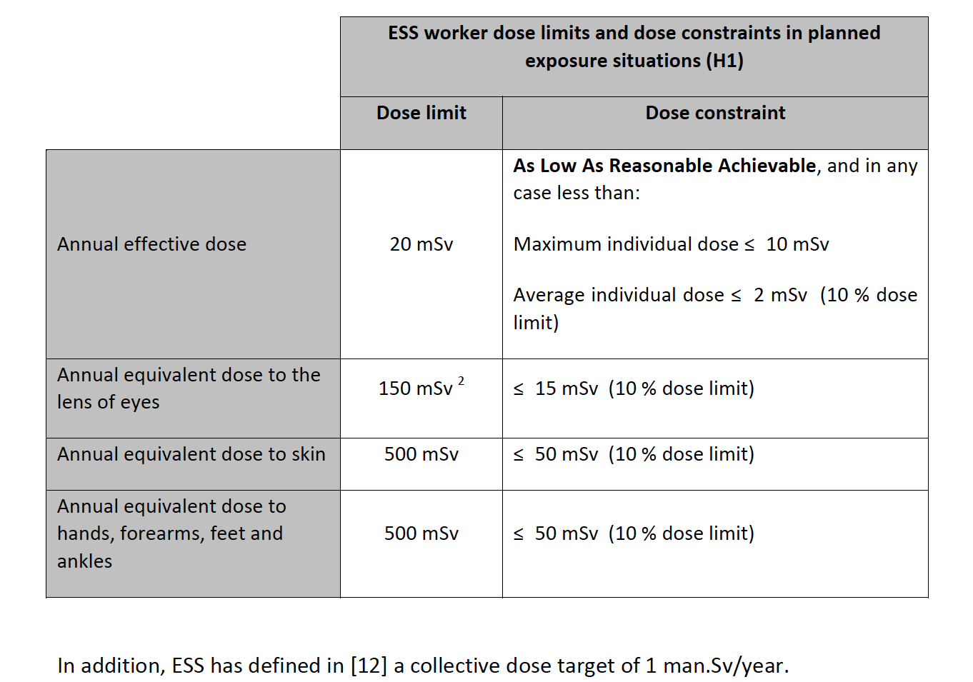
ESS dose constraints
(2) The European directive 2013/59 recommends a new average value of 20 mSv for the annual equivalent dose to the lens of eyes (with a maximum value of 50 mSv) instead of 150 mSv; it is not integrated yet in Swedish regulation.

Slide 7
Content of ALARA study
Context of intervention and basic inputs
Assessment of individual and collective predicted dose for the reference scenario of intervention (rough scenario without any specific provisions)
Identification of the main workplaces and equipment contributing to the dose
Identification of the distributions of the main tasks contributing to the dose
Identification of dose reduction factors enabling the reduction of the collective and individual dose (checklist)
For the different dose reduction factors identified, assessment of:
dose reduction
technical feasibility, cost, impact on other performances (radiation safety, conventional safety, operability, availability, waste, organisation)
option(s) selected based on previous assessment with brief justification
definition of individual and collective dose objectives based on previous choice.

Slide 8
ALARA study - Dose reduction factors checklist
Reduction of the source(s) responsible of the dose rate (prompt dose and/or activation):
Is it possible to reduce/stop the source?
Is it possible to remove the source?
Is it possible to shield the source?
Reduction of the source(s) responsible of the contamination level:
Is it possible to reduce/stop the source?
Is it possible to remove the source?
Is it possible to confine the source?
Reduction of exposure time:
Is it possible to reduce the exposure time (time for intervention, number of workers)?
Is it possible to delete some phases of the intervention?
Is it possible to improve the access and to reduce the human operation (quick connection/disconnection, more adequate or specific tool to be used/developed)?
Is it possible to use remote handling?
Is it needed to improve worker’s skill by implementing specific training? Is it possible to achieve a dedicated mock-up on this purpose?
Increasing the distance:
Is it possible to remove the equipment to be maintained and perform maintenance in low-level radiation area in order to reduce the impact of other sources?
Adapting modes of operation:
Is it possible to optimise the task order between different operations in order to reduce the dose?
Is it possible to optimise waiting time before human intervention in order to use radioactive decay effect and/or air renewal by HVAC?
Setting up shielding:
Is it possible to set up additional shielding on the equipment and the other sources?
Is it possible to protect the worker with individual shielding and/or mask?

Slide 9
ORWP template
DRAFT

Slide 10
ALARA Stakeholders
The ALARA study is performed by the team in charge of the intervention with the support of the radiation protection group.
When an ALARA report is needed and when the predicted dose is beyond 1 mSv for the individuals or beyond 5 man.mSv for the collective dose, the report must be reviewed and approved by the ALARA Committee in operation.
The members of the ALARA committee in operation are the following:
ALARA committee chairman
ALARA committee secretary
Operation leader
Associate director for ESH&Q
Radiation protection group leader
Maintenance group leader
Additional members can participate based on additional expertise needed case by case. The ALARA committee secretary is in charge of:
organizing the ALARA committee meetings,
recording decisions made based on ALARA reports and associated presentations and discussions.

