Slide 1
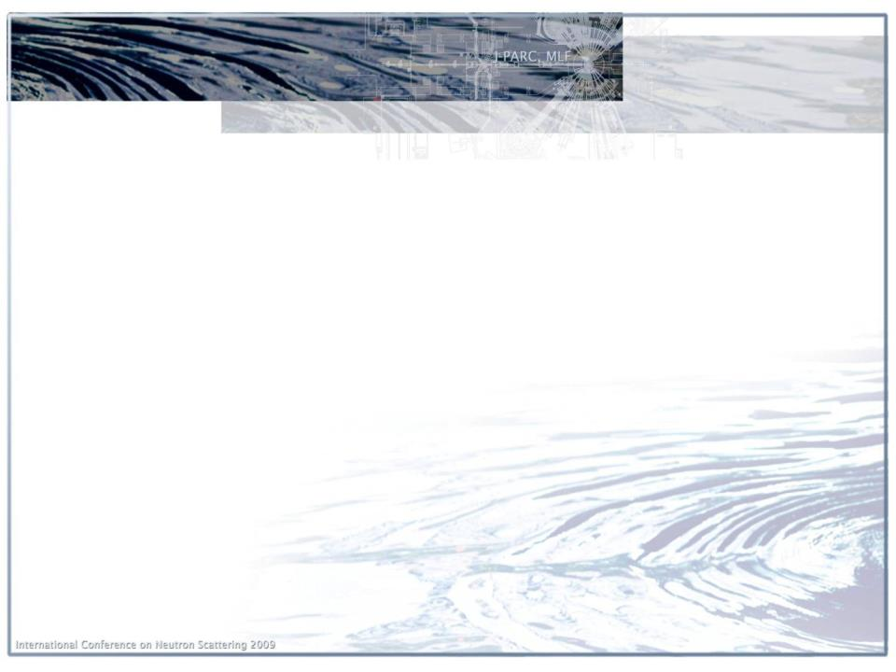










The 2nd ESS–J-PARC Collaboration Workshop
18-19 January, 2018
ESS, Lund, Sweden
III. Instrument technology and experiences
Performance of instruments (intensity & resolution in comparison to design, some of background issues)
K. Nakajima
Neutron Science Section
MLF, J-PARC Center

Slide 2
Neutron Instruments at MLF
Diffraction Group
・Single Crystal Diffractometer
BL03: iBIX for Bio-Materials
BL18: SENJU
・Powder Diffractometer
BL08: S-HRPD Hi-Resolution
BL09: SPICA for Battery Mat.
BL20: iMATERIA Hi-Intensity
BL11: PLANET Hi-Pressure
・Total Scattering Diffractometer
BL21: NOVA
・Engineering Diffractometer
BL19: TAKUMI
Spectroscopy Group
・Chopper Spectrometer
BL01: 4SEASONS Hi-Intensity
BL12: HRC Hi-Resolution
BL14: AMATERAS Cold-Neutron
BL23: POLANO Polarized
・Inverted Geometry Spectrometer
BL02: DNA
・Neutron Spin-Echo
BL06: VIN_ROSE
Operation
2008~
Operation
2008~
Operation
2011~
2008~
Operation
Operation
2009~
Operation
2008~
Construction
Operation
2011~
Operation
2008~
Operation
2011~
Operation
2010~
MIZE
Operation
2017~
Operation
2008~
NRSE
Commissioning
2008~
Pulsed Neutron Application Group
・Neutron Source Diagnostic & Test Port
BL10: NOBORU
・Neutron-Nucleus Reaction Meas. Inst.
BL04: ANNRI
・Fundamental Physics
BL05: NOP
・Neutron Imaging
BL22: RADEN
Operation
Operation
2008~
Nano-Structure Group
・Reflectometer
BL16: SOFIA Horizontal
BL17: SHARAKU Polarized
・Small&Wide-ANS
BL15: TAIKAN
Operation
2008~
Operation
2008~
Operation
2011~
Operation
2008~
Operation
2010~
Operation
2015~

Slide 3
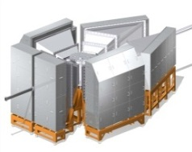
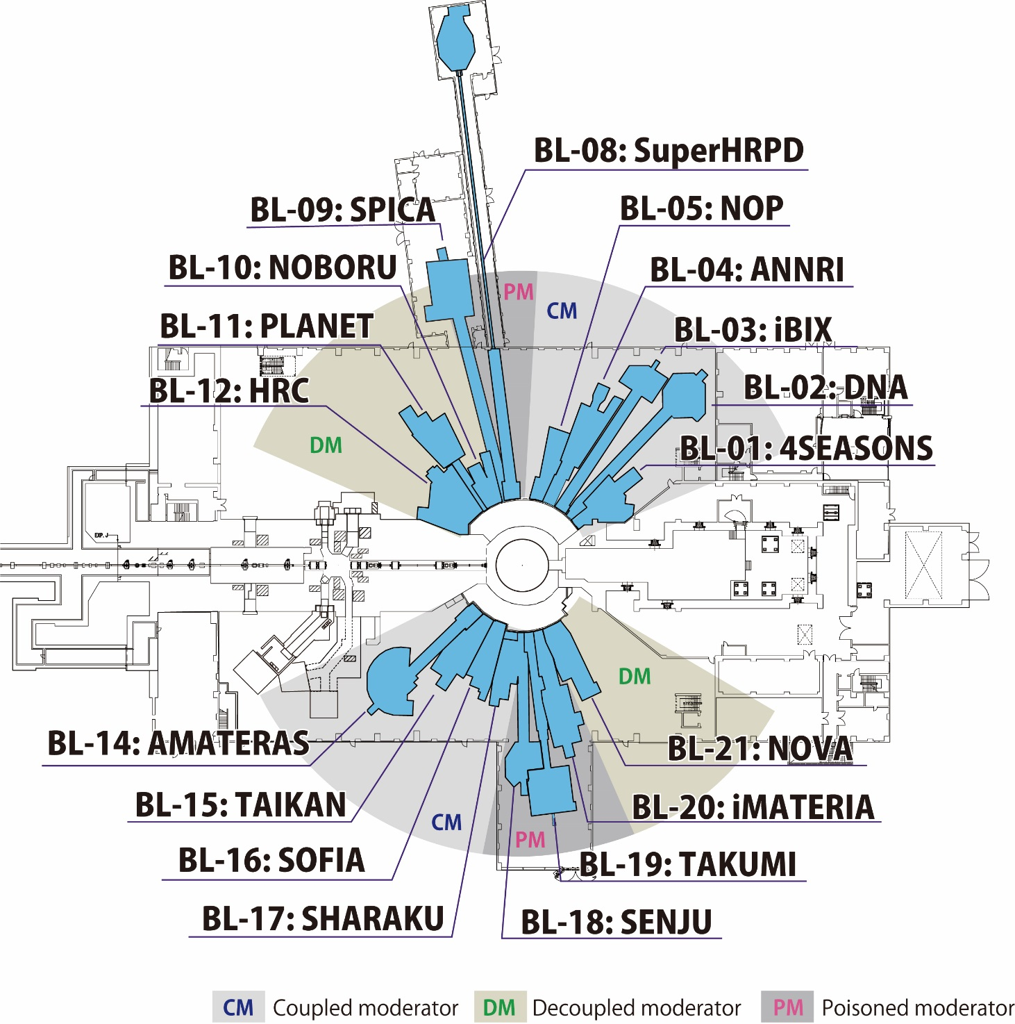

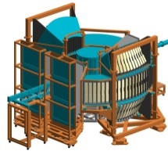
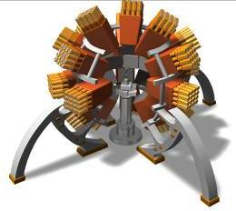
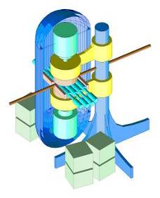
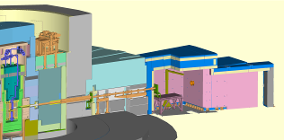
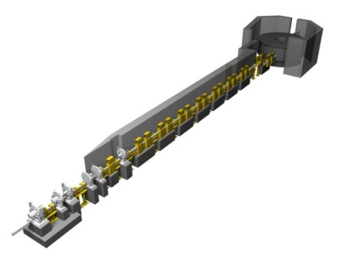
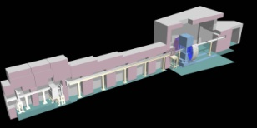
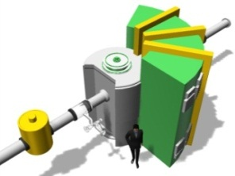
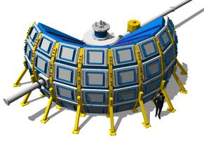
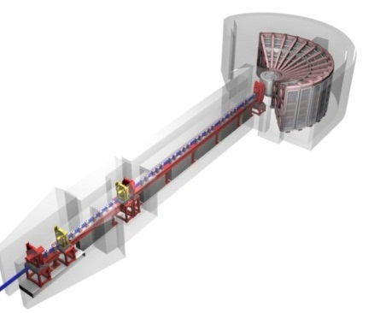

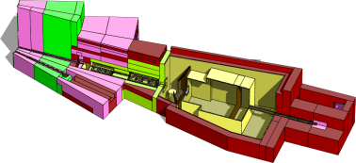
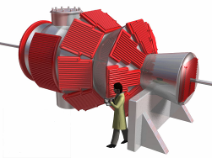
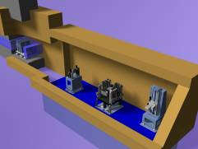
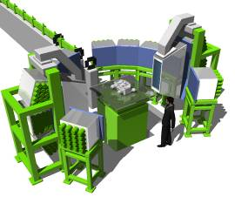
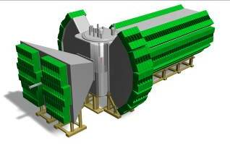
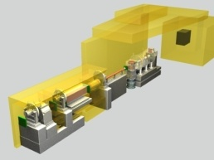
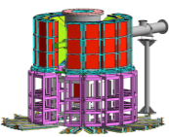
Neutron Instruments at MLF
－ Operation 19.5
－ Comissioning 0.5
BL06:
VIN ROSE
－ Construction 1
Empty lines 2 (BL07, 13)
BL23: POLANO
BL22: RADEN
Notes:
装置について、
BL18の立ち上げが進み、微小試料構造解析を実証したこと
BL03は検出器数が14台（去年）から３０台になったこと
昨年のNACではBL08とBL19のissue がspeed up to restartでしたので、
これらが復旧して、研究を開始したことがトピックスです。
BL09はコミッショニングを開始、リートベルト解析までができるように
なったこと（米村さんが中島さんに送ったファイルをCCします）
BL11はコミッショニングが終了、科研費メンバーにより、実験が開始
されたこと、来年度共用装置に移行すること（このファイルは持って
いると思います）
BL21は外部資金の期間が終了したこと
サイエンスについて、
BL03はトランスサイレチン以降ですが、課題審査部会報告にありますが、
詳しく説明を受けないと、使えません。
BL08は目ぼしい成果でないと思うかもしれませんが、重要です。
英語にしましたので、添付します。
BL19 成果あり（LPSO結果：日本語しかないので、英文を依頼中）
BL20 成果あり（英文を依頼中）
BL21去年はPhysical Review Lett.の結果を出していない思います。
（英文を依頼中）

Slide 4
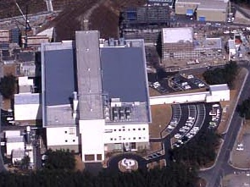
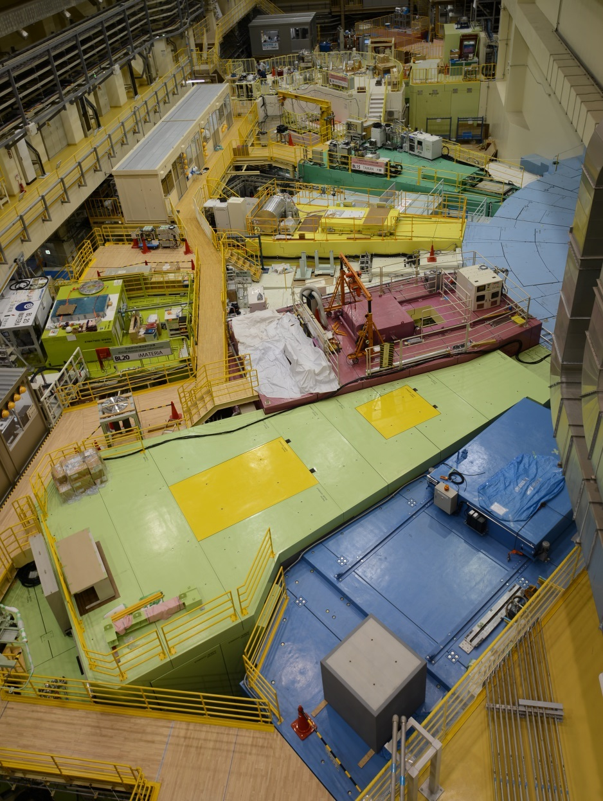
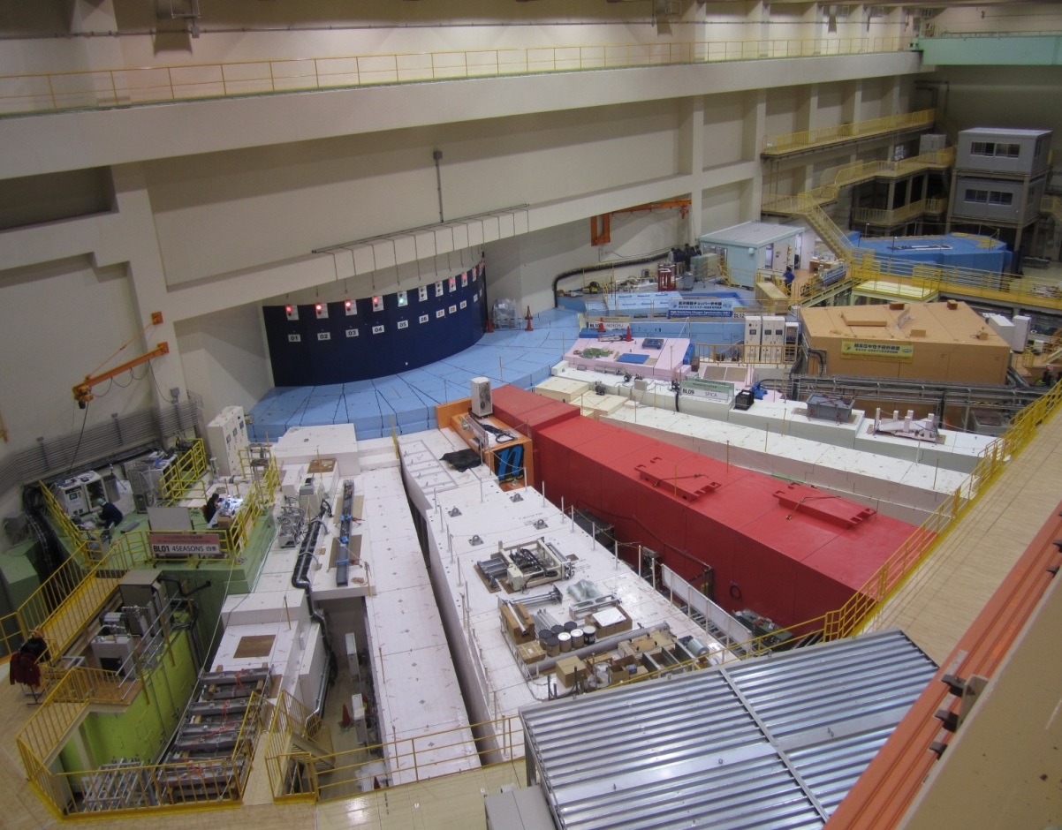

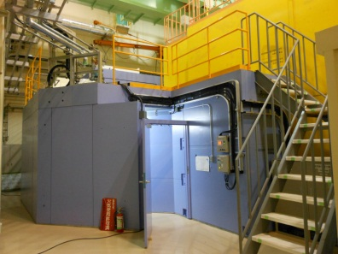
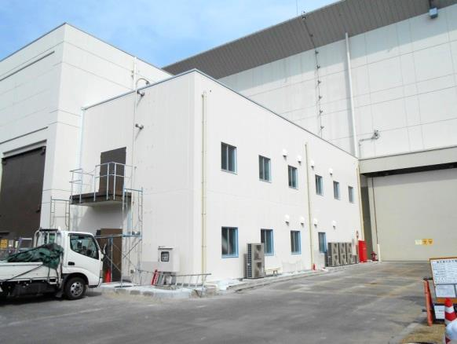
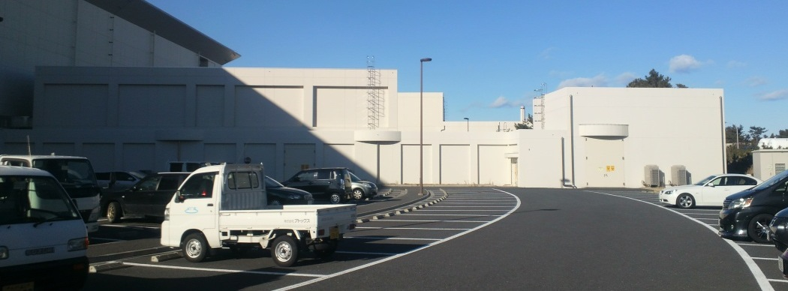
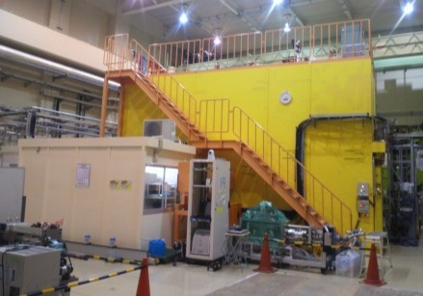
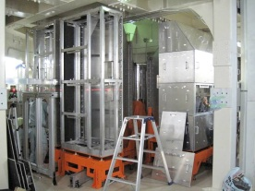
Neutron Instruments at MLF
Experimental
Hall No. 2
AMATERAS
BL14
↓
TAIKAN
BL15
Experimental Hall No. 1
SOFIA
BL16
SHARAKU
BL17
HRC
BL12
iMATERIA
BL20
4SEASONS
BL01
↓
NOBORU
BL10
PLANET
BL11
NOVA
BL21
NOP
BL05
RADEN
BL22
VIN ROSE
BL06
ANNRI
BL04
POLANO
BL23
DNA
BL02
↓
iBIX
BL03
SENJU
BL18
SPICA
BL09
S-HRPD
BL08
TAKUMI
BL19

Slide 5
I. Performance of Instruments in Comparison to Design
(PICD)
- Neutron Flux
- Resolution

Slide 6
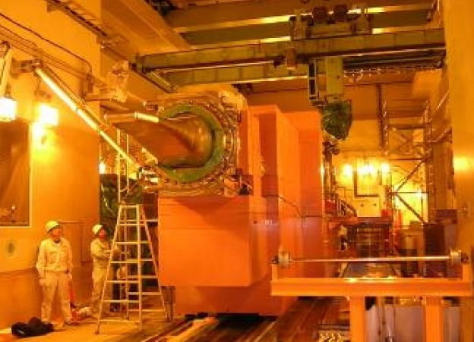
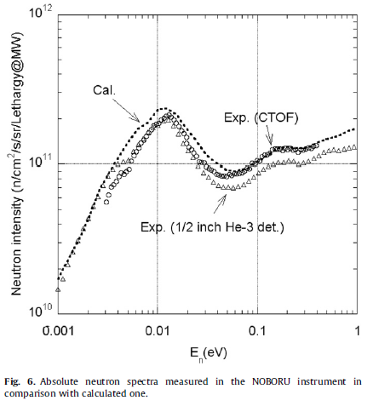
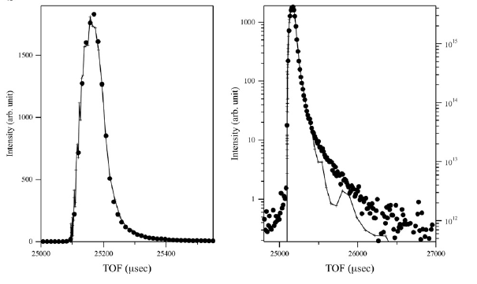
PICD: Neutron Flux
The performance of the neutron source
F. Maekawa et al., NIMA 620, 159 (2010)
Scattering from Mica.
The performance of the neutron source examined at BL10-NOBORU
  Intensity : well agreed with neutronics calculation result within 20% error.
  Profile : well agreed with neutronics calculation result, except small tails at long wave length region.

Slide 7
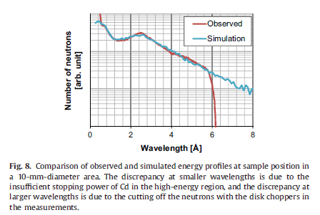
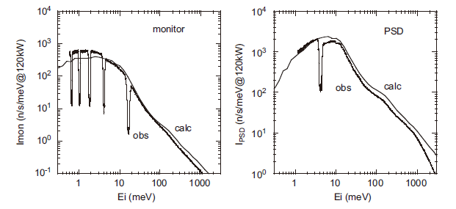
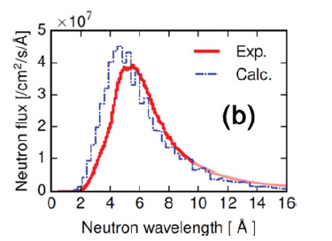
PICD: Neutron Flux
Examples of well-agreed cases
BL11 PLANET guide section L~12 m M&SN
BL12 HRC guide section L~5 m SN
T. Hattori et al., NIMA 780, 55 (2015)
S. Itoh et al., NIMA 631, 90 (2011)
BL06 VIN ROSE (NRSE) guide section L=20m KUR
Other examples
BL03: roughly agreed
BL15: obs./calc. = 96%
BL18: obs./calc. = 84%
BL20: obs./calc. ~ 70%
BL21: roughly agreed
M. Hino et al., J. Nuc. Sci. Tec., 54, 1223 (2017)

Slide 8
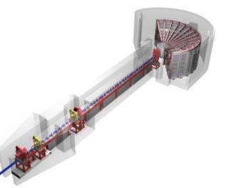
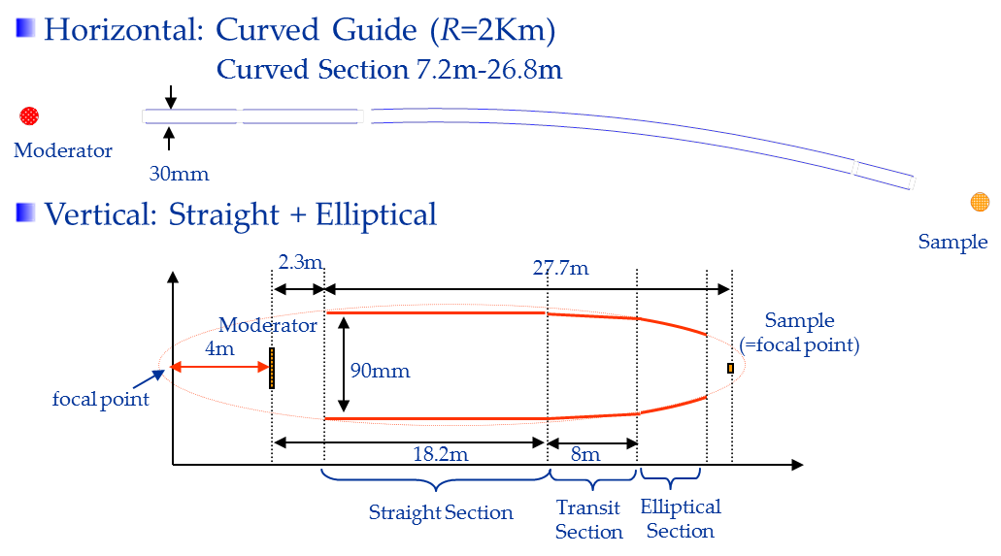
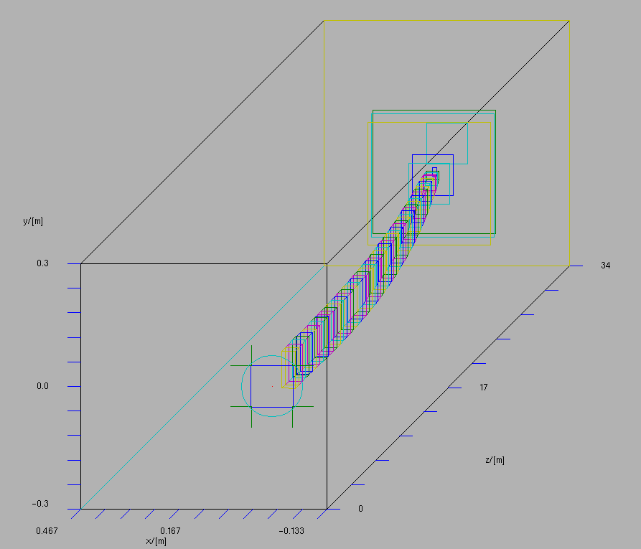
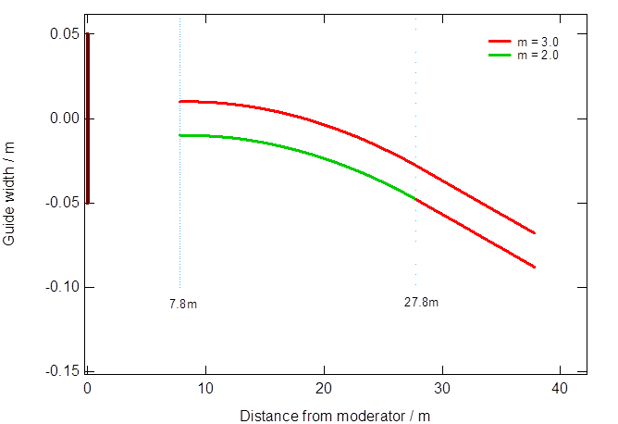
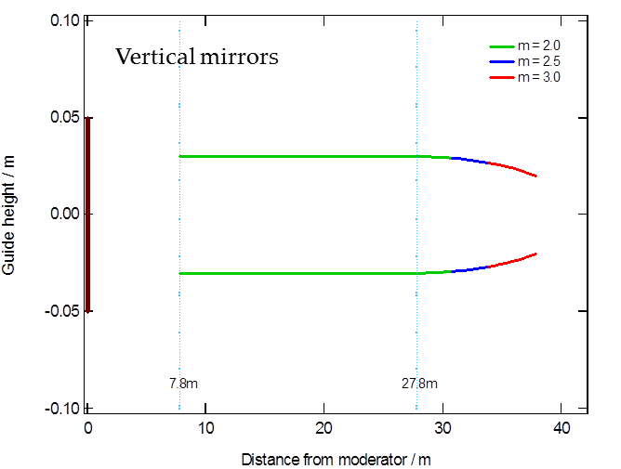
PICD: Neutron Flux
Examples of not-so-well-agreed cases
BL01 4SEASONS guide section L~13m I
observed / simulation = 65%
R. Kajimoto et al., Phys. Soc. Jpn. 80, SB025 (2011)
BL14 AMATERAS guide section L~26m I
observed / simulation > 10%
K. Nakajima et al., EPJ Web of Conferences 83, 03011 (2015)
BL19 TAKUMI guide section L~30 m M
observed / simulation = 60%
Other examples
BL02: Obs./Calc. = 61%
BL06(MIZE): Obs./Calc. = 65%
BL16: Obs./Calc. ~ 10%*

Slide 9
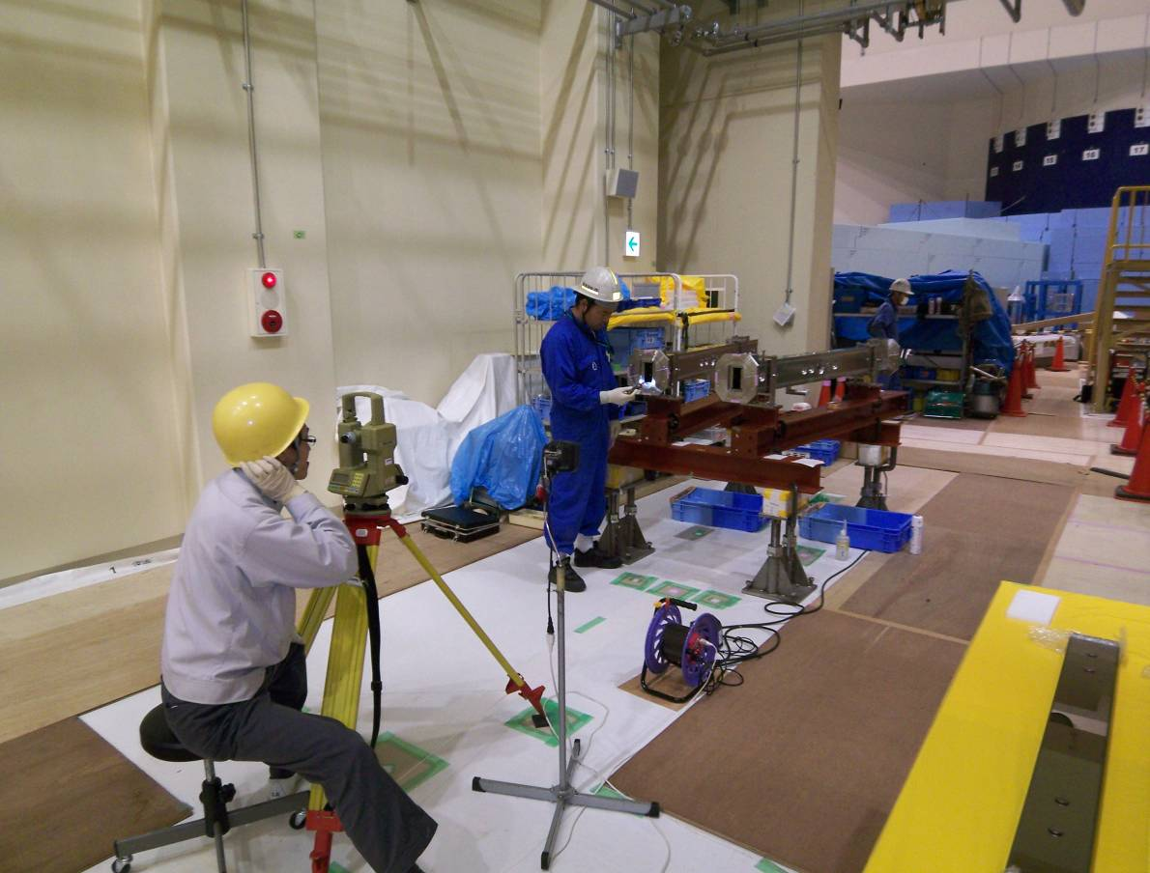
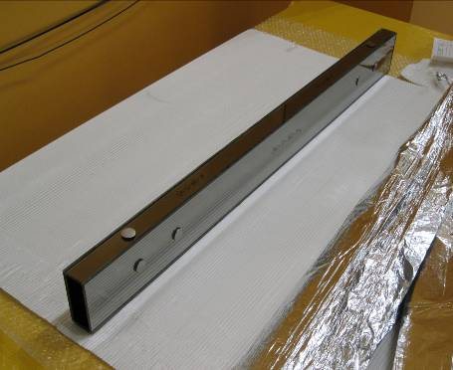
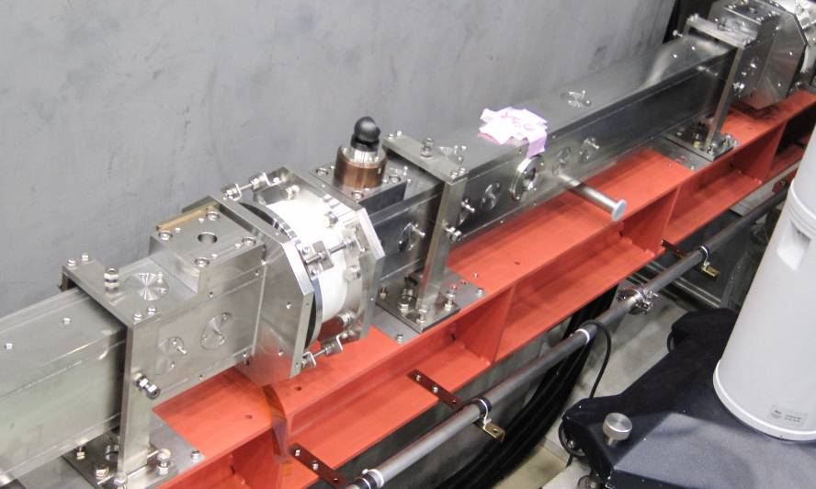



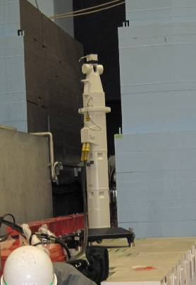
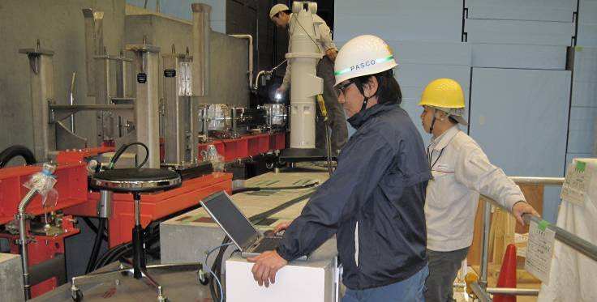

Beam-Transport of AMATERAS
Horizontal: Curved Guide (R=2Km)
Curved Section from 7.2m to 26.8m
Moderator
30mm
Vertical: Straight + Elliptical
2.3m
Sample
Mirrotron
(Hungary)
3Q_{c}
27.7m
Xenox
(France)
3&3.8Q_{c}
Moderator
Sample
(=focal point)
4m
90mm
focal point
J-PARC
(Japan)
3.8Q_{c}
18.2m
8m
Straight Section
Transit
Section
Elliptical
Section
Combination of 3Q_{c}&3.8Q_{c} super mirror
Corner Cube Refrector
2.3m
4.3m
7.0m
18.2m
26.8m
Shutter
Section
Biological Shielding
Curved Section
Curved Section
Straight
Conversing
(Elliptical)
Moderator
Sample
Bottom & Top 3.0Qc
Both Sides 3.0Qc
Bottom & Top 3.0Qc
Both Sides 3.8Qc
Bottom & Top 3.0Qc
In-Side of Curve 3.0Qc
Out-Side of Curve 3.8Qc
Bottom & Top 3.8Qc
In-Side of Curve 3.0Qc
Out-Side of Curve 3.8Qc
Bottom & Top 3.8Qc
Both Sides 3.8Qc
Laser Tracker

Slide 10
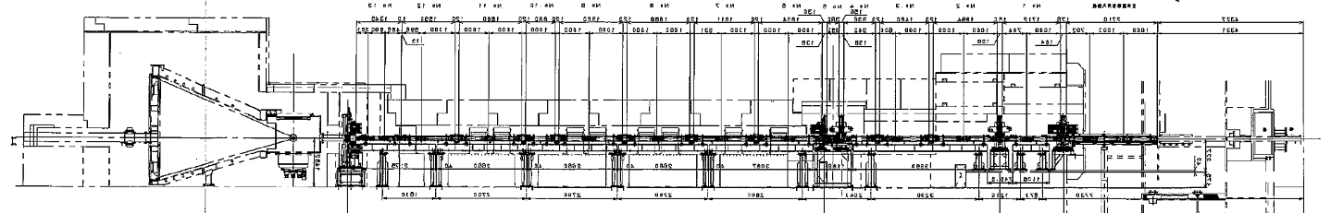
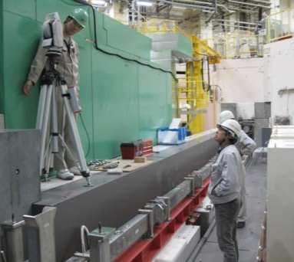
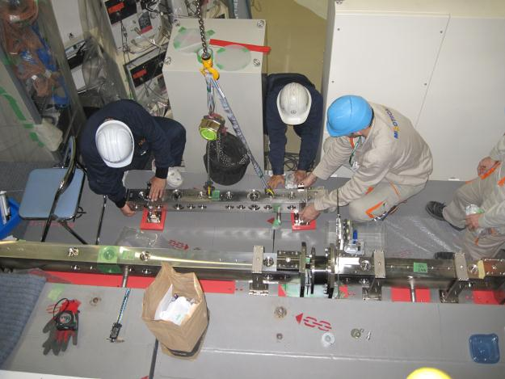
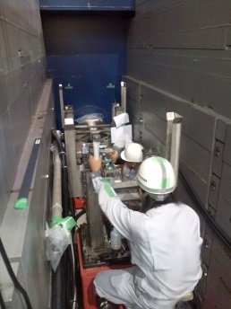
Intensity Problem at AMATERAS
Sources of the beam loss
Broken-alignment (movement after alignment)
At TAKUMI, intensity was partly recovered by re-alignment.
AMATERAS employed the same manner & the same company.
Borofloat-glass mirror problem
At the construction of DNA, it was found that borofloat-glass mirror reflectivity was 60% of expectation.
AMATERAS employed borofloat-glass mirror in 10 m of total guide section.
Others
Beam-transport re-work on AMATERAS (2012-2015）
re-alignment: all sections after the biological shielding. (including refurbishment of equipment)
Exchange of borofloat-glass mirror.
exchange of mirror
re-alignment

Slide 11
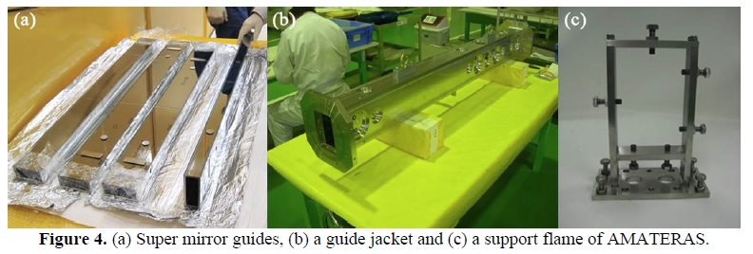
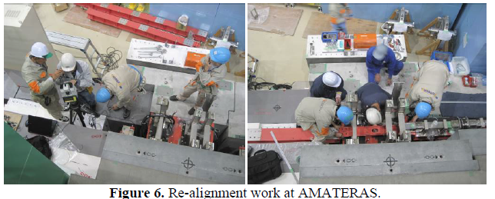
Re-Work on AMATERAS BT
AMATERAS beam-transport re-work (2014)
K. Nakajima et al., proc. of ICANS-XXI (JAEA-Conf-2015-002, 306 (2016))

Slide 12
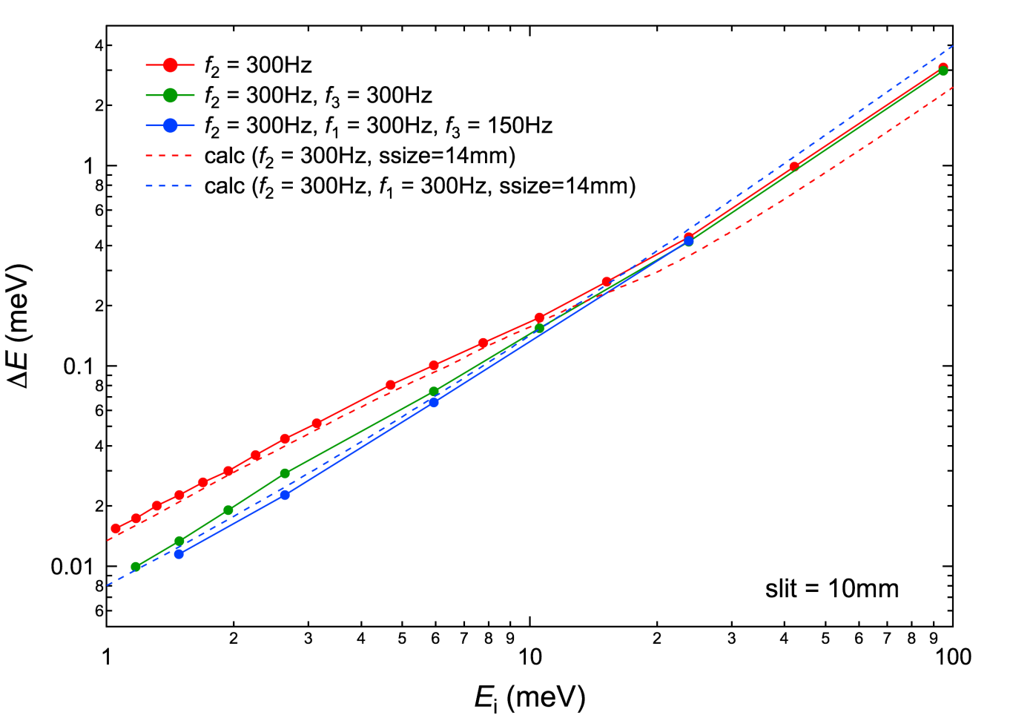

PICD: Resolution
AMATERAS
Energy resolution at elastic position well agrees with analytic calculation.
Monochro. Chop. = 300Hz, P-Shap. Chop. = Open, P-Rem. Chop. = Open
Monochro. Chop. = 300Hz, P-Shap. Chop. = Open, P-Rem. Chop. = 300Hz
Monochro. Chop. = 300Hz, P-Shap. Chop. = 300Hz, P-Rem. Chop. = 150Hz
Pulse Removal
Chop.
Δ
Δ
=
Δ
+
L
−
(
Δ
+
Δ
)
t
m
→
t
mPS
t
ch
−
mod
ch1
t
ch
t
ch
1
L
L
−
L
−
1
2
K. Nakajima et al., J. Phys. Soc. Jpn. 80, SB028(2011).
1
3
mod
ch1

Slide 13





PICD: Resolution
K. Iida et al., JPS Conf. Proc. 1, 014016 (2014)
R. Kajimoto et al., proc. of ICANS-XXI (JAEA-Conf-2015-002, 319 (2016))
4SEASONS
Energy resolution and Q resolution
well agreed with calculation.
Calculation of resolution in single-
crystal experiment at choppers.
  Simulation + Analytic calculation
C₄H₂I₂S
Al₂O₃
R. Kajimoto et al., arXiv:1705.04869
(AIP Conf. Proc., to be published )

Slide 14


Energy Resolution of AMATERAS
Sample： Single-Crystal of Cu
Ex. CH01&CH03 open； CH02 both 150 Hz; CL04&CL05 1st frame
E_{i} = 42.05 meV
(HHL) L=1.5 r.l.u.
E_{i} = 42 meV | Observed | Calculated | Simulation
0 meV | 4.72 meV | 3.8 meV | 4.59 meV
14 meV | 2.97 meV | 2.3 meV | 2.79 meV
30.5 meV | 1.49 meV | 1.0 meV | 1.14 meV
(HH0)
Q_{a} / r. l. u. = 1.42 - 1.58
Q_{b} / r. l. u. = 1.40 - 1.60 or 2.40 – 2.60
Q_{c} / r. l. u. = -0.08 - 0.08

Slide 15




II. Performance of Instruments Background
- AMATERAS
- 4SEASONS
4SEASONS 2008~
AMATERAS 2009~
R. Kajimoto et al., Phys. Soc. Jpn. 80, SB025 (2011)
K. Nakajima et al., Phys. Soc. Jpn. 80, SB028 (2011)

Slide 16



Improvement of S/N
Magnetic Excitations in CuGeO₃ at 4SEASONS
2009.6
~20 kW
2009.11
~100 kW
2012.01
~100 kW
First measurement
Addition of several shielding materials
Addition of detectors around the beam center
Installation of the T0 chopper
Further addition of shielding materials

Slide 17




Background problem at 4SEASONS
Background Caused by Continuously Emitted High-Energy Neutrons
This type of background becomes serious on 4SEASONS.
chopper open
chopper at π/4 position
direct beam position
High-energy neutrons continuously emitted.
High-energy neutrons penetrate B₄C beam catcher and ¹⁰B disk-chopper blades.
Even in the case of a Hg-target neutron source.
Possible sources of elements: ⁹Li, ¹⁷Ni, ⁸He, ¹⁶C...
R. Kajimoto et. al., JPS Conference Proceedings 8, 034013 (2015)

Slide 18







Counter background at AMATERAS
At the beam-line
a) Jacket of (curved) guide mirror (20t SUS)
b) Beam line shielding (concrete & iron )
c) Chopper housing (> 50t SUS)
d) Polyethylene

Slide 19









Counter background at AMATERAS
Around the scattering chamber
a) Cd inside the tank
b) B₄C mortar
c) B₄C & H₃BO₃ floring
d) B₄C liner inside the get-loss tube

Slide 20


Background at AMATERAS
Is background at AMATERAS really low?
― when accelerators off
Sources of background observed here...
Electrical noise
Neutrons from the floor
→Neutrons moderated in the floor concrete. Origin is cosmic ray.
Not only those!!!

Slide 21


Background at AMATERAS
3. Powder diff. of B₄C of narrower
4. Air scattering (~1Pa)
1. Electrical noise, cosmic ray
5. Other γ-ray
(from chopper disk?)
6. Unknown spot-like scattering
7. T0 Burst
2. γ-ray from optical devices

Slide 22




Background problems at AMATERAS
Time-independent background
beam-off
~30 Counts h⁻¹PSD m⁻¹
It doesn't depend of whether beam is on/off.
Background caused by prompt γ-ray.
Cd and, in sometime, a sample itself cause prompt γ-ray, which still can be detected by ³He counters.
We are trying to replace Cd on the direct beam line with other martials.
K. Nakajima et. al., proc. of ICANS-XXI; proc. of ICANS-XXII (to be appeared in JPCS )

Slide 23



Example of γ-ray Background
From users' paper
S. Ito et al. Nat. Com. 8, 235 (2017)
Cd at DW Narrower
Adjust LLD
Cd at UP Narrower

Slide 24
Summary
Performance in Comparison to Design
Intensity:
Majority of instruments achieve > 80% of expectation.
Some others suffered from BT problems.
Resolution:
In the case of chopper spectrometers, resolution well can be explained by analytic calculation.
Background at 4SEASONS & AMATERAS
Continuous efforts have been payed.
High-energy neutrons can be detected @ 4SEASONS.
Several sources of backgrounds are observed @ AMATERAS.

Slide 25
List of Publications
General overview of MLF instruments
K. Nakajima et al., Quantum Beam Science 1, 9 (2017)
Instrumental papers shown here
T. Hattori et al., NIMA 780, 55 (2015) PLANET(BL11)
S. Itoh et al., NIMA 631, 90 (2011) HRC(BL12)
M. Hino et al., J. Nuc. Sci. Tec., 54, 1223 (2017) VAN ROSE(BL06)
R. Kajimoto et al., Phys. Soc. Jpn. 80, SB025 (2011) 4SEASONS(BL01)
K. Nakajima et al., Phys. Soc. Jpn. 80, SB028 (2011) AMATERAS(BL14)
Beam transport design
K. Nakajima et al., EPJ Web of Conferences 83, 03011 (2015)
AMATERAS beam transport background issues
K. Nakajima et al., proc. of ICANS-XXI (JAEA-Conf-2015-002, 306 (2016))
K. Nakajima et. al., proc. of ICANS-XXII (to be appeared in JPCS)
4SEASONS background issues
R. Kajimoto et. al., JPS Conference Proceedings 8, 034013 (2015)
4SEASONS resolution issues
K. Iida et al., JPS Conf. Proc. 1, 014016 (2014)
R. Kajimoto et al., proc. of ICANS-XXI (JAEA-Conf-2015-002, 319 (2016))
R. Kajimoto et al., arXiv:1705.04869
Performance of the MLF neutron source
F. Maekawa et al., NIMA 620, 159 (2010)

