Slide 1
Materials at ESS Target Station
Yong Joong Lee
Group Leader – Materials
Target Division
www.europeanspallationsource.se
18 January, 2018

Slide 2
Welcome!
有朋自遠方來不亦樂乎
學而時習之不亦說乎

Slide 3
Outline
Material Selection and Lifetime Criteria
Irradiation Campaign and Post Irradiation Examination
Kinetics of Ortho-Para Conversion and Online Monitoring
Characterization of Beryllium as Reflector Material
Tritium Permeation and Release
Nitric Acid Problems
Advanced Simulation Technologies
Materials R&D Prospects at ESS

Slide 4
Material Selection and Lifetime Criteria

Slide 5
Material Selection and Lifetime Decision
Material Selection and Lifetime Decision
Operational Experiences of leading accelerator facility
Literature survey of PIE data
Irradiation campaign and PIE
Operational Risk Assessment
Nuclear Code: RCC-MRx

Slide 6
Radiation Damage Criteria
Negligible: The level of radiation damage doesn't affect design
Non-negligible: The radiation damage should be taken into account in design, but the component has a lifetime of the facility
Significant: The radiation damage should be taken into account in design, and the component has a finite dose limited lifetime requiring periodic replacement

Slide 7
Radiation Damage Specification
Material | Neutron DPA |  |  | Neutron Fluence |  |  | Proton DPA | Proton Fluence | Absorbed Dose Rate
 | Negl. | Non-negl. | Significant | Negl. | Non-negl. | Significant | Significant | Significant | Significant
304L with structural function | < 0.6 DPA | N/A | N/A | N/A | N/A | N/A | > 8 DPA | N/A | N/A
304L with shielding function | < 0.6 DPA | N/A | N/A | N/A | N/A | N/A | > 8 DPA | N/A | N/A
316L with structural function | < 2.75 DPA | < 53 DPA | > 53 DPA | N/A | N/A | N/A | N/A | N/A | N/A
316L with shielding function | < 2.75 DPA | < 53 DPA | > 53 DPA | N/A | N/A | N/A | N/A | N/A | N/A
Carbon Steel with shielding function | N/A | N/A | N/A | N/A | N/A | N/A | N/A | N/A | < 1 MGy/y
Al6061-T651 with structural function | N/A | N/A | > 20 DPA | n (E<0.625eV) < 1.8e22 n/cm2 | n (E<0.625eV) < 6.7e23 n/cm2 | n (E<0.625eV) > 6.7e23 n/cm2 | > 8 DPA | < 5.0e21 p/cm2 | N/A
Al5754-O with structural function | N/A | N/A | N/A | n (E<0.625eV) < 1.1e22 n/cm2 | n (E<0.625eV) < 7.3e22 n/cm2 | n (E<0.625eV) > 1.1e22 n/cm2 | > 8 DPA | < 5.0e21 p/cm2 | N/A
Neodymmagnet (NdFeB) | N/A | N/A | N/A | N/A | N/A | n (E>0.1 MeV) < 1.8e12 n/cm2 | N/A | N/A | N/A
CuCrZr beam stopping material | N/A | N/A | > 2 DPA | N/A | N/A | N/A | > 2 DPA | N/A | N/A

Slide 8
Selected Materials and Dose Limited Lifetime
System | Material | Lifetime Criteria | ESS Dose Limit | Lifetime in ESS-year
Target vessel | SS316L | Displacement damage | 8 DPA | 5.0
Spallation Mat. | Tungsten | - | - | 5.0
Target Drive Unit | NdFeB | Fast neutron fluence | 1.8e12 n_{>0.1 MeV}/cm2 | 3.0
MR vessel | Al6061-T6/Al5754-O | Therm. neut. fluence | 1.8e22 n_{th}/cm² | 1.0
Reflector | Beryllium | Helium transmutation | - | -
PBW | Al6061-T6 | Helium embrittlement | 2200 He-appm | 1.0
Monolith vessel | SS316L | Displacement damage | 2.75 DPA | 40.0
Inner shielding | SS304L | IASCC/RCC-MRx | 53 DPA | 40.0
Tuning dump | CuCr1Zr | Fatigue | - | 40.0
MWPM | SiC | Displacement damage | 12 | 2.0
Aperture monitor | Nickel | Displacement damage | 20 | 2.0
Vacuum sealing | EPDM | Neutron and 𝜸 dose | 1 MGy | 10.0

Slide 9
Potential Collaboration Area
Compilation and sharing of materials data

Slide 10
Irradiation Campaign and Post Irradiation Examination

Slide 11
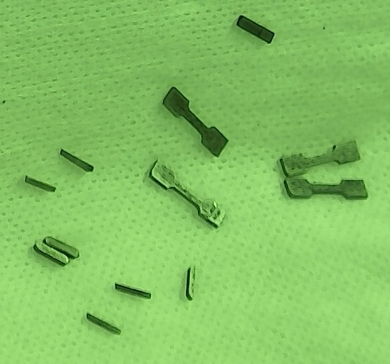
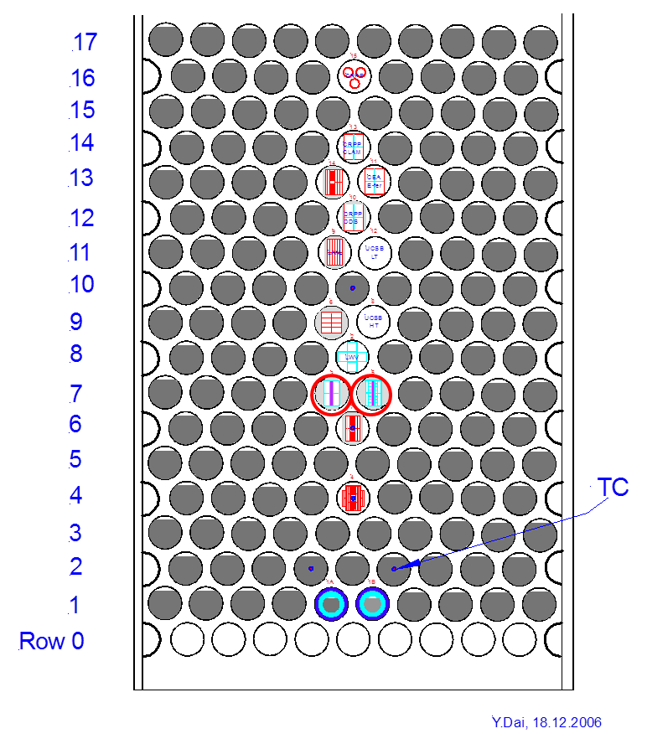
Tungsten: STIP-V W PIE
STIP-V Irradiated between 2007 – 2008
2 hot-rolled tungsten bars, size: 60x8x1mm
Displacement damage: 5 - 28 dpa
Irradiation Temperature: 100 °C-800 °C

Slide 12
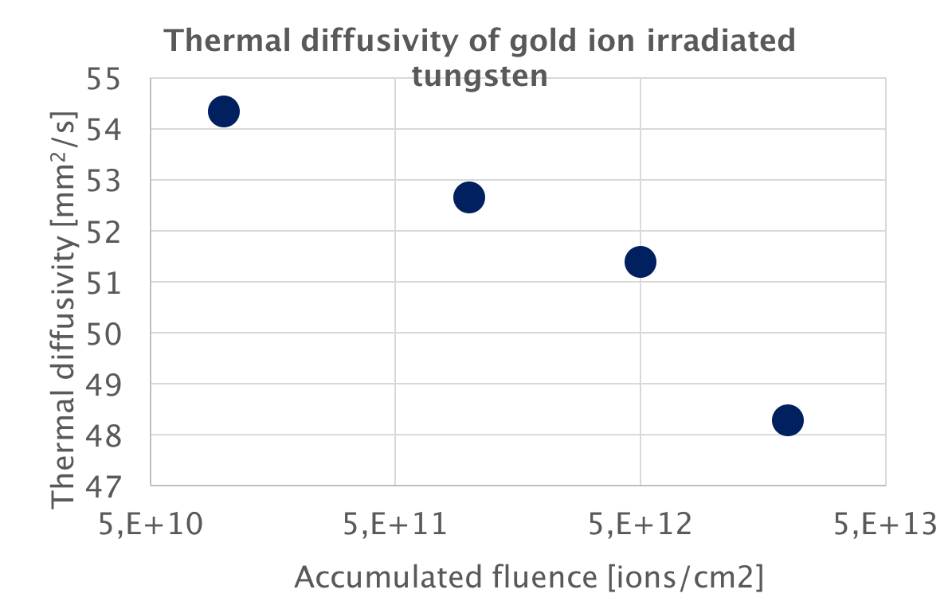
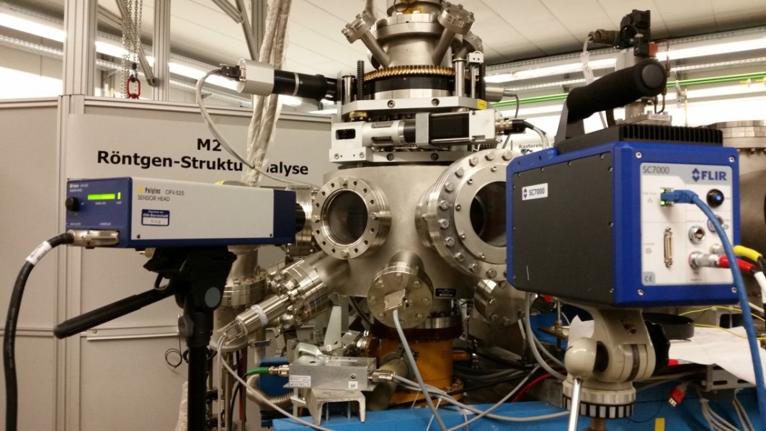
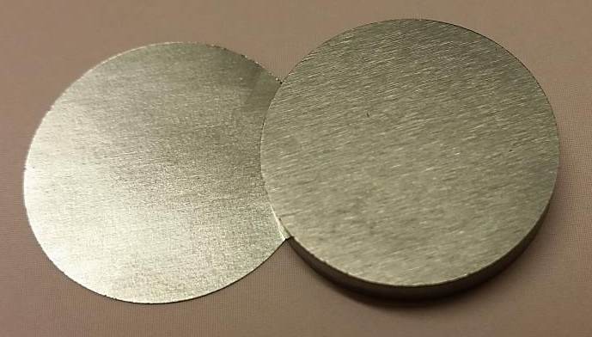
Tungsten: M3-beamline of GSI UNILAC
Uranium beam on tungsten coins
  Charge state +28
  Beam energy: 4.8 MeV/u
  Ion flux: Max. 1e10 ions/cm²/pulse
  Pulse length: 100 us
  Repetition rate: 1 Hz
ESS beam
Energy - 2.5 GeV
Rep. rate - 14 Hz
Pulse length - 2.86 ms

Slide 13
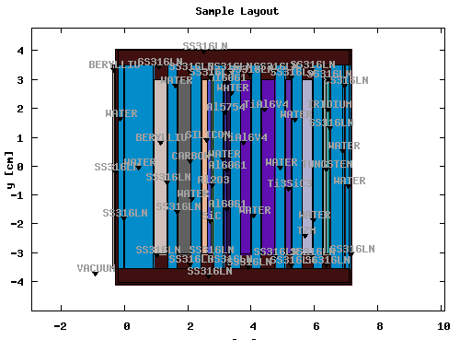
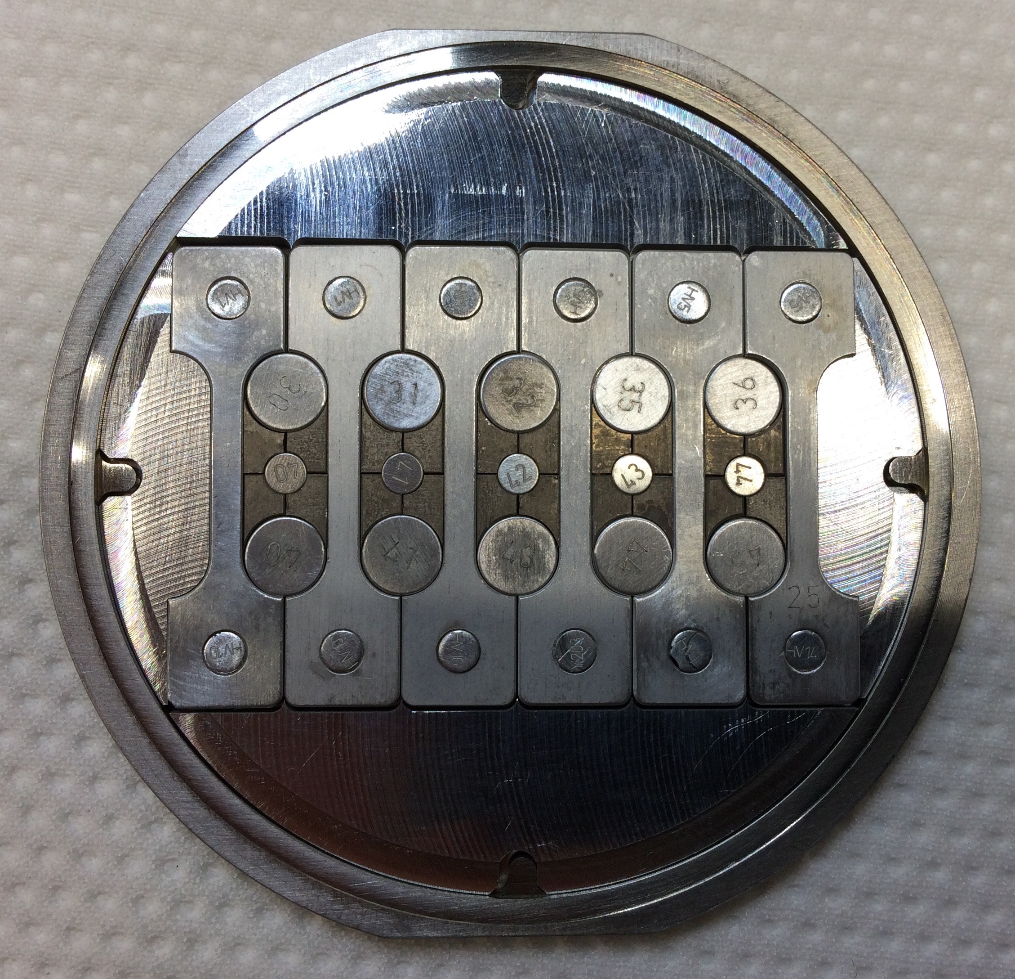
Proton Beam Window: BLIP Irradiation Program at BNL
Purposes:
  Characterization of helium bubble size and distribution in Al6061-T6 and Al5754-O
  Extension of PBW lifetime
Beam Parameters
  Energy: 181 MeV
  Current: 165 uA
  Rastered Beam Profile
  Assessment of the material properties of PBW under proton irradiation

Slide 14
Target Drive Unit: Polymers and Lubricants
The radiation resistance of polymers, adhesives and cables are compiled in CERN yellow book
  BUT, the compiled data is based on gamma radiation
  In the target monolith, most of the radiation dose is due to neutrons
  There has been progress in materials since 1980s when the CERN yellow book was published
This requires new R&D program to plan the service lifetime of polymers and lubricants at ESS

Slide 15
Ongoing Irradiation Campaign and PIE
Material | Application | Beam | Irradiation | PIE | Status
Tungsten | Spallation Material | Proton | PSI | PSI | Irradiation: Completed PIE: In Progress
 |  | Uranium | GSI | PSI/Darlana University | Irradiation: Completed PIE: Completed
Al6061-T6/Al5754-O | Proton Beam Window | Proton | BNL | PNNL | Irradiation: In Progress PIE: In Preparation
Polymers and Lubricants | Sealing, Cabling, Lubricating | Neutron/Gamma | INFN | INFN/Univ. of Brescia | Irradiation: In Progress PIE: In Progress
Cr:Al₂O₃ | Beam Imaging | Proton | BNL/DTU | PNNL/Diamond | Irradiation: In Progress PIE: In Preparation
Electronic devices are not yet covered.

Slide 16
Potential Collaboration Area
Spallation Materials and STS-JSNS
Proton Beam Window Materials
  Aluminum alloys
  Titanium alloys
  Alloy 718
Target Vessel Materials
Moderator Vessel Materials
Electronic Devices

Slide 17
Kinetics of Ortho-Para Conversion and Online Monitoring

Slide 18
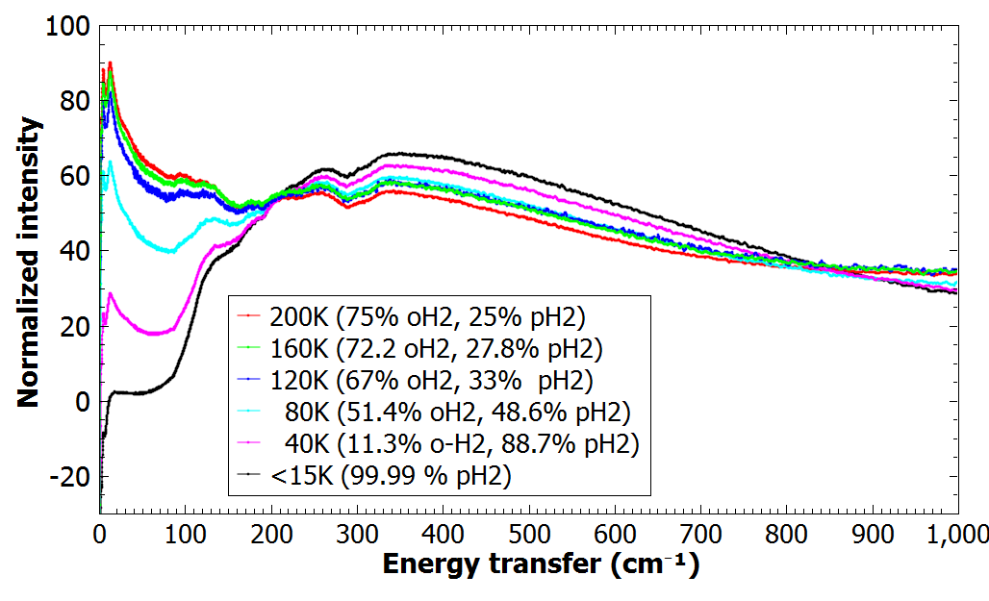

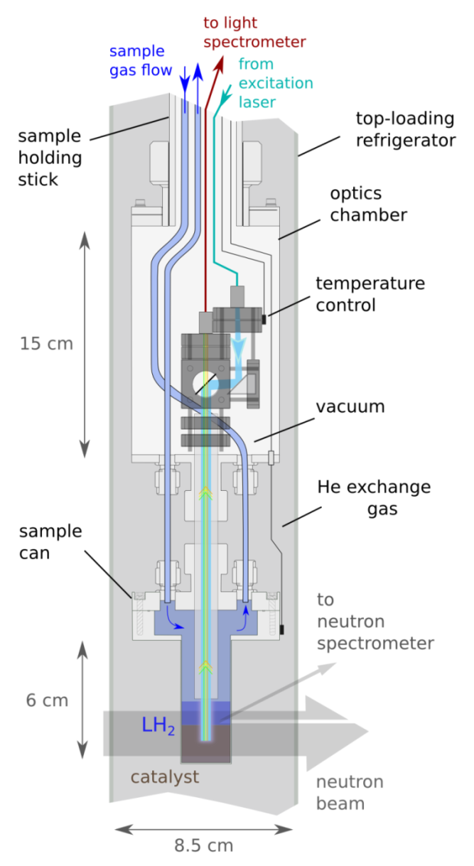
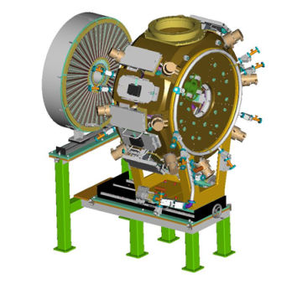
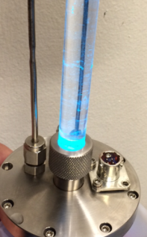
Observing Conversion in Liquid Hydrogen (17K) – in-situ Raman and Neutron Vibrational Spectroscopy
NVS
ortho:para
3:1
p-H₂ increas.
1:1
0:1
RAMAN
para
ortho
ortho/para H₂
converter
18

Slide 19
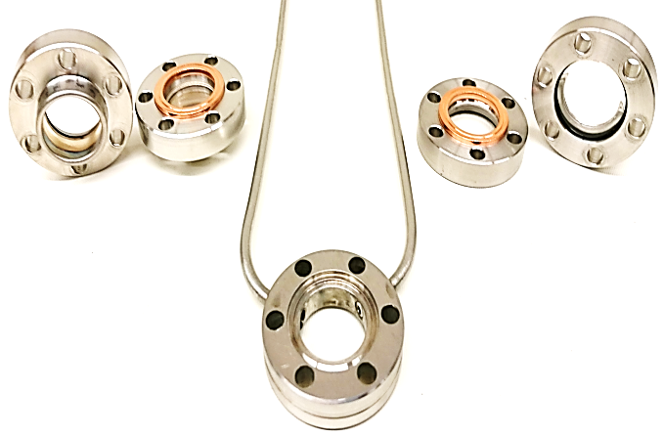
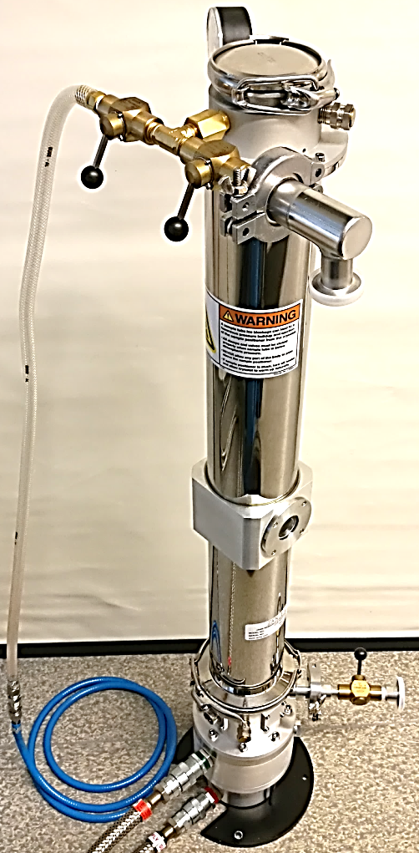
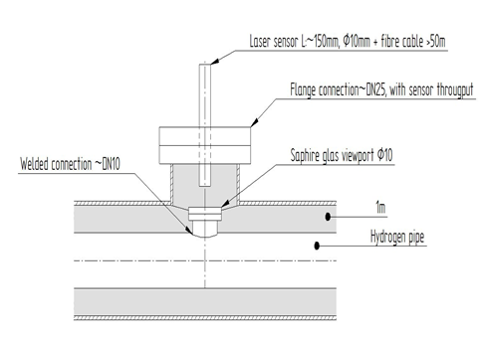
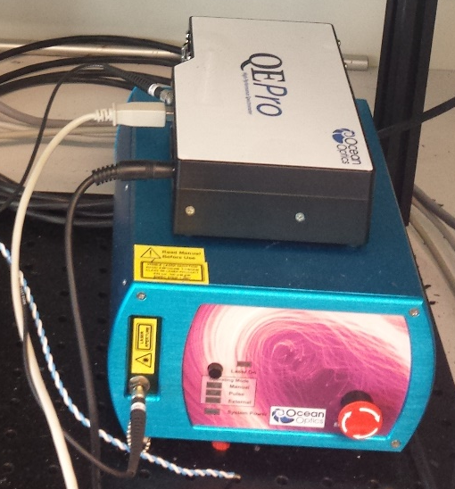
Offline catalyst testing and optimization of o/p H2 monitoring system
Test setup in the ESS hydrogen laboratory
Online Raman monitoring system for ESS moderator loop
Raman probe
Sample cells sapphire (left)and quartz (right)
Sapphire view
port
L-H2
Sapphire: good transmission for 532 nm ligh / high strength for l-H2 under pressure
Raman spectrometer and laser source
Cryostat

Slide 20
Potential Collaboration Area
Characterization of Catalyzers
Kinetics of Catalytic Conversion
  Dependence on catalyzer volume dimensions
  Fatigue with aging
Online Measurement Technique

Slide 21
Characterization of Beryllium as Reflector Material

Slide 22
Reflector Material: Beryllium
Beryllium Selection Criteria
  Isotropic texture
  Small grain size
  High purity
R&D on correlation between neutron scattering x-section and different beryllium
G. Muhrer et al.
NIMA, 2007

Slide 23
Potential Collaboration Area
Characterization of the correlation between different beryllium grades and neutronic performance
Setting up a common procurement guideline of beryllium for reflector applications

Slide 24
Tritium Permeation and Release

Slide 25


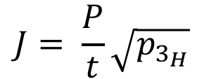
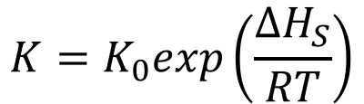
Tritium Permeation
Literature:
  Permeability (P) is a product of solubility (S) and diffusivity (D)
  Formula for permeation flux (J) based on assumption for constant T
Calculating the permeation flux (J) for the ESS heat exchangers
  Large temperature gradient across the HX
  Need to analyze HX made with bimetallic walls
$$K=K_{0}exp\left(\frac{∆H_{S}}{RT}\right)$$
$D$ $=D_{0}exp\left(\frac{∆H_{D}}{RT}\right)$
$$P=KD$$
$$J= \frac{P}{t}\sqrt{p_{3_{H}}}$$

Slide 26
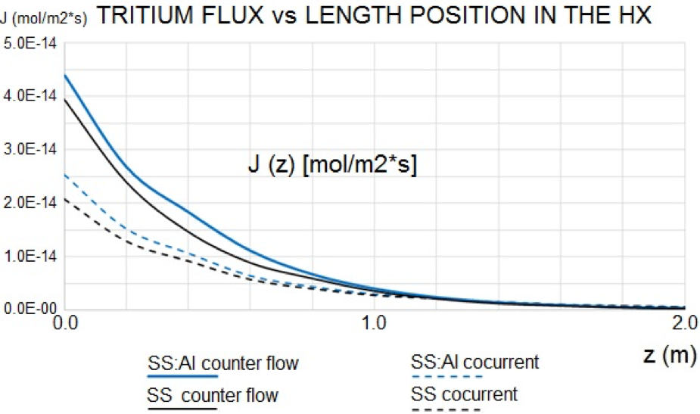
Tritium Permeation Flux through HX
Tritium Permeation Flux:
Total Tritium Permeation Rate:

Slide 27
Potential Collaboration Area
Study of residual tritium release from the steel structure surrounding the high power target

Slide 28
Nitric Acid Problems

Slide 29
Nitric Acid Formation in NBOA
G-value for HNO3 formation in moist air:
  2.7 HNO3-molecules/100 eV
Fast neutron flux at 2 meters from the source:
  1.9e19 neutrons/cm2/ESS-Year
Annual production of HNO3 molecules in NBOA:
  5.3e20 HNO3-molecules/ESS-Year
Assuming the diameter of HNO3 molecule to be 300 pm, 1.6e19 HNO3 molecules are needed to form a molecular monolayer on the NBOA mirror surface:
  About 30 HNO3 molecular layers will be formed on the NBOA mirror surface per year.

Slide 30
Nitric Acid Formation in Monolith Atmosphere
Atmosphere:
  Volume: 42 m3
  50% Air + 50% Water Vapour
  Total partial pressure: 1 mbar
    2 moles of any gas
    1.2e24 gas particles in the volume
Flight path from PBW to target: 3.5 m
Beam energy: 2 GeV
Energy deposition in the monolith atmosphere along the 3.5 m flight path of single 2 GeV proton:
  452.61 eV: Production of 12 HNO3 molecules/proton
HNO3 molecule production rate
  Beam current: 2.5 mA = 1.56e16 protons/s
  HNO3-molecule production rate:
    1.91e17 molecules/s (0.007 liter/s = 1.6e-7 mbar/s)
    3.71e24 molecules/ESS-Year: 4 orders of magnitudes higher than that in NBOA
  The monolith atmosphere (42 m3) is three orders of magnitudes larger than NBOA considered (0.035 m3)
    10 times higher relative production rate in monolith atmosphere than in NBOA

Slide 31
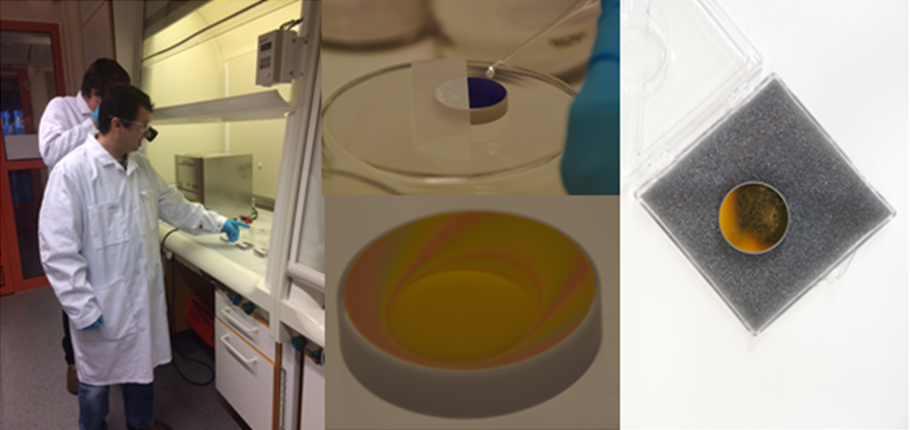
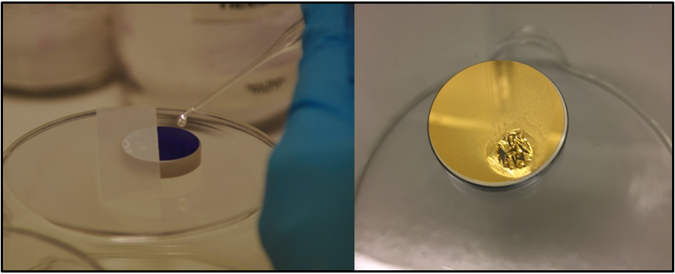
Potential Collaboration Area
Collaboration on experiments for studying beam induced nitric acid formation and surface damage mechanism

Slide 32
Advanced Simulation Technologies

Slide 33
Uncertainties in Simulations
Common miscommunication between the management and simulations specialists
  Nature is nonlinear
  Simulation is based on mathematical model which describes certain aspects of nature approximately
  The problem is approximately defined and the simulation solves the model exactly/approximately
Philosophy: How to handle the uncertainties?
  Validation of subsystems and make a prediction of full system performance
  Simulations are used to reduce the number of expensive prototyping and type testing, not intended to solve the real life problems completely
  Each spallation source is a prototype/experiment

Slide 34
Potential Collaboration Area
Strategy and Policy for handling simulation uncertainties based on well-defined philosophy
Sharing of experiences and resources in advanced multi-physics simulations technologies
Verification and Validation Experiments

Slide 35
Prospect for Materials R&D at ESS

Slide 36
Post Irradiation Examinations in Operation
PIE of the Components with Dose Limited Lifetime:
  After Service Lifetime
  After Premature Failure
Irradiation Campaign and PIE in Collaboration:
  Materials after service lifetime or premature failure at other institutions
  Dedicated irradiation campaign and PIE of materials of common interests

Slide 37
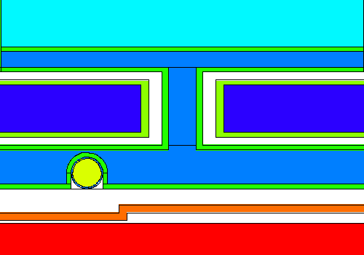
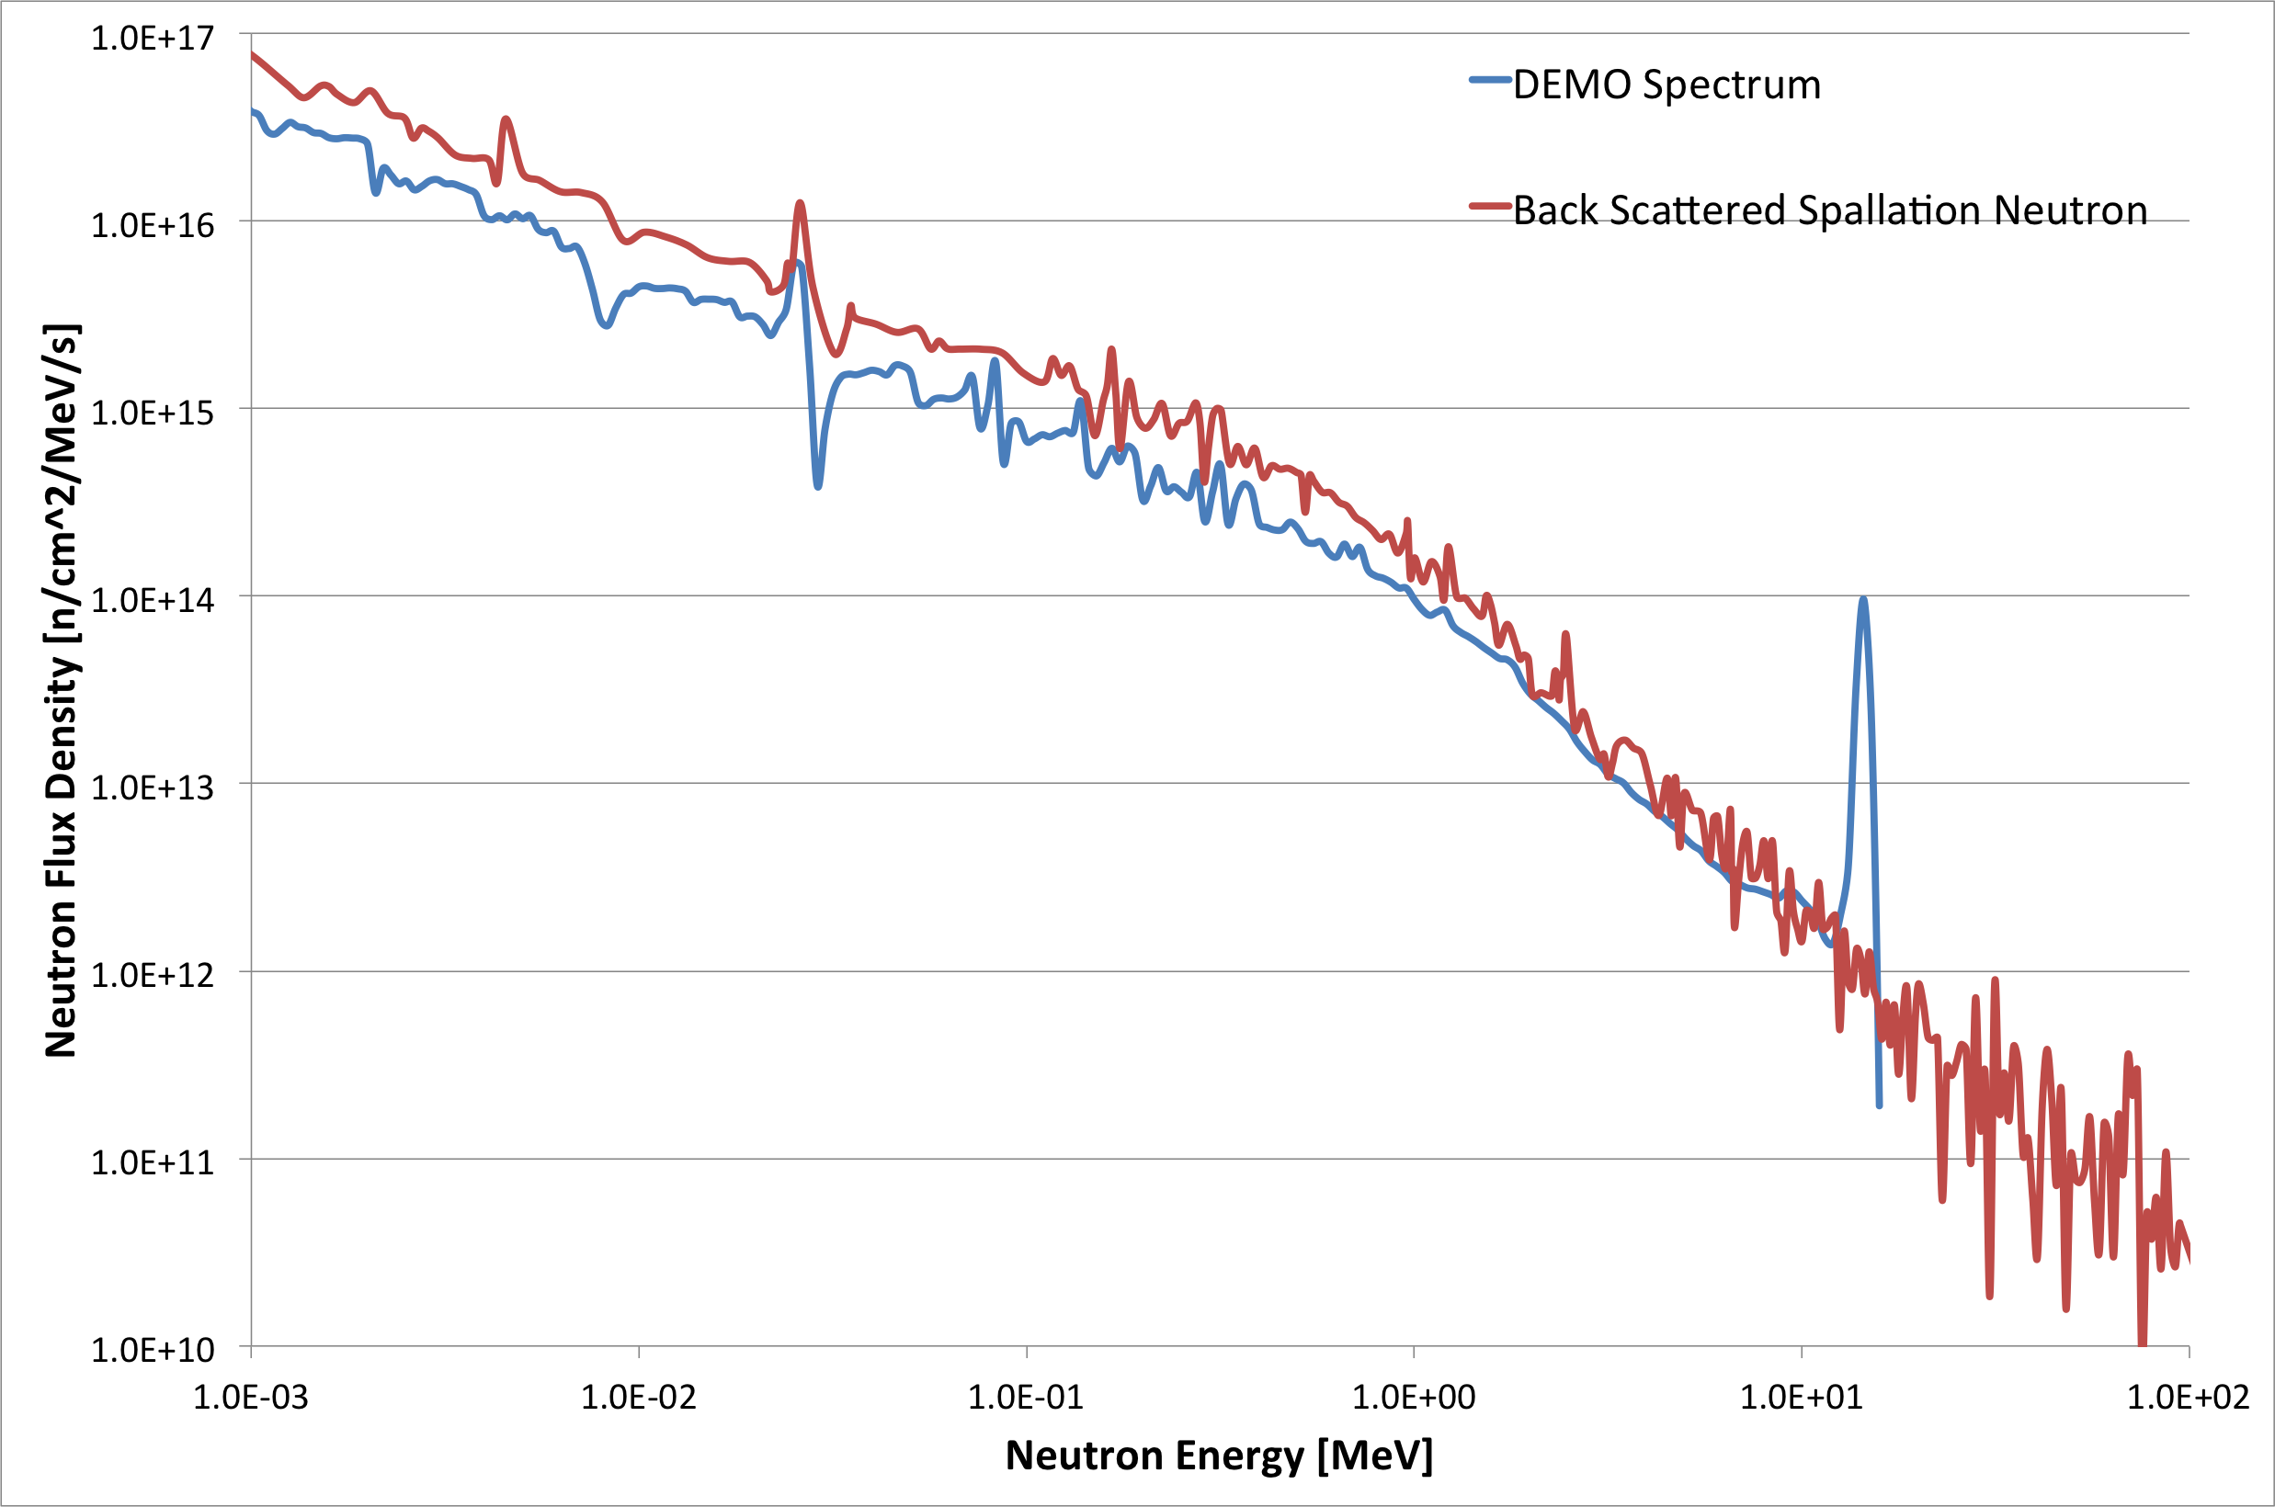
ESS Spallation Neutron Irradiation Program (ESNIP)
ESNIP-I (2019-2024)
  Proof of Concept Module
  Passively cooled by pre-moderator water flow
ESNIP-II (2024 and on): Vision
  Located at the hot spot position for optimal damage dose
  Active temperature control
  Larger Irradiation Volume
Potential application for fusion materials research

Slide 38
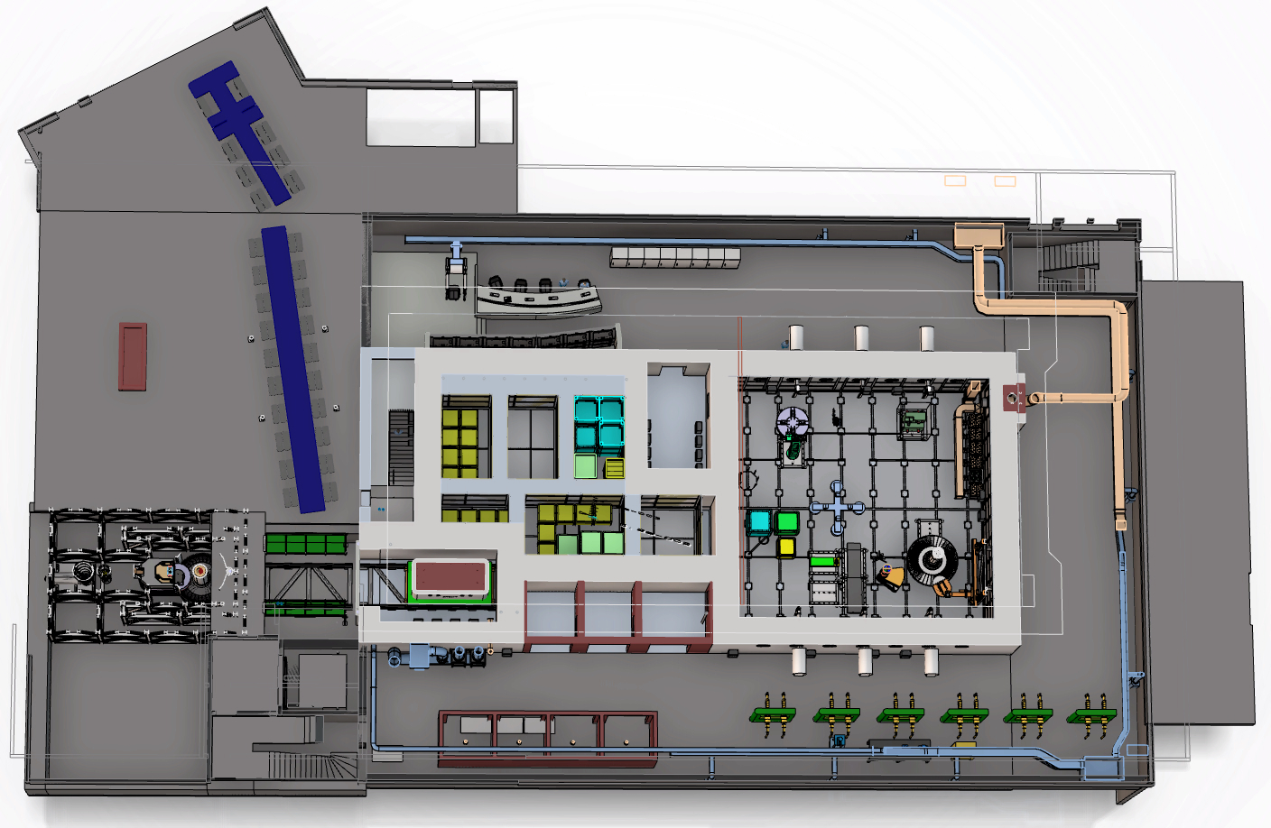
PIE Cells at ESS (PIECE)
Vision: Dedicated spallation materials research capability at ESS
Storage Pit
Process Cell
Research
Hot Cells
Transfer zone
Semi Hot Cells

Slide 39
ESS Medical Isotope Production Factory (EMIPF): Module in Target Upstream
Feasibility study proposal for external funding will be made
  Conceptual Design Study
  Operational Model Study
  Identification and Teaming-Up of Potential Stakeholders

Slide 40
Potential Collaboration Area
Feasibility Study Proposal
Electronic devices irradiation station for #23 beamline
Could muon beam be extracted from the ESS spallation target, by designing a solenoid horn in one of the beam ports?
Sharing of Operations Knowhow
Utilization of the infrastructure for the study of materials of common interests

Slide 41
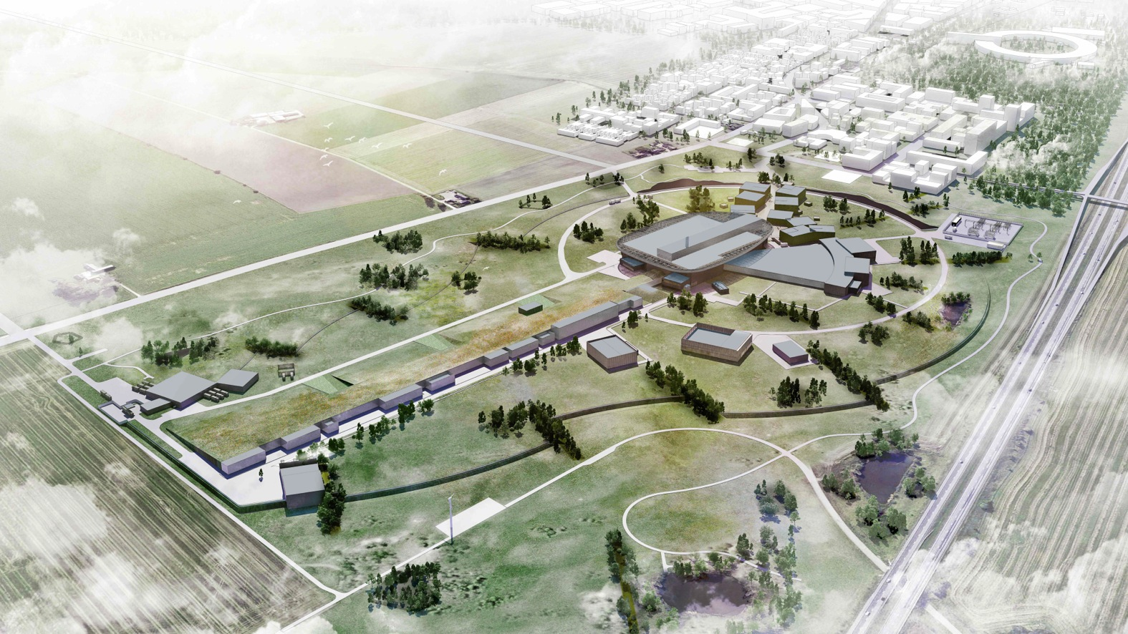
Thank you!

