Slide 1
ESS-J-PARC Instruments workshop
Charge to workshop
1) Identify mutually interested issues
2) draft vision how to tackle the issues including milestone and plan
3) make friends with each other and find a contact person for each issue.
Workshop runs from 9:00 – 12:30
Summary of all workshops at 16:30- 17:0

Slide 2
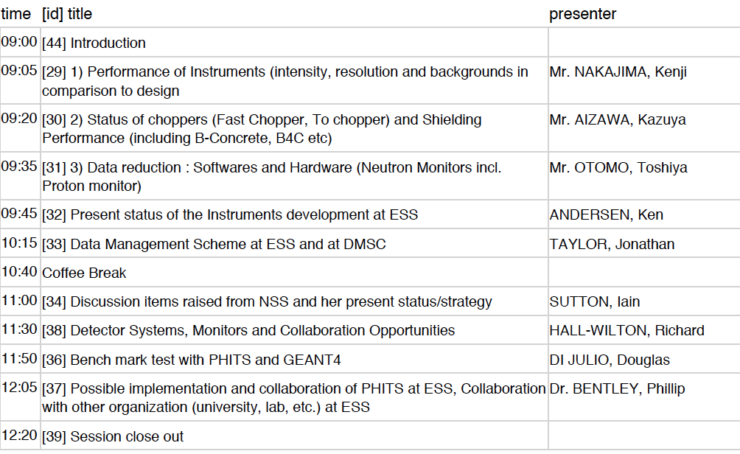
Instruments workshop Programme

