Slide 1
LLRF ESS
Anders Sunesson/Rihua Zeng/Anders Johansson
January 2018
www.europeanspallationsource.se

Slide 2
LLRF
Control of cavity phase and amplitude via feedback system
ESS will use a combination of feed forward (for repetitive, known, disturbances) and feed back (for random, unknown, disturbances, i.e. noise)
ESS will as far as possible compensate for error sources:
  Pulse shape, beam arrival
  Beam current live monitoring
How far can this be taken?

Slide 3
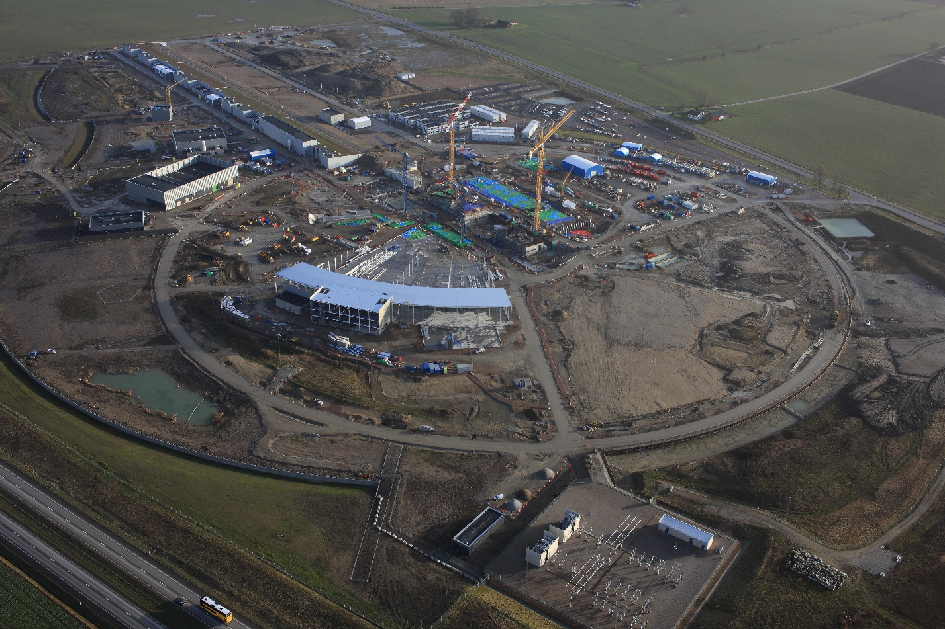
ESS now
Under construction and installation
This takes almost all effort

Slide 4
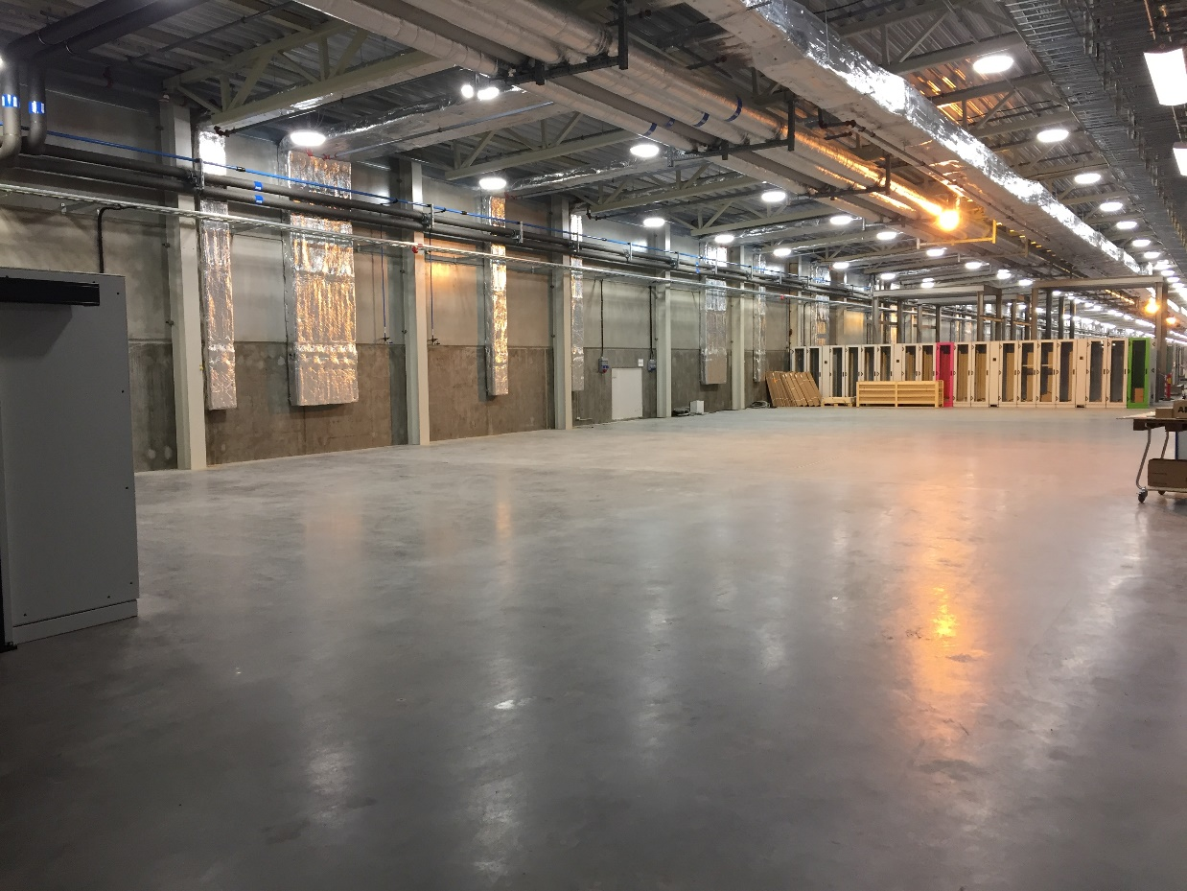
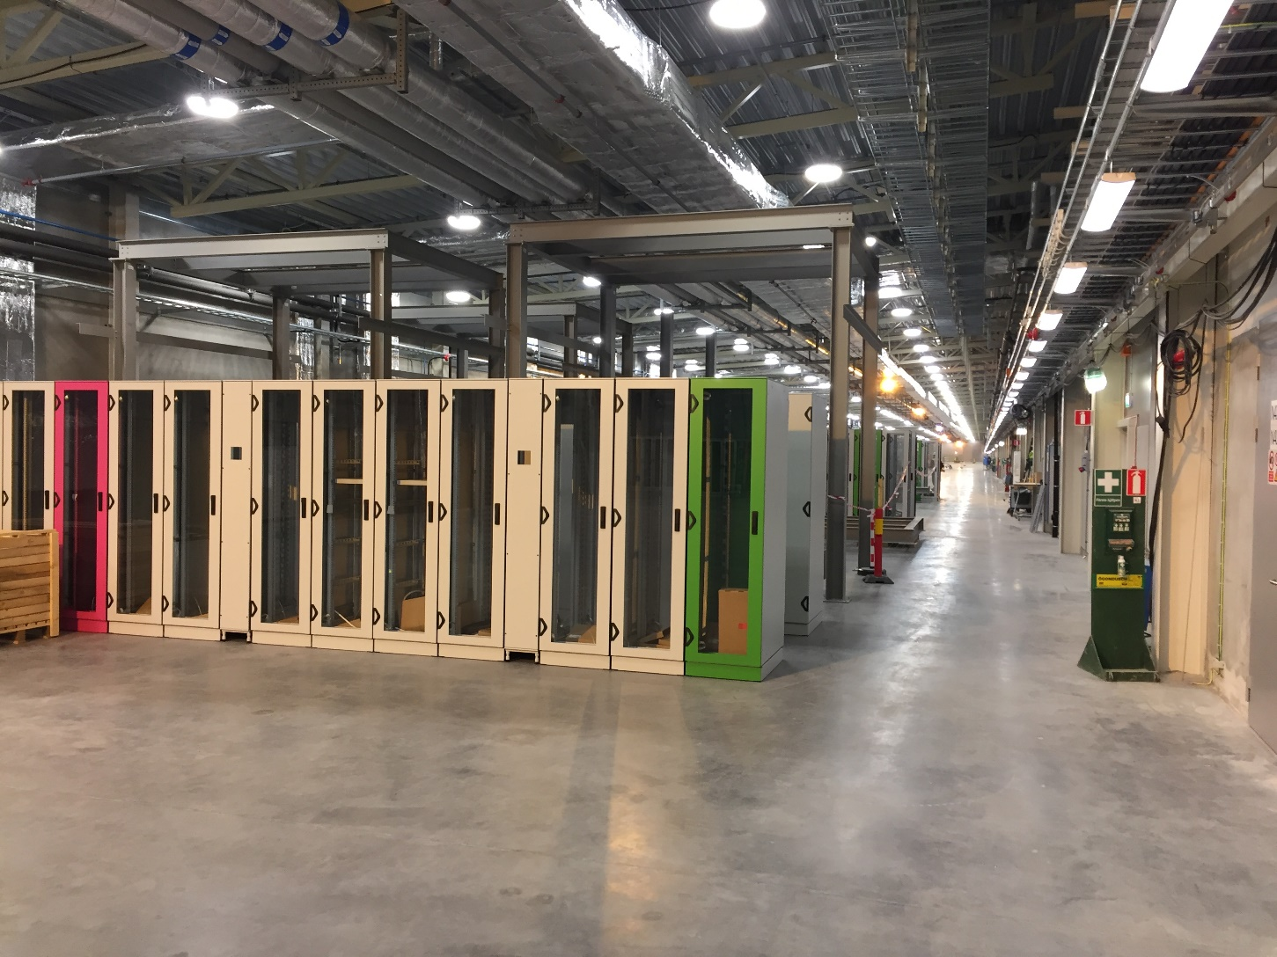
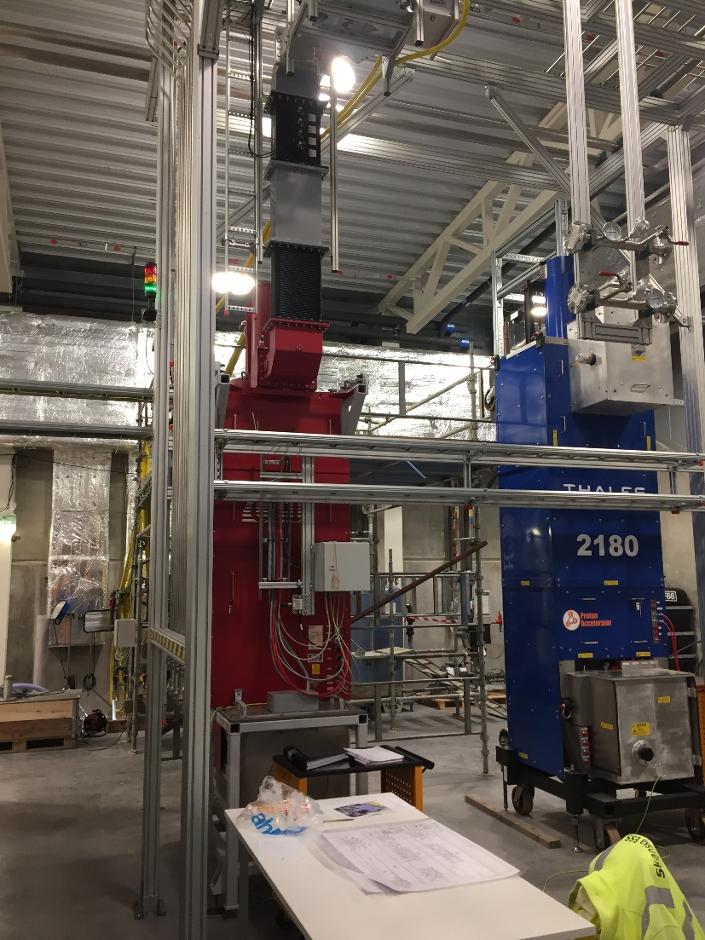
Inside gallery

Slide 5
ESS regulation requirements
ESS regulation demands
  For NC:
    ±1º and ±1% in the first 10us of beam pulse
    0.2º and 0.2% (RMS) in the remaining of 2850us
  For SC:
    ±0.5º and ±0.5% in the first 10us of beam pulse
    0.1º and 0.1% (RMS) in the remaining of 2850us
The requirements are challenging – J-parc ±1º and ±1%

Slide 6
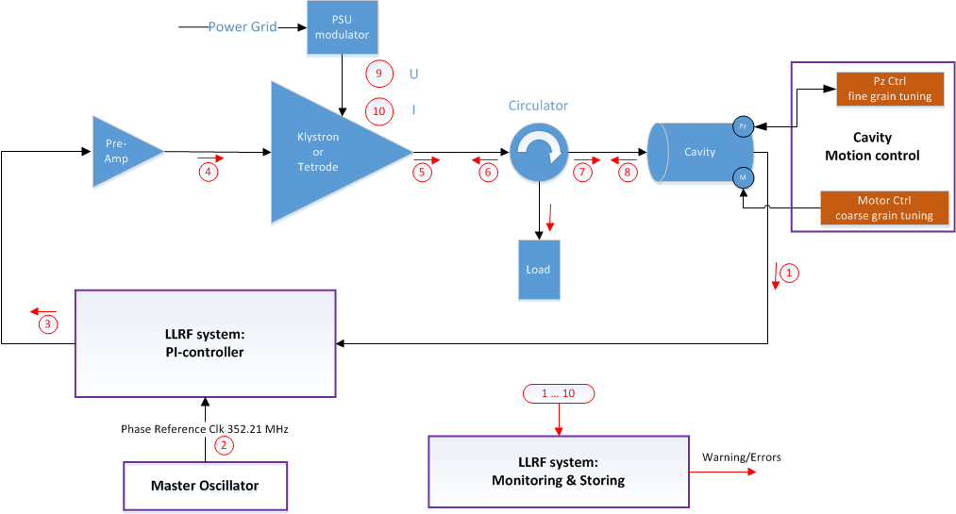
RF Cell
Interlock
Basic building block for RF systems is the RF cell:
High Voltage
Amplifiers
Regulation (LLRF)
Protection – Interlock
Waveguides

Slide 7
LLRF in cell
LLRF regulates cavity amplitude and field:
PI-control
Adaptive feedforward
Inner klystron loop
Beam current variation
compensation

Slide 8
ESS compared to J-Parc
ESS: 9 NC cavities, 146 SC cavities
  Energy 2 GeV, beam current 62.5 mA, 14 Hz, 2.86 ms
  352.21 MHz NC and spoke linac
  704.42 MHz elliptical linac
J-parc: ca 50 NC cavities (some bundled)
  Energy 400 MeV, beam current 50 mA, 25 Hz, 0.5 ms
  324 MHz RFQ-SDTL
  972 MHz ACS1 to ACS21/debunchers
Roughly similar except SC cavities

Slide 9
ESS comparison J-Parc cont
ESS construction ongoing:
  Expected to start user program 2023
  First proton beam (from ion source) 2018
  Start RFQ early 2019
  Ready for beam on dump 2020
J-Parc operational since many years

Slide 10
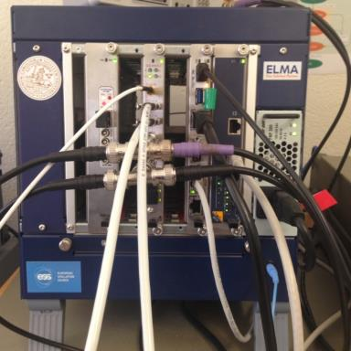
ESS LLRF system
MTCA.4 system
Status: design ready, prototypes exist, systems and subsystems to be delivered as IKC from Spain and Poland
352 and 704 tested and running
Tests at FREIA and Saclay

Slide 11
ESS control strategy
PI-loop, adaptive feed-forward
Beam compensation by beam current monitoring
Inner klystron loop
Lorentz force detuning compensation (Piezo)
Feed forward compensation for variety of beam modes in beam commissioning
Feedback system for random noise
One PhD study to investigate the regulation schemes
Control/cavity modeling error and noise propagation
Klystron linearisation

Slide 12
Error sources
HV pulse shape (rise, droop, …)
  Repetitive
  Compensated via adaptive feed-forward
Lorentz force detuning
  Repetitive
  Compensated via piezo tuners
Beam pulse shape
  Repetitive (?)
  Compensated via adaptive feed-forward

Slide 13
Noise sources
Beam current
  Random in nature
  Specification: +/- 2%
  Can be measured to some extent
HV HF ripple
  Random in nature
  Specification +/-0.3% (really hard to reach)
  Cannot be measured for feed-forward

Slide 14
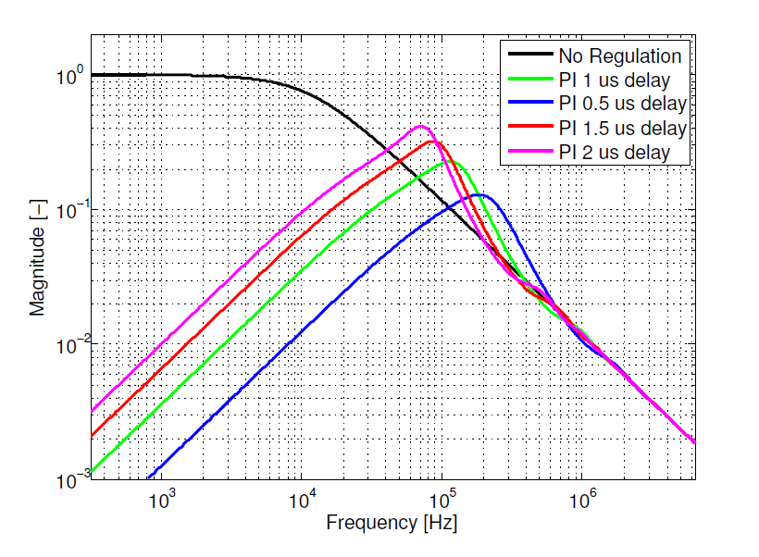
Highlights PhD (Olof Troeng, LTLH)
Field control analysis using complex-coefficient transfer functions -> simplifying the analysis for parasitic cavity modes
Computation of energy optimal filling profiles (not applicable to class A amplifiers)
Frequency band where noise has influence

Slide 15
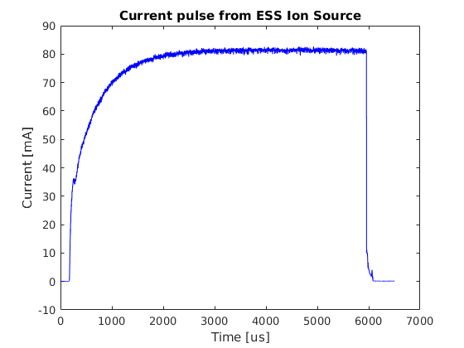
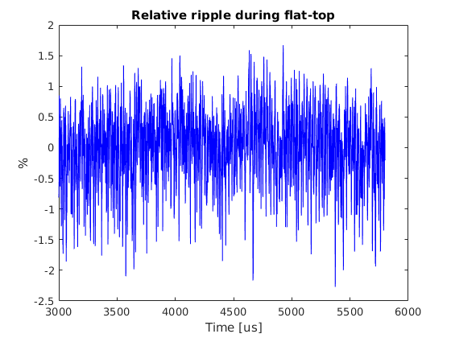
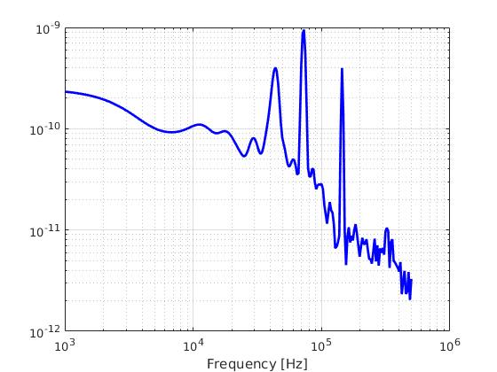
Beam – ion source data
Beam current pulse shape
Ripple <+/-2% (within spec)
Noise spectrum peaks at 72 and 144 kHz
This is where the disturbance rejection is weakest

Slide 16
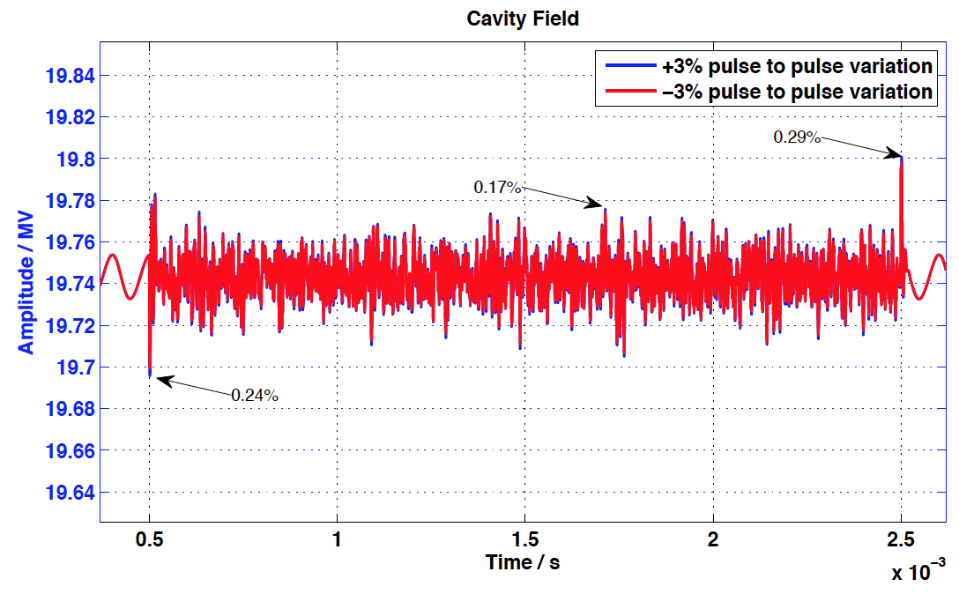
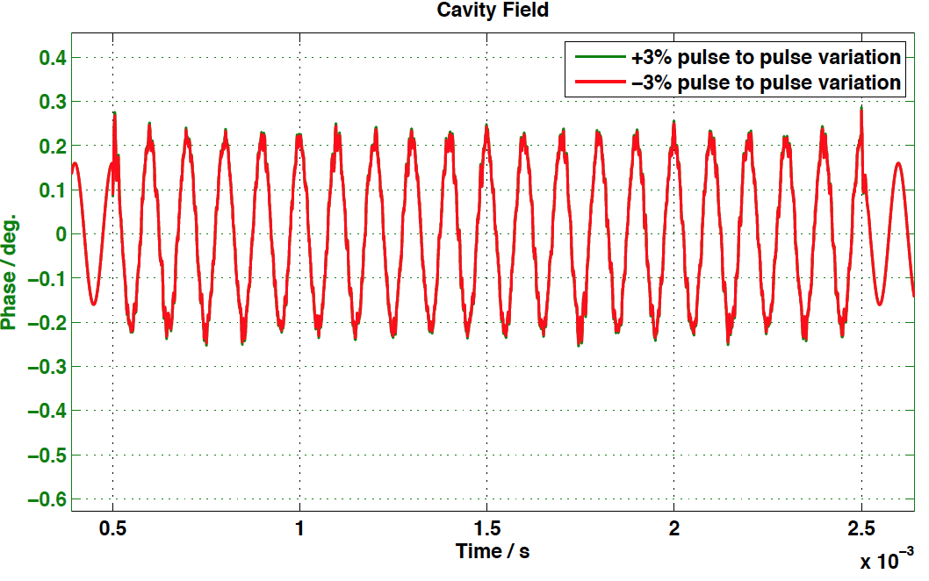
Multiple noise source perturbation simulation (for typical DTL cavity at ESS)
Noise source includes(for simulation only, not from real measurement):
Feedforward matching error: 100ns
Beam current fluctuation 3.5%(RMS) during pulse
Beam current variation ±3% from pulse to pulse
Modulator ripple 0.1% at 10kHz

Slide 17
Summary of ESS modeling results
Cavity | Time window | Amplitude | Phase | Note
NC | First 10 μs | Ok | Ok
NC | Rest of pulse | ∼Ok | ∼Ok | Beam current, HV ripple
SC | First 10 μs | Ok | Ok
SC | Rest of pulse | Ok | Ok | SC BW helps
HV ripple still a bit unknown
Modeling studies still – real test to come

Slide 18
Next steps
Do tests with cavities in Uppsala and Saclay and ESS cryomodule test stand (2018-2020)
Get the LLRF systems procured and installed
Tests with beam (2019-2020 + onwards)
J-parc has long experience of LLRF, auto-tuning, etc
Interesting to collaborate – visits, discussions
Test ESS style system @ J-parc

Slide 19
Conclusion
ESS will employ a MTCA 4 LLRF system
ESS will use adaptive feed-forward
System design ready, partners are constructing
Early tests at test sites (FREIA, Saclay, ESS test stand)
Modeling to predict performance
It will be challenging
Possibilities to collaborate: system tests, visits

Slide 20
Thank You

