Slide 1
Radiation Safety J-PARC-ESS Workshop 2018-01-18--19
Peter Jacobsson
Head of Environment, Safety & Health
www.europeanspallationsource.se
18-01-18

Slide 2
ESH & Q Organisation
ESH & Q
Ralf Trant (Ass. Director)
Nina Åsvatne (Assistant)
Licensing
Johan Waldeck
Security CM & ER
Ulrika Agnvik Erik Bernsland (c)
ESH Division
Peter Jacobsson (HoD)
Lars Aprin
Thomas Hansson
François Javier
Erica Lindström
Quality Division
Mattias Skafar (HoD)
Radiation Protection (RP) Group Peter Jacobsson (acting GL)
Occupation Health & Safety (OHS) Group Helen Boyer
HR: C. Olsson
Planner: C. Matheron

Slide 3
Environment, Safety & Health Division
ESH Division
Peter Jacobsson (HoD)
Thomas Hansson
François Javier
Environment
Erica Lindström
Safety Training
Lars Aprin
Radiation Protection (RP) Group
NN (Group Leader)
Ida Bergström
Alasdair Day
Daniela Ene
Lena Johansson
Per Persson
Fredrik Tidholm
Tobias Hörnfeldt (c)
Leif Spanier (c)
Occupation Health & Safety (OHS) Group
Helen Boyer (GL)
Fredrik Jörud
Jörgen Mattsson
Michael Plagge
Bertil Winér
Josefina Björneland (c)
Niklas Arvidsson (c)
Roland Lundberg (c)
Jonas Svensson (c)
Björn Yndemark (c)
Other contracted staff
Lund University (Point Zero)
Scanscot (Seismic)
Lloyds (Radiation Safety)*
Solvina (Safety)**
TDV Cons (OHS)**
*TD & ICS
**TD

Slide 4
ESH Responsibilities and Services
General
Interpret, and where necessary complement safety rules
Provide expert support in risk assessment, risk mitigation and risk control
Monitor compliance in ESH matters through targeted audits (via Q), reviews and inspections
Licensing
Responsible for the licensing processes for permits incl. the contacts to the authorities
Coordinate ESS activities
Radiation Safety
Expertise function
ALARA Principle
Radiation Protection
RP Responsibility for the machine and the users (1 RP technician 24/7 duty)
Radiation Monitoring System
Dosimetry service
Radioactive Waste Handling
OHS
OHS Support (Expertise function, infrastructure, machine, instruments and experiments)
Safety Training
Environmental monitoring and monitor hazardous waste handling (Dangerous Goods Safety Advisor)
Peter Jacobsson - May 2017 - ESS Initial operation Review

Slide 5
Legal Aspects and Permits
Environmental Code
Permissibility for construction & operation
Radiation Safety Protection Act (see next slide)
Planning & Building Act
Detailed Plan
Building Permit
Permits to be given as a graded approach
The Act on Flammable Materials and Explosives
Agreement with the Local Fire Brigade and the Local County Board
National Heritage Act
Archeological investigation

Slide 6
Authorities
Authorities
The Local County Board (Environmental Act, Heritage Act, Act on Explosives...)
SSM (Radiation Protection Act)
The Municipality Lund, including the Fire Brigade (The Planning & Building Act, the Act on Explosives..)
The Work Environment Authority (Work Environment Act)

Slide 7
Swedish Acts on Radiation
The Swedish Act for Nuclear Facilities can ONLY be applied on facilities dealing with fission material (U, Pu, Th, Am..)
Radiation Safety Protection Act applies for all facilities that uses ionization radiation
Already from the beginning, the Swedish Radiation Safety Authority (SSM) applied a graded approach for the licensing (identical as for a Nuclear Facility)
Permit for Construction (step 1)
Permit for Installation (step 2)
Permit for Commissioning (step 3)
Beam on Temporary Dump (Warm LINAC)
Beam on Dump (Cold LINAC)
Beam on Target
Permit for permanent operation (step 4)

Slide 8
Graded approach SSM - Schedule
Phase
1
2
3
4
PSAR 2012 + amendments
PSAR 2016-05-01 rev 2017-03-05
Update of PSAR SAR (2018/2020)
FSAR
General and conceptual information, enabling SSM to set the requirements
Reports and analyses showing that ESS is expected to fulfill the requirements
Reports and analyses verifying that ESS fulfills the requirements
Experience from test operation and maintenance incorporated in verifying analyses
ESS
Readiness Reviews
2014
2017
2018-2020
2025
Permit and conditions for building a spallation source
Permit for installation of equiipment that can generate ionisation radiation
Permit for Trial
Operation
3:1 Warm LINAC
3:2 SC LINAC
3:3 Beam on target
Permit for permanent operation
SSM
Ground break
Installation of Equipment
Commissioning of LINAC, Target, Instruments
Operation

Slide 9
Specific Conditions for the SSM Permit
Radiation Safety
Principles for design, operation and decommissioning
Organisation/Quality System/Review principles
Safety Program/Safety Goal
Handling of Radioactive Waste & Decommissioning
Financing
Security (Physical Protection)
Defence-in-depth
Emergency Preparedness
Organisation, Drills
Design & Construction
Defence-in-depth
Classification of system/components/structure
Event Classification
Accident Analyses (incl. Dose consequences)
Mechanical Components
Emissions/Dose to the public during normal operation
Archiving
Information Security

Slide 10
General Regulations
Radiation Zoning
Radiation Protection
Roles & Responsibilities
Rules
Training
Dosimetry
Monitoring
Choice of detectors
Calibration
Transportation

Slide 11
Reference values for ESS
Event Class | Frequency (/y) | Public Dose (mSv) SSM | Public Dose (mSv) ESS GSO
H1 | > 1 | 0,1 (/y) | 0,05 (/y)
H2 | 1 – 10⁻² | 0,1 | 0,1
H3 | 10⁻² – 10⁻⁴ | 1 | 1
H4 | 10⁻⁴ – 10⁻⁶ | 20 | 20
H5 | 10⁻⁶ – 10⁻⁷ | 100 | 100

Slide 12
ESS PSAR
Introduction
Site Description
Design rules
Facility Description
Source Terms - Hazard Analysis
Emissions
Radioactive Waste
Radiation Protection
Operation of the Facility

Slide 13
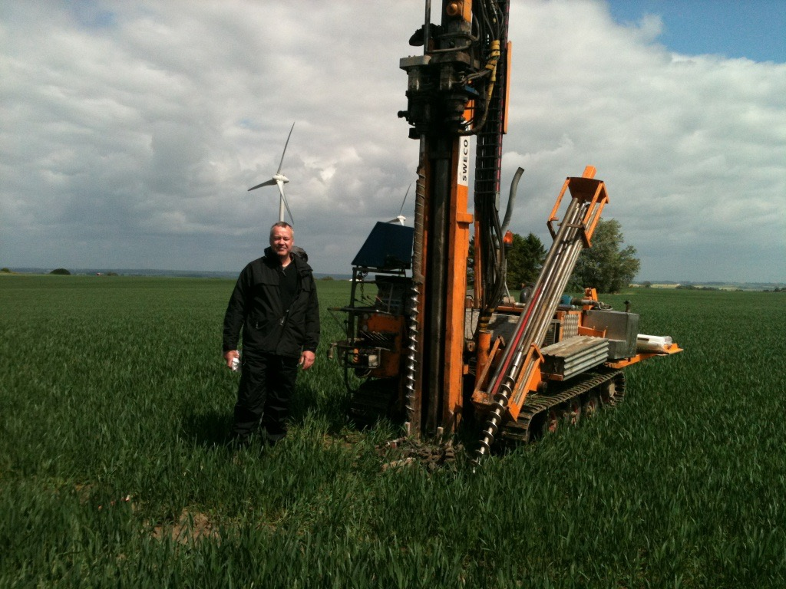
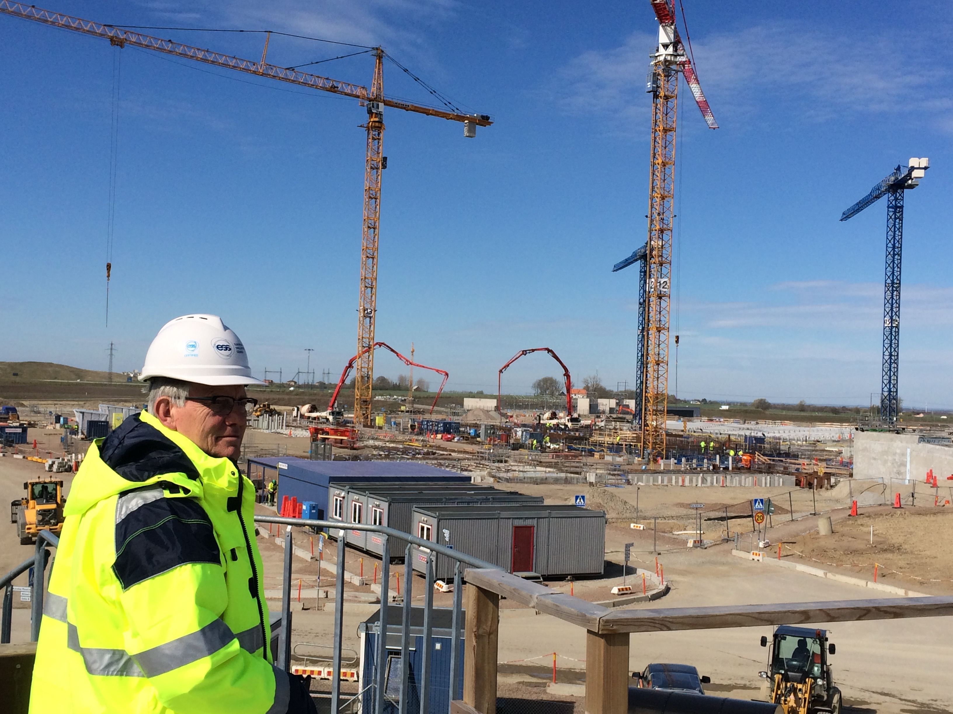
Retrospective

Slide 14
Safety Challenges
ESS is a true green-field project. There is not a host Laboratory able to supply the project with services
Design
Specific requirements for civil construction (external loads) have been challenging for the construction team
The specific target design is new technology
An aggressive time schedule
Installation
A large number of in-kind partners will be at site for installation at the same time as the construction company. Parallel activities will occur.
Commissioning of the machine
Starting a scientific operation (gives ESS money)

Slide 15
NI (Bq) Target Station

Slide 16
Responsible – Renewable – Recyclable
Responsible
CO₂: - 30 000 t.
€: + 3 M
Renewable
CO₂: -120 000 t.
€: + 8 M
Recyclable
CO₂: - 15 000 t.
€: + 4 M

