Slide 1
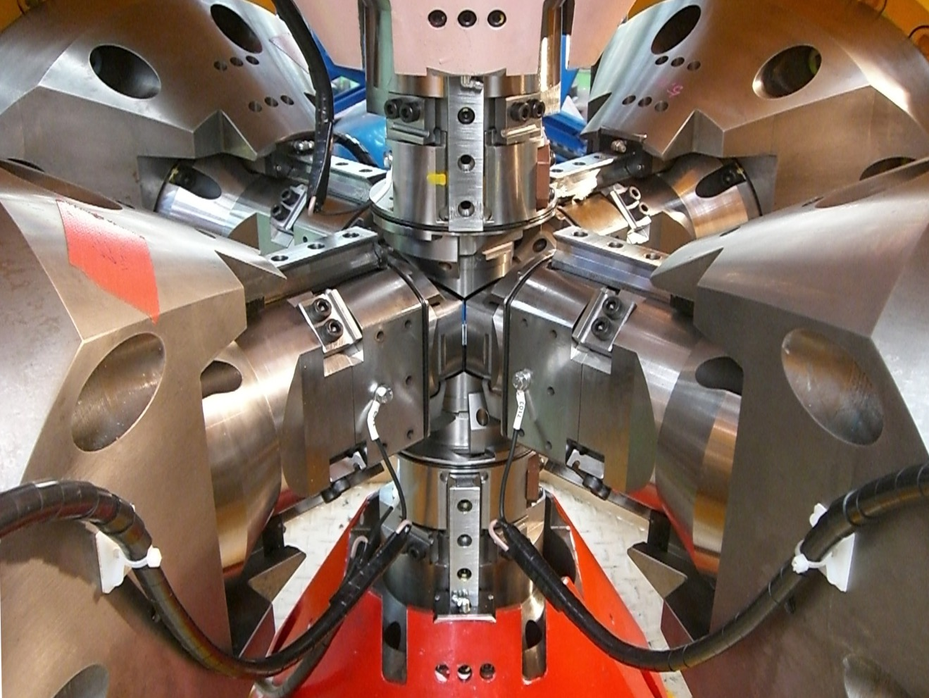

J-PARC Overview
January 18-19, 2018
ESS-J-PARC Collaboration Meeting, Lund
J-PARC
Naohito SAITO

Slide 2
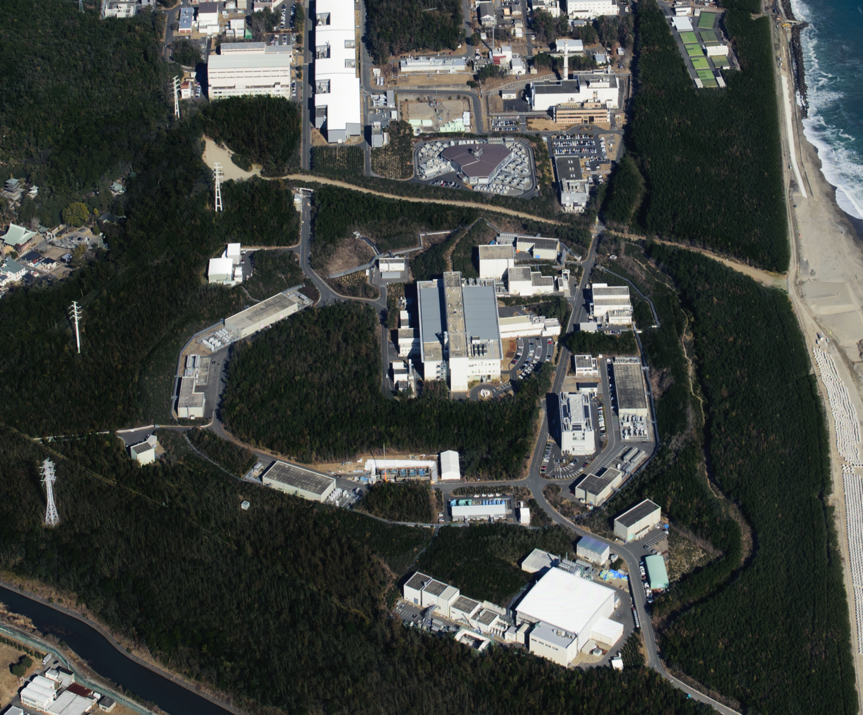


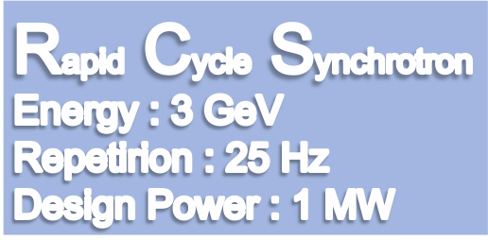




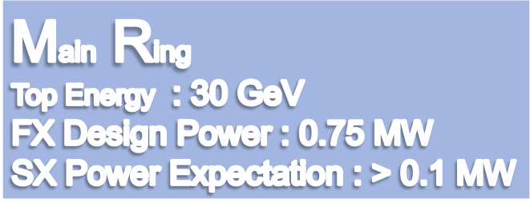
LINAC
400 MeV
Neutrino Beam to Kamioka
Material and Life Science Facility
Hadron Hall
Notes:
まず、こちらが、J-PARCの加速器複合施設です。陽子ビームを１８１MeVまで加速する（来年度以降４００ MeVになる）線形加速器ライナックがあり、その後、ビームは、40 msという短い時間の間に3 GeVまで加速されます。そのビームのほとんどは、この物質生命科学実験施設で中性子やミュオンを使った実験の為に使われています。

Slide 3
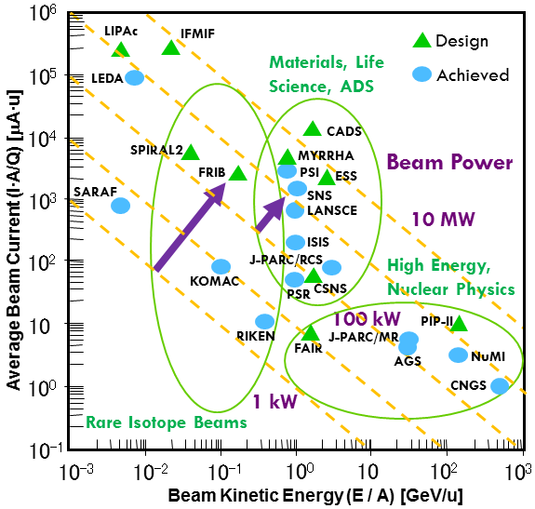
A Quest for High Intensity
High Intensity
High Statistics
1 MW
More Precision
More Rare Searches
More Materials
Discovery!
Jie Wei / Y. Yamazaki

Slide 4
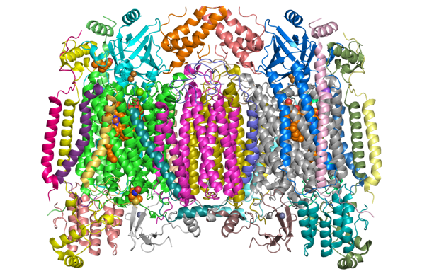
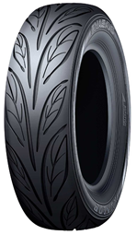


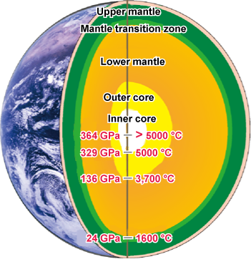
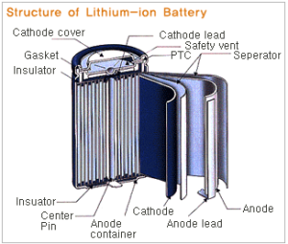
Neutron and Muon for…
Investigation of the origins of diversity in material and life！

Slide 5
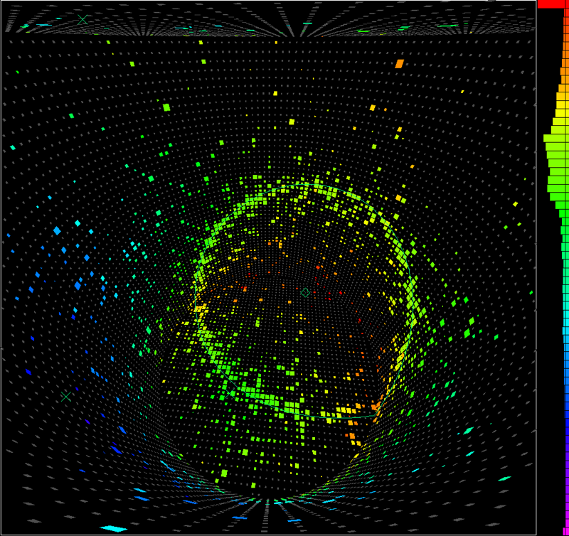
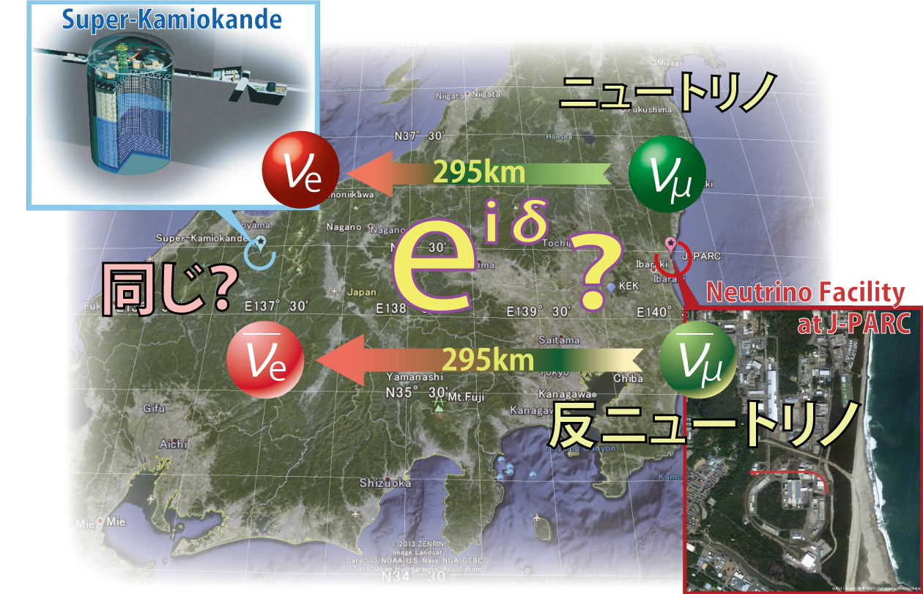

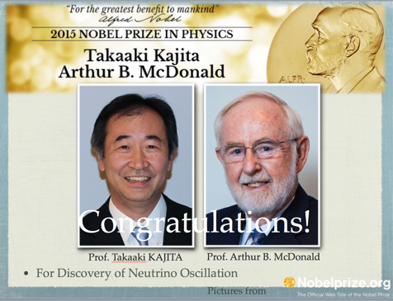
Neutrino and Anti-neutrino for…
Elucidation of the origin of universe and matter!
Where did anti-matter go?

Slide 6
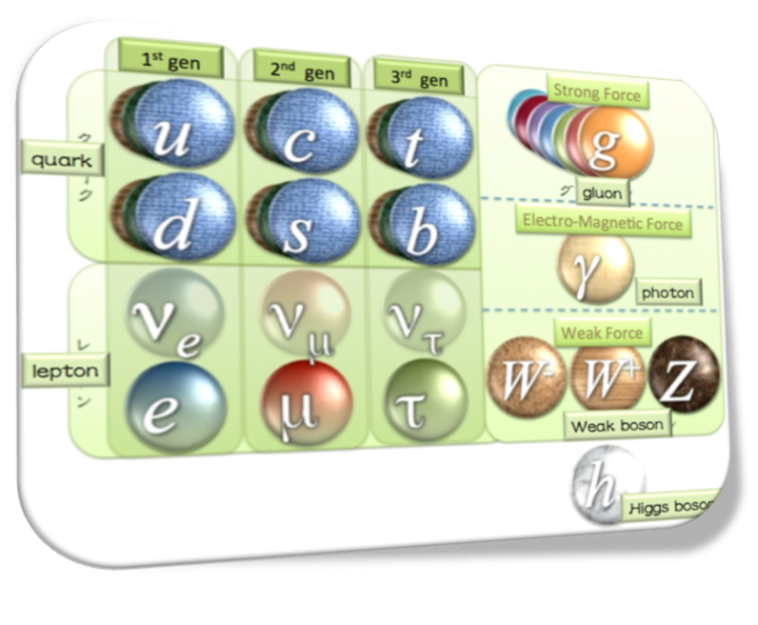
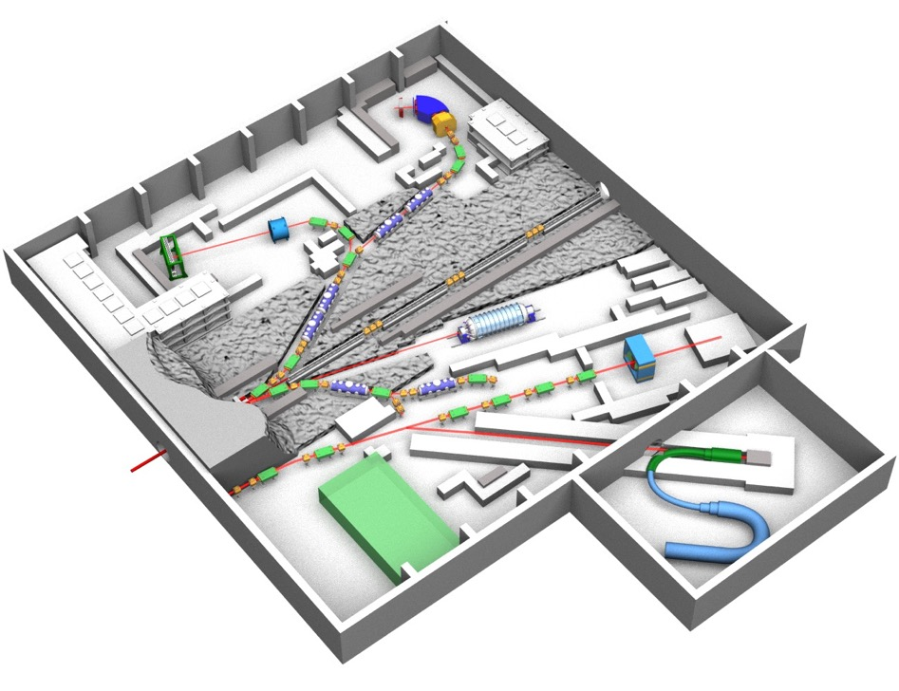
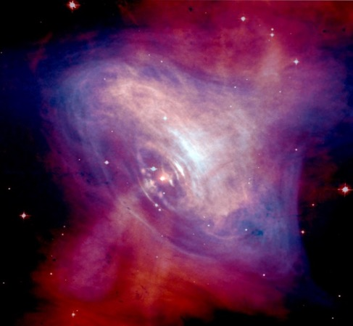
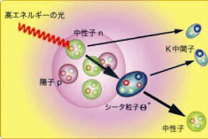
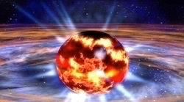

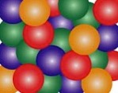
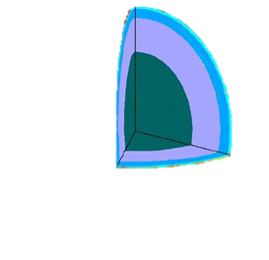



Hadron beams for…
Exploration of the mysteries in formation of matter!
陽子
中性子
Λ粒子
Ξ⁰、Ξ⁻
粒子
sクォーク
s
d
u
s
u
ストレンジクォークを含む物質
sクォークを2個含む原子核

Slide 7
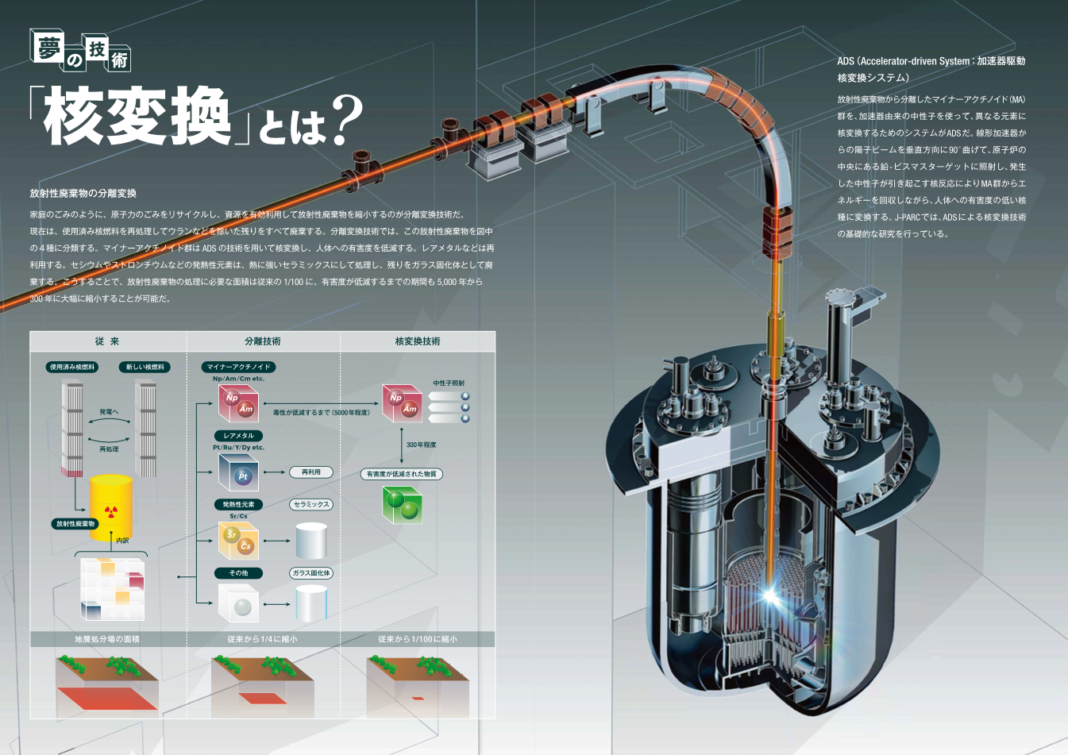
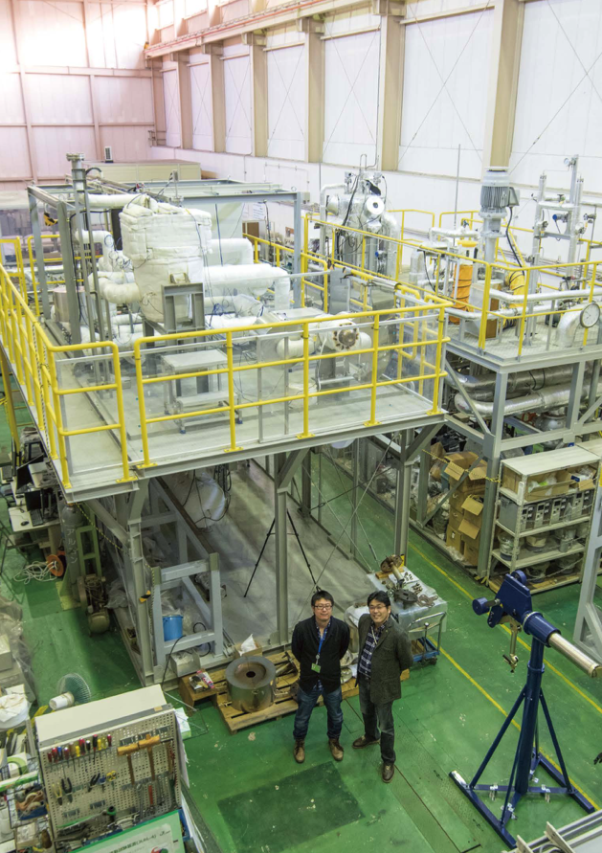
R&D of Accelerator Driven System for
Nuclear Transmutation

Slide 8
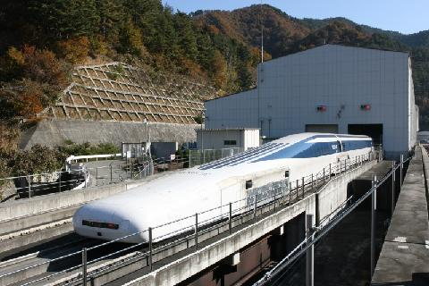
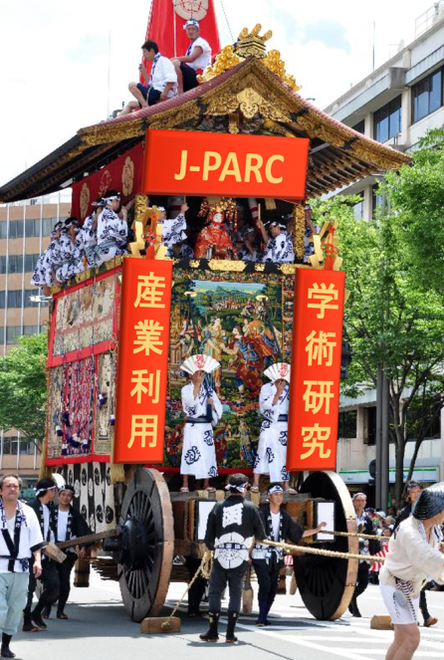
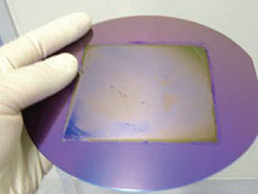
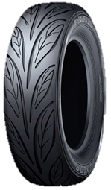
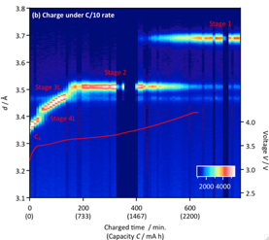
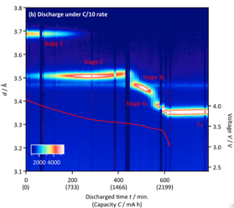

Industrial Applications for …
Acceleration of Near Future Technologies!
[Charge]
[Discharge]
Li脱離時のみに
出現する相が存在
Industrial Application and
Academic Research are
Two important wheels to accelerate the society for future!
共存する3L相
Scientific Reports (2016)

Slide 9
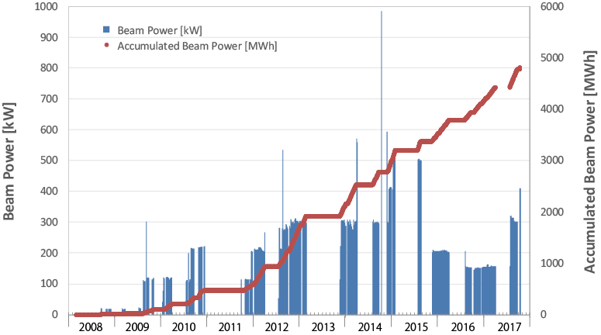
Beam Power History at MLF
1 MW eq. pulse
500 kW
Accident at
Hadron Facility
300 kW
Earthquake
Fiscal year
～1 month interruption
due to the fire in MLF
Interruption due to troubles of Hg-target
as of January 14, 2018
～10 months interruption
due to the earthquake

Slide 10
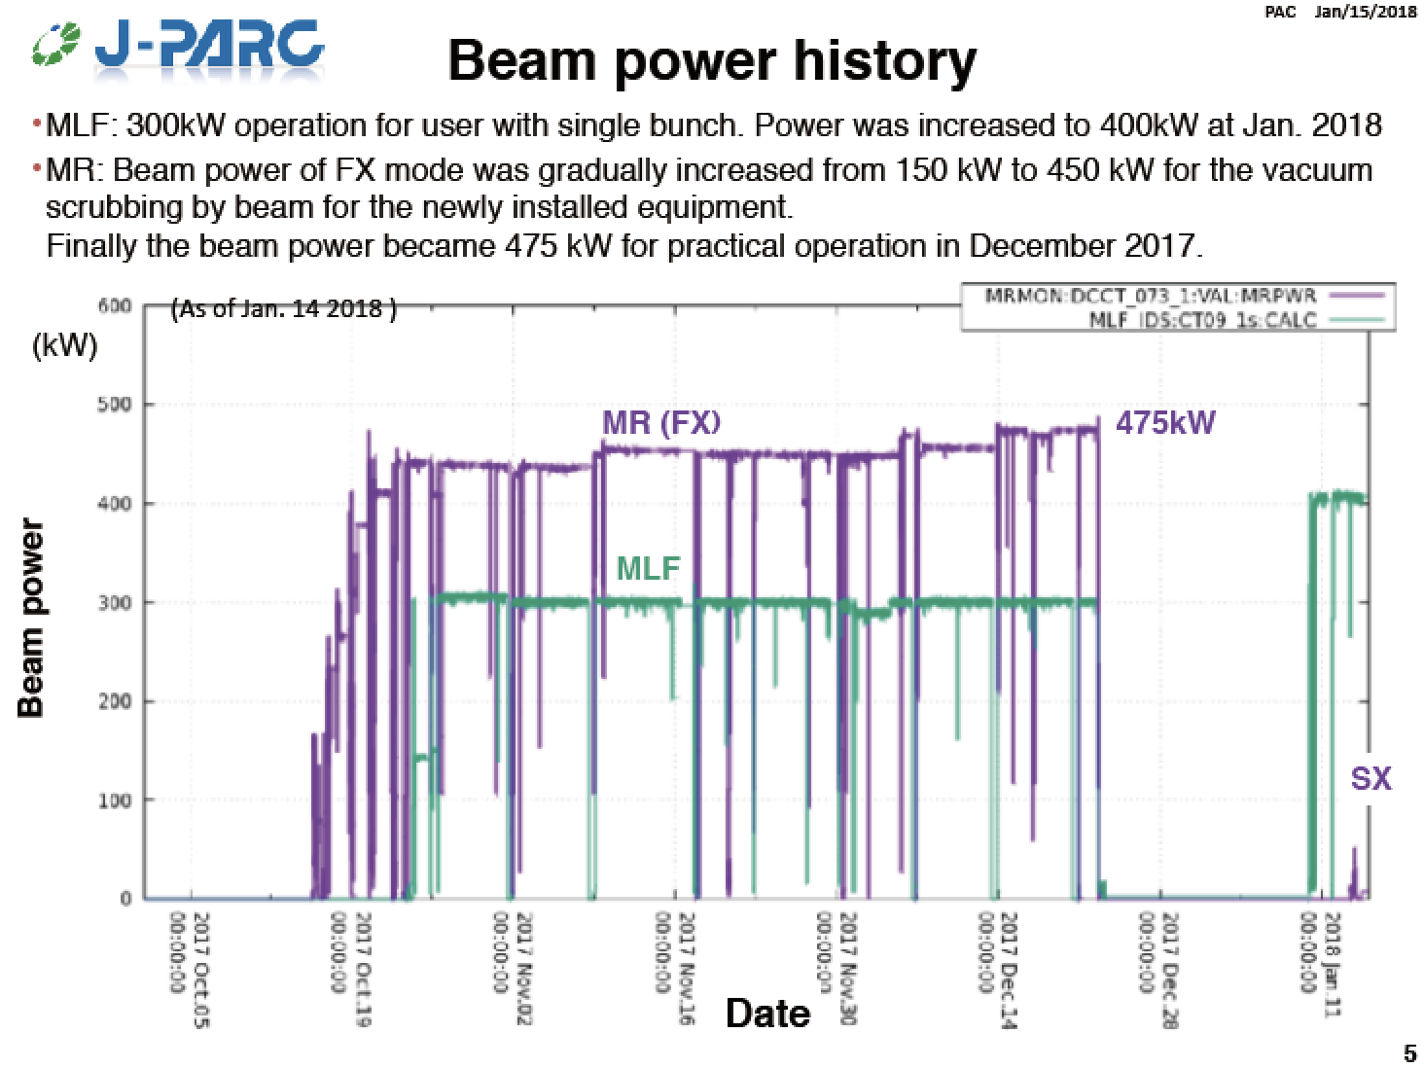
Slide by Naito-san

Slide 11
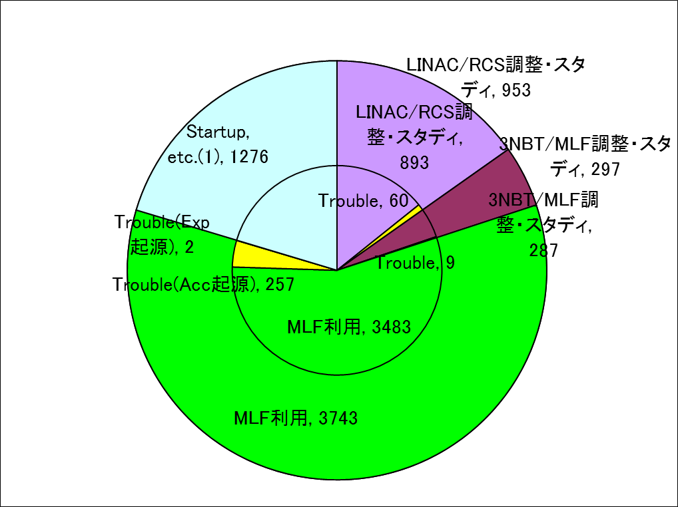
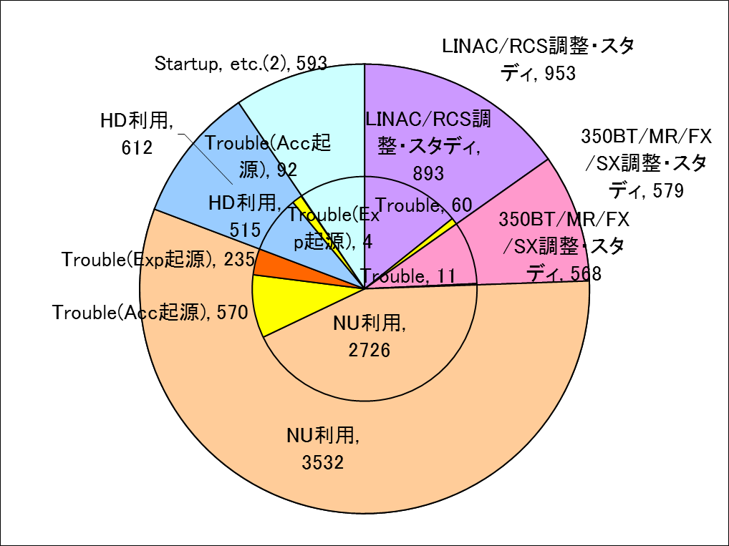
Operation Stats (JFY2016)
For MLF users
For MR users
JFY2016（H28） 4月4日9:00から2017年3月31日24:00まで: Total 6,271 時間
Facility | User time (hours) | Trouble, Acc. only (hours) | Trouble, Fac. only (hours) | Net time, (hours) | Availability, Total (%)
MLF | 3,743 | 257 | 2 | 3,483 | 93.1
Neutrino (FX) | 3,532 | 570 (稼働率低下への寄与16%) | 235 (稼働率低下への寄与7%) | 2,726 | 77.2%
Hadron (SX) | 612 | 92 | 4 | 515 | 84.1

Slide 12
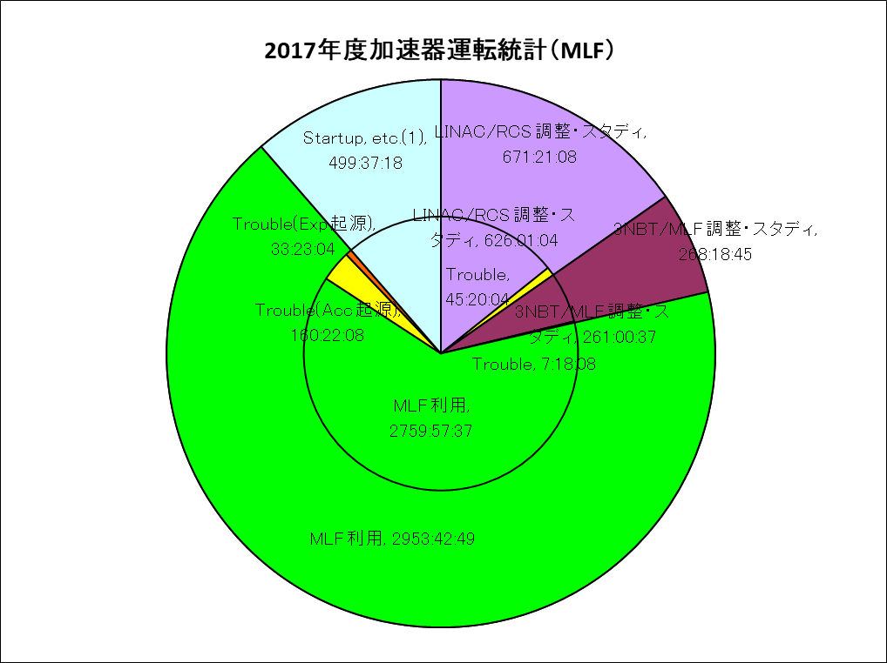
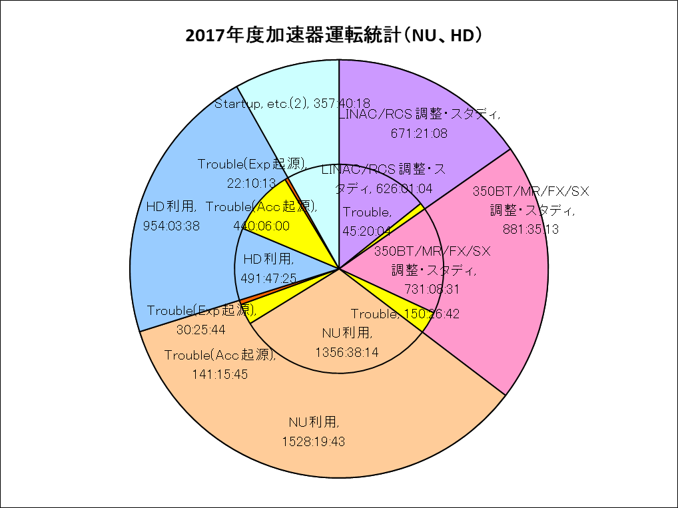
Operation Stats(April-December,2017)
2017年4月~2017年12月までの 4,393 hours
Facility | User time (hours) | Trouble, Acc. only (hours) | Trouble, Fac. only (hours) | Net time, (hours) | Availability, Total (%)
MLF | 2,953 | 160 | 33 | 2,759 | 93.4
Neutrino (FX) | 1,528 | 141 | 30 | 1,356 | 88.7
Hadron (SX) | 954 | 440 | 22 | 491 | 51.5

Slide 13
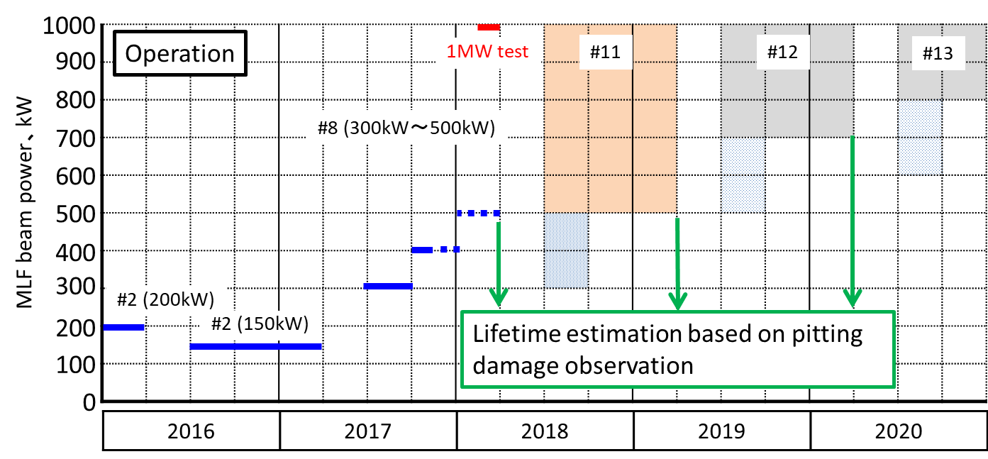
Near Future Plan of Power Upgrade
Suppressing the pitting damage of the mercury target caused by the pressure waves is the crucial issue.
Beam power will be increased step by step to ensure reliable operation.
Observation results of pitting damages will be the decisive factor to decide the beam power.
Preparation of targets
R&D is running.
Hg
Hg
Hg
Proton
beam
Proton
beam
Proton
beam
Double wall
Bubbler
Bubbler
Double wall
Notes:
This table shows the power upgrade scheme towards 1 MW. Now we are operating using 2nd target without any damage mitigation technologies, therefore, we should keep the beam power lower than 150 kW till next summer. From next year, we will be ramped up the beam power step by step up to 500 kW and will conduct 1 MW test at end of 8th target.
We will develop the constraint-free type target and be ramped up the beam power up to 1MW.
However, since the pitting damage is one of key factor to decide the allowable beam power, we will observe the damage by cutting the window at the end of operation of each target and decided allowable beam power.
And we will develop the mitigation technology on pitting damage to increase the allowable beam power.

Slide 14
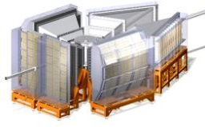
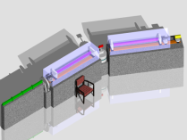
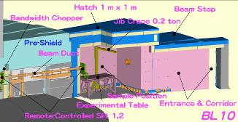
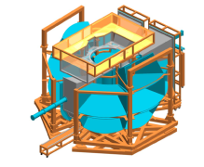
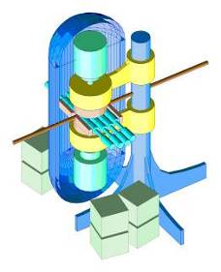
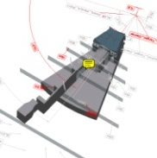

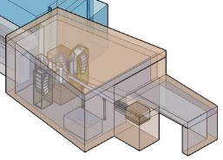
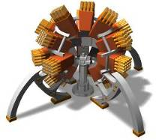
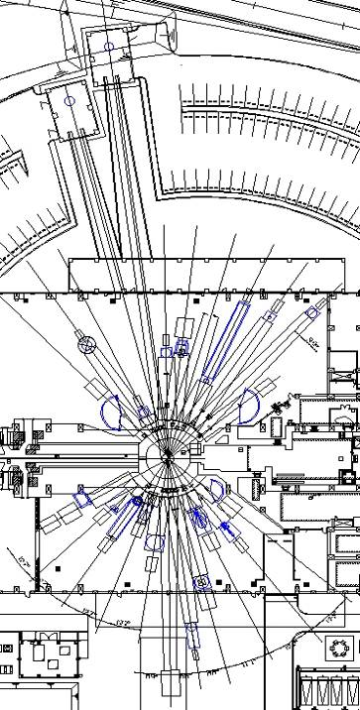
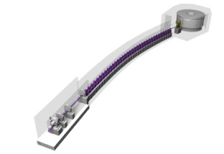
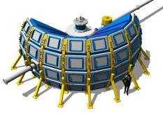
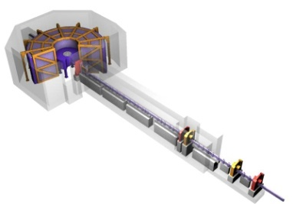
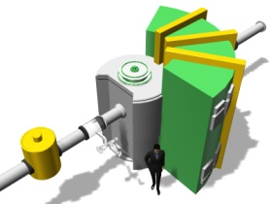
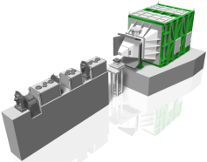
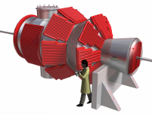
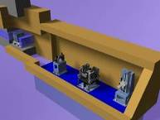




Neutron Instruments at MLF
Operation
Operation
Operation
Construction
The first neutron in May, 2008
23 Neutron Beam Ports
From Fundamental Physics to Industrial Uses
Operation: 19 (Apr., 2015)
Construction/Commissioning:2
Constructed by
・KEK
・JAEA
・Ibaraki Prefecture
・Universities, Institutes &
Government organizations...
Yearly Operation Days
・~180
Yearly Guest Number
・731 (2014)
NOBORU (JAEA)
Operation
ANNRI
(Tokyo Tech. U., JAEA,,
Hokkaido U.)
SHRPD(KEK)
VIN_ROSE
(KEK, Kyoto Univ.)
Operation
SPICA
(NEDO, KEK)
Operation
Operation
NOP(KEK)
iBIX
(Ibraki Pref.)
PLANET (JAEA, U. of Tokyo)
HRC (KEK)
Operation
Operation
DNA (JAEA)
Operation
Operation
4SEASONS
(JAEA)
AMATERAS
(JAEA)
Construction
POLANO
(Tohoku Univ,, KEK)
Operation
RADEN
(JAEA)
Operation
TAIKAN
(JAEA)
Operation
NOVA
(NEDO, KEK)
Operation
Operation
Operation
Operation
Operation
SOFIA (KEK)
SHARAKU
(JAEA)
iMATERIA
(Ibraki Pref..)
SENJU (JAEA)
TAKUMI (JAEA)

Slide 15




Muon Facility MUSE @ MLF
H-Line
S-Line
Fundamental Science with a large scale international coll.
Accommodate many
μSR experiments
U-Line
D-Line
Very unique Ultra-Slow Muon Beam
Mid-intensity beam line
For general use
Notes:
Page 4; From the graphite target, we designed MUSE facility extracting four muon beam lines.
D-Line is a general use muon beam line where either surface muon or decay muon up to 120 MeV/c can be extracted. This D-line is only one muon beam line where User’s RUN has been in operation.
U-Line is a dedicated muon beam line for the Ultra Slow Muon, intended to generate 0.05 to 30 keV.
S-Line is a muon beam line to extract surface muons for the 4 experimental areas.
H-Line is a muon beam line mainly for the fundamental physics.

Slide 16



Major Research Results 2016
Thirteen press releases in 2016 ( five in 2015)
  Solid electrolytes open doors to solid-state batteries
  Hydride-ion conduction makes its first appearance
  Development of whole-solid ceramics bettery with super-ion conductor
  Discover abnormal behavior of "pathological condition" protein molecule leading to the development of Parkinson's disease
  SEI coating that affects the characteristics of the battery ~ Develop method to approach its identity
  Observation of the quantum mechanical phase of the electronic state as a spin motion for the first time using metal ferromagnetic material SrRuO₃
  Successful analysis of internal behavior of charging /discharging lithium battery - realized by non-destructive and real-time observation using neutron beam –
  Discovering a new order condition on high-pressure ice - Solving one of the five unsolved problems of ice –
  T2K Experiment took the first step to elucidate neutrino's ”CP Symmetry breaking”
  Elucidation of the unique structure of ice containing large amounts of salt
  Development of high-speed texture measurement system of metallic materials by neutron diffraction
  And, two more
MLF
MLF
MLF
MLF
MLF
MLF
MLF
MLF
NU
MLF
MLF
MLF
MLF

Slide 17
Major Research Results 2017
11 from MLF
1 from Neutrino
2016-11 | 2017/01/13 | 地球形成期におけるコアの軽元素の謎に迫る- 鉄へ溶け込む水素を中性子でその場観察 - | MLF | 無 | 日刊工業新聞
2016-12 | 2017/03/14 | 1つの金属原子に9つもの水素が結合した新たな物質の誕生 | MLF | 無 | 化学工業日報
2016-13 | 2017/03/21 | コバルト酸鉛の合成に世界で初めて成功し、新規の電荷分布を発見 - 鉛、コバルトの両方に他に例のない電荷秩序、イオン価数制御の新手法により機能性酸化物の開発に期待 - | MLF | 無 | 鉄鋼新聞
2017-01 | 2017/04/20 | 数学のグラフ解析を用いて、新物質の結晶構造を解く手法を開発 | MLF | 無 | 日経産業新聞、山形新聞
2017-02 | 2017/06/19 | 電子：自転がふらつくと、軌道も変わる- 磁性物質における電子スピンのふらつきと電子軌道の結びつきが明らかに - | MLF | 無 | マイナビニュース、科学新聞
2017-03 | 2017/07/27 | 200年にわたる謎に終止符、ガラスの基本単位の構造を決定- オルトケイ酸を用いた高機能・高性能ケイ素材料の創出に期待 - | MLF | 無 | 日刊産業新聞、日経産業新聞、化学工業日報
2017-04 | 2017/08/04 | ニュートリノの「CP対称性の破れ」、可能性さらに高まる【KEK】 | NU | 無 | 朝日新聞、読売新聞夕刊、毎日新聞夕刊、毎日新聞夕刊、産経新聞、産経新聞夕刊、日本経済新聞夕刊、東京新聞夕刊、茨城新聞、東奥日報、北海道新聞、山形新聞、 福島民友、埼玉新聞、山梨日日新聞、下野新聞、河北新報、京都新聞、北国新聞、 静岡新聞、大分合同新聞夕刊、信濃毎日新聞夕刊、静岡新聞夕刊、赤旗、共同通信、毎日新聞、時事通信、産経新聞、マイナビニュース、イギリスSTFC
2017-05 | 2017/08/10 | シリコンを使わない太陽電池の設計に道筋 有機系半導体の特性を解明、次世代型太陽電池の実用化へ期待【JAEA】 | MLF | 無 | 日刊工業新聞、電気新聞、日刊産業新聞、電子デバイス産業
2017-06 | 2017/08/10 | J-PARC施設公開2017のお知らせ | 他 | 有 | 茨城新聞
2017-07 | 2017/08/19 | 世界初！ 白色中性子線を用いて微量な軽元素を含む物質の超精密原子像取得に成功 - 機能性材料の性能向上に貢献 - | MLF | 無 | 茨城新聞、電気新聞、中日新聞、つくばサイエンスニュース
2017-08 | 2017/08/29 | 生体適合性高分子材料の水和状態と分子構造因子の相関を解明 - 医療用高分子材料の革新的性能向上への応用に期待 - | MLF | 無 | マイナビニュース
2017-09 | 2017/09/08 | フラストレーションと量子効果が織りなす新奇な磁気励起の全体像を中性子散乱で観測 - 新しい磁気理論の指針を提示 - | MLF | 無 | つくばサイエンスニュース
2017-10 | 2017/11/10 | 第9回AONSA中性子スクール/第2回中性子・ミュオンスクールの合同スクールへの取材のご案内 | MLF | 有
2017-11 | 2017/11/15 | 大井川和彦茨城県知事J-PARCご視察のお知らせ | 他 | 有 | 茨城新聞
2017-12 | 2017/11/17 | 透過中性子によるスピン配列の観測に成功 - 従来の回折中性子の測定より装置設計の自由度が増し、未知のスピン配列観測が容易に - | MLF | 無 | 日刊工業新聞
MLF
MLF
MLF
MLF
MLF
MLF
NU
MLF
MLF
MLF
MLF
MLF
成果以外のお知らせ

Slide 18


Now a member of RaDIATE September, 2017
Collaborators gathered for MoU signing and Workshop

Slide 19



MIRAI kick-off! October, 2017
Japan-Sweden Collaboration of Universities

Slide 20






Collaboration with Academia & Industry
Domestic University
Oversea Institutions
Collaboration with TRIUMF
Experimental Collaboration and exchange program of researchers; share the know-how on facility and safety management
Collaboration with ANSTO
For improving user environment, sample environment, e.g. deuterization lab, and exchange program for researchers.
Collaboration with ESS
Contribute to the newly constructed major facility based on the experience of J-PARC construction.
New Graduate Course Established to include J-PARC science
Industrial Sector
Osaka U@J-PARC
Kyoto U@J-PARC
J-PARC/Sumitomo rubber Inc. Fellowship is established
Univ. branch at J-PARC
Education and training of students and young researchers at the very front of J-PARC operation, especially to raise the next generation who can create a future cutting edge facilities

Slide 21

ESS-J-PARC Relation Strengthened!
Our relation is widely known to be very successful.
Yes, we are ready for more success!

Slide 22


銘板出現＠MLF thanks to 林さん

Slide 23

J-PARC action plan JFY2018
Keep safe and stable operation towards Hi-Power
  Availability should be kept > 90%
  Hi-power frontier should be explored
    Accelerator
      LINAC&RCS: Stabilize 1 MW ops & plan for > 1 MW
      MR： > 450 kW now ; > 750 kW with the new PS
    Experimental facility
      MLF：Improve robustness of the target; safety
      NU：reduce down time, which start to be visible
      HD：bring new beam line to operational; new target for > 50 kW should be developed further
Continue to increase science outputs
  MLF：bring Science Gr onto track; Support data analysis efforts
  Strengthen ties with Universities and Industries further
Bring future projects to “ready-to-go” stage
  Neutrino beam improvements for HK
  The 2nd target start at MLF
  Hadron Hall extension and muon physics facilities
Accelerate ADS R&D
MLF：>90% @ > 500 kW
MR(FX) : > 475 kW
MR(SX) : > 45 kW

Slide 24





Japan Science Council Master Plan 2017
28 important projects are selected from 166 proposals
Two J-PARC related proposals are selected as important projects:
  Elucidation of the origin of matter with an upgrade of the J-PARC experimental facility
  Nucleon Decay and Neutrino Oscillation Experiment with a Large Advanced Detector (aka Hyper-Kamiokande)
One J-PARC proposal not selected
  MLF the 2nd target station for both neutron and neutron
MEXT roadmap (under public comment) now selected Hyper-K
g-2/EDM
Hyper-K and relevant J-PARC upgrade
MLF the 2nd target station for neutron x 10+muon x 50

Slide 25

Summary
J-PARC is improving operation efficiencies!
  MLF is recovered from neutron target troubles and runs at eff > 90%
  Both neutrino and hadron facilities are improving power
MR Power Supply started to be build, but…
  Both FX and SX will be benefited.
Operation fund is challenging for KEK part.
High power frontier is further explored
  MLF reaches 500 kW operation; 1 MW test likely to be done.
  MR-FX reached 500 kW! SX will be pushed to 50 kW soon.
  Targetry activities will be strengthened further (cf. RaDIATE)

Slide 26

We believe the cooperation with ESS would bring us to the next stage of research facility!

