Slide 1
Neutron Scattering Systems (NSS):
Overview and Status
Andreas Schreyer
Director for Science
ESS
www.europeanspallationsource.se
21.11.2017

Slide 2
Neutron facilities – reactors and particle driven
10²⁰
Reactor Sources
Spallation Sources
J-PARC
ESS
HFIR
ILL
LANSCE
ISIS
CSNS
10¹⁵
MTR
HIFAR
MARIA
ORPHEE
IPNS
SALAM
HANARO
SNS
NRX
HFBR
NIST
ZING-P’
Dhruva
CARR
PIK
NRU
SAFARI-1
JRR-3
ETERR-2
FRM-II
OPAL
LVR
RSG
SINQ
IBR-II
HOR
JEEP II
KENS
X-10
WNR
Effective thermal neutron flux n/cm²-s
ZING-P
10¹⁰
CP-2
CP-1
10⁵
Berkeley 37-inch cyclotron
Particle driven pulsed
350 mCi Ra-Be source
Particle driven steady state
Pulsed reactor
Fission reactors
1
Chadwick
1930
1940
1950
1960
1970
1980
1990
2000
2010
2020
2030
Year
(Updated from Neutron Scattering, K. Skold and D. L. Price, eds., Academic Press, 1986)
Notes:
CP-1 Chicago USA
CP-2 Chicago USA
X-10: Oak Ridge, USA
NRX: Chalk River, USA
MTR: Idaho, USA
LVR: Rez, Czech Republic
HIFAR: Sydney Australia
NRU: Chalk River, USA
HOR Delft Netherlands
SAFARI-1 Pretoria South Africa
HFBR: Brookhaven, USA
HFIR: ORNL, Oak Ridge, USA
NIST: National Inst. for Stds and Tech. Gaithersburg, USA
ILL: Grenoble, France
JEEP II Kjeller Norway
MARIA Swierk Poland
ORPHEE LLB Saclay France
Dhruva: Mumbai, India
RSG: serpong, Indonesia
SINQ: PSI, Switzerland
JRR-3: Tokai, Japan
ES-Salam Algiers Algeria
HANARO: Daejon KAERI, South Chorea
ETERR-2 Cairo Egypt
FRM-II: Munich, Germany
OPAL: Sydney, Australia
CARR: Beijing China
PIK: Gatchina, Russia
ZING-P Argonne USA
WNR Los Alamos USA
KENS Tsukuba Japan
IPNS Argonne USA
IBR-II Dubna Russia
LANSCE Los Alamos USA
ISIS Oxfordshire UK
SNS Oak Ridge USA
JPARC Tokai Japan
CSNS Beijing China
ESS Lund Sweden
More reactor sources exist across the world….

Slide 3
ESS Mission:
Build the world’s brightest neutron source
Reactor sources
Accelerator-driven sources
ESS
Effective thermal neutron flux 10¹⁵ n/cm²-s
J-PARC
NIST
ILL
LANSCE
ISIS
FRM-II
SNS
CSNS
Year

Slide 4
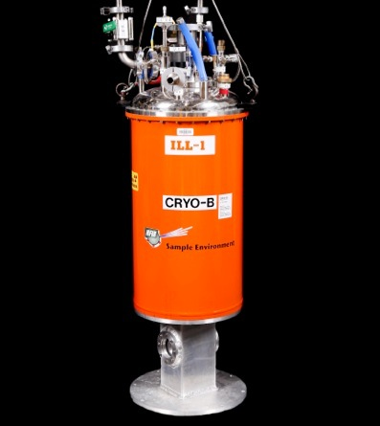
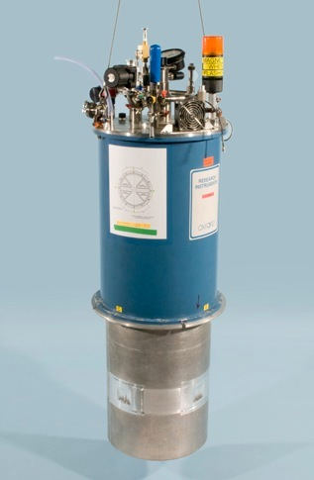
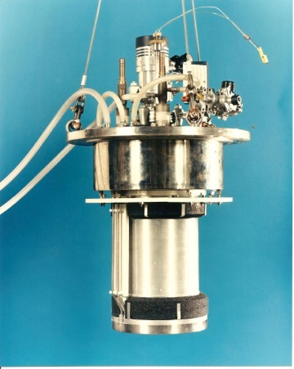


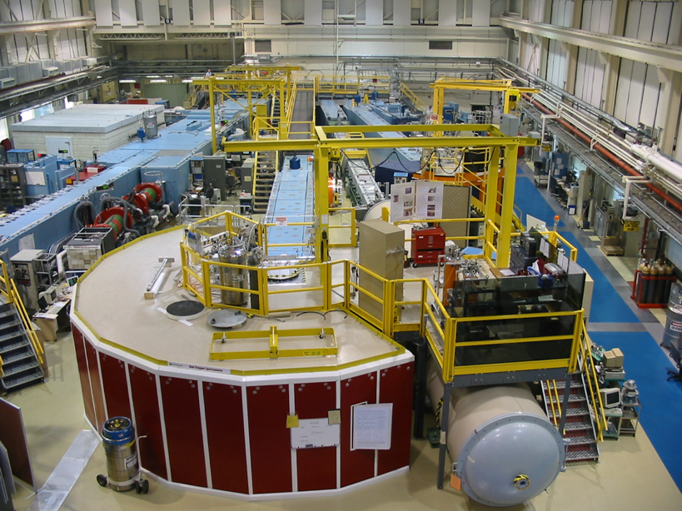
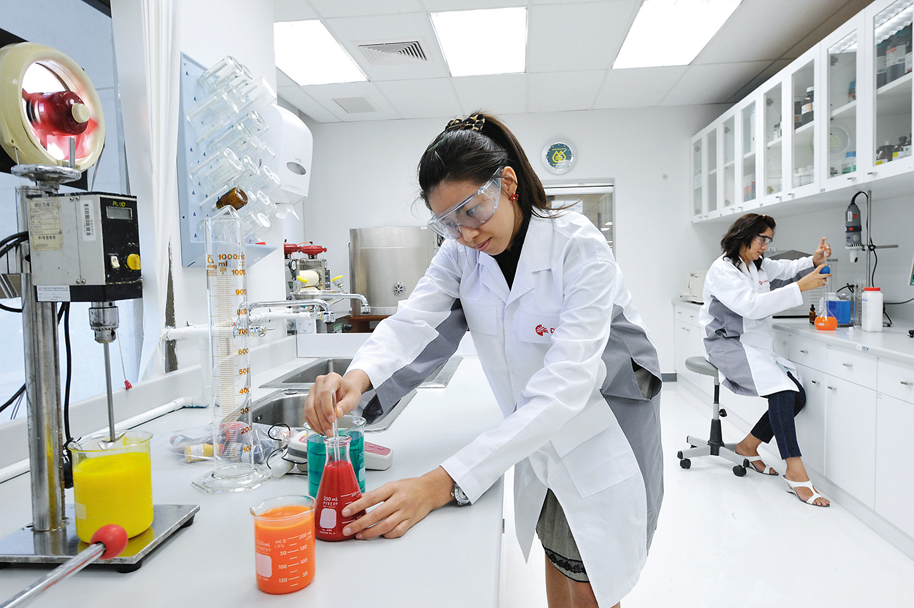
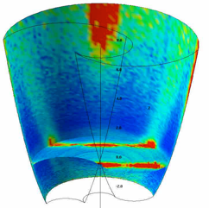
ESS Project Scope on Instruments
(Neutron Scattering Systems, NSS)
NSS Scope: 22 public instruments together with a technical and scientific support infrastructure that enables scientific excellence and high quality scientific user service.
Science
(Publications)
Sample Environment
Ideas
(Proposals)
Science Support
Laboratories
22 Instruments
Analysis and Visualisation Software

Slide 5
Long-pulse performance
15
x10¹³
ESS 5 MW
2015 design
λ = 5 Å
Possibilities of pulse shaping
10
Brightness (n/cm²/s/sr/Å)
ESS 5 MW
2013 design (TDR)
5
JPARC
0.3-1 MW
ESS 2 MW
2015 design
SNS
1-2 MW
ISIS TS1
128 kW
ISIS TS2
32 kW
ILL 57 MW
0
time (ms)
1
2
3
4

Slide 6
Two strategies for neutron instrumentation at ESS
Intensity
Use as much as possible of the whole pulse:
Good for low wavelength resolution instruments.
SANS, Reflectometry, single crystal diffraction.
Estimated gains 10-100 times than currently available.
0
1
2
3
4
time (ms)
Cut the long pulse into smaller pulses:
Good for higher wavelength resolution instruments
Diffraction, cold/thermal spectrometers.
Long Instruments (80-100 m)
Estimated gains 10-30 times than currently available.
Thermal gains lower.
0
1
2
3
4
time (ms)

Slide 7
15 Instruments funded so far
8 to be in user operation by 2023
ODIN imaging
SKADI GP-SANS
LOKI Broadband SANS
Surface Scattering
FREIA Hor. Refl.
ESTIA Ver. Refl.
HEIMDAL Pow. Diffr.
DREAM Pow. Diffr.
Monochromatic Powder Diffractometer
BEER Eng. Diffr.
Extreme Conditions Diffractometer
MAGIC Magn. Diffr.
NMX Macromol. Diffr.
CSPEC ColdChopSp
VOR BroadbandSp
T-REX ThChopSpec
BIFROST Xana Spec
VESPA Vibr.Spec.
MIRACLES BckScatt
High-Resolution Spin-Echo
Wide-Angle Spin-Echo
Fundamental & Particle Physics
Large-Scale Structures
Spectroscopy
Diffraction
life sciences | magnetism & superconductivity
soft condensed matter | engineering & geo-sciences
chemistry of materials | archeology & heritage conservation
energy research | fundamental & particle physics

Slide 8
The 15 NSS Project Instruments
All are funded to be world leading in 2023
Instrument Class | Instrument | Costbook Value (M€) | Performance targets (@ 2MW)
Large Scale Structures | LOKI (Broad band SANS) | 12.19 | 5 x D22 & 20 x SANS2D
 | SKADI (General Purpose SANS) (+SONDE funds) | 11.50 | 4 x D22
 | ESTIA (Focusing Reflectometer) | 11.80 | Conventional mode: ~ 100 x D17 High intensity mode: 1cm² samples = seconds
 | FREIA (Liquids Reflectometer) | 13.2 | 30 x FIGARO, INTER
Diffraction | DREAM (Bispectral powder diffractometer) | 13.66 | > 10 x POWGEN or WISH
 | HEIMDAL (Hybrid diffractometer) | 13.55 | ~ 50 x GEM, ~ 8 x new POLARIS
 | MAGIC (magnetism single crystal diffractometer) | 13.10 | Cold: > 100 x worlds best, Thermal: 1mm³ crystals = 10 min
 | NMX (Macromolecular crystallography) | 11.67 | > 10 x LADI & Biodiff
Engineering & Industrial | BEER (Engineering diffractometer) | 14.99 | world leading in strain scanning, unique flexibility
 | ODIN (multi-purpose imaging) | 11.60 | world leading for high resolution, > 10 x best for TOF methods
Spectroscopy | BIFROST (extreme environment spectrometer) | 13.45 | > 10 x THALES & MACS
 | C-SPEC (cold chopper spectrometer) | 16.50 | 100 x IN5 (w RRM)
 | T-REX (bispectral chopper spectrometer) | 16.85 | 3 x 4-SEASONS, 3 x IN5
 | VESPA (vibrational spectroscopy) | 12.0 | 10 x VISION (ΔE = 130 meV)
 | MIRACLES (backscattering spectrometer) | 13.53 | 2 x BASIS and DNA
Total cost book value |  | 199.59

Slide 9
The 15 NSS Project Instruments
All are funded to be world leading in 2023
Instrument Class | Instrument | Costbook Value (M€) | Performance targets (@ 2MW)
Large Scale Structures | LOKI (Broad band SANS) | 12.19 | 5 x D22 & 20 x SANS2D
 | SKADI (General Purpose SANS) (+SONDE funds) | 11.50 | 4 x D22
 | ESTIA (Focusing Reflectometer) | 11.80 | Conventional mode: ~ 100 x D17 High intensity mode: 1cm² samples = seconds
 | FREIA (Liquids Reflectometer) | 13.2 | 30 x FIGARO, INTER
Diffraction | DREAM (Bispectral powder diffractometer) | 13.66 | > 10 x POWGEN or WISH
 | HEIMDAL (Hybrid diffractometer) | 13.55 | ~ 50 x GEM, ~ 8 x new POLARIS
 | MAGIC (magnetism single crystal diffractometer) | 13.10 | Cold: > 100 x worlds best, Thermal: 1mm³ crystals = 10 min
 | NMX (Macromolecular crystallography) | 11.67 | > 10 x LADI & Biodiff
Engineering & Industrial | BEER (Engineering diffractometer) | 14.99 | world leading in strain scanning, unique flexibility
 | ODIN (multi-purpose imaging) | 11.60 | world leading for high resolution, > 10 x best for TOF methods
Spectroscopy | BIFROST (extreme environment spectrometer) | 13.45 | > 10 x THALES & MACS
 | C-SPEC (cold chopper spectrometer) | 16.50 | 100 x IN5 (w RRM)
 | T-REX (bispectral chopper spectrometer) | 16.85 | 3 x 4-SEASONS, 3 x IN5
 | VESPA (vibrational spectroscopy) | 12.0 | 10 x VISION (ΔE = 130 meV)
 | MIRACLES (backscattering spectrometer) | 13.53 | 2 x BASIS and DNA
Total cost book value |  | 199.59
Average gain factor 20@2MW
Excellent opportunities for science at 2 MW

Slide 10
The NSS Project Instruments
All are funded to be world leading in 2023
Instrument Class | Instrument | Costbook (M€) | Comple-tion (M€) | Performance target at Cost book value (@ 2MW)
Large Scale Structures | LOKI (Broad band SANS) | 12.19 | 3.0 | 5 x D22 & 20 x SANS2D
 | SKADI (General Purpose SANS) (+SONDE funds) | 11.50 | 3.0 | 4 x D22
 | ESTIA (Focusing Reflectometer) | 11.80 | 4.6 | Conventional mode: ~ 100 x D17 High intensity mode: 1cm² samples = seconds
 | FREIA (Liquids Reflectometer) | 13.20 | 5.0 | 30 x FIGARO, INTER
Diffraction | DREAM (Bispectral powder diffractometer) | 13.66 | 5.1 | > 10 x POWGEN or WISH
 | HEIMDAL (Hybrid diffractometer) | 13.55 | 3.7 | ~ 50 x GEM, ~ 8 x new POLARIS
 | MAGIC (magnetism single crystal diffractometer) | 13.10 | 1.9 | Cold: > 100 x worlds best, Thermal: 1mm³ crystals = 10 min
 | NMX (Macromolecular crystallography) | 11.67 | 2.5 | > 10 x LADI & Biodiff
Engineering & Industrial | BEER (Engineering diffractometer) | 14.99 | 9.3 | world leading in strain scanning, unique flexibility
 | ODIN (multi-purpose imaging) | 11.60 | 5.8 | world leading for high resolution, > 10 x best for TOF methods
Spectroscopy | BIFROST (extreme environment spectrometer) | 13.45 | 2.4 | > 10 x THALES & MACS
 | C-SPEC (cold chopper spectrometer) | 16.50 | 2.4 | 2 - 6 x IN5
 | T-REX (bispectral chopper spectrometer) | 16.85 | 3.1 | 3 x 4-SEASONS, 3 x IN5
 | VESPA (vibrational spectroscopy) | 12.00 | 2.9 | 10 x VISION (ΔE = 130 meV)
 | MIRACLES (backscattering spectrometer) | 13.53 | 1.7 | 2 x BASIS and DNA
Total cost book value |  | 199.59 | 56.4

Slide 11
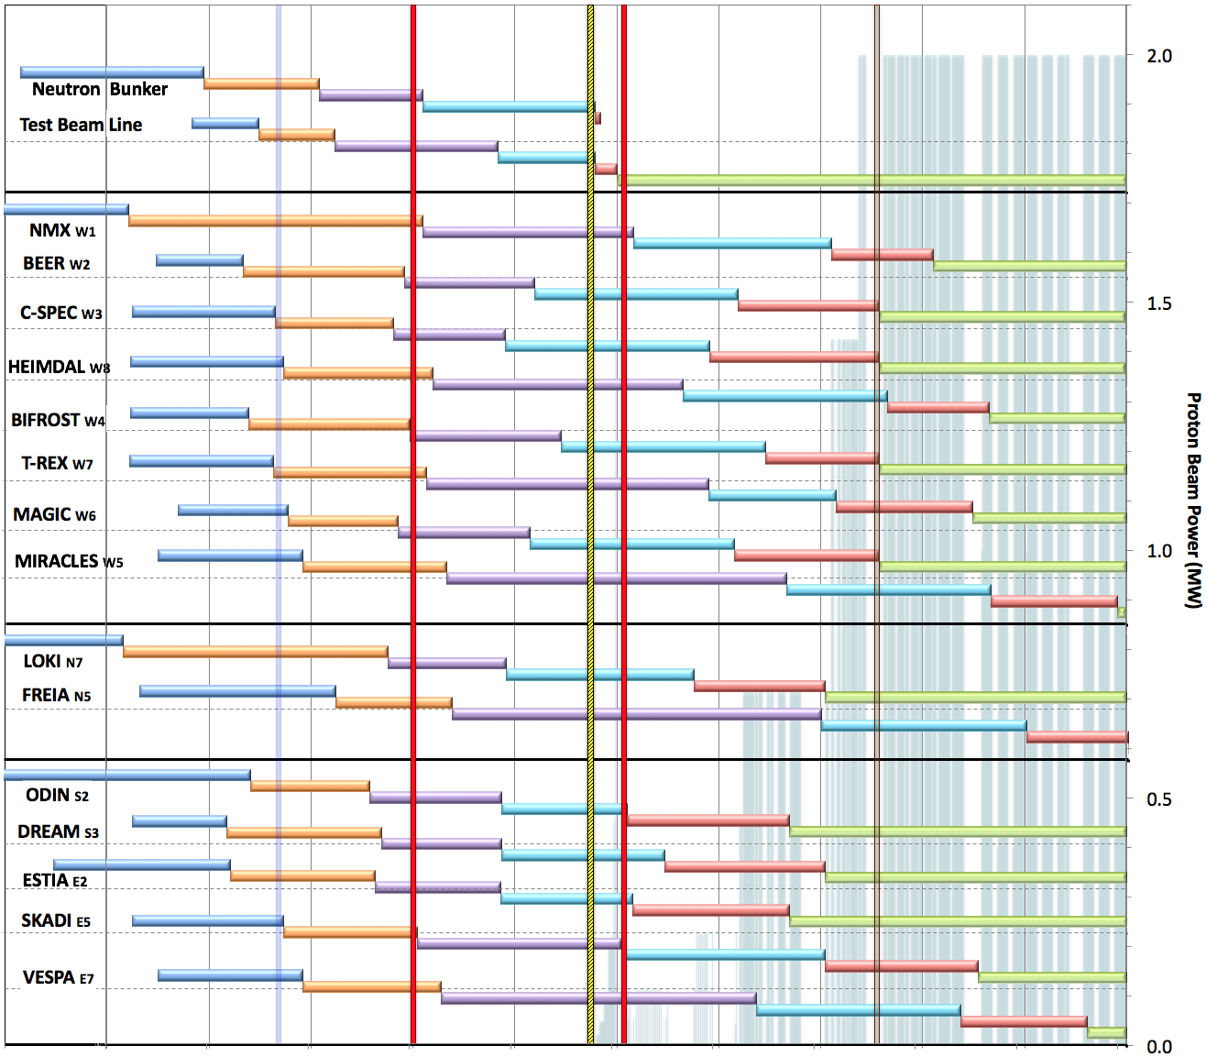

Internal* Neutron Beam Instrument Schedule
Draft for Discussion V3.4, 15th September 2017
Current date
First access to NSS areas
Hot Commission
instruments
Start User Program
* still under discussion with ESS-ERIC Council
Beam on Target
2.0
NOTES:
Assumes 2MW maximum power until end 2025
Phases aligned with TG2 reviews on 1st 10 NBIs
Installation & Integration (TG4) + Hot Commissioning (TG5) for first 8 NBIs aligned with draft BOI plan (schedule match typically within 1 month)
1.5
West sector
North sector
East and South sectors
0.5
Preliminary Design
Detailed Design
Manufacturing & Procurement
Installation & Integration
Hot Commissioning/Early science
Operation
2016 2017 2018 2019 2020 2021 2022 2023 2024 2025
0.0

Slide 12
Internal* Neutron Beam Instrument Schedule
Draft for Discussion V3.4, 15th September 2017
Current date
First access to NSS areas
Hot Commission
instruments
Start User Program
* still under discussion with ESS-ERIC Council
Beam on Target
2.0
NOTES:
Assumes 2MW maximum power until end 2025
Phases aligned with TG2 reviews on 1st 10 NBIs
Installation & Integration (TG4) + Hot Commissioning (TG5) for first 8 NBIs aligned with draft BOI plan (schedule match typically within 1 month)
1.5
West sector
Initially focus on reliable user operation at 2 MW
Ramp up to 5 MW later
North sector
East and South sectors
0.5
Preliminary Design
Detailed Design
Manufacturing & Procurement
Installation & Integration
Hot Commissioning/Early science
Operation
2016 2017 2018 2019 2020 2021 2022 2023 2024 2025
0.0

Slide 13
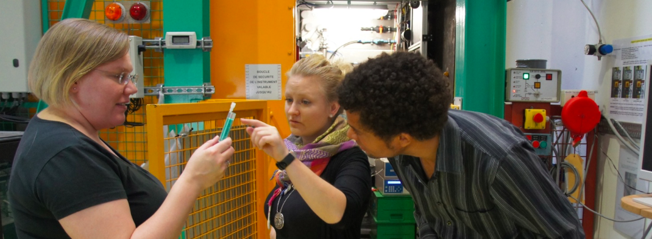
ESS will be a user facility
For researchers who need neutron beams for their experiments.
From universities, institutes, industry.
We provide tools & support; they bring their projects and perform the experiments. Selection of experiments via proposal scheme by scientific excellence
2000-3000 visiting users/year. A stay can be days or weeks.
Many different disciplines: materials research, physics, chemistry, life science…
Notes:
In this end of the facility the scientists sit by their instrument.

Slide 14

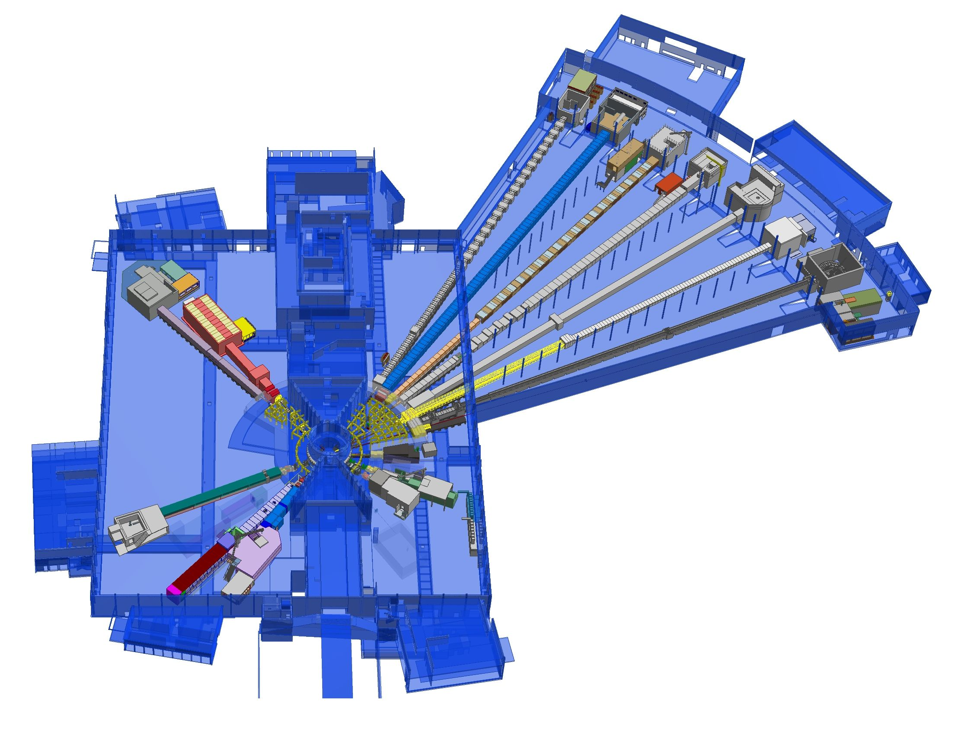











ESS Neutron Instruments 1-15 + test beamline
+
Nuclear Physics Institute
ESS Lead Partners for instrument construction
NMX
+
BEER
C-SPEC
BIFROST
MIRACLES
MAGIC
ODIN
T-REX
DREAM
HEIMDAL
D07
Test Beam Line
VESPA
LoKI
FREIA
ESS In-Kind Partners also collaborate on sample environment, data management systems etc.
SKADI
ESTIA
+
100 m
150 m
ESS Instrument Layout (September 2017)

Slide 15
ESS Neutron Instruments 1-15 and Support Infrastructure
Hall 1
D07 1 × Life Science,
1 × Cold room
D08 1 × Chemistry,
1 x Radioactive Mat. L.
E03
NMX
D08
BEER
C-SPEC
BIFROST
E04
MIRACLES
MAGIC
ODIN
T-REX
DREAM
HEIMDAL
D07 deferred
to early Initial
Operations
Hall3
E03 1 × Engineering
E04 1 × Life Science,
1 × Cold room
1 × Instrument room
1 × Chemistry,
1 × Characterization
Test Beam Line
VESPA
Hall 2
D04 1 × Life Science,
1 × Cold room
2 × Instrument room
D07
LoKI
FREIA
SKADI
ESTIA
D04
100 m
150 m
ESS Instrument Layout (September 2017)

Slide 16
Tentative Instrument Ramp-up
Version 17/11/2017, based on Instrument Construction Working Schedule V3.4
Instrument | 2014 | 2015 | 2016 | 2017 | 2018 | 2019 | 2020 | 2021 | 2022 | 2023 | 2024 | 2025 | 2026 | 2027 | 2028 | 2029 | 2030
LOKI
ODIN
NMX
ESTIA
CSPEC
DREAM
SKADI
BEER
BIFROST
MAGIC
T-REX
HEIMDAL
MIRACLES
VESPA
FREIA
Instrument 16
Instrument 17
Instrument 18
Instrument 19
Instrument 20
Instrument 21
Instrument 22
5MW
8 instruments in user programme
4MW
3MW
2MW
1MW
Construction Project
Hot Commissioning
50 75 100%
User Programme

Slide 17
Summary
The ESS construction project is moving forward fast
User operation with the first instruments is planned for 2023
ESS instruments will provide gain factors of one to two orders of magnitude
ESS will provide qualitatively new opportunities for science with neutrons

