Slide 1







ESS – J-PARC Workshop
Lund, 18, 19 January 2018
Current Status of J-PARC MLF
Toshiji Kanaya
J-PARC, MLF KEK

Slide 2

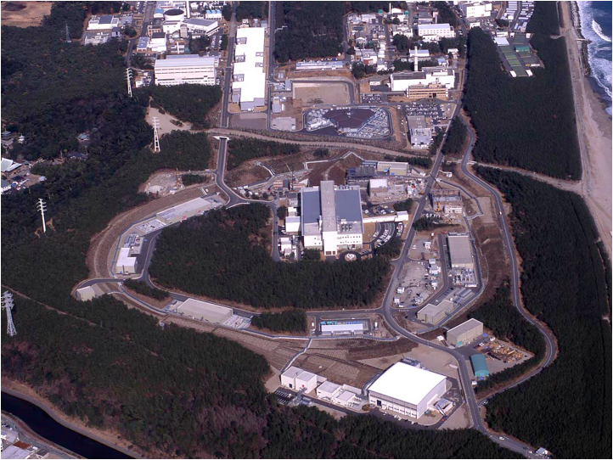





LINAC
400 MeV
Rapid Cycle Synchrotron
3 GeV, 25 Hz
Neutrio Experimental Facility
Material & Life Science Experimental Facility (MLF)
Main Ring
50 GeV
Hadron Experimental Facilty
Notes:
まず、こちらが、J-PARCの加速器複合施設です。陽子ビームを１８１MeVまで加速する（来年度以降４００ MeVになる）線形加速器ライナックがあり、その後、ビームは、40 msという短い時間の間に3 GeVまで加速されます。そのビームのほとんどは、この物質生命科学実験施設で中性子やミュオンを使った実験の為に使われています。

Slide 3
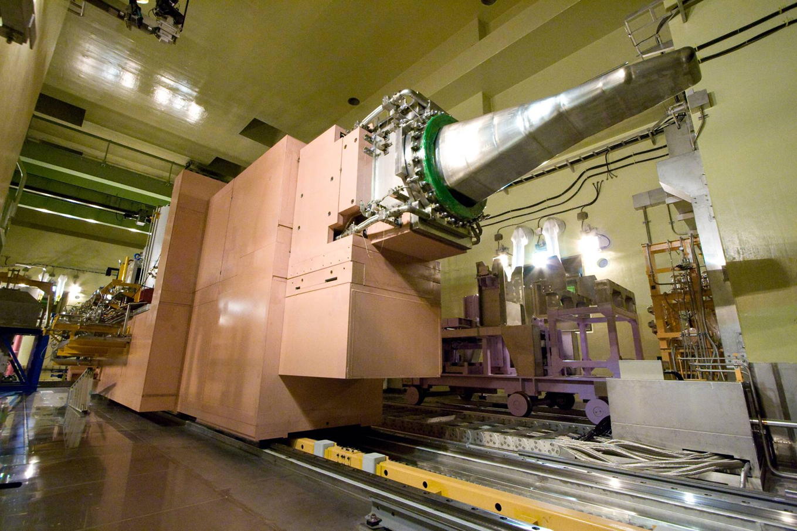
Proton
W
W/O
W
W/O
High power operation (1MW)
Stable operation
Higher freq. components, related with cavitation phenomena, were sufficiently mitigated.
Notes:
This is result.
The beam power is 300 kW.
Due to the bubble injection, the velocity of vessel wall dramatically reduced and the high frequency components also almost disappeared. The high frequency components are considered to be induced by the cavitation bubble collapsing.
So that, this means the cavitation inception is mitigated.

Slide 4
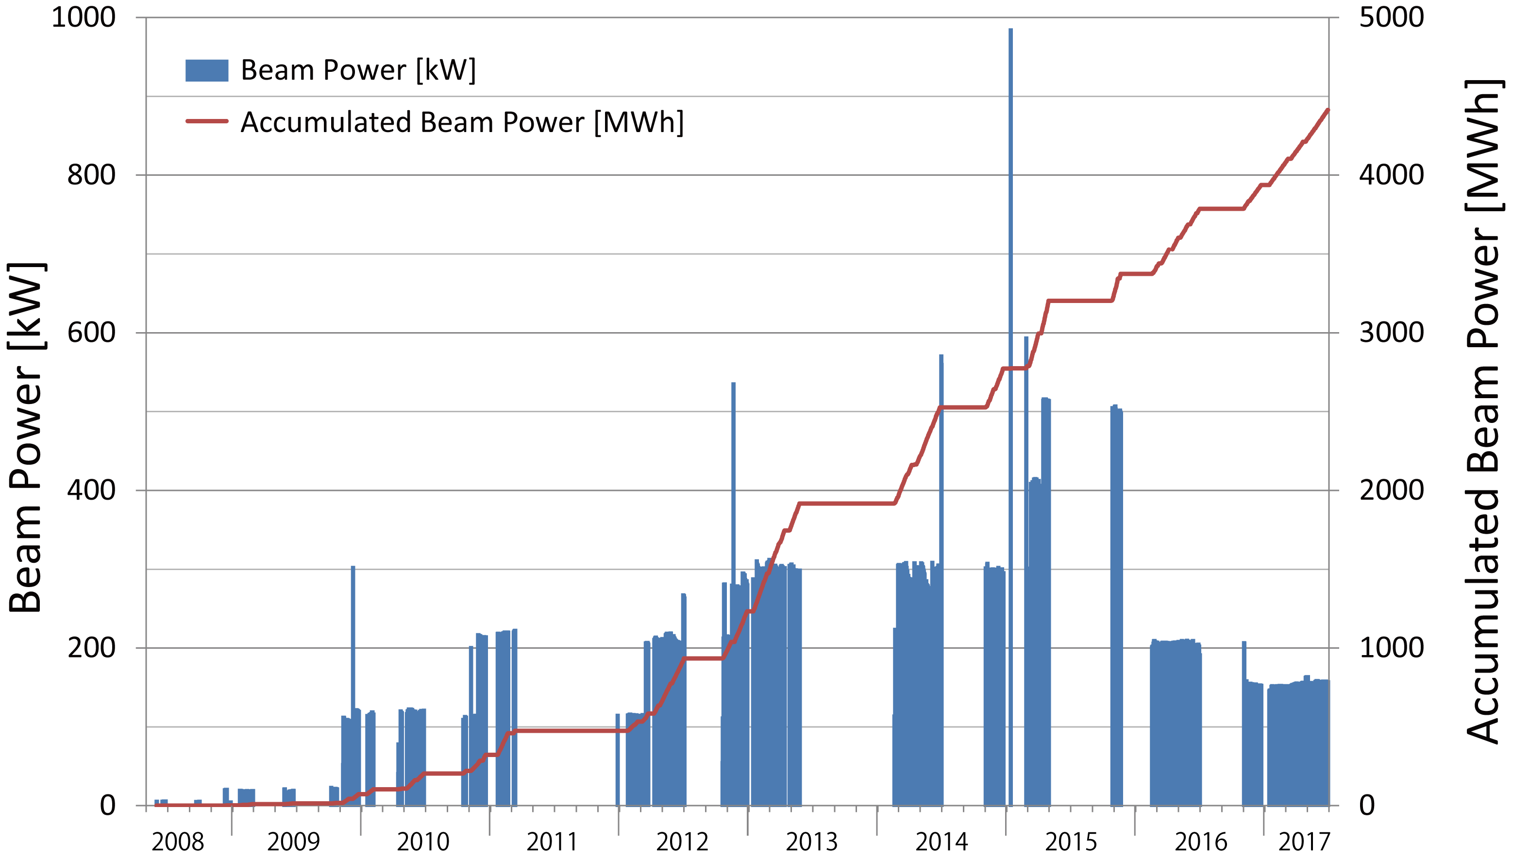
Beam Power History at MLF
(before the summer shutdown in 2017)
1 MW eq. pulse
500 kW
Accident at
Hadron Facility
300 kW
Earthquake
Operation of target #2
Just before the summer shutdown
～10 months interruption
due to the earthquake
～1 month interruption
due to the fire in MLF
Interruption due to troubles of Hg-target
(cooling water leakage)
as of June 28, 2017

Slide 5
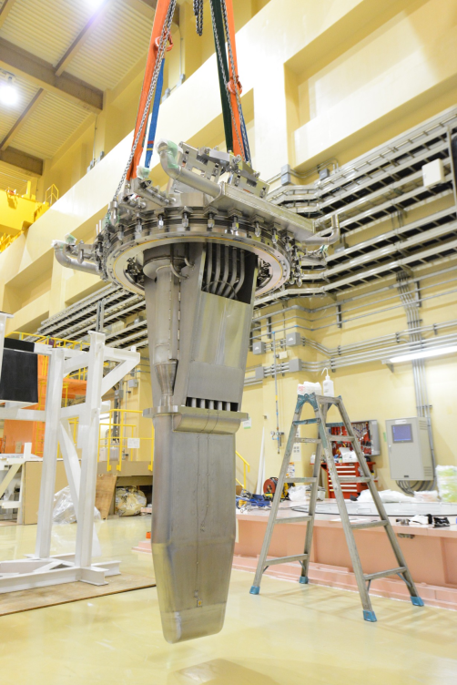
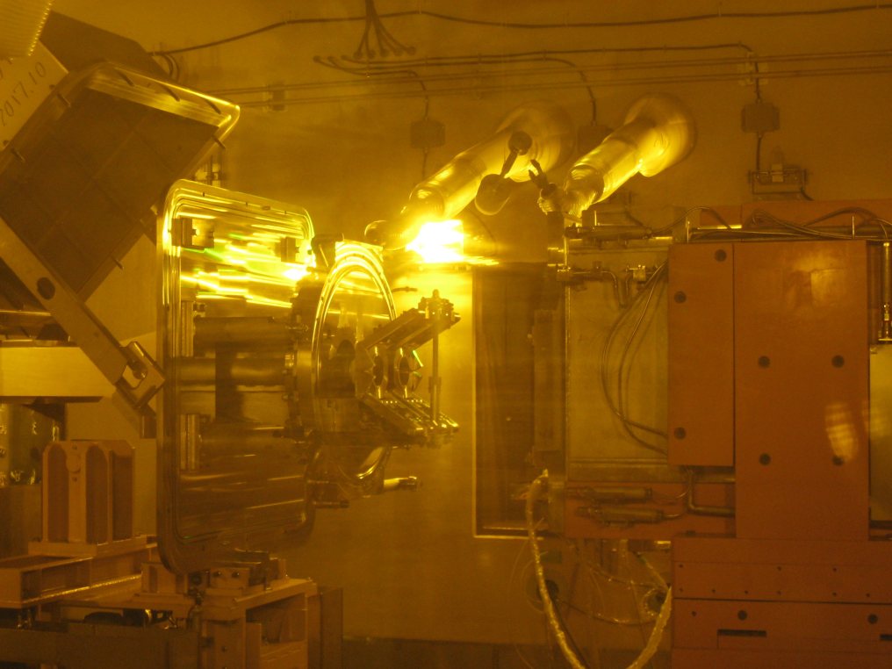
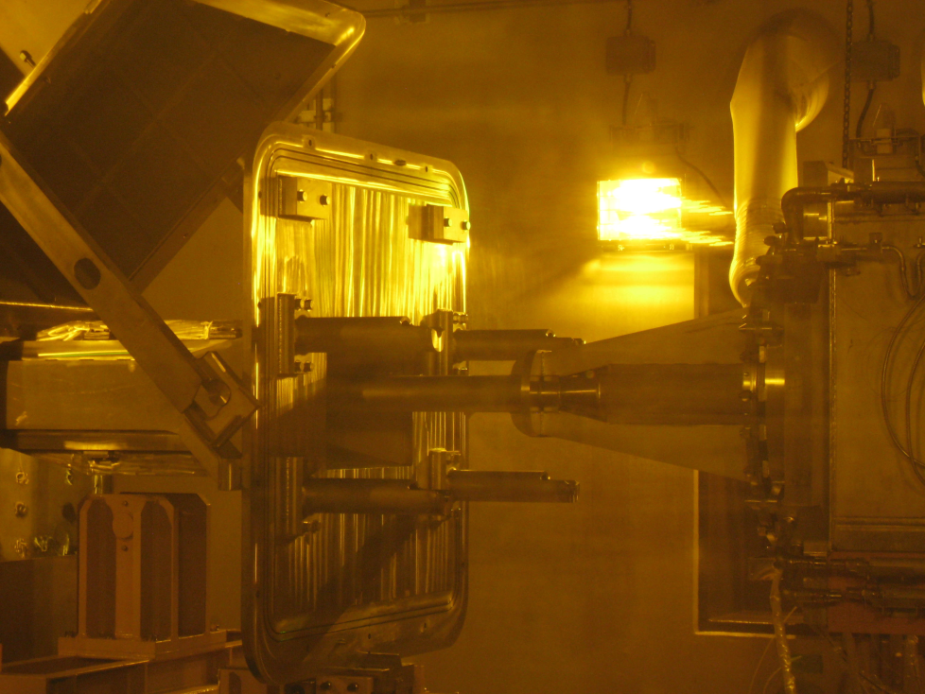
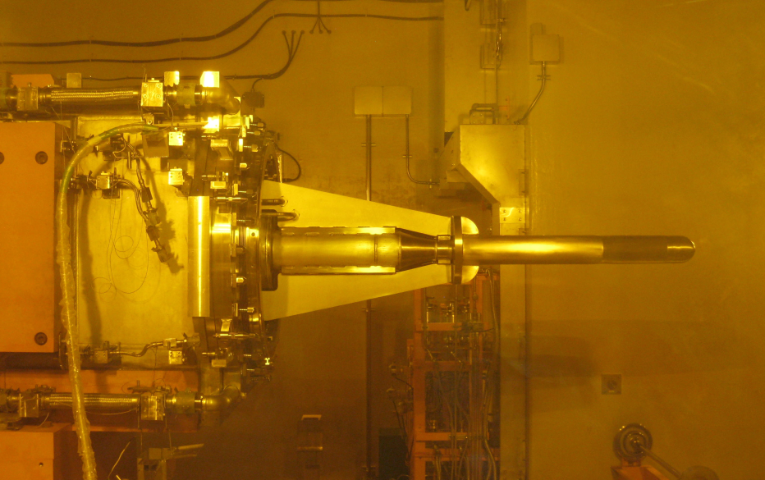
Replacement of target (#2) to new one (#8)
10/2：exchange work in hot cell
Storage container
Target trolley
Target #8
Storage container
New target (#8) in hot cell
9/22：transfer of new target (#8) to MLF

Slide 6
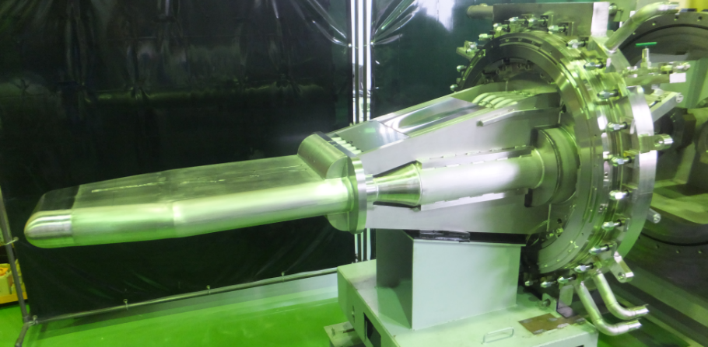
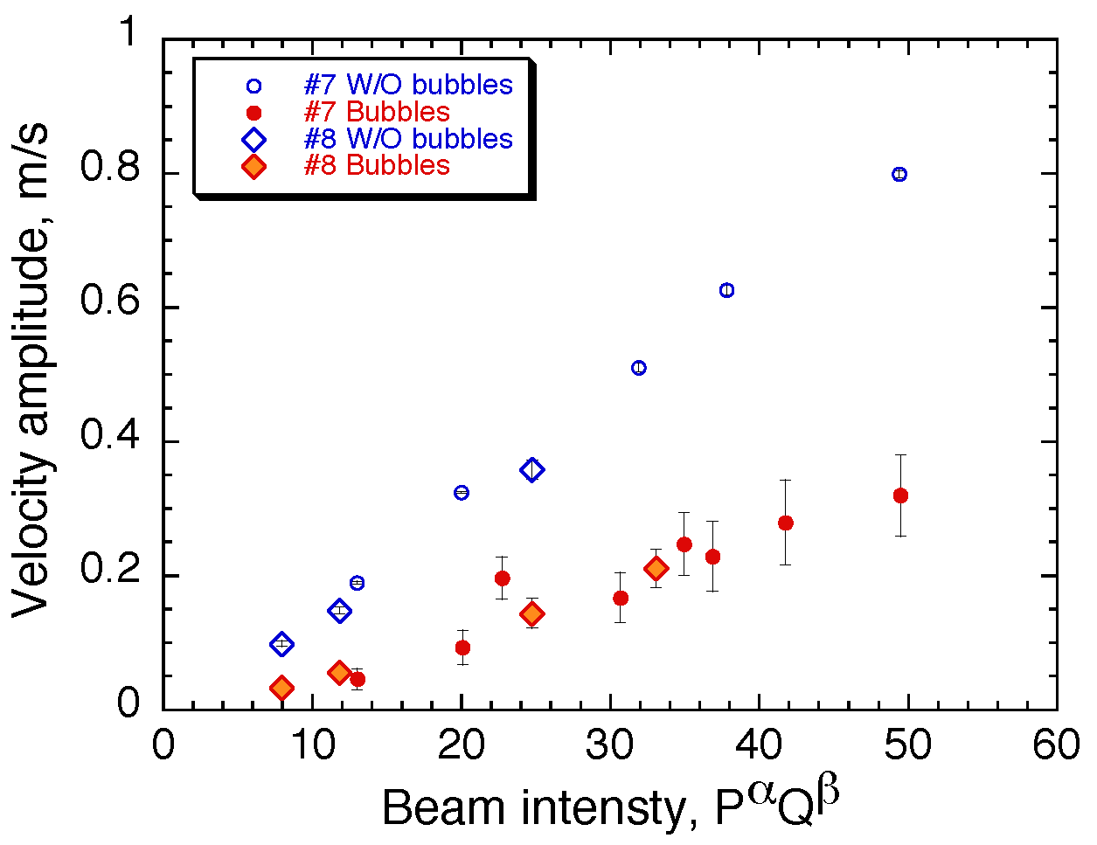
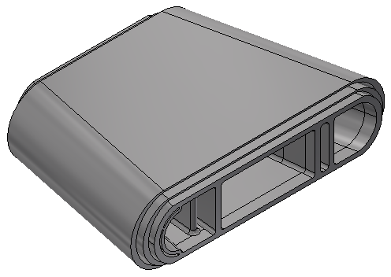
Characteristic Features in New Target (#8)
Region A
Region B
Robust structure
Mitigation of pitting damage
Target #8
Hg
Proton
Double walled
Swirl bubbler
Region A
Region B
Region A
Bolts
Region B
Mercury vessel
We employed
the double wall structure to make fast mercury flow in narrow channel
He gas bubbling system
  → effect was confirmed using laser doppler system
Monolithic structure（Region A &B)
cut out from stainless steel block
Reduction of welding parts

Slide 7
Operation history of target (#8)at MLF
Operation of new target (#8) started from Oct. 24th at a power of 300 kW
Scheduled operation of 120.5 days ended in Dec. 22, 2017 with a high efficiency of 92%.
Beam delivery resumed from Jan. 10th at 400 kW.
Daily operation
efficiency
Beam Power (kW)
Operation Efficiency (%)
Winter outage
(from Dec. 23 to Jan. 8)
2017
2018
As of January 14, 2018

Slide 8
R&D for further target design upgrade
1st～7th (previous)
8th(current)
10th or later
Failed at 500kW operation
Improved structure
Final goal for high power operation
1050 mm
Monolithic structure of water shroud & Hg vessel
Constraint-free
Hg vessel
Water shroud
Monolithic structure of water shroud
Helium layer
Bolts
Many welds incl. diffusion bonding with constraints between vessels
Much fewer welds with constraints
Few welds with no constraints
8th
  Increasing structural robustness and keeping stable beam operation are the first priority.
Constraint-free type
  Further R&D for the fabrication technique to keep the helium layer of 3 mm gap is needed.

Slide 9
Schedule to 1MW
1000
900
1MW test
800
Operation
#8
400 kW from January
500 kW from April
1MW test at end of June
700
600
MLF beam power、kW
500
400
#10 (gradually increase from 500kW to 1MW)
Depending on the results of PIE on #8, a possibility of 500 kW operation
300
#2 (200kW)
200
#2 (150kW)
100
0
JFY 2016 | JFY 2017 | JFY 2018 | JFY 2019 | JFY 2020
Under development
Jet flow Nozzle
mercury
mercury
mercury
Proton
Beam
Proton
Beam
Proton
Beam
No protection for damage
Double wall
Bubbler
Double wall
Bubbler
Countermeasure for the pitting damage

Slide 10
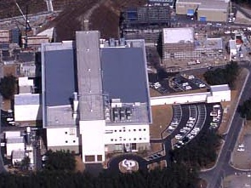
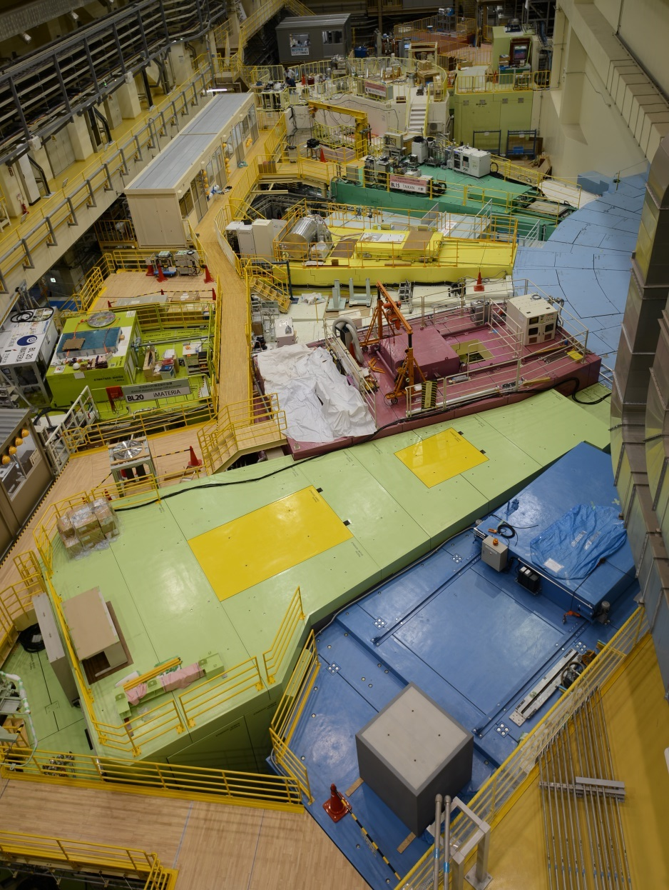
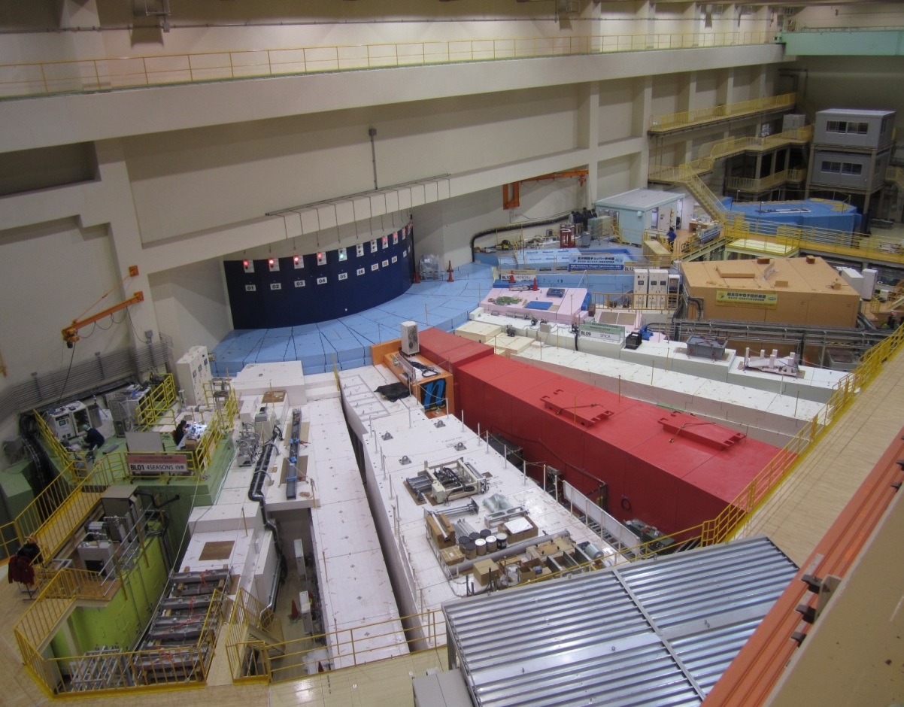

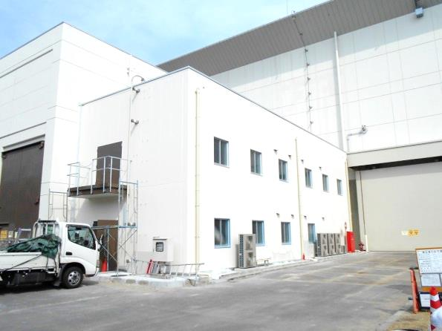
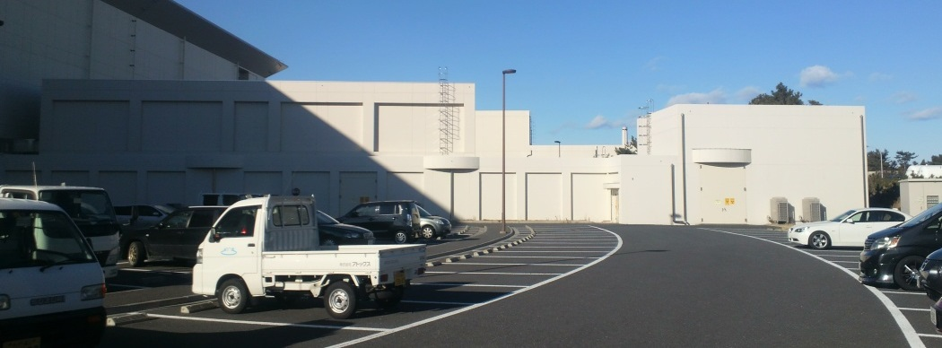
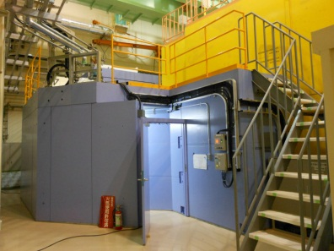
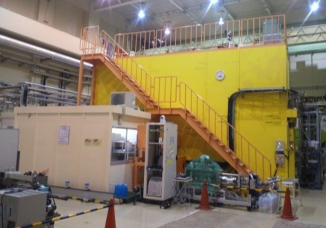
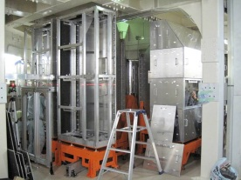
Neutron Instruments at MLF
Experimental
Hall No. 2
AMATERAS
BL14
↓
TAIKAN
BL15
Experimental Hall No. 1
SOFIA
BL16
SHARAKU
BL17
HRC
BL12
iMATERIA
BL20
4SEASONS
BL01
↓
NOBORU
BL10
PLANET
BL11
NOVA
BL21
NOP
BL05
RADEN
BL22
VIN ROSE
BL06
ANNRI
BL04
POLANO
BL23
DNA
BL02
↓
iBIX
BL03
SPICA
BL09
S-HRPD
BL08
SENJU
BL18
TAKUMI
BL19

Slide 11
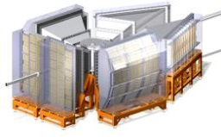
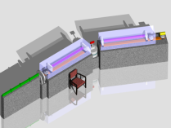
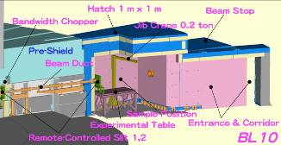
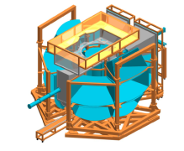
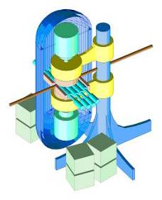
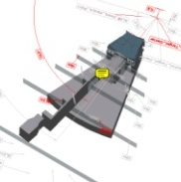

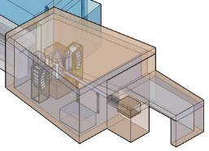
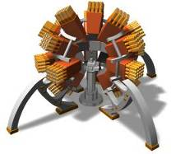
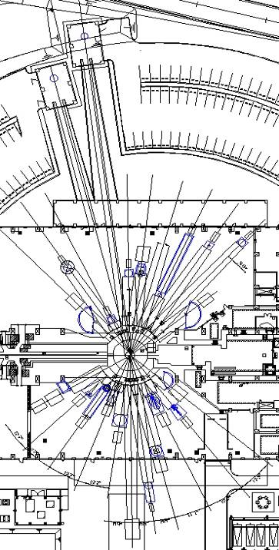
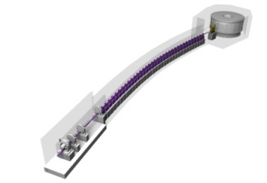
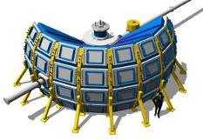
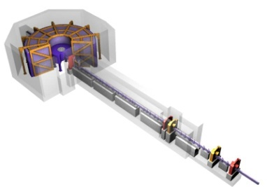
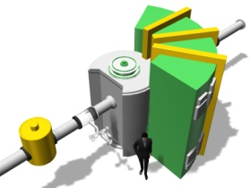
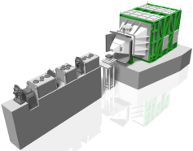
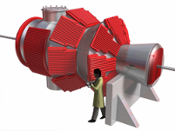
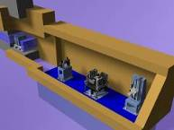
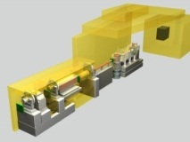
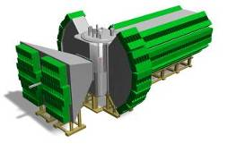
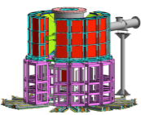
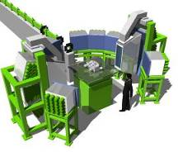
Neutron Instruments at MLF
Funded
Operation
Operation
Operation
Operation
Operation
NOBORU (JAEA)
ANNRI
(Tokyo Tech. U., JAEA,,
Hokkaido U.)
23 Neutron Beam Ports
Operation: 20
Commissioning: 1
Yearly Operation Days
・~180
Yearly Guest Number
・800~900
Funded
SHRPD(KEK)
VIN_ROSE
(KEK, Kyoto Univ.)
Operation
SPICA
(NEDO, KEK)
Operation
Operation
NOP(KEK)
iBIX
(Ibraki Pref.)
PLANET (JAEA, U. of Tokyo)
HRC (KEK)
Operation
Operation
Funded
DNA (JAEA)
Operation
Operation
4SEASONS
(JAEA)
Funded
AMATERAS
(JAEA)
commissioning
POLANO
(Tohoku Univ,, KEK)
Operation
Funded
RADEN
(JAEA)
Operation
Funded
TAIKAN
(JAEA)
Operation
NOVA
(NEDO, KEK)
Operation
Operation
Operation
Operation
Operation
SOFIA (KEK)
SHARAKU
(JAEA)
iMATERIA
(Ibraki Pref..)
SENJU (JAEA)
TAKUMI (JAEA)
Notes:
この核破砕中性子源を利用するMLFには，23の中性子を取り出すビームポートがあり，それらに，基礎物理から化学，生命科学，材料，機械工業まで多岐にわたる実験課題を遂行するための様々な実験装置が設置される予定です．最終的には，年間約1万人日が利用し，年間でおよそ2000件程度の実験課題を実行していくことになると予想されています．
現在は，そのうち14台の実験装置の設置計画が進行しており，KEK4台，茨城県が2台，その他大学等のグループから4台，そして，原研では，残留応力解析用パルス中性子回折装置，生物用非弾性散乱装置DIANA，大強度型小角散乱装置，汎用粉末回折計，生物用単結晶回折計，そして，冷中性子ダブルチョッパー型分光器の6台の設置計画を進めております．
本日は，この私が担当しております冷中性子ダブルチョッパー型分光器についてお話しさせていただきます．

Slide 12


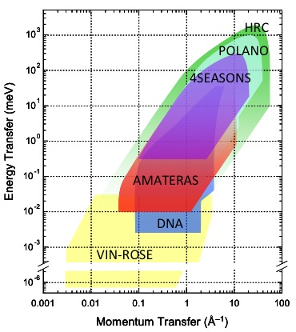
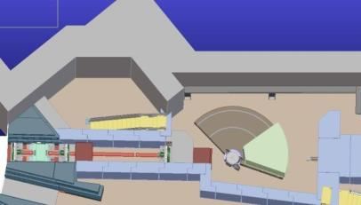
Spectroscopy Group
6 Inelastic Scattering Instruments covering a wide energy and momentum transfer range
R. Kajimoto, T. Yokoo
BL12 (HRC) (KEK)
Spin Echo
BL06(VIN_ROSE)
(KEK, Kyoto Univ.)
BL02 (DNA)
(JAEA)
BL14 (AMATERAS)
(JAEA)
BL23 (POLANO)
(Tohoku Univ., KEK)
Figure 2 Covered E-Q space of inelastic neutron scattering instruments in MLF.
BL01(4SEASONS)
(JAEA)
Notes:
We also have some inelastic scattering machines with various energy resolutions.
DNA on BL02 is a backscatterig machine with energy resolution of ~3ueV, AMATERAS on BL14 is a low energy inelastic machines below about 100 meV. 4SEASON can cover several to several hundred meV region.
Spin-Echo machine is under construction, which will cover neV region.
Using these inelastic scattering machines, we can cover a very wide energy region from ueV to 1000 meV

Slide 13
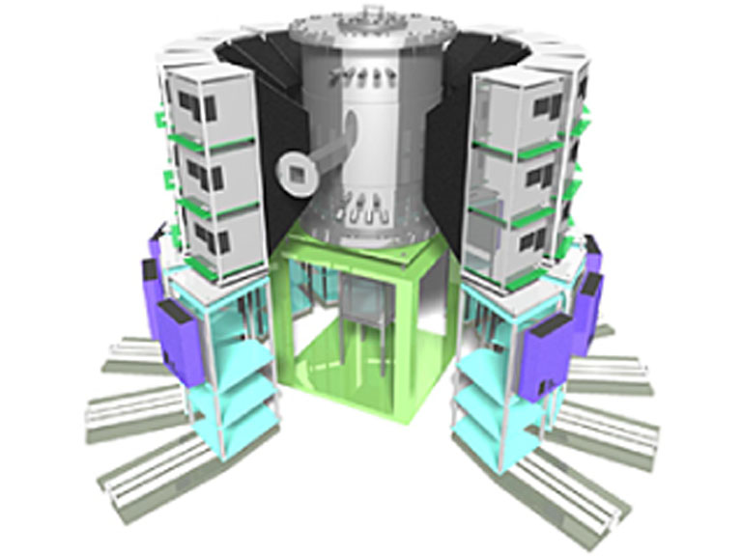
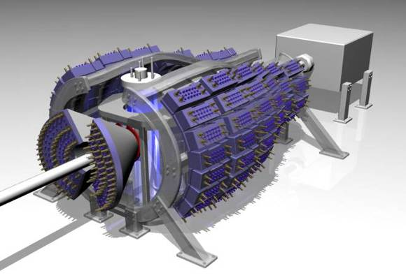
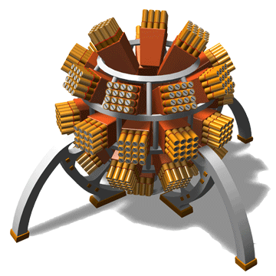
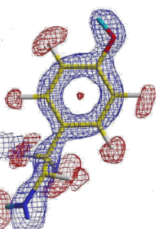
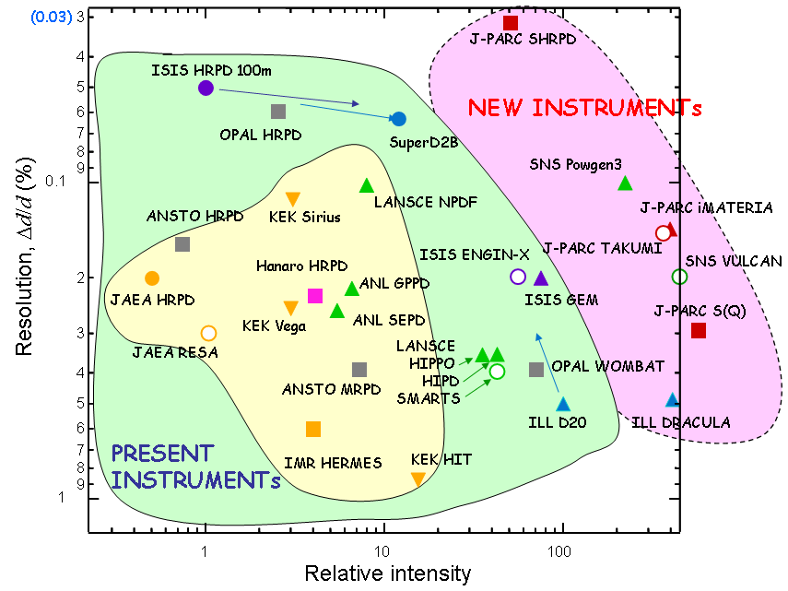
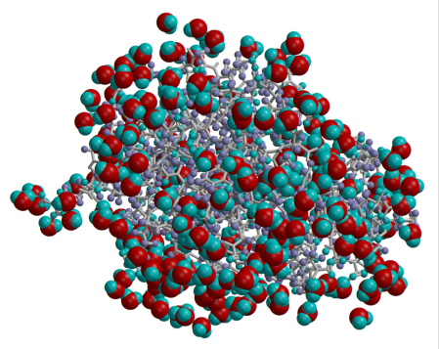
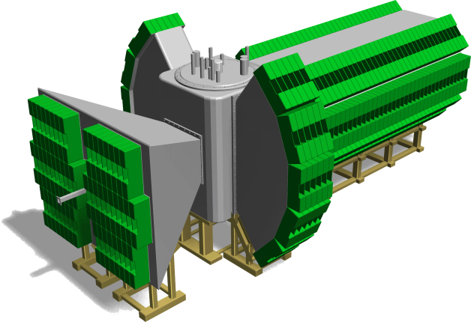
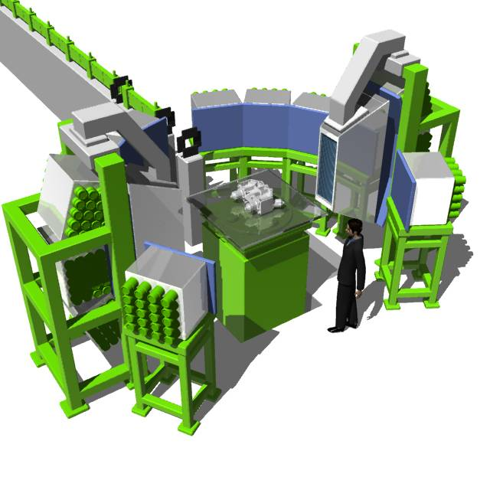
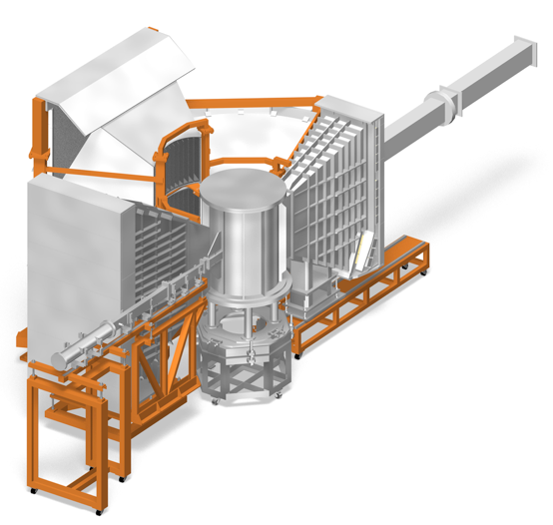
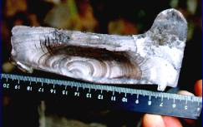



Crystal Structure Group
7 Diffraction Instruments at MLF
BL18, SENJU
Single Crystal Neutron Diffractometer
Ibaraki Biomaterial Single-Xtal Diff.
SHRPD
S. Harjo, M. Yonemura
Diffractometer in the World
TAKUMI: Engineering Materials Diff.
・50 x BIX-3@JRR-3
・d_{max} ~ 135 Å
SPICA
(BL09, KEK)
Ibaraki Powder Diff.
Versatile Total Scattering Diff.
・lowest gauge：1 mm³
・2×2×2mm³, 30mm path in Fe：～3 min
・stress resolution：～±15MPa（Steel）
Special sample environment
Notes:
Bases on the time-of-flight technique, we have developed many neutron scattering machines. They can be classified into several groups.
One is a group of diffraction machines with various resolution and intensity.
Super HRD has a very high resolution of 0.03%, which is the highest in the world.
On the other hand, NOVA has a very high intensity, but the resolution is not so good..
IBARKI power diffraction machine is in between
iBIX is dedicated to the biomaterial single crystal diffraction.
And TAKUMI is engineering materials diffraction machine,

Slide 14






Nano Structure Group
1 SANS Machine, 2 Refrectmeters and 1 total scattering
Diffractometer for Nano structure and surface/interface structure
K. Suzuya, N. Yamada
BL15 TAIKAN
(SANS)
Glassy Carbon
BL21 Versatile Total Scattering Diff. （NOVA)
Absolute intensity data of Glassy Carbon calibrated by Dr. Ilavsky (APS)
small - angle bank
(Semi Macro strct)
Middle
(intermid strct)
backward
High (atomic strct)
BL16 SOFIA
(horizontal NR)
BL17
(Vertical NR)
Polarized Neutron
Notes:
We also have SANS machine and reflectometers to investigate nanostructure and the surface/interface structure.
TAIKAN on BL15 is SANS machine and can cover a very wide Q range in one measurement. This is a great advantage of pulse neutron.
Refelectometer is also suitable machine to pulse neutron. Using our neutron reflectometer, we can cover a very wide dynamic range over 7 decades.

Slide 15






Pulsed Neutron Application Group
K. Oikawa, T. Ino
Neutron Source Diagnostic & Test Port
BL10: NOBORU
Neutron-Nucleus Reaction Meas. Inst.
BL04: ANNRI
Fundamental Physics
BL05: NOP
Neutron Imaging
BL22: RADEN

Slide 16

Benchmarking against world’s neutron facilities
Number of General Proposals
General Proposals to MLF
Total Applied Proposals(2018A) MLF: 287 SNS: 480 HFIR: 251 (2014B)
Number of General Proposals
SNS
Target Problem
Hadron Incident
287 proposals@2018A
HFIR
Earthquake and Restoration Work
Successful ratio: ～50% in every facilities

Slide 17
Classification of Approved Proposals in 2008-2016A
Number of approved proposals:1,596(Except IMT&Pj use)
KEK：２.４％
JAEA
１２.０％
Industry
29.4%
Overseas
9.6%
Institute
8.0%
University
38.6%
Industrial use is much as about 30% in J-PARC/MLF
17

Slide 18


Activities in MLF (1)
The 9th AONSA Neutron School and The 2nd Neutron and Muon School will be Jointly organized in Japan.
time: November 16 -20, 2017
Place: J-PARC MLF
Principal: professor Y. Kiyanagi (president of JSNS)
Number of participants: 49 from 13 countries
    Japan(9), Korea(10), India(5), Australia(5), Thailand(5), China(4), Indonesia(4), Malaysia(2), Nepal(1), New Zealand(1), Russia(1), Taiwan(1), Vietnam(1)

Slide 19




Improving MLF to produce high quality scientific outcomes
12 press release in 2016
12 press release in 2017
Publications
論文数の推移

Slide 20








Science and Technology in MLF
Characteristic features of neutron and muon
Magnetism and strongly correlated materials(Spin ,S=1/2)
Electric properties research Gr. (K. Nakajima)
    Quantum properties research Gr. (S. Ito)
Liquid and Soft Matter (distinguish H&D)
    Polymer research Gr. (T. Kanaya)
    Soft material research Gr. (H. Seto)
    Liquid and Amorphous Materials Research Gr. (Y. Kawakita)
Energy Material (sensitive to light elements)
    Hydrogen absorbing material research Gr. (T. Otomo)
    Structure science (battery) Gr. (T. Kamiyama)
Engineering Material (deep penetration into metals)
    Residual stress research Gr. (K. Aizawa)
    Structure sensitive material research Gr. (J. Suzuki)
Muon Science
    Muon property research Gr. (R. Kadono)
    Muon science research Gr. (Y. Miyake)
Neutron Optics
KENS-DAQ
Life Science
High pressure science
Industrial Application
Notes:
If I have time to spare at the end of my presentation, I will show you the activities of science areas based on the science groups.

Slide 21




Energy Materials
Research & Development Initiative of New Generation Batteries
NEDO RISING Project organized by Professor Ogumi
Aiming at understanding fundamental of chemical process in battery reaction and producing new generation batteries.
(Researches are done not only in MLF, but also in other facilities)
Professor Matsubara
SPICA (BL09) is a dedicated machine to the project
mobile
PC
camcorder
Sensors, Tags
Electric tools
electric vehicle
Data backup in time of disaster
Energy storage
scooter
robot
Sustainable society
Infrastructure for safety life
Notes:
I also want to mention about a big project on battery. It is organized by Professor Ogumi.
In the project, The are aiming at understanding fundamental of chemical process in battery reaction and producing new generation batteries.
For this project MLF has constructed SPICA on BL08, and many excellent results were obtained.

Slide 22



Real-time observations of lithium battery reactions
SPICA (BL09) is a dedicated machine to the NEDO project for battery research
SPICA (BL09)
Real-time observations of lithium battery reactions—operando neutron diffraction analysis during practical operation (BL09)
Scientific Reports 6, Article number: 28843 (2016)
Special sample environment
In operando
measurement
wide
coexistent
area
Notes:
They performed in operand studies on lithium ion batteries using SPICA during the discharging process.
They observed obvious difference in structure changes of anodes between 22 hrs and 2.2 hrs of discharge rates.
From this experiment we can understand the fundamental chemical process in battery reaction.

Slide 23







Photo-Voltaic (PV) Cell
Photon → Electricity
In 1839, experimenting with metal electrodes and electrolyte, French physicist Alexandre Edmond Becquerel observed light-electricity conversion.
Solar cell
Silicon
III-V semiconductors
Gallium Arsenide
Rapid grow-up
Organic system
Established technology
organic-inorganic hybrid perovskite semiconductors
as candidate of next generation
Dye-sensitized PV
Solar flux
(photons per unit area per unit time)
Current theoretical limit
Solar spectrum
Notes:
Last topic is Photo-Voltaic cell which is device for energy convergence from solar light to electricity. As you know silicon is everywhere most popular in our life. Gallium Arsenide has highest energy convergence rate. However in these several years, organic-inorganic hybrid perovskite materials are rapidly focused as candidate of next generation of PV.

Slide 24




Organic-inorganic hybrid provskite semiconductor
perspective to next generation solar cell
Three factors determining the solar cell efficiency
electron system
atomic system
Atomic dynamics
Materials | Carrier Mobility | Carrier Lifetimes | Thermal conductivity
Ideal PV’s | Large | Long | Low
CH₃NH₃PbI₃ | Small | Very long | Low
Silicon | Large | Medium | High
> 20%
???
inelastic neutron scattering
at AMATERAS, J-PARC
Bing Li et al., Nat. Commun. 8, 16086 (2017)
CH₃NH₃PbI₃
negative electrode(Au)
heat dissipation
TO: tranverse
optical phonon
4-fold rotation
photon
diffusion
5K
hole
TO mode of
inorganic
framework
vanishes!
ele. dipole
electron
3-fold rotation
(carrier)
organic molecule
（CH₃NH₃）
positive electrode
(FTO transparent film)
185K
inorganic frame
（PbI₃）
Peculiar rotation of organic molecules
causes vanishment of vibration of inorganic framework,
Very low heat dissipation!!
Notes:
Typical material is methyl-ammonium-lead-iodide. Lead-triiodide forms inorganic framework and metyl-ammonium ion locates in B site of this perovskite. Characteristic properties are very long lifetime of carrier and low thermal conductivity. Mobility is small compared with silicon. As you know, perovskite is structure easily replacing ions and molecules in this case. If we obtain an ideal valance among these three factors by replacing elements and molecules, we can probably achieve much higher convergence rate. So we have to know how electronic and atomic systems collaborate.
Even at relatively low temperature, C3 rotational motions of methyl part and ammonia part individually are activated. and at high temperature phase from 165K, C4 rotation mode by which the entire molecule is rotated is activated. C-N bonding has electrical dipole, therefore C4 motion make dipole rotation. We found that optical phonon of inorganic framework vanishes by C4 rotation mode, which causes very low thermal conductivity.

Slide 25

Development of all-solid ceramic buttery based on new super ionic conductor
New Generation Material Family
Tokyo Inst. Tech, KEK, TOYOTA, Ibaraki Pref.
Neutron diffraction have revealed the diffusion path of ions, which is a key for development of new buttery materials.
（数分で充電）
Single crystal β-alumina
(NaAl11O17)
Li_{9.54}Si_{1.74}P_{1.44}S_{11.7}Cl_{0.3}
β-alumina
(NaAl11O17)
LGPS-family
Organic solvent electrolyte
Super Ionic Conductor discovered in 2016
Super Ionic Conductor discovered in 2011
Li_{9.6}P₃S₁₂
3D diffusion path
Second Generation Material Family
1D diffusion path
Li7La3Zr2O12
Log [Ion conductivity (S/cm)]
First Generation Material Family
Li₂MCl₄
Polymer Conductor
LI3.3PO3.9N0.17
2020
Li₁₀GeP₂S₁₂
Nature Materials (2011)
450citations for 4 years
Li_{9.54}Si_{1.74}P_{1.44}S_{11.7}Cl_{0.3}
Nature Energy (2016)
Newspaper (Tokyo Newspaper (7/25), Chunichi News Paper (7/28))
TOYOTA will load all-solid buttery into Electric Vehicle in 2022
Notes:
今回開発した全固体セラミックス電池は、電解液を用いるリチウムイオン電池よりはるかに高出力であることを実証した。これは、蓄電池の「大容量の電気をためる」性質と、キャパシタの「大電流を流せる」という異なる特徴を兼ね備えているため、画期的な電池といえる。

Slide 26



High Pressure Science
Light Element in the Earth’s Core
Earth’s Core
・Main constituent :Fe-Ni Alloy
・Density of the outer core is smaller than that of Fe-Ni alloy
→Suggesting the existence of Light Elements, such as H, C, S, Si, O,....
What amount of hydrogen is involved?
How hydrogen is involved in the iron?
Notes:
Here shows the cutaway view of the Earth. The Earth has the layered structure, consisting of crust, mantle, core from the top to bottom. From the density of each layer which is precisely determined from the velocity of the seismic wave, we can estimate the constituent of each layers. The core is known to be composed of Fe-Ni alloy, but the density is 10 % smaller than the alloy. This indicates that lighter elements such as hydrogen, carbon, sulfur, silicon and oxygen, is included in the core. Most promising candidate is hydrogen because H is the abundant element of the Earth. Therefore, it is important to know what amount of hydrogen is included and how the hydrogen is included in the iron.

Slide 27


High-pressure Neutron Diffractometer PLANET (BL11)
Hydrogen in Fe lattice under high pressure and high temperature condition
Hydrogen in iron is directly related to hydrogen embrittlement of iron and the possible origin of the deficit in density of the Earth’s Core.
PLANET measured neutron diffraction from hydrogen (deuterium) in iron at high-PT condition (6.3 GPa and 988 K)
PLANET on BL11
The structure analysis revealed that small amount of deuterium do occupy the tetrahedral site, contrary to conventional model where all the deuterium occupy the octahedral site. More hydrogen in Fe in Earth Core.
Large press “ATSUHIME”
Recently , they measured neutron diffraction from hydrogen (deuterium) in iron as a function of P and T to reveal the early stage of Earth’s evolution.
Nature Comm., 5, 5065 (2014).
Nature Comm., 8, (2017)

Slide 28
Summary
J-PARC MLF is moving from the construction phase to the Operation phase.
Operation of new target (#8) is very stable at 400 kW.
We will exchange the target to a new one (#10) in the summer shutdown 2018 and achieve 1MW in 2018.
Instruments have the world level performance, and still developing.
Developments of sample environments and new neutron devices are on-going.
Spin-echo machine was open to users @2017B
Polarization Analysis Spectrometer (POLANO) is under beam commissioning
We still continue to improve J-PARC MLF to increase high quality outcomes

