Slide 1
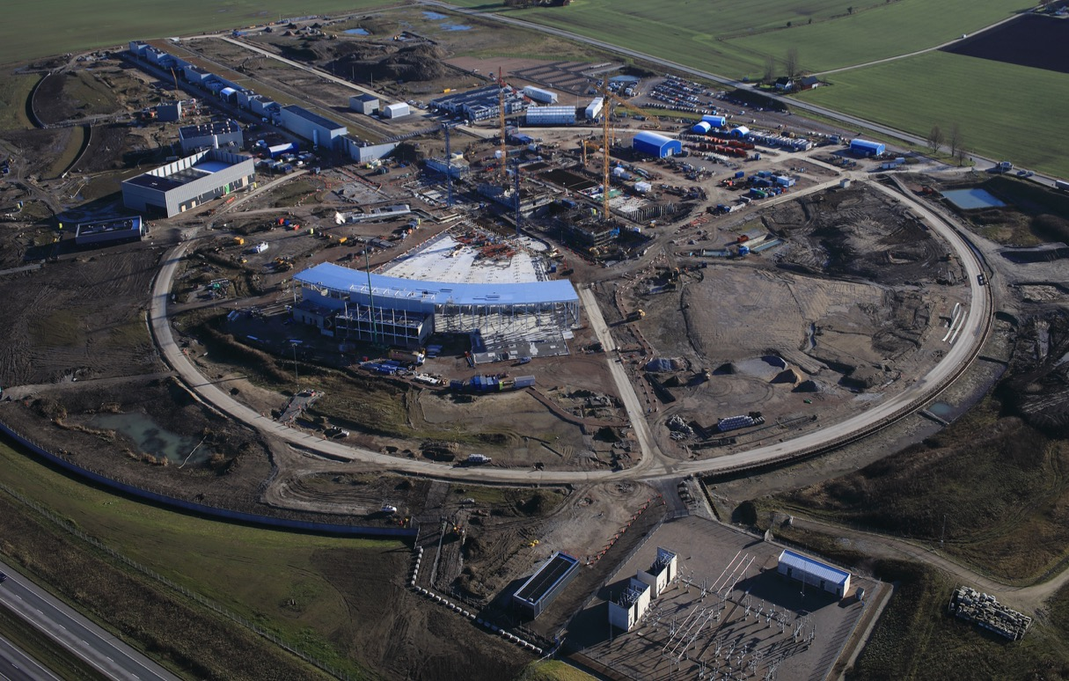
ESH status & topics
Ralf Trant, Associate Director Environment, Safety, Health & Quality
ESS – J-PARC workshop , Lund 18/19 January 2018

Slide 2
ESH&Q functions
ESH&Q is responsible for developing and maintaining the ESH&Q strategy, in particular the regulatory compliance strategy for ESH, developing an ESS safety and quality culture incl. the continuous improvement of related programs and activities, as well as the coordination of licensing activities and contacts with the host state(s) in ESH&Q matters.
ESH&Q develops, supports, monitors and assures the implementation of policies, rules, processes, objectives and best practices at all levels of the organization in matters of ESH&Q.
Environmental protection, Safety & occupational Health (incl. RP)
Quality
Licensing (SSM, Env. Court, Länsstyrelsen Skåne, Fire Brigade, Municipality)
Security, crisis management and emergency response coordination

Slide 3
ESH & Q
ESH & Q
Ralf Trant (Ass. Director)
Nina Åsvatne (Assistant)
Security (Physical & Information; CM & ER)
Ulrika Agnvik N.N.
Licensing
Johan Waldeck
ESH Division
Peter Jacobsson (HoD)
Training: L. Aprin
Environment: E. Lindström
Radiation Safety: T. Hansson, F. Javier
Quality Division
Mattias Skafar (HoD)
Radiation Protection (RP) Group N.N.
Occupation Health & Safety (OHS) Group Helen Boyer
HR: C. Olsson
Planner: C. Matheron
Notes:
Quality Division: 6 staff plus consultancy
ESH division: 16 staff plus consultancy
- RP group: 6 staff plus consultancy
- OHS group: 5 staff plus consultancy

Slide 4
Safety & Quality (ESH&Q)

Slide 5
Licensing – step wise approach
Detailed design
Procurement and Installation
Commissioning
Operation
Preliminary Design
ESS project phases
Permissibility
Permit
Installation
Permit
Trial operation
Permit
Routine operation
Permit
SSM stepwise licensing process

Slide 6
Split permit in parts to optimize overall ESS schedule
Analyse Conditions
Update facility documentation
Update PSAR
Update Self assessment
Perform Safety/Quality review
Submit application
Warm LINAC
Trial operation permit
SC LINAC
Trial operation permit
Neutron production
Trial operation permit
Need ≥3-4 months between permit and next submission

Slide 7
Green-field and stand-alone facility: a great opportunity & a major challenge
ES&H is increasing staff as needed for safe installation/commissioning
Licensing is a major and continuous task - across the organisation
1st version of RP Rules launched [Radiation protection handbook]
Radiation & Environmental Monitoring System : REMS project launched
Radioactive waste building.: going from layout to design
Worksite safety
Collaboration Skanska – ESS
Training process established and training program launched
Communication: e.g. booklet on Safety@work for in-kind partners
Safety culture: ESS 2018 Safety objectives (1st year)

Slide 8
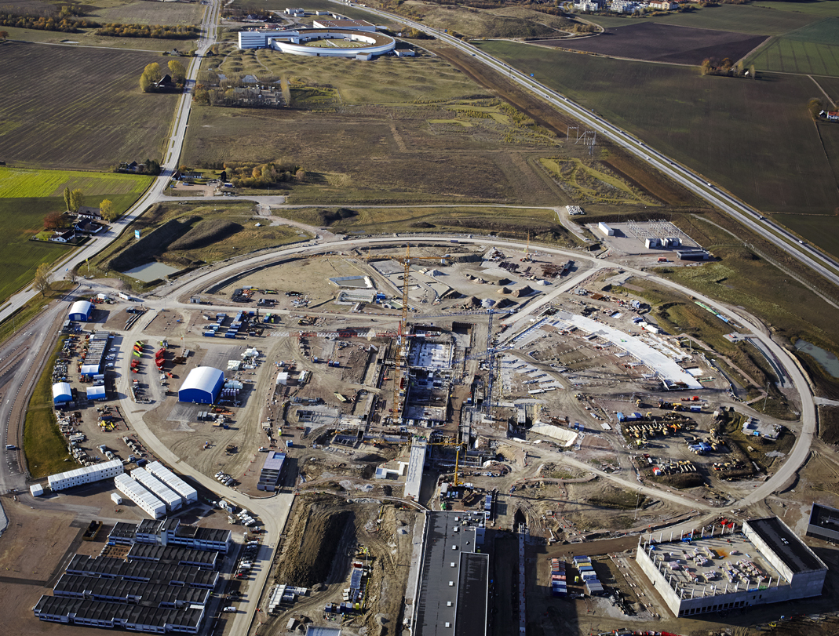
ESS site: Construction & installation & commissioning
One site & one safety culture
ESS mission: … facility …
is built safely, on time and on budget
Starting from a greenfield site is only possible thanks to the world-wide community knowledge (ITSF 2019 @ ESS)
“We work safely or not at all!”

