Slide 1
Instruments Workshop Summary
ESS-JPARC workshop,
Lund, 19th January 2018
Shane Kennedy & Toshiya Otomo (Moderators)

Slide 2
ESS-J-PARC Instruments workshop
Charge to workshop
1) Identify mutually interested issues
2) draft vision how to tackle the issues including milestone and plan
3) make friends with each other and find a contact person for each issue.
Workshop runs from 9:00 – 12:30
Summary of all workshops at 16:30- 17:0

Slide 3
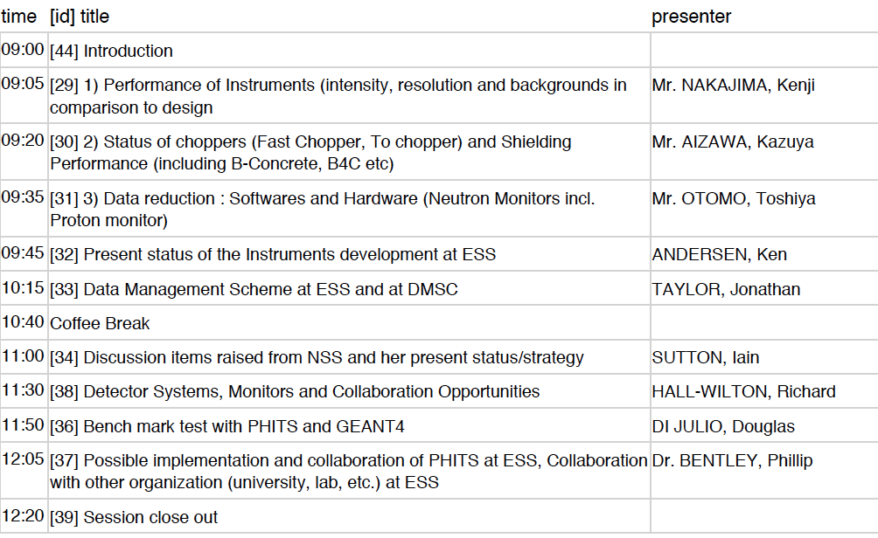
Instruments workshop Programme

Slide 4
Summary of mutual interests discussed
Choppers and shielding: (Aizawa & Niko)
JPARC now updating and replacing chopper (2nd generation). ESS designing choppers –chance to collaborate involving ESS chopper partners (e.g. with T_{zero} and High Speed disc choppers (e.g. with FZJ?))
Shielding –performance checking –facility mapping such as ESS did at SNS may be interesting for J-PARC
Data management (Toshiya & Jon)
JPARC-DMSC: possible future testing of integrated control and DAQ at JPARC. Further discussion to identify opportunities.
Radiation management
Collaborate on testing of radiation resistance of material in Japan ( Aizawa & Thomas)
Remote Handling: ESS is designing for extensive RH in bunker. In future JPARC may develop RH system for Tzero choppers. (Erik is managing RH for ESS Instruments)

Slide 5
Summary of mutual interests discussed
Detectors (Soyama & Richard)
ESS is developing high performance detectors and needs to test and benchmark in high flux spallation sources. JPARC is interested in high performance low cost detector for chopper spectrometers. Testing of ESS detector prototype at JPARC may benefit all.
Neutron Monitors: when ESS becomes active in monitor development testing of systems for ESS could be done at J-PARC.
Simulations and modelling (Harada & Phil)
good collaboration already exists . Total bgd over whole facility and maximization of signal to noise ratios (S/N) of mutual interest. Joint work with GEANT4 (for S/N) and Phits (for safety) is producing useful information.
Collaborate on continuous code development &
Benchmarking of codes and against measurements at J-PARC
Performance verification & corrective measures on intensity and bgd. For now ESS could learn from J-PARC (maybe for future collaboration)
ESS is in design stage, J-PARC is in operation. ESS could benefit from experience and lessons learnt at JPARC: JPARC experts could provide advice in NSS design reviews (Kenji & Ken (instruments) or Oliver (technologies) as appropriate)

