Slide 1
Target Design and Maintenance Scenario at ESS
Rikard Linander
Deputy Head of Target Division
www.europeanspallationsource.se
17 January, 2018

Slide 2
Target Design and Maintenance Scenario at ESS Presentation outline
Design and Layout of the ESS Target Station and the main Target Systems
Target Systems
Moderator and Reflector Systems
Neutron Beam Extraction System
Remote Handling Systems
Maintenance Scenario Example: Exchange of a Neutron Beam Port Insert

Slide 3
Design and Layout of the ESS Target Station and the main Target Systems

Slide 4
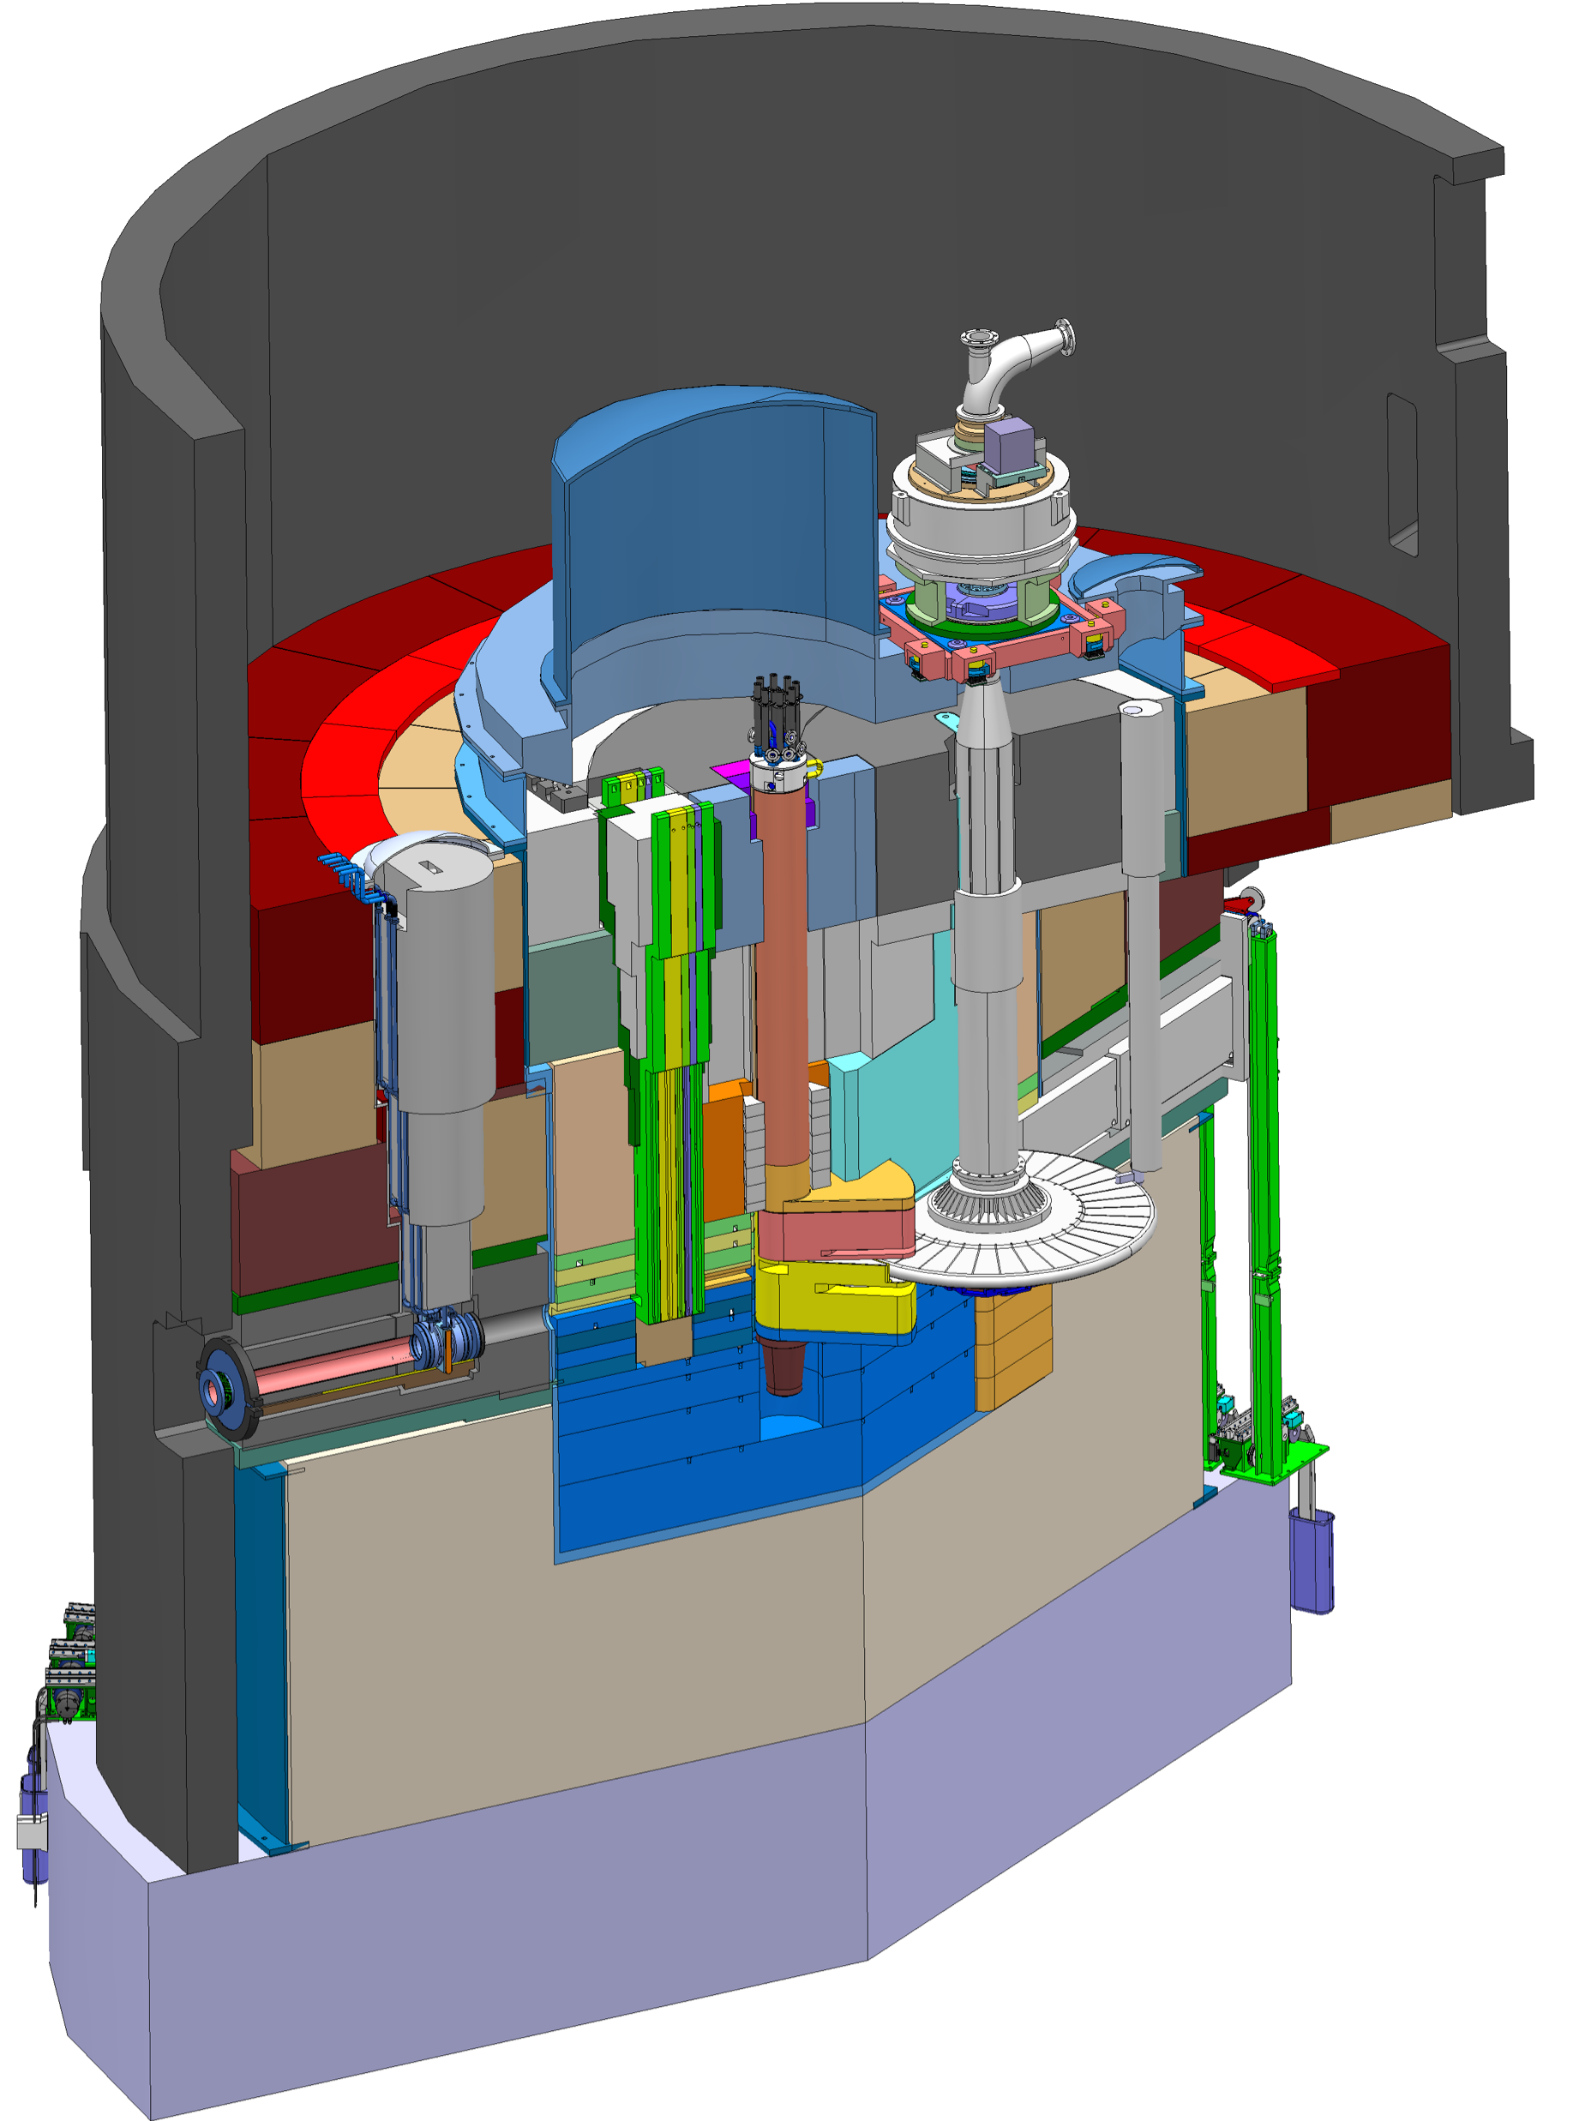
Key features of the ESS Target Station
Moderator and reflector
Target Safety System
Monitors target coolant flow, pressure and temperature, monolith pressure, & target wheel rotation
Prohibit beam on target if parameters are outside specified limits
proton beam instrumentation plug
Helium cooling of target material
Mass flow 3 kg/s
Pressure 11 bar
Temperature inlet/outlet 40 °C/240 °C
monolith vessel
neutron beam extraction port
Rotating solid tungsten target
36 sectors
Mass, total 11 tonnes, whereof 3 tonnes of W
Rotates 23.3 rpm, synchronized with pulsed proton beam 14 Hz
proton beam
target wheel
target monitoring plug
proton beam window
Diagnostics and instrumentation
Controlled and integrated commissioning and operation of the accelerator and target
Fluorescent coating of PBW and target front face
Optical paths, grid profile monitor, aperture monitor
Wheel monitoring including position, temperature, vibration, as well as internal structure
Moderators
Provisional locations of moderators above and beneath the target wheel, i.e. monolith centre
1st MR plug exploits the upper space, offering:
Cold, 30 mm high, liquid H₂ moderators, 17 K
Thermal, 30 mm high, H₂O moderator, 300 K

Slide 5
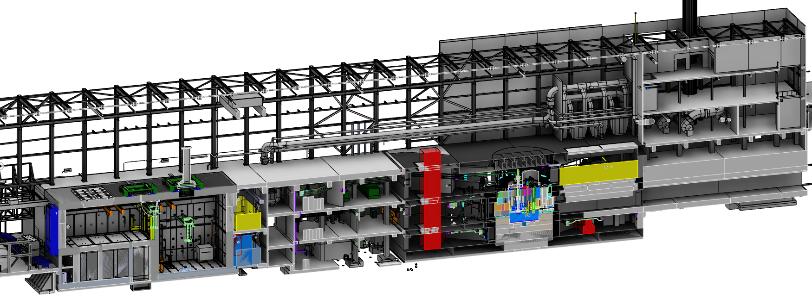
Key features of the ESS Target Station
Utilities and cooling plant
Helium cooling of target wheel
Water cooling of moderators, plugs and shielding
Intermediate water loops between primary circuits and conventional facility utilities
Helium cryoplant for refrigeration of cold moderator system
Nuclear grade HVAC system
Remote handling systems
Large active cells for safe storage and processing of spent radioactive target components
Shielded casks for transfer of spent components from monolith to active cells
High bay
22 m
130 m
Transport hall
37 m
Target monolith
Active cells
Utilities block
Beam expander hall

Slide 6
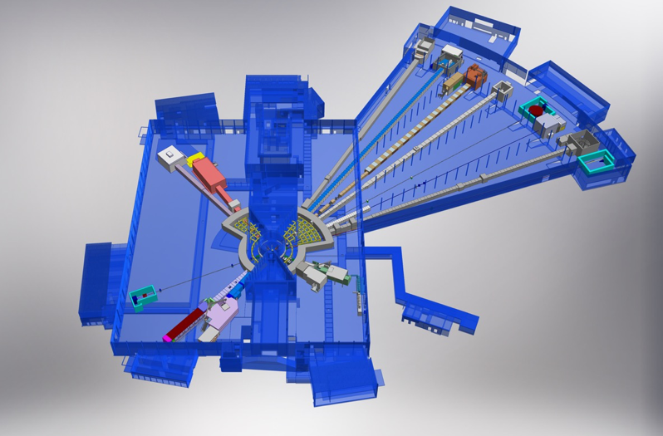
Experimental Halls and Layout of Beam Lines and Neutron Science Instruments
Monolith
Neutron beam extraction
Offers 42 neutron beam ports
Allows neutron science instruments to view either upper or lower moderator position
6

Slide 7
Target Systems

Slide 8
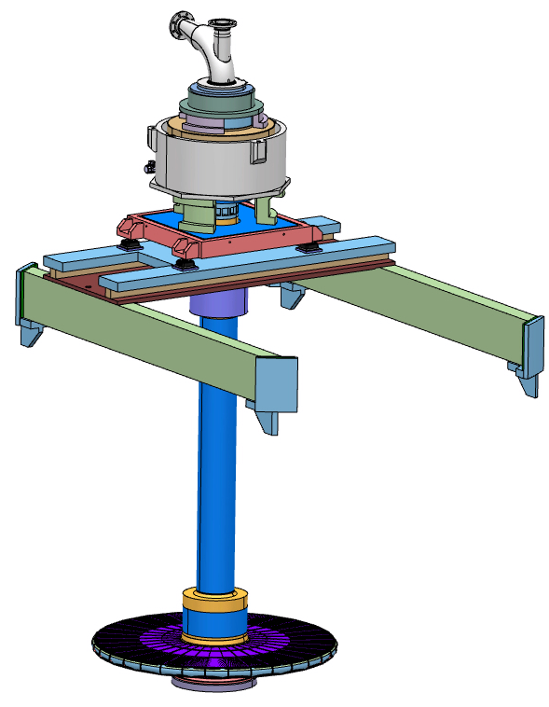
ESS will be the first spallation source to employ a helium-cooled rotating target
Motor and bearings are mounted far away (5 meters) from the high radiation zone
Wheel is suspended on a 6 meter long shaft
Helium removes 3 MW of heat deposited in the target by the 5-MW proton beam
Expected lifetime of 5 years
Wheel rotation scheme
Target wheel has 36 sectors of 10° each
The beam pulse is 2.86 ms wide, and pulses 14 times per second
Wheel rotation is synchronized with the beam pulse
Wheel rotational speed is14 Hz/36 = 0.39 Hz, or 10° rotation between each pulse
5 m
2.6 m

Slide 9
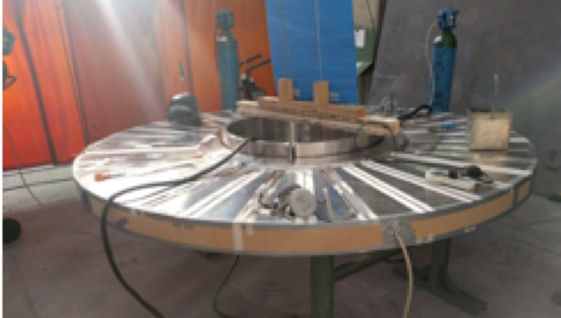
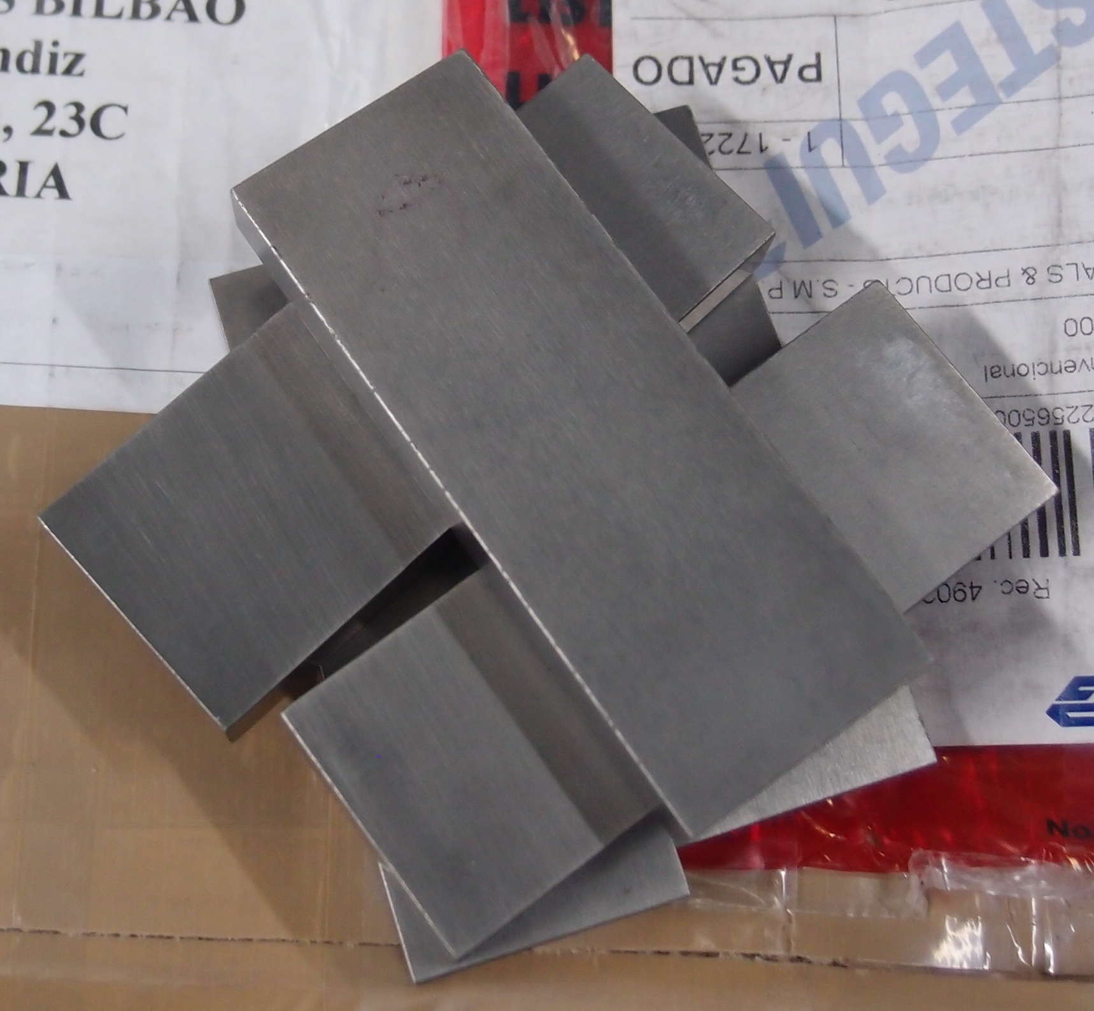
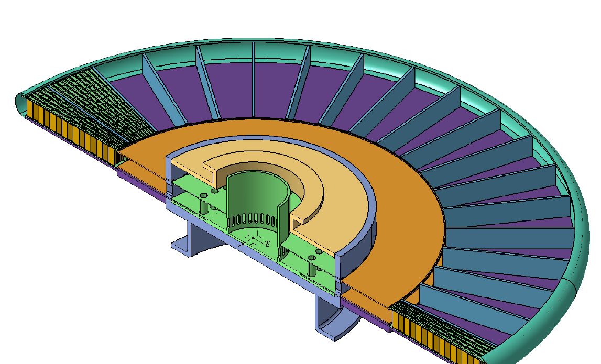
Each 10° sector is loaded with a tungsten-filled cassette
proton beam
48 cm
Target Wheel prototype
Tungsten bricks
Tungsten depth in the proton beam direction is 45 cm
The range of a 2-GeV proton in tungsten is 74 cm
Brick dimensions: 10 W x 30 D x 80 H mm³
190 bricks per sector, 6840 bricks in total
Helium flows
radially outward above and below the cassette,
reverses direction at the wheel rim,
and returns through the tungsten
Cassette

Slide 10
Target Wheel and Helium Cooling System

Slide 11
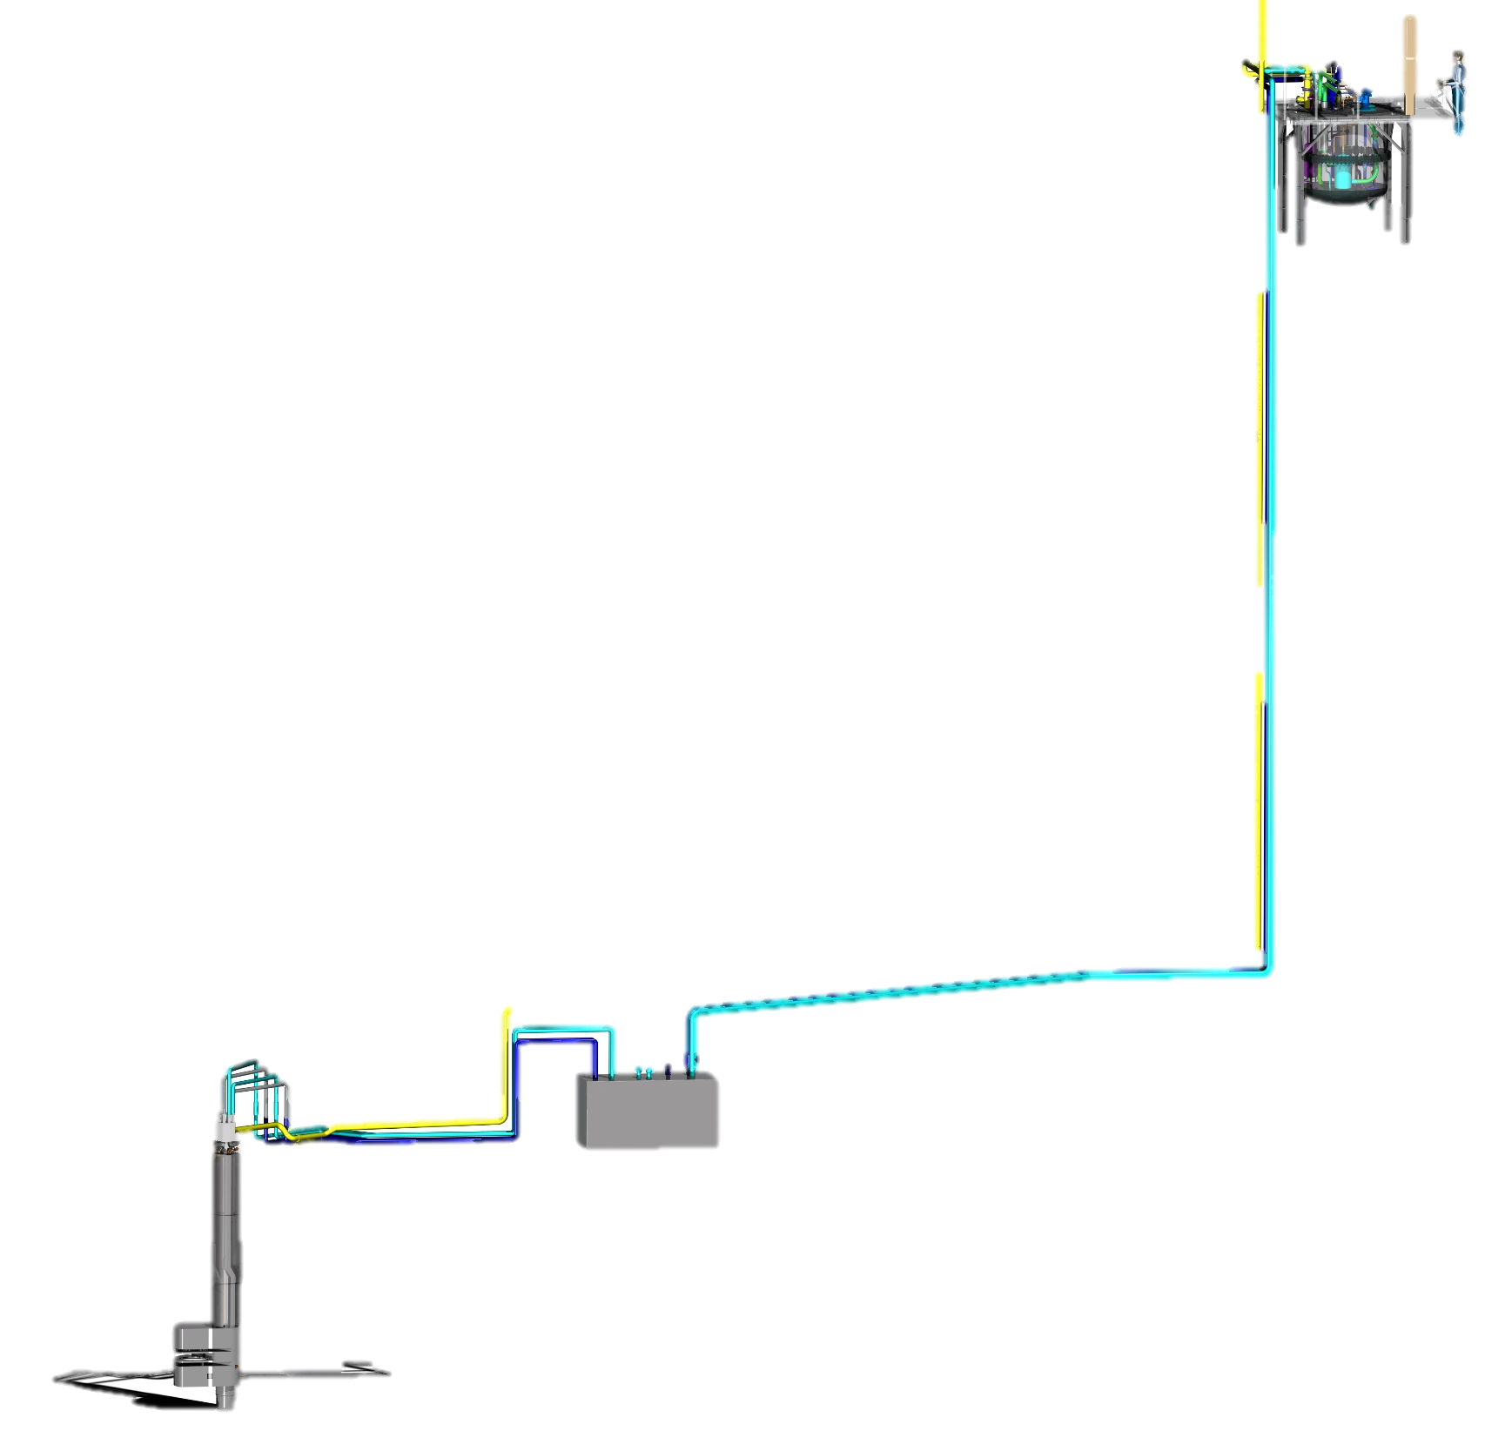
Moderator and Reflector Systems

Slide 12
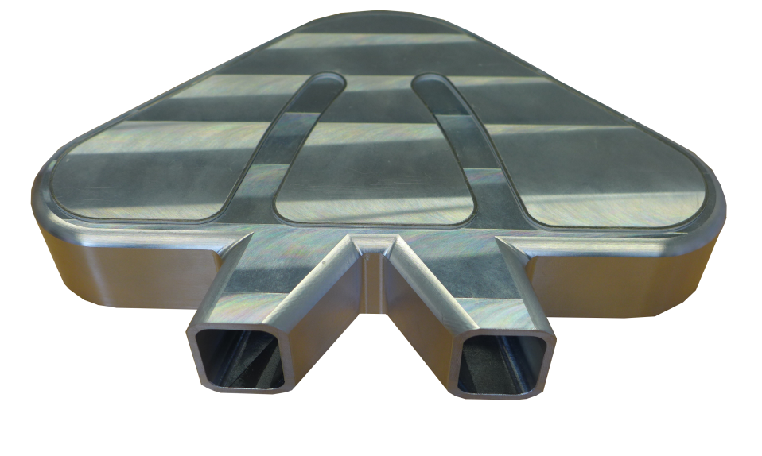
Main functions and design of the ESS Moderator and Reflector Systems
Moderate neutrons to low energies, thermal and cold, useful for the neutron scattering
Cooling the radiation heat in liquids and solid metal bodies
Cryogenic moderator prototype used for rupture test

Slide 13
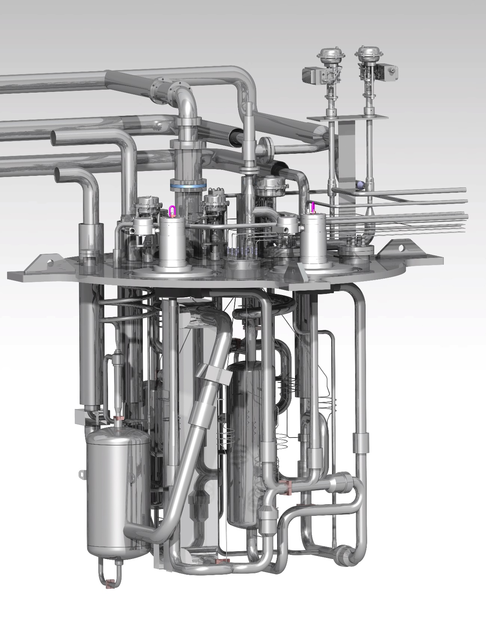
Moderator and Reflector Plug and Liquid Hydrogen Systems
Pre-milled raw material for the reflector vessels
Cryogenic hydrogen system
Deep-hole drilled thermal moderator
One of three final cold moderator vessels, of which two will be used in the first MR plug
Cryostat internals

Slide 14
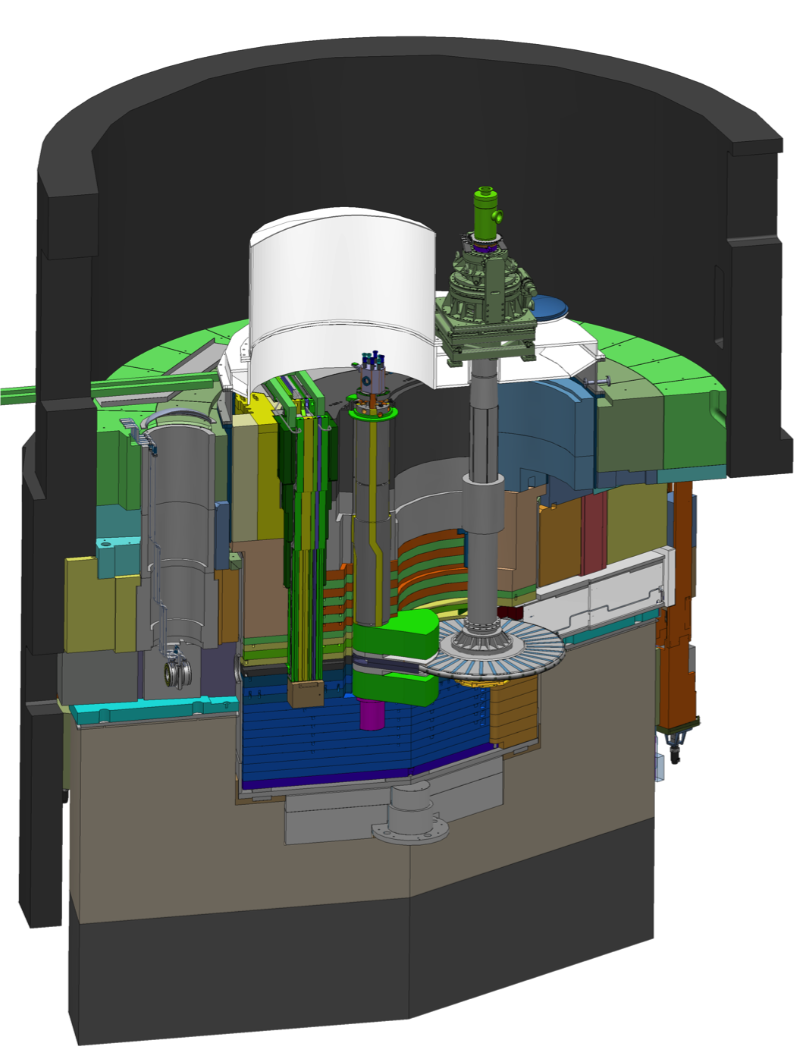
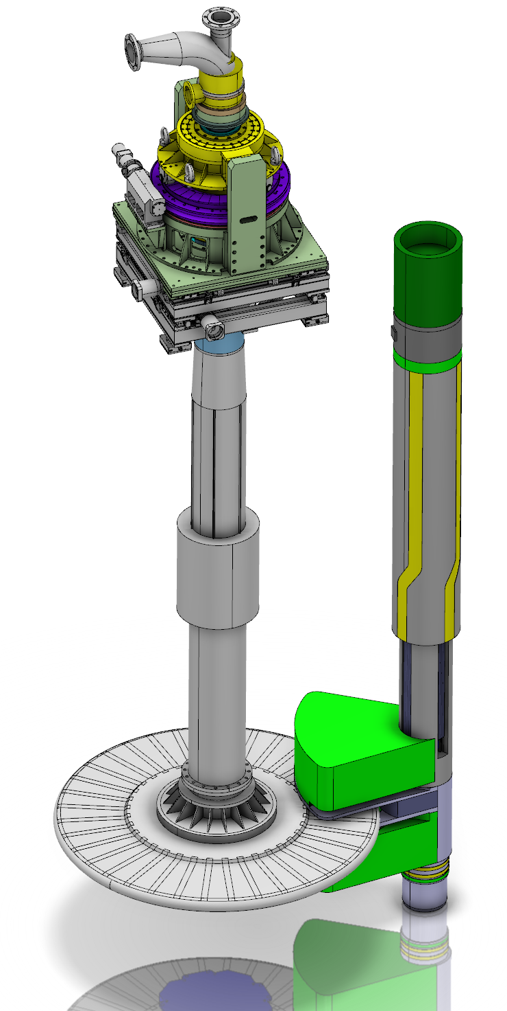
Target Wheel and Moderator and Reflector unit (MR Plug) placement in Monolith
Proton Beam
Target Wheel
MR Plugs

Slide 15
Neutron Beam Extraction System

Slide 16
Neutron Beam Port Insert Overview
The Neutron Beam Port Insert (NBPI) is part of the Neutron Beam Extraction System and is the in-vessel beam guide support structure.
Internal Neutron Beam Optics Assembly (NBOA)

Slide 17
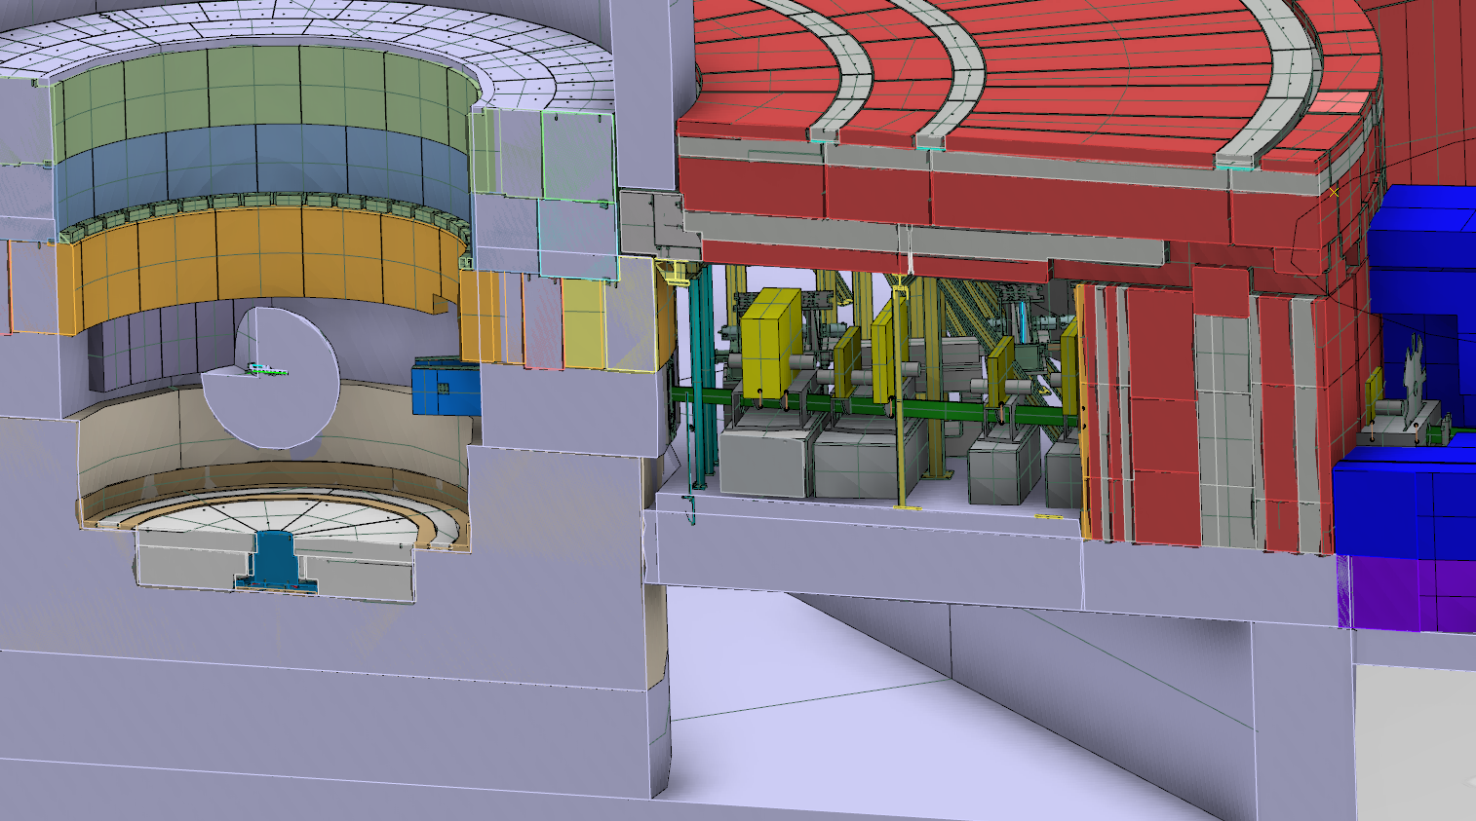
Interface to Neutron Scattering Systems
Bunker roof
Monolith wall
Instrument beam guide
Bunker wall
Notes:
The bunker roof, part of NSS, has to be dismantled during insert changes.
The sequence when changing the insert will be more detailed in Naja’s presentation during the decommissioning of inserts.

Slide 18
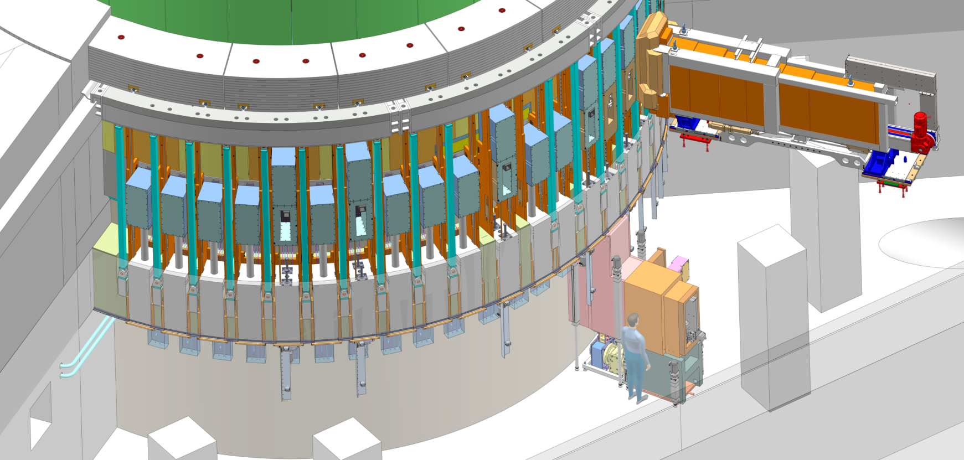
Neutron Beam Extraction View from Experimental Hall, No bunker shown, and transparent floor slab

Slide 19
Neutron Beam Extraction system Shutter system in basement
NBPI
Bunker roof support pillar
Neutron Beam Port Insert (NBPI)
GBS
Neutron Beam Window (NBW):
NBW
BBG
Light Shutter System:
Bridge Beam Guide (BBG) w optics,
Gamma Beam Shutter (GBS) acts as safety system,
Rail system.
Bunker floor
RH Tooling:
Horizontal of NBPI
Vertical of BBG and NBW
Handling tooling

Slide 20
Remote Handling Systems

Slide 21
Remote Handling Systems and Maintenance Logistics

Slide 22
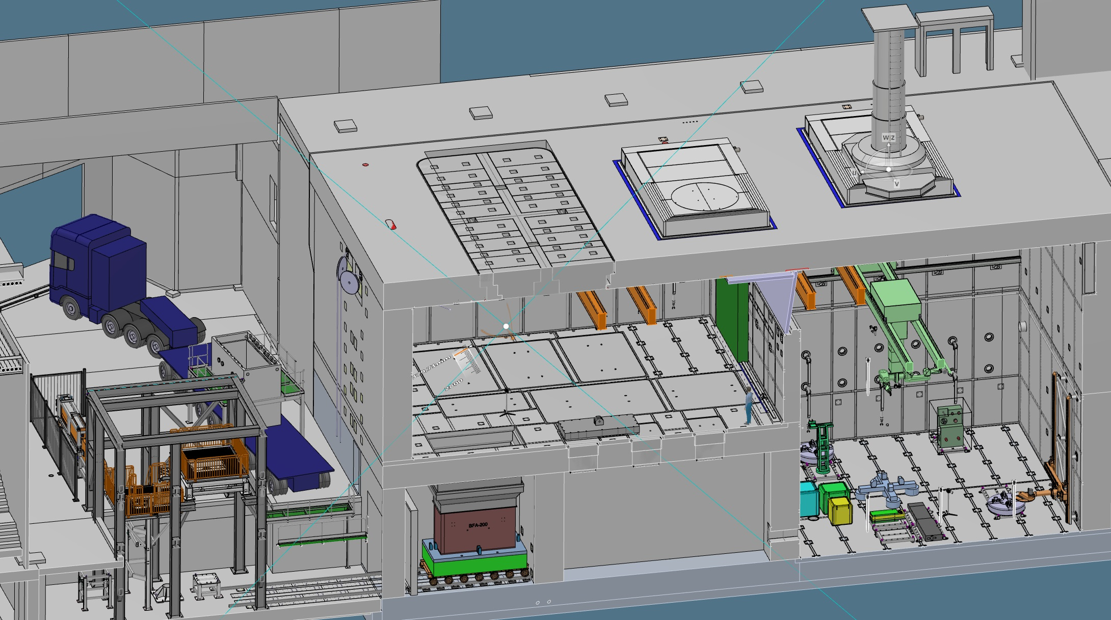
Remote Handling Systems
Casks
Active Cells Facility:
Length: 30 m
Depth: 12 m
Height: 15 m
MUTS
Active Cells Facility

Slide 23
Maintenance Scenario Example: Exchange of a Neutron Beam Port Insert

Slide 24
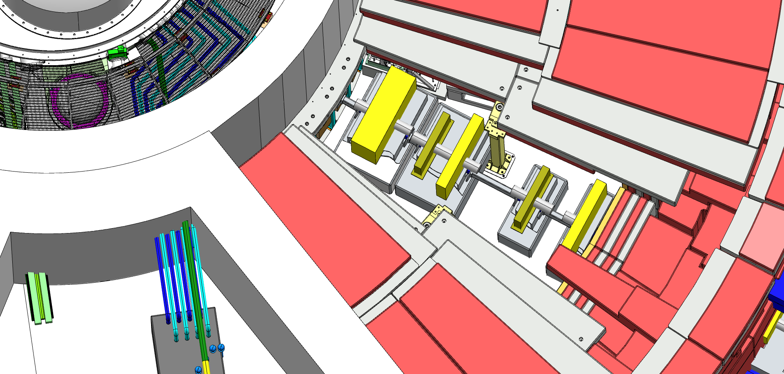
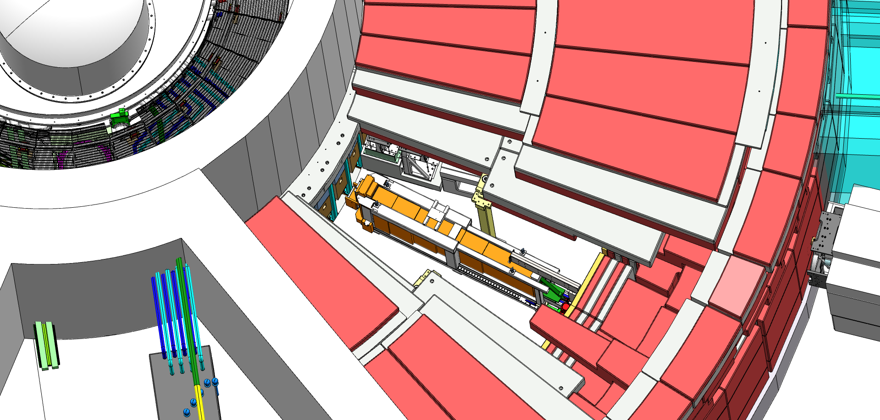
Exchange of a Neutron Beam Port Insert Removal of used item
Bunker preparations
removal of roof
sector cleared from Monolith boundary to Bunker wall.
Area is tented off.
Floor unit aligned on instrument baseplate.
Insert Extraction Tool (IET) is hoisted in.
Parallel LSS activities in basement - Dry and drain of NBPI.
Cold box arrival to ESS
Notes:
The NBPI is still in the design phase so operational and maintenance aspects are in the same state.
Based on this reasoning - each NBPI is expected to be changed every 15 years. When we are up and running with all 42 ports this will mean a change of approximately three beam guides each year.
Port block surface is refurbished due to potential damage from NBW

Slide 25
Vertical cross section of Monolith, NBPI and Insert Extraction Tool
NBPI
Notes:
Extraction tool (ej IET)

Slide 26
Exchange of a Neutron Beam Port Insert Removal of used item
Remote unbolting of NBW from basement.
Removal of NBW into cask.
Transport (of NBW) to Active Cell.
Refurbishment of port block surface – also remote from basement:
Refurbishment is done while the NBPI is still in place to minimize particle introduction into the monolith.
Cold box arrival to ESS
Notes:
The NBPI is still in the design phase so operational and maintenance aspects are in the same state.
Based on this reasoning - each NBPI is expected to be changed every 15 years. When we are up and running with all 42 ports this will mean a change of approximately three beam guides each year.
Port block surface is refurbished due to potential damage from NBW

Slide 27
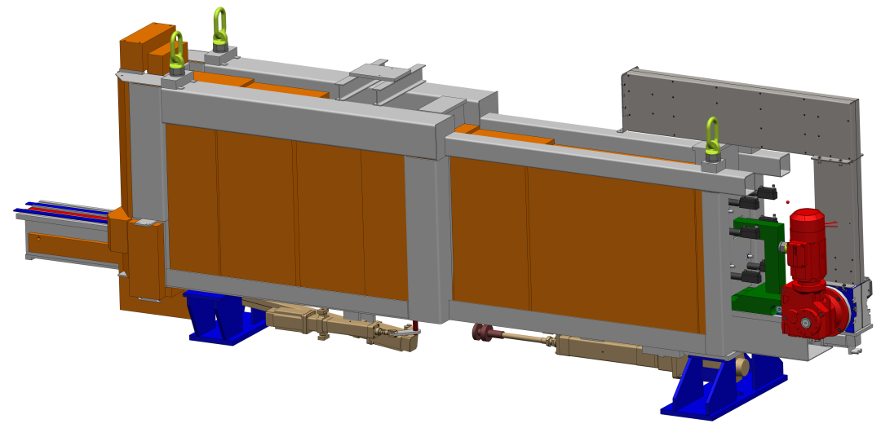
Exchange of a Neutron Beam Port Insert Removal of used item
IET docks on to NBPI.
NBPI is extracted.
IET is closed and undocks, hoisted up and transported to Bunker hand over point.
LSS activities initiates - GBS lowered to cover port opening.
IET is checked for surface contamination.
2nd generation NBPI can be installed.
IET lowered from handover point to horizontal transport by Experimental hall crane.
Transported to hatch in passageway between D01 and D03 for transfer to Active Cell.
Opening in bunker roof for NBPI exchange
IET

Slide 28
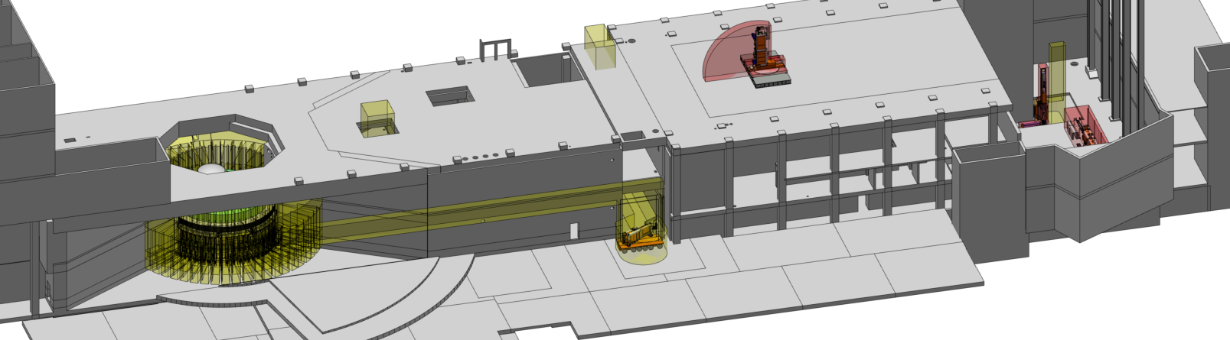
Exchange of a Neutron Beam Port Insert Transfer to active cells facility
Hatch opened by High Bay crane.
IET hoisted up.
Floor valve adapter transported and put in place on Active Cell floor valve.
IET docks to floor valve adapter horizontally.
Rigid chain actuator is replaced by winch unit.
IET is tilted 90 degrees.
Valve and floor valve is opened.
NBPI is lowered into Active Cell and disconnected.
Active Cell takes over responsibility for NBPI, cut the NBPI and package it for transport off site.

Slide 29
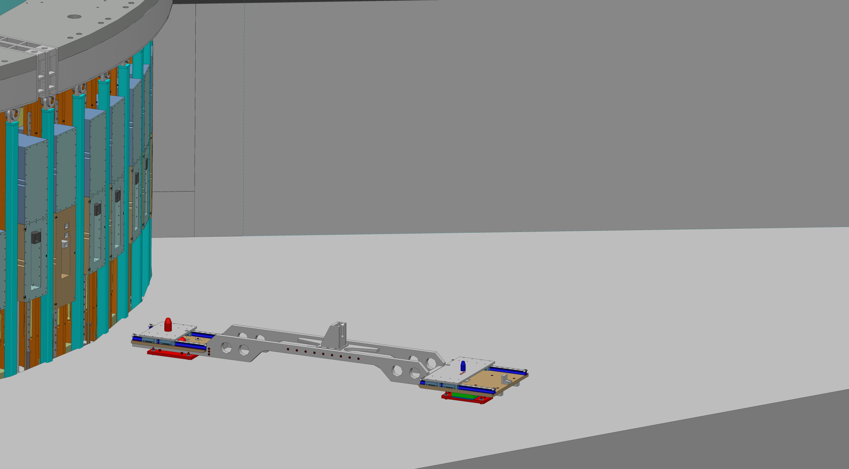
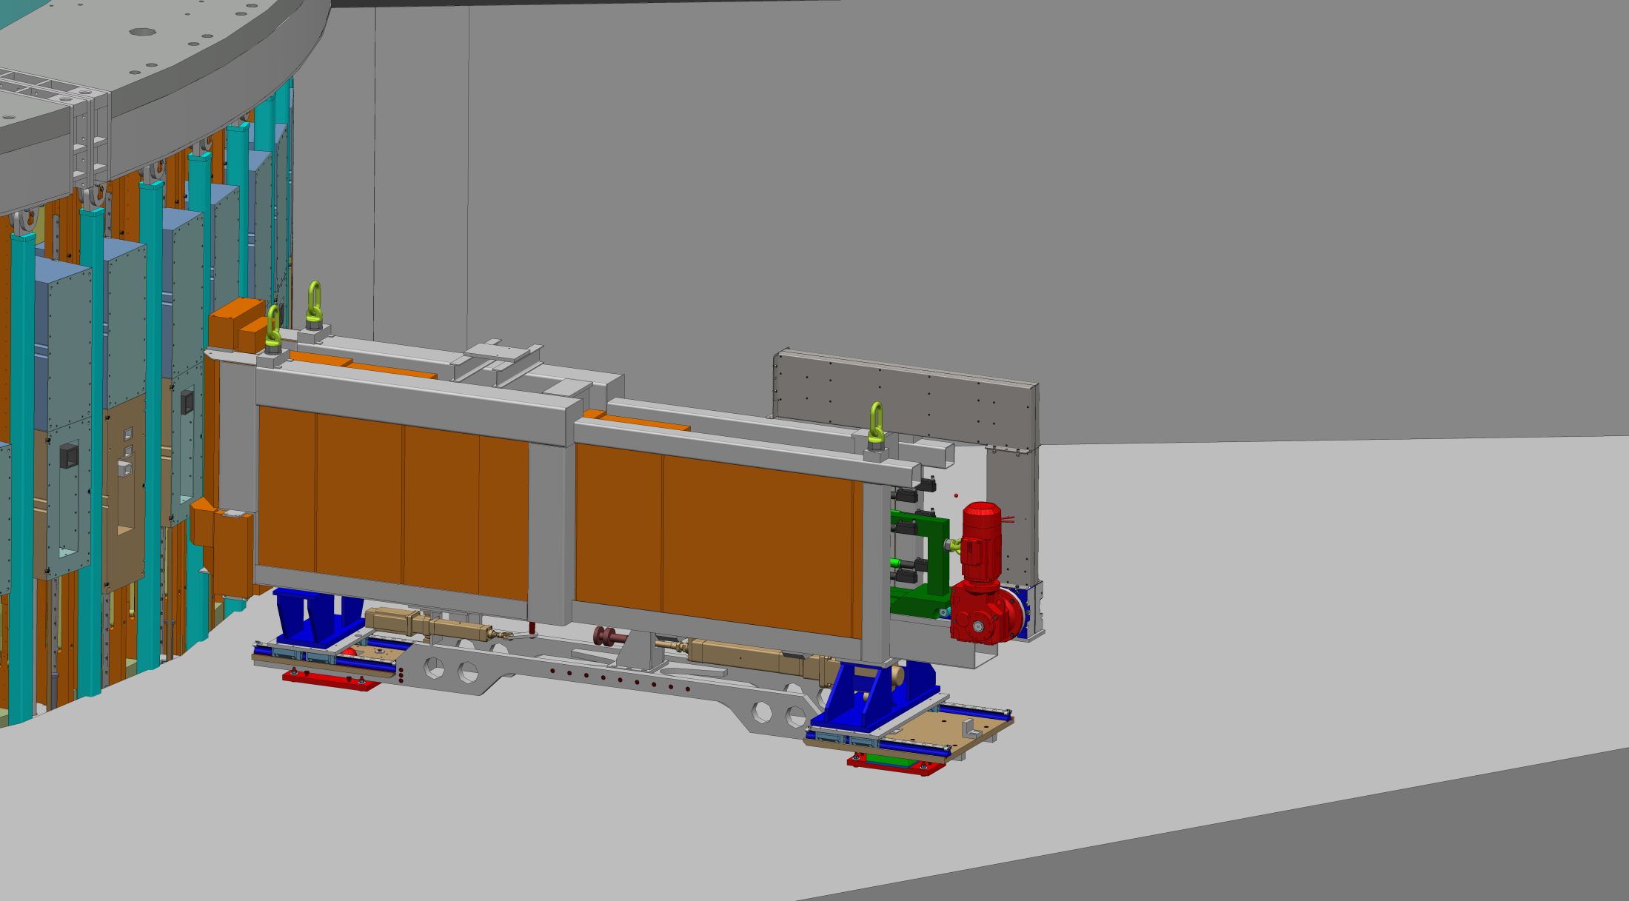
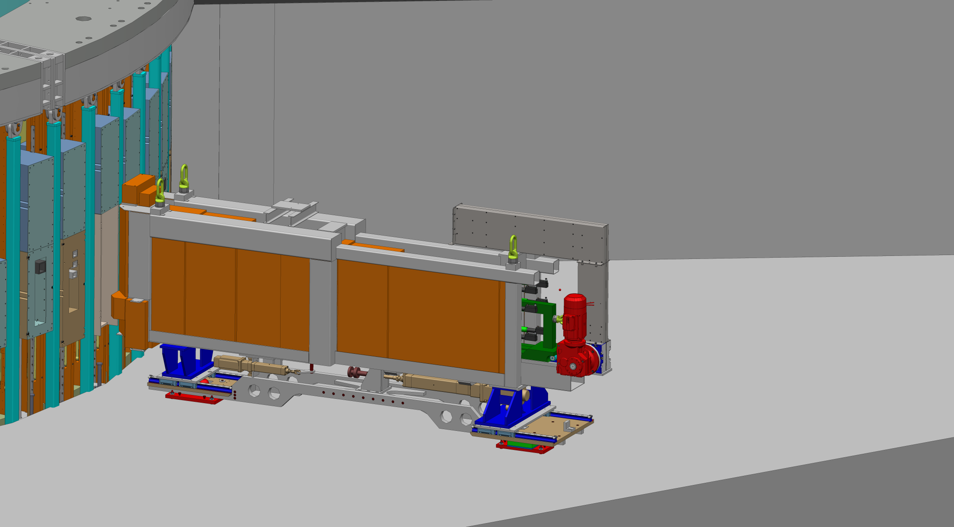
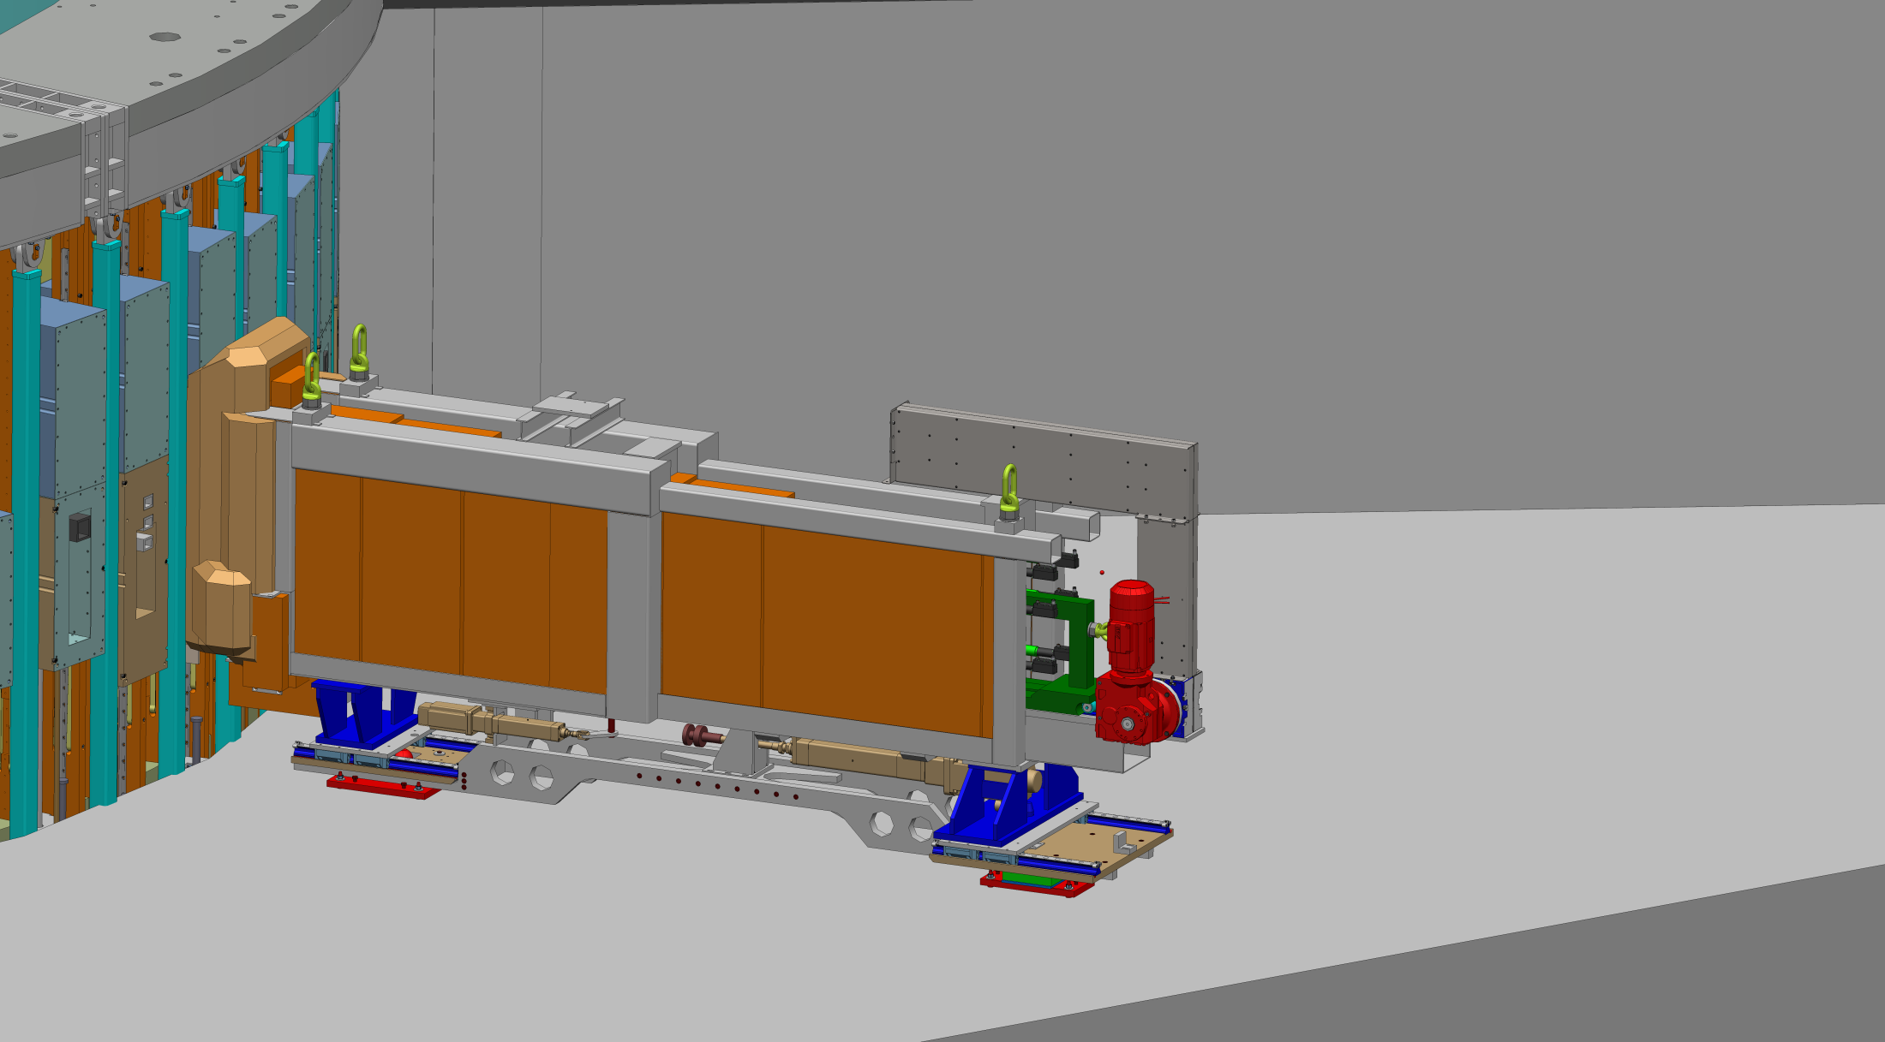
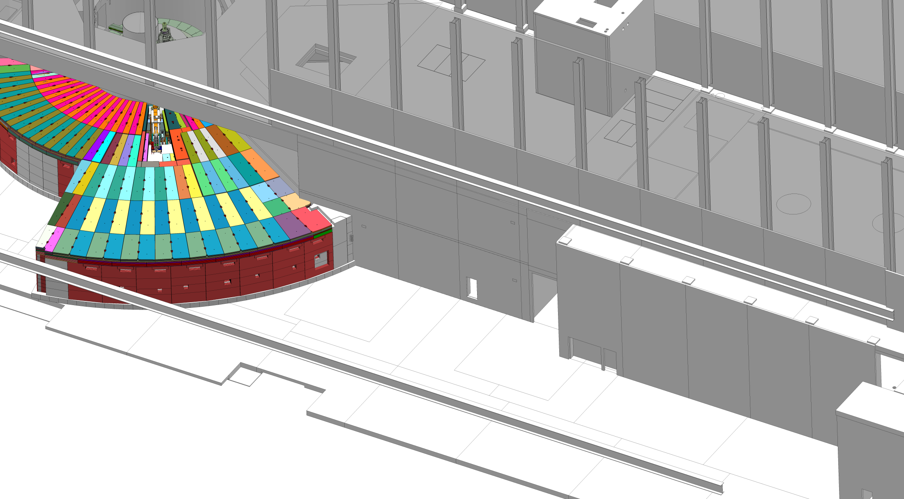
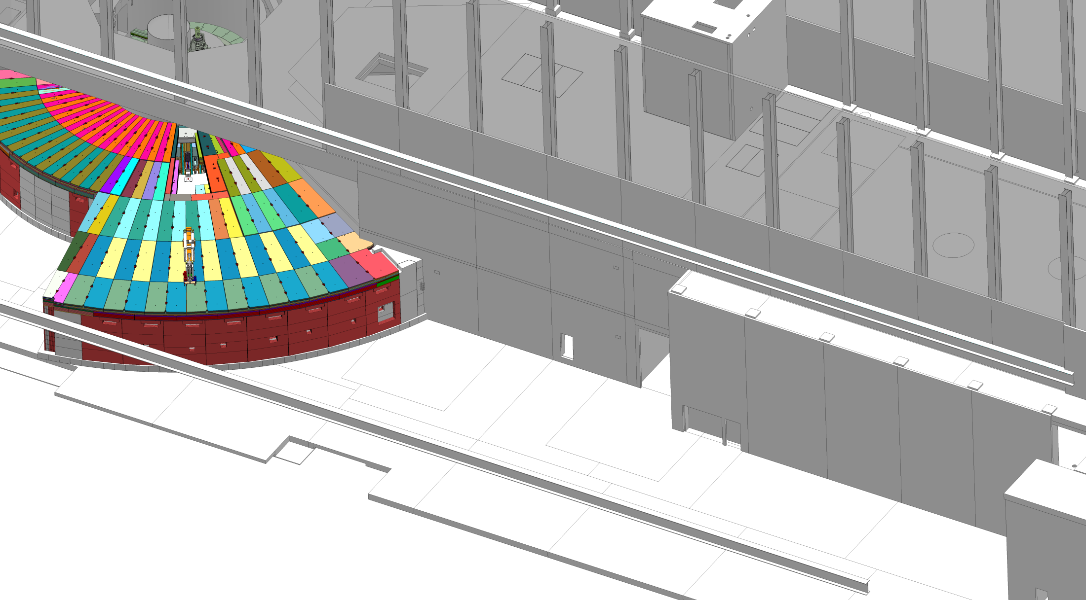
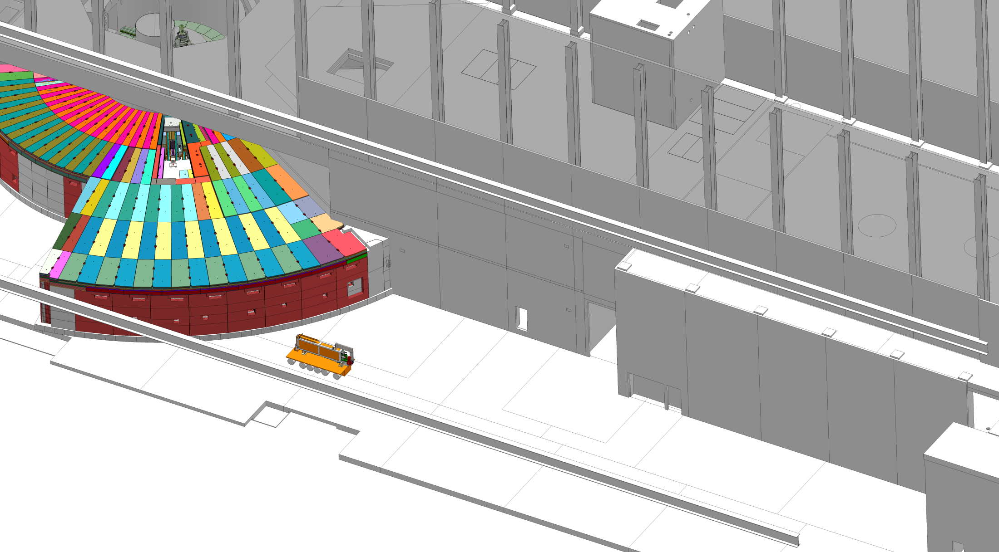
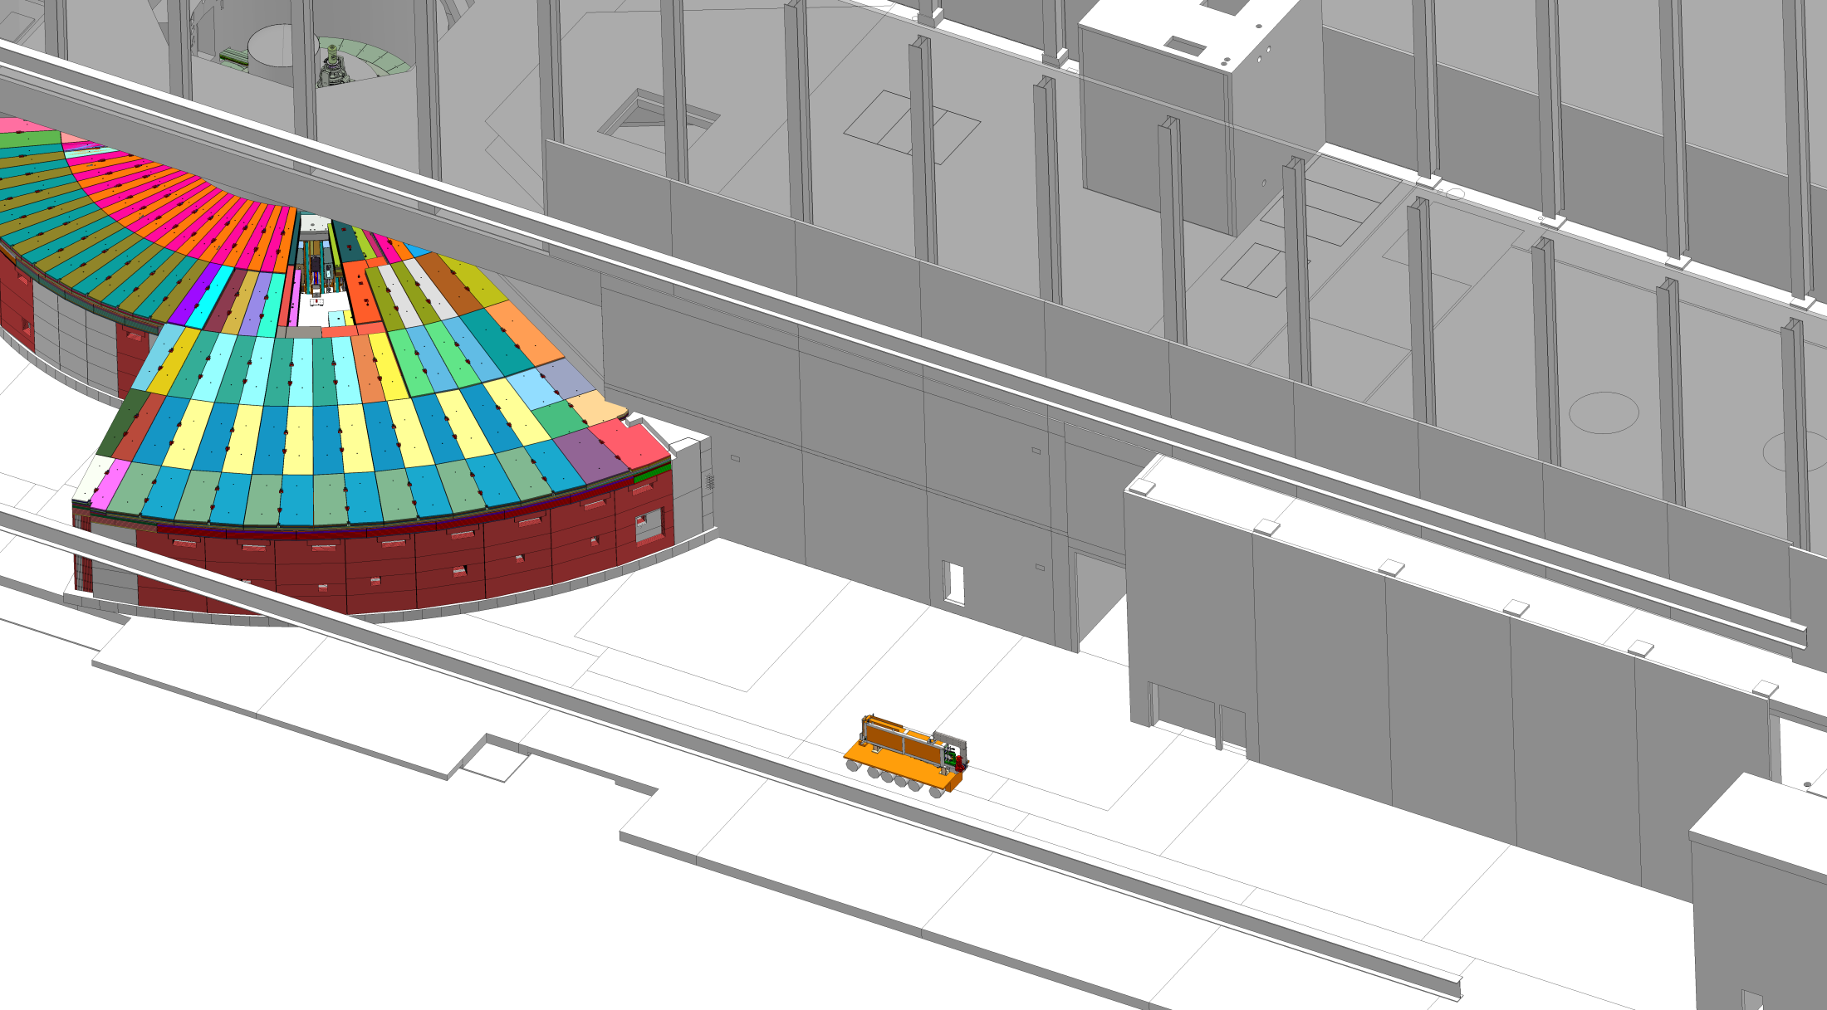
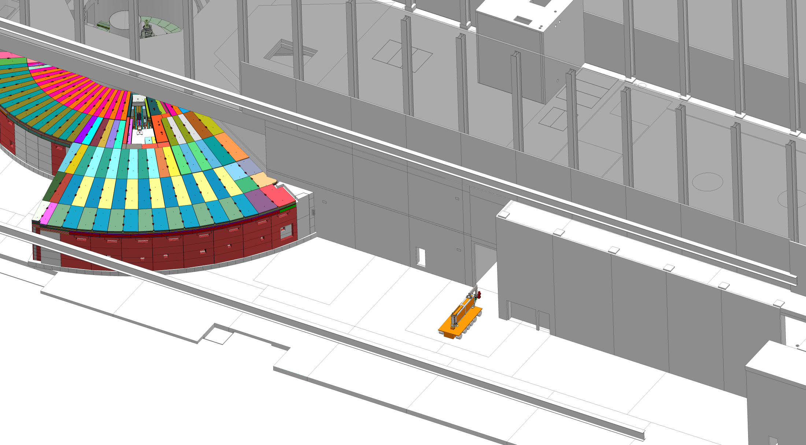
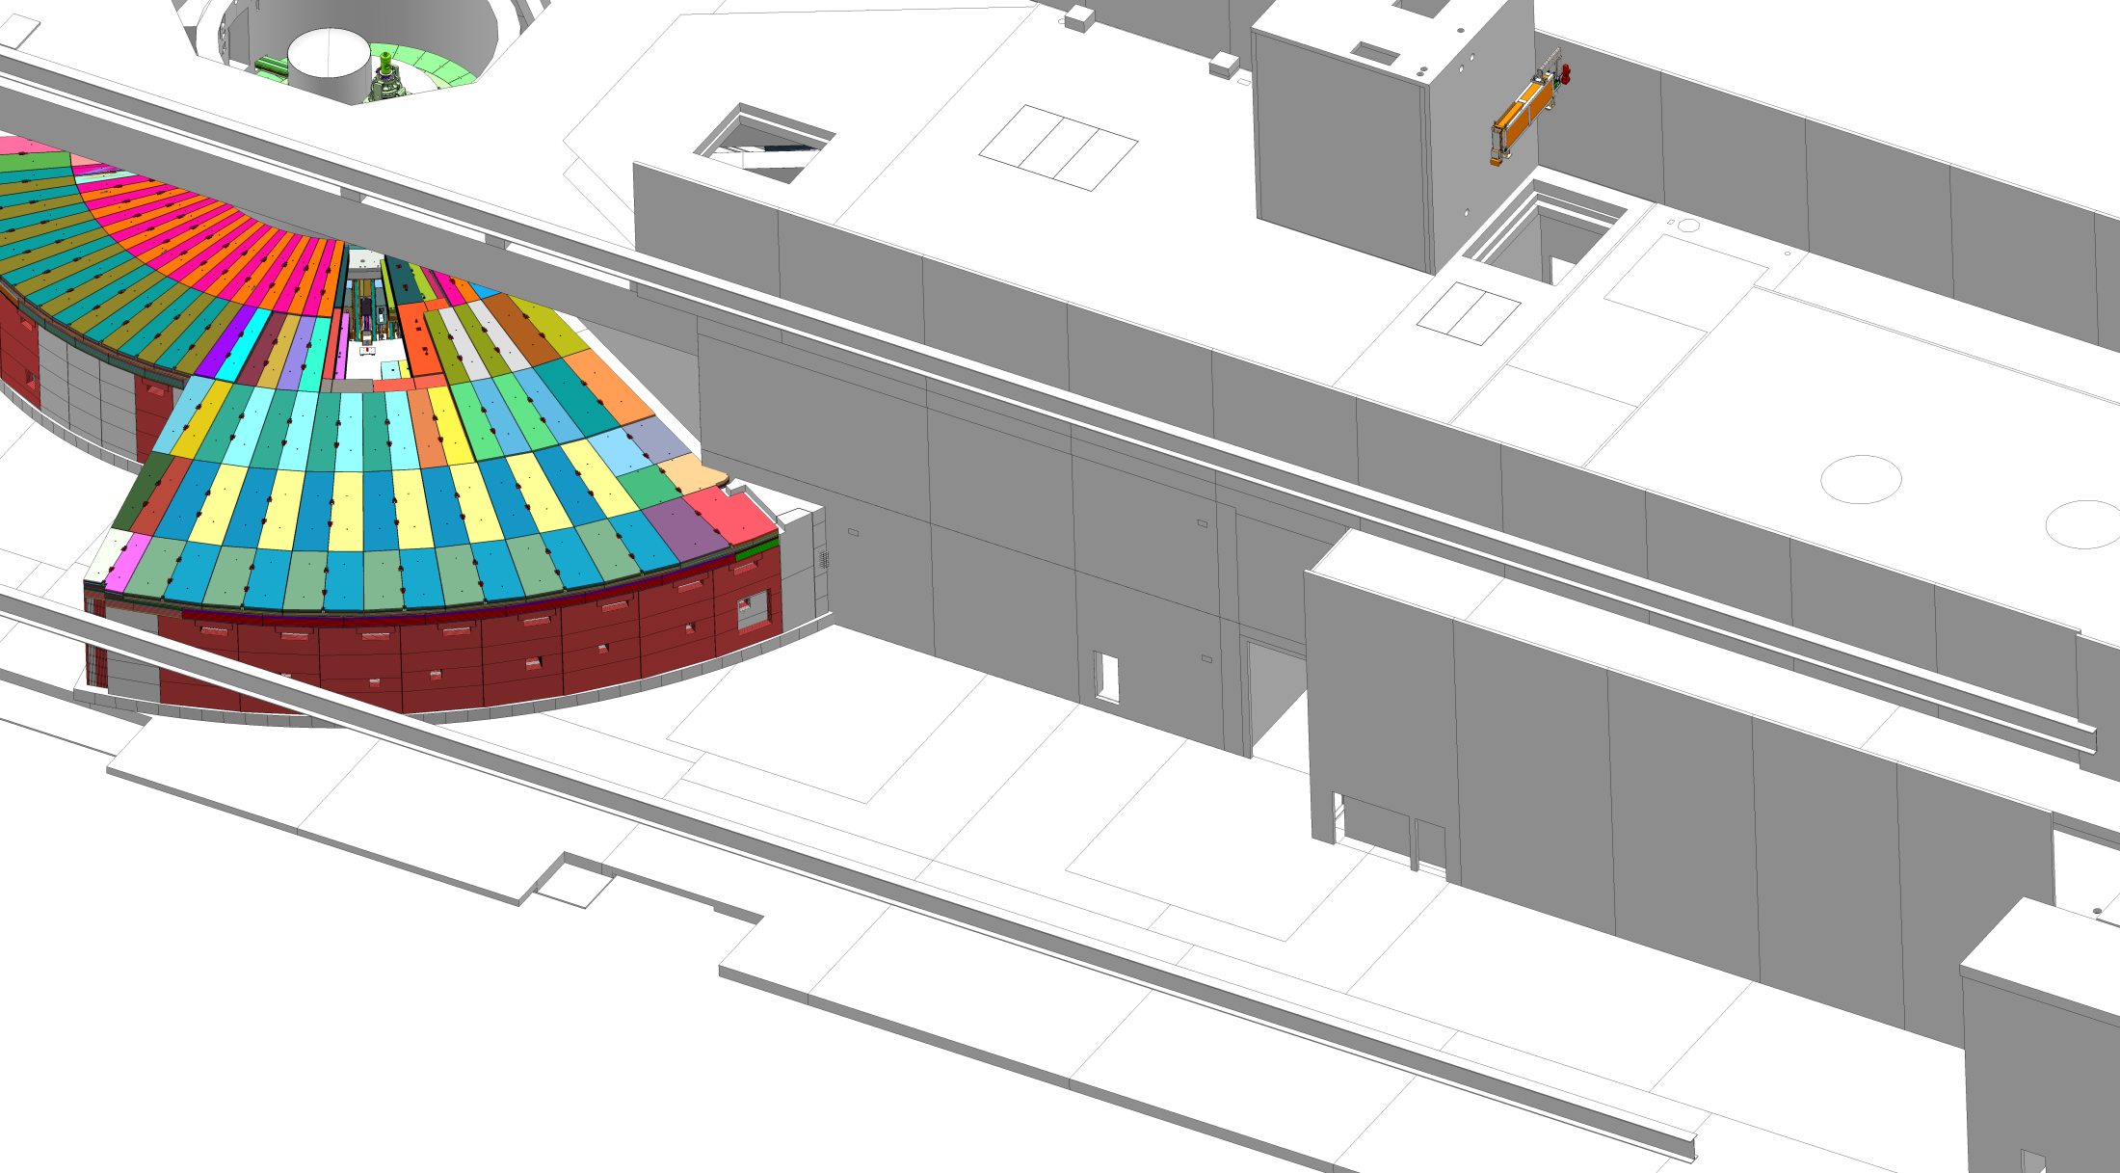
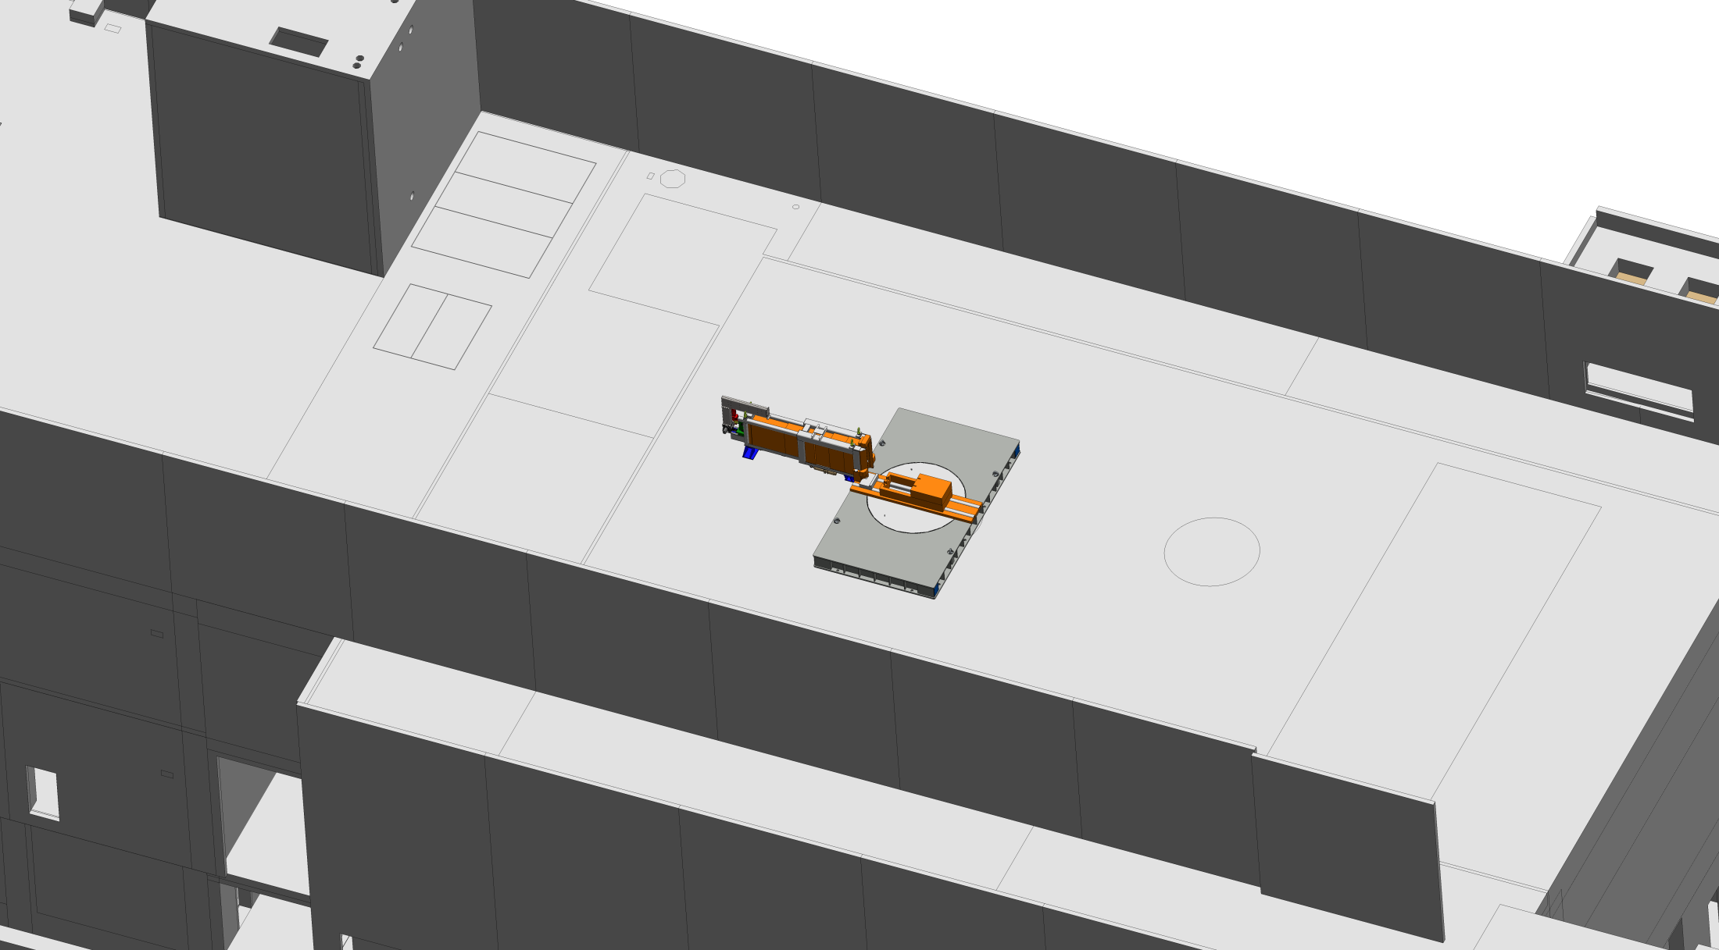
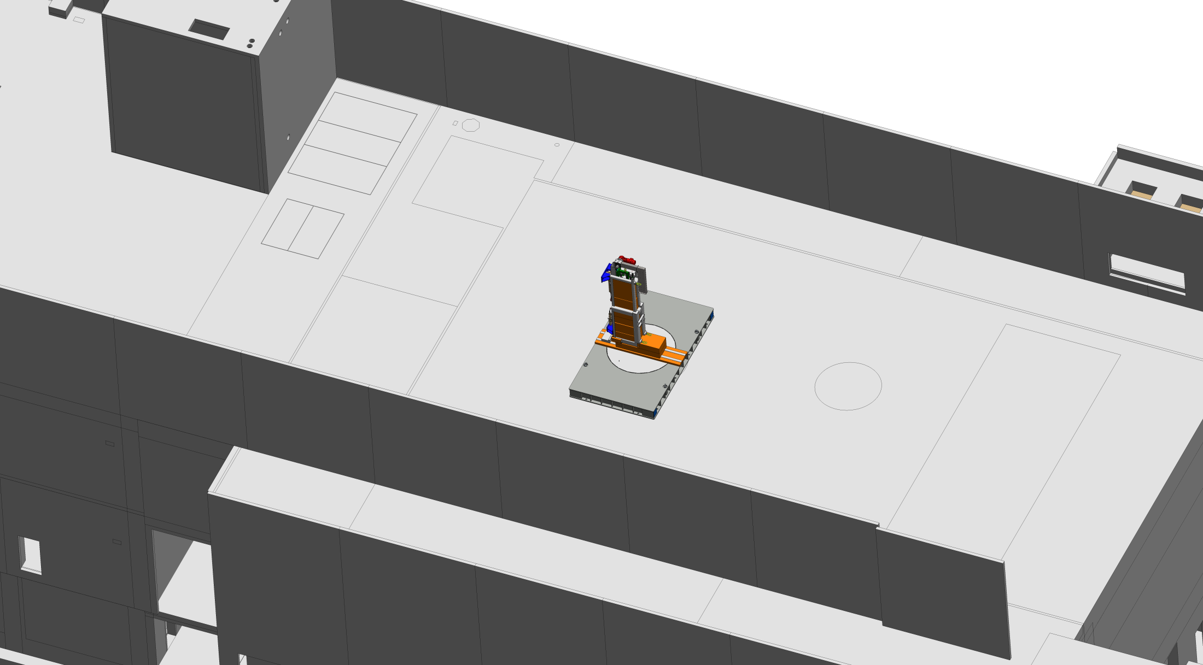
Exchange of a Neutron Beam Port Insert Removal and transfer sequence in pictures

