Slide 1
Present Status of Instruments at ESS
ESS-JPARC workshop,
Lund, 19th January 2018
Ken Andersen, Neutron Instruments Division, European Spallation Source ERIC

Slide 2
Long-pulse performance
8
x10¹⁴
ESS 5 MW
2015 design
7
λ = 1.5 Å
6
5
Brightness (n/cm²/s/sr/Å)
4
3
SNS
1-2 MW
JPARC
0.3-1 MW
2
ISIS TS2
32 kW
1
ISIS TS1
128 kW
ILL 57 MW
0
time (ms)
1
2
3
4

Slide 3
Long-pulse performance
15
x10¹³
ESS 5 MW
2015 design
λ = 5 Å
10
Brightness (n/cm²/s/sr/Å)
5
JPARC
0.3-1 MW
SNS
1-2 MW
ISIS TS1
128 kW
ISIS TS2
32 kW
ILL 57 MW
0
time (ms)
1
2
3
4

Slide 4
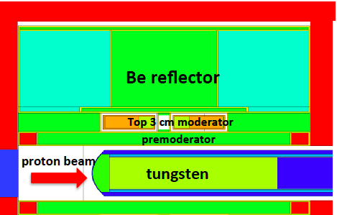
ESS Moderator Design: Butterfly
Above target:
3cm tall butterfly
moderator assembly
Below target:
space for future upgrade
20cm
4

Slide 5
ESS Moderator Design: Butterfly
Above target:
3cm tall butterfly
moderator assembly
Below target:
space for future upgrade
20cm
5
Fully coupled moderators
  No compromise
  Time structure determined mainly by proton pulse length
Hydrogen for cold spectrum
Water for thermal spectrum
All beamports can view both
water
para-H₂

Slide 6
ESS Moderator Design: Butterfly
Above target:
3cm tall butterfly
moderator assembly
Below target:
space for future upgrade
beamport axes
Fully coupled moderators
  No compromise
  Time structure determined mainly by proton pulse length
Hydrogen for cold spectrum
Water for thermal spectrum
All beamports can view both
water
para-H₂

Slide 7
ESS Moderator Design: Butterfly
Above target:
3cm tall butterfly
moderator assembly
Below target:
space for future upgrade
Fully coupled moderators
  No compromise
  Time structure determined mainly by proton pulse length
Hydrogen for cold spectrum
Water for thermal spectrum
All beamports can view both
thermal
cold
water
para-H₂

Slide 8
ESS Moderator Design: Butterfly
Above target:
3cm tall butterfly
moderator assembly
Below target:
space for future upgrade
Fully coupled moderators
  No compromise
  Time structure determined mainly by proton pulse length
Hydrogen for cold spectrum
Water for thermal spectrum
All beamports can view both
water
para-H₂

Slide 9
Adapting the pulse width
Short-Pulse Source
- set pulse width by choosing moderator
ESS
- set pulse width using pulse-shaping chopper
Intensity
Intensity
coupled
decoupled
poisoned
0
100μs
200μs
0
3 ms

Slide 10
Impact on bandwidth of pulse-shaping chopper

Slide 11
Impact on bandwidth of pulse-shaping chopper
T/𝜏 = 25 ⟹ L₂/L₁ = 25

Slide 12
Impact on bandwidth of pulse-shaping chopper
T/𝜏 = 25 ⟹ L₂/L₁ = 25
L₁ = 6.3 m ⟹ L₂ = 157.5 m

Slide 13
Impact on bandwidth of pulse-shaping chopper
T/𝜏 = 25 ⟹ L₂/L₁ = 25
L₁ = 6.3 m ⟹ L₂ = 157.5 m
⟹ Δλ = 1.8 Å

Slide 14
Impact on bandwidth of pulse-shaping chopper
water
hydrogen

Slide 15
Impact on bandwidth of pulse-shaping chopper
water
hydrogen

Slide 16
Impact on bandwidth of pulse-shaping chopper
water
hydrogen

Slide 17
Impact on bandwidth of pulse-shaping chopper
water
hydrogen

Slide 18
Hall Layout
West
West
165 m
North
North
South
East
South
East

Slide 19
Hall Layout
ISIS-TS2
West
West
West
East
North
North
Hall 2
South
East
South
East
Hall 1
ESS
J-PARC MLF
scale
0
100 m
200 m
300 m
400 m

Slide 20
Hall Layout
much longer
instruments
ISIS-TS2
West
West
West
similar length
instruments
East
North
North
Hall 2
South
East
longer
instruments
South
East
Hall 1
ESS
J-PARC MLF
scale
0
100 m
200 m
300 m
400 m

Slide 21
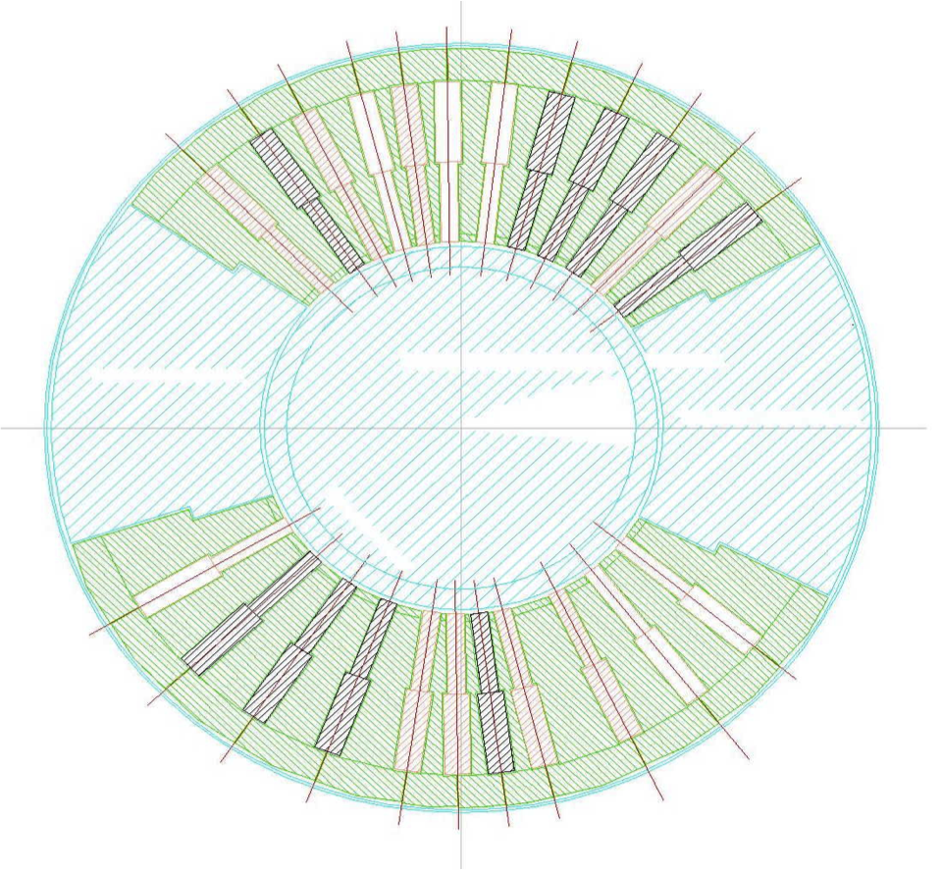
Beamport separation
ESS: 42 beamports
J-PARC: 23 beamports

Slide 22
Beamport separation
ESS: 42 beamports
J-PARC: 23 beamports
long
short
medium
short/medium

Slide 23
Beamport separation
ESS: 42 beamports
J-PARC: 23 beamports
long
short
medium/long
short/medium

Slide 24
Upgradeability
Primary upgrade path: more instruments
42 beamports with ~6° separation
HEIMDAL
MAGIC
T-REX
MIRACLES
BIFROST
West
C-SPEC
West
BEER
NMX
LOKI
FREIA
North
TBL
ESTIA
South
East
ODIN
SKADI
DREAM
VESPA
scale
GI-SANS

Slide 25
Upgradeability
Primary upgrade path: more instruments
42 beamports with ~6° separation
Upgrade areas
upgrade
HEIMDAL
MAGIC
T-REX
MIRACLES
BIFROST
West
C-SPEC
West
BEER
NMX
LOKI
FREIA
North
TBL
ESTIA
South
East
ODIN
SKADI
DREAM
VESPA
scale
upgrade

Slide 26
Upgradeability
n-nbar
Primary upgrade path: more instruments
42 beamports with ~6° separation
Upgrade areas
W9
W10
upgrade
HEIMDAL
MAGIC
T-REX
MIRACLES
BIFROST
West
C-SPEC
West
BEER
NMX
WA-NSE
Sleipnir
LOKI
FREIA
North
Mono-farm 2
HR-NSE
Mono-farm 1
ESTIA
South
East
ODIN
SKADI
DREAM
VOR
ANNI
ESPRESSO
GI-SANS
VESPA
scale
S5
upgrade
S6
S7
S8
S10
S9

Slide 27
ESS Advantages
Rapid data collection = short counting times
  enables kinetics & high-throughput studies
Can choose to sacrifice flux for other opportunities
  high resolution, polarisation analysis, …
Broad dynamic range in Q and E
  hierarchical structures
  survey measurements
Small beam spots
  scanning, biological and complex samples
Inherently flexible instruments
  adapt resolution to experimental needs
Integrated flexible sample environment
  non-equilibrium studies

Slide 28
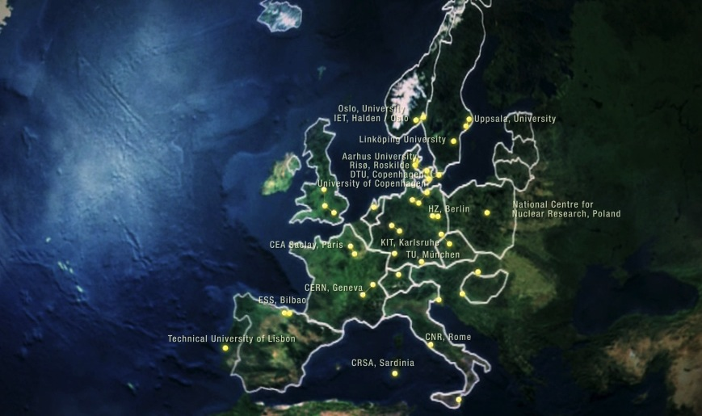
Built by In-Kind Collaborations
National Centre for Nuclear Research, Poland
Oslo University
Rostock University
Spallation Neutron Source, Oak Ridge
Stockholm University
Techical University of Darmstadt
Nuclear Physics Institute Of The ASCR
Czech Technical University, Prague
Aarhus University
University Of Copenhagen
University Of Southern Danmark
Technical University Of Danmark - DTU
Institut Laue-Langevin - ILL
LLB (Laboratoire Léon Brillouin)
Helmholtz-Zentrum, Berlin
Helmholtz-Zentrum, Geesthacht
Technical University, Munich
Forschungszentrum, Jülich
Elettra-Sincrotrone Trieste
Università Di Perugia
Consiglio Nazionale Delle Ricerche
Delft University Of Technology
Institute For Energy Technology, IFE
Linköping University
Mid Sweden University
Epfl | École Polytechnique Fédérale De Lausanne
Paul Scherrer Institute, PSI
Aarhus University
CEA Saclay, Paris
CNRS Orsay, Paris
ESS Bilbao
INFN, Catania
Lund University
Uppsala University
Accelerator Science and Technology Centre, Daresbury and Oxford
CERN, Geneva
Cockcroft Institute, Daresbury
DESY, Hamburg
ESS Bilbao
Fermi National Laboratory, Chicago
John Adams Institute for Accelerator Science, London and Oxford
Laval University, Canada
Maribor University, Slovenia

Slide 29
Instrument Proposal Rounds
Macromolecular
& Single Crystal
Diffraction
Direct Geometry
Spectroscopy
Indirect Geometry
Spectroscopy
Fundamental &
Particle Physics
Materials &
Engineering
Diffraction
Spin Echo
Spectroscopy
Reflectometry
Powder
Diffraction
SANS
Imaging
✔
✔
 | LOKI |  | NMX |  |  | ODIN
 | Sleipnir
✔
2012

Slide 30
Instrument Proposal Rounds
Macromolecular
& Single Crystal
Diffraction
Direct Geometry
Spectroscopy
Indirect Geometry
Spectroscopy
Fundamental &
Particle Physics
Materials &
Engineering
Diffraction
Spin Echo
Spectroscopy
Reflectometry
Powder
Diffraction
SANS
Imaging
✔
✔
 | LOKI |  | NMX |  |  | ODIN
 | Sleipnir
 | Sleipnir | THOR |  | DREAM | BEER |  | C-SPEC | BIFROST | ESSENSE
 | SKADI | VERITAS |  | HEIMDAL |  |  | VOR
 |  | ESTIA |  | HOD |  |  | T-REX
 |  | FREIA |  |  |  |  | Tempus Fugit
✔
2012
✔
✔
✔
✔
✔
✔
✔
2013
✔
✔

Slide 31
Instrument Proposal Rounds
Macromolecular
& Single Crystal
Diffraction
Direct Geometry
Spectroscopy
Indirect Geometry
Spectroscopy
Fundamental &
Particle Physics
Materials &
Engineering
Diffraction
Spin Echo
Spectroscopy
Reflectometry
Powder
Diffraction
SANS
Imaging
✔
✔
 | LOKI |  | NMX |  |  | ODIN
 | Sleipnir
 | Sleipnir | THOR |  | DREAM | BEER |  | C-SPEC | BIFROST | ESSENSE
 | SKADI | VERITAS |  | HEIMDAL |  |  | VOR
 |  | ESTIA |  | HOD |  |  | T-REX
 |  | FREIA |  |  |  |  | Tempus Fugit
 |  | HERITAGE | MAGIC | HOD |  |  | T-REX | MIRACLES | ESSENSE | ANNI
 |  |  |  | ESPRESSO |  |  |  | VESPA | RESPECT | UCN
✔
2012
✔
✔
✔
✔
✔
✔
✔
2013
✔
✔
✔
✔
✔
2014
✔

Slide 32
Instrument Proposal Rounds
Macromolecular
& Single Crystal
Diffraction
Direct Geometry
Spectroscopy
Indirect Geometry
Spectroscopy
Fundamental &
Particle Physics
Materials &
Engineering
Diffraction
Spin Echo
Spectroscopy
Reflectometry
Powder
Diffraction
SANS
Imaging
✔
✔
 | LOKI |  | NMX |  |  | ODIN
 | Sleipnir
 | Sleipnir | THOR |  | DREAM | BEER |  | C-SPEC | BIFROST | ESSENSE
 | SKADI | VERITAS |  | HEIMDAL |  |  | VOR
 |  | ESTIA |  | HOD |  |  | T-REX
 |  | FREIA |  |  |  |  | Tempus Fugit
 |  | HERITAGE | MAGIC | HOD |  |  | T-REX | MIRACLES | ESSENSE | ANNI
 |  |  |  | ESPRESSO |  |  |  | VESPA | RESPECT | UCN
✔
2012
✔
✔
✔
✔
✔
✔
✔
2013
✔
✔
✔
✔
✔
2014
✔
Scientific and Technical Advisory Panels (STAPs)

Slide 33
Instrument Proposal Rounds
Macromolecular
& Single Crystal
Diffraction
Direct Geometry
Spectroscopy
Indirect Geometry
Spectroscopy
Fundamental &
Particle Physics
Materials &
Engineering
Diffraction
Spin Echo
Spectroscopy
Reflectometry
Powder
Diffraction
SANS
Imaging
✔
✔
 | LOKI |  | NMX |  |  | ODIN
 | Sleipnir
 | Sleipnir | THOR |  | DREAM | BEER |  | C-SPEC | BIFROST | ESSENSE
 | SKADI | VERITAS |  | HEIMDAL |  |  | VOR
 |  | ESTIA |  | HOD |  |  | T-REX
 |  | FREIA |  |  |  |  | Tempus Fugit
 |  | HERITAGE | MAGIC | HOD |  |  | T-REX | MIRACLES | ESSENSE | ANNI
 |  |  |  | ESPRESSO |  |  |  | VESPA | RESPECT | UCN
✔
2012
✔
✔
✔
✔
✔
✔
✔
2013
✔
✔
✔
✔
✔
2014
✔
Scientific and Technical Advisory Panels (STAPs)
Scientific Advisory Committee (SAC)

Slide 34
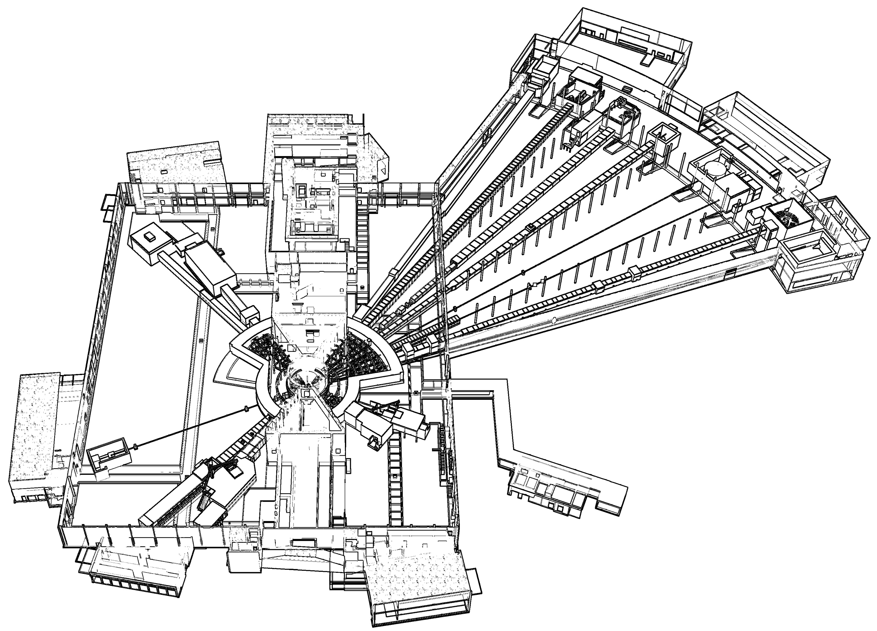











Instrument Suite
NMX
BEER
CSPEC
BIFROST
MIRACLES
MAGIC
DREAM
ODIN
T-REX
HEIMDAL
LoKI
SANS | LOKI, SKADI
Reflectometry | ESTIA, FREIA
Powder Diffraction | DREAM, HEIMDAL
Single-Crystal Diffraction | MAGIC, NMX
Imaging & Engineering | ODIN, BEER
Direct-Geometry Spectroscopy | CSPEC, T-REX
Indirect-Geometry Spectroscopy | BIFROST, MIRACLES, VESPA
VESPA
FREIA
SKADI
ESTIA

Slide 35
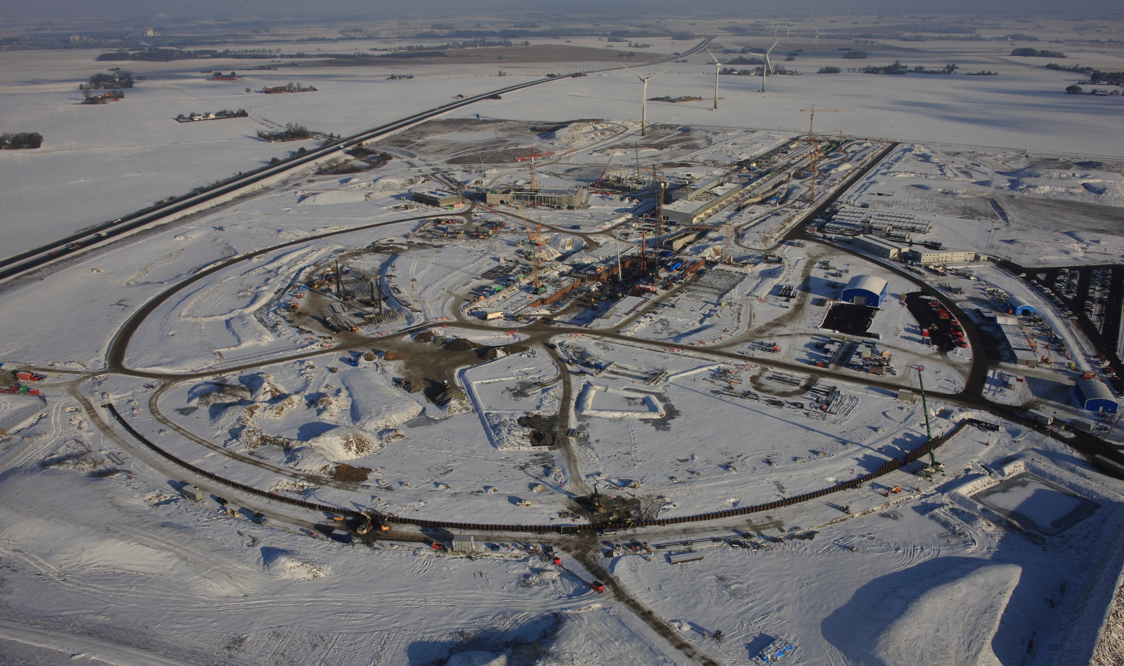
Thank you!
ESS site 2016
5th June 2015

Slide 36
Backup slides

Slide 37
ESS Moderator Design: Butterfly
Above target:
3cm tall butterfly
moderator assembly
Below target:
space for future upgrade
20cm
37

Slide 38
ESS Moderator Design: Butterfly
Above target:
3cm tall butterfly
moderator assembly
Below target:
space for future upgrade
20cm
38
moderator
guide

Slide 39
ESS Moderator Design: Butterfly
Above target:
3cm tall butterfly
moderator assembly
Below target:
space for future upgrade
20cm
39
moderator
guide

Slide 40
TDR Reference Suite 2013
Multi-Purpose Imaging
General-Purpose SANS
Broadband SANS
Surface Scattering
Horizontal Reflectometer
Vertical Reflectometer
Thermal Powder Diffractometer
Bispectral Power Diffractometer
Monochromatic Powder Diffractometer
Materials Science Diffractometer
Extreme Conditions Diffractometer
Single-Crystal Magnetism Diffractometer
Macromolecular Diffractometer
Cold Chopper Spectrometer
Bispectral Chopper Spectrometer
Thermal Chopper Spectrometer
Cold Crystal-Analyser Spectrometer
Vibrational Spectroscopy
Backscattering Spectrometer
High-Resolution Spin-Echo
Wide-Angle Spin-Echo
Fundamental & Particle Physics
Large-Scale Structures
Spectroscopy
Diffraction
life sciences | magnetism & superconductivity
soft condensed matter | engineering & geo-sciences
chemistry of materials | archeology & heritage conservation
energy research | fundamental & particle physics

Slide 41

Instrument Selection 2010-14
Conventional SANS
Small-Sample SANS
Compact SANS
Broadband SANS
Liquids Reflectometer
Magnetism Reflectometer
Vertical Focusing Reflectometer
Horizontal Focusing Reflectometer
Fast Kinetics Liquids Reflectometer
Macromolecular Diffractometer
Cold Magnetism Single-Crystal Diffractometer
Thermal Magnetism Single-Crystal Diffractometer
Bispectral Powder Diffractometer
Extreme Environments Beamline
High-Pressure Diffractometer
Hybrid Multiscale Diffractometer
Thermal Powder Diffractometer
Pulsed Monochromatic Diffractometer
Multiplexing Engineering Diffractometer
In-Situ Engineering Diffractometer
High Flexibility Engineering Diffractometer
Cold Chopper Spectrometer
Bispectral Chopper Spectrometer
Thermal Chopper Spectrometer
Broadband Chopper Spectrometer
Crystal Monochromator Spectrometer
Crystal-Analyser Spectrometer
Backscattering Spectrometer
Vibrational Spectrometer
High-Resolution Spin-Echo
Wide-Angle Spin-Echo
Longitudinal Resonance Spin-Echo
Fast Kinetics Imaging
High-Resolution Imaging
Multi-Purpose Imaging
Fundamental Physics Beamline
Ultra-Cold Neutron Facility
Chip Irradiation Facility
Neutron-AntiNeutron Oscillations
Large-Scale Structures
Spectroscopy
Imaging
Diffraction
FP
39 instrument concepts studied + 8 add-ons

Slide 42
Instrument Selection 2010-14
✓
proposal 2013 .
Conventional SANS
Small-Sample SANS
Compact SANS
Broadband SANS
Liquids Reflectometer
Magnetism Reflectometer
Vertical Focusing Reflectometer
Horizontal Focusing Reflectometer
Fast Kinetics Liquids Reflectometer
Macromolecular Diffractometer
Cold Magnetism Single-Crystal Diffractometer
Thermal Magnetism Single-Crystal Diffractometer
Bispectral Powder Diffractometer
Extreme Environments Beamline
High-Pressure Diffractometer
Hybrid Multiscale Diffractometer
Thermal Powder Diffractometer
Pulsed Monochromatic Diffractometer
Multiplexing Engineering Diffractometer
In-Situ Engineering Diffractometer
High Flexibility Engineering Diffractometer
✓
proposal 2013 .
Cold Chopper Spectrometer
Bispectral Chopper Spectrometer
Thermal Chopper Spectrometer
Broadband Chopper Spectrometer
Crystal Monochromator Spectrometer
Crystal-Analyser Spectrometer
Backscattering Spectrometer
Vibrational Spectrometer
High-Resolution Spin-Echo
Wide-Angle Spin-Echo
Longitudinal Resonance Spin-Echo
Fast Kinetics Imaging
High-Resolution Imaging
Multi-Purpose Imaging
Fundamental Physics Beamline
Ultra-Cold Neutron Facility
Chip Irradiation Facility
Neutron-AntiNeutron Oscillations
✗
proposal 2012&13 .
✓
✓
proposal 2013&14 .
proposal 2012 .
✓
✗
proposal 2013 .
proposal 2013 .
✗
Large-Scale Structures
✗
proposal 2013 .
proposal 2013&14 .
Spectroscopy
✓
✓
proposal 2013 .
proposal 2013 .
✓
proposal 2014 .
✓
✓
proposal 2013 .
proposal 2014 .
✓
✗
proposal 2012 .
proposal 2013&14 .
✓
✗
proposal 2014 .
proposal 2014 .
✓
proposal 2013 .
Imaging
✓
proposal 2012 .
✗
✗
Diffraction
proposal 2014 .
proposal 2014 .
✓
✗
proposal 2013 .
proposal 2014 .
✗
FP
proposal 2014 .
✓
proposal 2013 .
39 instrument concepts studied + 8 add-ons

Slide 43
15 Instruments selected so far
8 to be in user operation by 2023
Version 2/11/2017
ODIN Imaging Instrument
SKADI General Purpose SANS
LOKI Broadband SANS
Surface Scattering
FREIA Horizontal Reflectom.
ESTIA Vertical Reflectom.
HEIMDAL Powder Diffract.
DREAM Powder Diffract.
Monochromatic Powder Diffract.
BEER Engineering Diffract.
Extreme Conditions Diffract.
MAGIC Magnetism Diffract.
NMX Macromolecular Diffract.
CSPEC Cold Chopper Spec.
Broadband Spectrometer
T-REX Thermal Chopper Spec.
BIFROST Xtal Analyser Spec.
VESPA Vibrational Spec.
MIRACLES Backscatt. Spec.
High-Resolution Spin-Echo
Wide-Angle Spin-Echo
Particle Physics Instrument
Large-Scale Structures
Spectroscopy
Diffraction
life sciences | magnetism & superconductivity
soft condensed matter | engineering & geo-sciences
chemistry of materials | archeology & heritage conservation
energy research | particle physics

Slide 44
Tentative Instrument Ramp-up
Version 17/11/2017, based on Instrument Construction Working Schedule V3.4
Instrument | 2014 | 2015 | 2016 | 2017 | 2018 | 2019 | 2020 | 2021 | 2022 | 2023 | 2024 | 2025 | 2026 | 2027 | 2028 | 2029 | 2030
LOKI
ODIN
NMX
ESTIA
CSPEC
DREAM
SKADI
BEER
BIFROST
MAGIC
T-REX
HEIMDAL
MIRACLES
VESPA
FREIA
Instrument 16
Instrument 17
Instrument 18
Instrument 19
Instrument 20
Instrument 21
Instrument 22
5MW
4MW
3MW
2MW
1MW
Construction Project
Hot Commissioning
50 75 100%
User Programme

Slide 45
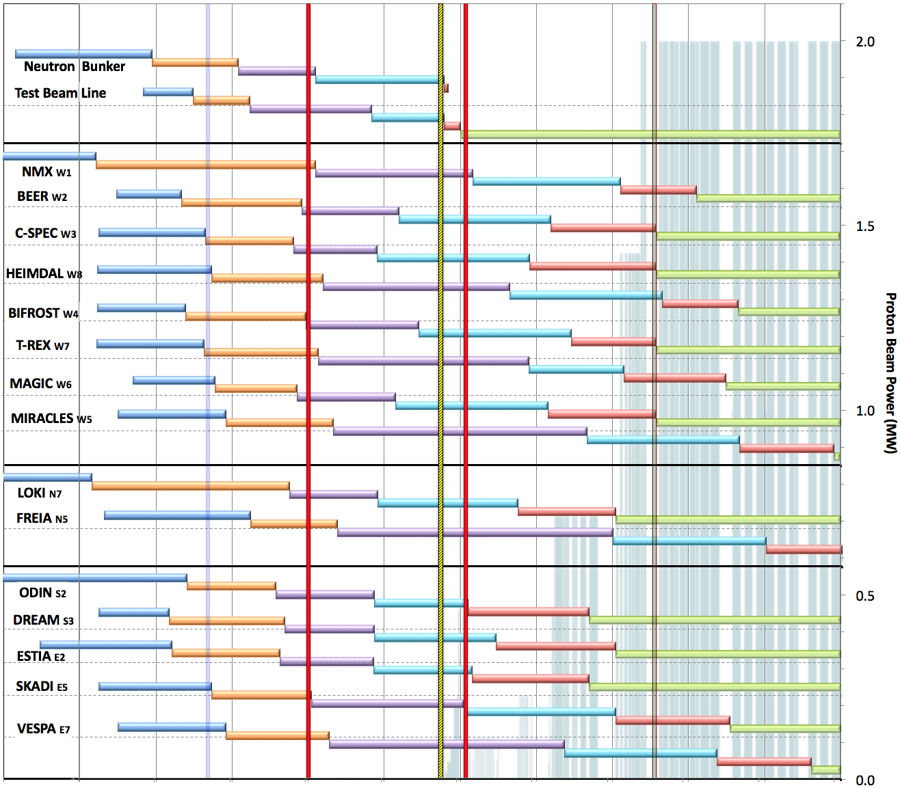

Internal* Neutron Beam Instrument Schedule
Draft for Discussion V3.4, 15th September 2017
Current
date
First access to NSS areas
Hot Commission
instruments
Start User Program
* still under discussion with ESS-ERIC Council
Current date
Beam on Target
NOTES:
Assumes 2MW maximum power until end 2025
Phases aligned with TG2 reviews on 1st 10 NBIs
Installation & Integration (TG4) + Hot Commissioning (TG5) for first 8 NBIs aligned with draft BOI plan (schedule match typically within 1 month)
West sector
North sector
East and South sectors
Preliminary Design
Detailed Design
Manufacturing & Procurement
Installation & Integration
Hot Commissioning/Early science
Operation
2016 2017 2018 2019 2020 2021 2022 2023 2024 2025
Notes:
This schedule assumes
obtaining the radiological licenses in a timely fashion from SSM. A trigger ‘first optical instrument component outside the monolith’ and a 6 months period from submission of the application to obtaining the SSM license - have been assumed (pending formal confirmation from ESH).
an initial hot commissioning of Accelerator and Target (A&T) to establish reliable beam on target at design frequency and pulse width.
In 2021, commissioning of the first (4-5) neutron instruments is to be conducted at low power, where possible, in order to minimize activation of in-bunker components of the neutron instruments. In the current plan, the duration of this initial commissioning period is 10-12 weeks.
Over 2022 and 2023 beam power and availability will increase, as the first 8 or more neutron instruments start hot commissioning, with a goal of reaching 2 MW source power by the start of the user program and maintaining that level until 2026.
Commencement of hot commissioning for the first 8 neutron instruments (TG5 in Table 1) is closely aligned with the schedules presented by those instrument build teams at TG2. This order matches well with the NSS “Early Science Success” strategy, and distributes responsibility for delivery widely among our experienced In-Kind partners. Changes to this order will be made if necessary to mitigate effects of delays to individual neutron instrument projects.
TG5 dates for neutron instruments 9-15 will be delayed to concentrate on-site resources for installation and commissioning (both cold commission and hot commissioning) on the first eight instruments to facilitate early science success for those instruments. This is discussed further below and illustrated in the NSS Installation and Commissioning schedule (Fig. 3).
TG3 dates refer to “final” approval of detailed design, when the integrated design of all major components is judged to be complete, and beyond which no further approval from NSS management is required for manufacturing. At this point in time these TG3 dates are not fixed, but NSS management plans for this to occur in staged manner. “Early procurement” approval dates for in-monolith optics and other critical path procurements (such as in-bunker components for the first instruments) are not shown in the figure

Slide 46
Instrument Performance & Upgrades
Instrument Class | Instrument | Costbook (M€) | Upgrade (M€) | Performance target at Cost book value (@ 2MW)
Large Scale Structures | LOKI (Broad band SANS) | 12.19 | 3.0 | 5 x D22 & 20 x SANS2D
 | SKADI (General Purpose SANS) (+SONDE funds) | 11.50 | 3.0 | 4 x D22
 | ESTIA (Focusing Reflectometer) | 11.80 | 4.6 | Conventional mode: ~ 100 x D17 High intensity mode: 1cm² samples = seconds
 | FREIA (Liquids Reflectometer) | 13.20 | 5.0 | 30 x FIGARO, INTER
Diffraction | DREAM (Bispectral powder diffractometer) | 13.66 | 5.1 | > 10 x POWGEN or WISH
 | HEIMDAL (Hybrid diffractometer) | 13.55 | 3.7 | ~ 50 x GEM, ~ 8 x new POLARIS
 | MAGIC (magnetism single crystal diffractometer) | 13.10 | 1.9 | Cold: > 100 x world’s best, Thermal: 1mm³ crystals = 10 min
 | NMX (Macromolecular crystallography) | 11.67 | 2.5 | > 10 x LADI & Biodiff
Engineering & Industrial | BEER (Engineering diffractometer) | 14.99 | 9.3 | world leading in strain scanning, unique flexibility
 | ODIN (multi-purpose imaging) | 11.60 | 5.8 | world leading for high resolution, > 10 x best for TOF methods
Spectroscopy | BIFROST (extreme environment spectrometer) | 13.45 | 2.4 | > 10 x THALES & MACS
 | C-SPEC (cold chopper spectrometer) | 16.50 | 2.4 | 2 - 6 x IN5
 | T-REX (bispectral chopper spectrometer) | 16.85 | 3.1 | 3 x 4-SEASONS, 3 x IN5
 | VESPA (vibrational spectroscopy) | 12.00 | 2.9 | 10 x VISION (ΔE = 130 meV)
 | MIRACLES (backscattering spectrometer) | 13.53 | 1.7 | 2 x BASIS and DNA
 | Total cost book value | 199.59 | 56.4 | M€

