Slide 1
2nd DMSC - Detector Group Readout Meeting
Morten Jagd Christensen
European Spallation Source
Data Management and Software Centre (DMSC)
Copenhagen

Slide 2
Topics
Documentation/Process
Design/Implementation
Readout protocol
Considerations
Readout ‘load balancing’

Slide 3
Documentation/Process
Where do we put this stuff?
Temporary(?) Wiki page created with initial encapsulation suggestion (may 2017)
Some comments and requests have been added
Is this the right format?
Is it sufficiently detailed currently?
New data types needed (?) - pulse time, heartbeat
(Addressing, packet sizes,...)
How do we work on it?

Slide 4
Design/Implementation
Have
Outline of packet encapsulation
Promise of 100G data transmission
Would like
discussion of DG TX / DMSC RX interface
detailed network topology and addressing discussions
new data types (?)
ideas/specifics of the expected processing hardware for DMSC

Slide 5
Consideration: Speed up
- by parallelisation
General solution
distribute readouts across multiple EFU’s
distribute readouts to a EFU across multiple queues
can have implications for design of readout backend

Slide 6
Considerations: Data path
Topology
A readout master sends to one or more EFUs
EFUs receive from one or more RO Masters
How to get the relevant readout data to the right destination?
mapping ‘channels’ to IP/UDP destinations
a single IP/UDP port may not be sufficient
Duplication?
‘overlapping’ regions, can they be transmitted to multiple receivers?

Slide 7
Speed up by parallelisation
Some detectors are easy
Multiblade - blades are independent
Multigrid – grid stacks are independent
SoNDe – comes as detector pixels (more or less)
DREAM – comes as detector pixels (more or less)
At least one is complicated
Gd-GEM – panels are independent, but cannot easily be segmented

Slide 8
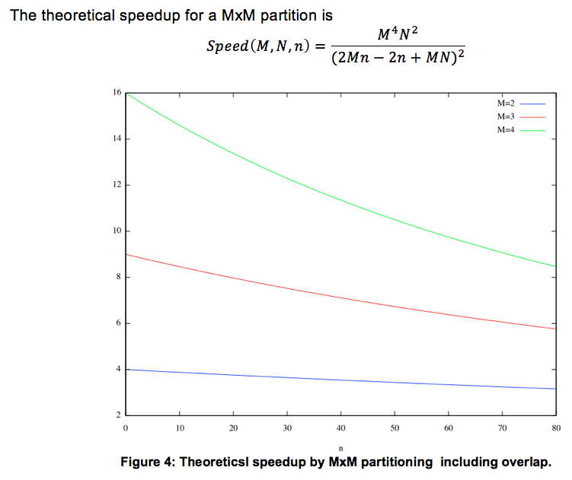
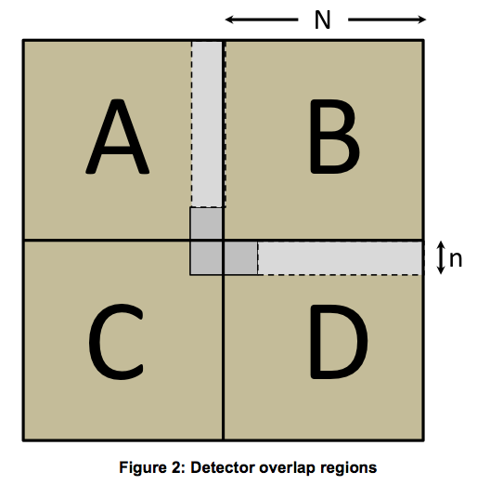
NMX Speedup

Slide 9
Readout Data Paths
static ip
ch1
ch2
ch3
ch4
ch5
ch6
readout
CPU00
CPU01
CPU02
dynamic ip mapping
ch1
ch2
ch3
ch4
ch5
ch6
readout
CPU00
CPU01
CPU02
CPU00
CPU01
CPU02

Slide 10
Readout Data Paths
static ip, dynamic port mapping
ch1
ch2
ch3
ch4
ch5
ch6
readout
CPU00
CPU01
CPU04
CPU02
CPU03
dynamic ip and port mapping
CPU00
CPU01
CPU04
ch1
ch2
ch3
ch4
ch5
ch6
readout
CPU02
CPU03
CPU00
CPU01
CPU04
CPU02
CPU03

Slide 11
Single Detector Panel
NMX panel, VMM3 readout
NMX panel, VMM3 readout
readout
Intel x86_64CPU
CPU00
CPU01
CPU02
CPU03
CPU04
CPU05
CPU06
CPU07
CPU08
CPU09
CPU10
CPU11

Slide 12
Single Detector Panel
NMX panel, VMM3 readout
NMX panel, VMM3 readout
readout
Intel x86_64CPU
CPU00
CPU01
CPU02
CPU03
CPU04
CPU05
CPU06
CPU07
CPU08
CPU09
CPU10
CPU11

Slide 13
Wish list for the collaboration
Roadmap for the DG/DMSC interface
Roles and responsibilities
Early detector readout prototype
first expected instrument, easiest implementation or most common readout technology (vmm?)
Documentation

