Slide 1
Equipment list for general user labs
www.europeanspallationsource.se
STAP Users and Samples
March 6-7, 2018

Slide 2
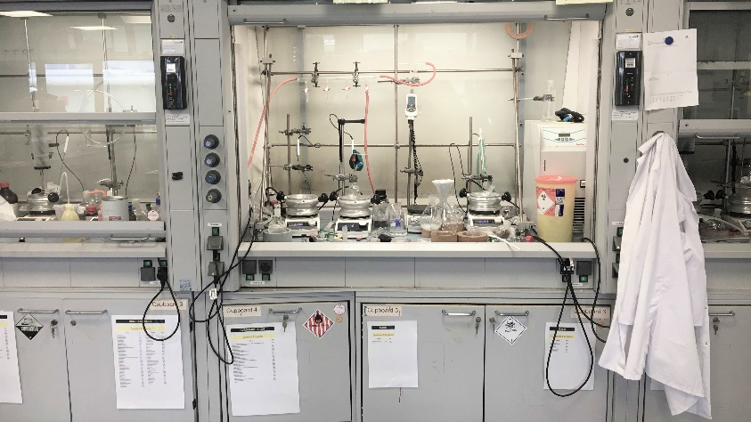
Strategy for glassware/small equipment
Have sets of lab equipment in any of the large labs to allow users to perform all basic procedures (filtering, evacuating, stirring, heating, concentrating…)
Have basic chemicals in all the labs (purification, recrystallization, drying...)
Have some specialized equipment to be able to quickly assist users = this will develop as ESS starts operating and depend on the current scientific interests
Have basic supplies to allow easy filling of sample cans for neutron scattering experiments

Slide 3
Activity
Lab design
Plan interior, but also equipment (e.g. balances, dewars, spectrometers)
Purchase basic glassware (e.g. volumetric flasks, conical flasks, round-bottomed flasks)
Equipment/
consumables
Request offers
Purchasing and testing, e.g. dewar, centrifuge, oven
Stock items and purchase more
Contractor work – labcoat service (Berendsen), Ahlsell protective wear, industrial waste supplier (Stena)
Purchase and stock consumables (e.g. gloves, paper wipes, Pasteur pipettes)
Glassware planning/ service

Slide 4
Activity
Lab design
Plan interior, but also equipment (e.g. balances, dewars, spectrometers)
Purchase basic glassware (e.g. volumetric flasks, conical flasks, round-bottomed flasks)
Equipment/
consumables
Request offers
Purchasing and testing, e.g. dewar, centrifuge, oven
Stock items and purchase more
Contractor work – labcoat service (Berendsen), Ahlsell protective wear, industrial waste supplier (Stena)
Purchase and stock consumables (e.g. gloves, paper wipes, Pasteur pipettes)
Glassware planning/ service

Slide 5
Activity
Lab design
Plan interior, but also equipment (e.g. balances, dewars, spectrometers)
Purchase basic glassware (e.g. volumetric flasks, conical flasks, round-bottomed flasks)
Equipment/
consumables
Request offers
Purchasing and testing, e.g. dewar, centrifuge, oven
Stock items and purchase more
Contractor work – labcoat service (Berendsen), Ahlsell protective wear, industrial waste supplier (Stena)
Purchase and stock consumables (e.g. gloves, paper wipes, Pasteur pipettes)
Glassware planning/ service

Slide 6
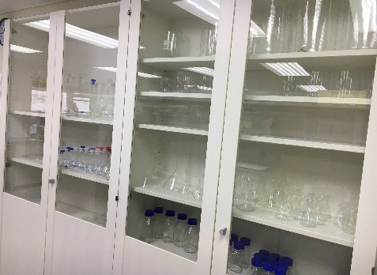
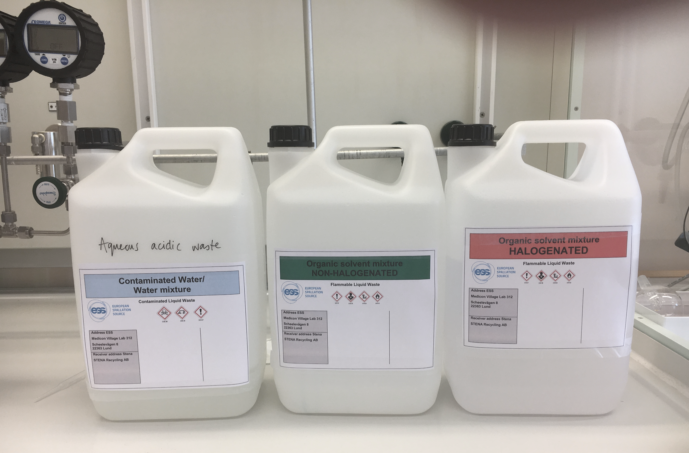
Present & Ongoing
Collecting experience from in-kind partners at ISIS, Support Laboratory Team
Service at Medicon Village laboratory
- lab coats service (ordering & laundry) - Industrial waste pick-up, according to recycling guidelines in Sweden
Glassware planning/ service

Slide 7
Present & Ongoing
Testing equipment
One-page user manuals as output
What is the best / easiest / longest lasting
Heating mantels (temperature regulation via controller, thermocouple)
Glass blowing equipment
Small furnace 1100 °C
Vacuum oven (200°C)
L-N2 dewars
Centrifuge
Tip Sonicator
…

Slide 8
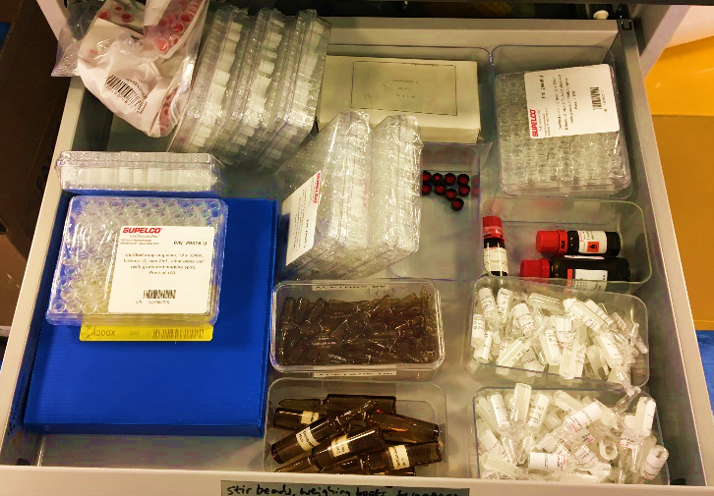
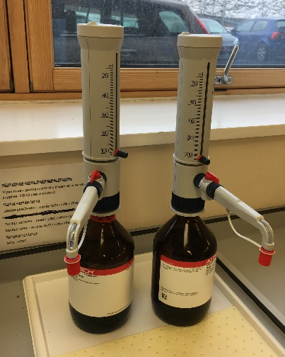
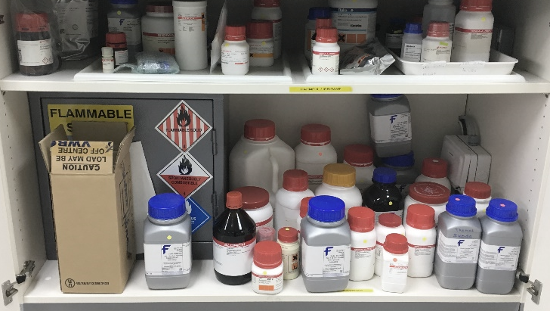
Present & Ongoing
Before operation starts:
- Stock of consumables
- Stock of chemicals for basic prep activities

Slide 9
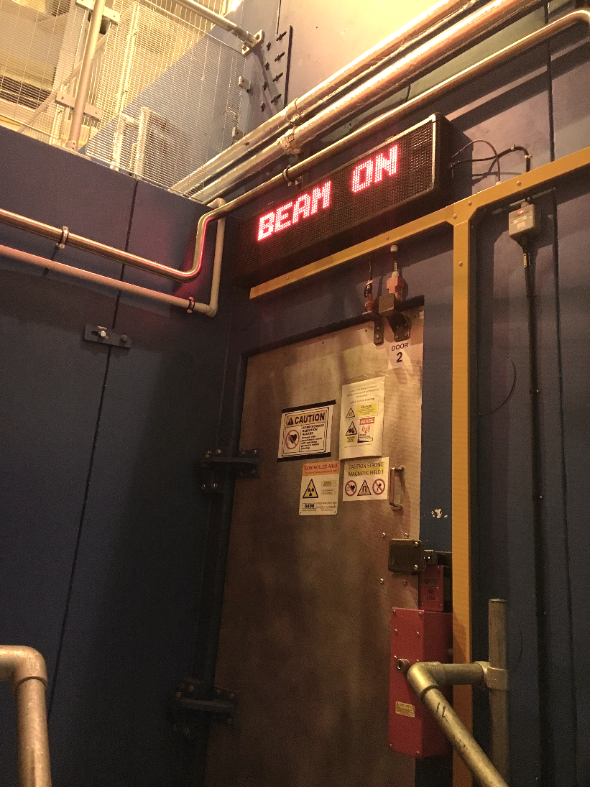
Large(r) equipment
Glove boxes (planned for every building)
Furnaces/vacuum ovens
Centrifuges
Spectrometer (FT-IR, UV/VIS, Raman)
Diffractometer/ XRF / SAXS
Surface area/adsorption (BET, TG/DTA)
Microscopy (optical, SEM,…)
…

Slide 10
Thank you for your attention!
MV & bio labs tour @ 1:30 pm

