Slide 1
MET workshop
Eldin Mukovic
Mechanical System Engineer / WP6 Installation coordinator
Fagerström Industrikonsult AB
Active Cells / Casks and Associated Handling Devices
www.europeanspallationsource.se
31 January, 2018

Slide 2
Eldin Mukovic Tasks & Responsibilities
Target Group – Remote Handling Systems WP6
Started September 2015
Conceptual design development
Active cell facilities
CASKS for handling of the components
Update of interface documentation, the interface requirements between CASKS and other stakeholders
Inspection Plan (IP) templates for RHS project
Preparation of manufacturing/installation templates
Responsibilities now
Detail design
Detail design of ACF incl. drawings and preparation of manufacturing and installation documentation
WP6 Installation coordinator, ACF Embedments
Follow up work at site
Time plan follow up:
components delivered at site in time
Availability of Certificate of Compliance before installation
Handling with deviations
Availability of Certificate of Compliance before installation

Slide 3
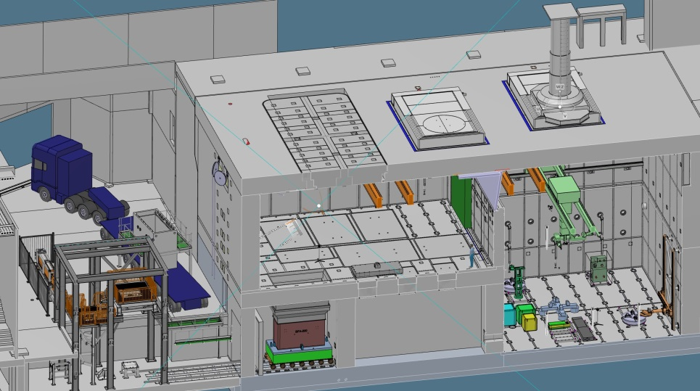
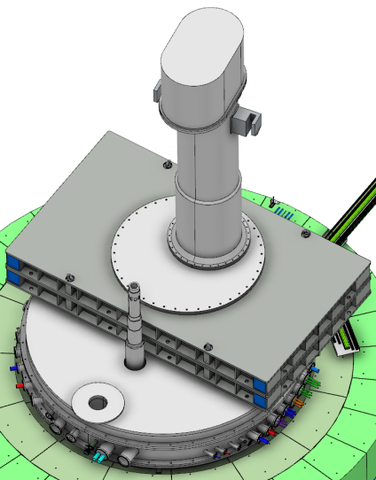
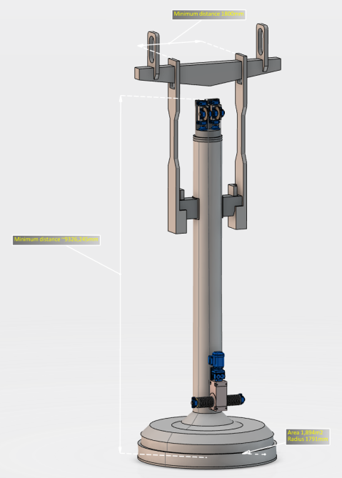
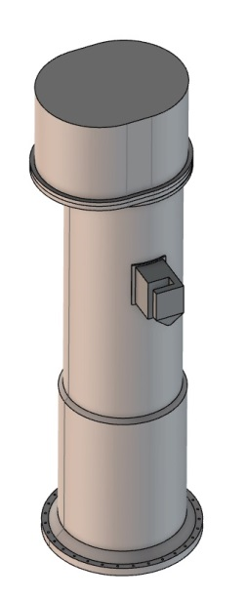
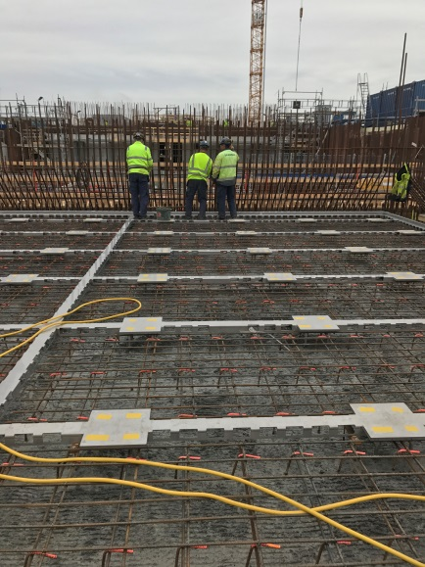
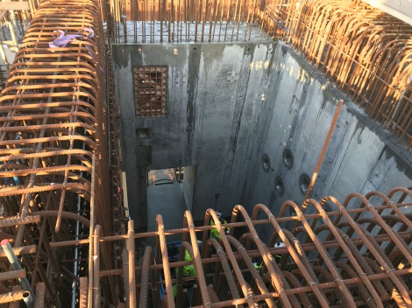
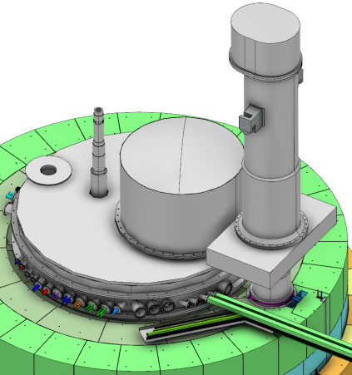
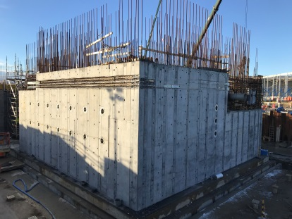
Eldin Mukovic Tasks & Responsibilities
Embedment ACF CASKS

Slide 4
Srdjan Vareskic Expectations & Needs
Boom list in drawings
CAD – Standard Parts

