Slide 1
Tasks, Responsibilities
Expectations and Needs
Nuno ELIAS
Mechanical Engineering and Technology (MET)
Workshop: Session 2
www.europeanspallationsource.se
1 February, 2018

Slide 2

Who is Nuno ELIAS
2013(Jan) to date
Mechanical Engineer
CERN – ATLAS Detector
Project Engineer
EACE S.A.
Project Engineer
Powertechnics Portugal S.A.
Design Engineer Cryogenics
ESS - EIS
Mechanical Engineer
CERN - CAST Experiment
Applied Fellow
CERN - Technology Department
Doctoral Student
CERN - Cryolab
PhD in Technological Physics Engineering
Technical University of Lisbon
Design, evaluation and feasibility studies of Cogeneration Power Plants.
See next slides
Design of Heating, Ventilation and Air Conditioning Systems (HVAC).
Design and Specification of Cooling systems for the ATLAS particle detector.
Design of a Cryogenic Gas System for the CAST experiment.
Design of Superconducting magnets and structural optimization.
Operation, maintenance and upgrade of the Helium-3 gas system.
Test and Simulation of Cooling systems.
Simulation, Construction, Test and Commissioning.
Training of personnel and gas system operation for Physics exploitation.
Development of fabrication processes for High Field Magnets.
Consultancy in Computational Fluid Dynamics simulations and analysis of results.
Consultancy in general mechanics. Training and supervision of operators.
MSc in Mechanical Engineering
Technical University of Lisbon
Specialization: Applied Thermodynamics
2011(Jul) 2012(Dec)
2008(May) 2010(Nov)
2005(Jan) 2008(Apr)
2002(Apr) 2004(Dec)
2001(Nov) 2002(Mar)
2000(Jan) 2001(Jul)
1996(Jul) 1999(Dec)

Slide 3
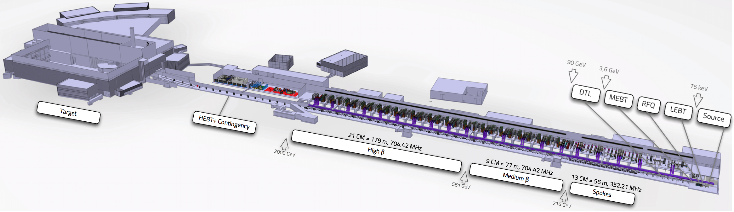
ESS Superconducting LINAC

Slide 4
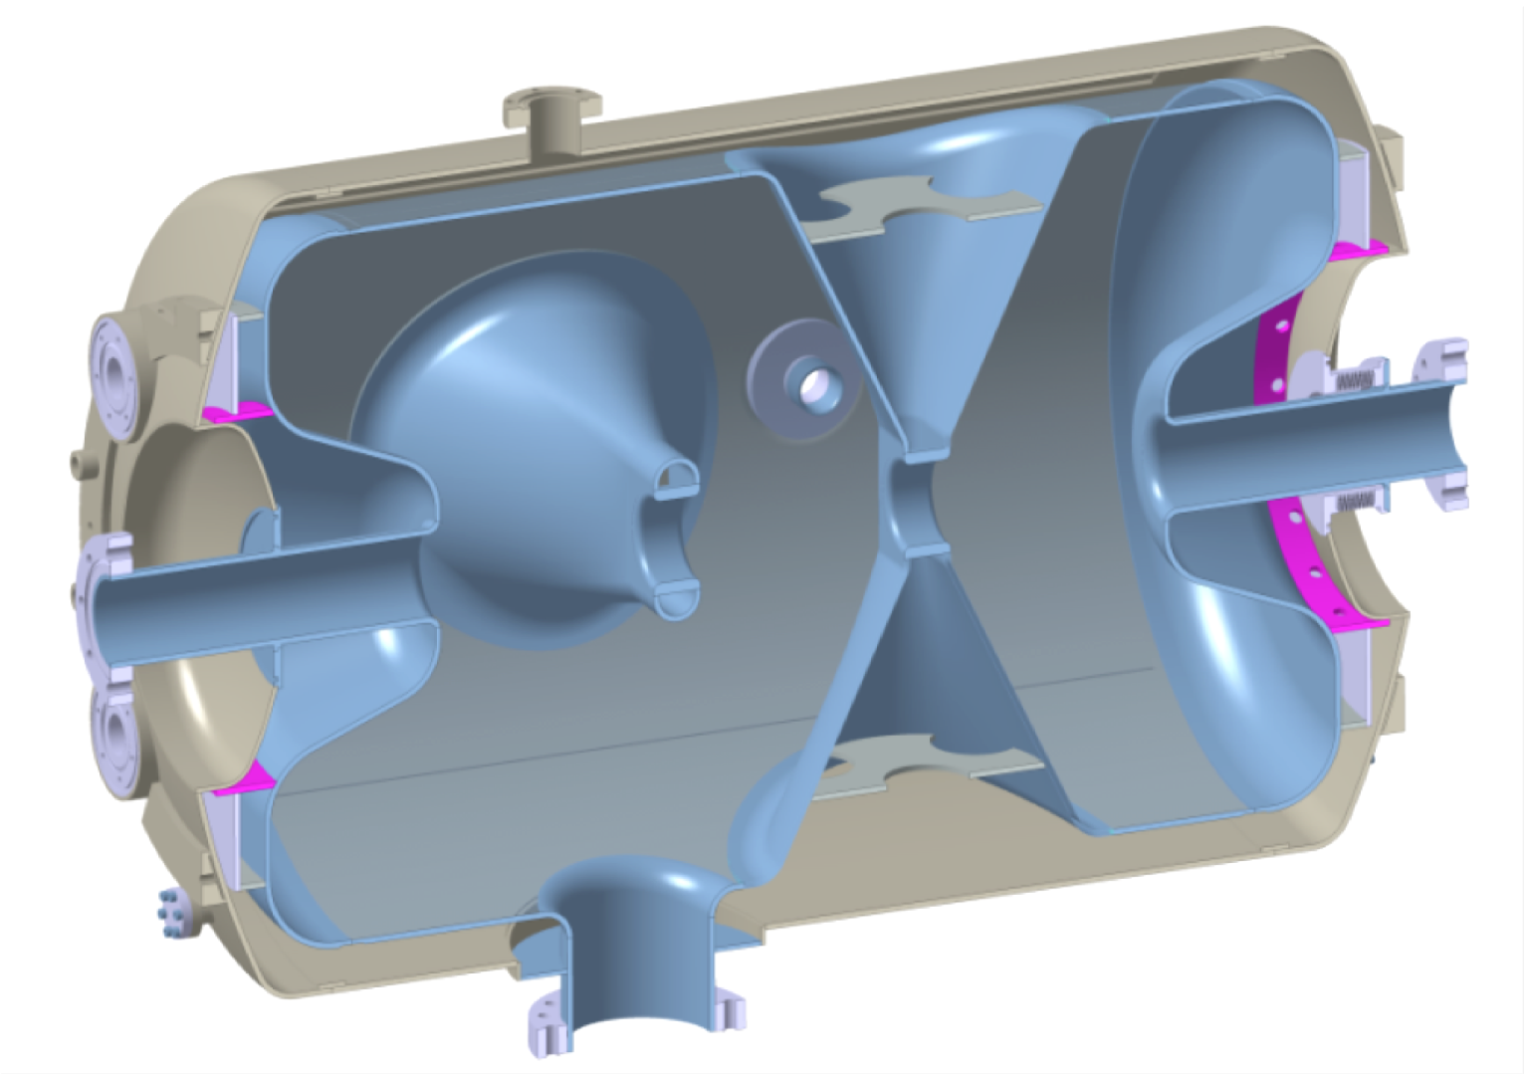
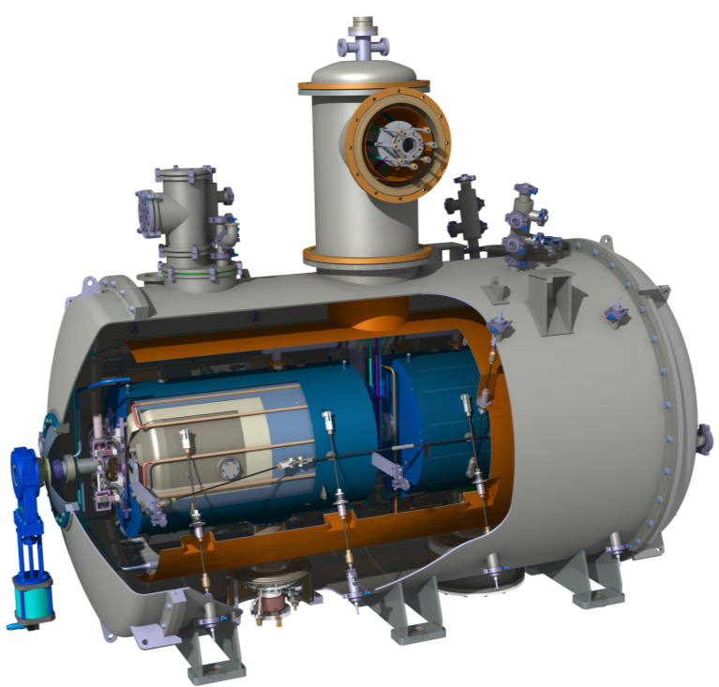
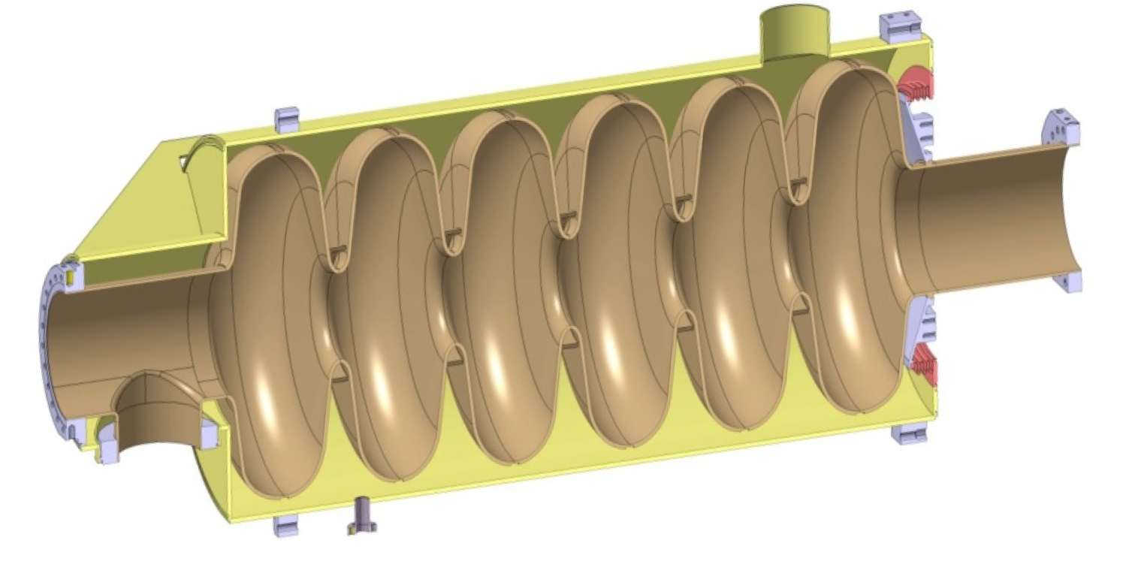
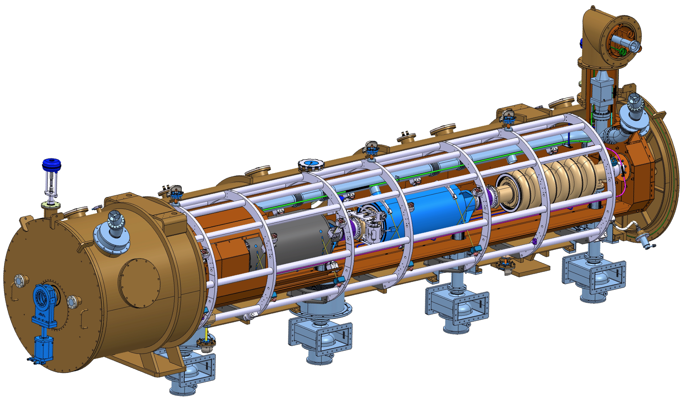
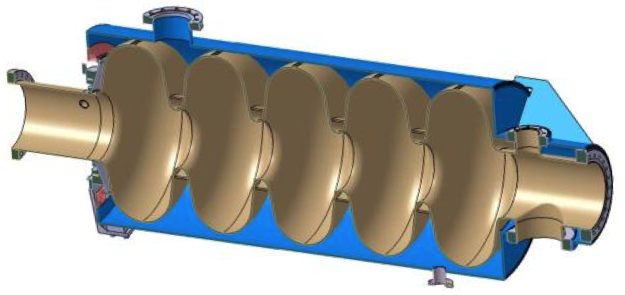
Cavities and Cryomodules
Cavities
Cryomodules

Slide 5
Cryomodule wildlife
Paolo Pierini (SL)
Christine Darve (WP_L)
Nuno Elias
Cecilia Maiano
Felix Schlander
Frederik Håkansson
Saeid Pirani
Design & Specification
Insulating
Vacuum
Beam
Vacuum
Support
System
Manufacture
Beam
Physics
Alignment
System
Control
System
Installation
SRF
Cavity
Cryogenics
Transport
System
SRF
Water
Cooling
System
Risks & Safety
Testing
Tuning
System
RFDS/
RFS
Commissioning
LLRF
Operation

Slide 6
Roles and Responsibilities
Lead activities for Cryomodule Disciplines
  Cryogenics, Vacuum , Water Cooling, Control
Support WP4 and WP5 related activities
  Design Integration
  Interfacing with in-house WPs and Groups
Controls and Operation
  Lead activities related to Cryomodule Operation and Control
  Interface with ICS .
Safety and Risk
  Identify and Report technical risks
  Provide expertise for risk mitigation
Planning and Coordination
  Master and revise activities plan of relevant IKP
Cryomodule Testing, Installation and Commissioning
  Define test plan, installation plan and commissioning activities

Slide 7
Expectations and Needs
Communication forum amongst Engineers
  Common problems, various approaches, best solution!
Well defined engineering processes
  Keep it simple and everyone updated
Training to develop and improve engineering skills
  Personally tailored, Project oriented.
Detailed engineering design to support activities.

